Slide 1
DDS
Last Update 2010.01.17
1.2.0

Slide 2
Objectives of This Section
Learn
What DDS is
Where DDS is used

Slide 3
What is DDS
Dedicated Digital Service
Dataphone Digital Service
Digital Data Service
It is so old no one can remember what DDS stands for
It was first deployed in 1974
It is a slow speed circuit, but fully digital

Slide 4
Context
Layer | 1
Network Type | WAN

Slide 5
Operation
This is a standard digital data circuit that works like a T1 line
Often it is just a channel out of a T1 circuit
We will cover its operation there

Slide 6
Speeds
Commonly used speeds include
2.4, 4.8, 9.6, 56Kbps
56Kbps is by far the most common

Slide 7
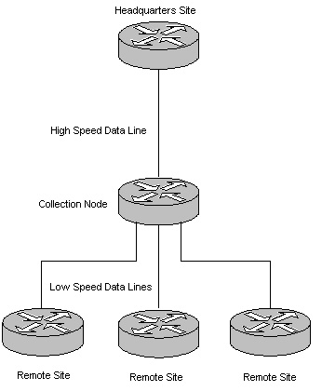
Current Use
A DDS line was often used to connect small sites to a collection node

Slide 8
Current Use
This line is designed for constant data traffic that operates at a level rate

