Slide 1
Cellular
Last Update 2011.05.28
2.5.0

Slide 2
Objective
Learn how a cellular connection can be used as part of a wide area network

Slide 3
Use of Cellular
Cellular data service is being used as an alternative to land lines where no other highspeed service is available
or
It can be used as a backup line for another primary service at small and remote sites

Slide 4
Sprint EV-DO/DV
As the primary connection the Sprint EV-DO/DV is an example of a 3G system
Here are some details on this system
First the hardware
The hardware can be connected to the computer in either of two ways
Into a holder then to the USB port
or
Directly to the USB port

Slide 5
Sprint EV-DO/DV

Slide 6
Sprint EV-DO/DV

Slide 7
Sprint EV-DO/DV

Slide 8
Sprint EV-DO/DV

Slide 9
Sprint EV-DO/DV

Slide 10
Sprint EV-DO/DV

Slide 11
Sprint EV-DO/DV

Slide 12
Sprint EV-DO/DV
On the screen a program runs to setup and monitor the connection
This adaptor appears to the computer as a PPP device
Speeds are adequate, but unimpressive

Slide 13
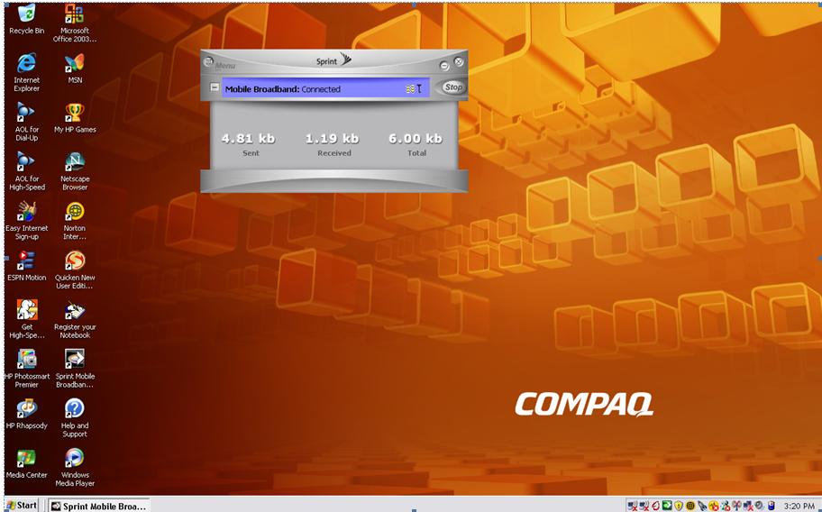
Sprint EV-DO/DV

Slide 14
Sprint EV-DO/DV

Slide 15
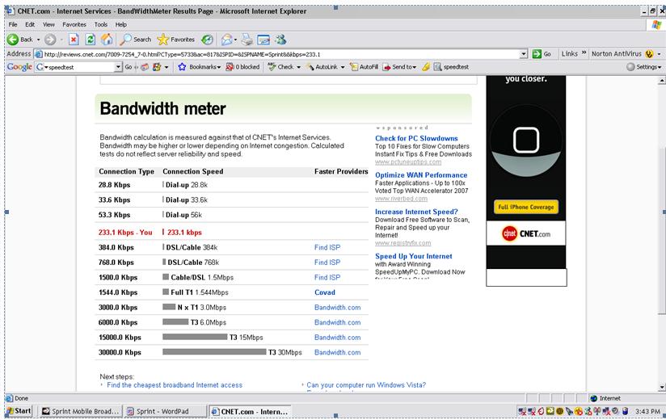
Sprint EV-DO/DV

Slide 16
Use of Cellular
As a redundant link Cradlepoint has a device that connects to a Cable or DSL line for the normal connection
If that line fails it will automatically switch to the cellular connection

Slide 17
Use of Cellular
Here is what Cradelpoint says about it
With its’ built-in failover capability, the MBR1000 automatically switches from a primary wired (DSL cable, T1, etc.) connection to wireless mobile broadband network when primary service is disrupted

Slide 18
Use of Cellular
Once service is restored, the MBR1000 will automatically failback from wireless mobile broadband to the primary wired ISP without interruption to users
Perfect for applications such as POS that can't afford to be offline
Your business is always connected

Slide 19
Use of Cellular

Slide 20
Use of Cellular

Slide 21
Cisco 3G Module
A Cisco router can also be fitted with a 3G module for use as a primary or backup connection
For example

Slide 22
Cisco 3G Module

Slide 23
Cisco 3G Module

Slide 24
Cellular Data Networks
Most cellular networks deployed worldwide are based on the GSM – Global System Mobile standard
This TDMA based method can operate in several frequency ranges
Most commonly used are the 900, 1800, and 1900 MHz bands
Each of these is divided into 200 MHz wide channels

Slide 25
Cellular Data Networks
Each 200 MHz channel is then divided into eight time slots
Each time slot is shared among users using a time division method
GSM is limited to 9.6 kbps
In its 2.5 generation form GSM evolves into GPRS - General Packet Radio Service or Enhanced Data Rates for GSM Evolution or EDGE

Slide 26
Cellular Data Networks
The GPRS creates a packet network using dedicated GSM channels
GPRS uses a completely different air interface that is designed to handle packet based data
At the customer end the GPRS unit tunes to a dedicated GPRS radio channel at a set time
This produces an always on connection

Slide 27
Cellular Data Networks
A GPRS unit can occupy multiple consecutive time slots so as to increase the data throughput
The maximum data rate occurs when all eight time slots of a GSM radio channel are dedicated to an individual use
This produces a maximum 171.2 kbps connection
But the average speed is only 28.8 kbps

Slide 28
Cellular Data Networks
EDGE, which is also called Enhanced GPRS or EGPRS, uses a digital modulation format in addition to the standard GSM modulation
EDGE defines several different air interfaces with differing modulation and coding schemes
Each of these offer varying degrees of error control protection

Slide 29
Cellular Data Networks
The one to use is selected according to the network and the operating conditions
The maximum data rate to an individual user is 384 kbps, with an average speed of 64 kbps
3G GSM cellular systems are based on W-CDMA or wideband code division multiple access, also known as UMTS - Universal Mobile Telecommunications Service

Slide 30
Cellular Data Networks
W-CDMA is backwards compatible with the 2G GSM networks, as well as with the 2.5G TDMA networks, such as EDGE
The W-CDMA air interface is designed for an always on packet based connection
It supports packet data rates of up to 2.048 Mbps for fixed user sites

Slide 31
Evolution of Cellular Networks
How did all of this start
All of the first generation cellular systems are analog FM systems designed for speech
Each call uses a separate frequency
Calls share the bandwidth through FDMA

Slide 32
AMPS
In North America and Australia the AMPS – Advanced Mobile Phone System is the first generation system used
25 MHz of bandwidth is available from 824 to 849 MHz for uplink and 25 MHz for downlink from 869 to 894 MHz
Data can be sent at 10 kbps

Slide 33
ETACS
In Europe the ETACS – European system provides 25 MHz uplink from 890 to 915 MHz and 25 MHz down from 935 to 960 MHz
Data can be sent at up to 8 kbps

Slide 34
NTT
The NTT – Nippon Telephone and Telegraph system in Japan uses 15 MHz both up and down
Uplink is from 925 to 940 MHz
Downlink is from 870 to 885 MHz
Data can be sent at 2.4 kbps

Slide 35
Second Generation Systems
In the second generation cellular systems analog was abandoned for digital transmission using TDMA or CDMA
CDMA is a North American system using IS-95
Several different TDMA systems have been deployed

Slide 36
CDMA IS-95
IS-95 is the only CDMA second generation system
It uses the same frequencies as the first generation systems in North America
A data rate up to 9.6 kbps is possible

Slide 37
TDMA IS-54
Deployed in North America IS-54 uses the same frequencies as the AMPS system
Data can be sent at up to 8 kbps

Slide 38
GSM
In Europe the GSM system is used in second generation networks
It uses the same frequencies as the ETACS system
Data can be sent at up to 13.4 kbps

Slide 39
PDC
The Japanese system is limited to a data rate of 6.7 kbps using the PDC method
It uses a different set of frequencies from the first generation NTT system
810 to 826 is used for uplink
940 to 956 is sued for downlink

Slide 40
Third Generation Systems
In the third generation of cellular systems the first useable data rates appear
These are

Slide 41
3G
Method | Data Rate | Outlook
GPRS | 30 to 60 Kbps | Used in GSM networks
EDGE | 75 to 150 Kbps | AT&T Cingular
WCDMA/UMT | Up to 384 Kbps | AT&T Cingular
CDMA 1x | 60 to 80 Kbps | Available now in CDMA systems
CDMA 1x EV-DO/DV | 300 to 500 Kbps | Verizon Sprint
WIDEN | 60 to 80 Kbps | Nextel

Slide 42
4G
4G systems are being rolled out
As Network World says about 4G
Several technologies available today may play a roll in 4G as it develops
Here are five of them

Slide 43
4G
Orthogonal Frequency Division Multiplexing (OFDM) and OFD Multiple Access (OFDMA)
OFDM transmits data by splitting radio signals that are broadcast simultaneously over different frequencies
OFDMA, used in mobile WiMax, also provides signals that are immune to interference and can support high data rates
It is said to use power more efficiently than 3G systems while using smaller amplifiers and antennas
This all translates to expected lower equipment costs for wireless carriers

Slide 44
4G
Mobile WiMAX is an IEEE specification also known as 802.16e and designed to support as high as 12Mbps data-transmission speeds
It uses OFDMA and is the next-generation technology of choice for Sprint Nextel and Clearwire Communications

Slide 45
4G
Ultra Mobile Broadband (UMB), also known as CDMA2000 EV-DO, is an expected path to 4G for legacy CDMA network providers
It’s an IP-based technology that is said to support 100Mbps through 1Gbps data-transmission speeds
Also key for business users, it is supposed to be able to support QoS

Slide 46
4G
Multiple-input multiple-output (MIMO) wireless LAN technology supports two or more radio signals in a single radio channel, increasing bandwidth
MIMO does this by using multiplexing
MIMO was developed by Airgo, which has been acquired by Qualcomm
MIMO is expected to support data rates as high as 315Mbps in 36MHz of spectrum

Slide 47
4G
Long Term Evolution (LTE) is a modulation technique designed for GSM/UMTS-based technology that uses OFDM and MIMO
It’s being developed by the Third Generation Partnership Project (3GPP) and is said to support 45M to 144Mbps in test networks today

Slide 48
Clearwire
On the WiMax side Clearwire has most major urban areas covered by WiMax
This service should average 3Mbps while downloading

Slide 49
Verizon
Verizon plans to have 4G LTE available in 25 or so markets
It too delivers about 3Mpbs
These LTE deployments will use the 700 MHz spectrum to aid propagation of the signal
This will require dual radio devices as LTE will be data only at first

