Slide 1
Cable Modem
Last Update 2011.09.08
1.0.0

Slide 2
Objectives of This Section
Learn
What type of device is used for a cable connection

Slide 3
Cable Modem
A box called a cable modem is required to connect a MSO cable data line to the LAN
Such as

Slide 4
Cable Modem

Slide 5
Cable Modem

Slide 6
Cable Modem
As can be seen all that is required is to connect the cable from the wall to the unit, then plug a UTP patch cable between the unit and the switch

Slide 7
Cable as a Backup
A cable connection can also make a good low cost backup line for a more typical line such as T Carrier, Frame Relay, or MPLS used to connect to a primary network
For example, at a remote office a Cisco 1800 ISR might have two modules in it

Slide 8
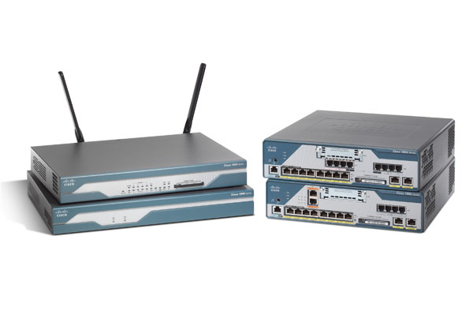
Cable as a Backup

Slide 9
Cable as a Backup
One for the primary connection in this example a serial line using this card

Slide 10
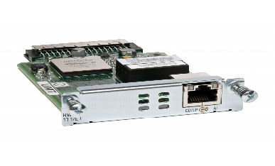
Cable as a Backup

Slide 11
Cable as a Backup
The other slot could hold a card that supports a cable connection using this card as the failover connection

Slide 12
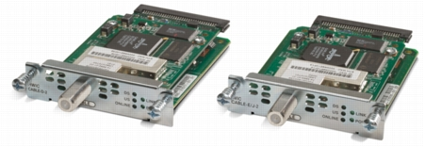
Cable as a Backup

