Slide 1
CSU/DSU
Last Update 2007.06.07
1.1.0

Slide 2
Objectives of This Section
What Will Be Learned
What a CSU/DSU does
What a CSU/DSU looks like
How to hookup a CSU/DSU

Slide 3
What is CSU/DSU
CSU/DSU stand for
Channel Service Unit/Data Service Unit
To ensure that a network interfaces properly with a telephone line, several functions must be performed
CSUs and DSUs were created to handle those functions

Slide 4
What Does a CSU Do
A channel service unit, or CSU, is the first device the external telephone line encounters on the customer premises
As recently as the early 1980s, CSUs were always owned by the telephone company, which leased the devices to customers

Slide 5
What Does a CSU Do
But during the course of telecommunications deregulation, users were allowed to buy and install their own CSUs
One of the principal functions of a CSU is to protect the carrier and its customers from any weird events your network might introduce onto the carrier's system

Slide 6
What Does a CSU Do
Since the Carterphone decision the phone company has been somewhat paranoid
A CSU provides proper electrical termination for the telephone line and performs line conditioning and equalization

Slide 7
What Does a CSU Do
It also supports loopback tests for the carrier, meaning the CSU can reflect a diagnostic signal to the telephone company without sending it through any CPE, so the carrier can determine if a problem is one it needs to correct itself
CSUs often have indicator lights or LEDs that identify lost local lines, lost connections, and loopback operation

Slide 8
What Does a DSU Do
Data service units - sometimes referred to as digital service units - or DSUs, sit between a CSU and customer equipment such as routers
DSUs are commonly equipped with RS-232 or V.35 interfaces

Slide 9
What Does a DSU Do
Their main function is to adapt the digital data stream produced by the customer equipment to the signaling standards of the telephone carrier equipment, and vice versa

Slide 10
Physical Types of CSU/DSUs
There are many physical types of CSU/DSUs
These range from table top to rack mount to shelf units
Let’s look at examples of these

Slide 11
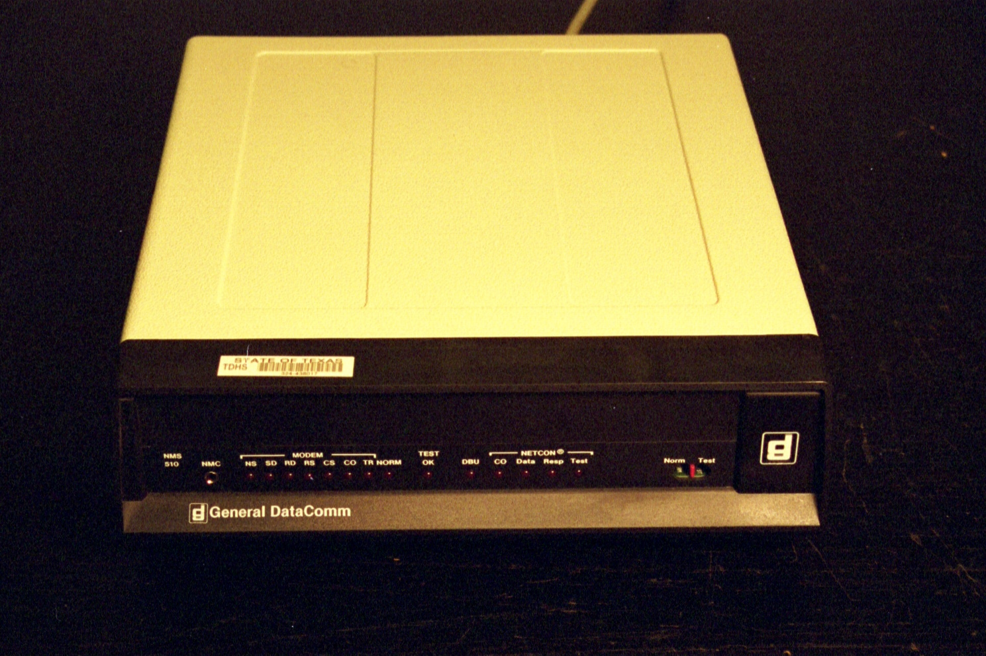
Table Top CSU/DSU

Slide 12
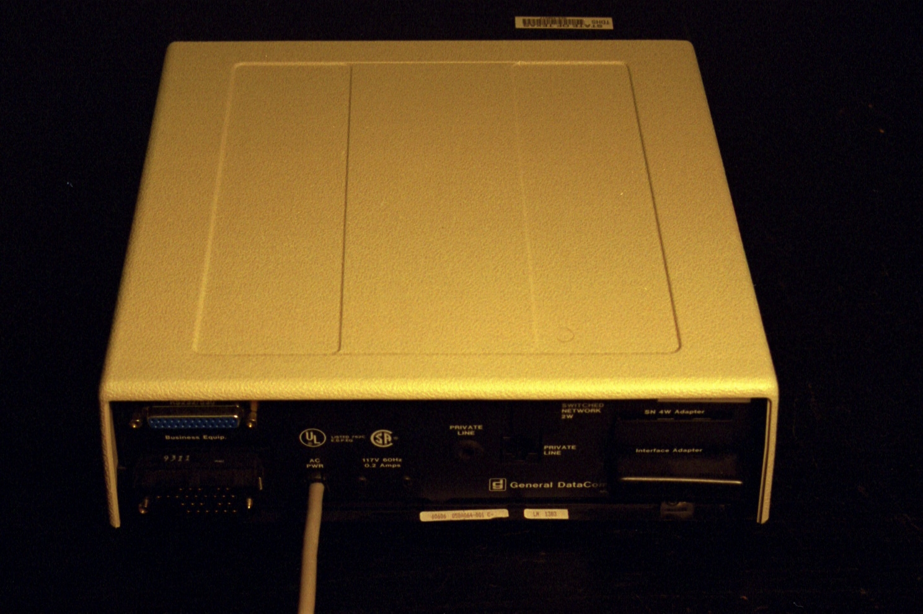
Table Top CSU/DSU

Slide 13
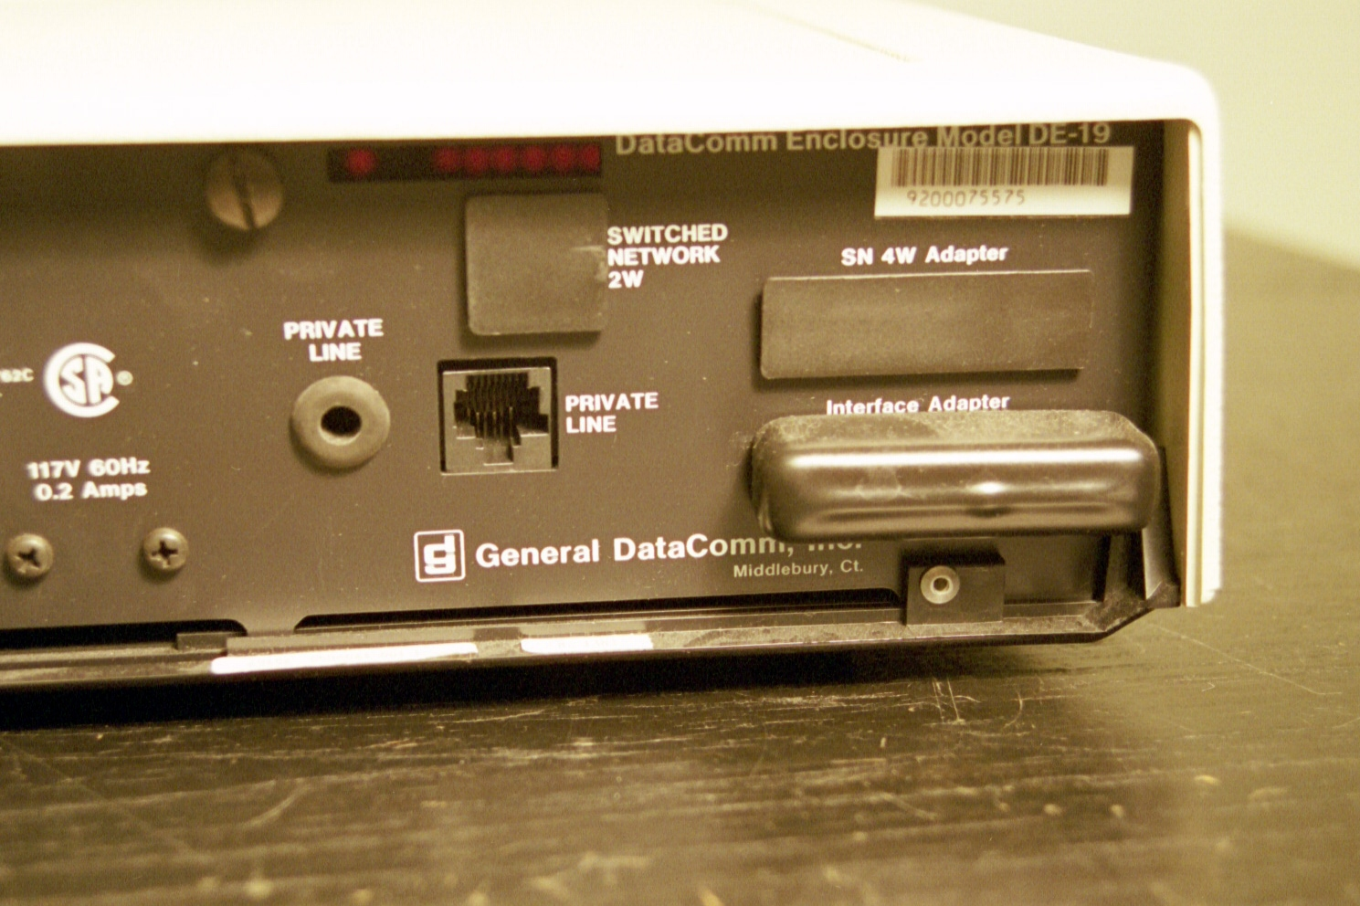
Table Top CSU/DSU

Slide 14
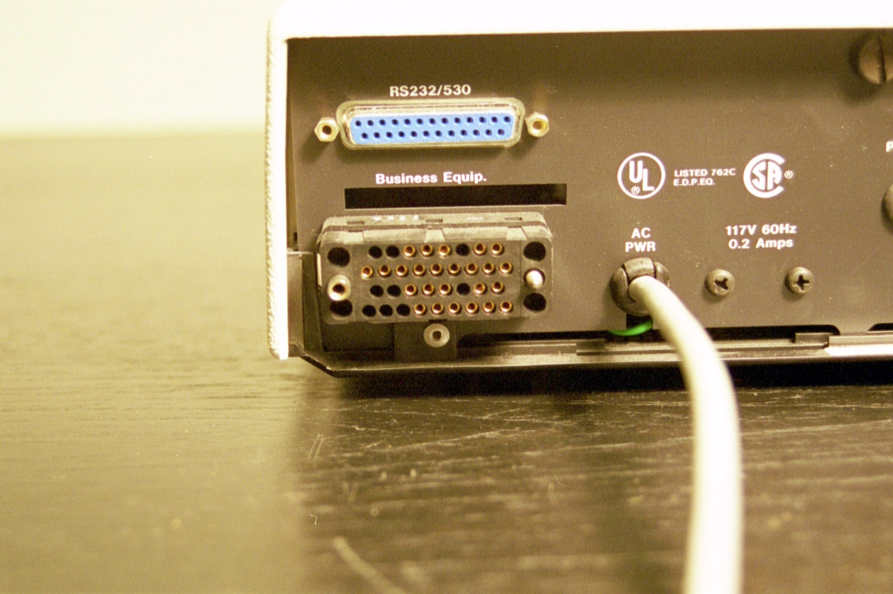
Table Top CSU/DSU

Slide 15
Rack Mounted CSU/DSU

Slide 16
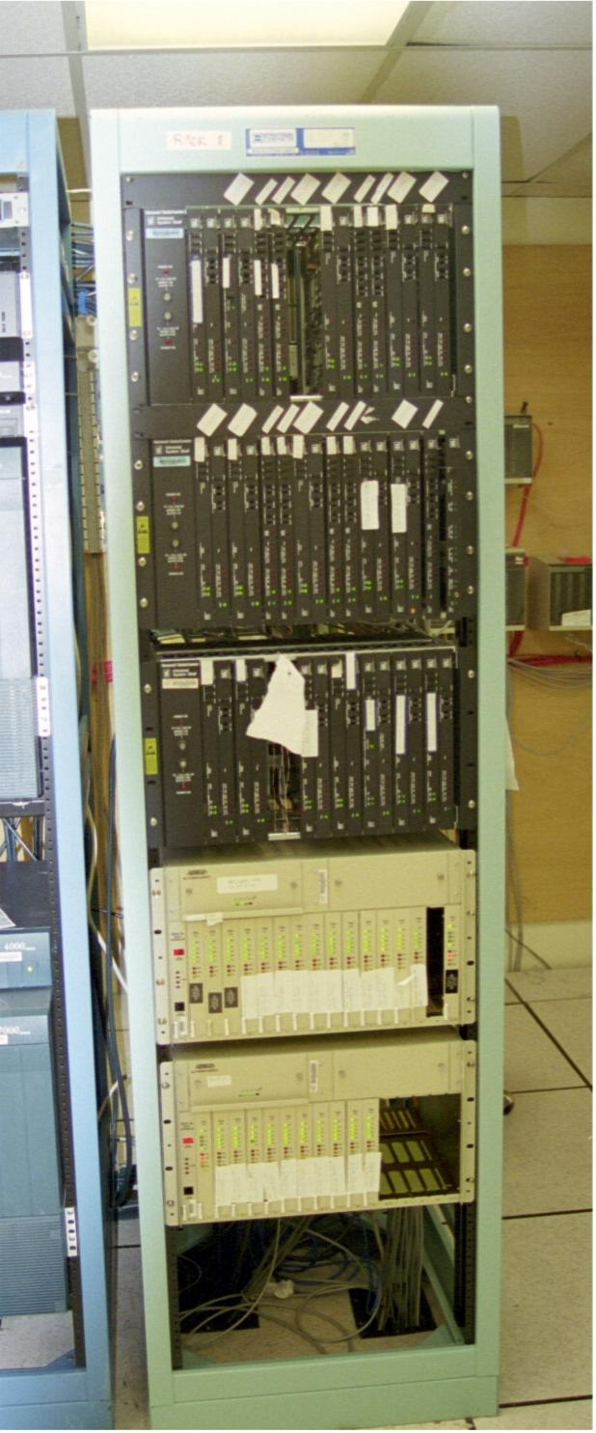
Shelf Mounted CSU/DSU

Slide 17
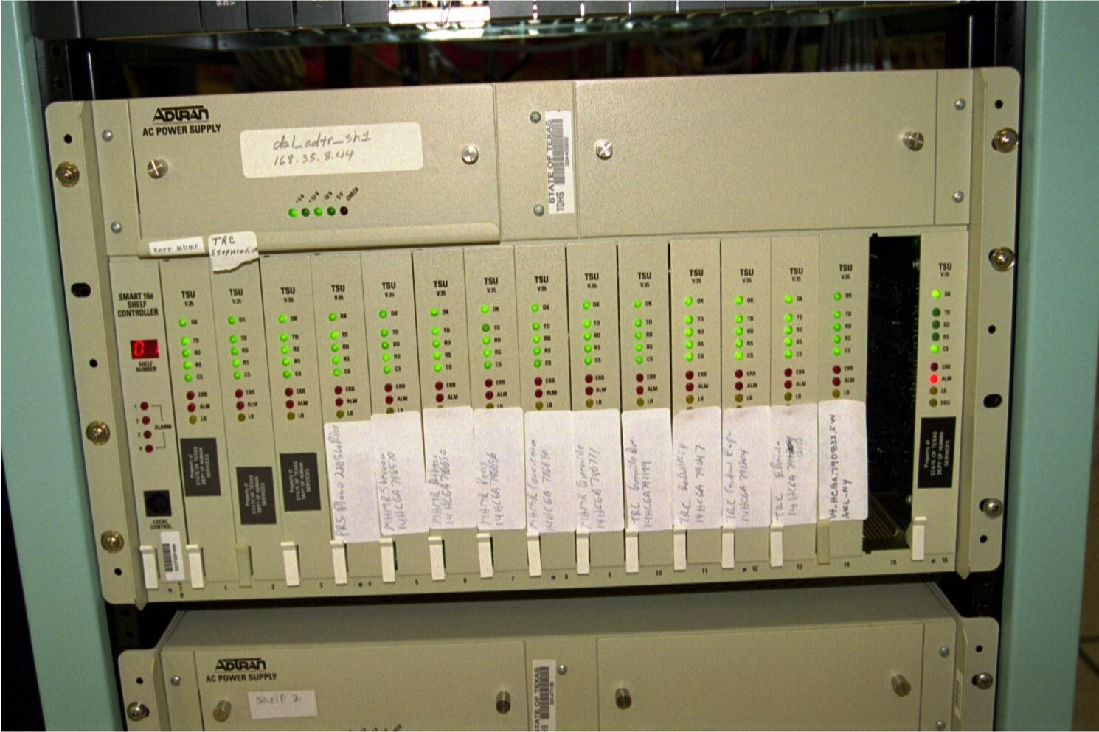
Shelf Mounted CSU/DSU

Slide 18
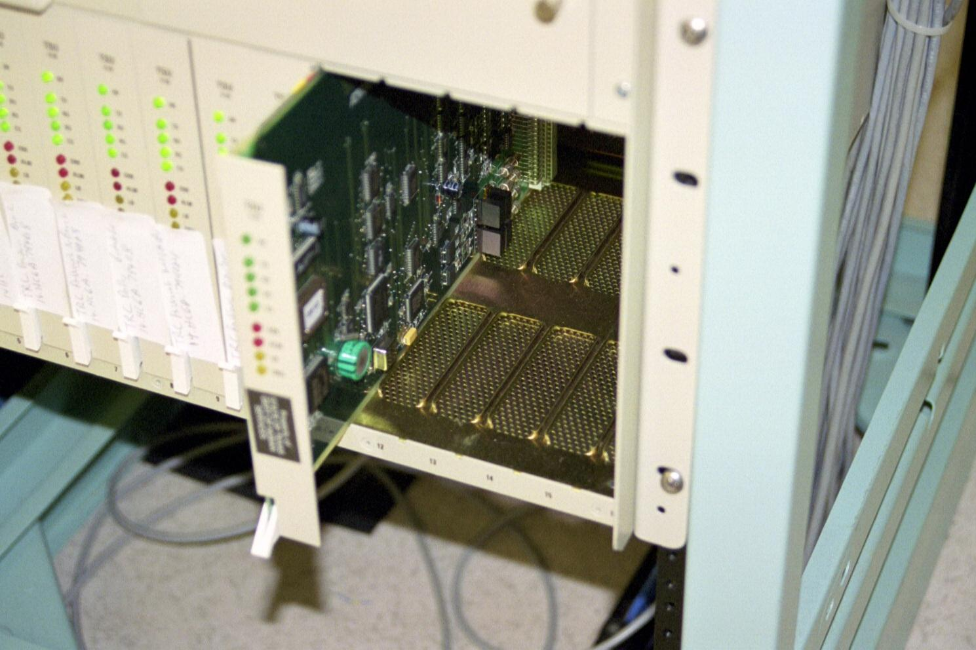
Shelf Mounted CSU/DSU

Slide 19
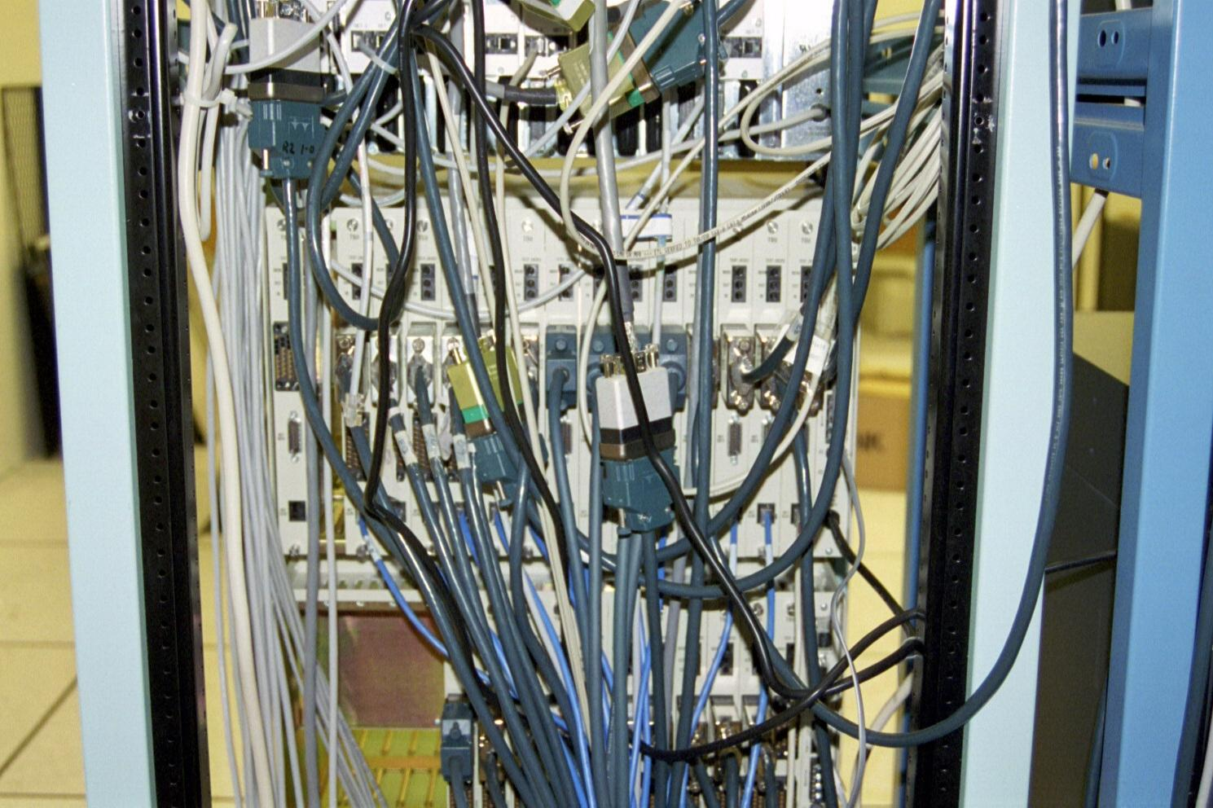
Shelf Mounted CSU/DSU

Slide 20
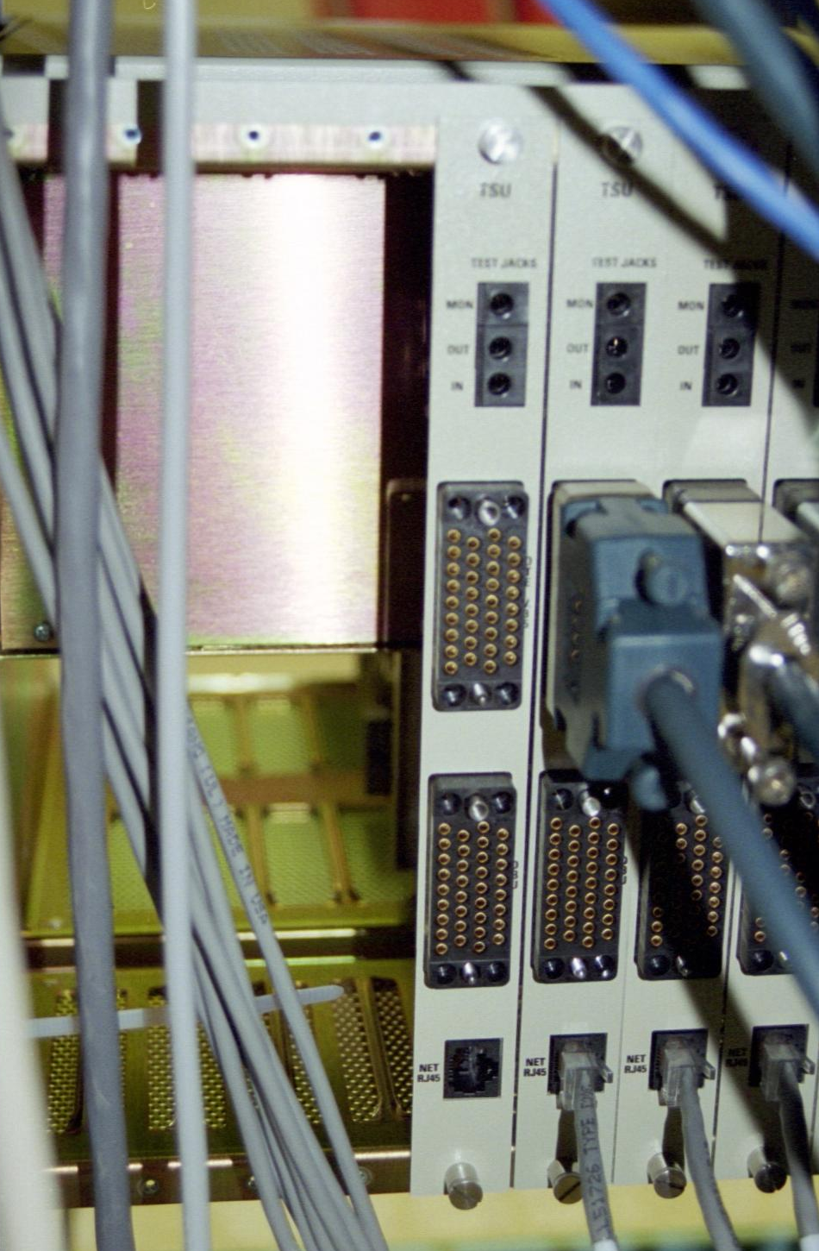
Shelf Mounted CSU/DSU

Slide 21
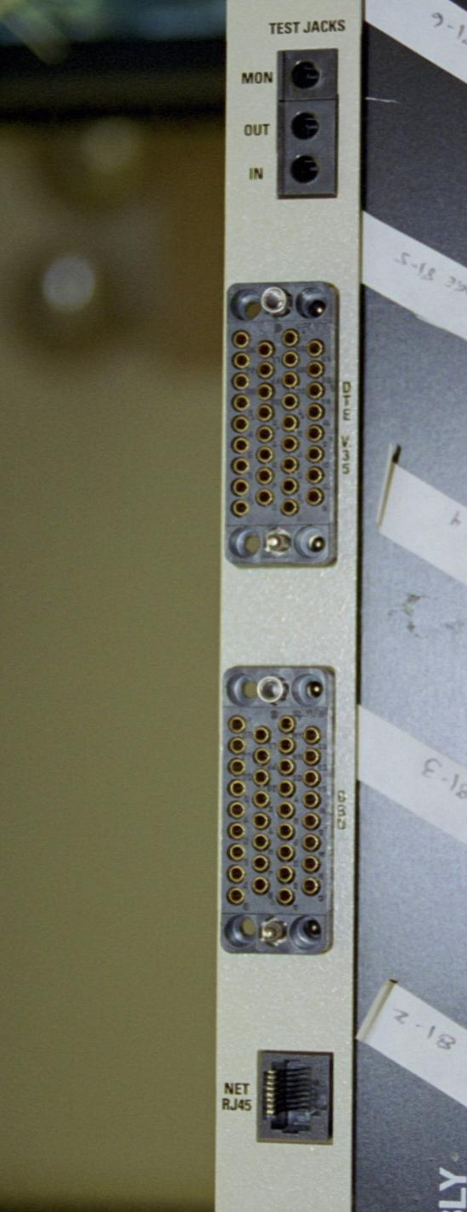
Shelf Mounted CSU/DSU

Slide 22
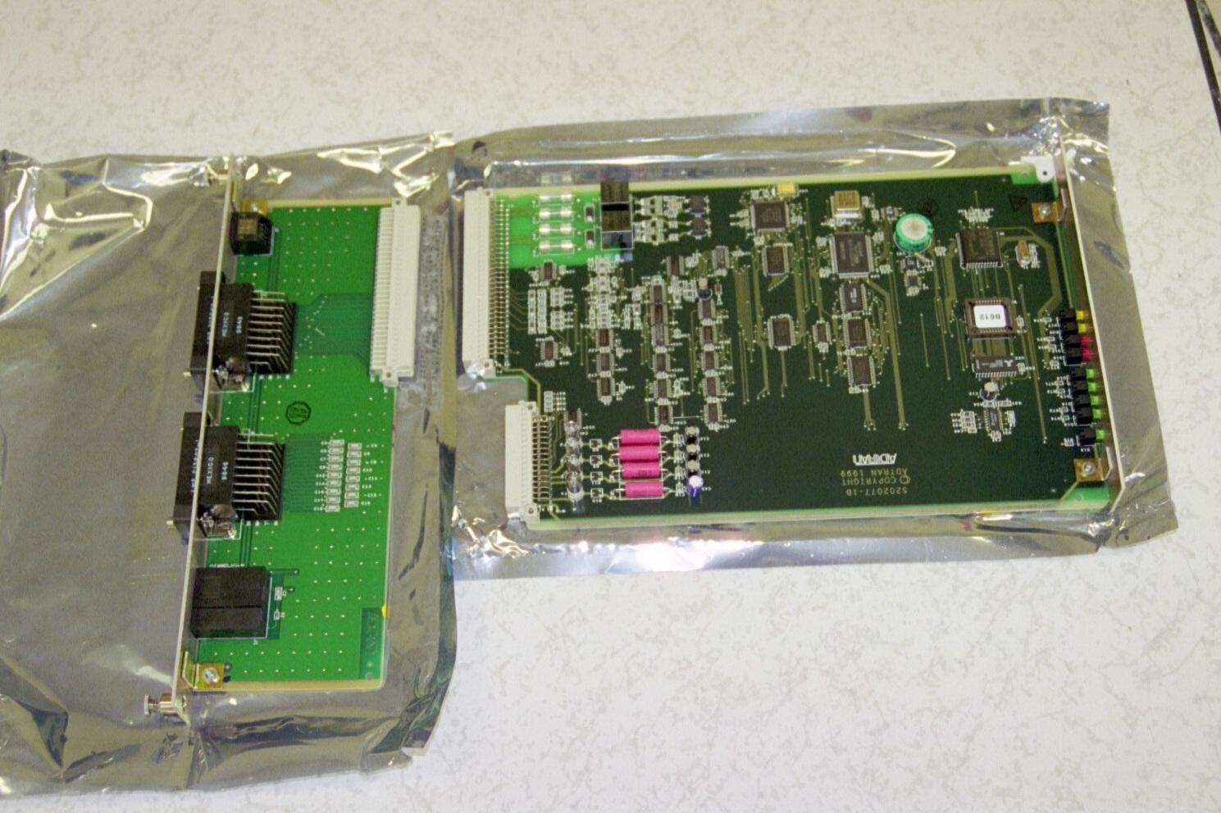
Shelf Mounted CSU/DSU

Slide 23
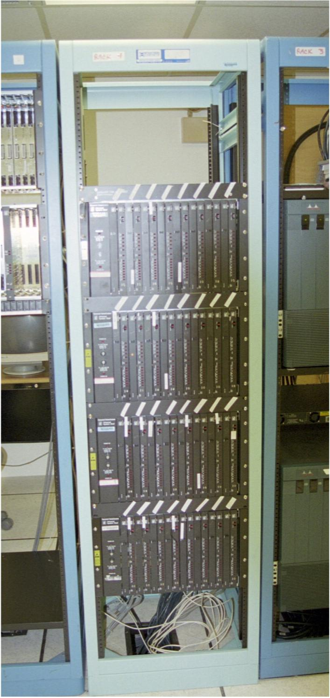
Shelf Mounted CSU/DSU

Slide 24
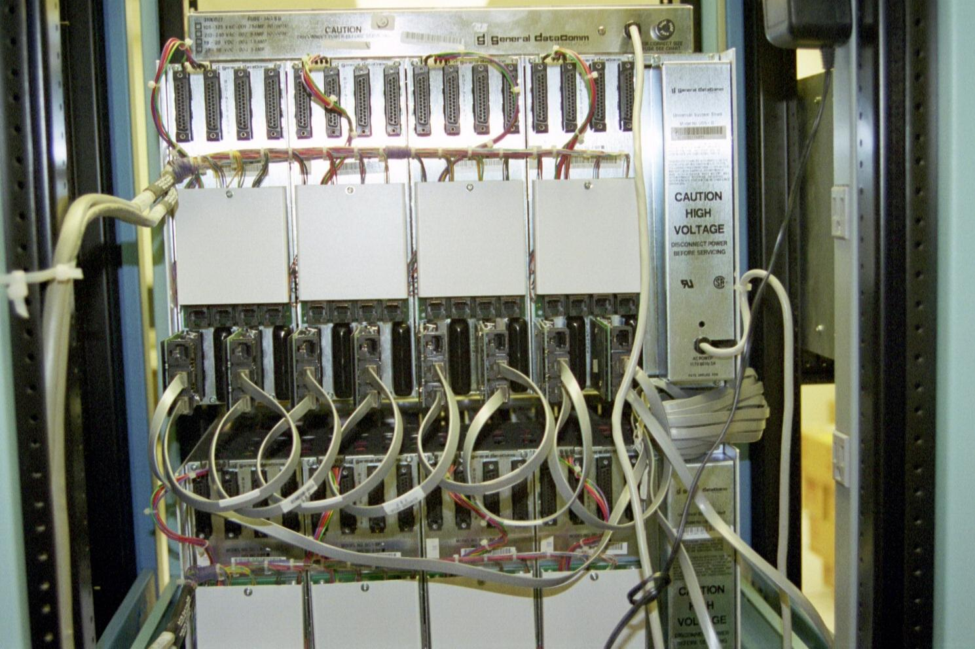
Shelf Mounted CSU/DSU

Slide 25
CSU/DSU Interfaces
When buying a CSU/DSU be sure to get the correct interfaces for the type of access line and other equipment being used
For example, CSU/DSUs for a Fractional T1 line can get by with a RS-232 serial interface
Whereas, a full T1 line requires a V.35 style connector on the serial line

Slide 26
CSU/DSU Configuration
In general just be sure you can hook it to both the demarc and the router that will be used
There are three basic things that must be done to configure a CSU/DSU for a typical T Carrier or Frame Relay application
Bit Framing
Data Stream Framing
Number of Channels

Slide 27
CSU/DSU Configuration
Let’s look at how to do these using a typical CSU/DSU
In this case an Adtran unit
To start, get out the manual

Slide 28
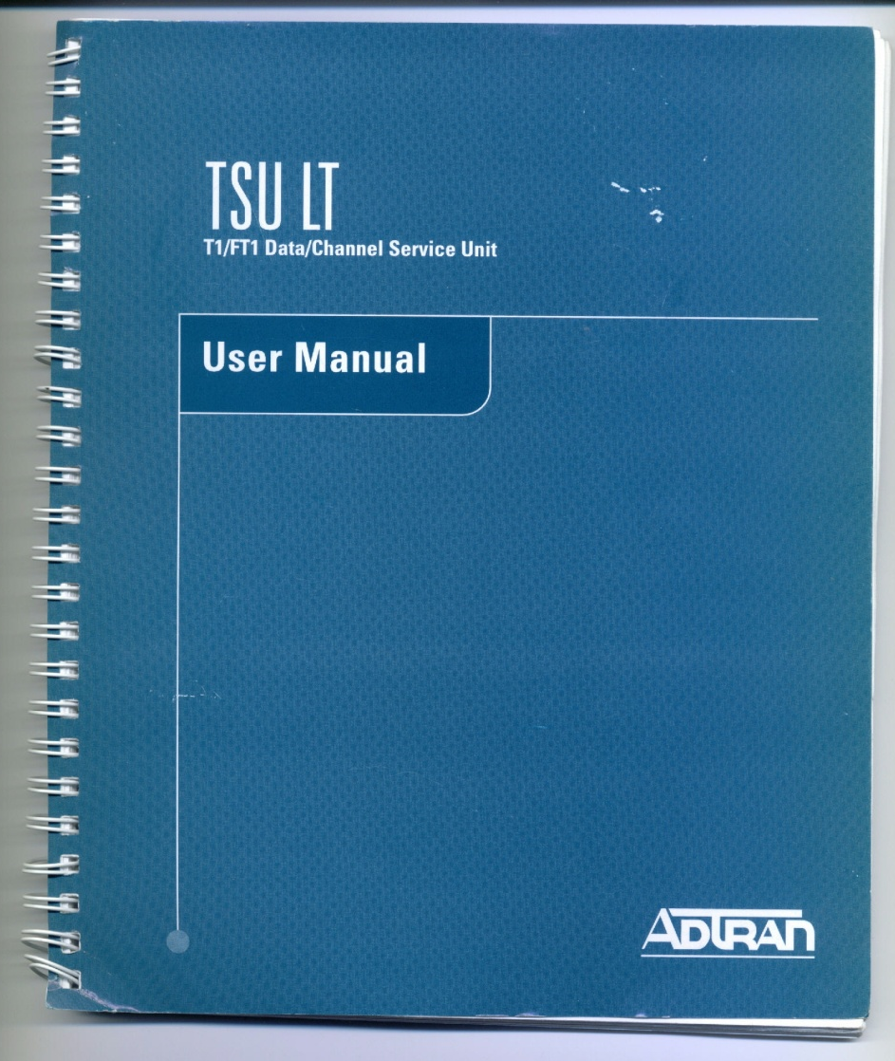
CSU/DSU Configuration

Slide 29
CSU/DSU Configuration
Set the bit framing
These are constraints on the basic bit stream defined by the DS hierarchy
These constraints are required to maintain signal quality and limited control functions
These bit framing methods include
B8ZS – Bipolar with 8-zero substitution
Most common
AMI – Alternate Mask Inversion
Also used

Slide 30
CSU/DSU Configuration
Then set the data stream framing
At the next level up the bit stream is formed into frames
Several frame types can be used
ESF - Extended SuperFrame
Most common
SF – SuperFrame
Also used
Also called D4

Slide 31
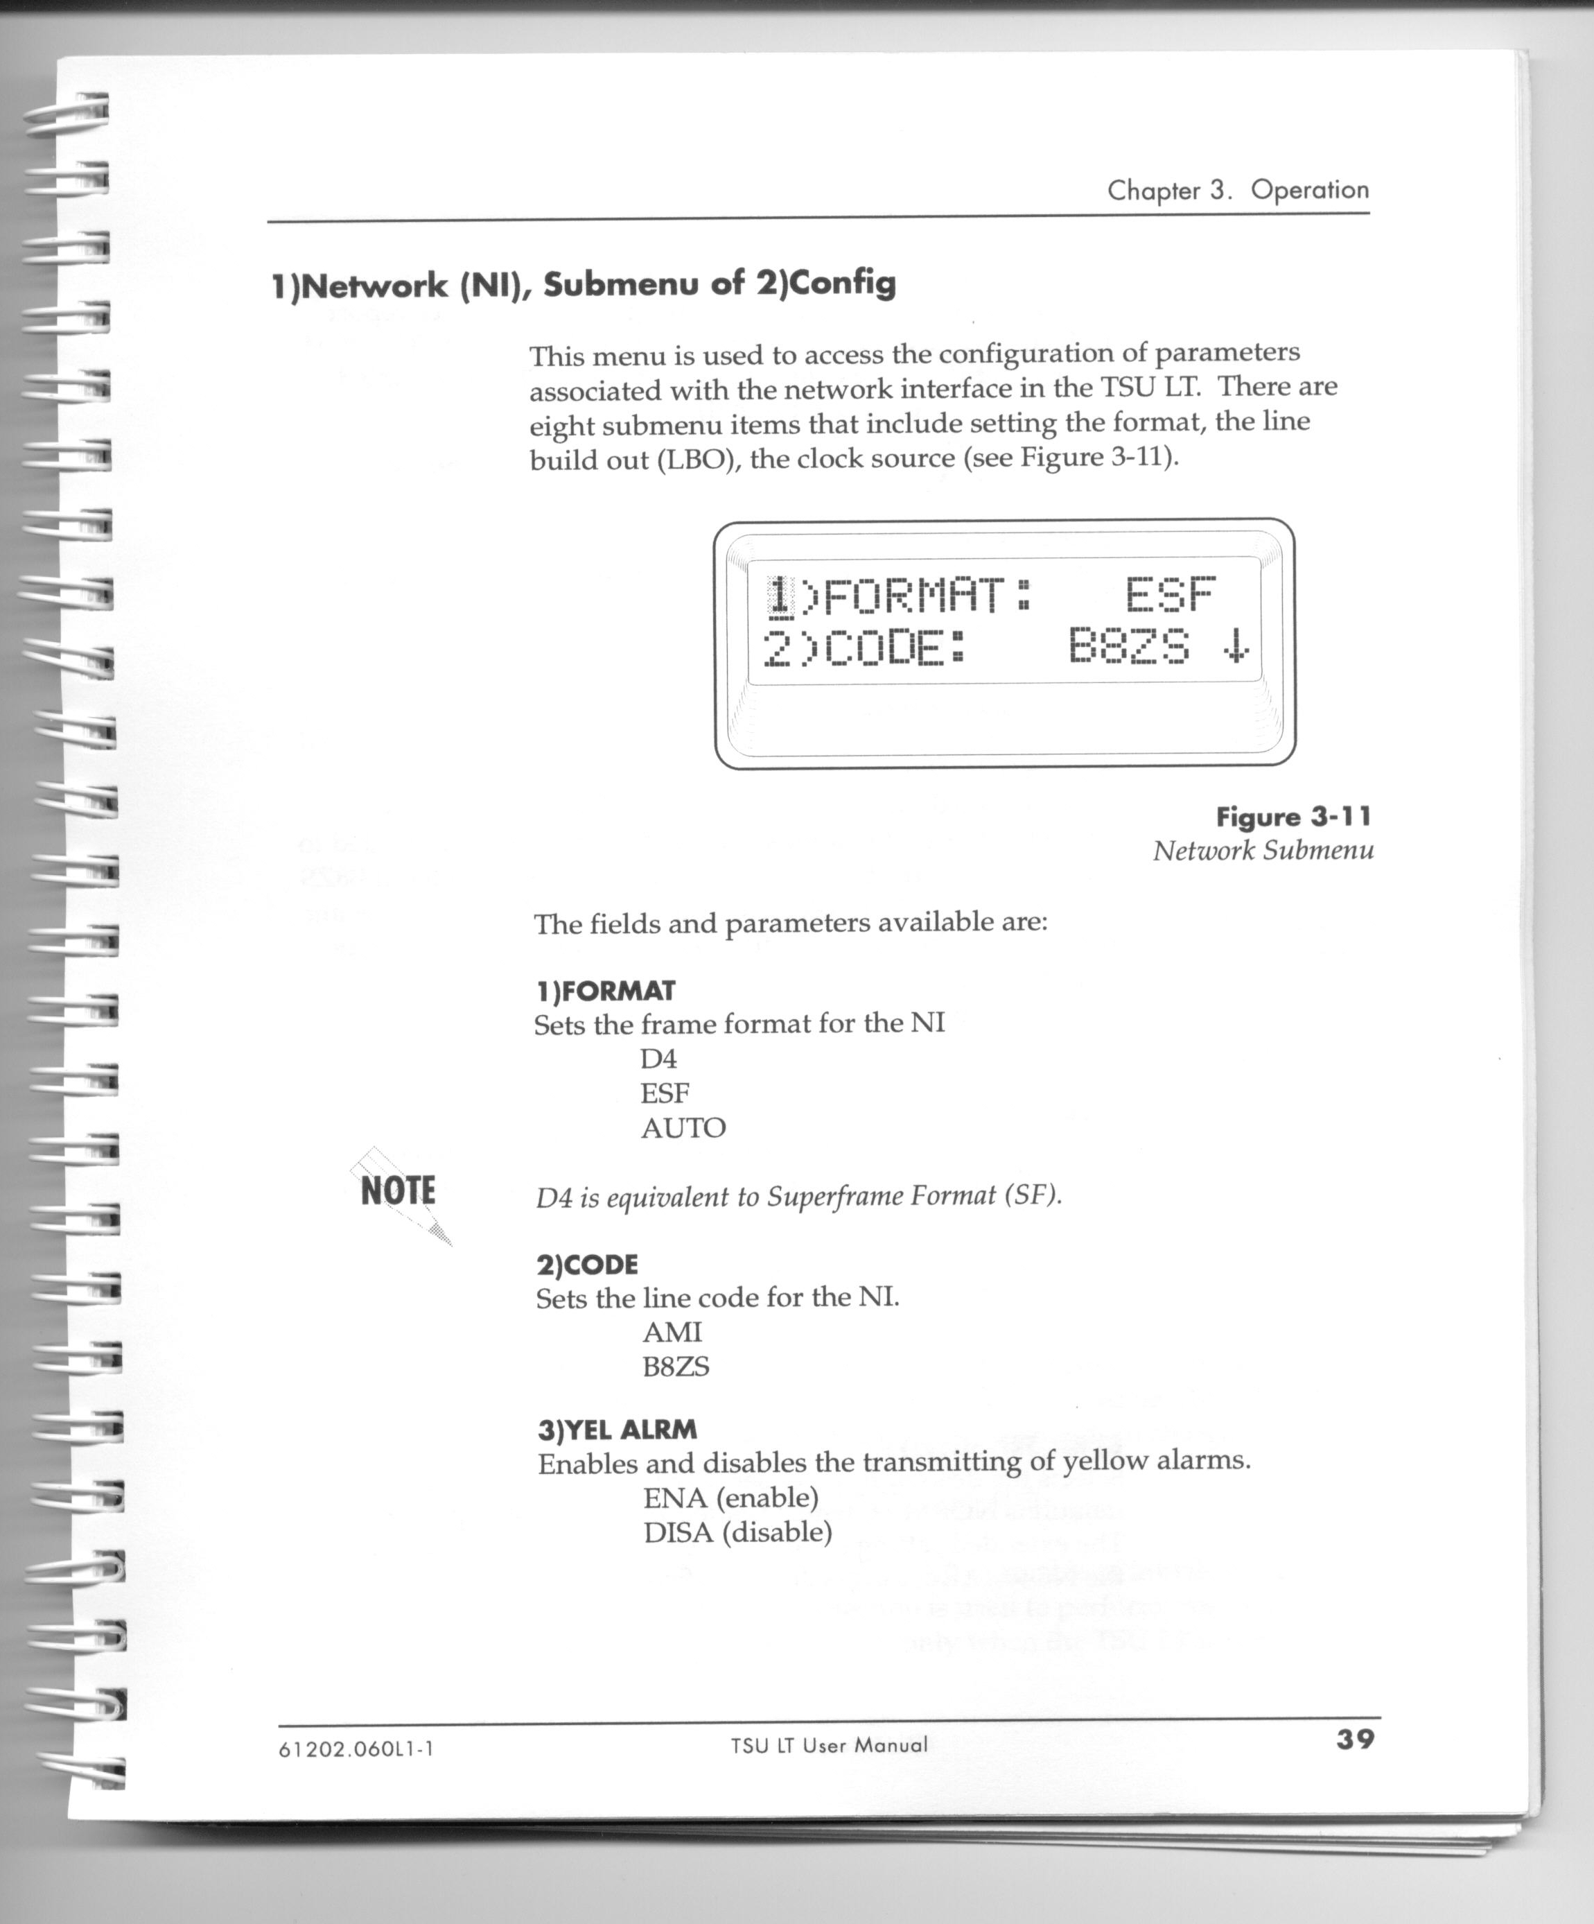
CSU/DSU Configuration

Slide 32
CSU/DSU Configuration
Finally set the number of channels
In a T Carrier circuit there are 24 possible channels
The number used depends on the bandwidth ordered from the service provider
From 1 to 24

Slide 33
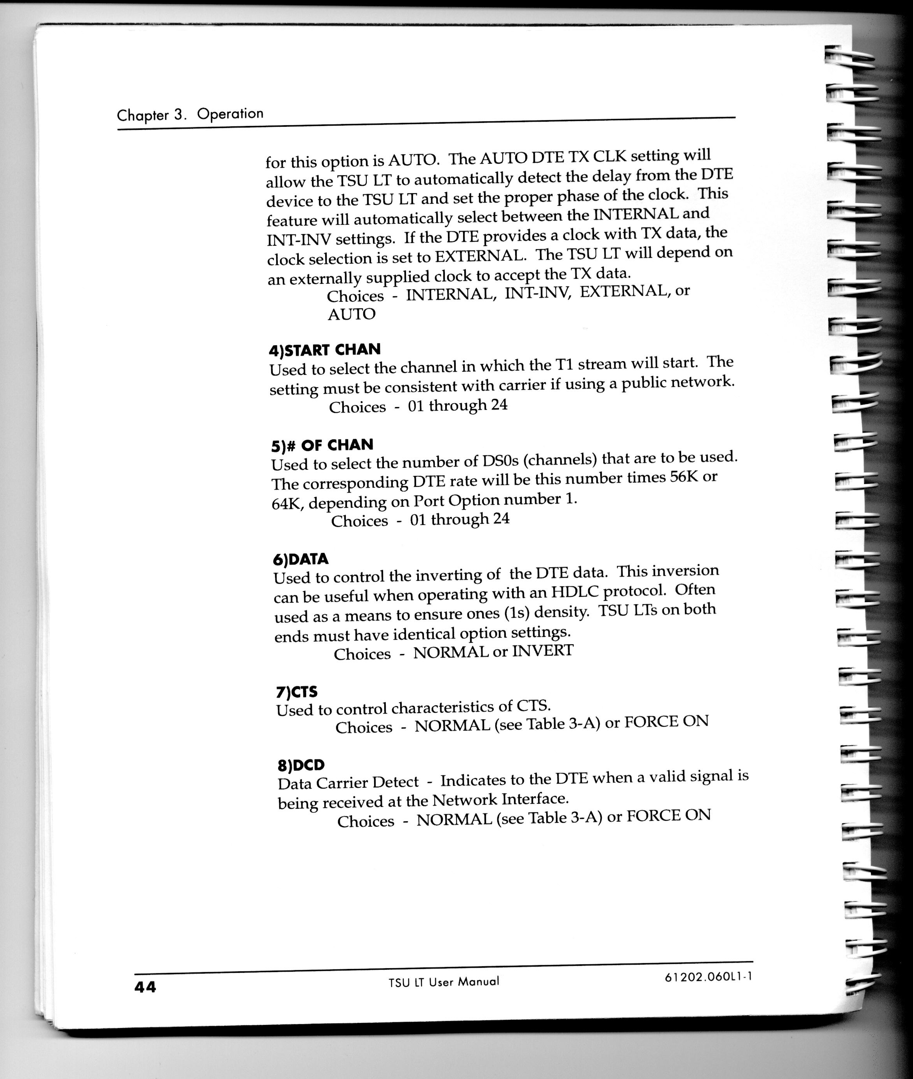
CSU/DSU Configuration

Slide 34
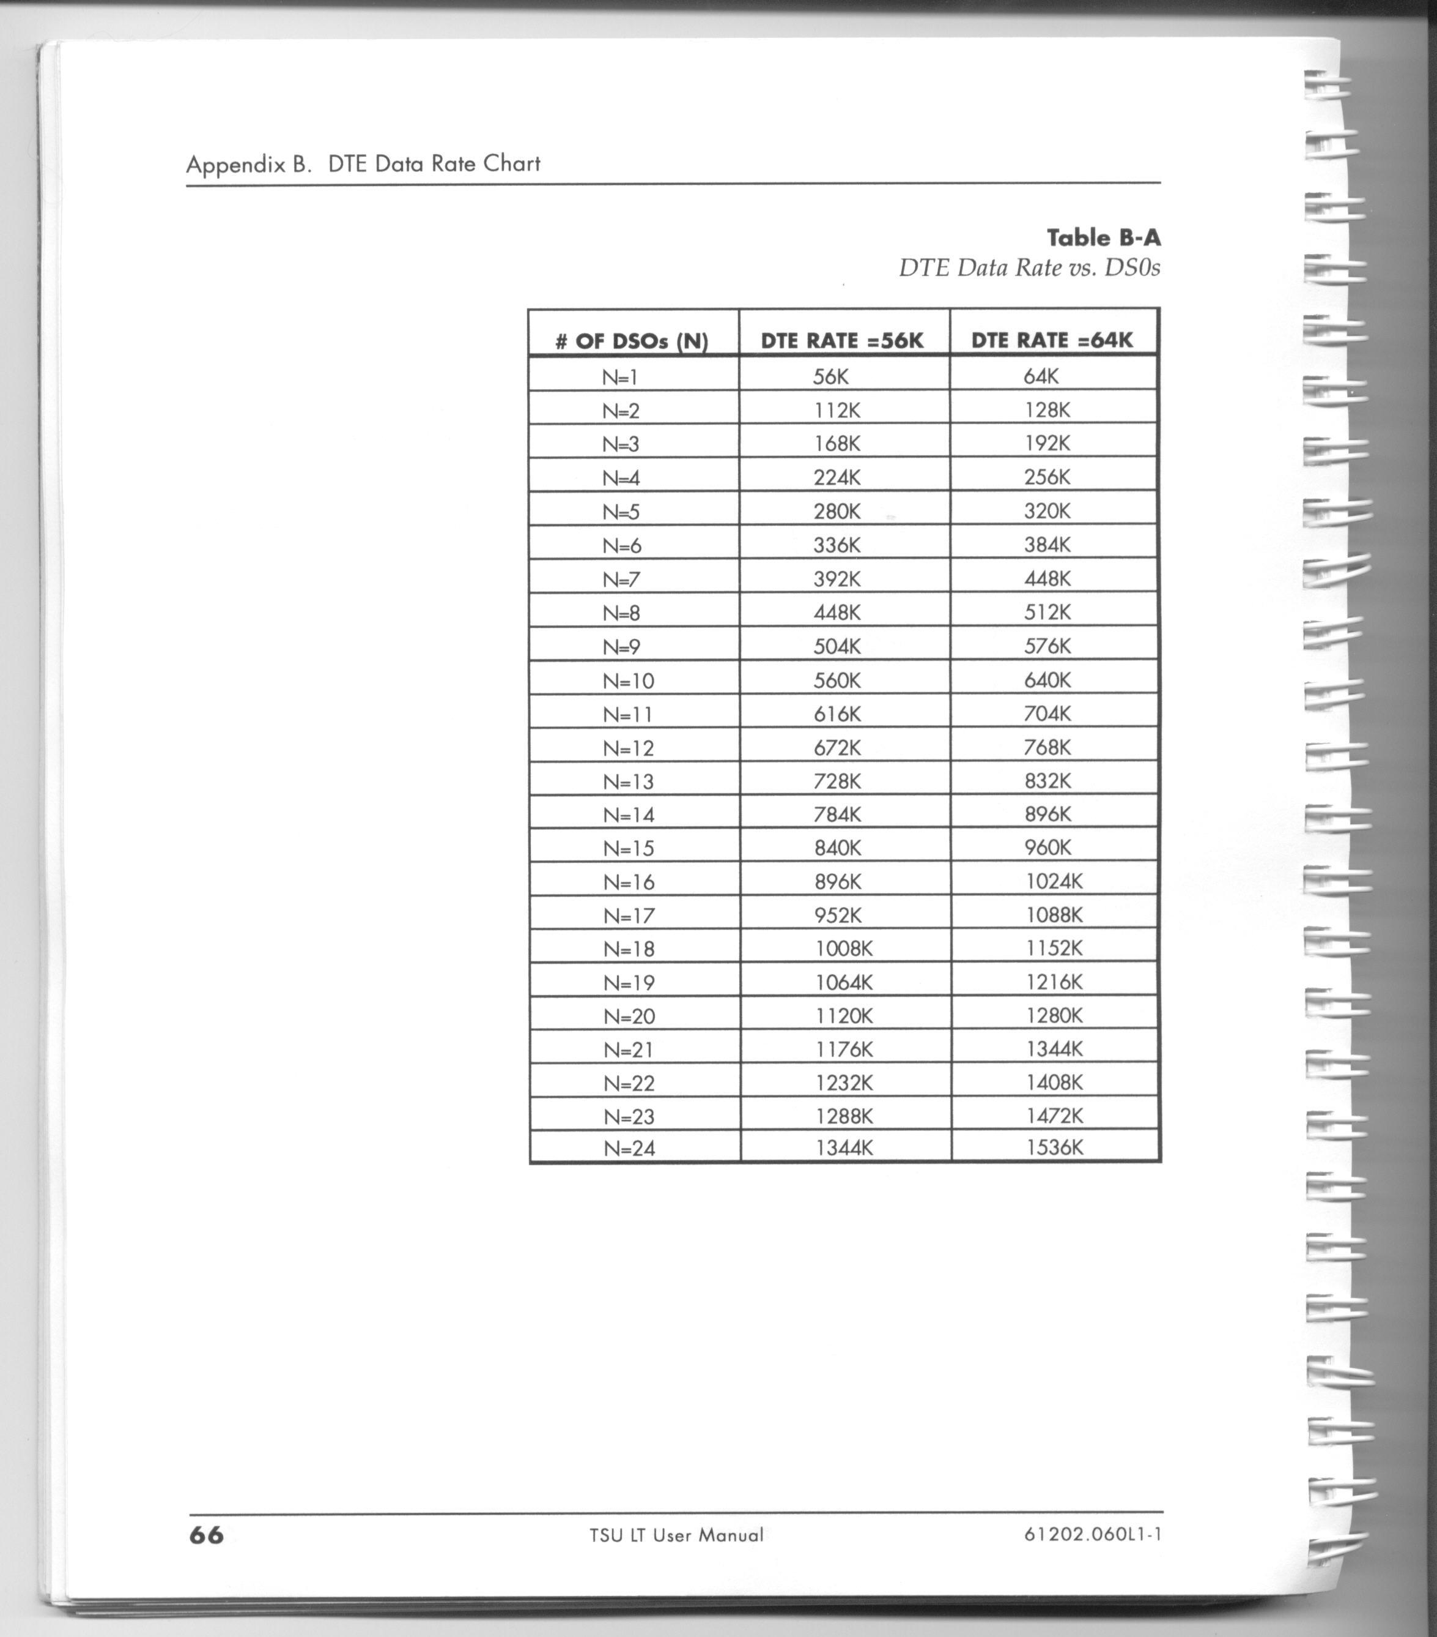
CSU/DSU Configuration

Slide 35
CSU/DSU Configuration
Let’s look at this in practice on a real unit

Slide 36
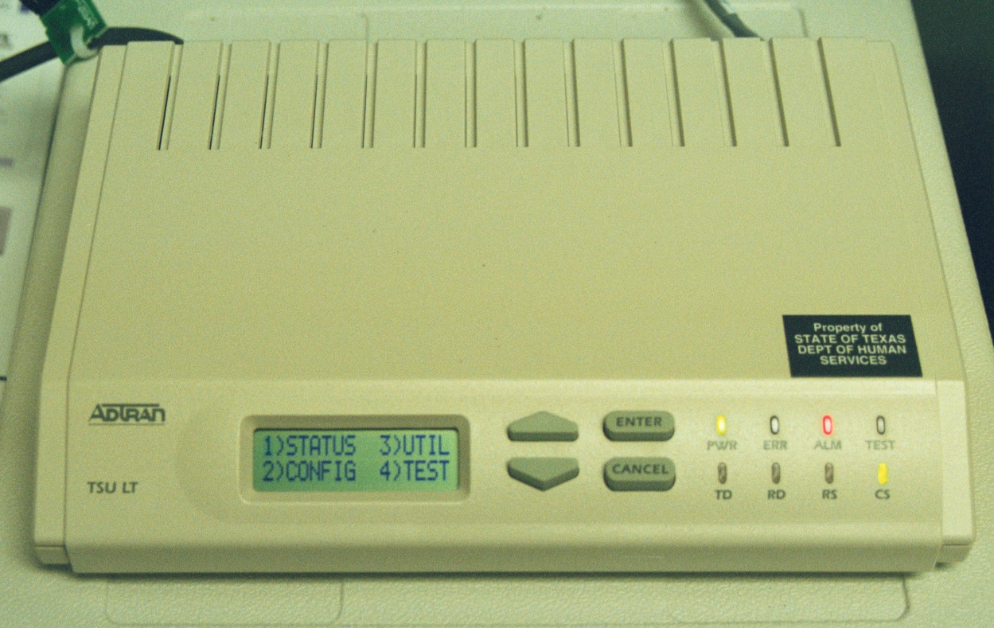
CSU/DSU Configuration

Slide 37
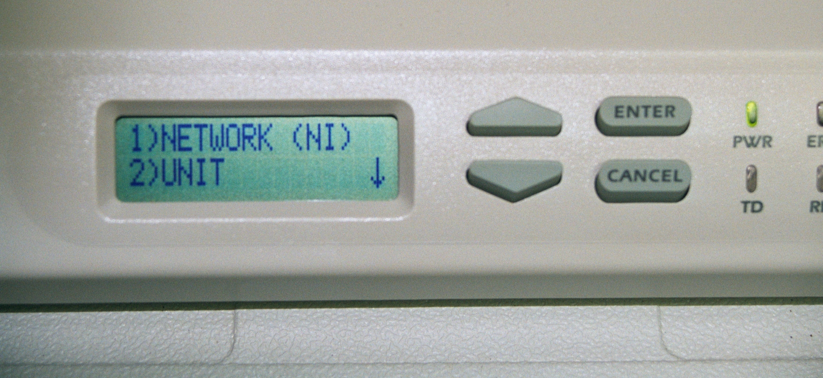
CSU/DSU Configuration

Slide 38
CSU/DSU Configuration

Slide 39
CSU/DSU Configuration

Slide 40
CSU/DSU Configuration

Slide 41
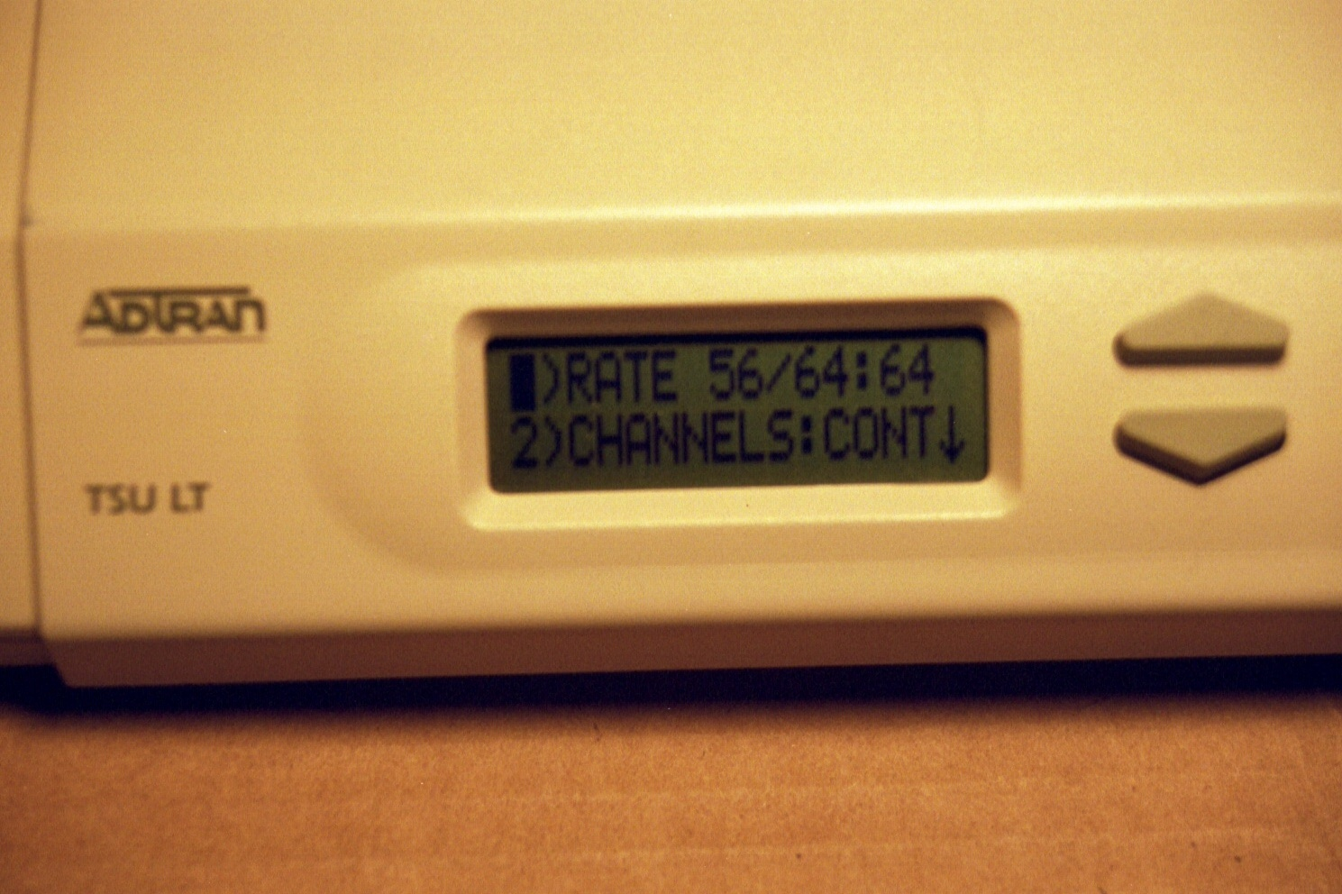
CSU/DSU Configuration

Slide 42
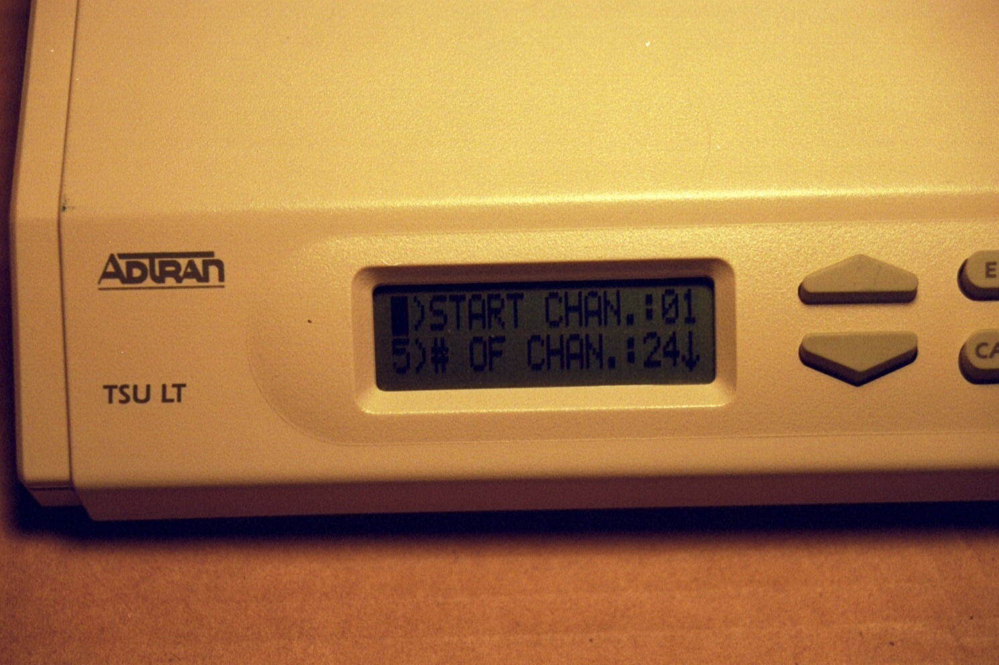
CSU/DSU Configuration

Slide 43
CSU/DSU Configuration
It is also a good idea to verify the clock source that will be used
In almost all cases the clock source will be the carrier’s network
Just be sure the CSU/DSU is set to this clock source

Slide 44
Diagnostic Functions
Many CSU/DSUs just do the standard functions
They are much more useful if they also include diagnostic capabilities
Basic diagnostics include line analysis which helps to determine what is wrong with a circuit
It can measure attenuation, noise, loopback problems, and mode problems

Slide 45
Diagnostic Functions
Attenuation tests look for excessive signal loss
Noise on a circuit will drown out the signal carrying the data you need
Noise must be detected so its source can be determined
If a line is in loopback mode it will not be able to transfer data

Slide 46
Diagnostic Functions
The CSU/DSU should signal this problem
If the circuit was setup in the wrong mode the circuit will not function
Again a CSU/DSU should show this

Slide 47
CSU/DSU Format
Although the functions performed by the CSU/DSU will remain the standalone unit will eventually go away
This function is increasingly being integrated into other units such as routers

Slide 48
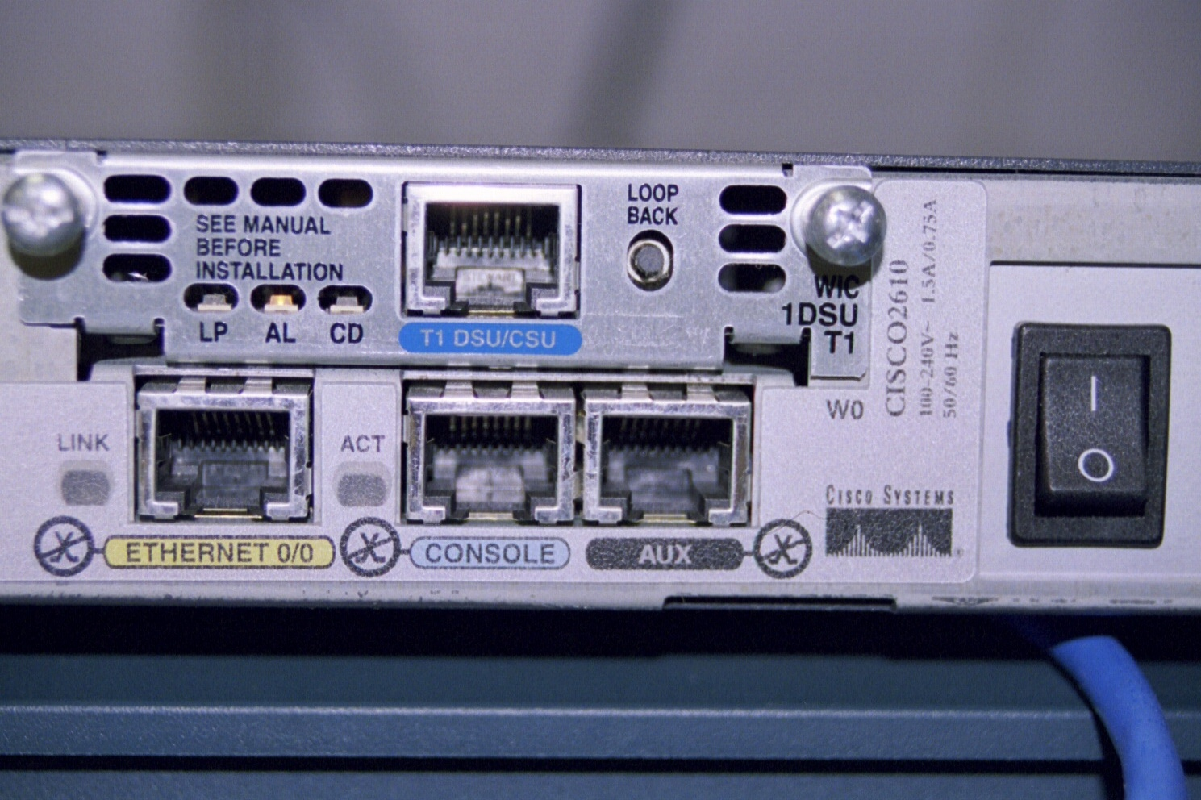
CSU/DSU in Router

Slide 49
For More Information
T1: A Survival Guide
Michael S. Gast
ISBN 0596001274

