Slide 1
Basic Network Security
Last Update 2011.05.28
2.1.0

Slide 2
Objectives of This Section
Learn about basic network security

Slide 3
Sources
The textbook chapter on this topic is very good
Most of this is copied directly word for word from it

Slide 4
Types of Attackers
There are many types of attackers
Such as
Hacker
An individual who attempts to gain unauthorized access to network resources with malicious intent
Black Hat
Another term for individuals who use their knowledge of computer systems to break into systems or networks that they are not authorized to use, usually for personal or financial gain

Slide 5
Types of Attackers
Cracker
A more accurate term to describe someone who tries to gain unauthorized access to network resources with malicious intent
Phreaker
An individual who manipulates the phone network to cause it to perform a function that is not allowed

Slide 6
Types of Attackers
A common goal of phreaking is breaking into the phone network usually through a pay phone to make free long-distance calls
Spammer
An individual who sends large quantities of unsolicited e-mail messages
Spammers often use viruses to take control of home computers and use them to send bulk messages

Slide 7
Types of Attackers
Phisher
Uses e-mail or other means to trick others into providing sensitive information, such as credit card numbers or passwords
A phisher masquerades as a trusted party that would have a legitimate need for the sensitive information

Slide 8
Types of Attacks
There are many types of attacks
Such as
Insider abuse of network access
Viruses
Mobile device theft
Phishing, in which an organization is fraudulently represented as the sender
Instant-messaging misuse
Denial of service

Slide 9
Types of Attacks
Unauthorized access to information
Bots within the organization
Theft of customer or employee data
Abuse of a wireless network
System penetration
Financial fraud
Password sniffing
Key logging
Website defacement

Slide 10
Types of Attacks
Misuse of a public web application
Theft of proprietary information
Exploiting an organization's DNS server
Telecom fraud
Sabotage
Computer crimes
System penetration

Slide 11
Types of Attacks
More specifically types of attacks often seen include
Social Engineering
The easiest attack involves no computer skills at all
If an intruder can trick a member of an organization into giving out valuable information, such as the location of files or passwords, the process of hacking is much easier

Slide 12
Types of Attacks
Reconnaissance Attacks
Reconnaissance is the unauthorized discovery and mapping of systems, services, or vulnerabilities
It is also known as information gathering, and, in most cases, it precedes another type of attack
Reconnaissance is similar to a thief casing a neighborhood for vulnerable homes to break into, such as an unoccupied residence, or one with easy-to-open doors or open windows

Slide 13
Types of Attacks
Reconnaissance attacks can consist of the following
Ping sweeps
Port scans
Packet sniffers

Slide 14
Types of Attacks
Access Attacks
Unauthorized system access is when an intruder gains access to a device for which he or she does not have an account or a password
Entering or accessing systems usually involves running a hack, script, or tool that exploits a known vulnerability of the system or application being attacked

Slide 15
Types of Attacks
Password Attacks
Password attacks can be implemented using a packet sniffer to yield user accounts and passwords that are transmitted as clear text
Password attacks usually refer to repeated attempts to log in to a shared resource, such as a server or router, to identify a user account, password, or both
These repeated attempts are called dictionary attacks or brute-force attacks

Slide 16
Types of Attacks
Trust Exploitation
The goal of a trust exploitation attack is to compromise a trusted host, using it to stage attacks on other hosts in a network
If a host in a company's network is protected by a firewall (inside host) but is accessible to a trusted host outside the firewall (outside host), the inside host can be attacked through the trusted outside host

Slide 17
Types of Attacks
Port Redirection
A port redirection attack is a type of trust exploitation attack that uses a compromised host to pass traffic through a firewall that would otherwise be blocked
For example, the attacker gains access to Host A, which is in the publicly accessible demilitarized zone (DMZ)

Slide 18
Types of Attacks
As soon as Host A is compromised, the attacker can install software to redirect traffic from the outside host directly to the inside host
Although neither communication violates the rules implemented in the firewall, the outside host has now achieved connectivity to the inside host through the port redirection process on the public services host

Slide 19
Types of Attacks
Man-in-the-Middle Attack
A man-in-the-middle (MITM) attack is carried out by attackers who manage to position themselves between two legitimate hosts
The attacker may allow the normal transactions between hosts to occur and only periodically manipulate the conversation between the two

Slide 20
Types of Attacks
DoS Attacks
Denial of service is when an attacker disables or corrupts networks, systems, or services with the intent to deny services to intended users
This can be accomplished by physically disconnecting a system, crashing the system, or slowing it down to the point that it is unusable

Slide 21
Types of Attacks
For example
SYN Flood Attacks
A SYN flood attack exploits the TCP three-way handshake
It involves sending multiple SYN requests (more than 1000) to a targeted server
The server replies with the usual SYNACK response, but the malicious host never responds with the final ACK to complete the handshake
This ties up the server until it eventually runs out of resources and cannot respond to a valid host request

Slide 22
Types of Attacks
DDoS Attacks
Distributed DoS attacks are designed to saturate network links with illegitimate data
This data can overwhelm an Internet link, causing legitimate traffic to be dropped
DDoS uses attack methods similar to standard DoS attacks but operates on a much larger scale

Slide 23
Types of Attacks
Malicious Code Attacks
Malicious software can be inserted onto a host to damage or corrupt a system; replicate itself; or deny access to networks, systems, or services

Slide 24
Defense Against Attacks
To defend against attacks use the same methods the attacker uses so as to develop and test the defenses against these attacks
Perform footprint analysis or reconnaissance
For example, a company web page can lead to information, such as the IP addresses of servers
From there, an attacker can create a picture of the company's security profile or footprint

Slide 25
Defense Against Attacks
Enumerate information
An attacker can expand on the footprint by monitoring network traffic with a packet sniffer such as Wireshark, finding information such as version numbers of FTP servers and mail servers
A cross-reference with vulnerability databases exposes the company's applications to potential exploits

Slide 26
Defense Against Attacks
Manipulate users to gain access
Sometimes employees choose passwords that are easily crackable
In other instances, employees can be duped by talented attackers into giving up sensitive access-related information
Escalate privileges
After attackers gain basic access, they use their skills to increase their network privileges

Slide 27
Defense Against Attacks
Gather additional passwords and secrets
With improved access privileges, attackers use their talents to gain access to sensitive information
Install back doors
Back doors give the attacker a way to enter the system without being detected
The most common back door is an open listening TCP or UDP port

Slide 28
Defense Against Attacks
Leverage the compromised system
After a system is compromised an attacker uses it to stage attacks on other hosts in the network

Slide 29
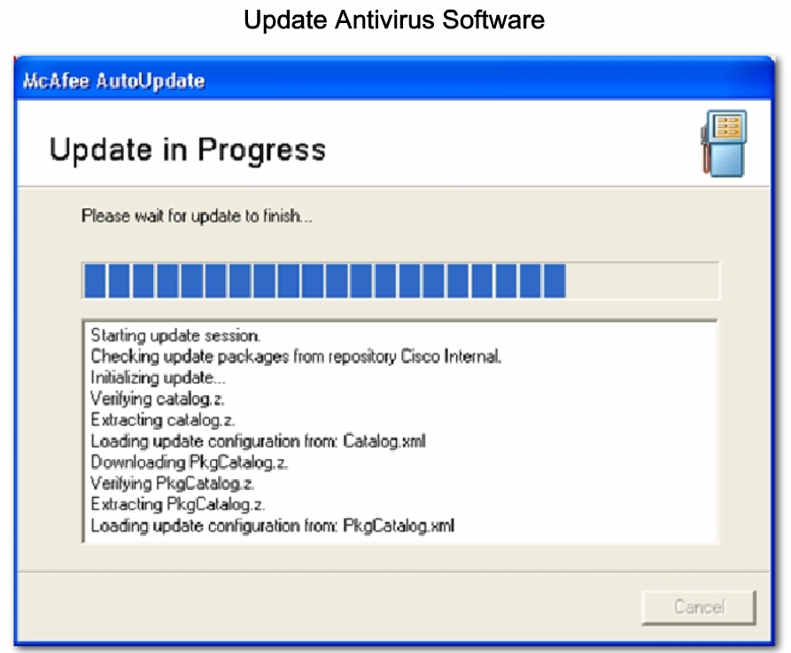
Defense Against Attacks

Slide 30
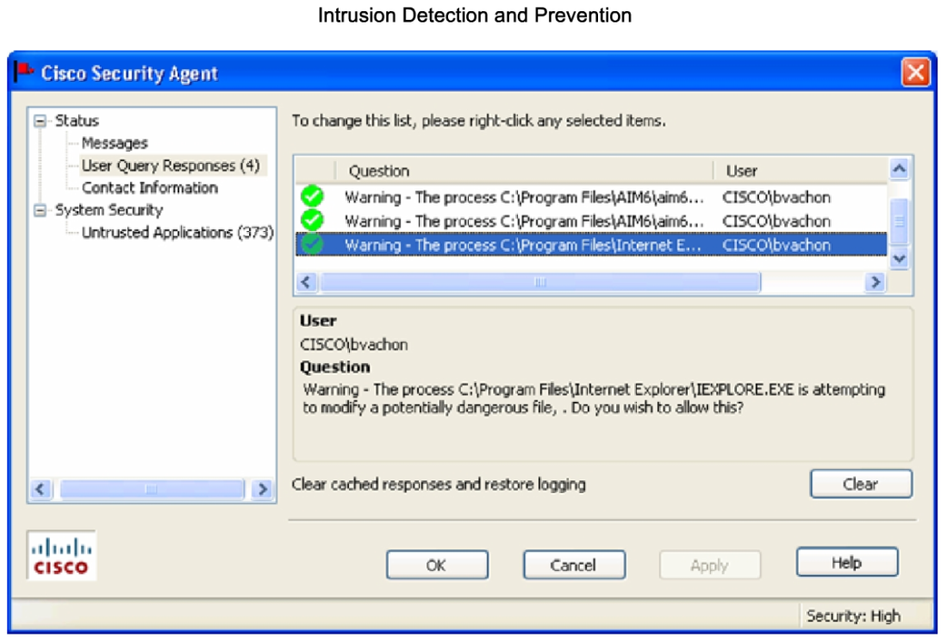
Defense Against Attacks

Slide 31
Defense Against Attacks
Specific methods to defend against attacks include
Host-and Server-Based Security
Host-and server-based security must be applied to all network systems
Mitigation techniques for these devices include
Device hardening
Antivirus software
Personal firewalls
Operating system patches

Slide 32
Defense Against Attacks
Intrusion Detection and Prevention
IDS - Intrusion detection systems detect attacks against a network and send logs to a management console
IPS - Intrusion prevention systems prevent attacks against the network and should provide the following active defense mechanisms in addition to detection

Slide 33
Security Policy
The first step any organization should take to protect its data and itself from a liability challenge is to develop a security policy
A security policy is a set of principles that guides decision-making processes and enable leaders in an organization to distribute authority confidently

Slide 34
Security Policy
RFC 2196 states
A security policy is a formal statement of the rules by which people who are given access to an organization's technology and information assets must abide
A security policy can be as simple as a brief Acceptable Use Policy for network resources, or it can be several hundred pages long and detail every element of connectivity

Slide 35
Security Policy
The security policy also varies based on business type, company size, number of users, type of industry, threats, and vulnerabilities

Slide 36
Security Policy
A security policy meets these goals
It informs users, staff, and managers of their obligations for protecting technology and information assets
It specifies the mechanisms through which these requirements can be met
It provides a baseline from which to acquire, configure, and audit computer systems and networks for compliance with the policy

Slide 37
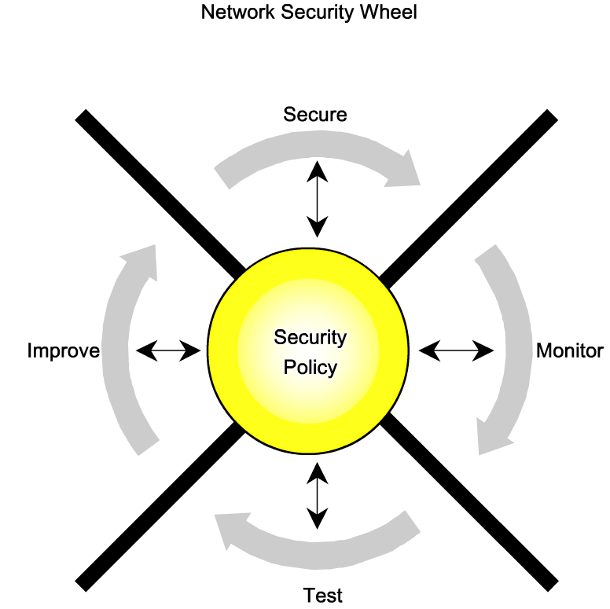
Security Policy

Slide 38
Common Security Threats
When discussing network security, three common factors are
Vulnerabilities
Threats
Attacks

Slide 39
Vulnerabilities
Vulnerability is the degree of weakness that is inherent in every network and device
This includes routers, switches, desktops. servers, and even security devices
Vulnerability also includes the users
Even when the infrastructure and devices are secured employees can be targets of social-engineering attacks

Slide 40
Vulnerabilities
The three primary categories of vulnerabilities are
Technology weaknesses
Configuration weaknesses
Security policy weaknesses

Slide 41
Technology Weaknesses
Some protocols are inherently insecure
TCP
HTTP
FTP
ICMP
SNMP
SMTP
POP
for example

Slide 42
Technology Weaknesses
Operating systems have security problems that must be addressed no matter who made them
Network equipment, such as routers, firewalls, and switches, have security weaknesses that must be recognized and protected against
These include password protection, lack of authentication

Slide 43
Configuration Weaknesses
The configuration maybe problematic
Unsecured user accounts
User account information may be transmitted insecurely across the network, exposing usernames and passwords to snoopers.
System accounts with easily guessed passwords
This common problem is the result of poorly selected user passwords

Slide 44
Configuration Weaknesses
Misconfigured Internet services
A common problem is to turn on JavaScript in web browsers, enabling attacks by way of hostile JavaScript when accessing untrusted sites
IIS, FTP, and Terminal Services also pose problems
Unsecured default settings
Many products have default settings that enable security holes

Slide 45
Configuration Weaknesses
Misconfigured network equipment
Misconfigurations of the equipment itself can cause significant security problems
For example, misconfigured access lists, routing protocols, or SNMP community strings

Slide 46
Security Policy Weaknesses
The lack of written security policy can be a problem
An unwritten policy cannot be consistently applied or enforced
Corporate politics
Political battles and turf wars within the organization can make it difficult to implement a consistent security policy

Slide 47
Security Policy Weaknesses
Lack of continuity
Poorly chosen, easily cracked, or default passwords can allow unauthorized access to the network

Slide 48
Security Policy Weaknesses
Logical access controls not used
Inadequate monitoring and auditing allow attacks and are not applied unauthorized use to continue, waiting company resources
This could result in legal action against or termination of IT technicians, IT management, or even company leadership that allows these unsafe conditions to persist

Slide 49
Security Policy Weaknesses
Software and hardware installation and changes do not follow policy
Unauthorized changes to the network topology or the installation of unapproved applications creates security holes

Slide 50
Security Policy Weaknesses
The lack of a disaster recovery plan allows chaos, panic, plan is nonexistent
The lack of a disaster recovery plan allows chaos, panic, and confusion to occur when someone attacks the enterprise

Slide 51
Pesky Users
No matter what you do the people already inside the network are the major security threat
The best possible network is one with no users
As this is unlikely to exist in the real world the actions of the pesky users must be monitored and controlled

Slide 52
Pesky Users
As stated every organization must have a security policy
Further the policy must be disseminated to the user community often as they will forget
Use of a security policy will also protect the organization from liability to some extent, as well as make it easier to terminate problem children

Slide 53
Physical Security
If the physical structure is not secure, then nothing is
Hardware threats
Theft or vandalism causing physical damage to servers, routers, switches, cabling plant, and workstations
Environmental threats
Temperature extremes, either too hot or too cold or humidity extremes, such as too wet or too dry

Slide 54
Physical Security
Electrical threats
Voltage spikes, brownouts, unconditioned power and total power loss
Maintenance threats
Electrostatic discharge from poor handling of key electrical components, lack of critical spare parts, poor cabling, and poor labeling

Slide 55
Secure Routers
Ensure the physical security of the router
Keep the IOS and configurations up to date
Backup the IOS and configurations
The basic steps are
Secure local access
Secure remote administrative access to routers

Slide 56
Secure Routers
Log router activity
Secure vulnerable router services and interfaces
Secure routing protocols

Slide 57
Secure Local Access
Securing local access means using strong passwords as well as ensuring physical access
By default, Cisco lOS software leaves most passwords in plain text when they are entered on a router

Slide 58
Secure Local Access
This is not secure, because anyone walking behind you when you are looking at a router configuration could snoop over your shoulder and see the passwords
This applies to the line console, line vty, enable password, and username username password password commands
Plaintext passwords are identified as being type O

Slide 59
Secure Local Access
All passwords should be encrypted
The Cisco lOS provides two password protection schemes
Simple encryption, called a Type 7 scheme uses the Cisco-defined encryption algorithm and hides the password using a simple encryption algorithm
Complex encryption, called a Type 5 scheme uses a more secure MD5 hash

Slide 60
Secure Local Access
To encrypt passwords using Type 7 encryption, use the service password-encryption global configuration command
The Type 5 password encryption is configured by replacing the keyword password with secret
For example, by using the enable secret and username secret commands

Slide 61
Secure Remote Access
Telnet should not be used for remote access, because Telnet forwards all network traffic in clear text
An attacker could capture network traffic while an administrator is logged in remotely to a router and sniff the administrator passwords or router configuration information

Slide 62
Secure Remote Access
Administrative traffic must be protected at all times
If remote administrative access is required, your options are as follows
Establish a dedicated management network
The management network should include only identified administrative hosts and connections to infrastructure devices
This typically is accomplished using a management VLAN

Slide 63
Secure Remote Access
However, an additional physical network could be used to connect the devices as well
You could also encrypt all traffic between the administrator computer and the router
An access control list should also be configured to allow only the identified administrative hosts and protocol to access the router

Slide 64
Secure Remote Access
If the auxiliary port is not being used, then disable it by entering
R1(Config)# line aux 0
R1(config-line)# no password
R1(Config-line)# login

Slide 65
Secure Remote Access
For the over the network VTY connections by default all VTY lines are configured to accept any type of remote connection
VTY lines should be configured to accept connections with only the protocols actually needed
This is done with the transport input command

Slide 66
Secure Remote Access
For example, to enable both telnet and SSH access
R1(config)# line vty 0 4
R1(config-line)# no transport input
R1(config-line)# transport input telnet ssh
It is best to limit access to SSH, but only cryptographic lOS images support it
Typically, these images have k8 or k9 in their image names

Slide 67
Secure Remote Access
To enable SSH on a router, the following parameters must be configured
Hostname
Domain name
Asymmetric keys
Local authentication

Slide 68
Log Activity
Logs allow you to verify that a router is working properly or to determine whether the router has been compromised
In some cases, a log can show what types of probes or attacks are being attempted against the router or the protected network
You should carefully configure logging on the router

Slide 69
Log Activity
Send the router logs to a designated syslog server that is running syslog software such as KiwiSyslog
The syslog server should be connected to a trusted or protected network or an isolated and dedicated router interface

Slide 70
Disable Unneeded Services
Services that are not needed should be disable
For example

Slide 71
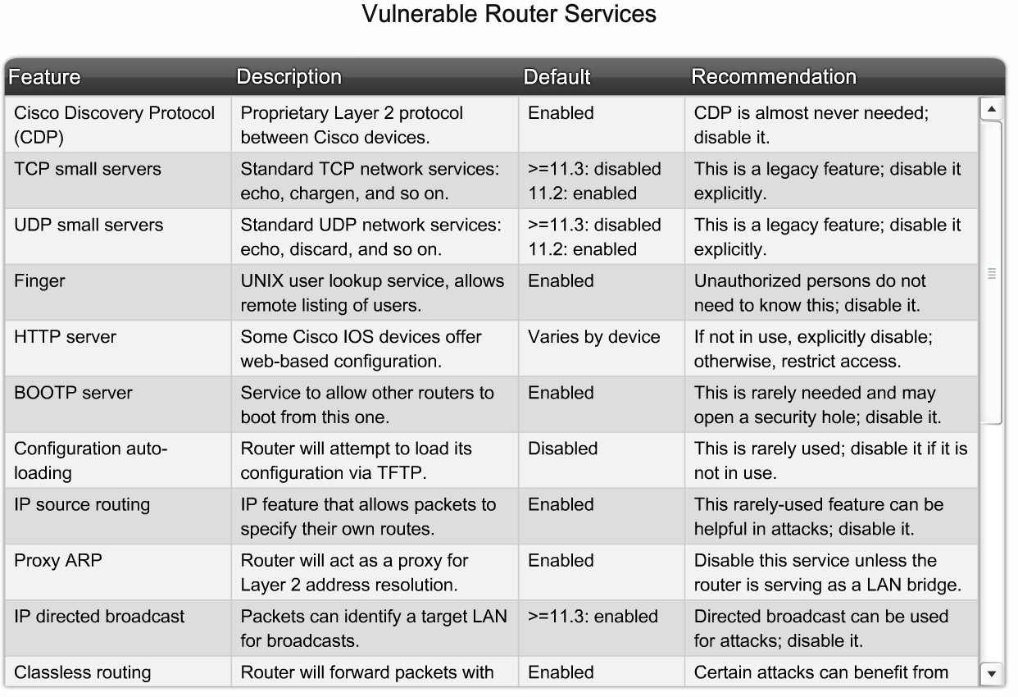
Disable Unneeded Services

Slide 72
Secure Services Used
Services that must be used should be hardened

Slide 73
Secure Services Used

Slide 74
Secure Routing Protocols
A more subtle class of attack targets the information carried within the routing protocol
Falsified routing information generally may be used to cause systems to misinform to each other
The effects of falsifying routing information are as follows

Slide 75
Secure Routing Protocols
It redirects traffic to create routing loops
It redirects traffic so that it can be monitored on an insecure link that would potentially allow a hacker to gain access to confidential information
It redirects traffic to discard it
Most routing protocols can be implemented with authentication such as CHAP

Slide 76
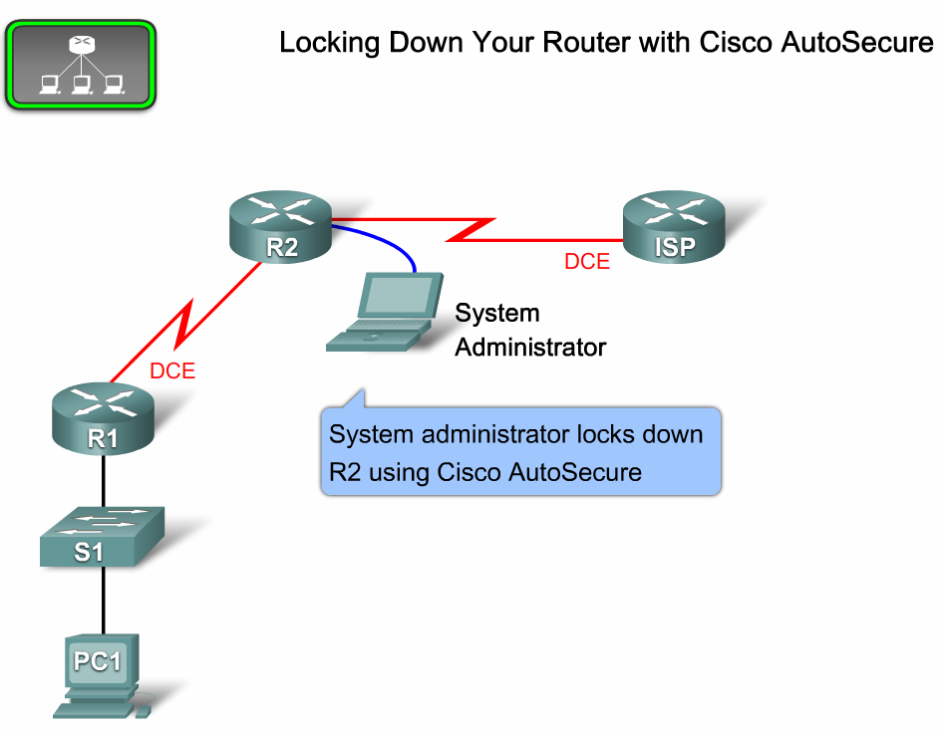
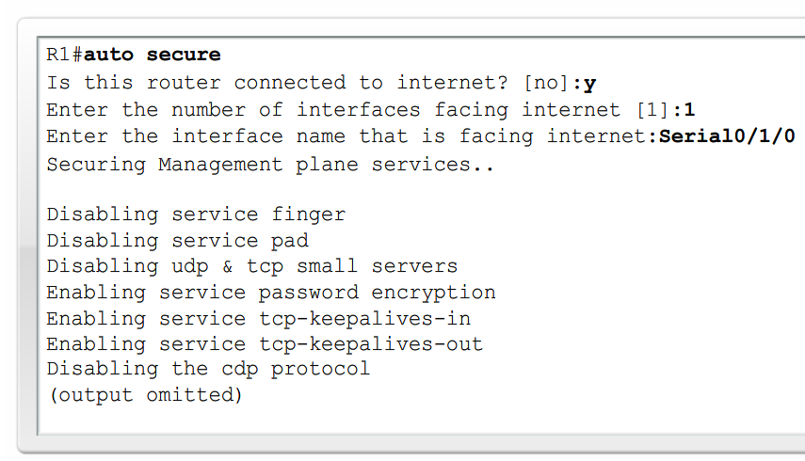
The Easy Way

