Slide 1
Analog Modem
Last Update 2007.06.07
1.1.0

Slide 2
Objectives of This Section
Learn
What an analog modem is
How an analog modem works

Slide 3
What is a Modem
A modem is a modulator and demodulator in that it converts, in this case, analog phone signals into digital signals and back
This device is required as computer equipment generates a digital signal, whereas the PSTN can only deal with an analog signal

Slide 4
What is a Modem

Slide 5
Modem
The modem used in the workstation or at the central site if only a few remote sites are supported can attach to the computer using
Adaptor Card plugged into the bus
External connection through a serial port
PCMCIA card in a PC Card or Cardbus slot
External connection through a USB port

Slide 6
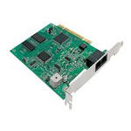
Modem

Slide 7
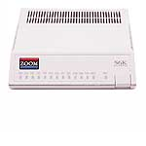
Modem

Slide 8
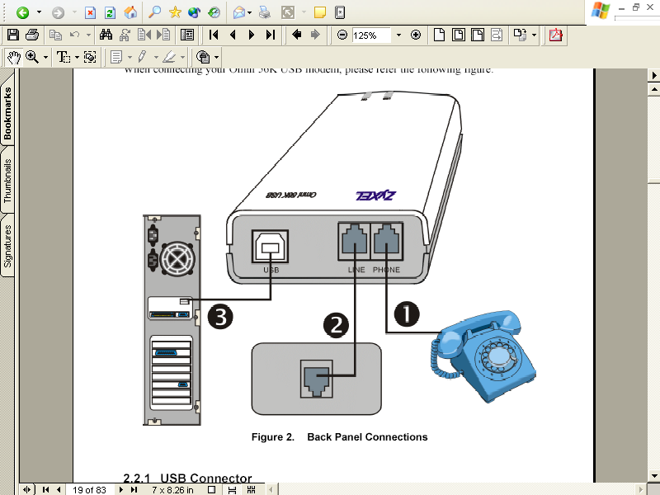
USB Modem

Slide 9
Modem Standards
When modems were first introduced the old Bell System defined the standards, today the ITU does
ITU modem standards are denoted by a V
The standards of interest include
Compression
Data Transfer Rate
Error Correction

Slide 10
Compression
Compression is a method required for a modem to be useable as an access device
Without compression of the data, the actual speed of the line would be only 600 bps
In compression, familiar, repeating character sets are replaced with symbols or strings

Slide 11
Compression
These symbols or strings require fewer bits to send the information
The current standards for compression are V.44, the slightly older V.42bis, and the even older MNP5

Slide 12
Data Transfer Rate
V.90 and V.92 define two data transfer rates that are widely used
These, however, or only useful when the central site is connecting to the PSTN through a digital, rather than an analog, data line
When these standards are used the speed from the central site back to the remote site is 53 Kbps

Slide 13
Data Transfer Rate
But since the remote site is connecting using an analog line, the speed from that site to the central site is 33.6 Kbps for V.90 and 48 Kbps for V.92

Slide 14
Error Correction
Because of the noise on regular phone lines error correction is required
The most commonly used standards for compression are V.42 and MNP4

