Slide 1
Access Line Summary
Last Update 2014.03.07
2.2.0

Slide 2
Objectives of This Section
Learn
  All the ways to connect Point A to Point B

Slide 3
Creating a WAN
A WAN is all about connecting Point A to Point B
The best way to connect two points is to just extend the LAN
Since this keeps the same equipment, frames, protocols, and bandwidth end-to-end
No translation is required, no inefficiencies are introduced, no overhead occurs

Slide 4
Creating a WAN
Currently in most cases to connect Point A to Point B in a WAN you must create, what geographers call, a break in transportation
To illustrate this let’s use an example from the American West

Slide 5
Creating a WAN
Does everyone know where the Mississippi River is
If not, here it is

Slide 6
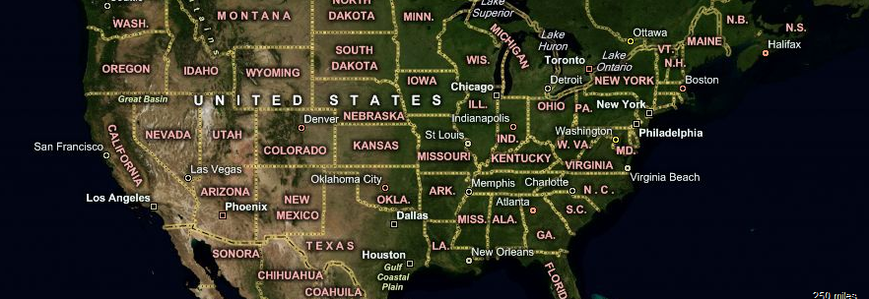
Creating a WAN

Slide 7
Creating a WAN
This is a break in transportation
It is a break in transportation because connecting Point A to Point B, in this case Point A is the east bank of the Mississippi River and Point B is the west bank, requires changing the mode of transportation

Slide 8
Creating a WAN
As the WAN manager your job is to find the most efficient way to bridge the gap from Point A to Point B
In the case where the Mississippi must be crossed the most efficient at present is a bridge to carry cars and trucks
This requires no change in carriage or speed from one side of the Mississippi to the other

Slide 9
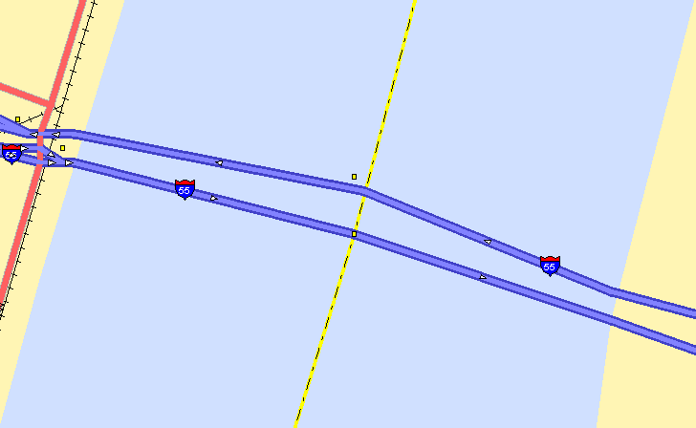
Creating a WAN

Slide 10
Creating a WAN
In the old days when the Mississippi was reached a stop was required
Why stop
Would it not be simpler to just keep on driving the wagon down the same old trail
Well sure, but there is a little problem of driving a wagon over water

Slide 11
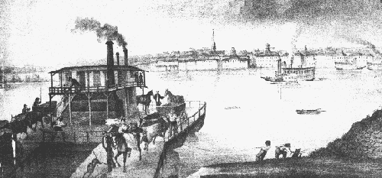
Creating a WAN

Slide 12
What Does a WAN Manager Do
Since you cannot do that the wagon manager had to come up with some way to connect Point A to Point B
What options did the wagon manager have
  Float the wagon across
  Build a raft
  What else
So what does a WAN Manager do

Slide 13
What Does a WAN Manager Do
Exactly what the wagon manager did over 150 years ago
Figure out a way to get the wagons or packets from Point A to Point B

Slide 14

What Does a WAN Manager Do

Slide 15
What Does a WAN Manager Do
The WAN manger must decide
  What points need to be connected
  At layer 1, what type of physical connection to use
  At layer 2, how the data will be encapsulated so as to cross this physical link
  At layer 3 and above, what routed protocol will be used to carry the data
  Finally, what routing protocol will be used to guide these data carrying packets on their journey

Slide 16
Connecting Point A to Point B
The first step then is for you as the network manager to find out from the local service providers what types of layer 1 circuits they can provide between the Point A and Point B that need to be connected to each other
Here are all of the possibilities that have ever existed from the beginning of time to date

Slide 17
Summary Table
Just memorize this table

Slide 18
Summary Table
Line | Network | Speed | Carries | Cost | Availability | Trend | Complexity
Analog | WAN | Low | Data/Voice | Low | Everywhere | Down | Low
ISDN-BRI | WAN | Low | Data | Low | Widespread | Down | Medium
ISDN-PRI | WAN | Medium | Data/Voice/Video | High | Widespread | Down | Medium
Cable | WAN | Medium | Data/Voice/Video | Low | Limited | Growing | Low
ADSL | WAN | Medium | Data/Voice/Video | Low | Limited | Growing | Low
IDSL | WAN | Low | Data | Medium | Limited | Steady | Low
SDSL | WAN | Medium | Data | Medium | Limited | Steady | Low
HDSL | WAN | Medium | Data/Voice/Video | Medium | Limited | Down | Low
HDSL2 | WAN | Medium | Data/Voice/Video | Medium | Limited | Down | Low
VDSL | WAN | Medium to High | Data/Voice/Video | Medium | Limited | Steady | Low
Cellular | MAN | Low to Medium | Data/Voice/Video | Medium | Limited | Growing | Low
MPLS | WAN | High | Data/Voice/Video | High | Limited | Growing | High
X.25 | WAN | Low | Data | Low to Medium | Widespread | Down | Medium
DDS | WAN | Low | Data | Medium | Widespread | Down | Medium
Switched 56K | WAN | Low | Data | Medium | Unknown | Down | Medium
T Carrier | WAN | Low to High | Data/Voice/Video | High | Widespread | Down | Medium
Channelized ATM | WAN | High | Data/Voice/Video | High | Widespread | Down | Medium
Frame Relay | WAN | Low to Medium | Data | Medium | Widespread | Down | Medium
SMDS | WAN | Medium to High | Data/Voice | Medium | None | Down | Low
SONET | CAN/MAN/WAN | High | Data/Voice/Video | Medium to High | Widespread | Steady | High
ATM | CAN/MAN/WAN | High | Data/Voice/Video | Medium to High | Widespread | Steady | High
Satellite | WAN | Low to Medium | Data | Medium to High | Widespread | Steady | Medium
Wireless | CAN/MAN | Low to High | Data/Voice/Video | Medium to High | Limited | Growing | Medium
FDDI | CAN | Low | Data | Medium | None | Down | Low
Ethernet | CAN/MAN/WAN | Low to High | Data/Voice/Video | Low to Medium | Limited | Growing | Low
VPN | WAN | Low to High | Data/Voice/Video | Medium | Widespread | Growing | Low

Slide 19
Connecting Point A to Point B
How do we select one of these options
  First, eliminate whatever the local service providers do not offer
  Second, decide what type of traffic will need to cross the data line
  Third, how much speed do you need for this traffic
  Fourth, is this a type of data line many people are currently using in new installs

Slide 20
Connecting Point A to Point B
For example, let’s say that we need to connect Fort Worth to Atlanta
The first step is to find out what the local service providers offer
If we look at the AT&T web site since it is the local service provider we can see that they offer the following

Slide 21
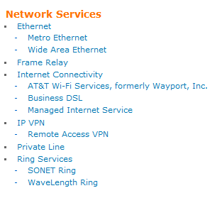
Connecting Point A to Point B

Slide 22
Connecting Point A to Point B
If we translate these marketing names to real service names this means they offer

Slide 23
Connecting Point A to Point B
  T Carrier
  Frame Relay
  Channelized ATM
  Carrier Ethernet
  MPLS
  Dark Fiber through SONET
  DSL through the Internet
  VPN through the Internet

Slide 24
Connecting Point A to Point B
Step two is to determine what type of traffic will cross this circuit
These days we should assume that at least data and voice will need to be carried
Does this eliminate anything
Yes, we can throw out
  Frame Relay as it is too slow for voice
  DSL and VPN as they use the Internet which is a poor choice for voice as well

Slide 25
Connecting Point A to Point B
Step three, do all of these have enough speed for the traffic
Yes they all do
Step four, is the use of the data line increasing or decreasing
It is decreasing for
  T Carrier
  Channelized ATM

Slide 26
Connecting Point A to Point B
So, we are left with
  Carrier Ethernet
  MPLS
  Dark Fiber
Which one should we use
The decision would be based on cost, familiarity with the technology and the equipment required by it, and whatever the sales person says

Slide 27
Connecting Point A to Point B
Now, wasn’t that easy
How about some guidelines to guide us further

Slide 28
Methods Not Generally Used
We can start by eliminating those methods that no one uses much anymore
SMDS is no longer used
Switched 56K may still exist, but certainly not in new installations
FDDI may still exist, but also certainly not in new installations

Slide 29
If the Network is a CAN
The choices are SONET, ATM, wireless, or Ethernet
In the old days ATM was the most widely used with SONET being seen in some installations
Wireless is the choice where nothing else works
Today if a cable can be used Ethernet is the only choice

Slide 30
If the Network is a MAN
What method to use at the MAN level depends on the size of the MAN and who is building it
Most large MANs used by old line service providers use SONET
Newer MANs use Ethernet

Slide 31
To Connect Remote Offices
Any technique can be used here, but some are more appropriate than others
The ones most often used in the old days were Analog, ISDN, DDS, and Frame Relay
Now Cable, DSL, and Fixed Wireless are better options, along with Cellular as it becomes faster

Slide 32
To Connect Remote Offices
ISDN is also an alternative for very remote sites since it is more widely available than most other methods
Satellite can be used as well if its limitations are accounted for

Slide 33
Low Data Rate Applications
Data such as sales reports, credit card authorizations, and ATM transactions are often handled using X.25, and analog dial up connection, or even satellite
These are all low speed but reliable technologies

Slide 34
High Data Rate Applications
Common methods for this are T3, T1, ATM, Frame Relay, or MPLS

Slide 35
Redundant Links
Outside of the redundancy a partial or full mesh design gives to a network, it is often best to use a lower cost solution as the standby method
Switched 56K and ISDN were used in older installations because these can be deployed as dial up solutions
They do not accrue any cost until used

Slide 36
Redundant Links
Current methods include a connection of some type to the Internet such as satellite, wireless, or DSL link

Slide 37
To Avoid All of This
To not have to worry about any of this hire someone to setup a VPN or just outsource the whole thing
Of course you could setup your own VPN, but then you would be back into arranging for data lines at least to the various ISPs

Slide 38
Implementation
The way you implement all of this is
  You buy the equipment required to connect to whatever layer 1 method you will use
  You tell the equipment to encapsulate the data it sends out the physical circuit in the format you have selected for layer 2
  Finally you tell all of the devices that will communicate over these two layers to use the layer 3 method that was selected whenever they have data to send

Slide 39
Implementation
For example
  For a T carrier circuit defined at layer 1 a router with a serial port is purchased
  It is configured to encapsulate the data it sends out through this port as an HDLC frame
  Carried inside this HDLC frame, in the frame’s data area, is the stuff generated by the device that is using this data line to communicate with the outside world that the device created according to the rules of TCP/IP

Slide 40
Look at the Installed Base
For those who do not pay attention in class another way to select the data line is to see what everyone else is using and the trends this information reveals
Here is a report from Network Computing in March 2011

Slide 41
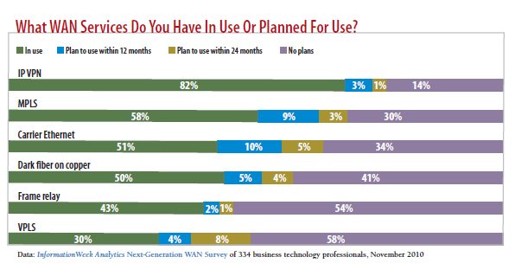
Look at the Installed Base

Slide 42
Look at the Installed Base
And one from an AT&T webinar in May 2011

Slide 43
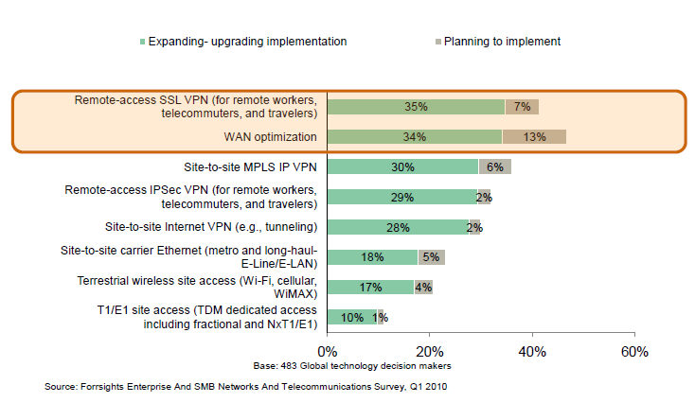
Look at the Installed Base

Slide 44
Progression Over Time
Lastly let’s see how we got here and where we are going
In the beginning
  9600 baud DDS lines connected each remote site to a collection point
  A 56K DDS line went from the collection point to the headquarters

Slide 45
Progression Over Time
Soon more speed was needed
  The same hub and spoke arrangement was maintained but the speeds were increased by going to 56K DDS lines to the collection point and a T1 line to the headquarters
Even more speed was needed
  The same hub and spoke arrangement was maintained but the speeds were increased by going to T1 lines to the collection point and a T3 line to the headquarters

Slide 46
Progression Over Time
Simplification was needed
  The same hub and spoke arrangement was maintained but the management of the increasing number of lines needed to be simplified by going to a channelized ATM to connect both remote sites to the collection point and to the headquarters

Slide 47
Progression Over Time
As connectivity spread there were soon too many sites for dedicated lines to be used efficiently
  Now too many sites needed to be connected
  Costs needed to be lowered
  A move needed to be made to a shared solution

Slide 48
Progression Over Time
Frame Relay becomes widespread
  The first of these shared methods was a series of Frame Relay connections connecting all of these sites to each other
MPLS replaces Frame Relay
  The current method is the same approach but using MPLS in place of Frame Relay

Slide 49
Progression Over Time
Ethernet extends into the WAN
  Some organizations use native Ethernet connections instead of MPLS
Use of the Internet
  Many smaller organizations or even large organizations just use a connection to the Internet instead of a dedicated network

Slide 50
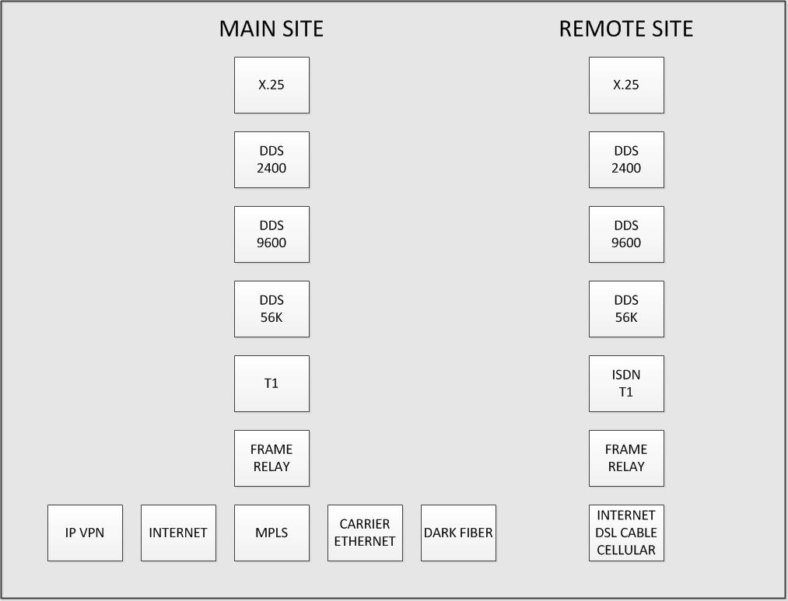
Progression Over Time

Slide 51
Where Next
The question now is which one of these will dominate or will a new method be the best choice
Andy Gottlieb in a series of articles in Network World in 2012 and 2013 has argued that a new method is the best choice

Slide 52
Where Next
In essence it argues that a distributed method based on using the Internet and hosted data centers is the way of the future
Here is why he believes while MPLS was the best choice it is no longer
Here is what he writes

Slide 53
Where Next
  As we began to cover last time, until recently, if you were an enterprise WAN manager responsible for a serious WAN, you probably needed MPLS
  Thanks to the Next-generation Enterprise WAN (NEW) architecture, this is no longer the case
  Yet many myths persist as to why MPLS is necessary for the enterprise WAN

Slide 54
Where Next
  If my main point in this series is that going forward MPLS need not be the guts of an enterprise WAN strategy, and certainly is not the service to which companies should be putting additional resources as me move towards the age of the cloud, my secondary point is that WAN managers almost surely made the right choice in going with MPLS, despite how expensive it is, given the choices and technologies available at the time

Slide 55
Where Next
  Today, we'll tackle a couple of commonly held myths around MPLS
    I need a full mesh between all my locations because we have any-any traffic patterns
    and
    need a full mesh for VoIP
  And if I need a full mesh, it follows that I basically need MPLS

Slide 56
Where Next
  The historical truth here is that MPLS came along after Frame Relay, right around the same time that enterprises were looking to deploy VoIP on their WAN
  Frame Relay required paying for Permanent Virtual Circuits (PVCs) between any pair of locations
  Given the cost of the PVCs, creating a full mesh was quite expensive under Frame Relay

Slide 57
Where Next
  Telecom service providers were eager to upgrade customers from Frame Relay to MPLS, frequently getting customers to upgrade smaller sites from fractional T1 links to the full T1 connections that in practice are the minimum for MPLS in the process
  The fact that migrating customers from Frame Relay to MPLS could also lower the SP's internal costs by coalescing around a single WAN architecture was icing on the cake

Slide 58
Where Next
  And so the SPs sold full mesh MPLS as a less expensive way to deploy VoIP in the enterprise WAN
  MPLS also had better QoS capabilities than Frame Relay, something we'll return to in a future column
  But the fact is that MPLS was superior to Frame Relay from a price perspective, not that a full mesh was necessary to effectively support applications

Slide 59
Where Next
  Apart from better pricing then Frame Relay offered, full mesh capability does have some advantages from the enterprise customer's perspective
  It is easier to manage than a system with a bunch of PVCs
  For bulk data transfer applications, bandwidth available is a much more important factor than latency

Slide 60
Where Next
  For real-time traffic like voice, avoidance of packet loss and large latency variability (i.e. jitter) are what matters
  But 10 to 30 additional milliseconds of fixed latency, which is what results from a typical hub-and-spoke approach, has no real impact on the quality of a voice call

Slide 61
Where Next
  Only if the call were going halfway around the world in the first place, and so perhaps on the edge of the ~250 millisecond end-to-end delay where voice conversations start to "feel" materially different than across-town conversations, might the additional delay make any appreciable difference, and even then the difference is likely to be small indeed

Slide 62
Where Next
  Other than real-time applications like voice and perhaps the occasional large file transfer, the data center consolidation trend of the last decade means the old 80-20 rule is probably more like 90-10 now in terms of most WAN traffic going to/from one or a small number of data centers
  And so a full mesh isn't needed to deal with real-life traffic patterns, nor is it needed to deal with real-time traffic either

Slide 63
Where Next
  Now, if there are no downsides to having a full mesh, then by all means an enterprise should take advantage of it, which is part of why enterprise WAN managers made the correct decision last decade in switching from Frame Relay to MPLS
  But there are in fact some disadvantages

Slide 64
Where Next
  From a technical perspective, it is much harder to do optimum inbound traffic management of last-mile links when faced with a full mesh, as opposed to handling traffic from a much smaller number of locations
  And to support public and hybrid cloud computing, doing a full mesh from every public cloud location is likely to be prohibitively complex

Slide 65
Where Next
  More importantly, by leveraging the vastly lower cost, more competitive public Internet, non-meshed enterprise WAN approaches this decade can be far less expensive
  Done properly, they can offer far more bandwidth and so deliver better application performance

Slide 66
Where Next
  So while there may be benefits to MPLS, and while some WAN managers will be more comfortable with it than alternatives for some time to come, the need for a full mesh is definitely not a legitimate justification for deploying MPLS

