Slide 1
ATM Frame
Last Update 2011.06.01
1.0.0

Slide 2
Objectives of This Section
Learn
What an ATM frame looks like

Slide 3
Channelized ATM Configuration
When used as a way to replace a large number of T1 circuits coming into a site a service provider’s SONET/ATM MAN can be extended to a customer’s location as Channelized ATM
For example here is a site that once had 200 T1 lines connecting to it as part of a hub and spoke network
Here is the original setup

Slide 4
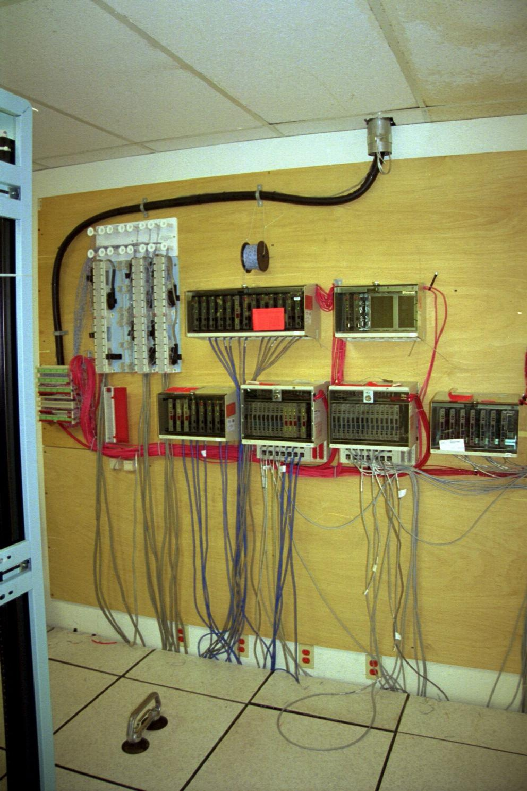
Demarcs for the T1 Lines

Slide 5
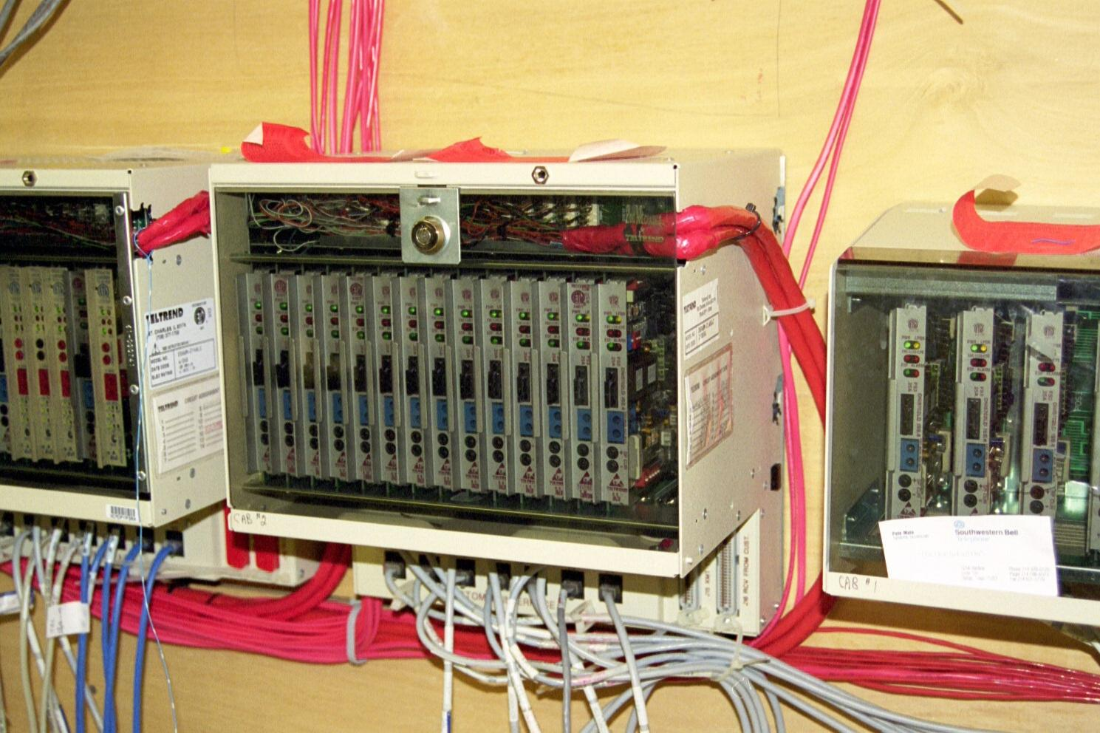
Demarcs for the T1 Lines

Slide 6
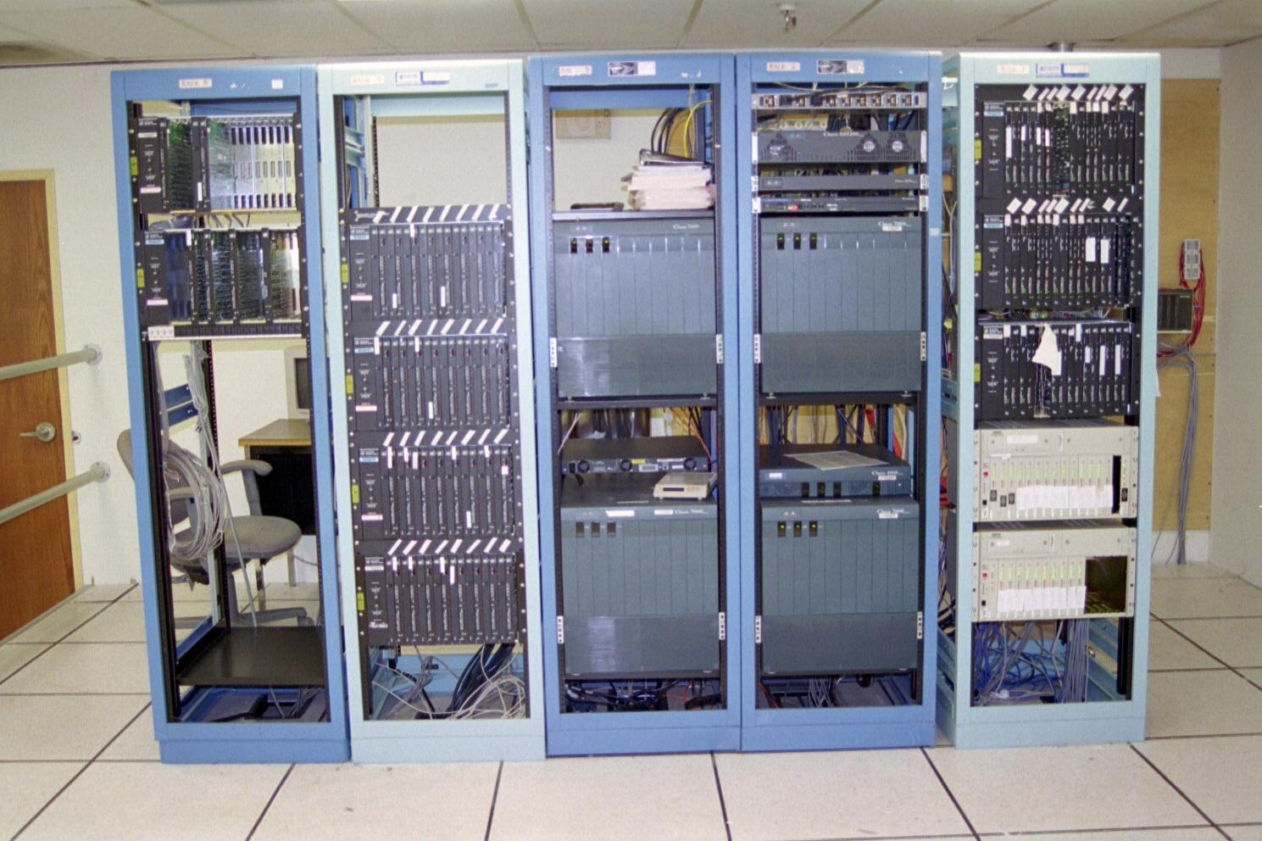
Equipment Required

Slide 7
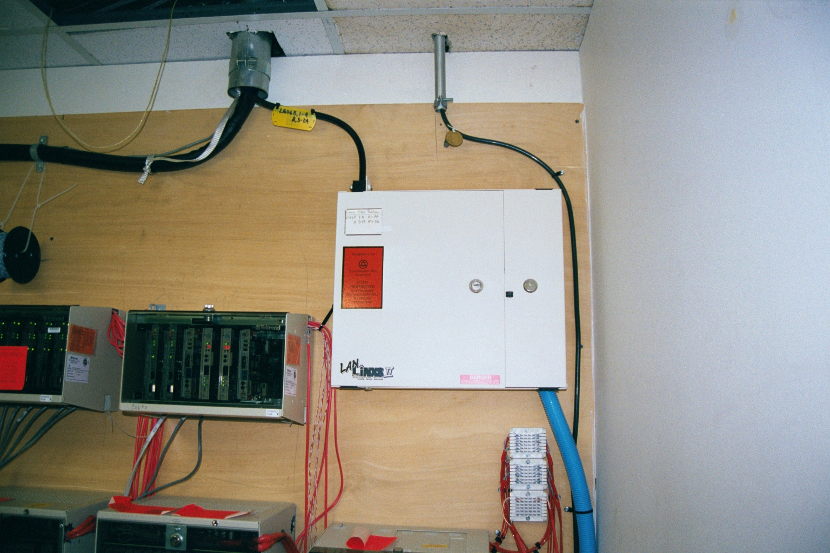
Change to Channelized ATM

Slide 8
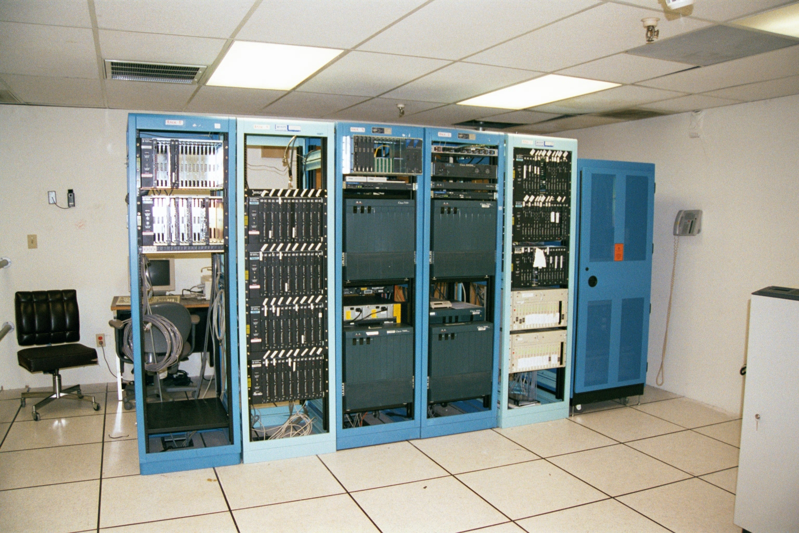
Service Provider’s ADM

Slide 9
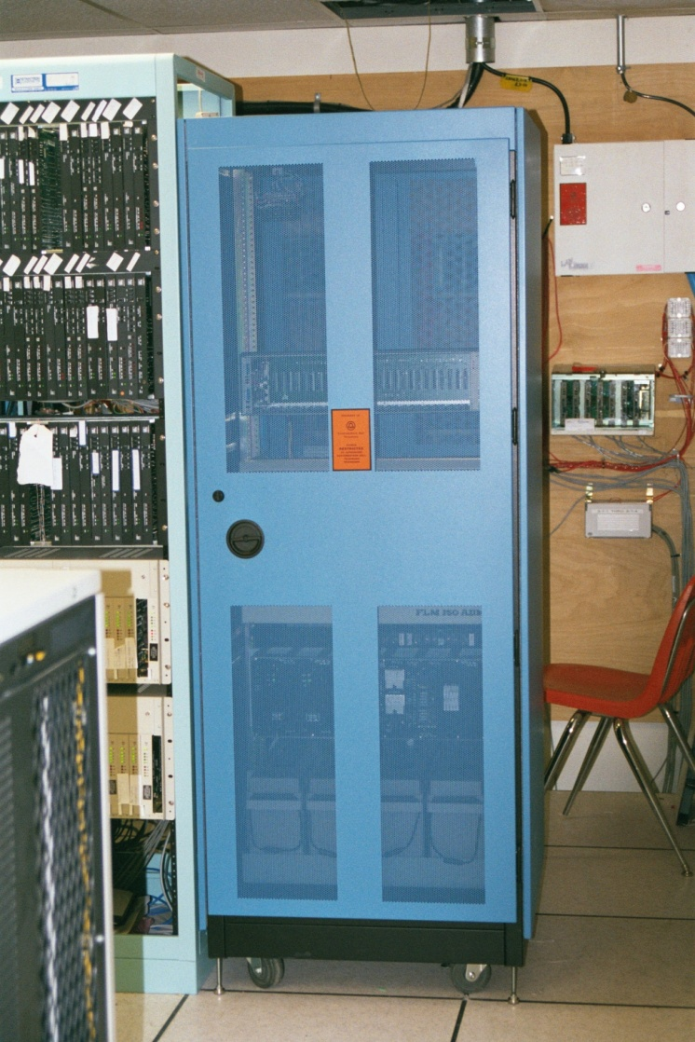
Service Provider’s ADM

Slide 10
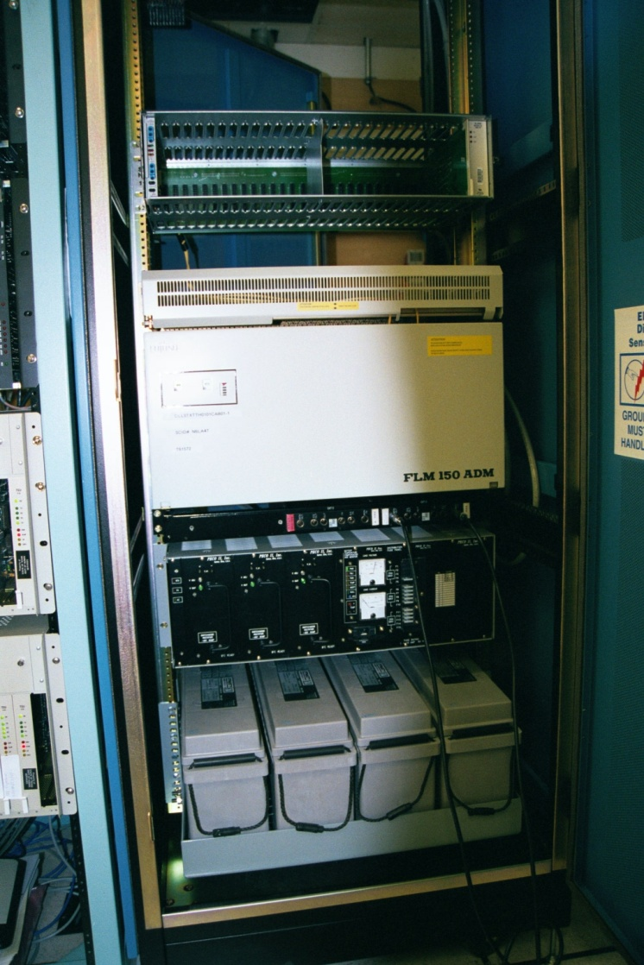
Service Provider’s ADM

Slide 11
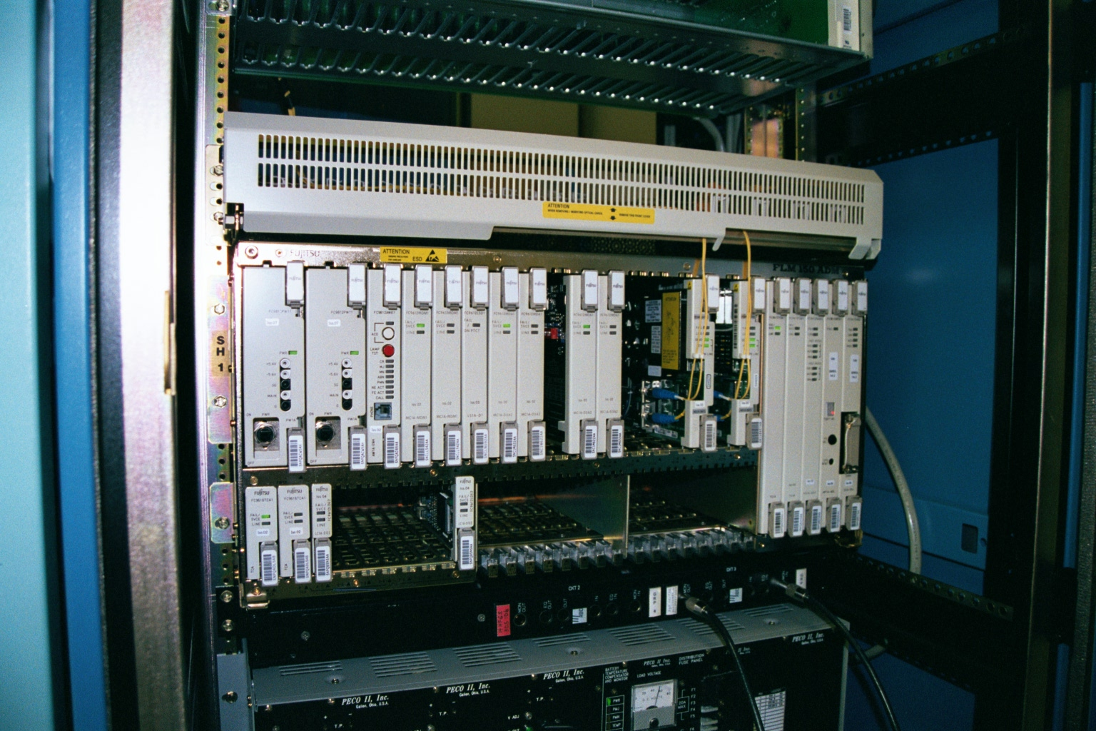
Service Provider’s ADM

Slide 12
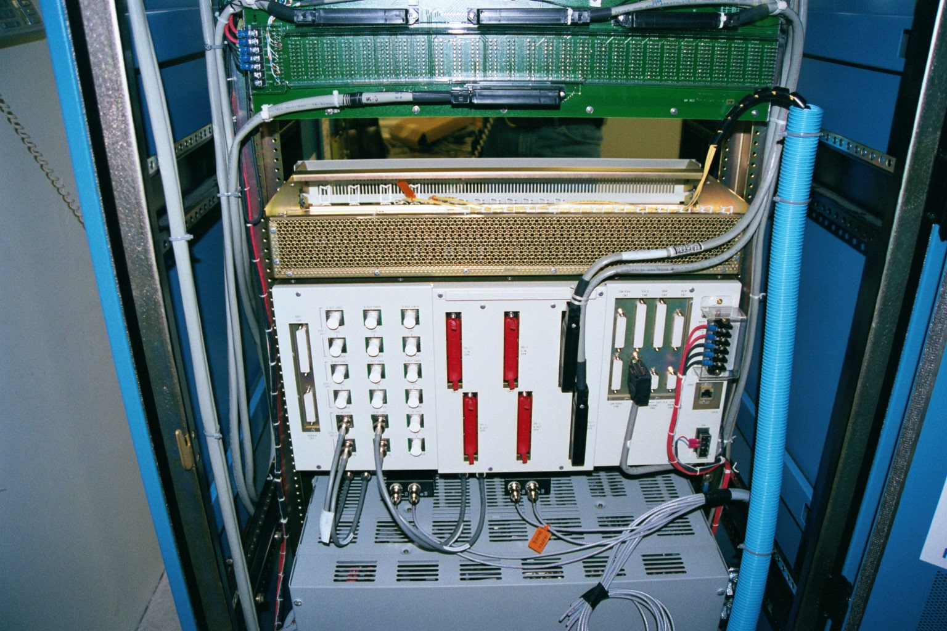
Service Provider’s ADM

Slide 13
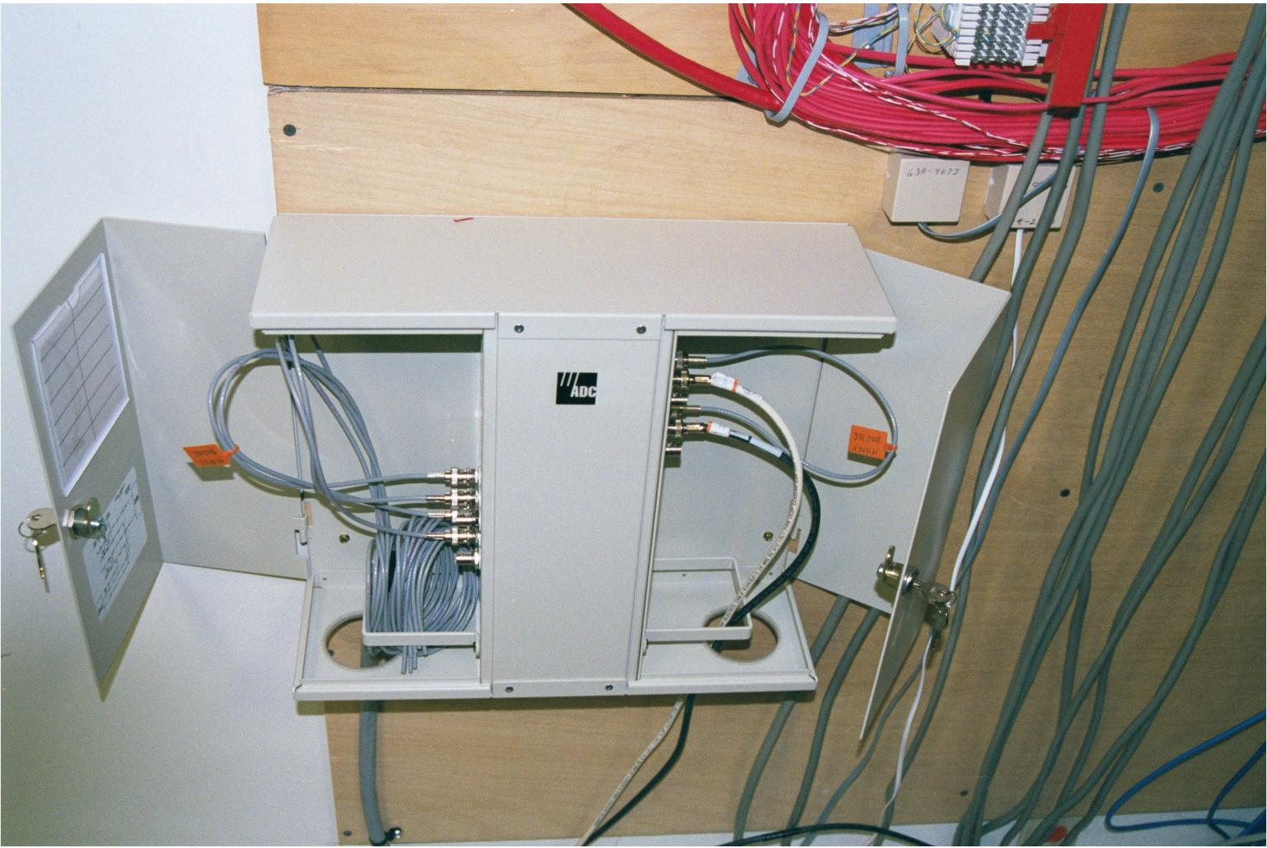
New Demarc

Slide 14
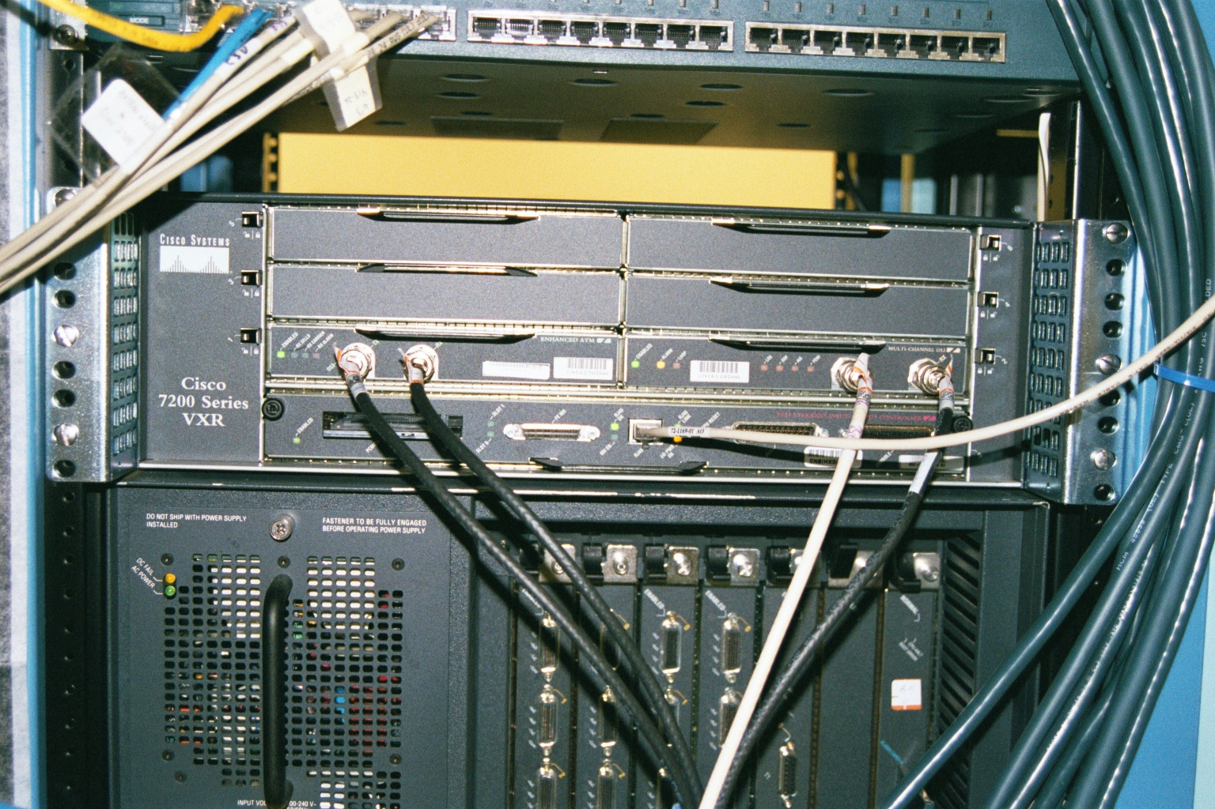
Router

Slide 15
ATM Card

Slide 16
All of This Goes Away

Slide 17
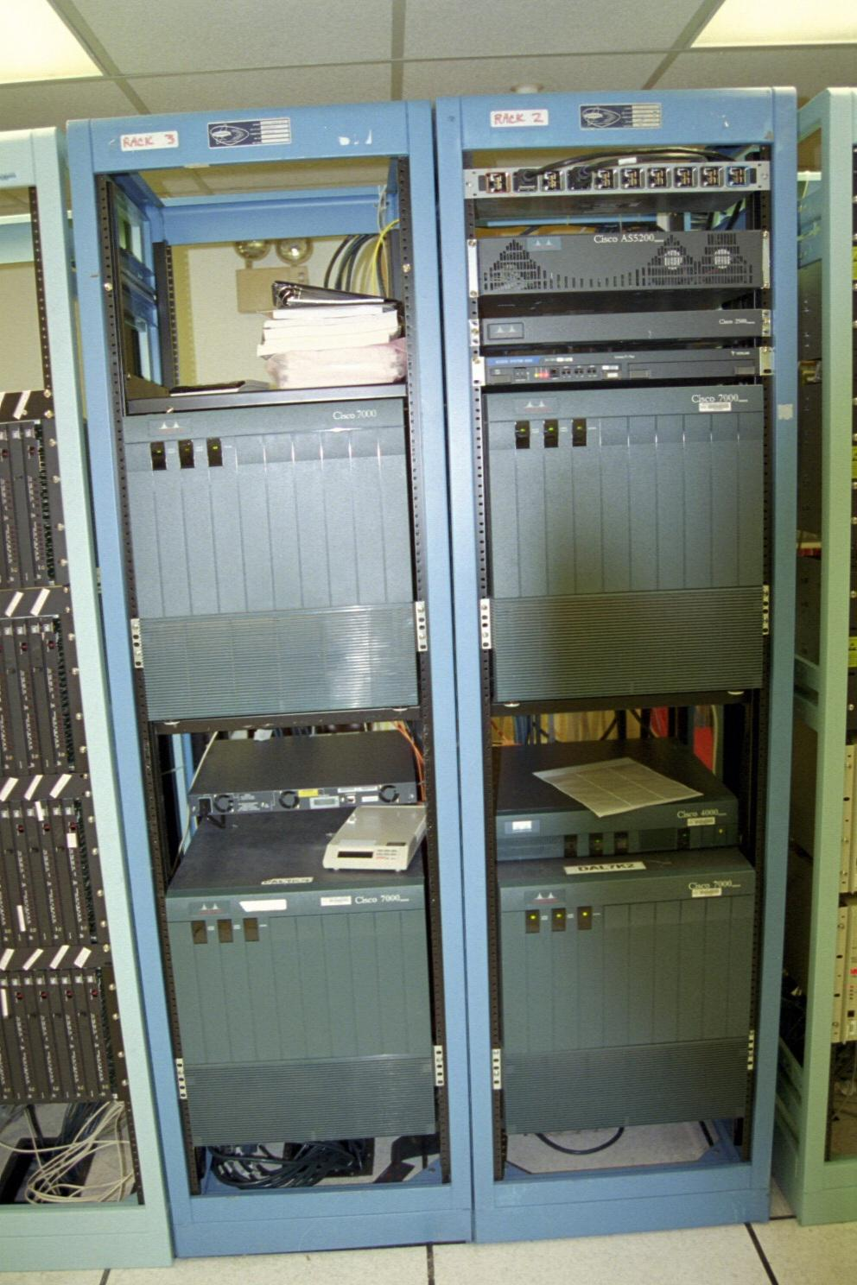
All of This Goes Away

Slide 18
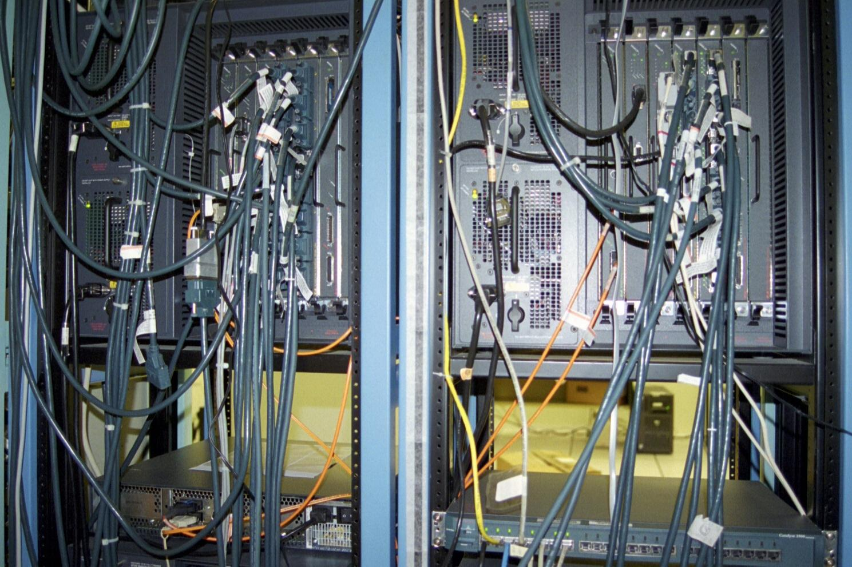
All of This Goes Away

Slide 19
What Stays

Slide 20
What Stays

Slide 21
What Stays

Slide 22
Router Configuration
There are several ways of setting up Channelized ATM in a router
Here is one example
interface ATM1/0.1 multipoint
ip address 10.0.0.2 255.0.0.0
no ip directed-broadcast
pvc ip 1/116
protocol ip 10.0.0.1 broadcast
encapsulation aal5mux ip

Slide 23
Router Configuration
pvc ipx 1/117
protocol ipx AA.00d0.069a.7c00 broadcast
encapsulation aal5mux ipx
ipx network AA

Slide 24
ATM Cell
There are many types of ATM cells
Let’s look at a standard format ATM cell
Download and open in Wireshark
atm_sscop.pcap
Select frame 1
Expand the Asynchronous Transfer Mode layer

Slide 25
ATM Cell
The only fields displayed by Wireshark are
VCI
VPI
PTI shown on three lines
They appear in this capture file in reverse order of how the cell is typically defined

Slide 26
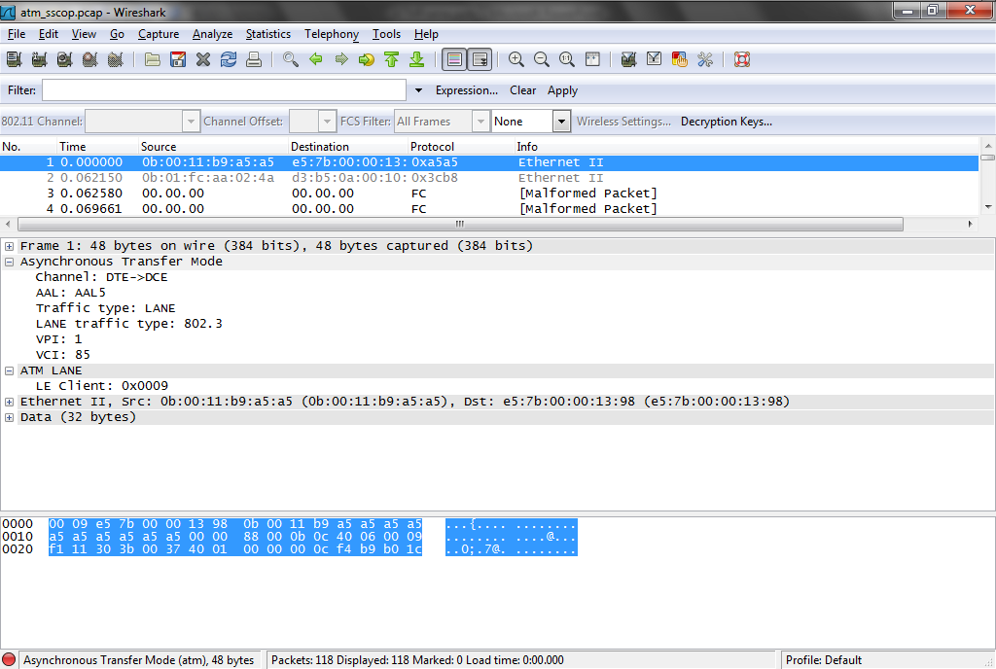
ATM Cell

Slide 27
ATM Cell
Here are the fields in an ATM 5 byte header as shown in a discussion on the Microsoft TechNet web site

Slide 28
ATM Cell Header

Slide 29
GFC Field
The GFC – Generic Flow Control is 4 bits that was designed for flow control, but was never standardized
So this field is always set to 0000

Slide 30
VPI Field
VPI – Virtual Path Identifier is an 8 bit field that defines the path or virtual path for the cell
This field along with the VCI field are used by the ATM switches along the circuit so the will know how to forward the cell

Slide 31
VCI Field
VCI – Virtual Channel Identifier is a 16 bit field that represents the channel in a path the cell will use
This is similar to a DLCI in Frame Relay that indicates which PVC to use

Slide 32
PT Field
The PT - Payload Type indicator is a 3-bit field
These bits are used for the following
The first bit indicates the type of ATM cell that follows
0 indicates user data
1 indicates OA&M - Operations, Administration & Management data

Slide 33
PT Field
The second bit is the EFCI - Explicit Forward Congestion Indication indicates if the cell experienced any congestion from source to destination
0 if set by the source
1 if set by an interim switch
The third bit indicates the last cell in a block for AAL5 in user ATM cells
For non-user ATM cells, the third bit is used for OA&M functions

Slide 34
CLP Field
The CLP - Cell Loss Priority field is a 1-bit field to tell the forwarding switches what priority to give to the cell
0 is high priority
Switches must make every effort to forward the cell successfully
1 means the switch may discard the cell if congestion warrants it like the DE - Discard Eligibility bit in Frame Relay

Slide 35
HEC Field
The HEC – Header Checksum Field is an 8 bit field
This is the checksum to ensure the cell header arrived undamaged
It relies on the upper layers to check the data
A single bit error can be repaired
A multi-bit error calls for it to be discarded

Slide 36
ATM Cell
Now let’s look at another type of ATM cell such as would be used in a CAN
ATM CAN links and ATM in the LAN to the extent it ever migrated that far used a different format for their cells
These are the AAL5 cells used to send data over these local as opposed to long distance service provider networks that use the standard 53 byte cell

Slide 37
ATM Cell
The format of these cells is defined in RFC 2364
As it says
ATM AAL5 protocol is designed to provide virtual connections between end stations attached to the same network
Here is the format of these cells

Slide 38
ATM Cell

Slide 39
ATM Cell
Notice that in this cell the header has become a trailer

Slide 40
ATM Cell
Let’s look at an example of a real cell in this format
Download and open in Wireshark
ftpsmbnb.atc
Select frame 72
This is a ftp data frame where a file is being retrieved from a FTP server by a client

Slide 41
ATM Cell
Notice how the common LAN layers of
LLC
IP
TCP
FTP
are all present
The difference is the data link transportation is being done over ATM as the first layer shows

Slide 42
ATM Cell
The physical layer is likely some form of fiber optic cable, although we cannot tell from the capture file
Expand the LLC layer
Notice that is carrying encapsulated Ethernet

Slide 43
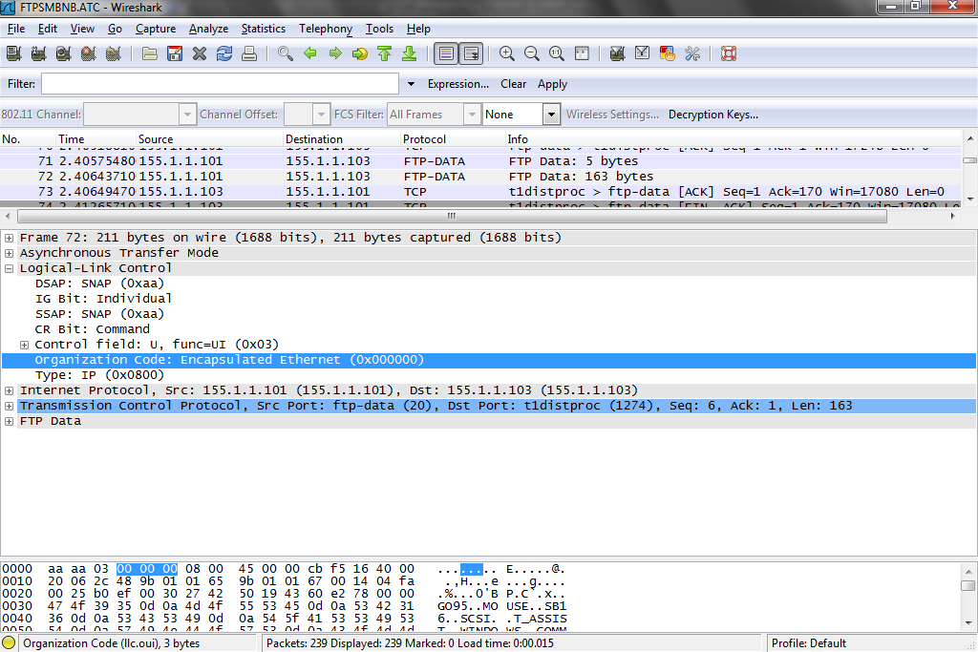
ATM Cell

Slide 44
ATM Cell
Expand the Asynchronous Transfer Mode layer
From bottom to top we see these fields
CRC
The error free transmission verification normally seen in a trailer
Len
This field indicates the length in octets of the Payload field
The maximum value for this field is 65535 octets

Slide 45
ATM Cell
CPI
This field is not normally used
The RFC says this about it
The CPI (Common Part Indicator) field aligns the CPCS-PDU trailer to 64 bits
Possible additional functions are for further study in ITU-T
When only the 64 bit alignment function is used, this field shall be coded as 0x00

Slide 46
ATM Cell
UU
This field is always set to zero zero since as the RFC says
The CPCS-UU (User-to-User indication) field is used to transparently transfer CPCS user to user information
The field has no function under the multi-protocol ATM encapsulation described in this memo and can be set to any value

Slide 47
ATM Cell
Above these fields we see the usual VCI and VPI fields to indicate the channel and path for the cells and that this is a AAL5 format cell

Slide 48
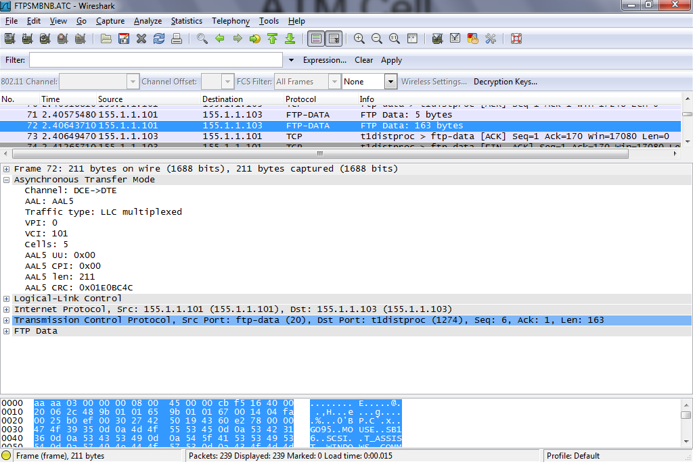
ATM Cell

Slide 49
ATM Cell
Here is a sample configuration that would be used for this type of connection
config t
interface atm 2/0/0
pvc 0/200 l2transport
encapsulation aal5snap
interface gigabitethernet 5/1/0
connect atm-enet gigabitethernet 5/1/0 atm 2/0/0 0/200 interworking ip

