Slide 1
ATM
Last Update 2007.05.27
1.2.0

Slide 2
Objectives of This Section
Learn
What ATM is
Where ATM is used
How ATM operates

Slide 3
Context
Layer | 2
Network Type | CAN MAN WAN

Slide 4
What is ATM
ATM - Asynchronous Transfer Mode is a ITU-T International Telecommunication Union - Telecommunication Standardization Sector standard for cell switching
Multiple service types, such as data, voice, and video can be transmitted using fixed-size cells
ATM networks are connection oriented

Slide 5
Operation
ATM is a cell-switching technology
ATM is an asynchronous transfer method
As such ATM is more efficient than a synchronous technology, such as TDM
Recall that with TDM, each user is assigned a time slot
No other station can send in that time slot

Slide 6
Operation
If a station has a lot of data to send, it can send only when its time slot comes up, even if all other time slots are empty
If, however, a station has nothing to transmit when its time slot comes up, the time slot is sent empty and is wasted

Slide 7
Operation
Because ATM is asynchronous, time slots are available on demand with information identifying the source of the transmission contained in the header of each ATM cell
ATM transfers information in fixed-size units called cells

Slide 8
ATM Cells
Each cell consists of 53 octets, or bytes
The first 5 bytes contain cell-header information, and the remaining 48 contain the data
Header | Data
5 Bytes | 48 Bytes

Slide 9
ATM Cells
Small fixed-length cells are well suited for transferring voice and video traffic because such traffic is intolerant of delays that result from having to wait for a large data packet to download

Slide 10
ATM Cell Headers
An ATM cell header can be one of two formats
UNI – User to Network Interface
The UNI header is used for communication between ATM endpoints and ATM switches in private ATM networks
NNI – Network to Network Interface
The NNI header is used for communication between ATM switches

Slide 11
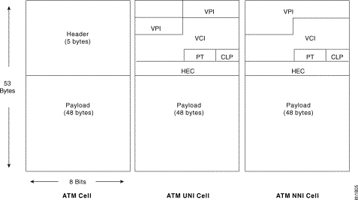
ATM Cell Header Formats

Slide 12
ATM Circuit Types
Three types of ATM services exist:
PVC - Permanent Virtual Circuits
A PVC allows direct connectivity between sites
In this way, a PVC is similar to a leased line
Among its advantages, a PVC guarantees availability of a connection and does not require call setup procedures between switches
Disadvantages of PVCs include static connectivity and manual setup

Slide 13
ATM Circuit Types
SVC - Switched Virtual Circuits
An SVC is created and released dynamically and remains in use only as long as data is being transferred
In this sense, it is similar to a telephone call
The advantages of SVCs include connection flexibility and call setup that can be handled automatically by a networking device
Disadvantages include the extra time and overhead required to set up the connection

Slide 14
ATM Circuit Types
Connectionless service
ATM networks are fundamentally connection oriented, which means that a VC - Virtual Channel must be set up across the ATM network prior to any data transfer
A virtual channel is roughly equivalent to a virtual circuit

Slide 15
ATM Circuit Types
Two types of ATM connections exist:
Virtual paths, which are identified by VPI - Virtual Path Identifier
Virtual channels, which are identified by the combination of a VPI and a VCI - Virtual Channel Identifier

Slide 16
ATM Circuit Types
A virtual path is a bundle of virtual channels, all of which are switched transparently across the ATM network on the basis of the common VPI
All VCIs and VPIs, however, have only local significance across a particular link and are remapped, as appropriate, at each switch

Slide 17
ATM Layers
ATM functionality corresponds to the physical layer and part of the data link layer of the OSI reference model
The ATM physical layer is similar to the physical layer of the OSI reference model; the ATM physical layer manages the medium-dependent transmission

Slide 18
ATM Layers
The AAL - ATM Adaptation layers are roughly the same as the data link layer of the OSI reference model
The ATM layer is responsible for establishing connections and passing cells through the ATM network
The AAL is responsible for isolating higher-layer protocols from the details of the ATM processes

Slide 19
ATM QoS
One of the most important functions of ATM is its support for QoS - Quality of Service
ATM uses three forms of QoS guarantees
Traffic contract specifies an envelope that describes the intended data flow
This envelope specifies values for peak bandwidth, average sustained bandwidth, and burst size, among others

Slide 20
ATM QoS
When an ATM end system connects to an ATM network, it enters a contract with the network, based on QoS parameters
Traffic shaping is the use of queues to constrain data bursts, limit peak data rate, and smooth jitter so that traffic will fit within the promised envelope
ATM devices are responsible for adhering to the contract by means of traffic shaping

Slide 21
ATM QoS
Traffic policing uses ATM switches to enforce the contract
The switch can measure the actual traffic flow and compare it against the agreed-upon traffic envelope
If the switch finds that traffic is outside of the agreed-upon parameters, it can set the cell loss priority bit of the offending cells

Slide 22
ATM QoS
Setting the cell loss prority bit makes the cell discard eligible, which means that any switch handling the cell is allowed to drop the cell during periods of congestion

Slide 23
ATM Service Classes
There are five classes of service available in ATM that enables users to obtain a particular QoS
Each of these parameters is used with other parameters to define one of the five classes of service for which a carrier may offer cell loss, cell delay, and bandwidth guarantees

Slide 24
ATM Service Classes
Service Class | Applications Using | Priority
CBR | Real time voice and video | High
VBR-RT | Packetized voice and compressed video | High
VBR –NRT | Interactive data | High
ABR | ATM oriented interactive data | Low
UBR | Bursty data | Low

Slide 25
ATM Service Classes
These abbreviations stand for
CBR - Continuous Bit Rate
VBR-RT – Variable Bit Rate–Real Time
VBR-NRT - Variable Bit Rate–Non-Real Time
ABR - Available Bit Rate
UBR - Unspecified Bit Rate

Slide 26
LANE
LANE - LAN Emulation is a standard defined by the ATM Forum that gives stations attached via ATM the same capabilities they normally obtain from LANs, such as Ethernet
As the name suggests, the function of the LANE protocol is to emulate a LAN on top of an ATM network

Slide 27
LANE
The basic function of the LANE protocol is to resolve MAC addresses to ATM addresses

Slide 28
ATM Equipment
An ATM network is made up of an ATM switch and ATM endpoints
An ATM switch is responsible for cell transit through an ATM network
An ATM endpoint contains an ATM NIC
Examples of ATM endpoints are workstations, routers, DSUs, LAN switches, and video coder-decoders

Slide 29
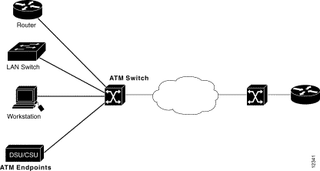
ATM Equipment

Slide 30
ATM Interfaces
An ATM network consists of a set of ATM switches interconnected by point-to-point ATM links or interfaces
ATM switches support two types
UNI – User to Network Interface
The UNI connects ATM end systems, such as hosts and routers, to an ATM switch
NNI – Network-to-Network Interface
The NNI connects two ATM switches together

Slide 31
ATM Interfaces
Depending on whether the switch is owned and located at the customer's premises or publicly owned and operated by the telephone company, UNI and NNI can be further subdivided into public and private UNIs and NNIs
A private UNI connects an ATM endpoint and a private ATM switch

Slide 32
ATM Interfaces
Its public counterpart connects an ATM endpoint or private switch to a public switch
A private NNI connects two ATM switches within the same private organization
A public one connects two ATM switches within the same public organization

Slide 33
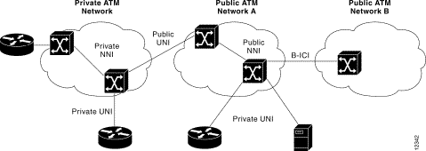
ATM Equipment

Slide 34
ATM Speeds
1.5 Mbps to 2.5 Gbps
622 Mbps is a commonly used speed

Slide 35
ATM Trends
The future of ATM is not bright
Ethernet is closing in on its primary market, the CAN, very fast
Basically ATM when compared to Ethernet is too complex and too expensive
The two major errors of ATM are two wrong assumptions
First, ATM was designed when bandwidth was expensive

Slide 36
ATM Trends
The idea was to suck every bit of use out of the available bandwidth
Today and certainly in the future bandwidth will be dropping in cost as its capacity goes up
Second, ATM was designed to go end-to-end; that is from the desktop on one end through the common carrier to the desktop on the other end

Slide 37
ATM Trends
This came from the problems of intermixing different kinds of transport methods at different levels
The idea was to have only one method to deal with from the LAN through the WAN
Unfortunately the cost and complexity stopped ATM at the CAN level

Slide 38
ATM Trends
It is one more case of a technically superior technology losing out
If you have an existing ATM network there is no reason to rip it out
But there is also no reason to put in a new one where one has not existed before if an Ethernet solution is available
If not, then ATM still

