Slide 1
Add/Drop Multiplexer
Last Update 2010.01.11
1.2.0

Slide 2
Objectives of This Section
Learn what an ADM is and how it is used

Slide 3
SONET
We will be begin this discussion with a short explanation of SONET
The most common way of creating the physical layer for a large network, such as a MAN or WAN is to use a SONET - Synchronous Optical Network ring
A SONET ring consists of individual network elements connected to form a closed loop

Slide 4
SONET
As shown in the figure below, SONET rings can cover a metropolitan area such as San Francisco or a larger geographic area such as the western United States, as this example diagram shows
The SONET standard was approved in 1988 to allow interconnection of equipment from different vendors to create these rings

Slide 5
SONET
The SONET network is reliable, manageable, flexible, scalable, and can utilize the high bandwidth of fiber
SONET is the name of the U.S. implementation while SDH is the European standard
Both use the term Optical Carrier or OC in reference to signals in fiber

Slide 6
SONET
The electrical equivalents for OC in SONET and SDH are the STS - Synchronous Transport Signal and STM - Synchronous Transport Mode respectively
The following table shows the relationship between these standards at the popular speeds

Slide 7
SONET
Optical | Electrical | Speed
OC-1 | STS-1 | 51.84 Mbps
OC-3 | STS-3 | 155.52 Mbps
OC12 | STS-12 | 622.08 Mbps
OC-48 | STS-48 | 2.48 Gbps
0C-192 | STS-192 | 9.95 Gbps
OC-768 | STS-768 | 39.8 Gbps

Slide 8
What is an Add/Drop Multiplexer
The network elements can be gateways, such as one connecting a metro ring with an OTN - Optical Transport Network ring, or they can be ADM – Add/Drop Multiplexers
An ADM provides access to a SONET network much like exit and entrance ramps provide access to a freeway

Slide 9
What is an Add/Drop Multiplexer
ADM systems combine all traffic that will exit the ring into one lane, which will be dropped
All other lanes will be reserved for through-traffic
Similarly, associated add traffic will enter the system through the associated entrance lanes

Slide 10
What is an Add/Drop Multiplexor
The diagram shown next describes an OC-192 ADM with OC-12 and OC-48 drops
Access concentrators typically have OC-12 or OC-48 uplinks to optical networks

Slide 11
What is an Add/Drop Multiplexer

Slide 12
What is an Add/Drop Multiplexer
What does one of these things look like
Like this

Slide 13
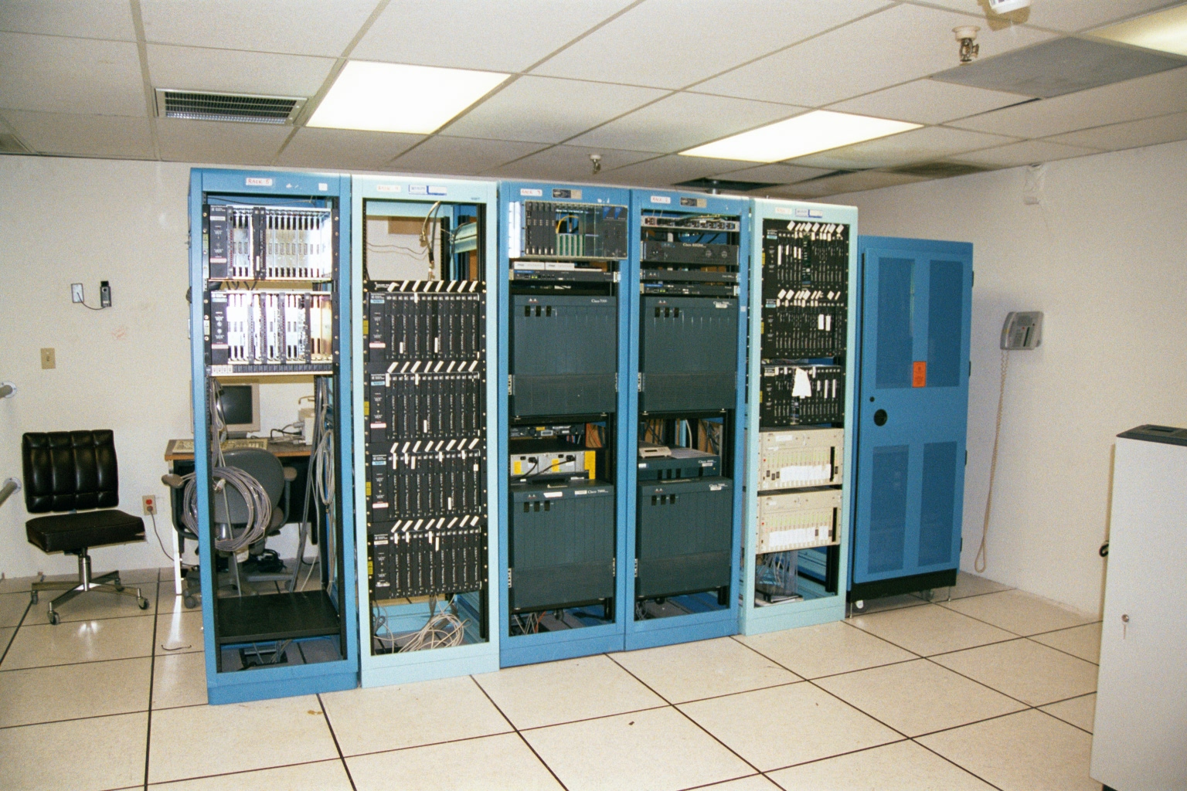
Add/Drop Multipexer

Slide 14
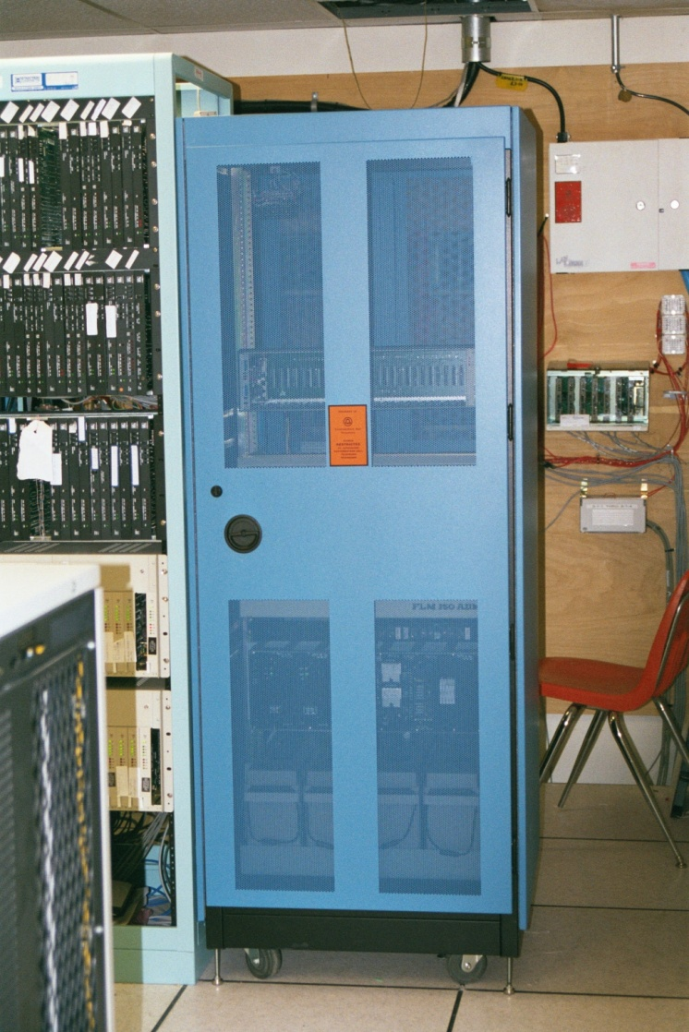
Add/Drop Multipexer

Slide 15
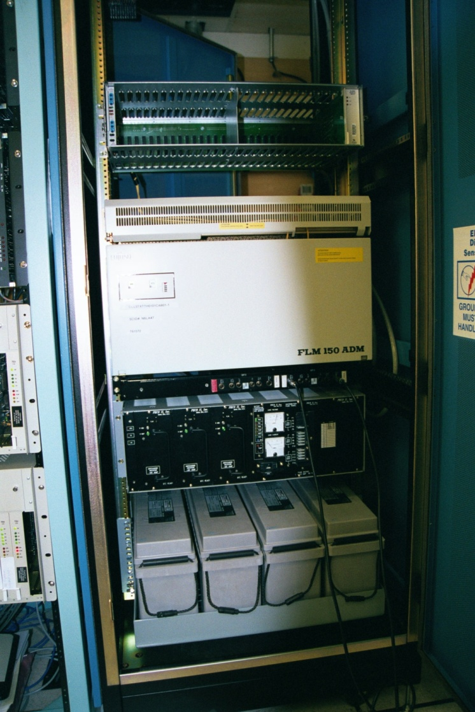
Add/Drop Multipexer

Slide 16
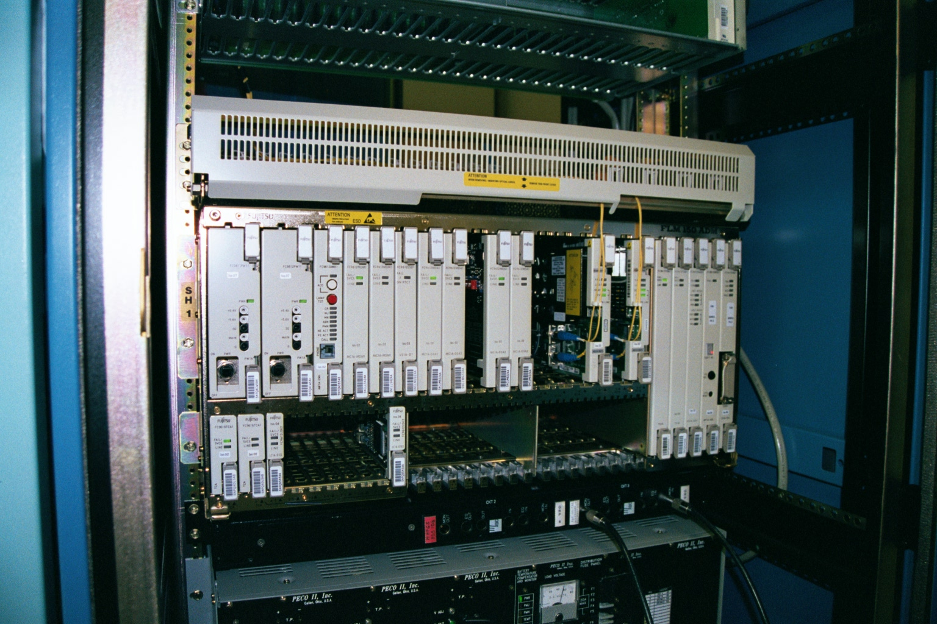
Add/Drop Multipexer

Slide 17
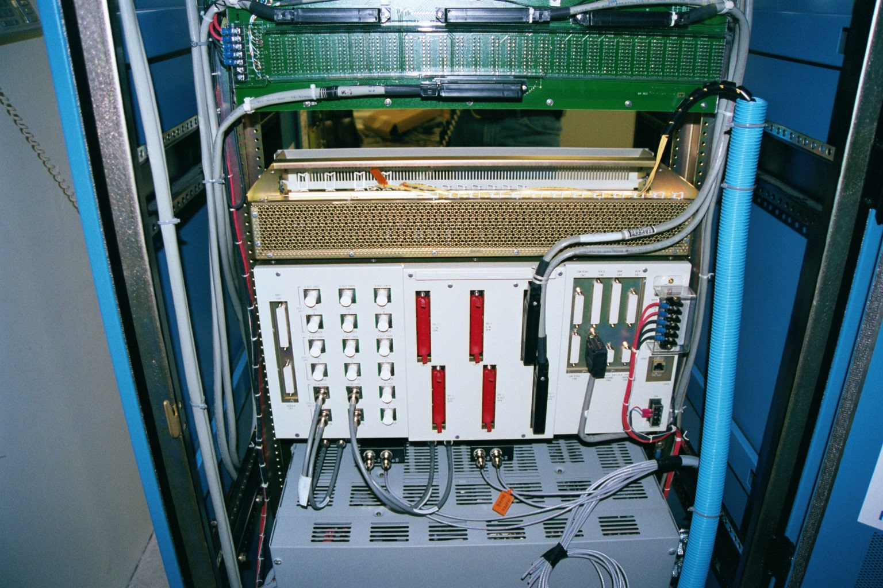
Add/Drop Multipexer

Slide 18
ADM Operation
The ADM enables plesiochronous and lower bit rate synchronous signals to be dropped from or inserted into SONET bit streams without affecting the remaining traffic
This is achieved through a crossconnect function, which redistributes SONET STS-1 signals or higher rates into the predefined lanes

Slide 19
ADM Operation
The figure below shows the data flow in an OC-192 ADM with OC-12 and OC-48 drops
This architecture makes it possible to set up ring structures, which have the advantage of automatic back-up path switching in the event of a fault

Slide 20
ADM Operation

