Slide 1
Access Control Lists Last Update 2015.06.09 1.4.1

Slide 2
Objectives
Learn what access control lists are and how to construct them

Slide 3
Access Control Lists
An access control list is list of conditions that categorize packets
It takes the form of a collection of permit and deny statements that can
Apply to just addresses
or
Upper layer information as well
It tells the router what types of packets to accept or deny

Slide 4
How ACLs Work
Regardless of use how the access list is configured is the same
The difference is how it is applied
Such as to a routing protocol instead of an interface

Slide 5
How ACLs Work

Slide 6
Form
ACLs are lists of instructions that are applied to a router’s interface in the form of a series of if-then statements
If the condition is meet, then the action is taken
If the condition is not meet, then the next statement is evaluated
ACLs are defined for each protocol enabled for an interface

Slide 7
Reasons for Use
Access lists are used for the following
Restrict access to a network
Restrict access to the VTY ports
Categorize packets for QoS
Control which networks will or will not be advertised by dynamic routing protocols
Provide traffic flow control
Limit routing updates

Slide 8
Process
This is a two part process
Create the access list
Apply the access list to the interface

Slide 9
Creating an ACL
Order matters
Each packet is compared to each statement until a match is found
At that point comparison stops and action is taken
Place the most restrictive statements at the top
Place the least restrictive statements at the bottom

Slide 10
What Do ACLs Look Like

Slide 11
Creation Mode
ACLs are created at the global configuration level
For example
Router(config)#

Slide 12
Application Mode
ACLs are applied at the interface or subinterface level
For example
Router(config-if)#

Slide 13
Types of ACLs
There are two types of ACLs
Standard
Extended

Slide 14
Creating a Standard ACL
No one uses a standard ACL as they are quite limited
They can only read the source IP address
But we will cover them anyway

Slide 15
Creating a Standard ACL
Creating an ACL is a process of filling in the blanks
Command to initiate an access list
Number of the access list
Action to take
Source IP address to watch for
Source wildcard mask

Slide 16
Command
The command is always
access-list

Slide 17
Number of the Access List
The number of the access list indicates the protocol of interest
About the only numbers used are
1-99
1300-1999

Slide 18
Action to Take
The actions that can be taken include
deny
permit

Slide 19
Source IP Address
There are several ways the source IP address can be listed
A specific IP address when one is of interest
A network address when a range is of interest
The word host then the IP address
Which can take one of two forms
host 192.168.1.23
or just
192.168.1.23

Slide 20
Source IP Address
The word any
Any source IP address will match
any = 0.0.0.0 255.255.255.255

Slide 21
Source Wildcard Mask
To specify a network rather than just a host a wild card mask is needed
The word any
Any source IP address will match
any = 255.255.255.255

Slide 22
Ending a Standard ACL
Must include as the last line
permit any

Slide 23
Standard ACL Creation
Here is an example of the whole process
Router(config)# access-list 1 permit 192.168.1.1
Router(config)# access-list 1 deny 192.168.1.2
Router(config)# access-list 1 permit 192.168.1.0 0.0.0.0.255
Router(config)# access-list 1 deny any
Router(config)# interface s0
Router(config-if)# ip access-group 1 in

Slide 24
Extended ACLs
An extended access list is better
It can check
Source IP address
Destination IP address
Protocol
Port
This is basically a fill in the blanks process

Slide 25
Creating an Extended ACL
Fill in the blanks
Command to initiate an access list
Number of the access list
Action to take
Protocol to restrict the action to
Source IP address to watch for
Source wildcard mask
Destination IP address to watch for
Destination wildcard mask
Action to take
Port or service name to watch for
Log results

Slide 26
Command
The command is always
access-list

Slide 27
Number of the Access List
The number of the access list indicates the protocol of interest
About the only numbers used are
100-199
2000-2699

Slide 28
Action to Take
The actions that can be taken include
deny
permit
dynamic

Slide 29
Layer 3 or 4 Protocol
The protocol from layer 3 or 4 that will be acted upon is listed by number or by name
If a layer 3 protocol is listed, then nothing is specified at the application layer
If a layer 4 protocol is listed, then later an application layer protocol can be defined
The layer 4 protocol must match the application layer protocol

Slide 30
Layer 3 or 4 Protocol
In other words, tcp goes with ftp, whereas utp goes with tftp and so on
Protocol number
0 to 255
Protocol number by name
Layer 3
ip
ipinip
igrp
eigrp
ospf

Slide 31
Layer 3 or 4 Protocol
icmp
igmp
gre
nos
Layer 4
tcp
udp

Slide 32
Source IP Address
There are several ways the source IP address can be listed
A specific IP address when one is of interest
A network address when a range is of interest
The word host then an IP address which can take one of two forms
host 192.168.1.23
or just
192.168.1.23

Slide 33
Source IP Address
The word any
Then any source IP address will match
any = 0.0.0.0 255.255.255.255

Slide 34
Source Wildcard Mask
A wildcard mask as discussed below
The word any
Any source IP address will match
any = 255.255.255.255

Slide 35
Destination IP Address
There are several ways the destination IP address can be listed
A specific IP address when one is of interest
A network address when a range is of interest
The word host then an IP address
The word any
Any source IP address will match
any = 0.0.0.0 255.255.255.255

Slide 36
Destination Wildcard Mask
A wildcard mask as discussed below
The word any
Any destination IP address will match
any = 255.255.255.255

Slide 37
Action to Take
The action in this case is
eq
Equal the port number of service
gt
Be greater than the port number
lt
Be less than the port number
neq
Do not match a port number

Slide 38
Action to Take
range
Match a range of port numbers
established
Match on established tcp connections
fragments
Check fragments
precedence
Match on a precedence value
tos
Match on a tos value

Slide 39
Port or Service Name
Specify the port by number or by service name
Port number
0-65535
Port by name, such as the common ones
telnet - 23
ftp control - 21
ftp data - 20
www - 80

Slide 40
Log the Hits by the Access List
log
log-input

Slide 41
How ACLs Work
An ACL is a group of statements that define how packets do the following
Enter inbound router interfaces
Relay through a router
Exit outbound router interfaces

Slide 42
Entering an Interface
The router checks to see if the packet is routable
Checks if the inbound interface has an ACL
Tests packets against the ACL
If a packet is allowed in, checks the packet against the routing table to determine the destination interface

Slide 43
Entering an Interface
Checks if the outbound interface has an ACL
Tests packets against the ACL

Slide 44
Packets That Are Checked
ACLs filter not packets that originate in the router itself, but packets from other sources

Slide 45
Implicit Deny
Packets are checked against each statement in order
If it does not match any statement, then it is denied access, as there is an implicit deny at the end of every ACL
Therefore every access list must have at least one permit statement

Slide 46
Placing ACLs
Standard ACLs should be placed close to the destination
Extended ACLs should be placed close to the source

Slide 47
Placing ACLs
If you place a standard ACL that denies access by a network or device IP address at the port where the network or device connects to the router nothing will be allowed out of the local network
This is why standard lists are suggested for placement near the destination
To me this is a silly rule

Slide 48
Placing ACLs
As the diagram above shows this sends a bunch of unnecessary traffic through the router and out on the network
In my view place it where is does the job, but does not restrict access to things the network or device needs to access

Slide 49
Applying ACLs
When assigning an ACL to an interface inbound or outbound placement should be specified
The filter direction can be set to check packets that travel into or out of an interface
When determining if the ACL is addressing inbound or outbound traffic, look at the interface from inside the router

Slide 50
Applying ACLs
Traffic coming in from an interface is filtered by an inbound access list
Traffic going out an interface is filtered by an outbound access list
Apply the ACL with the access-group command from interface configuration mode such as
ip access-group 10 in

Slide 51
Inbound v Outbound
Outbound ACLs are generally more efficient
Therefore they are preferred
A router must check every incoming packet against the ACL before checking the routing table, where it may not even be routable

Slide 52
Wildcard Mask
A wildcard mask is used to specify a range of addresses for the access list to impact
It is like an inverted subnet mask
For example
A subnet mask of 255.255.0.0
11111111.11111111.00000000.00000000
Is a wildcard mask of 0.0.255.255
00000000.00000000.11111111.11111111

Slide 53
Wildcard Mask
The 0s mean match this part of the address
The 1s mean ignore

Slide 54
Wildcard Mask
255.255.0.0 is easy
What about 255.255.240.0
Convert to binary
11111111.11111111.1111.0000.00000000
Reverse the bit position values
00000000.00000000.00001111.11111111
Convert the reversed to decimal
0.0.15.255

Slide 55
Wildcard Mask Shortcut
Another way is to take the subnet mask value in decimal, then subtract that number from 255
For example
255-255=0
255-255=0
255-240=15
255-0=255

Slide 56
Wildcard Mask Block Size
Block sizes can also be used to explain wildcard masks
Block sizes are used to specify a range of addresses
Common block sizes are
64 32 16 8 4
When you need to specify a range of addresses, you select the next largest block size

Slide 57
Wildcard Mask Block Size
For example
To specify 34 networks, use a block size of 64
To specify 18 networks, use a block size of 32
To specify 2 networks, use a block size of 4
In other words, select the next largest block size

Slide 58
Wildcard Mask Block Size
In practice all that you have to remember is the wildcard number is always one number less than the block size
If the block size is 8, the wildcard number is 7

Slide 59
Form of a Wildcard Mask
Let’s look at an example
What wildcard mask is used to permit all packets from any host in the 172.30.16.0 to 172.30.31.0 subnets
The answer is 0.0.15.255
Why
0.0 because these two octets are checked and passed
255 because this is the decimal equivalent of all 1s in the last octet
We will pass anything in the last octet

Slide 60
Form of a Wildcard Mask
To see the 15 we must think in binary
Decimal 15 in binary is 00001111
The 16 in this third octet is 00010000
The first four 0s in the mask for this octet tell to match the first four bits in the IP address
The last four bits in the IP address are ignored as the wildcard mask values are 1s
Therefore everything from 16 to 31 will be passed as each of these numbers in binary begins with 0001

Slide 61
Wildcard Any
Using any is the same as using 255.255.255.255
Keep in mind 255.255.255.255 is the same as 11111111.11111111.11111111.11111111
in binary
Recall that a 1 means do not check this bit value
In other words, pass it through

Slide 62
Wildcard Host
To match an exact host address
For example
172.30.16.29 0.0.0.0
Is the same as
172.30.16.29 any
0 means check this bit value
In other words, everything must match

Slide 63
Extended ACLs

Slide 64
Named ACLs
Named ACLs allow you to both create and apply standard or extended access lists
The only difference is some changes to the syntax
ip access-list
Instead of
access-list
Also
ip access-list standard nameofthelist
Instead of
access-list 10

Slide 65
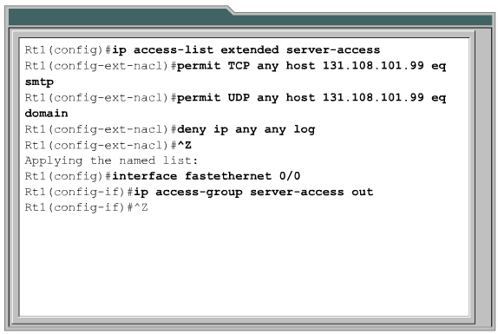
Named ACLs

Slide 66
Restricting VTY Access
Create an access list that permits only the host or hosts that should be able to telnet
Then deny all others
For example
access-list 50 permit 172.16.10.3
line vty 0 4
access-class 50 in
Recall that there is an implied deny at the end, so every other host is denied access

Slide 67
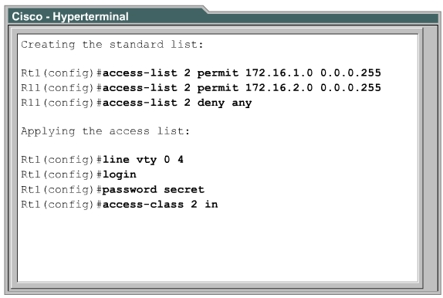
Restricting VTY Access

Slide 68
Restricting VTY Access

Slide 69
Verifying ACLs
Show commands are used to check access lists
show access-lists
show ip interface
show running-config

Slide 70
Verifying ACLs
log command
The log command can be added at the end of an access list beginning with IOS 12.0
This causes any match of the statement to be printed to the console
They do not appear on telnet connections unless the command
terminal monitor
is issued

Slide 71
To Change an Access List
To change an access list execute the show run command
Copy the access list commands to Notepad
Edit the commands
Remove the old access list from the interface using
no ip access-group whateverthenumberis in/out

Slide 72
To Change an Access List
Remove the access list itself using
no access-list whateverthenumberis
Select and copy the revised access list commands back to the router
Apply the access list

Slide 73
To Remove an ACL
To remove an access list
Remove the access list from the interface using
no ip access-group whateverthenumberis in/out
Remove the access list itself using
no access-list whateverthenumberis

Slide 74
Automatic Creation of ACLs
The protocol analyzer Wireshark can be used to create some ACLs based on a packet that exhibits the problem the ACL is intended to solve
Here is the procedure as explained by Laura Chappell

Slide 75
Automatic Creation of ACLs

Slide 76
Automatic Creation of ACLs
Here is an example using the sick-client.pcap file opened in Wireshark

Slide 77
Automatic Creation of ACLs

Slide 78
Automatic Creation of ACLs
Select a packet

Slide 79
Automatic Creation of ACLs

Slide 80
Automatic Creation of ACLs
Select Tools then adjust the values placed there if needed

Slide 81
Automatic Creation of ACLs

Slide 82
Automatic Creation of ACLs

Slide 83
Automatic Creation of ACLs

Slide 84
Automatic Creation of ACLs
Select Copy and place the data where needed

