Slide 1
Servers Last Update 2010.07.30
1.1.0

Slide 2
Objectives of This Section
Learn how to
Use a server in a local area network

Slide 3
What is a Server
A server is a computer with a network operating system running on it
This server can perform a variety of functions
The functions a server can perform depend on the hardware installed and the capabilities of the software on the machine
A server can perform several of these functions at the same time

Slide 4
Typical Server Functions
Typical functions performed by a server in a local area network include
File
Application
Database
Mail
Web
DHCP

Slide 5
File Server
A file and print server was the first function performed by a server in a networked environment
In this use the server stores the data used by the users of the network
This was done in the beginning because of the high cost of storage

Slide 6
File Server
It was also done then and is still done to allow for easy sharing of information and to maintain security
If data is stored on a user’s workstation, there may be no access to this information by anyone else

Slide 7
File Server
Security is maintained by the ability of the server operating system to restrict who can see the information and what they can do to it
PC operating systems do not have this ability
Backup of the data is also easier, if it is all in one location

Slide 8
Application Server
An application server holds a program that is shared by the network users
This application can be anything that more than one user needs to use at the same time
A common application server program is the accounting program for the organization

Slide 9
Database Server
Large shared databases are stored on a server
The server is used to maintain control over the database and to backup this important data
A database can contain information such as inventory records or accounting data

Slide 10
Mail Server
A server is used to transfer the email back and forth
It receives email messages being sent to a user of the network
It holds these messages until the user asks for them

Slide 11
Mail Server
Going the other way the mail server handles the transfer of email messages from users on its network to other networks

Slide 12
Web Server
A web server is used to serve up web pages
Most network operating systems have this capability built in or it can be added with a program running on the server

Slide 13
DHCP Server
DHCP – Dynamic Host Configuration Protocol servers provide IP addresses to workstations
This precludes the need to go from computer to computer and enter an address by hand
It also precludes the need to go back to each computer whenever a change is needed

Slide 14
DHCP Server
The client computer sends out a request for an IP address as a broadcast over the network
The DHCP server answers this request with an IP address

Slide 15
Lab
Let’s find one of each
File
Application
Database
Mail
Web
DHCP

Slide 16
Optimizing the Server
Optimizing a server centers on five aspects
CPU
Memory
Disk Drive Speed
Disk Channel Speed
Network I/O

Slide 17
CPU
The first factor is the load on the CPU
To check this use whatever monitoring tools are appropriate to check the CPU utilization on a regular basis
If this figure grows too large, such as 70 to 80 percent on a constant basis, then consider changing the CPU for a higher powered model or adding CPUs

Slide 18
CPU
When selecting a CPU the amount of cache memory is important
Processor speed is also important
Speed goes up on a regular basis

Slide 19
Memory
The second factor is the amount of memory
It is hard to throw too much memory at a server
The actual amount will depend on the load on the server and the operating system being used

Slide 20
Speed of the Disk Drives
The third aspect is the speed at which the disk drives can respond
This is based on several factors including
The speed of the interface to the drive
The speed of the drive itself
The interface used in most servers is SCSI - Small Computer System Interface

Slide 21
Speed of the Disk Drives
This interface is used because it has a wider data path than the standard IDE - Integrated Drive Electronics drives used in desktop computers
Although IDE drives, especially the Serial ATA versions, are coming close to SCSI speeds
For smaller servers IDE drives are usually sufficient

Slide 22
Speed of the Disk Drives
The fastest servers are using Fibre Channel drives or SCSI
The speed of the drive itself is important
In all cases the faster the better
Basic factors are access time, the rate at which a drive transfers data, and the speed at which the drive turns are all factors to balance against cost

Slide 23
Disk Channel Speed
The last factor is the way the disk channel is made
In general this relates to how many disks there are and how they relate to one another
There may be more than one disk in a server

Slide 24
Disk Channel Speed
If these multiple disks are all simply linked together by the operating system software to form one big storage area, then there is no speed advantage, but there is a larger area for storage of data

Slide 25
Network I/O
Last is the network I/O
No matter how fast a server can serve up information if it cannot get out of the server onto and through the network it is of little use
A PCI bus NIC made for a server is the card to use

Slide 26
Network I/O
These cards have more buffer space for incoming and outgoing packets
NIC congestion is a problem in servers using standard NICs

Slide 27
Lab
Find a dual port NIC

Slide 28
Server Benchmarks
Server benchmarks are done by several organizations
These benchmarks can be used to compare the servers offered by different vendors to find the right match for your organization
One organization that does this is the Transaction Processing Performance Council at www.tpc.org

Slide 29
Hardware Used for Servers
The hardware used in most servers is basically the same stuff used in workstations
The main differences are
Amount of each thing
Redundancy of each component
Ability to remotely check on these things
To some extent the quality of each

Slide 30
Hardware Used for Servers
By amount is meant the number of
CPUs
Amount of memory
Size of the disk drives
Redundancy is how many of each thing the server has
This is important to the ability of the server to keep going when one of the set fails

Slide 31
Hardware Used for Servers
This usually applies to disk drives – as in RAID – to power supplies, fans and so forth
Redundancy relates to uptime
Uptime is also helped by having the components be hot-swappable
This means the part can be replaced while the server keeps running and the users keep using everything

Slide 32
Hardware Used for Servers
High end servers include SNMP capability that is monitored by a management program
These programs notify the managers when a component fails
Quality is a questionable factor
In most cases, despite what the marketing people say, the parts are all the same

Slide 33
Hardware Used for Servers
The main thing to look for in terms of quality are things like access speed for hard drives and the interface used for the hard drives for example

Slide 34
How Big of One Do You Need
The best way to determine the size of server you need is to consult the vendor or reseller of the programs you will run on it
A general idea can be determined from server sizing tools or the trade press
For example, a search for server sizing popped up this tool
Notice what it suggests for a common Oracle database

Slide 35
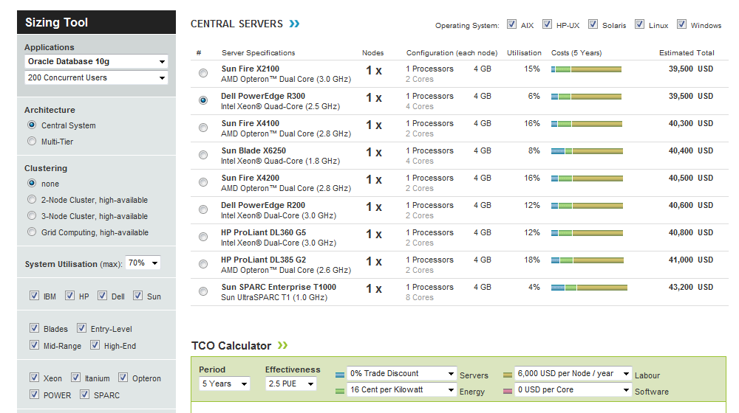
How Big of One Do You Need

Slide 36
Lab
Search for
Server sizing tool

Slide 37
How Big of One Do You Need
Here are some older guidelines that show you what elements to consider

Slide 38
How Big of One Do You Need
Users | CPU | Memory | Drives | RAID | NIC | Backup | Power
10 or so | 1 | 256 to 512 | 1 18GB 7,200 rpm | None | 1 10/100 | 20GB DAT | 1
25 to 50 | 1 Or 2 | 512 to 1GB | 5 9 to 19GB 10,000 rpm | 5 | 2 10/100 | 35 to 70GB DAT | 2
100 to 250 | 2 | 1GB to 2GB | External | 5 | 4 10/100 | External | 2
500 to 1000 | 4 | 2GB to 4GB | External Redundant | 5 | Depends | External | 2

Slide 39
How Big of One Do You Need
Once you get near 1,000 users and especially above the servers tend to be many individual units rather than bigger and bigger versions of a single server
These are arranged as clusters of servers to share the load

Slide 40
Server Virtualization
Server virtualization has become an important topic in the selection and use of servers
Here is part of a report on this from Infoworld from September 2006

Slide 41
Server Virtualization
Server virtualization divides a physical server into multiple virtual machines, each of which can run its own isolated operating environment and applications
That means less hardware, reduced power and cooling costs, and extended datacenter life

Slide 42
Server Virtualization
The ability to provision a new server simply by loading a virtualized image onto existing hardware not only saves IT management budget, it makes the business more agile
Applications that hog I/O and memory resources, such as large database deployments and Microsoft Exchange, often are not good candidates for sharing server hardware with other applications, even in a virtual environment

Slide 43
Server Virtualization
Before virtualization, IT departments tended to limit each physical server to a single application and operating environment, as multiple applications tended to conflict with one another
The result was often server sprawl and inefficient use of server resources

Slide 44
Should You Use Virtualization
Computerworld says this
Consolidating hardware is the No. 1 reason for considering virtualization
Aging hardware, bursting data centers and burgeoning power needs all have played a part in the move to virtualization
Why should you continue to acquire distinct physical machines when you can move real servers to even bigger machines at ratios of 3-to-1 or even 10-to-1

Slide 45
Should You Use Virtualization
The first step in virtualization is determining if you have the right type of infrastructure to support it
Look for a lot of machines doing similar tasks, and make sure you have more than 10 of them
For 10 or fewer, the payoff is questionable

