Slide 1
SAN
Last Update 2011.04.28
1.11.0

Slide 2
Objectives of This Section
Learn
What a SAN is

Slide 3
What is a SAN
A SAN is a Storage Area Network
It is used to remove data storage and backup from the servers on a local area network to a data storage and backup network that is separate from the local area network

Slide 4
How SANs Are Used
In general it is recommended for medium to large installations
That is those that require storage over 1 TB
A SAN is not an inexpensive solution as prices range in the $100,000 to $500,000 area

Slide 5
How SANs Are Used
Although lately some companies have put lower cost solutions on the market for $10,000 to $20,000, without the required storage devices however
Here a slide from a presentation at Nanog 51 from January 2011 that shows common SAN sizes

Slide 6
SAN Sizes

Slide 7
Reasons for Interest in SANs
There are several reasons this solution is being promoted at present
First, as more and more servers are added to a server farm - in this case we are talking tens or hundreds of servers - the management of the data spread out among this many servers becomes quite difficult

Slide 8
Reasons for Interest in SANs
Second, by using a separate network all of the data transfer is taken off of the LAN, which reduces traffic on the LAN
Last, backup traffic is also taken off the LAN
This means the backup can take place at anytime, not just during off hours; of which there are fewer and fewer

Slide 9
Operation
The idea of a SAN is to remove the data from the servers and manage it from one location and one box
As seen in the diagram below the Fibre Channel Disk Array holds all of the data regardless of its use

Slide 10
Operation
The applications that provide the means to share the data whether external or internal still operate on the same server, but the actual data resides on the Fibre Channel Disk Array box
In this model backup is also done on a single box that is directly attached to the SAN the Tape Drive Cabinet

Slide 11
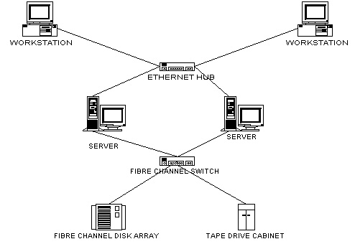
Operation

Slide 12
Operation
SANs using Fibre Channel use block level protocols to access the storage devices just like directly attached storage devices
This means operations are quite fast despite the increased distance from the storage device to the device that requested the data

Slide 13
Equipment
This approach requires the following equipment
In each server a HBA - Host Bus Adaptor for the SAN is installed
This provides a connection to the SAN much like a NIC provides a connection to a LAN

Slide 14
Equipment
The HBA connects to the disk array through a Fibre Channel Arbitrated Loop, a Fibre Channel Switch, Gigabit Ethernet, or SCSI using fiber or copper cable
The data storage and tape drive boxes connect to this hub or switch as well
A method to manage all of this is also required

Slide 15
Cautions About SANs
Although the components have been agreed on by all of the vendors competing in the SAN market the solutions are proprietary
SANs are not standards based
Interconnection of products from various vendors ranges from problematic to impossible
This is very much a proprietary solution

Slide 16
Fibre Channel v Ethernet
When SANs were first developed Ethernet speeds and TCP/IP protocols were not up to the reliability levels required for massive data transfer, thus the development of Fibre Channel
With the increase in Ethernet speeds coming on the market a migration to Ethernet is expected over the next few years

Slide 17
Fibre Channel v Ethernet
This technology currently goes by many names such as
Fibre Channel and iSCSI
Fibre Channel over Ethernet (FCoE)
Converged Enhanced Ethernet (CEE)
Data Center Ethernet (DCE)
Data Center Bridging (DCB)

Slide 18
Fibre Channel v Ethernet
These are all the same thing
All of them are designed to make Ethernet act like a channel rather than a network
This will allow for a single network regardless of the use

Slide 19
Fibre Channel v Ethernet
An article from Network World by Jon Olstik from April, 2011 argues that this transition will be sooner rather than later
The points he makes include
Two years ago, I told my storage colleagues that the tipping point for FCoE momentum would be when 10GbE was selling for less than $500 per port and when Intel servers regularly shipped with 10GbE NICs

Slide 20
Fibre Channel v Ethernet
That's roughly where we are today. Since demand for 10GbE is increasing, 10GbE server NICs will become the rule and switch price per port will drop driving more FCoE demand
An informal poll he did at a conference elicited the following
Do you believe your organization will make Ethernet a standard transport for storage networking

Slide 21
Fibre Channel v Ethernet
42% Yes, but no specific timeline at this point
32% Yes, we are doing this today
5% Yes, over the next 12-24 months
21% No, we will continue to run separate networks for data and storage in the data center

