Slide 1
Microsoft Virtualization
Last Update 2011.01.01
1.0.0

Slide 2
Objectives of This Section
Learn
  About Microsoft's approach to virtualization

Slide 3
Microsoft Virtualization
As is common with Microsoft when they wakeup to the fact that they are behind someone else in an area they release a blizzard of products
All this does is make it extremely confusing as to what they offer, what each one does, and which one they will actually follow through with over the long term
The Microsoft world is littered with orphans

Slide 4
Microsoft Virtualization
The second problem is Microsoft tries to tie any new product area into some old product area
Why I do not know
This just makes the naming confusing
Such is the case with virtualization

Slide 5
Microsoft Virtualization
I still have not figured out what they think is their mainstream approach other than it is called Hyper-V
To see what I mean let’s see what Wikipedia says about this
  Hyper-V exists in two fairly distinct versions: as a stand-alone product called Microsoft Hyper-V Server 2008 R2, and as a part of Microsoft Windows Server 2008 R2

Slide 6
Microsoft Virtualization
Then further on it says
  The stand-alone Hyper-V Server does not require an existing installation of Windows Server 2008 nor Windows Server 2008 R2
  The standalone installation is called Microsoft Hyper-V Server and Microsoft Hyper-V Server 2008 R2
Huh
How about a summary from Microsoft

Slide 7
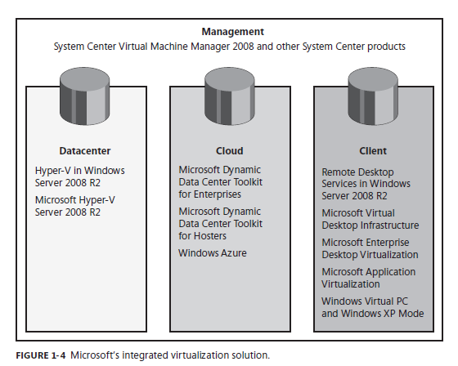
Microsoft Virtualization

Slide 8
Microsoft Virtualization
As to Hyper-V Microsoft itself says this
  Virtual machine technology applies to both server and client hardware
  Virtual machine technology enables multiple operating systems to run concurrently on a single machine
  In particular, Hyper-V, a key feature of Windows Server 2008 R2, enables one or more operating systems to run simultaneously on the same physical system

Slide 9
Microsoft Virtualization
As that is what we want to do we will limit this discussion to Hyper-V as used by Windows Server 2008 R2
As to all the other ones they talk about that support virtualization, I have no clue

Slide 10
Microsoft Virtualization
Hyper-V is available in two versions
  Installed on a system already running Windows Server 2008 R2
  Setup as Hyper-V Server 2008 R2 as a standalone server
    This is the limited versions with no GUI interface for example
  Here is a summary

Slide 11
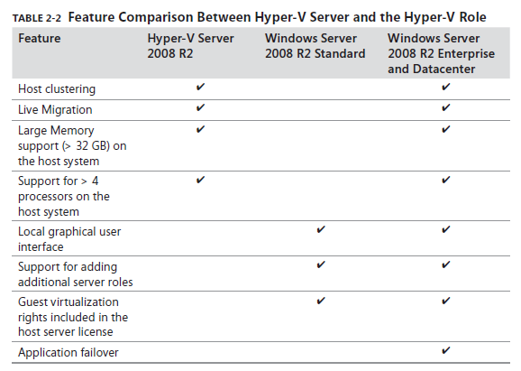
Microsoft Virtualization

Slide 12
The Hypervisor
As with all other approaches to virtualization Microsoft uses a hypervisor that talks directly to both the hardware and the operating system
The hypervisor is what enables multiple operating systems to use one set of physical hardware at the same time

Slide 13
Hyper-V Architecture
Microsoft likes the concept of parent and child relationships
This is true of Hyper-V as well
The parent partition contains Windows Server 2008 R2 that manages the other partitions
The guest operating systems reside in the child partitions

Slide 14
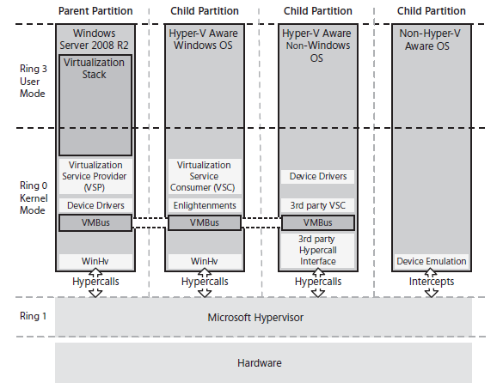
Hyper-V Architecture

Slide 15
Management Tools
With a full installation of Windows Server 2008 R2 with the Hyper-V role installed on it the Hyper-V Manager becomes part of Administrative Tools as we will see below

Slide 16
Virtual Networking
In the Microsoft version of virtual networking the virtual NIC in a child partition connects back to a virtual switch in the parent partition that then connects to a virtual NIC that talks to the real NIC that connects to the physical network

Slide 17
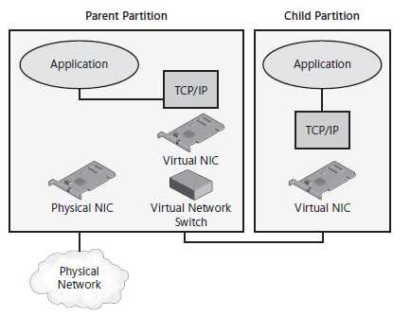
Virtual Networking

Slide 18
Install Windows Server 2008 R2
To install Windows Server 2008 R2 place the disc with the ISO file in the drive
Boot the computer from that drive
The installation begins
Just follow along with the screens
It is very straight forward

Slide 19
Install Windows Server 2008 R2
Check the selections
Click
  Next
Click
  Install Now

Slide 20
Install Windows Server 2008 R2
Select the operating system to install
In this case
  Windows Server 2008 R2 Enterprise (Full Installation)
Click
  Next
Agree to the license

Slide 21
Install Windows Server 2008 R2
Select the type of installation
In this case
  Custom
Select the drive to install to
Installation begins

Slide 22
Install Windows Server 2008 R2
The computer will restart a few times
Then a screen appears regarding a required password change
It must be a somewhat complex password
The installation is now complete
Unlike many POSIX and Linux based programs Windows installed without objecting to any of the hardware

Slide 23
Install Hyper-V
The next step is to install Hyper-V
Hyper-V is considered to be a role of the server such as being a DHCP server
The Server Manager is used to add this role to the server

Slide 24
Install Hyper-V
Open the Server Manager
In the left pane select Roles
In the right pane select Add Roles
On the Before You Begin page click Next
Select Hyper-V as the role to add
An Introduction to Hyper-V screen will appear click Next

Slide 25
Install Hyper-V
Select the physical NIC that the virtual network will use
  Notice that unlike VMware the motherboard NIC is supported
The Confirm Installation Selections screen appears click Install
Installation proceeds
Of course as in all cases with Windows a restart is required

Slide 26
Verify Hyper-V Installation
Let’s now be sure it installed and is ready to use
Open the Hyper-V Manager in Administrative Tools
Accept the license
Select the Hyper-V server
If there are no error messages the installation is complete

Slide 27
Create a Virtual Machine
Now on to creating a virtual machine
Start the Hyper-V Manager in Administrative Tools
Select the server in the left pane
Select New Virtual Machine under Actions in the right pane
On the Before You Begin screen click Next

Slide 28
Create a Virtual Machine
Provide a name for the virtual machine
Adjust the amount of memory if desired
Select the NIC to use
Let it create a virtual hard disk
Either install the operating system later or now as you prefer
In this case we will do it later from an ISO file stored on the physical hard drive

Slide 29
Create a Virtual Machine
Click Next
On the Summary screen click Finish
The virtual machine is created
It is listed in the middle pane under Virtual Machines
Now to install the operating system
Right click on the virtual machine name and select Start

Slide 30
Create a Virtual Machine
Right click and select Connect
A console screen will open showing a boot failure as the operating system has not been loaded yet
Open the Media menu
  Select DVD Drive Insert Disk
  Navigate to the location of the operating system installation file
  Select Open

Slide 31
Create a Virtual Machine
Press Enter
The installation process will commence
After a restart a new virtual machine is running

Slide 32
Create a Virtual Machine
Now wasn’t that easy
See after you push through all of the Microsoft obfuscation their approach to virtualization is just as easy as VMware
It is just getting to this point that is the problem
It is the old separating the wheat from the chaff issue

