Slide 1
Disaster Recovery
Last Update 2009.07.30
1.5.0

Slide 2
Objectives of This Section
Learn how to
Protect yourself from disaster

Slide 3
How to Approach This Task
There are many elements to a good disaster management plan
Each of these elements must be in place, monitored for effectiveness, and updated as required

Slide 4
Elements
Backup
Spare Parts
Complete Disaster Plan
Business Continuity Planning

Slide 5
Backup
Why do we back things up
Who cares
What difference does it make
Well, actually sometimes it is important
For example

Slide 6
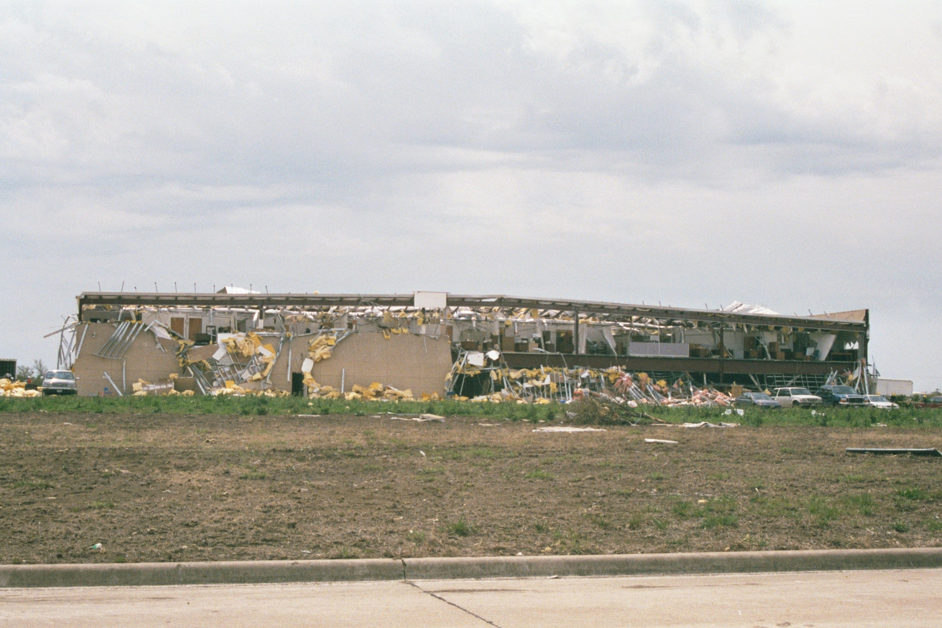
Backup

Slide 7
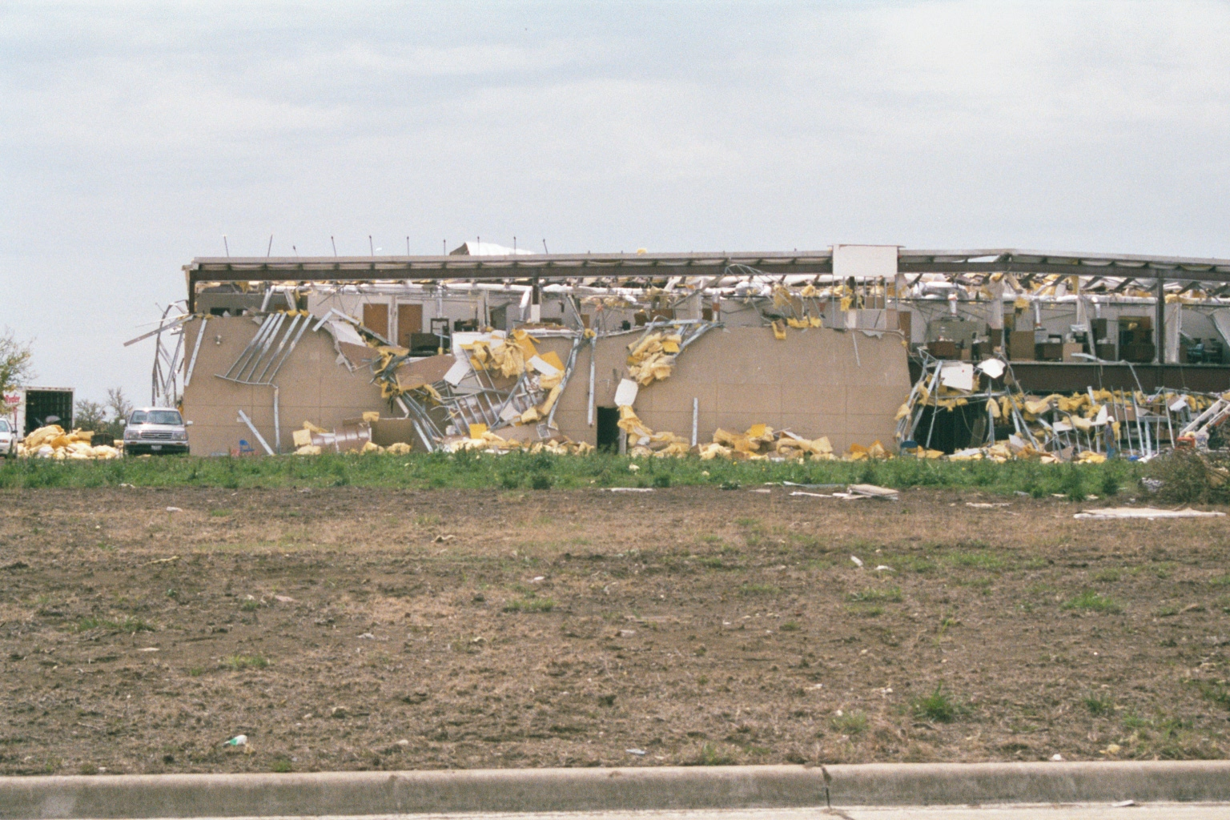
Backup

Slide 8
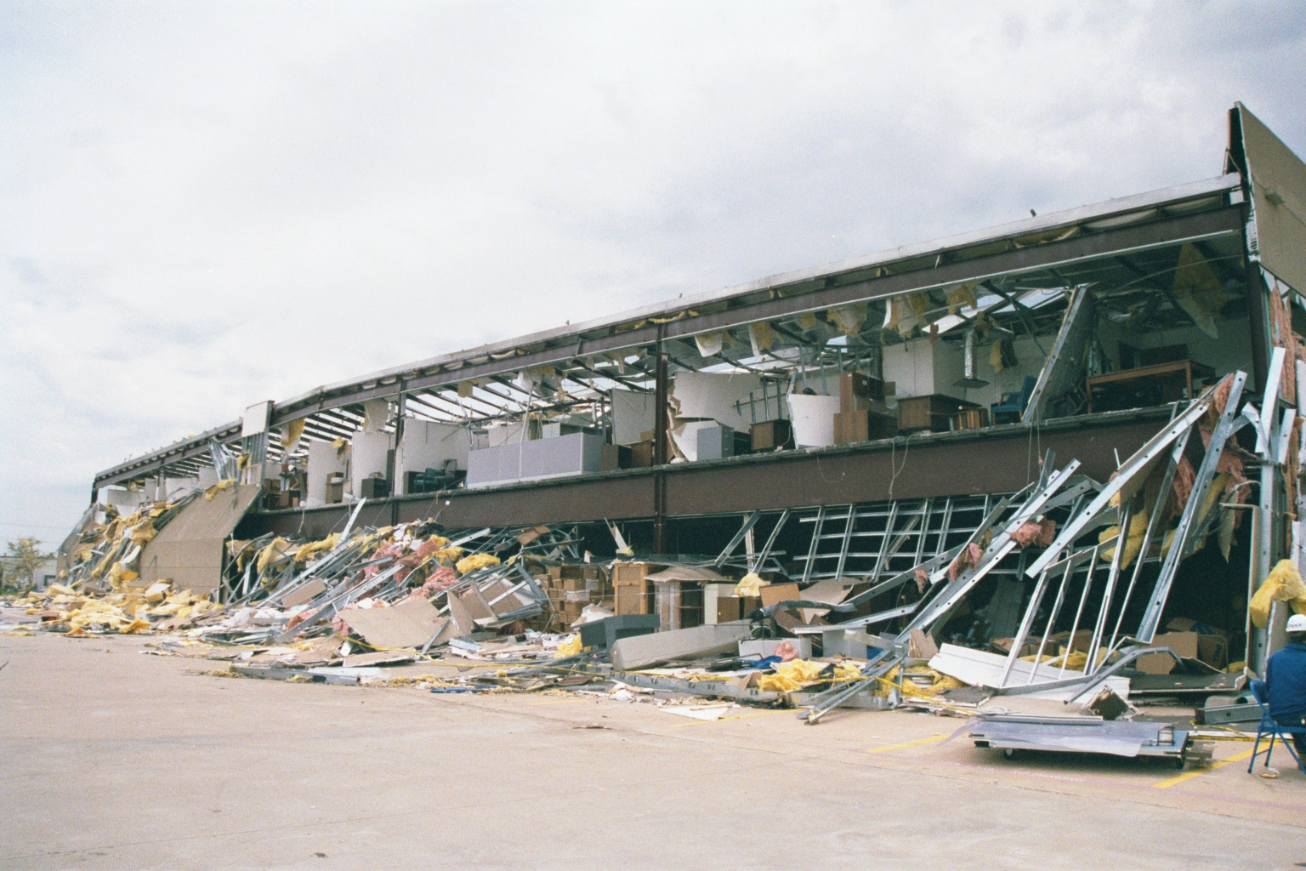
Backup

Slide 9
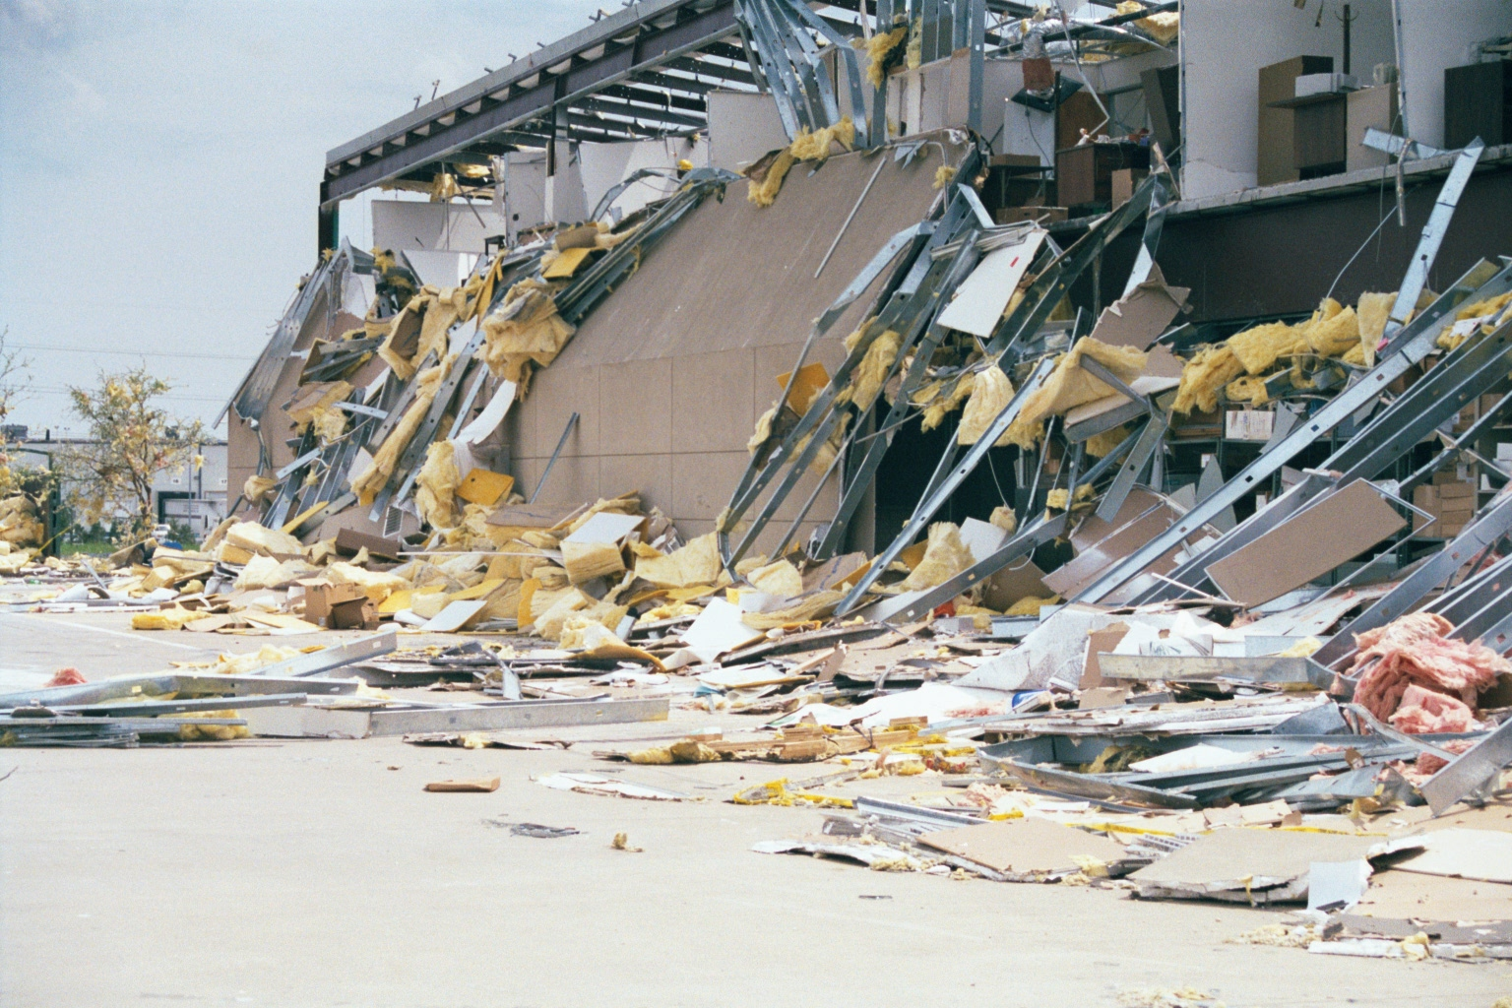
Backup

Slide 10
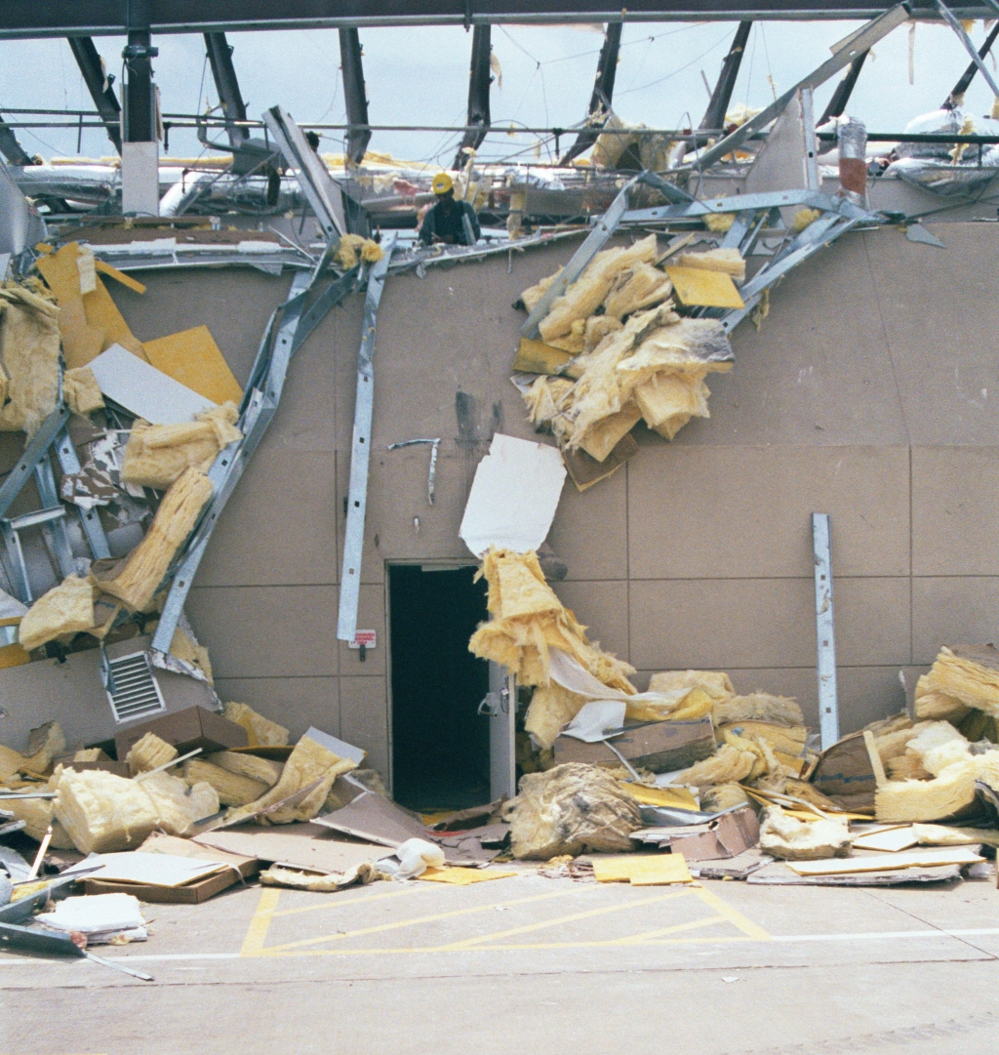
Backup

Slide 11
Backup
Right inside the door there and slightly to the left was the LAN room
So, sometimes it is a good idea to back things up after all
The first thing to do is develop a plan
This plan should include what will be backed up, who should do the backup, and what will be done with the backup

Slide 12
Backup
Certainly the data should be backed up
You may also wish to backup everything else on the drive or just parts of it such as configuration files
In some cases it is easier to just reload everything from scratch than to attempt a restore
Be sure you know where the data is

Slide 13
Backup
Is all data on the servers or do users store some on their workstations
Some operations will store data on the workstations and just copy it over to the server once a week or once a month
You must account for all data, no matter where it is
Where should the backup be stored

Slide 14
Backup
A copy should be kept onsite in a sealed and fireproof box or vault
Not in a fire resistant, but an absolutely I do not care how hot it gets fireproof box

Slide 15
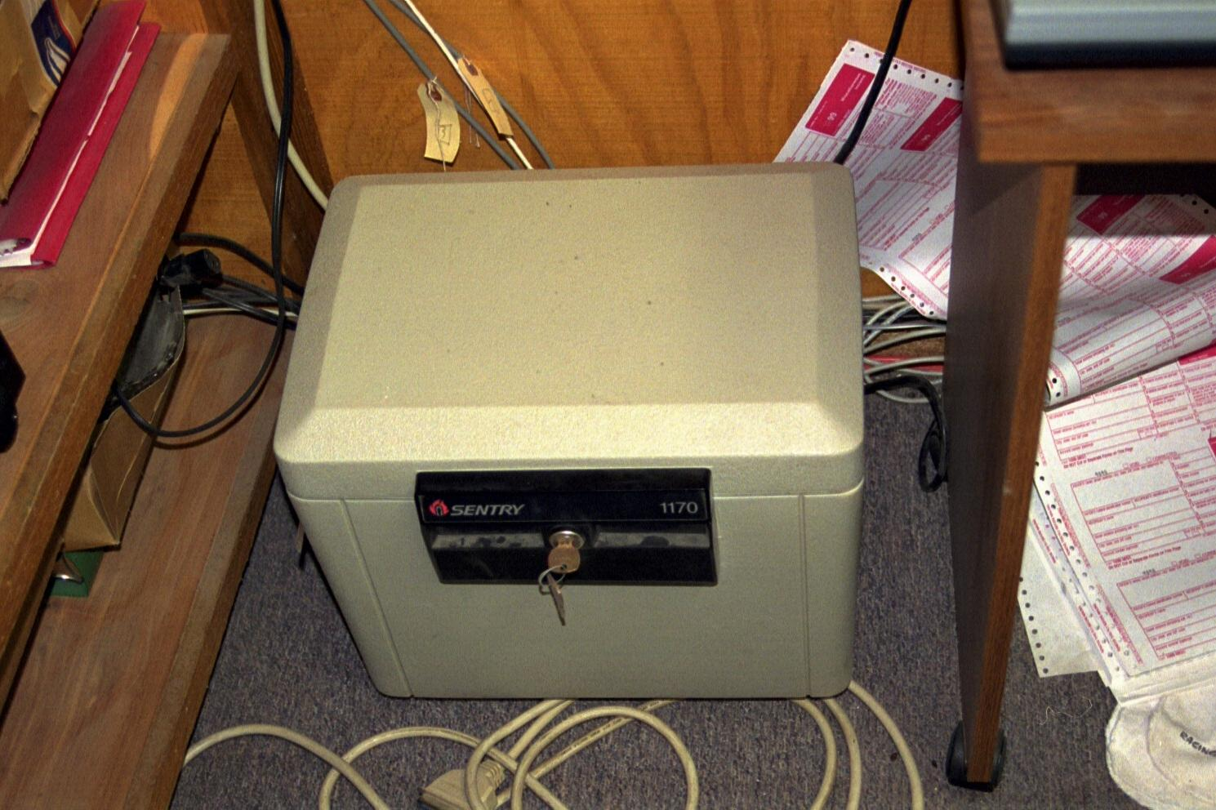
Backup

Slide 16
Backup
A copy must also be stored off site on a regular basis
For small and medium size operations a safe deposit box is a good choice
If you have two locations copy the data from one to the other over the Internet
Third party companies will also come by and pickup the backup tapes on a regular basis

Slide 17
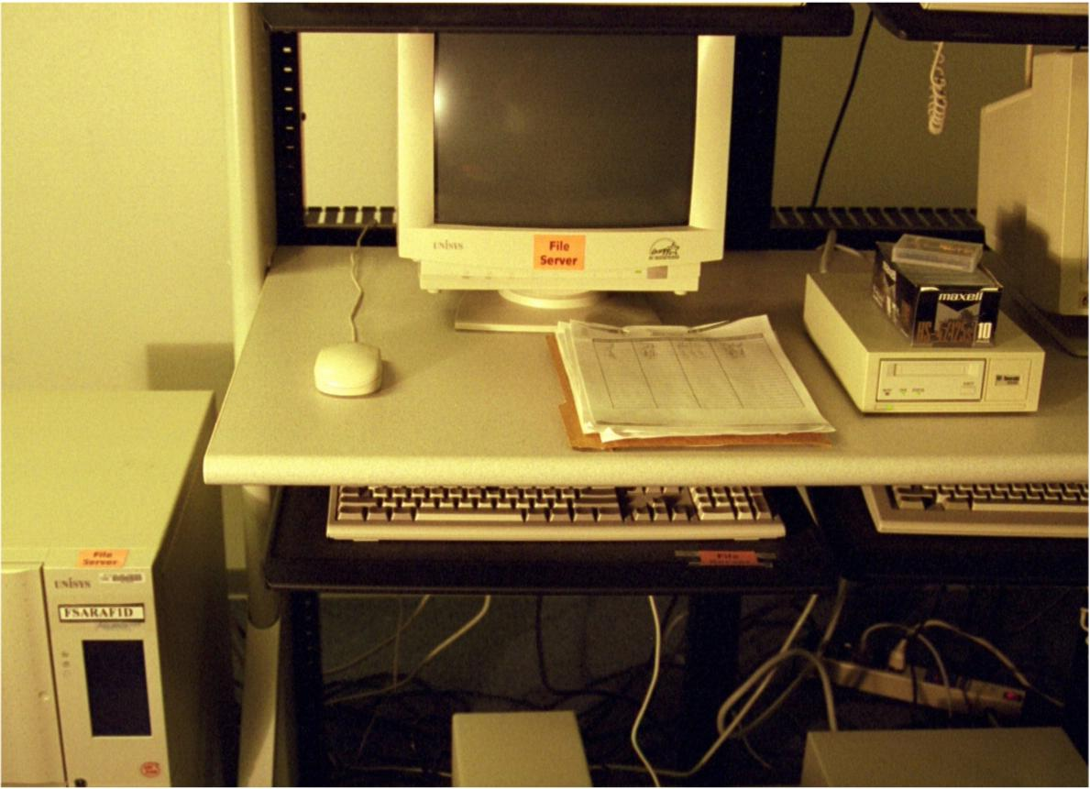
Backup
What can you see wrong in the picture shown below

Slide 18
Backup
This picture was taken in the LAN room referred to above before the tornado rearranged things
I found the tapes laying on the floor in a pool of water
Notice all of the backup tapes in a cardboard box out in the open, right beside the tape drive
No, this arrangement was not my idea

Slide 19
Backup
The schedule of backups depends on how much data can be lost
If it is not too much trouble to redo a week’s worth of work, then backup once a week
If you cannot loose even a second of data, then use a solution to meet that problem
The business model and procedures will drive the backup plan to a large extent

Slide 20
Backup
Who should do the backup
It does not matter as long as it is always done
Someone needs to be assigned the task of doing and verifying the backup
Be certain they maintain a log that shows the date of the backup, the number of the media used, and the success or failure of the attempt

Slide 21
Backup
A backup can be
Full
Incremental
Differential
Let’s compare these

Slide 22
Backup
Aspect | Full | Incremental | Differential
Time to Backup | Longest | Shortest | Middle
Time to Restore | Shortest | Longest | Middle
Tape Space | Largest | Smallest | Middle
Tapes to Restore | Just the Last Full | The last Full and all Incrementals | The last Full and the last Differential

Slide 23
Archive Bits
To understand the differences let’s first discuss archive bits
Whenever a file is created or updated the archive bit is turned on
To see a file's attributes in Windows right-click on a file in Windows Explorer and select Properties

Slide 24
Archive Bits
The Attributes section, located towards the bottom of the General tab, has an Archive check box
Data backup methods rely on this archive bit
If the check box is empty, the file will not be archived during the next backup process

Slide 25
Archive Bits
If the file is updated, a check will be placed in the box, and the file will be archived during the next backup process

Slide 26
Full Backup
Everything in the target set is copied
The target set is all files regardless of the setting of the archive bit
Then all archive bits are turned off
This type of backup archives all files, including system files, application files, user files, and so forth

Slide 27
Full Backup
While this method offers excellent protection, it takes a significant amount of time
Restoring data from a full backup, however, is simpler and faster than many other backup methods because all data is readily available on a single tape or a series of tape

Slide 28
Full Backup
Full backups are not practical for every situation
Most normal backups are done at night during nonbusiness hours
Some organizations have limited or no nonbusiness hours

Slide 29
Full Backup
Far too much data must be backed up in such a short time period
Some systems are available for large organization to work around this limitation, such as faster backup methods or SANs

Slide 30
Incremental Backup
Just those files that have changed from the last full backup are copied
In other words those with the archive bit turned on
Then the archive bit is reset on those
So if a full backup has not been done, then the only files that have been backed up are just those with the archive bit on

Slide 31
Incremental Backup
To restore an when this method is used the last full backup must be loaded first, then all of the incremental backups since that full backup

Slide 32
Differential Backup
The changed files are copied
But the archive bit is not changed
To restore when this method is used the last full backup and the last differential backup are used

Slide 33
Restores
To restore when using a full and incremental method the full backup is copied to the disk, then each incremental made since the last full backup
To restore from a full and differential method the full backup is copied to disk, then the differential is copied back to disk

Slide 34
Restores
This is faster to restore, but the differential will take more and more time to backup to because of the constantly increasing number of files

Slide 35
Testing the Backup
There is little point in doing a backup if no one ever tests it to see if it can be restored
Do not do this to the production system
This is one reason for a test lab
Do it there in an environment that is totally isolated from the real LAN

Slide 36
Backup Media
You will note I have not mentioned the device to use for the backup yet
It makes no difference what you use as long as it gets the job done and is reliable
Forget tape
It is time to move to disk based or over the Internet backup

Slide 37
Backup Media
If a tape drive is used, be sure to clean the drive as specified by the manufacturer
There are several types of tape backup methods

Slide 38
Tape Drive

Slide 39
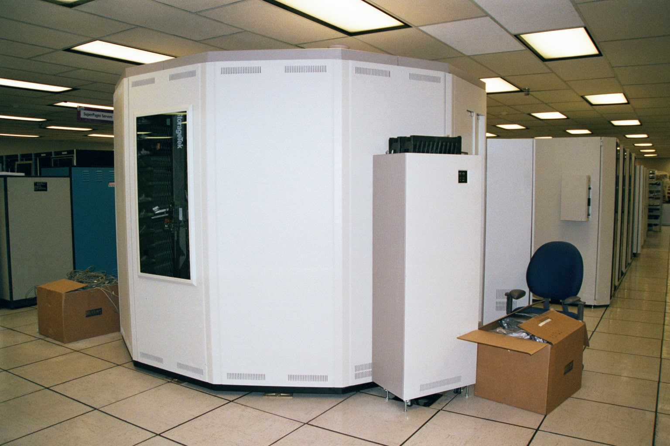
Tape Drive

Slide 40
Media Rotation
Media rotation with tape systems is an area that often causes confusion
Mostly this is due to sadistic instructors trying to make students learn the Tower of Hanoi and GFS - Grandfather, Father, Son
These are so obtuse that I do not believe anyone in the world actually uses them so I will not discuss them

Slide 41
Media Rotation
By far the most common method, despite what the books and articles say, is the Round Robin method
A set of tapes usually a box of ten is simply rotated each time the tape is changed
Each tape is numbered from one to 10
Most tapes are changed once a day

Slide 42
Media Replacement
Some just use half a box of tapes and label them Monday through Friday
The media must be replaced on a regular basis
Using the same set of tapes for years at a time will cause them to wear out
Track this on the same form where the daily check of the backup is recorded

Slide 43
Backup Planning
Backing up sites that have no off hours is difficult since backups are commonly done when everyone is at home in the middle of the night
In a small to medium size operation a full backup can be done once a week, then incremental backups can be done daily in between

Slide 44
Backup Planning
In the case of a web store there may not be any time like this
One way is to use a replication procedure as would be used to keep a real time copy of the data for disaster recovery purposes
Then take this replica server offline and back it up

Slide 45
Backup Planning
Another method is to mirror the main site to one in another location, thereby creating a constant backup
Companies that cannot tolerate any downtime do this
New approaches to backup and more importantly restore are gaining ground

Slide 46
Backup Media
The issue is becoming not so much how long it takes to do a backup, as backups can be made from a mirrored device or from a SAN, if the backup window has shrunk too low
The issue is becoming the time required to restore
This is what will do in tape based systems
They are too slow to restore

Slide 47
Backup Media
Method | Cost | Backup Time 1 TB of Data | Restore Time
Disk to Tape | Tapes | 1 Hour | 2 to 3 Hours
Disk to Disk | Another Disk | 20 Minutes | 20 Minutes
Point-in-Time | Several Disks | 20 Minutes | Seconds

Slide 48
Backup Media
The disk to disk method is basically mirroring the data to another physical disk
The point-in-time method makes a copy on a periodic basis

Slide 49
Backup Retention
The amount of time that backups must be retained and what must be on these is changing
Legislation and securities rules now require that in addition to financial information, such as accounting records, that email and instant messaging be retained as well
The retention period is four years

Slide 50
Backup Retention
This means you must be able to find the actual information on the backup media

Slide 51
Backup Retention

Slide 52
Spare Parts
It is wise to keep common spare parts on hand for critical systems
Or even better design redundancy into the network
Common spares to keep are
Power supplies
Memory
Hard drives
In short as much as possible for vital systems

Slide 53
Complete Disaster Plan
What happens if everything falls apart
What do you do if everything is lost
Decide what is to be done before it happens
This may be a plan to just rebuild the LAN
It may need to be a 24 X 7 hot site where business can be shifted within a few hours
The main thing that drives this is how fast you need to be back at work

Slide 54
Complete Disaster Plan
The key point is to think about it before it happens
Because

Slide 55
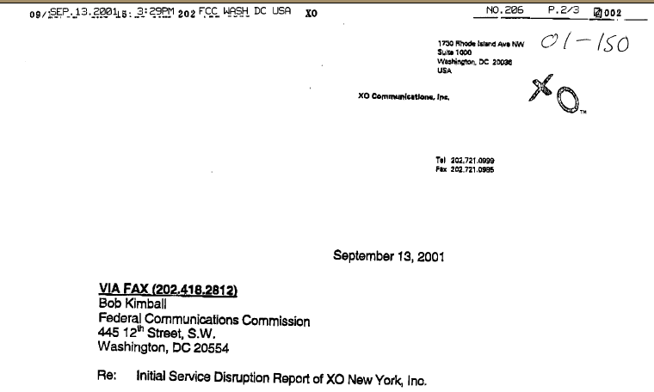
Complete Disaster Plan

Slide 56
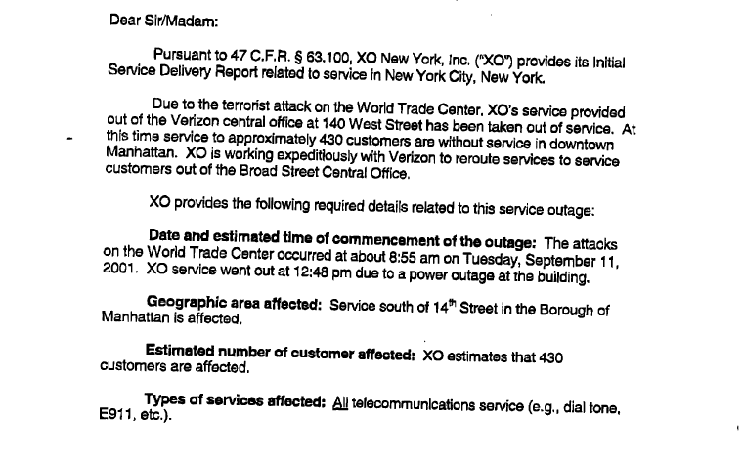
Complete Disaster Plan

Slide 57
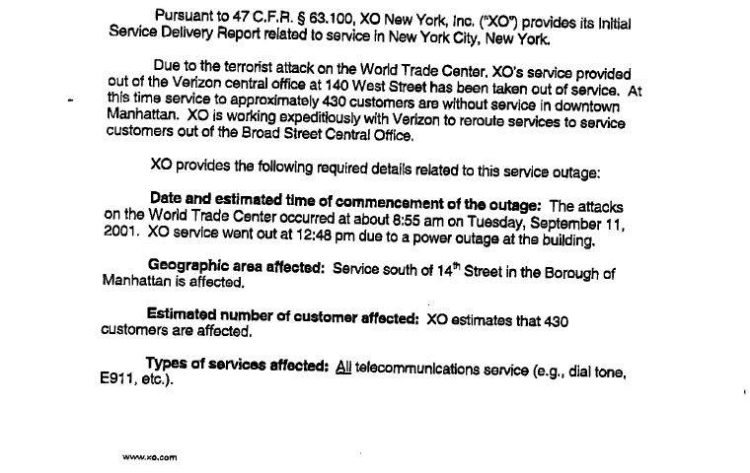
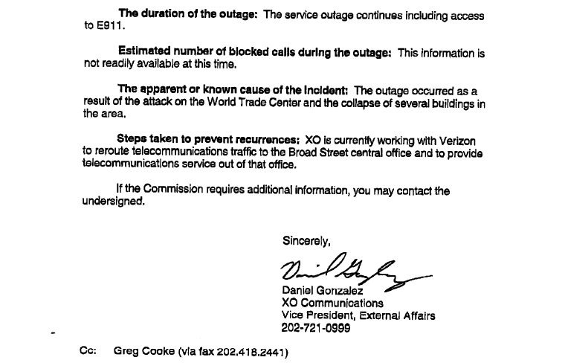
Complete Disaster Plan

Slide 58
Complete Disaster Plan
Address at least the following aspects
Are adequate backup systems in place
Are backup systems tested on a regular basis
How will data be recovered
Is there a disaster management team
Does the infrastructure include backup or redundant connections

Slide 59
Complete Disaster Plan
Is equipment completely documented including
Serial numbers
Specifications
Passwords
Naming plans

Slide 60
Complete Disaster Plan
Will support materials be available such as
Installation disks
Startup disks
License numbers
How will the groups in the organization be affected
What groups need to be functional first
Will each group be able to function without access to the network
If so for how long and how

Slide 61
Audit
Most operating systems for networks produce security logs
Check these logs
Also run a port monitoring program to see what outside user is scanning your network
They only do this to see where they can get in

Slide 62
Audit
Do not let them in an open window in the basement you forgot about

Slide 63
Business Continuity Planning
Recent events have called into question many of the disaster recovery plans organizations had made
The potential catastrophic nature of a terrorists attack on a building or area has highlighted the need for a more complete approach to disaster recovery, than merely storing tapes off site

Slide 64
Business Continuity Planning
The need to create an entire new site, rapidly has become more important
One approach to this process is Business Continuity Planning
Most of the following is word for word from an excellent article titled “Ensuring Business Continuity” by Wing Lam that appeared in IT Pro – an IEEE publication – in June 2002

Slide 65
Business Continuity Planning
BCP - Business Continuity Planning is a cyclical approach
This is the first error many organizations will make when doing this process
They will proceed through it, then put it on the shelf
This is an approach that must run in a cycle

Slide 66
Business Continuity Planning
This is especially true of IT operations, as this field and the technology in it changes almost daily
The plan must be revisited whenever the organization introduces changes to the business or alters its business priorities

Slide 67
BCP Steps
The steps in BCP are
Initiate the BCP project
Identify business threats
Conduct a risk analysis
Establish the business continuity team
Design the business continuity plan
Define the business continuity process
Test the business continuity plan
Review the business continuity plan

Slide 68
Initiate the BCP Project
Obtain and confirm support from senior management
Identify key business and technical stakeholders
Form a business continuity working group
Define objectives and constraints
Establish strategic milestones and draw up a road map

Slide 69
Initiate the BCP Project
Begin a draft version of business continuity policy

Slide 70
Identify Business Threats
Identify the community of business and technical stakeholders
Conduct threat identification workshops
Delineate and document business threats

Slide 71
Conduct a Risk Analysis
Conduct risk analysis workshops
Assess the likelihood and impact of threat occurrence
Categorize and prioritize threats according to risk level
Review outputs of risk analysis with management

Slide 72
Conduct a Risk Analysis
Ascertain level of risk acceptable to the organization
Document outputs in business continuity policy

Slide 73
Establish the Team
Identify key business, technical, and customer services stakeholders
Form and empower the business continuity team
Clarify and agree on team objectives and working mode
Define roles and responsibilities; produce a work plan

Slide 74
Establish the Team
Identify incident engagement and response processes
Update business continuity policy

Slide 75
Design the Plan
Identify critical and noncritical business services
Establish preferred business continuity service levels and profiles for continuity and recovery
Reaffirm key constraints, such as time and cost

Slide 76
Design the Plan
For each threat, identify possible continuity strategies and evaluate them in terms of time, cost, and benefits
Identify and engage potential business continuity partners
Draft a set of continuity plans
Produce and execute an implementation plan

Slide 77
Define the Process
Identify, define, and document business continuity processes
Review and verify business continuity processes with relevant stakeholders
Identify training requirements
Develop training exercises, role-playing scripts, and simulation case studies
Initiate training and awareness programs

Slide 78
Test the Plan
Define business continuity acceptance criteria
Formulate the business continuity test plan
Identify major testing milestones
Devise the testing schedule
Execute tests via simulation and rehearsal; document test results

Slide 79
Test the Plan
Assess overall effectiveness of business continuity plan; pinpoint areas of weakness and improvement
Iterate tests until the plan meets acceptance criteria
Check, complete, and distribute business continuity policy

Slide 80
Review the Plan
Develop a review schedule for different types of review
Arrange a business continuity review meeting or workshop
Update the business continuity document
Kick off another BCP cycle if necessary

Slide 81
For More Information
Effective Physical Security
Lawrence J. Fennelly
ISBN 075069873X

