Slide 1
KVM Last Update 2013.03.05
1.0.0

Slide 2
Objectives of This Section
Learn what a KVM is

Slide 3
KVM
To reduce the amount of equipment that has to be put in the rack or on the table a KVM – Keyboard, Video, Monitor – switch can be used
With such a thing a single keyboard, a single monitor, and a single mouse can be used to control from two to hundreds of computers

Slide 4
KVM
There are two types of these
Analog
Digital
Analog uses local dedicated cables to connect everything together
Digital systems use UTP cables to connect over long distances
Here is the concept as shown by Dell

Slide 5
Analog

Slide 6
Digital

Slide 7
Analog
Analog devices look like this as shown by IOGear

Slide 8
Two Port KVM

Slide 9
Eight Port KVM

Slide 10
Eight Port KVM

Slide 11
16 Port KVM

Slide 12
16 Port KVM

Slide 13
KVM Cables
These two to 16 port KVMs require propriety cables for each device to be controlled by it
This adds to the cost
Here is what the cables look like

Slide 14
KVM Cables

Slide 15
KVM Connection
Here is a diagram from IOGear that shows how these are connected

Slide 16
KVM Connection

Slide 17
KVMP
A KVMP – Keyboard Video Monitor Mouse Peripheral adds the ability to access external USB devices
These USB devices can be accessed and shared across the computer systems connected to the KVMP
A USB hub can be connected so that for multiple devices can be sharing

Slide 18
iKVM
Digital or iKVM devices make more sense than analog when the number of devices to be remotely managed exceeds more than 20 or 30 or if they are at a long distance in the datacenter or in another location entirely
The i stands for over IP
The local management console looks like this as shown by APC

Slide 19
iKVM

Slide 20
iKVM
This connects to the remote server over a UTP cable connected to the normal data network
For example as shown in the APC manual

Slide 21
iKVM

Slide 22
iKVM

Slide 23
Device Module
Each device to be controlled requires a device module to handle the KVM traffic

Slide 24
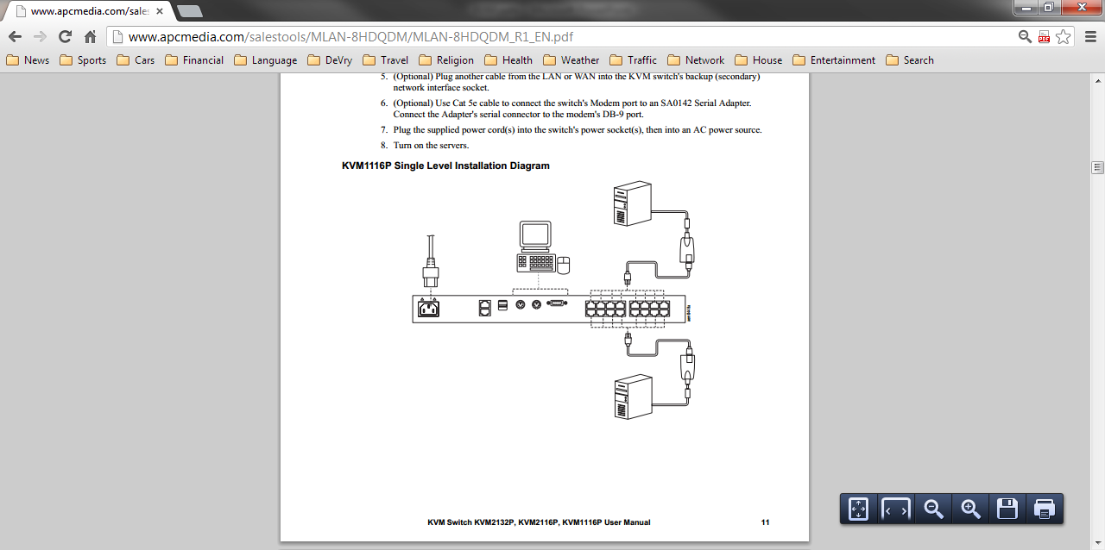
Device Module

Slide 25
iKVM Display
The device to be controlled appears on the management consoles screen such as seen here

Slide 26
iKVM Display

Slide 27
iKVM Problems
As might be expected the latency in a long distance connection such as this causes only near real time display of the remote device

Slide 28
Headless Server
A server can also be managed remotely without a keyboard, monitor, or mouse being attached to it at all
This is done using SSH or some other remote management program
This is called a headless server

