Slide 1
Hubs Bridges Switches Last Update 2009.02.27 1.0.0

Slide 2
Hubs Bridges Switches
As the size of local area networks have grown the devices used to form the central connection point for the devices that will use the local area network have changed
The progression has been from hub to bridge to switch

Slide 3
Hubs Bridges Switches
We will use the marketing created names here
But the nerd names are more descriptive of the evolution of the functions they perform
Hubs are multiport repeaters at layer 1
Bridges are collision domain dividers at layer 2
Switches are multiport bridges also at layer 2

Slide 4
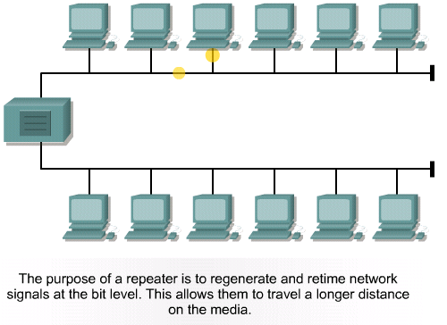
Repeater

Slide 5
Hub

Slide 6
What is a Hub
A hub is the point of connection for all devices that will access a local area network
Once powered up the hub is the network
It creates the network
It is not very useful as a network by itself
But it is a complete network nevertheless
Hubs have just about disappeared

Slide 7
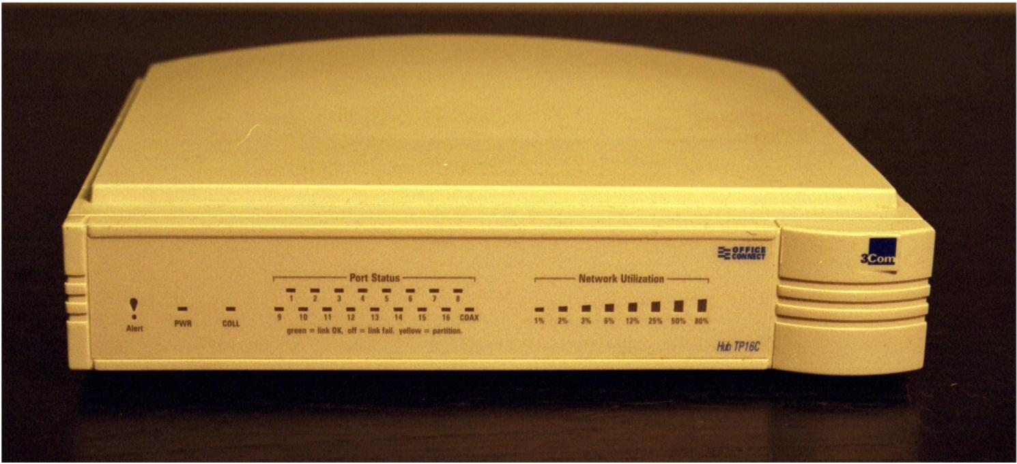
Basic Hub - Front

Slide 8
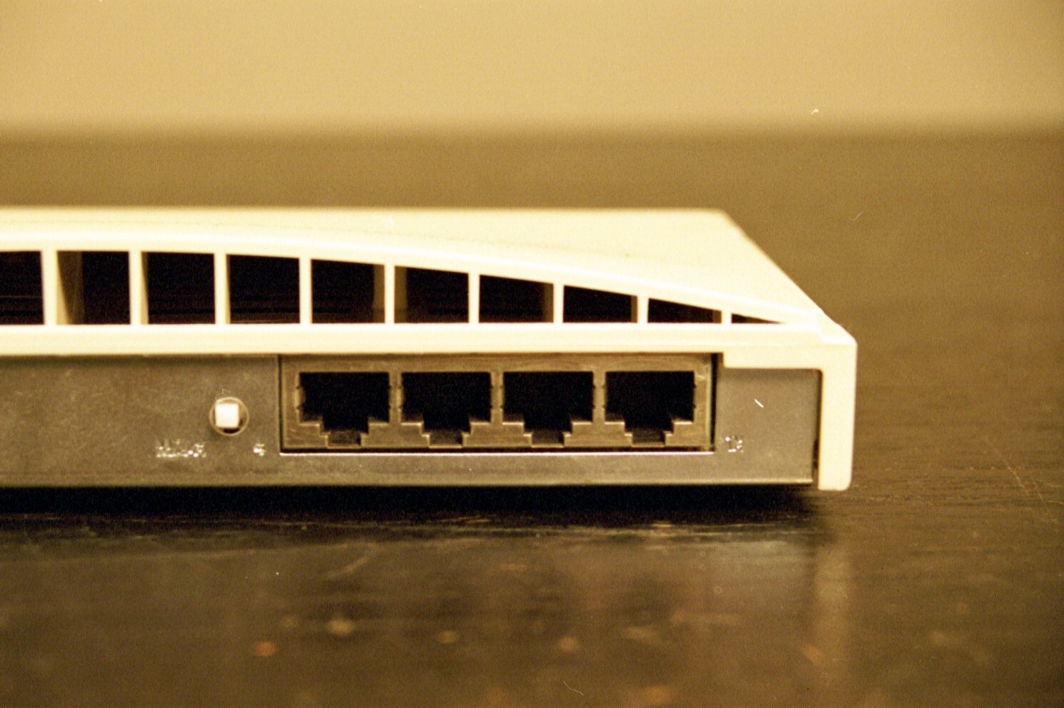
Basic Hub - Back

Slide 9
Characteristics of Hubs
A hub is a layer 1 device, as such it is not very intelligent
It only deals with bits – 1s and 0s
The hub forwards bits from one port to all the other ports
The ports are used to connect devices used on the network
A hub usually has from 2 to 96 ports

Slide 10
RJ-45 Port
RJ-45 Port

Slide 11
Linking Hubs
Hubs can be hooked together in order to increase the number of ports available to the network
There are two ways to do this
Uplink
Stack
These methods are not mutually exclusive

Slide 12
Uplink
When hubs are uplinked, each hub is still a distinct entity
To create an uplink connection between hubs a port from one hub is connected to a port on another hub
One of the ports must be an uplink port
This can be a port that is dedicated to this use

Slide 13
Uplink
Or a normal port can be converted to this by flipping a switch or through a software setting

Slide 14
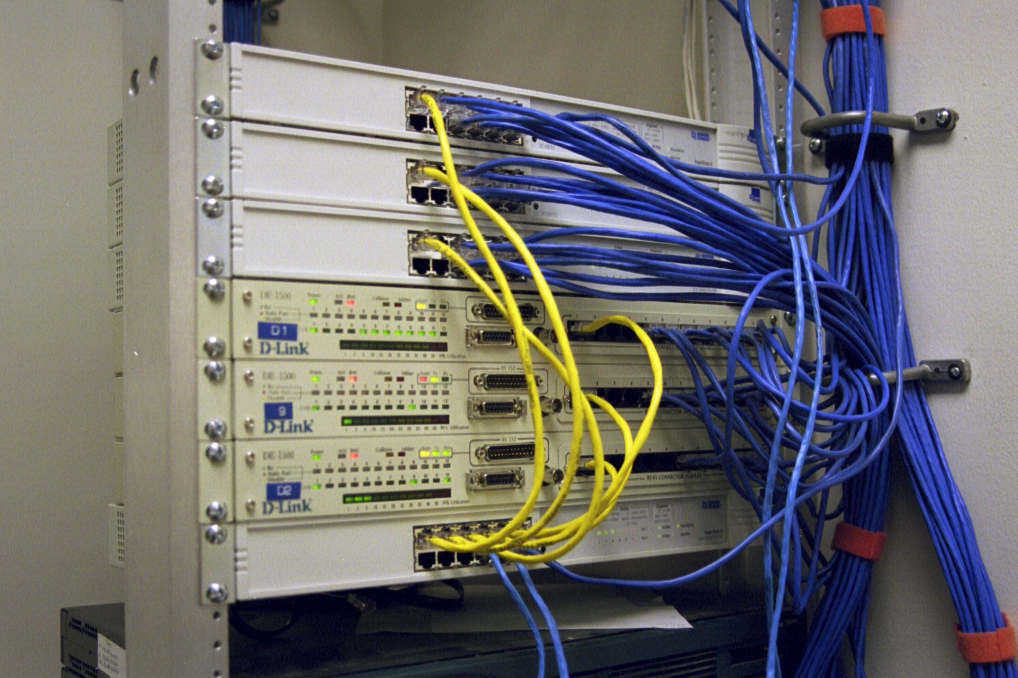
Uplink
The yellow cables are the uplink cables in this example

Slide 15
Uplink

Slide 16
Uplink
Each hub is different, for this one a switch called the MIDI switch is used to tell the hub whether a normal device like a PC is plugged into the port or if it is another hub
This allows you to use normal patch cables instead of crossover cables to uplink the hubs
If there is no MIDI switch, just use a crossover cable

Slide 17
Stacking
When hubs are stacked they become one hub for purposes of management
One logical hub
Usually stacking requires a special proprietary cable
There is a limit to the number of hubs that may be stacked
Normally all must be the same type

Slide 18
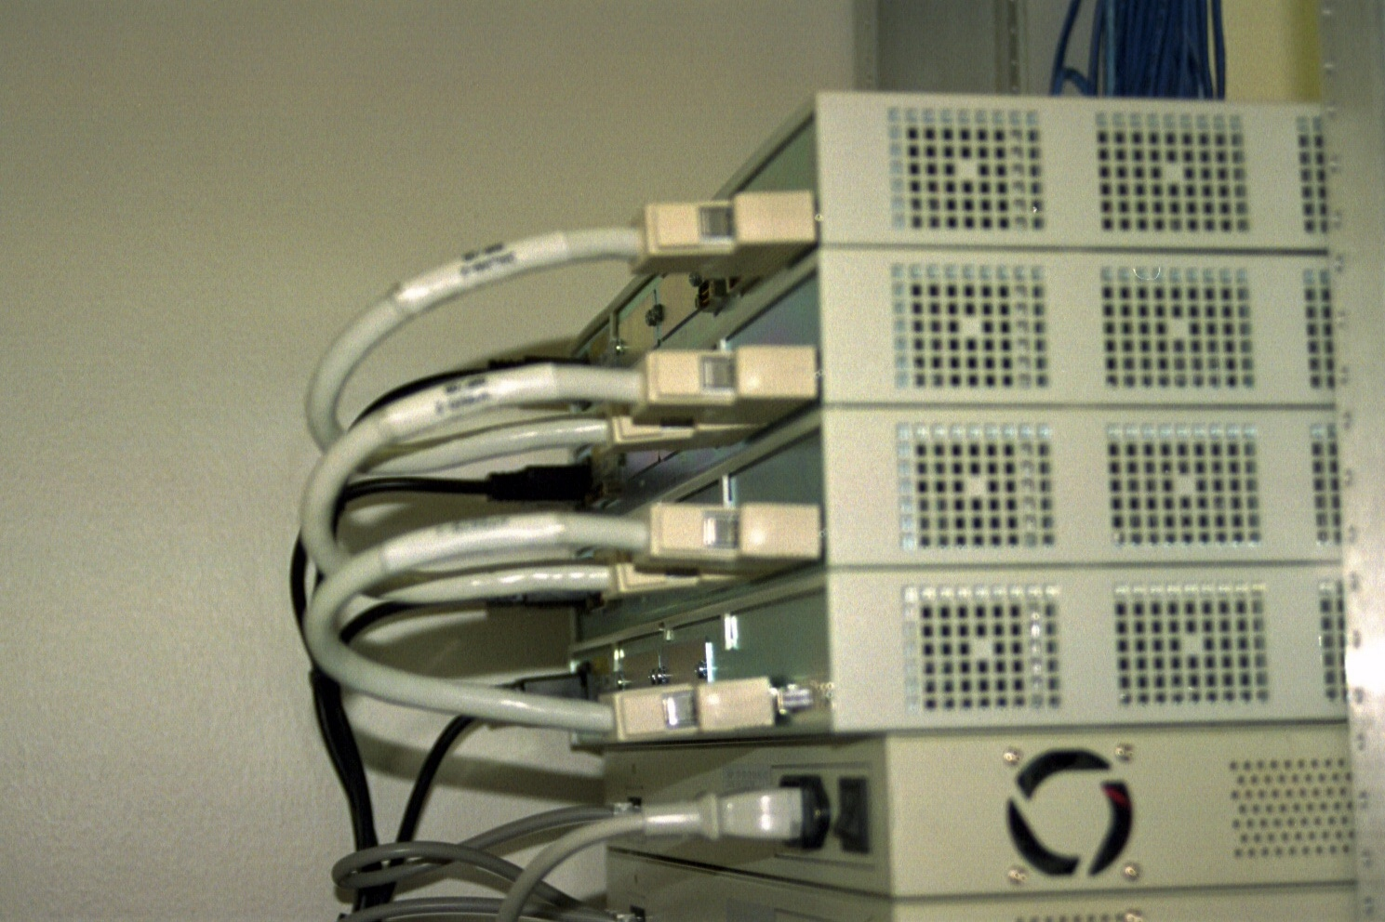
Stacking
Stacking Cables

Slide 19
Stacking

Slide 20
Stacking
In this case starting from the bottom unit attach the UP port on the bottom unit to the DOWN port on the unit just above
Continue on like this for each unit
Up to eight units can be stacked

Slide 21
Speeds
Hubs operate at
10 Mbps
100 Mbps
All ports in a hub must operate at the same speed

Slide 22
What is a Bridge
In the old days, before switches, bridges were used to segment LANs
A bridge was used to isolate traffic and thereby collisions by placing a server and most of the workstations needing access to that server all on the same side of the bridge

Slide 23
Bridges
Bridges were also used to connect different network access methods to each other, such as Ethernet to Token Ring

Slide 24
How a Bridge Operates
Devices on this side of the bridge | List of devices by MAC address | Bridge | List of devices by MAC address | Devices on this side of the bridge

Slide 25
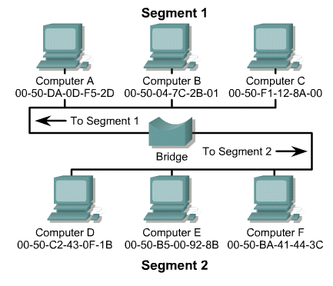
How a Bridge Operates

Slide 26
How a Bridge Operates
An Ethernet bridge connects two or more segments and operates by inspecting all frames on the network for their address
The bridge can receive all frames since it operates in promiscuous mode
This device operates at the MAC sublayer of the Data Link layer

Slide 27
How a Bridge Operates
As each frame is examined by the bridge, the source address is recorded and entered into a table of addresses
This process of observing and recording addresses is referred to as learning
This type of bridging is known as transparent bridging, since the devices that are communicating over the network are not aware of the bridge's existence

Slide 28
How a Bridge Operates
All frames are addressed to the destination address, not the bridge
When the bridge receives a frame, it will look up the destination address in its table
If a match is found, the frame will be discarded since the destination was on the same segment as the source, there is no need to forward the frame to another network

Slide 29
How a Bridge Operates
In essence, the frame has been filtered
If the destination address is not found in the table, the frame will be forwarded to all segments to which the bridge is attached
The process of forwarding to all active ports is referred to as flooding

Slide 30
How a Bridge Operates
When the destination station sends a response to the frame that was just flooded the bridge will then learn the address and the device's location
It will not have to flood the same address twice, since the location will be added to the address table

Slide 31
How a Bridge Operates
Typically, forwarding an unknown frame is a rare occurrence, and the learning process is very brief
Otherwise, the act of flooding frames out of all ports would have a negative effect on surrounding networks
An exception is broadcast frames, which must be sent to all devices
Therefore, broadcast frames will always be flooded onto all active ports

Slide 32
Uses of Bridges
Today, except for wireless and campus area networks, bridges are not used anymore
The bridge of today is called a switch, which is discussed next

Slide 33
Switches

Slide 34
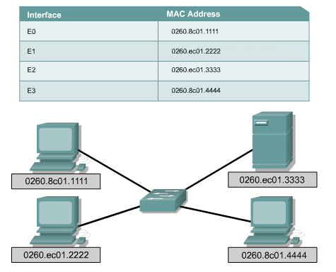
Switches

Slide 35
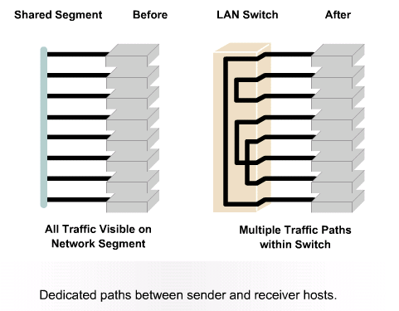
Switches

Slide 36
What is a Switch
A basic switch is a layer two device
It is the point of connection for all devices that will access the network
Once plugged into electrical power and turned on a switch is the network
It is not yet useful, but it is a network
That sounds exactly like my description of a hub doesn't it

Slide 37
Operation
Ports in the switch are used to connect devices
There are usually from four to 96 ports on a switch
The standard ports use RJ-45 connectors
A switch may have a connector for a backbone cable as well
This can be for copper or fiber cable

Slide 38
Uplinking
It is possible to uplink switches over a considerable distance using standard UTP cables
This is sometimes preferable to creating a multilayer backbone

Slide 39
Stacking
If the network runs out of ports more can be added by stacking another switch on top of the existing one
Switches use proprietary cables for this
There will be a limit on the number of switches that can be stacked

Slide 40
Operation
Switches typically operate at 10, 100, 1000, or 10000 Mbps
Each port can be set to its own speed independent of the other ports
Hopefully, the switch will autosense the speed of the NIC connecting to it

Slide 41
Operation
It is better to just configure every NIC and switch port for the desired speed, as autosensing has been known to get confused

Slide 42
Front of Switch

Slide 43
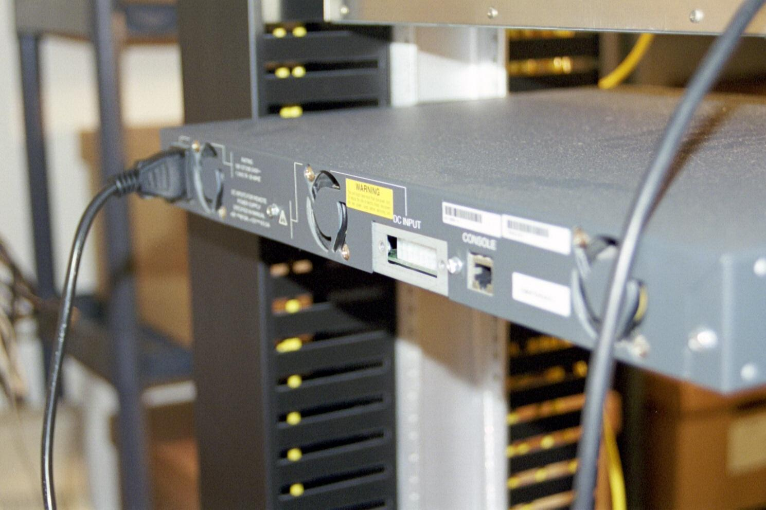
Back of Switch

Slide 44
Larger Switch
The switch just shown uses a fixed configuration
There is no way to increase the number of ports without buying another switch
Another larger style of switch uses blades that are inserted into a chassis
Up to the capacity of the chassis, ports can be added by just inserting more blades

Slide 45
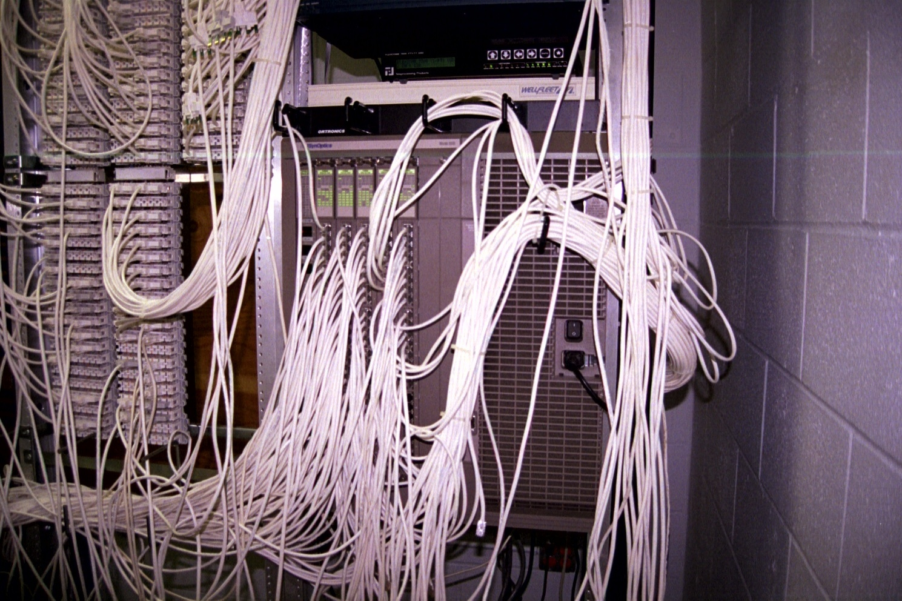
Larger Switch

Slide 46
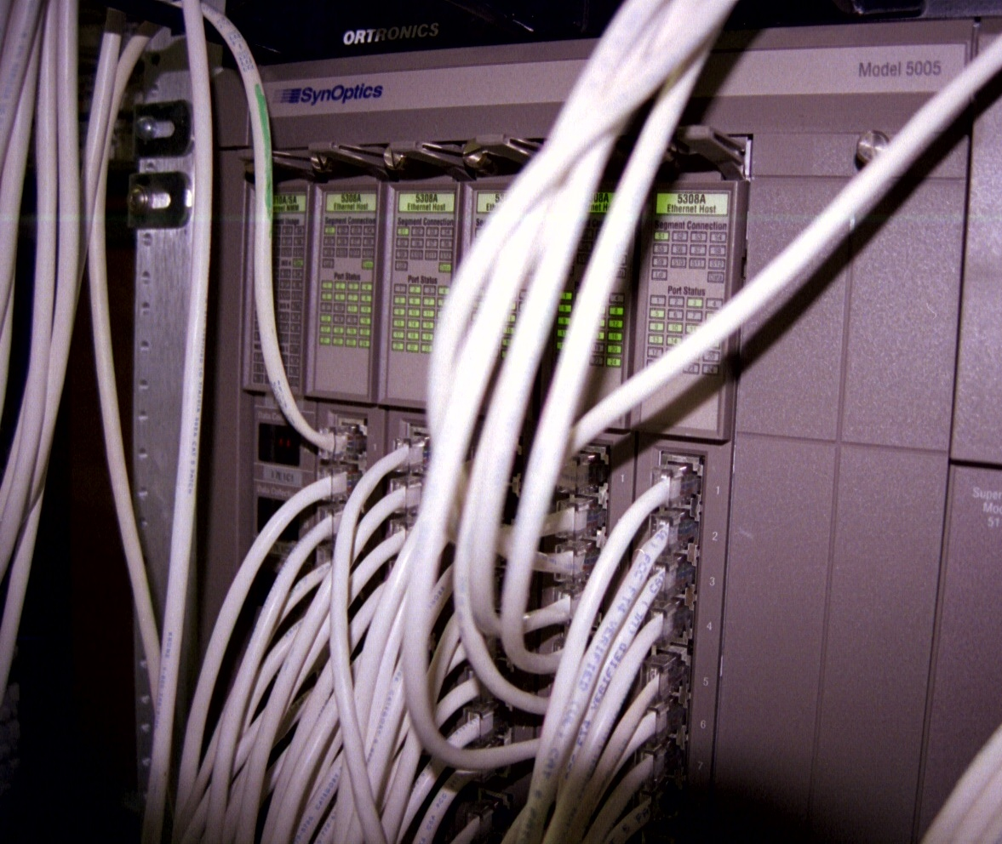
Larger Switch

