Slide 1
InterVLAN Routing
Last Update 2009.03.08
1.1.0

Slide 2
Objectives
Learn about routing between VLANs

Slide 3
Routing Between VLANs
All of these VLANs we have been talking about usually need to talk to each other
Since they are separate broadcast domains using separate subnets this requires they talk through a layer 3 device
Cisco explains how to do this in this chapter in a strange way

Slide 4
Routing Between VLANs
They state that there are three theoretical ways to route between VLANs, then they proceed to say that the best way, a layer 3 switch, will not be discussed as it is beyond the scope of the book
Then what was the point in bringing up the topic if they did not intend to explain it totally

Slide 5
Layer 3 Switch Routing
Even more the configuration of a layer 3 switch as a router for interVLAN routing is fairly simple
So we will cover it anyway
Of the other two methods they mention the first one where a separate port on the layer 3 device is used for each VLAN is a dim bulb idea so we will not cover it at all
The third method is a router on a stick

Slide 6
Layer 3 Switch Routing
We will cover this method
So of the three Cisco mentions we will talk about
Router on a Stick
Layer 3 Switch Routing

Slide 7
Router on a Stick
In a router on a stick configuration a router without any WAN interfaces is used
It has a single LAN interface that carries all of the traffic for the various VLANs using subinterfaces
This single port is configured as a trunk link between the switch and the router
A subinterface is a virtual interface created on the single physical interface

Slide 8
Router on a Stick
Each VLAN gets its own subinterface

Slide 9
Router on a Stick Configuration
configure terminal
interface f0/0.10
encapsulation dot1q 10
ip address 192.168.10.1 255.255.255.0
interface f0/0.30
encapsulation dot1q 30
ip address 192.168.30.1 255.255.255.0
interface f0/0
no shutdown

Slide 10
Lab
Let’s do a little Router on a Stick
Start Packet Tracer
Open file e3-6225.pka

Slide 11
Layer 3 Switch Routing
To route VLANs on a layer 3 switch a SVI – Switch Virtual Interface is created
Here is a configuration from a paper on the Cisco web site
In this example a Cisco 3550 switch will be used
This is the sample network they used

Slide 12
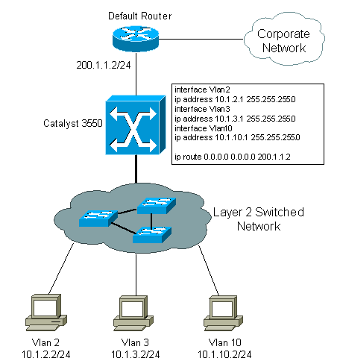
Sample Network Layout

Slide 13
Configuration
Enabling routing
Switch(config)#ip routing
Create the VLANs
Switch#vlan database
Switch(vlan)#vlan 2
Switch(vlan)#vlan 3
Switch(vlan)#vlan 10
Switch(vlan)#exit

Slide 14
Configuration
Assign an IP address to each VLAN
Switch(config)#interface vlan2
Switch(config-if)#ip address 192.168.2.1 255.255.255.0
Switch(config)#no shutdown

Slide 15
Configuration
Assign an IP address to each VLAN
Switch(config)#interface vlan3
Switch(config-if)#ip address 192.168.3.1 255.255.255.0
Switch(config)#no shutdown

Slide 16
Configuration
Assign an IP address to each VLAN
Switch(config)#interface vlan10
Switch(config-if)#ip address 192.168.10.1 255.255.255.0
Switch(config)#no shutdown

Slide 17
Configuration
Configure the interface to the default router
Switch(config)#interface FastEthernet 0/1
Switch(config-if)#no switchport
To make the interface layer 3 capable
Switch(config)#ip address 192.168.1.1 255.255.255.0
Switch(config)#no shutdown

Slide 18
Configuration
Setup the default route
Switch(config)#ip route 0.0.0.0 0.0.0.0 192.168.100.1

Slide 19
Layer 3 Switch Routing
That is all there is to it

Slide 20
Lab
Let’s configure a Layer 3 Switch to do InterVLAN Routing
Start Packet Tracer
Open the file Configuring InterVLAN Routing.pka

Slide 21
Lab
Let’s configure interVLAN routing
Lab 6-1

