Slide 1
STP
Last Update 2014.02.02
1.8.0

Slide 2
Objectives
Learn about STP

Slide 3
Redundancy
For an Ethernet network at layer 2 to function as it is designed there should be only one path between any two devices attached to the network
However, the main method used to maintain the uptime of a network is to introduce redundancy in the network
In the case of individual devices this takes the form of redundant components, such as dual power supplies

Slide 4
Redundancy
For the network connections this is done using dual or redundant connections to a single device
These multiple paths create both a physical and a logical loop in the network
A physical loop is fine
A logical loop produces instability
For example

Slide 5
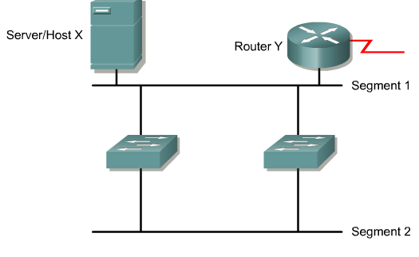
Redundant Switched Topology

Slide 6
Problems With Redundancy
Redundant connections without safeguards in place can case problems in the network such as a broadcast storm

Slide 7
Broadcast Storm
A broadcast storm occurs in a network with redundant connections when broadcasts and multicasts, which are treated as broadcasts by a switch, are flooded out each port, except the one on which it was received
For example

Slide 8
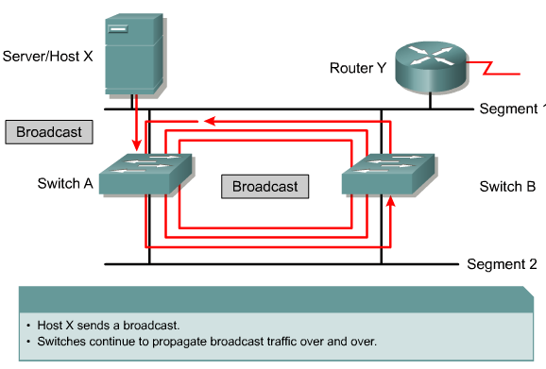
Broadcast Storm

Slide 9
Broadcast Storm Result
As each switch forwards the broadcast traffic received from the other switch the devices on the network spend all of their time processing these endless broadcasts
As a result the network slows down so much as to appear to be down

Slide 10
Multiple Frame Transmissions
Another problem in a redundant switched network is that an end device can receive multiple copies of the same frame
This occurs when the receiving switches that are redundantly connected do not have an entry in their MAC address databases
When this occurs they flood the traffic to all ports

Slide 11
Multiple Frame Transmissions
The device to which the original frame was sent can then receive two copies of this single frame

Slide 12
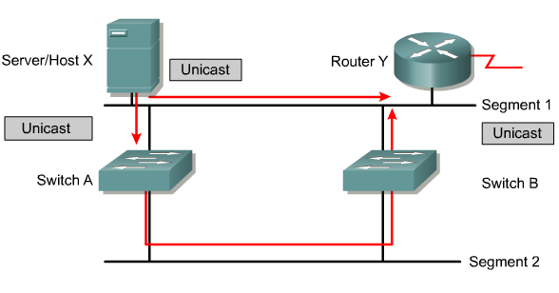
Multiple Frame Transmissions

Slide 13
Spanning-Tree Protocol
The solution to these problems while maintaining the redundancy in the network is to use the spanning-tree protocol
All switches do so these days by default
802.1D is the IEEE specification for STP
STP creates a loop free path through the network by blocking unneeded ports from being used unless they are needed

Slide 14
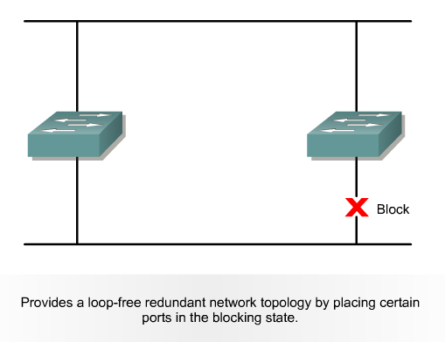
Spanning-Tree Protocol

Slide 15
Spanning-Tree Protocol
In essence the process is
Elect a root bridge
Calculate the best path to the root bridge
Block any ports that create a logical loop
This protocol was developed by Radia Perlman in 1985 while she was with DEC – Digital Equipment Corporation
She wrote a poem explaining the concept

Slide 16
Algorhyme
I think that I shall never see a graph more lovely than a tree
A tree whose crucial property is loop-free connectivity
A tree that must be sure to span so packet can reach every LAN
First, the root must be selected
By ID, it is elected
Least-cost paths from root are traced
In the tree, these paths are placed
A mesh is made by folks like me, then bridges find a spanning tree

Slide 17
Spanning-Tree Protocol
Aren’t nerds just too funny
And what does a nerd look like

Slide 18
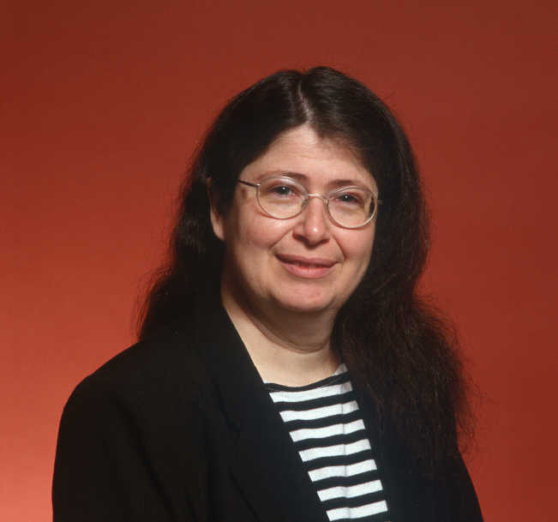
Spanning-Tree Protocol

Slide 19
STP Nomenclature
Here are the bits and pieces that makeup STP
Root Bridge
Path Cost
Types of Ports
BPDU

Slide 20
Root Bridge
The root bridge is a single switch used as the reference point for the STP algorithm's calculations
The root bridge is selected based on the bridge ID of each switch as they are compared to each other
The lowest bridge ID number wins the election

Slide 21
Root Bridge
The bridge ID is made up of the MAC address of the switch and the bridge priority number of the switch
The bridge priority number is always the same value of 32768
The MAC address is arbitrary

Slide 22
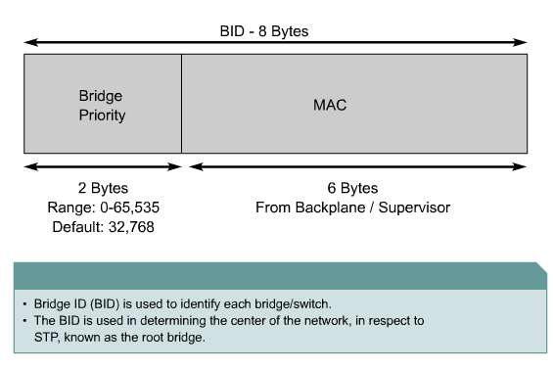
Bridge IDs

Slide 23
Selecting the Root Bridge
In a network of any size the root bridge’s election should be fixed
In other words, you select which switch is to be the root bridge based the network design

Slide 24
Selecting the Root Bridge
There are two ways to fix the election
One is to specify the root switch as the primary switch using
spanning-tree vlan 1 root primary
The second way is to alter the bridge priority value using
spanning-tree vlan 1 priority 24576
The 24576 number is arbitrary it can be any number from 1 to 65535

Slide 25
Selecting the Root Bridge
For example

Slide 26
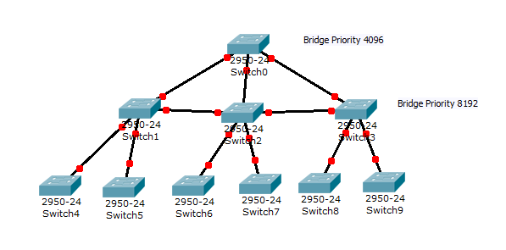
Selecting the Root Bridge

Slide 27
Selecting the Root Bridge
Here is a perfect example of why you might want to force one specific switch to always be the root switch
This is a posting to a Cisco related mailing list from June 2013

Slide 28
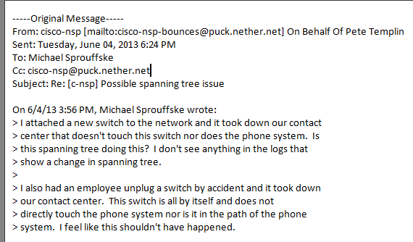
Selecting the Root Bridge

Slide 29
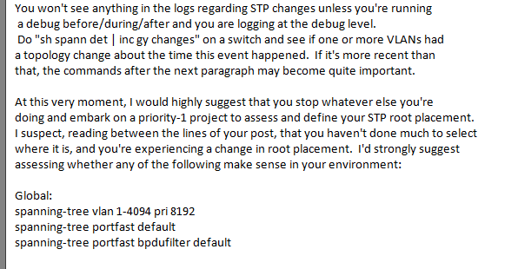
Selecting the Root Bridge

Slide 30
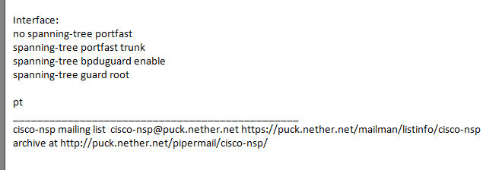
Selecting the Root Bridge

Slide 31
Path Cost
To select the best path to the root bridge, recall that there will be two, the path cost is used
The path cost is based on the port speed with the faster ports used

Slide 32
Types of Ports
Each switch port in the redundant interconnection is designated as one of four types of port automatically during the STP startup or at recalculation
Root
Designated
Nondesignated
Disabled

Slide 33
Types of Ports
On nonroot switches
The root port is the port with the best path to the root switch
This port forwards traffic toward the root switch
One root port per switch
One per switch for every switch that is not the root switch

Slide 34
Types of Ports
If the path cost is equal then the lowest port number is used
This can be altered by adjusting the port priority, which is 128 by default

Slide 35
Types of Ports
On root and nonroot switches
On the root switch
All ports are designated ports
On nonroot switches
A designated port is a nonroot port allowed to send traffic as needed
Only one per segment
On nonroot switches
A nondesignated port is in blocking state to prevent the logical loop

Slide 36
Types of Ports
A disabled port is one that is shutdown
It is excluded from the STP process

Slide 37
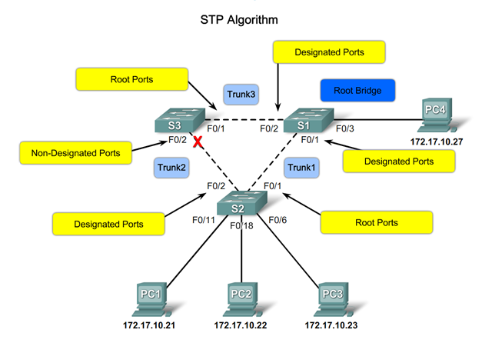
Types of Ports

Slide 38
BPDU
The BPDU or Bridge Protocol Data Unit is the frame sent out by each switch running STP so the information needed for STP to operate can be exchanged
These go out every 2 seconds

Slide 39
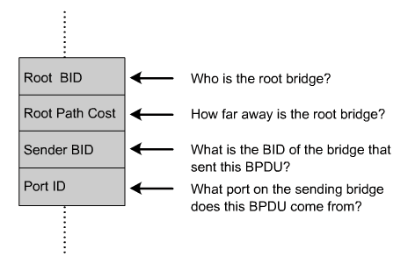
Bridge Protocol Data Unit

Slide 40
Lab
Let’s look at some BPDUs
Start Wireshark
Capture and examine some BPDUs

Slide 41
STP Operation
The switches run the STP algorithm, which involves first electing a root switch
Each switch determines how many connections it has to the root switch
The other switches measure their distance from the root switch
If there is more than one way to get to the root switch then there is a loop

Slide 42
STP Operation
The switches follow the algorithm to determine which ports should be blocked in order to break the loop
The least cost port is set as the root port
Then the other ports are set as designated or nondesignated

Slide 43
Lab
Let’s look at STP in operation
Start Packet Tracer
Open file e3-5133.pka

Slide 44
A Problem with STP
Running STP causes all ports that are included in the spanning tree process to become active much slower than they otherwise would, as it detects and blocks loops
The specific problem that will be seen is that when a device is turned on the switch will detect this due to the link pulse

Slide 45
A Problem with STP
The switch port will then go through blocking, listening, and learning phases before it is set to the normal forwarding mode
Spanning Tree Protocol transitions from the blocking phase to the forwarding phase in about 30 to 50 seconds as
A port remains in the blocking phase for 10 to 20 seconds

Slide 46
A Problem with STP
It then moves to the listening phase for 20 to 15 seconds
Then the port transitions to the learning phase, which is 10 to 15 seconds in length
Finally once STP determines that the port has not experienced a looping problem it is moved to forwarding mode

Slide 47
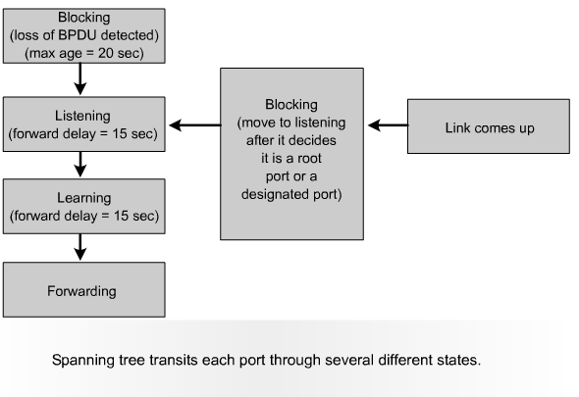
Spanning Tree Port States

Slide 48
A Problem with STP
The problem is it has become common for many newer PCs and operating systems to send requests for services well in advance of 50 seconds of system boot
This creates the problem of not being able to obtain a DHCP lease, find a domain controller, or login to a server for example; since the port will not forward the request until this process is done

Slide 49
A Solution to the Problem
The solution is to enable portfast on all ports that have end systems, instead of hubs, switches, or routers attached to them
But be sure that ports that have other switches attached can detect STP problems
Or use RSTP as explained below

Slide 50
STP Convergence
Let’s now see how STP convergences on the loop free configuration
The process is
Elect a root bridge
Elect root ports
Set remaining ports as designated or nondesignated

Slide 51
Elect a Root Bridge
After booting each switch starts sending BPDU frames advertising their bridge ID
All switches assume they will be the root bridge
As the switches receive the BPDUs from other switches they compare the bridge ID values
If the received bridge ID is lower, then that switch is assumed to be the root switch

Slide 52
Elect Root Ports
Each switch now decides which ports to set as root ports
Every port on the root switch is a root port

Slide 53
Set Remaining Ports
All the remaining ports on the nonroot switches must be set to designated or nondesignated
For each connection between any two switches one port on one switch is set as designated the other port on the other switch is set as nondesignated
The designated port is the one nearest in path cost to the root bridge

Slide 54
Set Remaining Ports
If both ports are equal cost then the bridge ID is used
The nondesignated ports are the blocked ports

Slide 55
STP Topology Change
When a port changes state STP begins again

Slide 56
Lab
Let’s work with STP design
Start Packet Tracer
Open file e3-5254.pka

Slide 57
Newer Versions of STP
There are four newer versions of STP
Cisco Proprietary
PVST
PVST+
IEEE Standards
RSTP
MSTP
The only one we need to talk about is RSTP

Slide 58
RSTP
RSTP – Rapid Spanning Tree Protocol does just what it says, it runs faster
This is the 802.1w standard
What is different

Slide 59
RSTP Ports
There are only three port states in RSTP
The disabled, blocking, and listening states are merged into a single discarding state

Slide 60
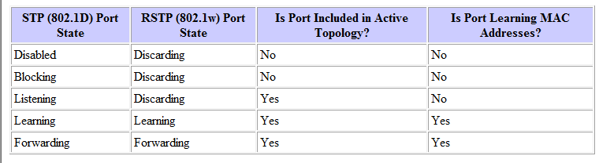
RSTP Ports

Slide 61
RSTP Port Roles
The port role is a variable assigned to a port
These roles are
Root port
Designated port
Backup port
Alternate port

Slide 62
Rapid Transition
The original STP waited for the network to converge before it turned a port into the forwarding state
RSTP can be certain that a port can safely transition to the forwarding state without having to rely on any timer configuration
This is done through two functions
Edge Ports
Link Type

Slide 63
Edge Port
A edge port is basically the portfast setting
The switch assumes these are edge ports which can be set immediately to send and receive traffic unless a BPDU is received
If one is, then the port goes to a STP role

Slide 64
Link Type
The link type is automatically set based on the duplex mode of a port
A port that operates in full-duplex is assumed to be point-to-point
While a half-duplex port is considered as a shared port by default
Links that operate in full-duplex mode and are treated as point-to-point links by RSTP

Slide 65
Link Type
This allows them to transition immediately to the forwarding state

Slide 66
Common STP Mistakes
In a January 2013 article in Network World Scott Hogg covered some common STP related problem you should be aware of
Let’s see in a summarized form what he had to say

Slide 67
No Root Bridge Configured
Many organizations take spanning tree for granted and simply accept the default configuration settings
This leaves all switches in the environment using the default root bridge priority of 32768
If all switches have the same root bridge priority, the switch with the lowest MAC address will be elected as the root bridge

Slide 68
No Root Bridge Configured
It is possible that a small access-layer switch with a low MAC address could be the STP root
This situation would add some performance overhead and make for longer convergence times because of the root bridge reelection

Slide 69
No Root Bridge Configured
It is a best practice to configure the main core switches with lower STP priorities so that one will be the root bridge and any other core bridges will have a slightly higher value and take over should the primary core bridge fail

Slide 70
No Root Bridge Configured
Having tiered STP priorities configured on the switches determines which switch should be root bridge in the event of a bridge failure
This makes the STP network behave in a more deterministic manner

Slide 71
No Root Bridge Configured
On the first core Cisco switch configure the primary root switch with this command
Core-Sw1(config)# spanning-tree vlan 1-4096 root primary
On the second core Cisco switch configure the secondary root switch with this command
Core-Sw2(config)# spanning-tree vlan 1-4096 root secondary

Slide 72
No Root Bridge Configured
The net effect from these two commands will set the primary switch root bridge priority to 8192, and the secondary switch root bridge priority to 16384

Slide 73
Use of STP Instead of RSTP
Many switches are capable of Rapid Spanning Tree Protocol - IEEE 802.1w, but few network administrators have enabled it
RSTP vastly improves convergence times by using port roles, using a method of sending messages between bridges on designated ports, calculating alternate paths, and using faster timers

Slide 74
Blocked Uplinks
If one port was blocked as is common with STP, it cannot be used to carry traffic as in traffic aggregation
There are several ways to do this such as
Port-channel/EtherChannel (LACP(IEEE 802.3ad), PAgP) or some form of multi-chassis port-channel (MC-LAG IEEE802.3AX/AY) or use Cisco Nexus switches with a virtual Port Channel (vPC)

Slide 75
Exceeding STP Dimensions
Large networking environments supporting applications that rely on layer-2 connectivity across the entire network should be aware of this growth
These organizations can experience problems if their topology exceeds STP's maximum dimensions

Slide 76
Exceeding STP Dimensions
The 802.1D specifications recommends that a spanning tree have no more than seven bridge hops
This can easily occur when there are many daisy-chained switches

Slide 77
VTP Domains
VTP can often create problems in large networks that span WAN links
Many organizations will just set all switches to transparent mode

Slide 78
STP and HSRP
Many organizations have redundant core switches that are also the layer 3 default gateway for computers on the connected LANs
First Hop Redundancy Protocols like HSRP, VRRP,GLBP, among others, provide default gateway redundancy for hosts that are configured with only a single default gateway IP address

Slide 79
STP and HSRP
The issue arises when the HSRP active default gateway is not the same Layer2/3 switch that is root of the STP for that VLAN
This creates non-optimal traffic paths which can lead to higher congestion on the inter-core-switch trunk

Slide 80
STP and HSRP
Organizations that use a First Hop Redundancy Protocol should make sure that there is alignment between the active default gateway and the STP root

Slide 81
Use of Portfast
Cisco’s Portfast setting brings up a link immediately without going through the STP steps
By setting a port to Portfast you are promising the switch that you will never plug a switch into that port
Mistakes happen, so Portfast should be combined with BPDU-Guard so that when this does occur the port is shutdown

Slide 82
Use of Portfast
The Cisco IOS global command to active this feature is
Core-Sw1(config)# spanning-tree portfast edge bpduguard
The Cisco IOS interface configuration command to active this is
Core-Sw1(config-if)# spanning-tree bpduguard enable

Slide 83
Use of Portfast
If a switch has any port-channels configured, then it is a good idea to configure EtherChannel guard
The Cisco IOS global command to active this feature is
Core-Sw1(config)# spanning-tree etherchannel guard misconfig

Slide 84
Use of Portfast
Organizations should also use Root Guard on all access-switch ports connecting to servers
The Cisco IOS interface configuration command to active this is
Core-Sw1(config-if)# spanning-tree guard root

Slide 85
Inconsistent STP Metrics
Traditionally, spanning tree has used a 16-bit value for the link cost used by bridges for calculating the shortest path to the root
With these older 16-bit metrics, a 10Mbps link would have a cost of 100 and a 1Gbps link would have a cost of 4
However, link speeds have outgrown these metrics and there are now a 32-bit long path cost

Slide 86
Inconsistent STP Metrics
With the newer 32-bit metrics, a 1Gbps link would have a cost of 20,000 a 10Gbps link would have a cost of 2,000 and a 100Gbps link would have a cost of 200
To enable the long path cost on a Cisco switch, simply enter this global configuration command
Core-Sw1(config)# spanning-tree pathcost method long

Slide 87
Inconsistent STP Metrics
Problems occur when networks have a mix of switches that use the 16-bit and 32-bit path cost values
Therefore, it is important to be consistent in your configuration and strive to have all your network devices use the newer 32-bit long path cost metrics

Slide 88
STP Disabled
Occasionally we encounter a network where the spanning tree protocol has been purposely disabled
Maybe a network administrator felt that STP was not required because the network did not have any cabling loops
Maybe the network administrator felt that disabling STP would lead to faster layer 3 convergence time

Slide 89
STP Disabled
Running STP on modern switches does not add any noticeable overhead
Just a few configuration BPDUs per second does not significantly contribute to bandwidth usage

Slide 90
Troubleshooting a STP Loop
Finding the source of an improperly working spanning tree is very difficult
The first thing to do is to ensure STP is running on each switch
To do this run the show spanning-tree command

Slide 91
Troubleshooting a STP Loop
Next find the ports seeing the looping traffic
Use the show interface command for this
Look at the packets per second count for each port
Write this down

Slide 92
Troubleshooting a STP Loop
Next try to break the loop by disconnecting or shutting down ports involved one at a time
Look to see if the switch backplane utilization drops after this
If the change is small, then this is not the source, keep looking

Slide 93
Troubleshooting a STP Loop
Once the loop is broken look for the reason for the loop by
Does each switch know the correct STP root
Is the root port correctly identified
Are BPDUs being received on the root port and the blocking ports
Are BPDUs being sent on nonroot designated ports

Slide 94
TRILL
A proposed replacement for STP is TRILL
This is Transparent Interconnect of Lots of Links
It is defined in RFC 5556 from May 2009
The basic idea of TRILL is to replace STP by applying network layer routing protocol concepts to the data link layer

Slide 95
TRILL
It is implemented by using devices called RBridges or Routing Bridges
This creates a combination of bridging and routing
The RBridges run a link state protocol amongst themselves

Slide 96
TRILL
By doing so they are able to establish not just one but multiple paths through the Layer 2 network instead of the single path STP provides
Since it runs directly over Layer 2 it can be run without configuration
This proposed solution will only apply to very large networks, such as data centers

Slide 97
VXLAN
VXLAN - Virtual Extensible LAN is a virtualization method that seeks to deal with the server virtualization scalability problems seen in very large data centers
It adds a VLAN like header to the Ethernet frame
This frame is then carried across the network at layer 3 using UDP
This creates an overlay network

Slide 98
VXLAN
VXLAN was developed by VMware, Arista Networks and Cisco
To carry the traffic a tunnel is created between two end points called VTEPs - Virtual Tunnel Endpoints
Cisco explains these tunnels this way

Slide 99
VXLAN
VXLAN uses VXLAN tunnel endpoint (VTEP) devices to map tenants’ end devices to VXLAN segments and to perform VXLAN encapsulation and de-encapsulation
Each VTEP function has two interfaces: One is a switch interface on the local LAN segment to support local endpoint communication through bridging, and the other is an IP interface to the transport IP network

Slide 100
VXLAN
The IP interface has a unique IP address that identifies the VTEP device on the transport IP network known as the infrastructure VLAN
The existing layer 3 network is independent of the VXLAN

Slide 101
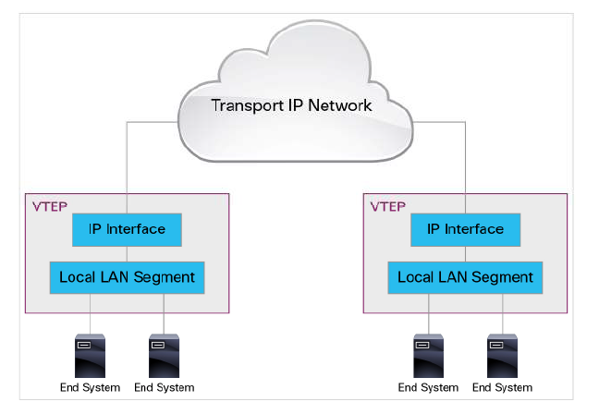
VXLAN

Slide 102
VXLAN
This is similar to the VLAN process as the VXLAN header is added at the originating end point and stripped back off at the destination end point
As shown in an article from September 2013 by Terry Huber the frame looks like this

Slide 103
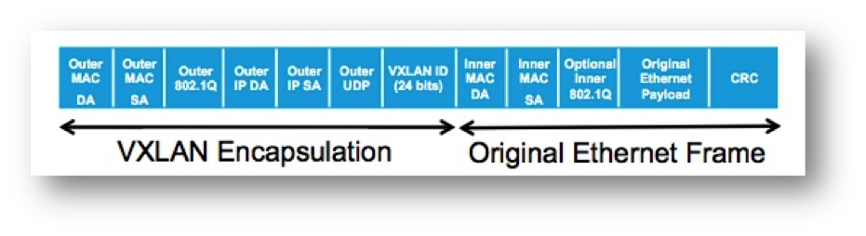
VXLAN

Slide 104
VXLAN
And a view of the entire frame as provided by Cisco

Slide 105
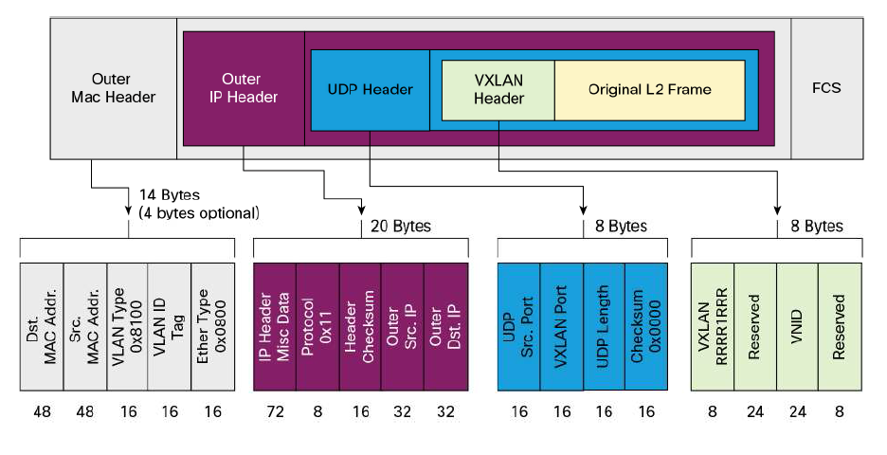
VXLAN

Slide 106
VXLAN
The end result of all of this is to create a logical network that can span across physical networks
This avoids the need to route at layer 3 to connect different physical networks
It also avoids the problem of trying to scale up STP

Slide 107
VXLAN
It makes the data center look like a single layer 2 network that spans the entire physical area
This is done by abstracting the network hardware just as server virtualization abstracts the server’s hardware

Slide 108
VXLAN
Without this method the tendency in very large data centers is to group virtual machines based on their physical location rather than where there is unused capacity

Slide 109
Troubleshooting STP
The main troubleshooting commands are
show spanning-tree summary
show spanning-tree detail
show spanning-tree root

Slide 110
Lab
Let’s work a little more with STP
Lab 5-1

