Slide 1
VLANs
Last Update 2015.05.12
1.9.0

Slide 2
Objective
Learn what a VLAN is and how to configure one

Slide 3
What is a VLAN
Another way to separate a LAN that gets too large, besides a physical basis, is to divide it logically using a VLAN
A VLAN is a collection of nodes grouped together in a broadcast domain without necessarily being physically near each other

Slide 4
What is a VLAN
A VLAN is a single or stack of switches that instead of connecting to a single network can be divided port by port into distinct networks merely by configuring the switch
The standard for VLANs is 802.1Q

Slide 5
When to Use a VLAN
The main reasons to divide a network are
Maintain security
Traffic management
Control broadcast traffic

Slide 6
Security
Security is another concern these days as we find more and more security holes on the inside of the network
When a group of users belongs to the same broadcast domain, all of the network traffic generated within that broadcast domain is accessible by each user

Slide 7
Security
Thus, if a user is running a network analyzer, they can see every frame that crosses the network
Security issues arise when programs send data that needs to be protected, such as payroll data

Slide 8
Security
For example, if all human resource computers are assigned to a VLAN, access to that virtual network could be limited to only those computers that are part of the HR department
This is done by restricting which MAC addresses are allowed access to any VLAN

Slide 9
Security
Keeping track of which MAC address is assigned to a particular VLAN and switch port can be a difficult task of course

Slide 10
Traffic Management
One can also look at a VLAN in terms of the use, such as
Data
Voice
Video
Management
This use might be for ease of network management or for QoS reasons

Slide 11
Control of Broadcast Traffic
Layer 3 devices block broadcasts from traveling between network segments
However, in a flat, switched – using layer 2 switches - network, broadcasts travel throughout the entire network and are seen by every PC connected to the wire
In a large LAN, broadcasts can overwhelm the network and eventually lead to network failure

Slide 12
Control of Broadcast Traffic
By dividing switch ports into VLANs, separate broadcast domains are created without using layer 3 devices
For example, a single switch, that supports this function, with say 24 ports
Ports 1 through 12 would be on one VLAN and users on ports 13 through 24 would be on another VLAN

Slide 13
Control of Broadcast Traffic
Using this scenario, if all groups were generating the same amount of broadcast traffic, you would cut the broadcasts seen by each switch port in half, without having to buy any additional switches

Slide 14
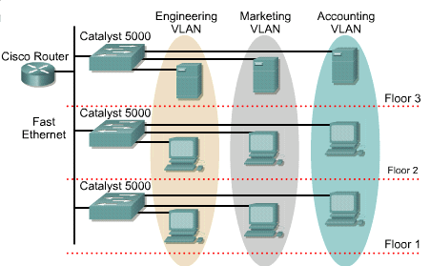
VLANs

Slide 15
VLAN ID Ranges
Basic VLAN IDs are 1 to 1005
VLAN 1 is the default VLAN which always exists
IDs 1002 through 1005 are reserved for Token Ring and FDDI VLANs, which of course no longer exist
IDs 1 and 1002 to 1005 are automatically created and cannot be removed

Slide 16
VLAN ID Ranges
There are also extended range VLANs
These are identified by a VLAN ID between 1006 and 4094
These support fewer VLAN features than normal range VLANs
VTP as explained later cannot deal with extended range VLANs

Slide 17
VLAN Database File
Configurations are stored in a database file named vlan.dat
This file is stored in the flash memory of the switch
Erasing the startup config will not delete the vlans

Slide 18
VLAN Database File
If you are brave, this is done by issuing the command
delete flash:vlan.dat
It is better is to just go to global configuration mode, display the vlan database, and then remove each one by preceding the command that created each one with no in front

Slide 19
VLAN Database File
For example
enable
show vlan brief
config t
no vlan 2
no vlan 3
end

Slide 20
Types of VLANs
The only type of VLAN used today is a static port based VLAN where each port is assigned to a VLAN
By default all ports are assigned to VLAN 1, which is also the default native or management VLAN
VLAN 1 cannot be used for any other purpose

Slide 21
Management VLAN
By default the management VLAN is VLAN 1
This can be changed
Cisco says to do this for security reasons
However, Cisco recommends changing to 99
Of course, everyone knows this, so what is the point, leave it at 1

Slide 22
Native VLAN
The native VLAN is how a switch identifies frames that should be forwarded as normal frames
In other words, these are not VLAN frames
They are not modified when they are sent over the trunk links

Slide 23
Management VLAN
If you change the management VLAN on one switch, but not on another switch, a common error will display on the CLI
This is Native VLAN Mismatch
This means the native or management VLAN on one or more switches differs from the other switches

Slide 24
VLAN Trunk
A VLAN trunk is a point-to-point link between a switch port on one switch and a port on another device, such as a switch or router
The trunk carries the traffic of multiple VLANs over this single link
This allows VLANs to be extended across an entire network

Slide 25
VLAN Trunk
802.1Q defines trunk formation on Fast Ethernet and Gigabit Ethernet ports

Slide 26
Tagging Frames
As the standard Ethernet II frame format does not include a facility to indicate which if any VLAN a frame belongs to this marking is done using tags
The 802.1Q form of the tag is inserted into the frame as opposed to being placed at the beginning of the frame as the older Cisco ISL method used
Here is the 802.1Q tag format as shown in a graphic from Fluke Networks

Slide 27
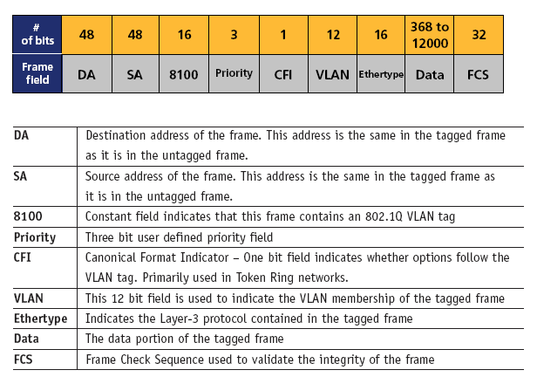
Tagging Frames

Slide 28
Tagging Frames
The 802.1Q method inserts 4 bytes of information between the Source MAC Address and Type Fields
These fields are
Type Code
Priority
CFI
VLAN ID

Slide 29
Tagging Frames
Let’s look at an example
Here one computer with an IP address of 10.0.0.1 is pinging another computer at IP address 10.0.0.2
In this display from Wireshark the VLAN tags look like a layer between the Data Link and Network layers

Slide 30
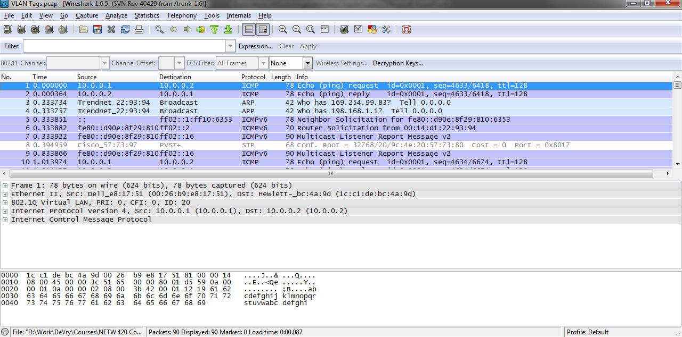
Tagging Frames

Slide 31
Tagging Frames
They are not
Wikipedia provides us with a nice graphic that shows where these extra fields go in the Ethernet II frame

Slide 32
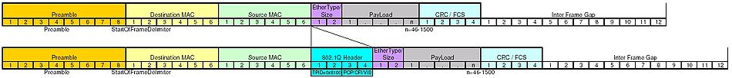
Tagging Frames

Slide 33
Tagging Frames
Notice below in this display of an actual capture using Wireshark that the Type code has a hex number code of 8100 to indicate that the next protocol to be encountered is the VLAN protocol
Wireshark very nicely explains to use that this is telling us that 802.1Q Virtual LAN information will appear next

Slide 34
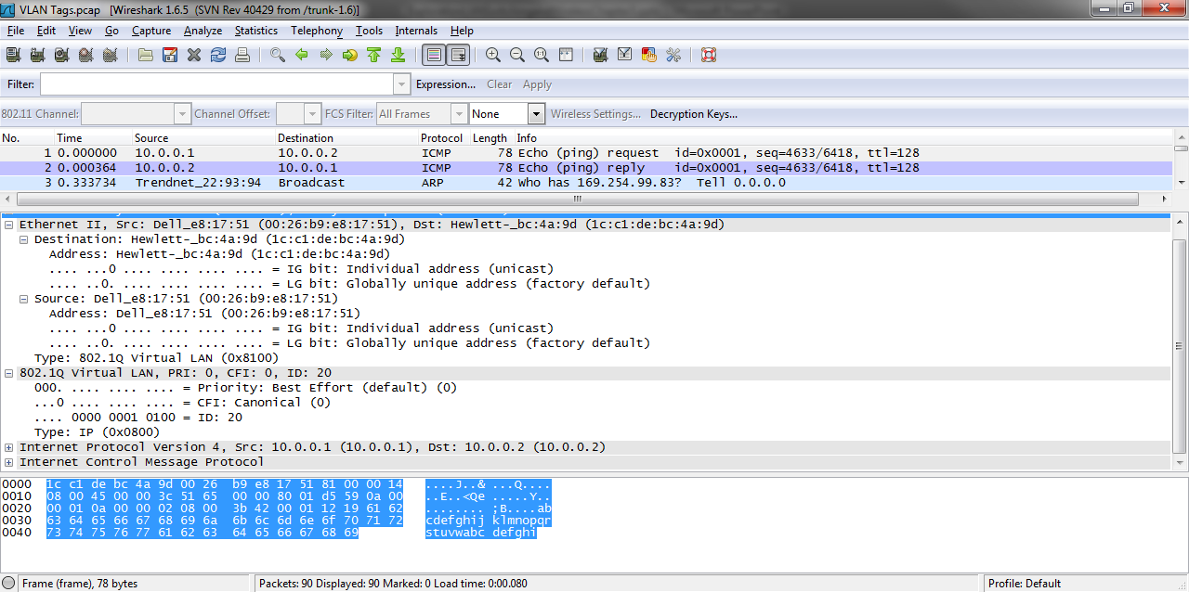
Tagging Frames

Slide 35
Tagging Frames
Sure enough there it is
The three fields that carry the information needed are
Priority
CFI
ID
as summarized for us in the first line of the VLAN tag display

Slide 36
Tagging Frames
In this case the
Priority is 0
CFI is 0
VLAN is 20
What does all of this mean
Just below the summary line we see that
The priority value in this example is Best Effort

Slide 37
Tagging Frames
This priority refers to the 802.1p defined priorities of
0 and 1 Best Effort
2 Excellent Effort
3 Critical Application
4 Video
5 Voice
6 Internetwork Control
7 Network Control

Slide 38
Tagging Frames
Here is a frame with a higher priority
In this case 7 as STP is used for Network Control

Slide 39
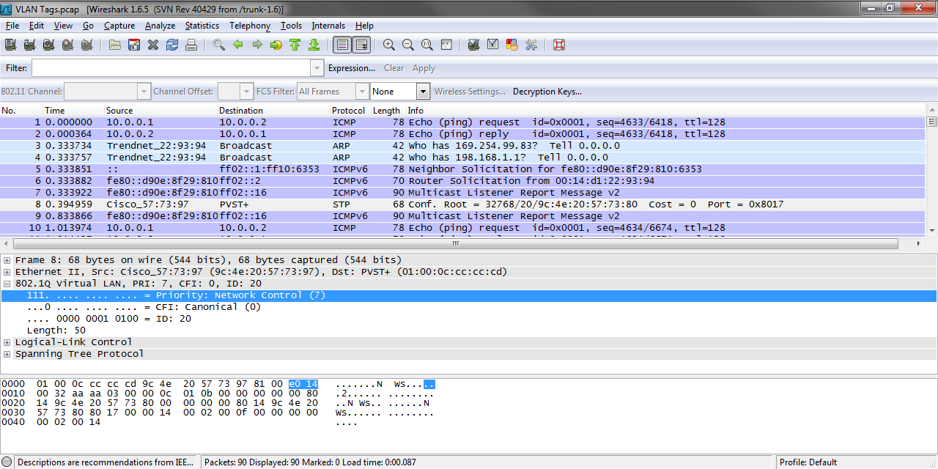
Tagging Frames

Slide 40
Tagging Frames
The next field or tag is CFI
This is the Canonical Format Indicator
These days it is always 0
The values are
0 where the MAC address is in canonical format
1 where the MAC address is in non-canonical format

Slide 41
Tagging Frames
In the old days this code was used for compatibility between Ethernet and Token Ring networks
Since Token Ring is dead, so is the code
The last field carries the number of the VLAN
In this case VLAN 20

Slide 42
Tagging Frames
In the format that Wireshark uses to show us these tags the normal Type code field appears next
In this example the protocol to which the Data Link layer will hand the data to at the Network layer is the Internet Protocol or IP
Its code is 0800 in hex

Slide 43
Frame Tags
Let’s look at some example frames where on the same setup we can see the native or management VLAN which is VLAN 1
The VLAN on the first switch which is VLAN 2
And the VLAN on the second switch which is VLAN 3
In this case the VLANs talk to each other through a Router on a Stick

Slide 44
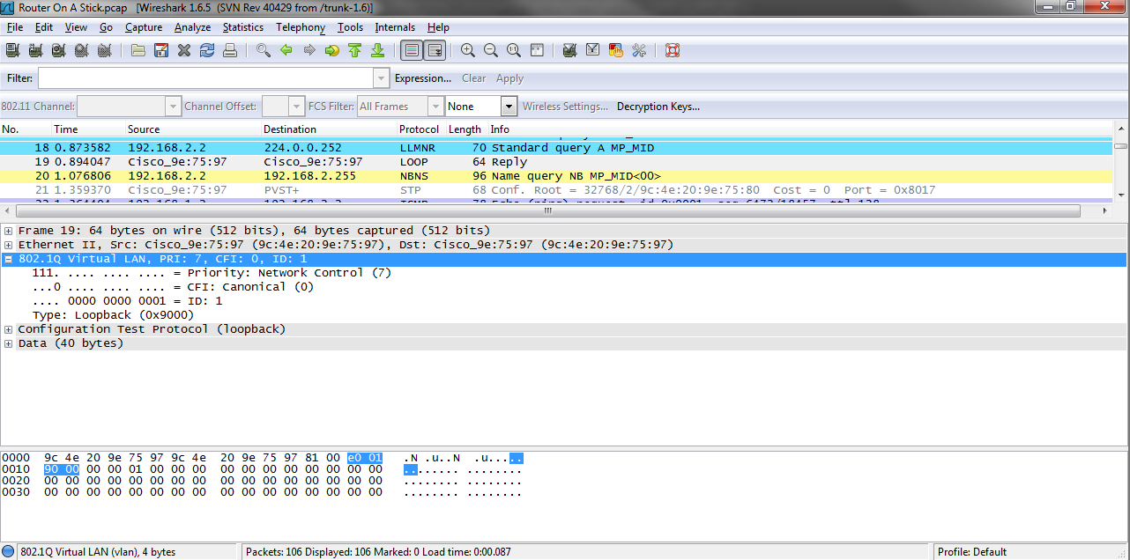
VLAN 1

Slide 45

VLAN 2

Slide 46

VLAN 3

Slide 47
VLANs and Subnets
A VLAN should entirely encompass a single IP address subnet
There should be a one to one correspondence between VLANs and subnets
A VLAN should never cross a subnet boundary
A subnet should never be used on more than one VLAN

Slide 48
VLAN Configuration
The basic VLAN configuration steps are
Add the VLANs
Assign the ports to the VLANs

Slide 49
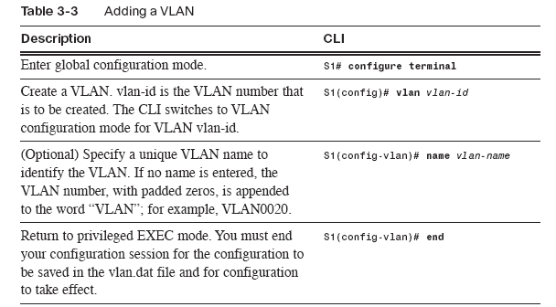
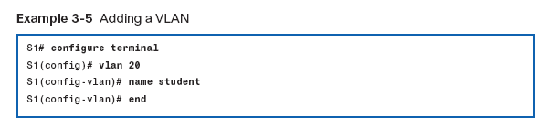
Add a VLAN

Slide 50
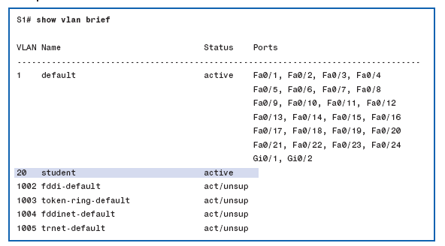
Where Are the Ports

Slide 51
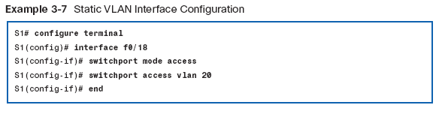
Assign Ports to VLANs

Slide 52
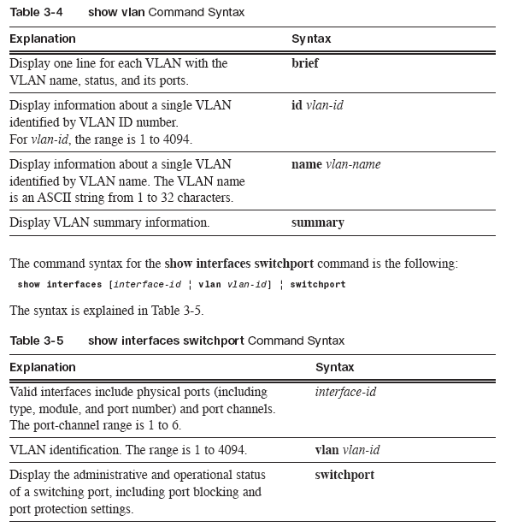
Verifying VLAN Configuration

Slide 53
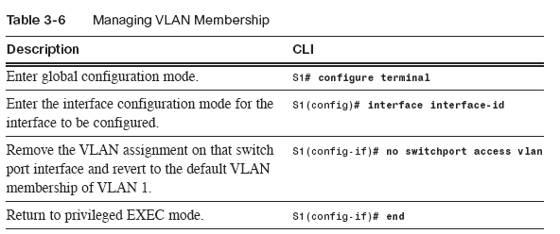
Changing a VLAN Assignment

Slide 54
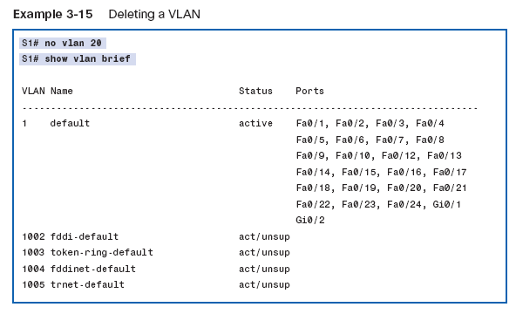
Deleting a VLAN

Slide 55
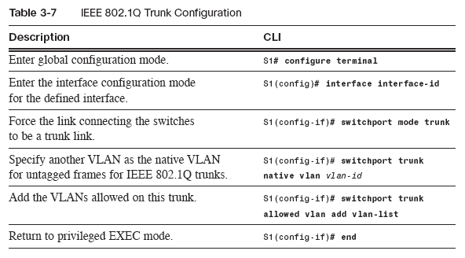
Configuring VLAN Trunks

Slide 56
Configuring VLAN Trunks
You can also restrict which VLANs may be sent over a trunk

Slide 57
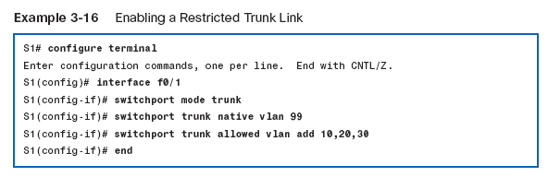
Configuring VLAN Trunks

Slide 58
Lab
Let’s make some VLANs
Start Packet Tracer
Open file e3-3344.pka

Slide 59
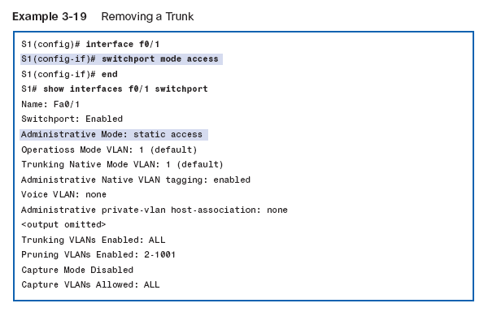
Remove a Trunk

Slide 60
Voice VLAN
A single switch port can be carry the traffic for two VLANs even while set to access mode if the second VLAN is for voice traffic

Slide 61
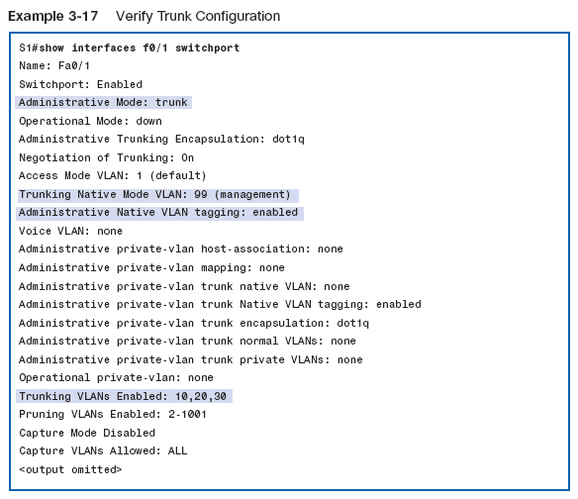
Verifying Trunk Configuration

Slide 62
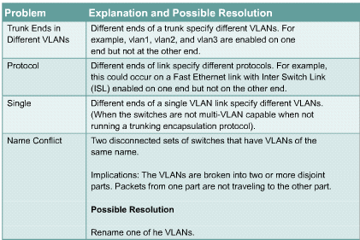
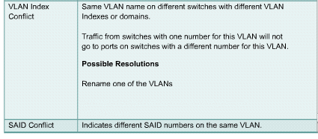
Common VLAN Problems

Slide 63
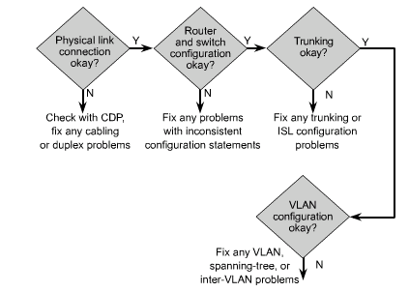
VLAN Problem Isolation

Slide 64
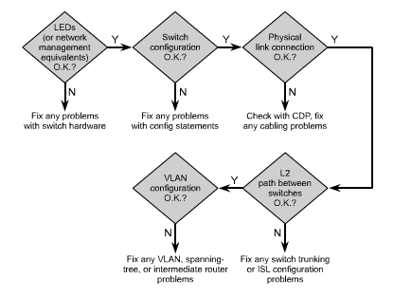
VLAN Problem Isolation

Slide 65
Sources
The information on the frame alterations for VLANs was copied word for word from a paper on VLANs from Fluke Networks

Slide 66
Lab
Let’s make some VLANs
Lab 3-1

