Slide 1
Basic Switch Concepts and Configuration
Last Update 2012.03.10
1.4.0

Slide 2
Objectives
Learn about how switches work, as well as how to configure them

Slide 3
How a LAN Operates
We discussed the basic design of a LAN in Chapter 1
Let’ s now see how a LAN operates

Slide 4
What is Ethernet
LAN operation requires a network access method as the basis for its operation
Ethernet is the most common network access method in use today for local area networks
It will most likely rule the world from end to end in the next few years in one form or another

Slide 5
Development
Ethernet was first suggested in May 1973 by Bob Metcalfe and David Boggs at the Xerox Palo Alto Research Center
It was patented in 1977 by Xerox
The first effort at standardizing it was in 1980 by DEC/Intel/Xerox
In 1983 the IEEE released the 802.3 standard, which is the base standard for Ethernet networks today

Slide 6
Development
Ethernet lives at layers 1 and 2 of the OSI model

Slide 7
How It Works
There are two forms of transmission in an Ethernet network
Half Duplex
The first and traditional form
Full Duplex
The newer and faster version

Slide 8
Half Duplex
Each network device has something that acts like a NIC – Network Interface Card
A NIC puts information onto the network and takes it off the network
Ethernet works by transmitting a frame out onto the network media, which in half duplex mode is shared by all devices on the network

Slide 9
Half Duplex
Every device on the network copies this frame into their NIC’s buffer space
Each device then checks to see if the frame’s destination address is its address
If it is, it takes the frame in
If it is not, it discards it

Slide 10
Half Duplex
But before any station can access the network in order to place a frame on the network it must follow the rules of CSMA/CD
CSMA/CD - Carrier Sense Multiple Access/ Collision Detection is how half duplex Ethernet networks decide who gets first crack at this shared network that only one of them can use at a time

Slide 11
Half Duplex
I’ll explain this with an example
Recall that a basic network consists of a NIC, a cable, a hub, another cable, and another NIC
One NIC is in a device that needs to send something to the device with the other NIC
Let’s take this example and apply it to two classrooms

Slide 12
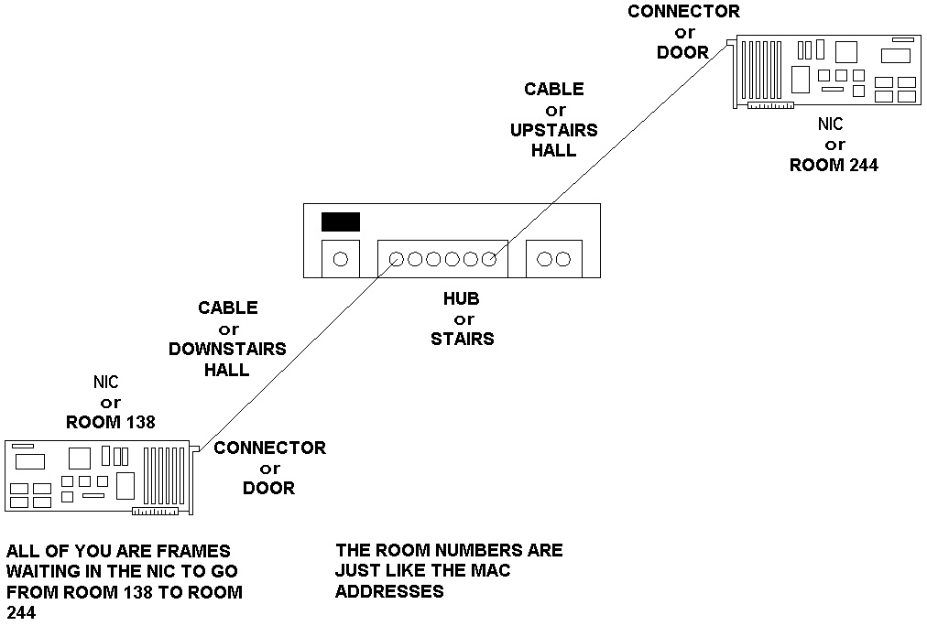
Half Duplex Ethernet Operation

Slide 13
Half Duplex Ethernet Operation
Carrier Sense means before a station talks, it listens for the carrier signal generated when another station is talking
If another station is talking, this station will wait until there is no carrier present, in other words when no one else is talking

Slide 14
Half Duplex Ethernet Operation
Multiple Access refers to the fact that when a station is done transmitting it is allowed to immediately transmit again or another station may access the network
Turns do not have to be taken
Everyone has an equal chance to transmit

Slide 15
Half Duplex Ethernet Operation
Collision Detection is the ability of an adapter to detect the collision of electrical signals that will result if two stations do start transmitting at the same instant
In a normally operating Ethernet network, sometimes two stations simultaneously detect no carrier and begin to talk
The two electrical signals will interfere with each other and result in a collision

Slide 16
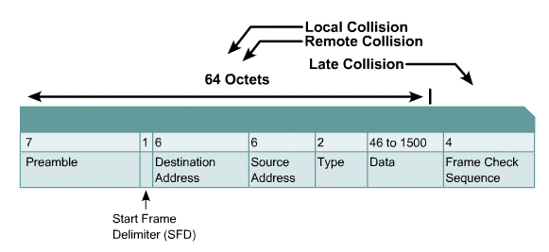
Types of Collisions

Slide 17
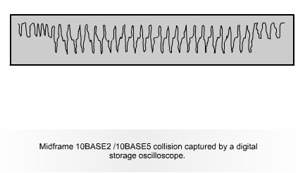
Collision Signal

Slide 18
Half Duplex Ethernet Rules
The network is monitored for a carrier, or presence of a transmitting station – carrier sense
If an active carrier is detected, then transmission is deferred
The station continues to monitor the network until the carrier ceases

Slide 19
Half Duplex Ethernet Rules
If an active carrier is not detected, and the period of no carrier is equal to or greater than the interframe gap, then the station immediately begins transmission of the frame

Slide 20
Half Duplex Ethernet Rules
While the transmitting station is sending the frame, it monitors the medium for a collision
If a collision is detected, the first transmitting station that detects the collision stops sending the frame data and sends a 32-bit jam sequence

Slide 21
Half Duplex Ethernet Rules
After sending the jam sequence the transmitting station waits a random period of time chosen using a random number generator before starting the transmission process over from the first step above

Slide 22
Jam Signal Specifics
As discussed above, when a collision is detected by a node, it immediately transmits a jam signal to ensure the other nodes on the shared network are aware of the problem
The problem is the frames sent out are now too damaged by the collision to be trusted
They must be ignored

Slide 23
Jam Signal Specifics
Specifically when a transmitter detects a collision, the transmitter continues to send the preamble - if the preamble has not completed - and it also sends 32 additional bits, which are called a jam signal
The jam signal extends the duration of the collision event to ensure that all stations hear about the collision

Slide 24
Jam Signal Specifics
The contents of the jam signal can be any pattern that is not intentionally designed to be the 32-bit CRC value corresponding to the partial frame already transmitted
Most implementations send all ones

Slide 25
Jam Signal Specifics
Completely sending the preamble and transmitting a jam signal guarantees that a signal stays on the media long enough for all transmitting stations involved in the collision to recognize the collision and react accordingly

Slide 26
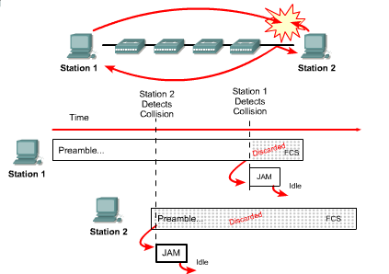
Error Handling

Slide 27
Collision Domain
All stations that share a media are said to be in the same collision domain
This means that they must cooperate in sending messages over the media using the rules described above
Too many stations attempting to use the same media slows or stops the network
Layer 2 switches are used to breakup collision domains

Slide 28
Broadcast Domain
Another domain of importance in an Ethernet network is the broadcast domain
One way of looking at a broadcast domain in a half duplex Ethernet network is that information is sent by broadcasting it to all stations on the shared media

Slide 29
Broadcast Domain
That is once a station has access to the network even though it knows what station is to receive the message, it does not send it directly to that station and only that station
Rather all stations on the shared media pick it up

Slide 30
Broadcast Domain
Only the station it is intended for will process the message, but all will still receive it
Another aspect of broadcasting is that some messages must be broadcast
This occurs when the MAC address of the intended recipient is not known
In this case the message must be broadcast

Slide 31
Broadcast Domain
These broadcasts put traffic on the entire network
Broadcast domains are divided up using Layer 3 switches or routers

Slide 32
Slot Time
The slot time is a key parameter for half-duplex Ethernet network operation
It is defined as 512 bit times for Ethernet networks operating at 10 and 100 Mbps
It is 4096 bit times for Gigabit Ethernet, if it is operating in half duplex mode, which it never does

Slide 33
Slot Time
This also then defines the minimum frame size of 64 bytes for a 10 or 100 Mbps network
Since 64 x 8 = 512
The minimum frame size then takes 512 bit times to send it

Slide 34
Slot Time
For a NIC to detect collisions, the minimum transmission time for a complete frame must be at least one slot time, and the time required for collisions to propagate to all stations on the network must be less than one slot time
Thus, a station cannot finish transmission of a frame before detecting that a collision has occurred

Slide 35
Slot Time
Slot time is important because it
Establishes the minimum size of an Ethernet frame
Sets a limit on the size of a network
Ensures that if a collision is going to occur, it will be detected within the first 512 bits - 4096 for Gigabit Ethernet - of the frame transmission
This simplifies the Ethernet hardware's handling of frame retransmissions following a collision

Slide 36
Interframe Gap
Ethernet devices must allow a minimum idle period between transmission of frames known as the IFG - interframe gap or IPG - interpacket gap
This gap provides a brief recovery time between frames to allow devices to prepare for reception of the next frame
In other words to switch from transmit mode to receive mode

Slide 37
Interframe Gap
The minimum interframe gap is 96 bit times, which is 9.6 microseconds for 10 Mbps Ethernet, 960 nanoseconds for 100 Mbps Ethernet, and 96 nanoseconds for 1 Gbps Ethernet

Slide 38
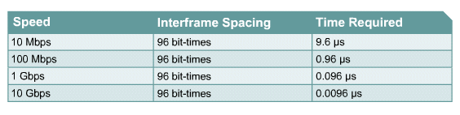
Interframe Spacing and Backoff

Slide 39
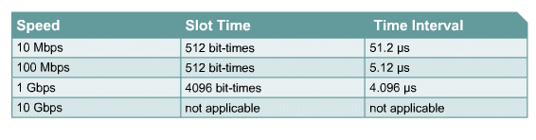
Interframe Spacing and Backoff

Slide 40
Full Duplex Ethernet
The IEEE 802.3x standard introduced the idea of full duplex operation to Ethernet
In this mode a point-to-point connection is made between two devices
They may both transmit and receive at the same time
Since only two devices are talking at any one time, there can be no collisions

Slide 41
Full Duplex Ethernet
CSMA/CD no longer applies
Speed is instantly doubled in a full duplex Ethernet network, due to simultaneous transmitting and receiving
Segments lengths are increased dramatically, since the timing requirements of half-duplex no longer apply

Slide 42
Full Duplex Ethernet Problems
The Ethernet controllers of each end-device must be capable of supporting full-duplex operation

Slide 43
Full Duplex Ethernet Problems
If one end of a connection has been configured for half-duplex operation while the other end has been configured for full-duplex operation, a high number of collisions and late collisions will be observed on the network interface set to operate in half-duplex mode

Slide 44
Full Duplex Ethernet Problems
This is because when that end receives on its receive pair while sending on its transmit pair, it considers this a collision event
An Ethernet interface configured for full-duplex operation does not sense the media for a carrier before transmitting
The potential exists for the full-duplex interface to begin transmitting while the half-duplex interface is transmitting

Slide 45
Full Duplex Ethernet Problems
As a result, the two transmissions collide
It is usually safest to set both ends of a link to use half or full duplex and to set both to the desired speed rather than allowing them to autosense these

Slide 46
Types of Traffic
Next we will talk about frames and their use on a LAN
But first we need to understand that there are three types of traffic that can be carried by a frame
Unicast
Multicast
Broadcast

Slide 47
Types of Traffic
Unicast traffic has the address of a single end point in the address field
Multicast traffic has the address of a multicast IP address in the address field
As such this is not carried by a frame
A broadcast frame has the FF:FF:FF:FF:FF:FF address in the address field in which case all NICs to read in the frame

Slide 48
Frames
At layer 2 just before the information goes to the physical layer where the bit stream will be put on the wire it must be defined
This definition – called a frame – tells the receiver where each portion of the information starts and where it stops

Slide 49
Frames
This formatting is needed since current systems cannot send an entire message such as - “Here is the current inventory of widgets you asked for” - intact
Each message must be broken up into predefined slices
These slices are called different things at different levels

Slide 50
Frames
At this level the slice is called a frame
There were once multiple types of Ethernet frames
Now there is only one commonly used
This is the Ethernet II frame

Slide 51
Frames
At one time there were four different Ethernet frame types out there
Novell will be referred to several times since they are the cause of much of this mess
The Ethernet frame types are

Slide 52
Ethernet Frame Types
Common Name | Cisco Name | Novell Name
Ethernet II | ARPA | Ethernet_II
802.3 Raw Novell Raw | Novell-Ether | Ethernet_802.3
IEEE 802.3 | SAP | Ethernet_802.2
IEEE 802.3 SNAP | SNAP | Ethernet_SNAP

Slide 53
Ethernet Frame Types
The background to this is
In 1980 a consortium of companies consisting of DEC, Intel, and Xerox first released Ethernet for widespread use
They used a frame format called Ethernet I
In 1982 they released a new version of the Ethernet frame which they called Ethernet II
Also in 1980 the IEEE meetings on developing a standards based version of Ethernet began

Slide 54
Ethernet Frame Types
In 1983, Novell NetWare was released, with a proprietary frame format based on a preliminary release of the 802.3 spec
Two years later, when the final version of the 802.3 spec was released, it had been modified to include the 802.2 LLC Header, making NetWare's proprietary format incompatible
Finally, the 802.3 SNAP format was created to address backwards compatibility issues between Version II and 802.3 Ethernet

Slide 55
Ethernet Frame Types
Which one to use
Of the four, the one to use today is the frame commonly called Ethernet II or just Ethernet
This is the one we will look at in detail

Slide 56
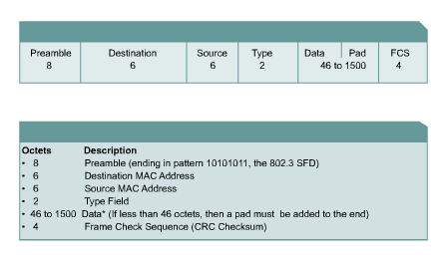
Ethernet Frame Structures

Slide 57
Ethernet II Frame Format
Field | Bytes
Preamble | 8
Destination Address | 6
Source Address | 6
Type | 2
Data | 46-1500
Frame Check Sequence | 4

Slide 58
Ethernet II Frame Format
Preamble
This is a sequence of 7 bytes or 56 bits of alternating ones and zeros
It is used for synchronization
It gives components time to detect the signal, and be ready before the frame arrives
It was set at this length because it originally took the equipment this long to sync up
A preamble is not required for speeds above 10 Mbps

Slide 59
Ethernet II Frame Format
SFD - Start Frame Delimiter
Also part of the preamble is a sequence of 1 byte or 8 bits having the bit configuration 10101011 that indicates the start of the frame
Note the similarity of the bit pattern between the Preamble and the SFD
The only difference is that the last two bits of the SFD are both 1’s
Many people do not separate the Preamble and Start Frame Delimiter

Slide 60
Ethernet II Frame Format
They consider it to all be the preamble
Because it takes a station an unknowable amount of time to lock on, it does not know how many bits of the Preamble have gone by
For this reason, it is said that the Preamble is lost in the synching up process

Slide 61
Ethernet II Frame Format
As such no part of the Preamble ever enters the NIC’s buffer
This is why the size of the Preamble/SFD is excluded when the minimum and maximum Ethernet frame sizes are discussed

Slide 62
Ethernet II Frame Format
Destination Address
This is the MAC address of the station the message is for
This address may specify either an individual address destined for a single station, a multicast address destined for a group of stations, or an address of all 1s bits that refers to all stations on the LAN and is called a broadcast address

Slide 63
Ethernet II Frame Format
Source Address
This is the MAC address of the sending station
Type
Type indicates the protocol type that the frame is for at the network layer, such as
0800 for TCP/IP
8137 for IPX
These are hexadecimal numbers

Slide 64
Ethernet II Frame Format
Data
This is the important stuff and has a maximum size of 1500 bytes
If the size is less than 46 bytes, then bytes are placed in the Pad field to bring the frame length up to at least 64 bytes
What goes into this data area is the original message and the headers placed in front of that message at each of those layers

Slide 65
Ethernet II Frame Format
CRC - Frame Check Sequence
This is used for error checking
When the source station assembles a MAC frame, it performs a CRC calculation on all the bits in the frame from the Destination MAC Address through the Pad fields
The source station stores the value in this field and transmits it as part of the frame
When the frame is received by the destination station, it performs an identical check

Slide 66
Ethernet II Frame Format
If the calculated value does not match the value in this field, the destination station assumes an error has occurred during transmission and discards the frame

Slide 67
Lab
Start Wireshark
Capture and examine some frames

Slide 68
Ethernet II Frame Size
The original Ethernet standards defined the minimum frame size as 64 bytes or 512 bits and the maximum as 1518 bytes
This includes all bytes from the Destination MAC Address field through the Frame Check Sequence field

Slide 69
Ethernet II Frame Size
Recall the Preamble and Start Frame Delimiter fields are not included when quoting the size of a frame
So without the preamble and SFD
64 to 1518 bytes
And with the preamble and SFD
72 to 1526 bytes
This makes the header 14 bytes, the trailer 4 bytes for a total overhead of 18 bytes

Slide 70
Ethernet II Frame Size
The amount of data that can be sent is 1518 bytes including the IP and TCP headers for a net data size of 1460 bytes at the most
IEEE 802.3ac standard released in 1998 extended the maximum frame size to 1522 bytes to allow for VLAN information
The frame size of 1518 bytes is arbitrary

Slide 71
Ethernet II Frame Size
It was selected based on four goals
Fairness in that no station can then take up the media for too long
To limit the size of the buffers that receivers must maintain
To keep overhead low so that most of the frame is the payload
To make the network efficient so if a frame is damaged not too much bandwidth is wasted

Slide 72
Ethernet II Frame Size
The minimum frame size of 64 bytes was set to this value to ensure that a sending station is still sending if a collision occurs on the opposite end of the network

Slide 73
MAC Address
Each NIC needs a name so that we and the network can tell them apart
This name is the MAC address
Media Access Control Address
These addresses are assigned by the card manufacturer as they produce the NIC
The address is made up of six hex numbers

Slide 74
MAC Address
The address is in two parts
The first part is a code for the manufacturer
The code is assigned by the IEEE
It is called an OUI – Organizationally Unique Identifier
This is the first three hex numbers
The second part is a number assigned by the manufacturer
The address is burned into the card on a chip

Slide 75
MAC Address
To see this address on a Windows computer, from the command prompt type
ipconfig /all
This shows

Slide 76
MAC Address
C:\>ipconfig /all Windows IP Configuration Host Name . . . . . . . . . . . . : home Primary Dns Suffix . . . . . . . : Node Type . . . . . . . . . . . . : Unknown IP Routing Enabled. . . . . . . . : No WINS Proxy Enabled. . . . . . . . : No Ethernet adapter Local Area Connection: Connection-specific DNS Suffix . : Description . . . . . . . . . . . : SiS 900-Based PCI Fast Ethernet Adapter Physical Address. . . . . . . . . : 00-E0-06-09-55-66 Dhcp Enabled. . . . . . . . . . . : No IP Address. . . . . . . . . . . . : 192.168.1.3 Subnet Mask . . . . . . . . . . . : 255.255.255.0 Default Gateway . . . . . . . . . : 192.168.1.1 DNS Servers . . . . . . . . . . . : 209.246.139.252 206.168.213.252

Slide 77
MAC Address
In this example the manufacturer code is
00-E0-06
The manufacturer’s tracking number is
09-55-66

Slide 78
Lab
Go to the command line
What is your NIC’s MAC address
Who made this NIC

Slide 79
Switches
This network access method and the frames that carry the data around the network must exist somewhere
This somewhere was a hub in the old days
These days it is a switch
The switch is the central connection point for all the devices that will access the network

Slide 80
Switch v Hub
What is the difference between a hub and a switch
Well they are the same except for one major difference
That difference is a switch allows for microsegmentation of the network
Microsegmentation means that each device attached to a layer 2 switch port has a collision domain of its own

Slide 81
Operation
Even though it is still called Ethernet, in a switched environment there is no need for carrier sense and no need for collision detection; since there cannot be any collisions
To connect two devices a temporary virtual circuit is created for the transmission
For example

Slide 82
Hub Operation
Port 1 | Port 2 | Port 3 | Port 4 | Port 5

Slide 83
Switch Operation
Port 1 | Port 2 | Port 3 | Port 4 | Port 5

Slide 84
Switch Operation
Port 1 | Port 2 | Port 3 | Port 4 | Port 5

Slide 85
Switch Operation
Port 1 | Port 2 | Port 3 | Port 4 | Port 5

Slide 86
Operation
After the transmission is completed the circuit is broken down
This medium that is internal to the switch is called the switching fabric
Switches use the MAC address to handle traffic
A switch also allows full duplex operation where the devices on both ends of the virtual network can send and receive at the same time

Slide 87
Operation
This is possible because there are no other devices contending for access

Slide 88
Modes of Operation
There are two basic modes of operation for a switch
Cut Through
This is the fastest
In this mode the switch just reads the address and sends the frame on
The address is in the first 16 bytes of the frame
This means latency is minimized

Slide 89
Modes of Operation
Store and Forward
In this method the switch reads the entire frame and checks the CRC before it forwards it
This increases latency

Slide 90
Modes of Operation
Cisco had another mode called
Fragment Free
This is a modified Cut Through approach
It waits for the collision window to pass, which is the first 64 bytes, and then it sends the frame on
The belief is if a frame has an error it is almost always within the first 64 bytes of the frame
They appear to have abandoned it
All switches are store and forward these days because they operate so fast

Slide 91
Autonegotiation
Autonegotiation is another problem seen in switches
It was included in the standard as a convenience feature
It has proven to be a major problem
The problem is the negotiation is not so auto

Slide 92
Autonegotiation
PCs and switch ports can never seem to reliably agree on the speed and full duplexing
In general just turn it off
Set the duplex and speed manually for each port on each device

Slide 93
Autonegotiation
Fluke has a different view
They say
The default state for virtually all new Ethernet interfaces today is for Auto-Negotiation to be enabled
This is good
Many vendors describe it as bad, primarily because the design and support engineers do not have a solid understanding of how it works

Slide 94
Autonegotiation
The likelihood of Auto-Negotiation actually failing to produce a viable link is very low
Some implementations do not operate correctly, but in almost all cases the vendor has learned about the problem and a new build of code is available to resolve the problem
If they are not aware of the problem, they will be very interested in working with you to resolve it

Slide 95
Autonegotiation
Review IEEE 802.3 clause 28 for specific details, however a very simplified description of Auto-Negotiation follows
A negotiating station will send a handshake signal called an FLP - Fast Link Pulse)This is composed of a burst of normal link pulses common to 10BASE-T
The FLP defines the capabilities of the negotiating station that sent them

Slide 96
Autonegotiation
If the link partner is also sending FLPs then they will compare the offered capabilities and will select the highest performance match in offered capabilities, then change to that link technology and begin communicating over it
If the negotiating station does not detect FLPs from its link partner it will then attempt to detect the link partner’s transmission speed
Speed detection is virtually always successful as long as both link partners support a common speed

Slide 97
Autonegotiation
If the negotiating station did not detect FLPs from its link partner, it is required to choose half duplex for the connection
A negotiating station will not try to detect the link partner’s duplex setting when FLPs are not received

Slide 98
Autonegotiation
This is the cause of most problems related to duplex problems
Far too many support engineers wrongly believe that the negotiating station will detect the duplex setting of the fixed-setting link partner
Another misconception is that a duplex mismatch will cause a link failure

Slide 99
Autonegotiation
The link will experience errors if the duplex does not match, and the visible symptom will be slowness, but it will still pass traffic
If the duplex mismatch appears between two switches it is possible to review the reported interface errors and infer the duplex setting of each end of the link just from the nature of the reported errors

Slide 100
Autonegotiation
The default state for some switches is to disable any port involved in too many collisions, regardless of whether or not it negotiated to half duplex
This results in normal 802.3 medium arbitration collisions on a shared media collision domain causing the switch to block or disable the affected port
As an example, Cisco calls this parameter errdisable

Slide 101
Memory Buffering
Frames can be stored in a switch while being processed in one of two ways
Port-based memory buffering
Frames are stored in queues that are linked to specific incoming ports
A single frame could block all other frames because its destination port is busy, even if the other frames could be delivered
Shared-memory buffering
All frames use a common memory buffer
Frames in the buffer are then linked dynamically to the appropriate destination port

Slide 102
Symmetric Switching
The link from a switch to a set of devices can be symmetric or asymmetric
In that the connection to the server attached to the switch is the same speed or a higher speed than the other devices

Slide 103
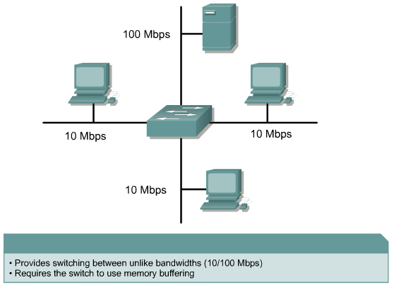
Asymmetric Switching

Slide 104
Layer 3 Switch
A switch operates at layer 2
However, some marketing folks decided to sell routers without WAN ports
They call these layer 3 switches
This is a router in disguise
It routes in hardware rather than software
It does not have WAN type ports

Slide 105
Switch Configuration
Now we will switch to switch configuration
Just as on a router there are two basic levels on a Cisco switch
User
You may look around
Privileged
You have total control

Slide 106
Levels
To move from one to the other
Enable
Disable

Slide 107
Configuration Levels
The top level configuration is called the global config level
You go there by entering
config t
Where as
exit
Takes you back out of it

Slide 108
GUI Access
Although real nerds use the command line, for wimps there are three GUI interfaces

Slide 109
GUI Access
Cisco Device Manager
Free
Runs on the switch
Cisco Network Assistant
Free
Runs on PC
CiscoView
Extra cost
Runs on PC

Slide 110
Help
For help use the ? either to have a command shown or to compete a command
cl?
clock ?

Slide 111
Switch Bootup
On bootup the switch loads the boot loader software stored in NVRAM
The boot loader then
Initializes the CPU registers
Runs the POST
Sets up the flash file system
Loads the operating system

Slide 112
Basic Switch Configuration
The most basic level of switch configuration is to do nothing
You do not have to do any configuration to a switch
It will work just fine out of the box
However, for a network of any size some basic configuration will make management easier and performance better

Slide 113
Basic Switch Configuration
The basic configuration tasks are
Setup the management interface
Set a default gateway
Set speed and duplexing of all ports
Setup support for GUI access
Setup MAC address table management

Slide 114
Management Interface
To manage a switch remotely layer 3 access must be setup
This requires assigning an IP address to the management VLAN
By default that VLAN is 1
This can be changed to another VLAN for security reasons
For example

Slide 115
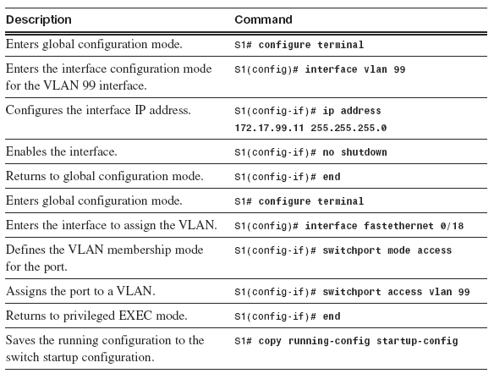
Management Interface

Slide 116
Default Gateway
In order to send packets back and forth a default gateway must also be set
As in
ip default-gateway 192.168.1.1

Slide 117
GUI Access
To be a wimp and use a GUI interface http access must be turned on
To do so from global configuration level enter
ip http server
If authentication is desired
ip http authentication enable

Slide 118
MAC Address Table
The MAC address table is maintained automatically by the switch as frames come and go
These aspects can be adjusted if desired

Slide 119
Lab
Let’s configure a switch
Start Packet Tracer
Open file e3-2384.pka

Slide 120
Automatic Configuration
Cisco has a method to automatically configure a set of switches once a master switch has been setup
This is called Smart Install
Here is what Cisco said about this in a 2012 white paper
Smart Install is a plug-and-play configuration and image-management feature that provides zero-touch deployment for new switches

Slide 121
Automatic Configuration
You can use it to set up a primary switch as a centralized management “director” that then autoconfigures additional equipment with the same software images or different images based on rules setup
A typical use case is in organizations with a number of distributed branch-office sites, such as a bank or a school district

Slide 122
Automatic Configuration
If branch sites have more than one switch, centralized IT staff can configure one switch or router in each branch over the network; that device serves as the director
Local personnel then simply plug the other switches into the director to automatically download their configurations

Slide 123
Automatic Configuration
In cases where there’s a large central site and several single-switch branch locations, the enterprise might want to have all switches shipped to the central location for staging, image them using a director switch, then send autoconfigured switches to the sites where they are simply plugged in

Slide 124
Checking on the Configuration
As always show commands are used to check on the actual configuration
Common ones include

Slide 125
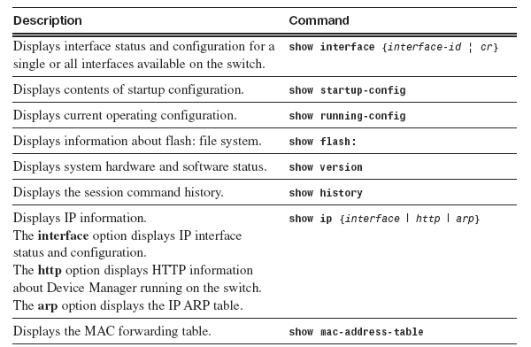
Checking on the Configuration

Slide 126
Backing Up the Configuration
Backing up the configuration to the switch itself can be done one of three ways
For example

Slide 127
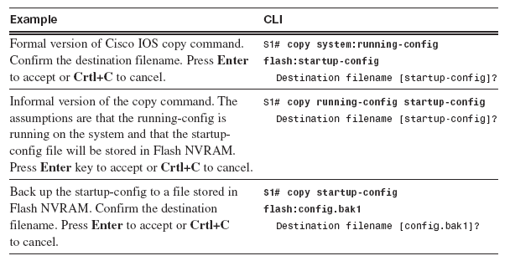
Backing Up the Configuration

Slide 128
Backing Up the Configuration
Backing up the configuration to another device is done using tftp
This is done this way

Slide 129
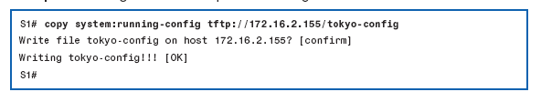
Backing Up the Configuration

Slide 130
Clearing the Configuration
Sometimes you need to start over on a configuration
To remove what is there type
erase nvram
reload

Slide 131
Securing Access to a Switch
Passwords are used to control who may access a switch

Slide 132
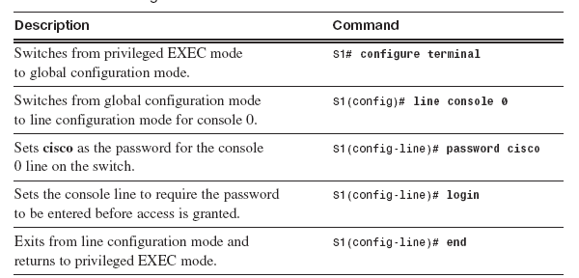
Console Access

Slide 133
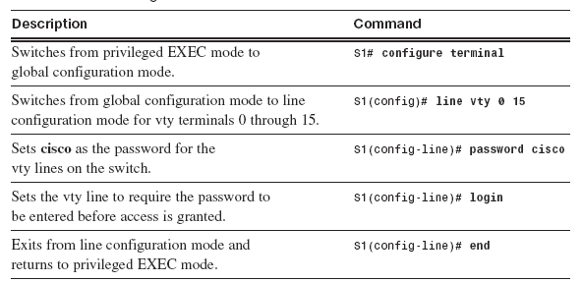
Remote Access

Slide 134
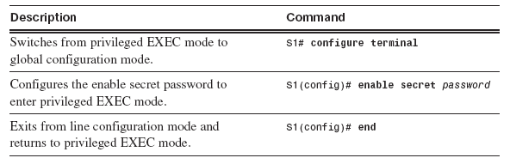
Privileged Mode Access

Slide 135
Password Recovery
Sometimes the password needs to be recovered
The exact procedure varies by device
In general this requires physical access to the switch

Slide 136
Login Banners
Some like to use login banners as a security feature
These just say things like you do not belong here

Slide 137
SSH Access
Remote access has traditionally been done using telnet
However, this method is less secure than SSH
SSH is the preferred method these days
To enable SSH a SSH server must be setup on the switch
For example

Slide 138
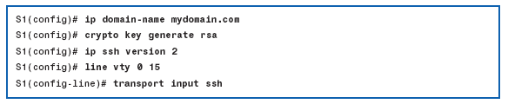
SSH Access

Slide 139
Port Security
To prevent undesired access to a network all ports should be secured
This limits the MAC addresses allowed on a port
The suggested methods include
Specify a group of MAC addresses allowed on a port
Allow only one MAC address on a port
Shutdown the port on a violation

Slide 140
Port Security
To do this
Set static secure MAC addresses
switchport port-security mac-address
Set dynamic secure MAC addresses
These MAC addresses are dynamically learned and stored in the address table
Use sticky secure MAC addresses
This is the same as the dynamic secure MAC addressees except that these are stored in the running configuration

Slide 141
Port Security
If a violation occurs these actions can be used
Protect
When the number of MAC addresses reaches the limit allowed on the port, frames with an unknown source address are dropped
You are not notified that a security violation has occurred

Slide 142
Port Security
Restrict
When the number of secure MAC addresses reaches the limit allowed on the port, frames with unknown source addresses are dropped
You are notified that a security violation has occurred through a SNMP trap or a Syslog message

Slide 143
Port Security
Shutdown
When a violation occurs the interface is disabled
A SNMP trap and a Syslog message are sent

Slide 144
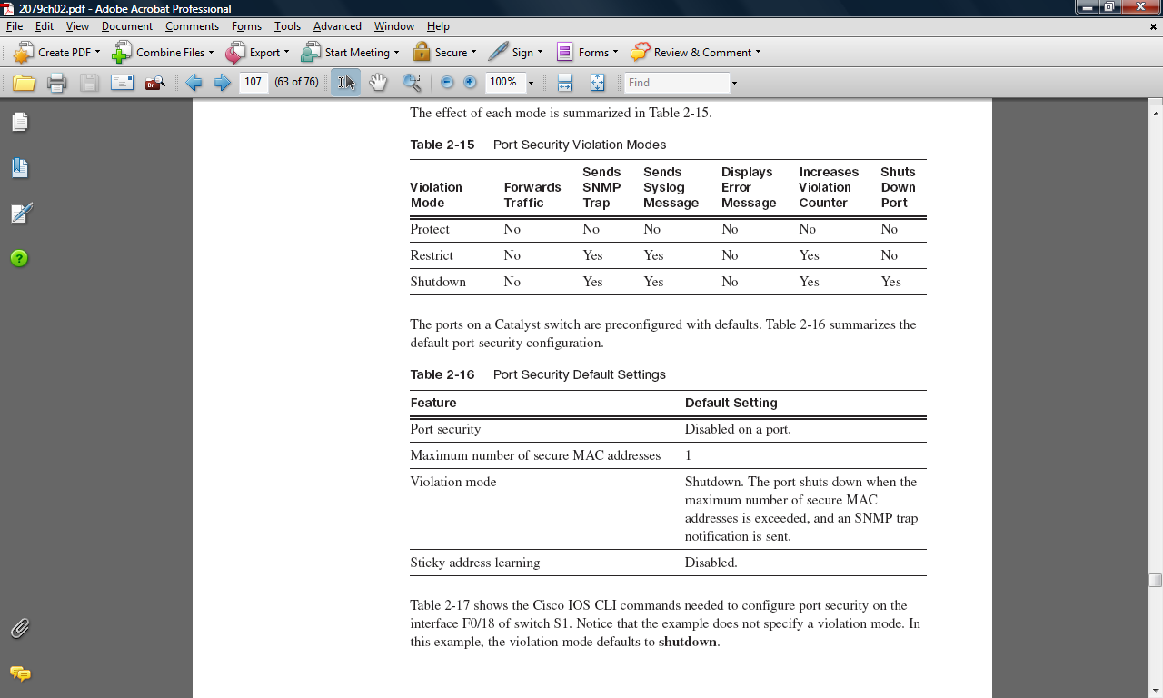
Port Security

Slide 145
Port Security

Slide 146
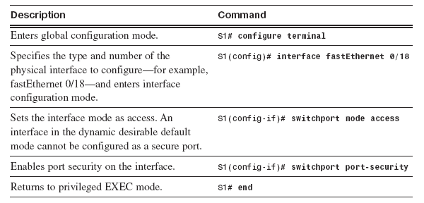
Port Security Configuration

Slide 147
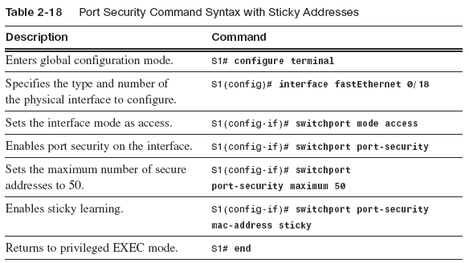
Port Security Configuration

Slide 148
Securing Unused Ports
Although tedious disabling unused ports is a good idea, as well as not plugging a patch cable into them
To do this
Issue the shutdown command port by port
or
Use the interface range command for several ports at a time

Slide 149
Switch Interface Access Codes
Here is a list of the access codes for switch ports from the Wendell Odom ICND1 book

Slide 150
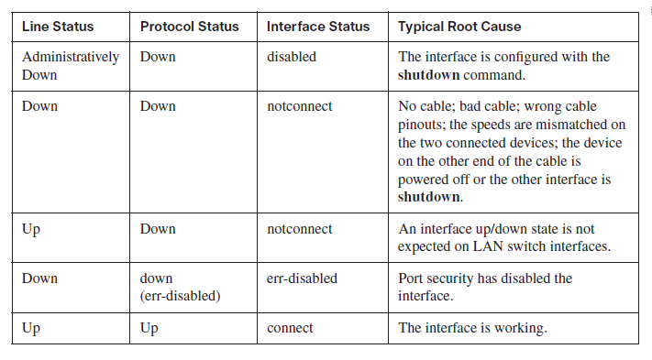
Switch Interface Status Codes

Slide 151
Lab
Let’s configure a switch
Lab 2-1

