Slide 1
LAN Design Evolution
Last Update 2011.07.05
1.2.0

Slide 2
Objectives
Learn about basic LAN design

Slide 3
Organization Size
Books and articles in the trade press would make you think that every organization in the country is huge
That each one of these has a highly complex network with layer after layer of equipment
In reality most organizations are fairly small

Slide 4
Network Size
The network needed by most organizations is therefore also fairly small
Keep in mind that a single broadcast domain can work just fine with anywhere from 200 to 1,000 active users depending on the nature of the network traffic

Slide 5
Organization Size
Let’s see how many firms and the dependent establishments there are at various sizes
Here is data from 2004 from the Census Bureau

Slide 6
Organization Size

Slide 7
SOHO
Let’s look first at the small firms
Those with 1 to 19 employees
As this table shows there are 4,453,810 of those
Clearly none of these need more than a single local area network consisting of a single switch or hub, a Server or NAS box, and a printer

Slide 8
SMB
Small and Medium sized businesses are defined as those with 500 or fewer employees
There are 612,893 of those
No doubt an organization with up to 500 staff in a single location could also work well with a single local area network, a set of switches, a server, maybe separate storage, and a number of printers

Slide 9
SMB
This too is not a very complicated setup

Slide 10
Large
This leaves just 37,629 organizations with more than 500 employees out of over 5 million total firms

Slide 11
Do Not Over Complicate
What is the point to this discussion
To point out to you to not over complicate this
A basic, simple, single layer network design will work for over 99 percent of all firms

Slide 12
Hierarchical Network Design
The best method to use when designing a network is the top down network design methodology detailed in Top Down Network Design by Priscilla Oppenheimer
The methodology Cisco suggests in this chapter is an abbreviated version of the top down approach

Slide 13
Hierarchical Network Design
This discussion will provide you with a solid basis for further study of this preferred design methodology
As the book points out this model divides the network into three distinct layers
Access
Distribution
Core

Slide 14
Hierarchical Network Design
In practice most organizations only use the first two layers, with the smallest organizations collapsing even these two layers into one
Only the largest entities need all three layers
A judicious use of these layers will create a network design that can be grown in size indefinitely

Slide 15
Hierarchical Network Design
Let’s look at each of these three layers of a hierarchical network design

Slide 16
Access Layer
The access layer is where all end devices connect to the network
End devices range from PCs to printers to wireless access points, and even routers
Any device that connects using a NIC typically
No redundancy exists at the access layer

Slide 17
Distribution Layer
The distribution layer aggregates the data from the access layer
This layer also controls the flow of traffic using policies
Broadcast domains are defined at the access layer edge of this layer
High availability through redundant devices is required at this layer

Slide 18
Core Layer
The core layer is designed to move data at high speed
This layer moves data as fast as possible between the various distribution layer devices
High availability and redundancy are critical to this layer

Slide 19
Hierarchical Network Model

Slide 20
Hierarchical Network Design
Several benefits are listed for this design model including
Scalability
Redundancy
Performance
Security
Manageability
Maintainability

Slide 21
Scalability
Scalability refers to what is needed today as well as the future
The ability to grow, for example
Cabling is meant to last for 10 years
Switches and routers are meant to last for 2 to 5 years, since it is easier to change these

Slide 22
Redundancy
Redundancy is how a network maintains high availability
Availability is uptime
It is expressed as a percent and is related to the time period
Such as

Slide 23
Availability Downtime Allowed Per Week in Minutes Based on a 24 Hour Day 99.7% at 30 minutes looks ok, what if all at one time 95% sounds good, but 504 minutes doesn’t
99.999 | .10 |  | 99 | 101
99.95 | 5 |  | 98 | 202
99.9 | 10 |  | 97 | 302
99.7 | 30 |  | 96 | 403
99.5 | 50 |  | 95 | 504

Slide 24
Performance
Performance is a key indicator for most projects
In some cases it is only that
“No one complains”
In most cases it is more definitive

Slide 25
Performance
Common performance measures include
Capacity v Throughput
Bandwidth Utilization
Offered Load
Accuracy
Efficiency
Latency
Response
Device CPU Utilization

Slide 26
Performance
Capacity
This is the data carrying capacity of a circuit
Usually measured in bits per second
Throughput
This is the quantity of error free data transmitted per unit of time
This is normally the packets per second
Bandwidth Utilization
The percent of total available capacity in use

Slide 27
Performance
Offered Load
This is the sum of all the data all network devices have ready to send at a particular time
Accuracy
Exactly what goes out gets to the other end
To check accuracy use a network analyzer to check the CRC on received frames

Slide 28
Performance
Track the number of frames received with a bad CRC every hour for one or two days
It is normal for errors to increase as network utilization goes up
So check the number of errors against the network load
The error rate is acceptable if there are not more than one error per megabyte of data

Slide 29
Performance
Efficiency
How much overhead is required to deliver an amount of data
How large a packet can be used
Larger better
Too large means too much data is lost if a packet is damaged
How many packets can be sent in one bunch without an acknowledgment

Slide 30
Performance
Latency
This is the delay in transmission
or
The time that passes from when a user expects something to appear, to when it does appear
Instantaneous response is the only goal

Slide 31
Performance
Response
Related to latency, but also a function of the application and the equipment the application is running on
Most users expect to see something on the screen in 100 to 200 milliseconds

Slide 32
Performance
Device CPU Utilization
High utilization on a device may create a bottleneck as the device will be unable to handle the offered load regardless of the bandwidth coming in or going out of the device
In other words, the device becomes the bottleneck

Slide 33
Security
In assessing the amount of security, balance the risks against the cost
There is no point in locking things down so tight, nothing can be used
Common risks include
Use of resources
Loss of data
Alteration of data
Denial of service

Slide 34
Manageability
Manageability refers to how easy will it be to monitor the network
To check for
Performance problems
Errors
Security problems
Configuration
Accounting, if chargeback used

Slide 35
Maintainability
How difficult will it be for the network management team to run the network you will be leaving
How difficult will it be for the network team to change the network by themselves

Slide 36
Network Design Considerations
When designing the network the layout and subsequently the devices used are dictated by
Location of network users
Location of the data stores
QoS requirements

Slide 37
Network Design Considerations
To design a network some basic information is required
The first thing to determine is where the users of the data are located
Users are not by level or job function
Rather they are determined by what use they are making of the network
For example

Slide 38
Network Design Considerations
In a law firm the users are not
Lawyers
Paralegals
Secretaries
The network does not care how much they are paid or what their function is
Rather the users are
Word processing users
Internet users

Slide 39
Network Design Considerations
Once the users are located the next step is to decide where their data is stored
This data is for example
Hard drives in one form or the other
Internet access
With the ends points in hand the next question is how large of a pipe is needed to connect these two points

Slide 40
Network Design Considerations
The amount of traffic can be determined by measurement or estimation
With this information in hand a topology map is created
Such as

Slide 41
Network Topology

Slide 42
Lab
Let’s build a hierarchical network design
Start Packet Tracer
Open file e3-1243.pka

Slide 43
Network Diameter
Other things to consider include the diameter of the network
This is the number of devices that a frame most cross from one end device to another
The smaller the diameter the less latency
Proper use of the three layers in the hierarchical model will prevent network diameter from being a problem

Slide 44
Network Diameter

Slide 45
Types of Traffic
In current large networks in addition to data, voice and video traffic is carried over the same set of wires
This requires the traffic be prioritized
QoS – Quality of Service places the time sensitive traffic in front of the traffic that can wait

Slide 46
Devices Used in LANs
At all three layers switches are commonly used as the connection point
As such their selection requires careful consideration at each level of the hierarchy
Common features include the following

Slide 47
Switch Features
Form Factor
Performance
Link aggregation
PoE
Layer 3

Slide 48
Form Factor
The switch may be
Fixed
Stackable
Modular

Slide 49
Fixed Configuration
A fixed configuration switch cannot be physically altered or added to

Slide 50
Fixed Configuration

Slide 51
Stackable
A stackable switch cannot be altered, but it can be added to by attaching other switches in such a way that several switches appear as one

Slide 52
Stacking
If the network runs out of ports more can be added by stacking another switch on top of the existing one
Switches use proprietary cables for this
There will be a limit on the number of switches that can be stacked
In the Cisco StackWise method the limit is nine

Slide 53
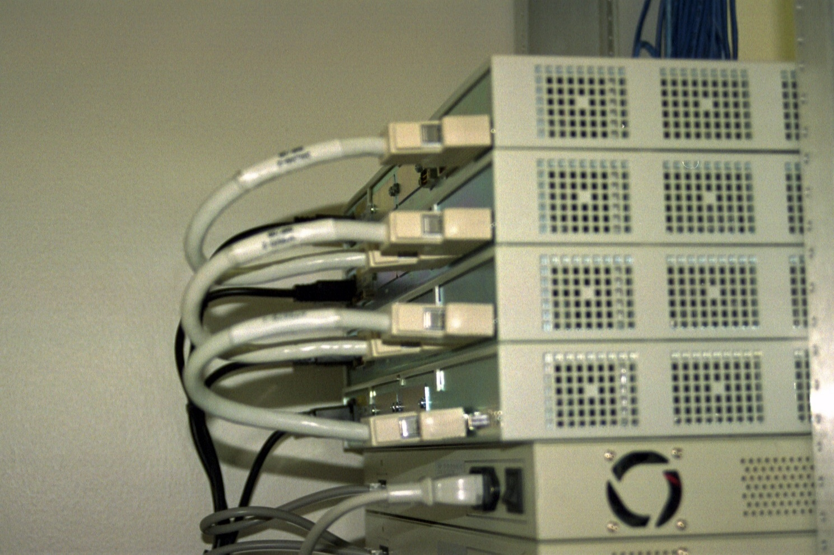
Stacking
Stacking Cables

Slide 54
Modular
A modular switch allows blades to be added to a single chassis when additional capacity is required
Up to the capacity of the chassis, ports can be added by just inserting more blades

Slide 55
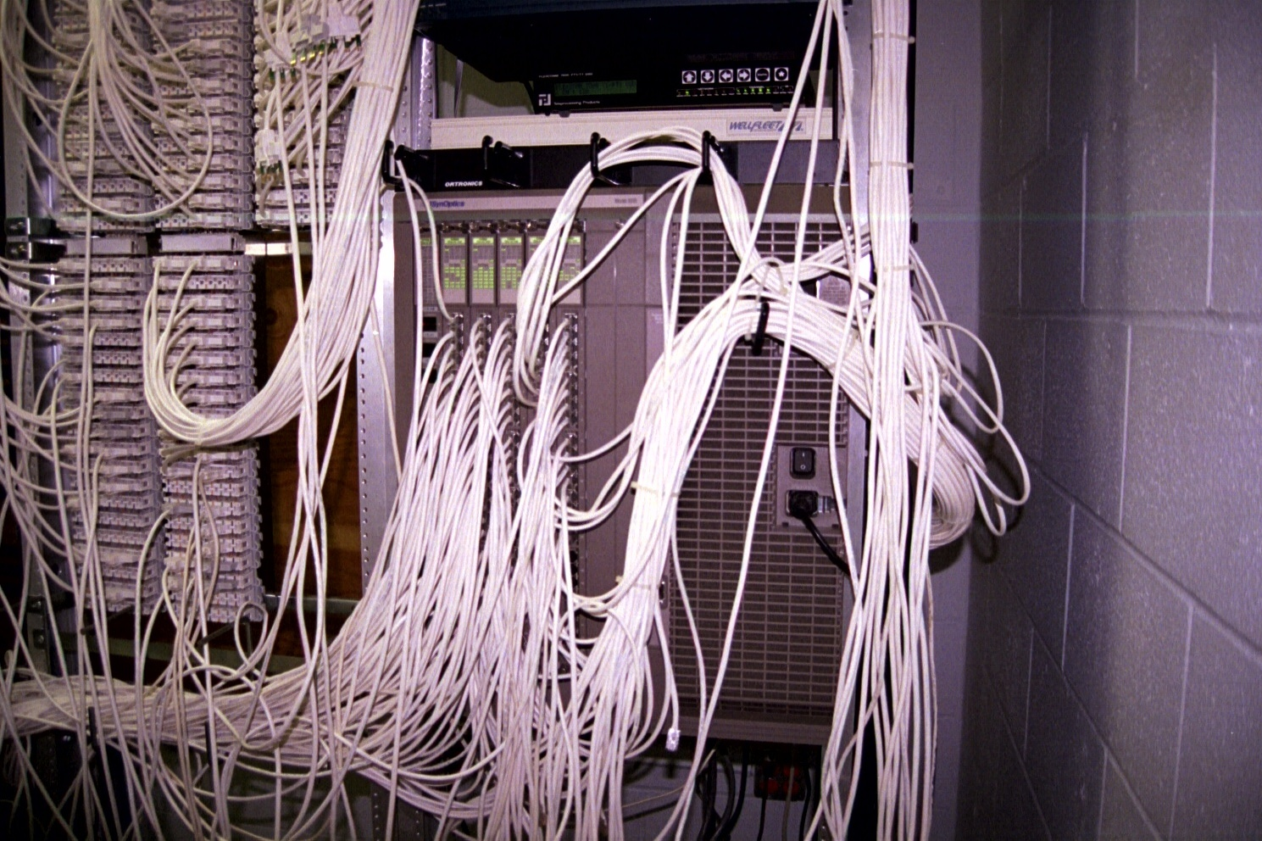
Modular

Slide 56
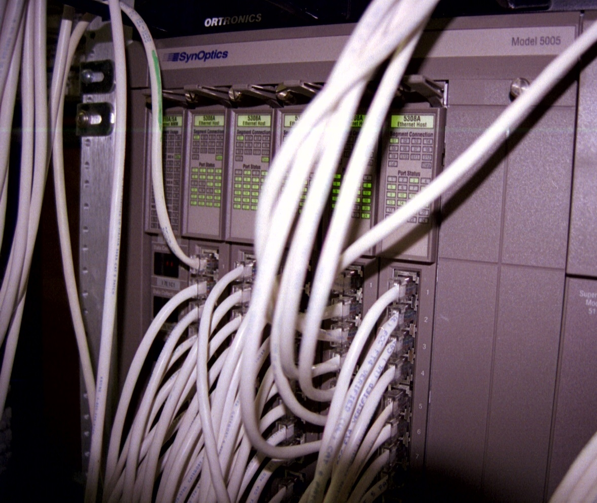
Modular

Slide 57
Performance
Main performance measures include
Port Density
Forwarding rate

Slide 58
Port Density
The port density is the number of ports on a single switch
Typically this is four to 96 although some switches can support many more

Slide 59
Forwarding Rate
The forwarding rate is how quickly the switch can process frames
This is in frames per second
The desired performance is wirespeed where the switch can process any frame presented
For a 24 port Gigabit switch this would be 24 Gbps

Slide 60
Forwarding Rate
Wirespeed switches are seen at the distribution and core layers

Slide 61
Link Aggregation
In link aggregation up to eight ports are bound together to move the traffic from one switch to another one
Etherchannel is the Cisco method for this

Slide 62
PoE
To power devices such as access points and IP phones a switch needs to be able to generate electrical power as well as send and receive data
PoE – Power Over Ethernet does this
Not all switches support PoE

Slide 63
Layer 3 Functions
To interconnect the various broadcast domains in the hierarchical network a layer 3 device is needed
To avoid having to use a router for this layer 3 switches were developed

Slide 64
Development of Switches
Let’s also look at the development and use of switches over the years
The development of switches has progressed over the years as new technologies appear
Let’s look at the various designs that have been used to create networks to see why switches were developed and how they are used

Slide 65
Point-to-Point Backbone
In the first example a LAN that originally covered only a single floor has been extended to cover two floors using a point-to-point backbone design

Slide 66
Point-to-Point Backbone

Slide 67
Collapsed Backbone
In the next design we see the single LAN extended to even more floors
All of the servers are now centralized in a single location to ease management
In this collapsed backbone design all of the devices are still in a single collision domain and a single broadcast domain, since hubs at layer 1 are used
This is called a flat design

Slide 68
Collapsed Backbone

Slide 69
Hierarchical Backbone Design
A flat design does not scale well
As more and more devices are added to the shared domains – collision and broadcast – things start to slow down
The solution is to introduce hierarchy to the design so as to divide up these domains

Slide 70
Bridged Backbone
In this first example of a hierarchical design a layer 2 device, in this case a bridge, is used to divide the collision domain

Slide 71
Bridged Backbone

Slide 72
Routed Backbone
Bridges worked well for isolating collisions, but did nothing for the broadcast domain
In the next example a single router was introduced, as a layer 3 device, to isolate the broadcast domains

Slide 73
Routed Backbone

Slide 74
Switched Backbone
Routers were not the best device for this so layer 3 switches were created to handle this function
Further hubs are now replaced with layer 2 switches on each floor so as to divide up the shared collision domain that still existed on each floor when hubs are used there

Slide 75
Switched Backbone

Slide 76
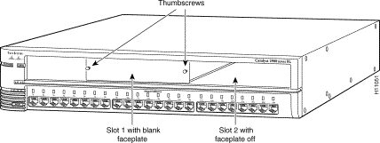
Switched Backbone
In this example the PCs and servers are connected to the layer 2 switches using UTP
These are the ports across the bottom

Slide 77
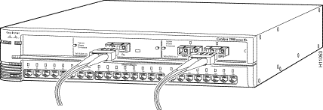
Switched Backbone
The backbone connections are fiber optic cable
A fiber module is inserted in the top part of the layer 2 switch for connection to the layer 3 switch on the bottom floor

Slide 78
Switched Backbone

Slide 79
Switched Backbone
On the bottom floor, where all of the layer 2 switches connect together, a layer 3 switch is placed
There must be a module for each layer 2 switch

Slide 80
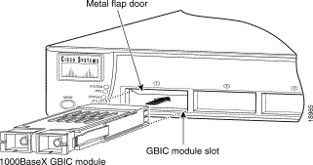
Switched Backbone
And close up

Slide 81
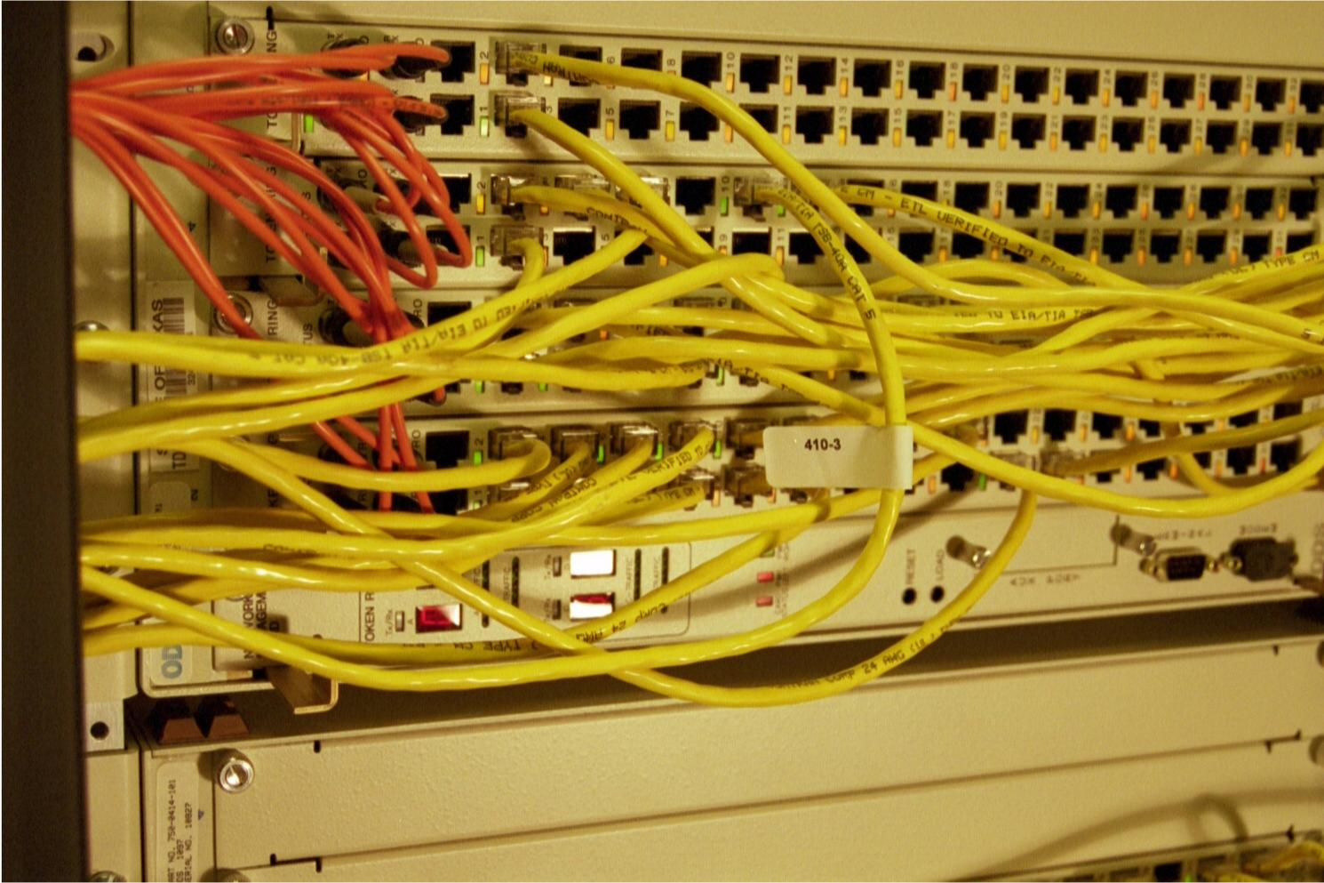
Backbone
Fiber Optic Cable backbone connection

Slide 82
Switches by Layer
Next we will look at the desirable characteristics of switches at each layer of the hierarchical model

Slide 83
Access Layer Switches
An access layer switch needs to support
VLAN creation
Link aggregation
QoS
and perhaps
Port security
PoE
Cost per port is a significant consideration at this layer

Slide 84
Distribution Layer Switches
This is the layer where all the work is done
These multilayer switches – layers 2 and 3 – must be able to interconnect the VLANs created at the access layer
Processing power is the main consideration here, not cost
Layer 3 functions are also used at this layer to implement Access Control Lists

Slide 85
Distribution Layer Switches
These ACLs are used to control the flow of traffic
Link aggregation and QoS as at the access layer are also needed here

Slide 86
Core Layer Switches
Speed is the major consideration at the core layer
Of course these must also support the same QoS and link aggregation of the other layers

