Slide 1
Data Storage Methods Last Update 2007.02.27
1.3.0

Slide 2
Objectives of This Section
Learn how to
Recognize the different methods that can be used to store information on a network

Slide 3
Methods of Storing Data
There are several methods or models that can be utilized when deciding how to store data that is shared over a network
DAS
NAS
SAN
SSP
More than one of these may be used in a network

Slide 4
DAS
The most basic storage model is DAS - Directly Attached Storage
In this model each server contains one or more disk drives
Each drive is managed at the server where it is installed
Backup is by tape or a RAID array

Slide 5
DAS
There may be multiple servers, such as file servers, database servers, and Web servers, each with its own drives and backup media

Slide 6
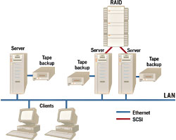
DAS

Slide 7
NAS
The second method is to remove the disk drives from the server and place them in their own box
By attaching storage directly to the network, instead of directly to a server, NAS – Network Attached Storage allows storage to be reconfigured more easily

Slide 8
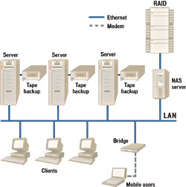
NAS

Slide 9
SAN
In a SAN – Storage Area Network the data is removed entirely from the local network
In this model the data is placed on a subnetwork attached to the rest overall network

Slide 10
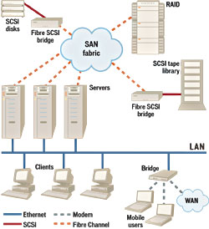
SAN

Slide 11
NAS and SAN
Any of these methods can be and usually are mixed together on the same network
Such as

Slide 12
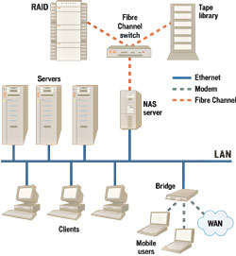
NAS and SAN

Slide 13
SSP
What about not even storing the data at your site
Why might you want to do such a thing

Slide 14
SSP
Perhaps your business is in nice, sunny, hurricane-prone Florida
But your data is in nice, safe Arizona

