Slide 1
DAS Last Update 2012.03.19
1.9.0

Slide 2
Objectives of This Section
Learn how to
Recognize what DAS is
Know when to use DAS
Use RAID and the levels of RAID

Slide 3
What is DAS
DAS – Directly Attached Storage is just another way of talking about hard drives contained inside a server or in a separate box directly attached to the server
This distinction is made and the term DAS is used only in relation to the other forms of storage that will be discussed in the next few presentations
In other words NAS, SAN, and SSP

Slide 4
What is DAS
So when you think of DAS, just think of a file server
DAS can be one or more drives inside the server using SCSI, SAS – Serial Attached SCSI, SATA, or IDE or in a box directly attached to the server using SCSI, SAS – Serial Attached SCSI, or eSATA
In this case these drives can be in one of two configurations

Slide 5
What is DAS
The first is JBOD – Just a Bunch of Disks
This is a collection of drives of the same or different size that contain the applications and data
This information can be contained on a single drive or it can span drives
This method does nothing for fault tolerance, which is the ability to not loose data when a drive dies

Slide 6
What is DAS
The second way to configure a DAS is to use RAID – Redundant Array of Inexpensive Disks
In this case capacity, fault tolerance, or both are increased
RAID has been used since 1989

Slide 7
RAID
RAID can be done in software or hardware
Use the hardware version as discussed below
Many server operating systems support software RAID, but using it is a bad idea
First is its reliance on the host CPU
Since software RAID runs on the host processor and uses system memory resources, there is a performance penalty

Slide 8
RAID
Every compute cycle used to run software RAID drains bandwidth from the system's host processor and limits it from performing other tasks
Software RAID is also not bootable
Since the RAID functionality is contained within the operating system, it cannot mirror the operating system itself
Software RAID offers no protection from errors within the operating system

Slide 9
RAID
Therefore, it cannot provide as high a level of reliability as RAID implemented outside the operating system
To provide faster performance and greater fault tolerance drives can be linked together in a RAID array

Slide 10
RAID
Simple RAID subsystems are just a collection of disk drives in a cabinet that are all connected to a single controller board
The RAID controller orchestrates read and write activities in the same way a controller for a single disk drive does, and treats the array as if it were in fact a single drive

Slide 11
RAID
RAID management software that resides in the host system provides the means to manage data to be stored on the RAID subsystem
RAID can be optimized for performance, the highest capacity, fault tolerance or a combination of two or three of the above

Slide 12
RAID
Several RAID levels have been defined and standardized in accordance with those general optimization parameters

Slide 13
RAID 0
An array configured as RAID Level 0 is an array optimized for performance, but at the expense of fault tolerance
RAID Level 0 is achieved through a method known as striping
The collection of drives in a RAID Level 0 array has data laid down in such a way that it is organized in stripes across all the drives

Slide 14
RAID 0
A typical array can contain any number of stripes, usually in multiples of the number of drives present in the array
As an example, imagine a four-drive array configured with 12 stripes - four stripes of designated space per drive
Stripes 0, 1, 2 and 3 would be located on corresponding hard drives 0, 1, 2 and 3

Slide 15
RAID 0
Stripe 4, however, appears on a segment of drive 0 in a different location than Stripe 0; stripes 5 through 7 appear accordingly on drives 1, 2 and 3
The remaining four stripes are allocated in the same even fashion across the same drives

Slide 16
RAID 0
The reason RAID 0 is a performance-enhancing configuration is that striping enables the array to access data from multiple drives at the same time
In other words, since the data is spread out across a number of drives in the array, it can be accessed faster because it's not bottled up on a single drive

Slide 17
RAID 0
This is especially beneficial for retrieving very large files, since they can be spread out effectively across multiple drives and accessed as if it were the size of any of the fragments it is organized into on the data stripes

Slide 18
RAID 0
The downside to RAID Level 0 configurations is that it sacrifices fault tolerance, raising the risk of data loss because no room is made available to store redundant data
If one of the drives in the RAID 0 fails for any reason, there is no way of retrieving the lost data

Slide 19
RAID 1
The RAID Level 1 configuration employs what is known as disk mirroring, and is done to ensure data reliability or a high degree of fault tolerance
RAID 1 also enhances read performance, but the improved performance and fault tolerance come at the expense of available capacity in the drives used

Slide 20
RAID 1
In a RAID Level 1 configuration, the RAID management software instructs the controller to store data redundantly across a number of the drives in the array
In other words, the same data is copied and stored on different disks or mirrored to ensure that, should a drive fail, the data is available somewhere else within the array

Slide 21
RAID 1
In fact, all but one of the drives in a mirrored set could fail and the data would remain intact
A read performance gain can be realized if the redundant data is distributed evenly on all of the drives of a mirrored set within the subsystem

Slide 22
RAID 1
The number of read requests and total wait times both drop significantly
Inversely proportional to the number of hard drives in the RAID
For example, three read requests could be made

Slide 23
RAID 1
The first request looks for data in the first block of the virtual drive, the second request goes to block 0, and the third seeks from block 2
Each request is then sent to the various drives
The RAID management software can assign each read request to an individual drive

Slide 24
RAID 1
So that rather than having to handle the flow of each data stream one at a time the controller can send three data streams almost simultaneously, which in turn reduces system overhead

Slide 25
RAID 5
This is the last of the most common RAID levels in use, and is probably the most frequently implemented
RAID Level 5 provides redundancy by interleaving parity check data with user data throughout the drive array
This allows the system to recover any lost data should a single drive fail

Slide 26
RAID 5
This is done by using the parity data to recreate any data lost by failure of a single drive
Since all drives can be read simultaneously read performance is maximized

Slide 27
RAID 5
Writing can be slower because of the need to also write parity information in addition to the
data
There is loss of storage space due to the need to store the parity information
For example in a set of five 18GB hard drives, which totals 90GB of space, only 72GB of actual data can be stored

Slide 28
Parity
Here is what EMC says about parity from their book titled Information Storage and Management
Parity information can be stored on separate, dedicated HDDs or distributed across all the drives in a RAID set
Figure 3-4 shows a parity RAID

Slide 29
Parity

Slide 30
Parity
The first four disks, labeled D, contain the data
The fifth disk, labeled P, stores the parity information, which in this case is the sum of the elements in each row
Now, if one of the Ds fails, the missing value can be calculated by subtracting the sum of the rest of the elements from the parity value

Slide 31
Other RAID Levels
Some other RAID levels have been developed as custom solutions by independent vendors
These are not established standards
They have the usual risks of any proprietary solution

Slide 32
Other RAID Levels
RAID Level 6, which emphasizes ultra-high data integrity
RAID Level 0 + 1 - also known as RAID Level 10 - which focuses on high I/O performance and very high data integrity
In this method the data is striped, then mirrored

Slide 33
Forms of RAID
Here is a nice table from Storage magazine from May 2010 that shows all of the different types of RAID

Slide 34
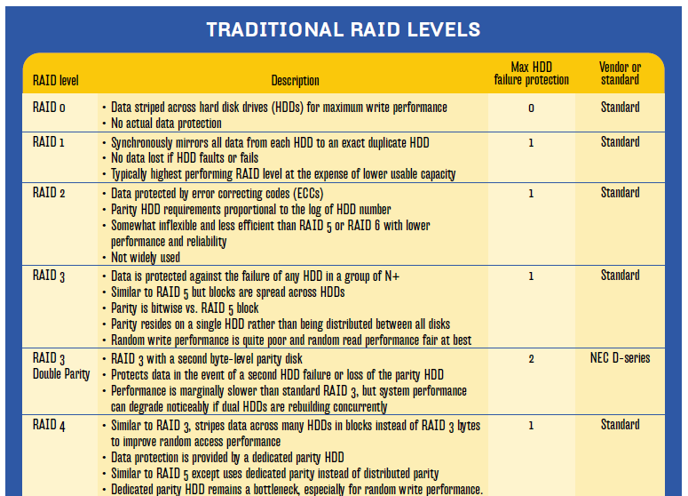
Forms of RAID

Slide 35
Forms of RAID

Slide 36
Other RAID Factors
RAID Level 53, which combines RAID Level 0 and 3 for uniform read and write performance
The final factor in a RAID system is the amount of cache - memory - on the RAID controller card
The more memory the better since this speeds performance

Slide 37
Problems with DAS
DAS has limitations
Primarily it does not scale easily
It also cannot be separated very far from the server itself
This is why the other methods have been developed

Slide 38
Problems with DAS
When the needs of the organization outgrow the size of the drive in the server, either a new server must be purchased, a bigger drive must be put in the server, or more drives must be added to the attached box
All of this produces downtime and management problems

Slide 39
Problems with DAS
In particular you must manage the data on each server by its self
Each server will require that
Volumes be setup
Rights assigned to files and directories
Data be backup
And so on

Slide 40
Lab
Let’s find a hot swappable RAID box

