Slide 1
Citrix Virtualization Last Update 2011.01.01 1.0.0

Slide 2
Objectives of This Section
Learn
About the Citrix approach to virtualization

Slide 3
Citrix Virtualization
The Citrix approach to virtualization looks very much like the Xen approach
This makes sense as Citrix purchased XenSource in 2007
The current Xen solution is an open source offshoot of this

Slide 4
Citrix Virtualization
The product line now consists of four versions
XenServer
XenServer Advanced Edition
XenServer Enterprise Edition
XenServer Platinum Edition
The basic version - XenServer - is now free and open source as well

Slide 5
Citrix Installation
The installation is in two parts
First the XenServer is installed on one computer
Then the XenCenter manager is installed on a different computer
Let’s begin by installing XenServer

Slide 6
XenServer Installation
Place the disc with XenServer on it in the drive
Boot the computer
Various Linux things will load
Then a text based GUI will appear
This is a standard Linux based installation
On it select the keymap language
Next tell it to install XenServer

Slide 7
XenServer Installation
Agree to the license
Tell it where to store the virtual machines
Select any supplemental packs
Skip verification
It loads
Enter a password
Select a NIC

Slide 8
XenServer Installation
Tell it how to get an IP address
Tell it how to get a hostname and DNS entries
Select the timezone country then the timezone city
Select the time source
Confirm the installation and proceed
The installation proceeds

Slide 9
XenServer Installation
If a NTP source is not available, the time is requested
Installation resumes
The media is removed
The computer reboots
The main screen appears

Slide 10
XenCenter Installation
It and the other screens accessible from this main screen all look like the open source Xen screens but in a different color
The next task is to install the management program on a computer that has network access to the server

Slide 11
XenCenter Installation
This installation can be done from a disc with the msi file on it or from a browser by entering the IP address of the XenServer
In this case we will use the browser method
Enter the IP address of the XenServer
Go there
Select XenCenter installer

Slide 12
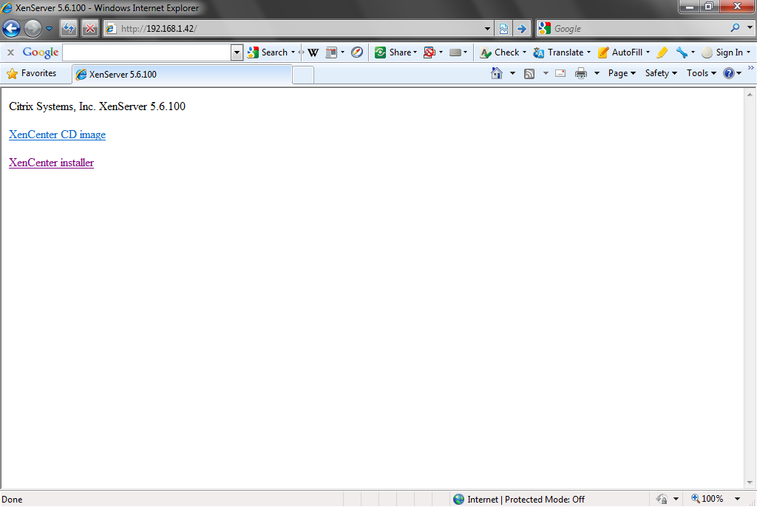
XenCenter Installation

Slide 13
XenCenter Installation
Select Run, then Run again
Click Next
Tell it where to install it
Click Next
Click Install

Slide 14
XenCenter Installation
Click Finish
Open it to access the XenServer
The result is

Slide 15
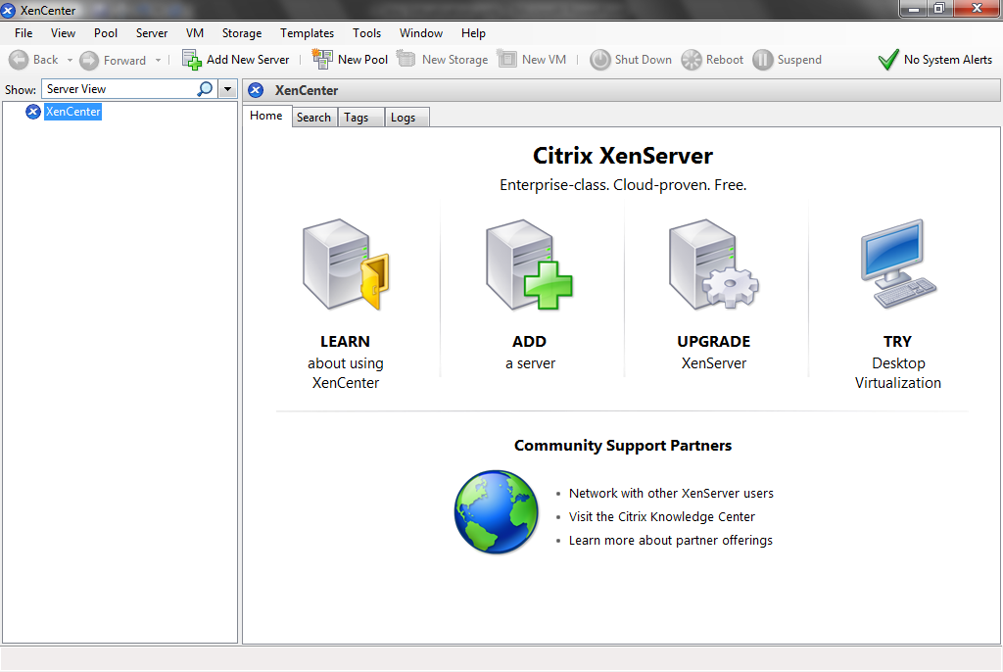
XenCenter Installation

Slide 16
Add a Server
After both the server and the manager are installed a server must be created
Click the Add Server icon
In the box that appears enter the IP address of the server, the username, and the password

Slide 17
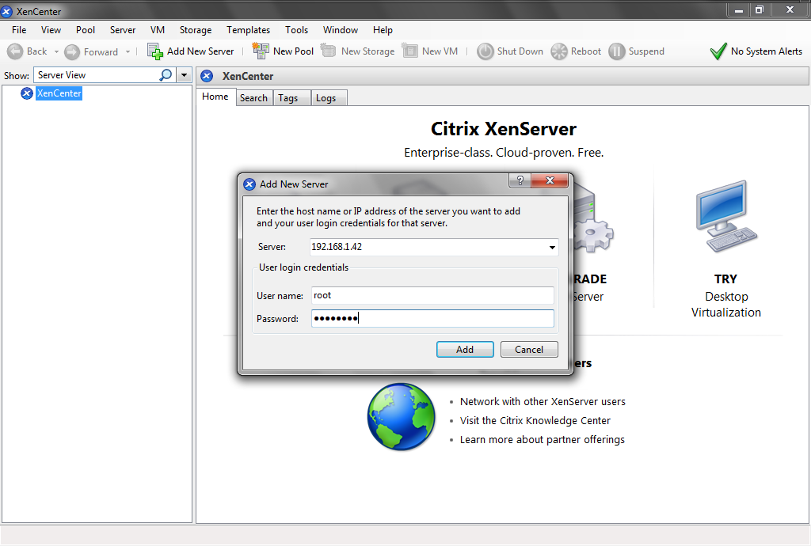
Add a Server

Slide 18
Add a Server
Tell it to save the login information

Slide 19
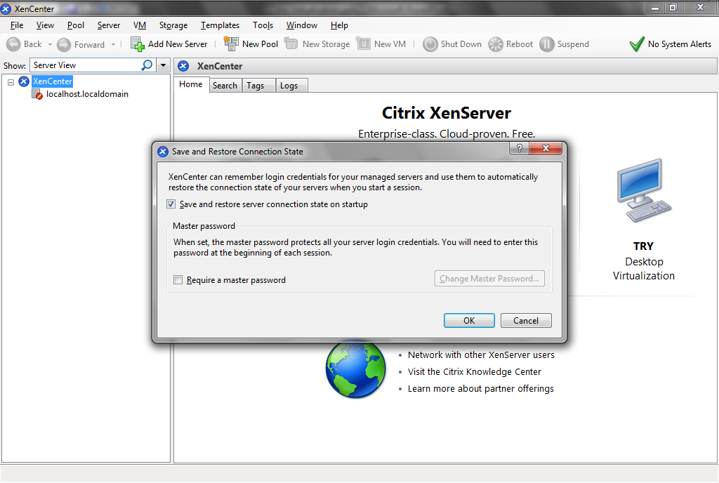
Add a Server

Slide 20
Add a Server
Now we have to add a server so a virtual machine can be created
Click on the Add Server icon
Now we have a server

Slide 21
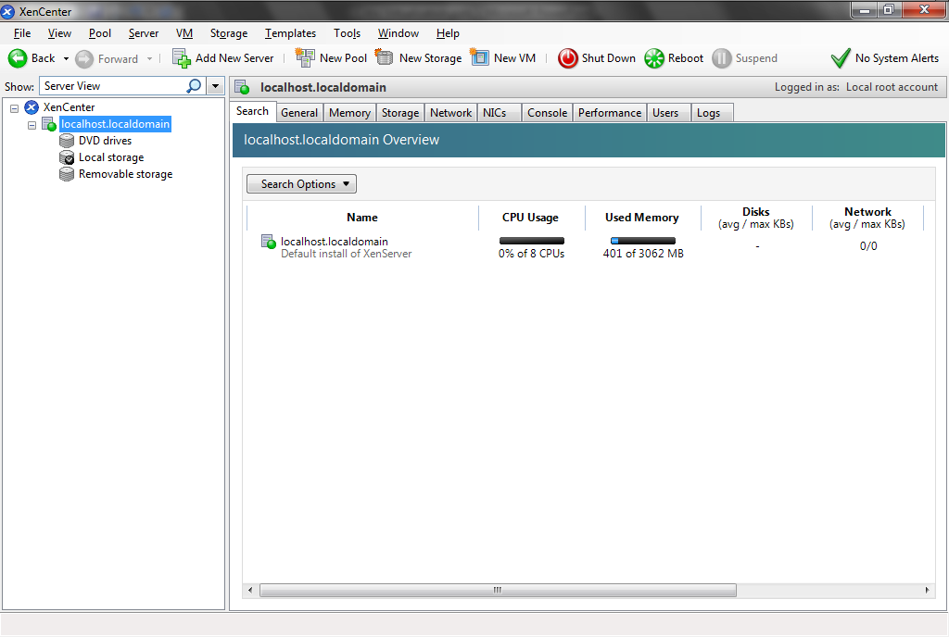
Add a Server

Slide 22
Create a Virtual Machine
To create a virtual machine select New VM from the VM menu

Slide 23
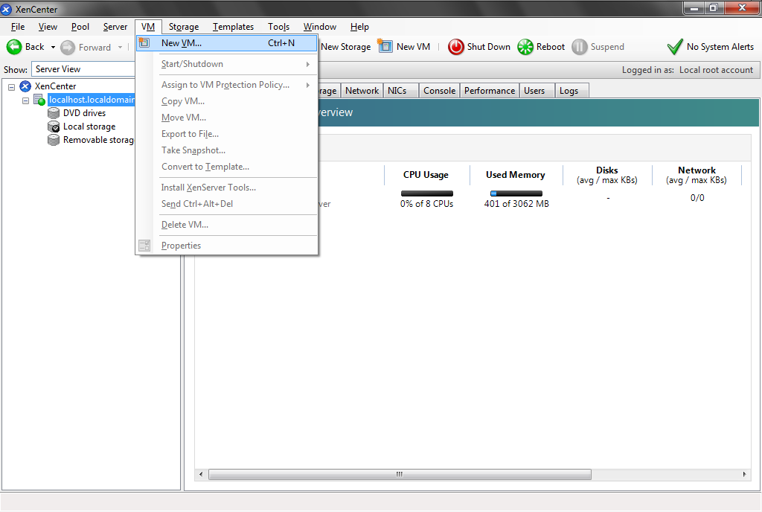
Create a Virtual Machine

Slide 24
Create a Virtual Machine
Select the operating system template to use

Slide 25
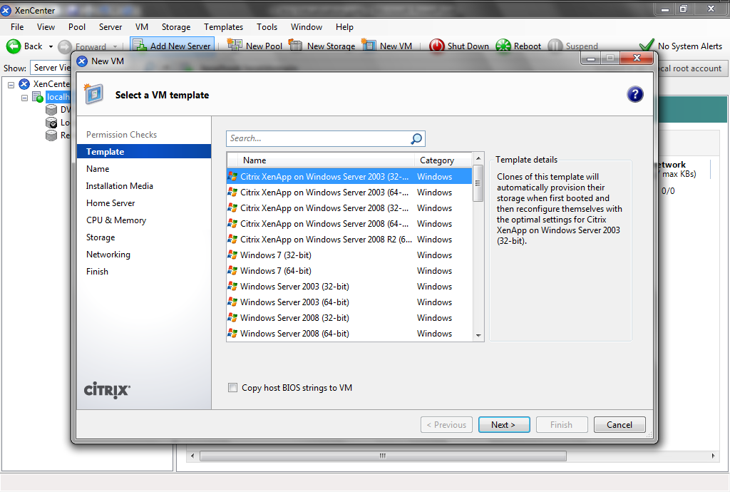
Create a Virtual Machine

Slide 26
Create a Virtual Machine
Name the virtual machine

Slide 27
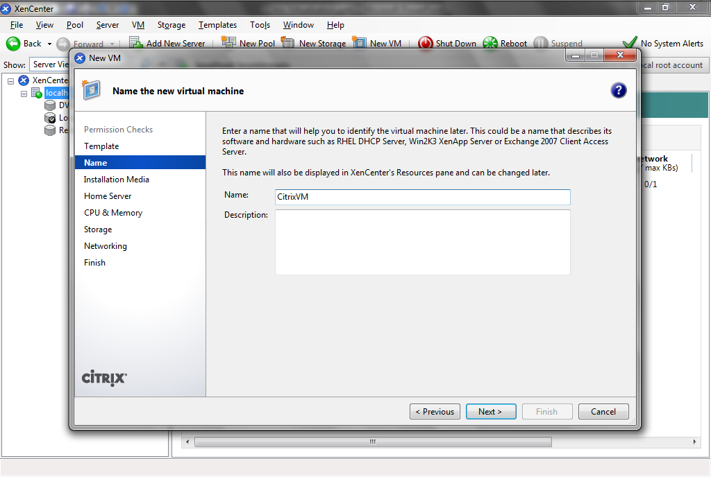
Create a Virtual Machine

Slide 28
Create a Virtual Machine
Tell it where to find the installation files for the new virtual machine’s operating system

Slide 29
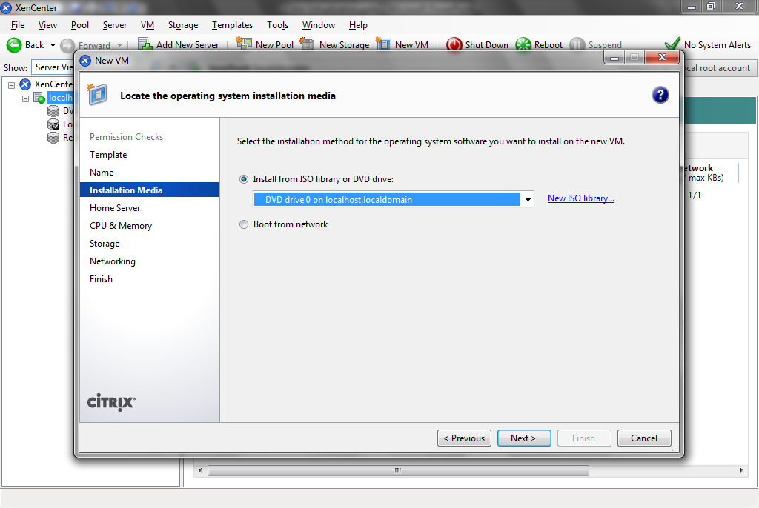
Create a Virtual Machine

Slide 30
Create a Virtual Machine
Tell it the server to use to store the virtual machine

Slide 31
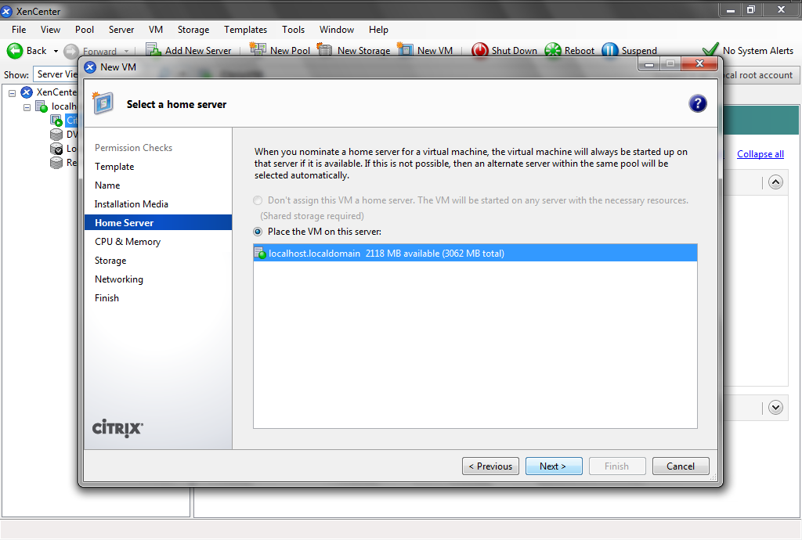
Create a Virtual Machine

Slide 32
Create a Virtual Machine
Adjust the number of CPUs and memory for the virtual machine if needed

Slide 33
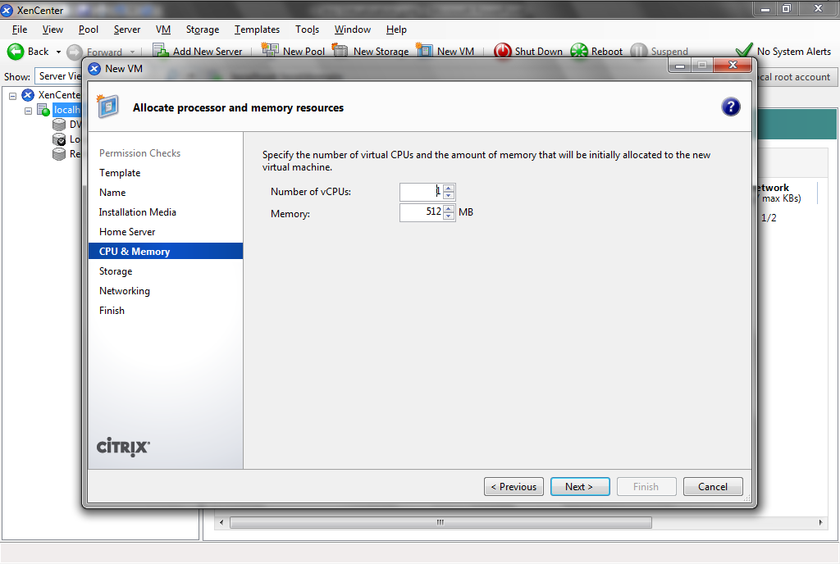
Create a Virtual Machine

Slide 34
Create a Virtual Machine
Adjust the virtual machine’s storage if needed

Slide 35
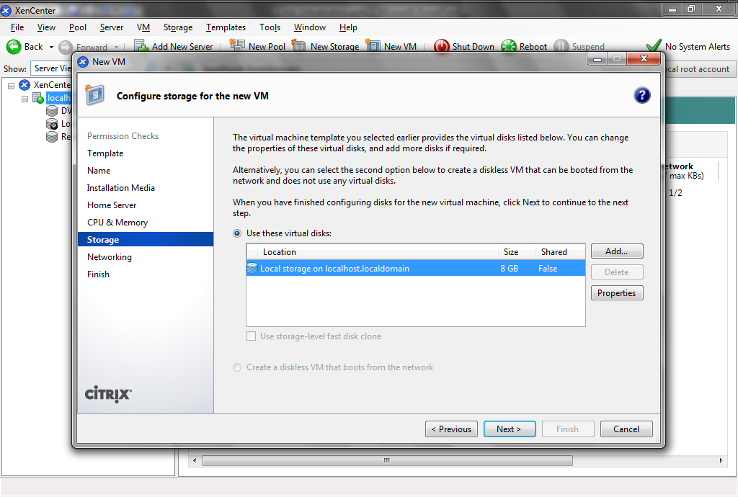
Create a Virtual Machine

Slide 36
Create a Virtual Machine
Setup the network connection for the virtual machine

Slide 37
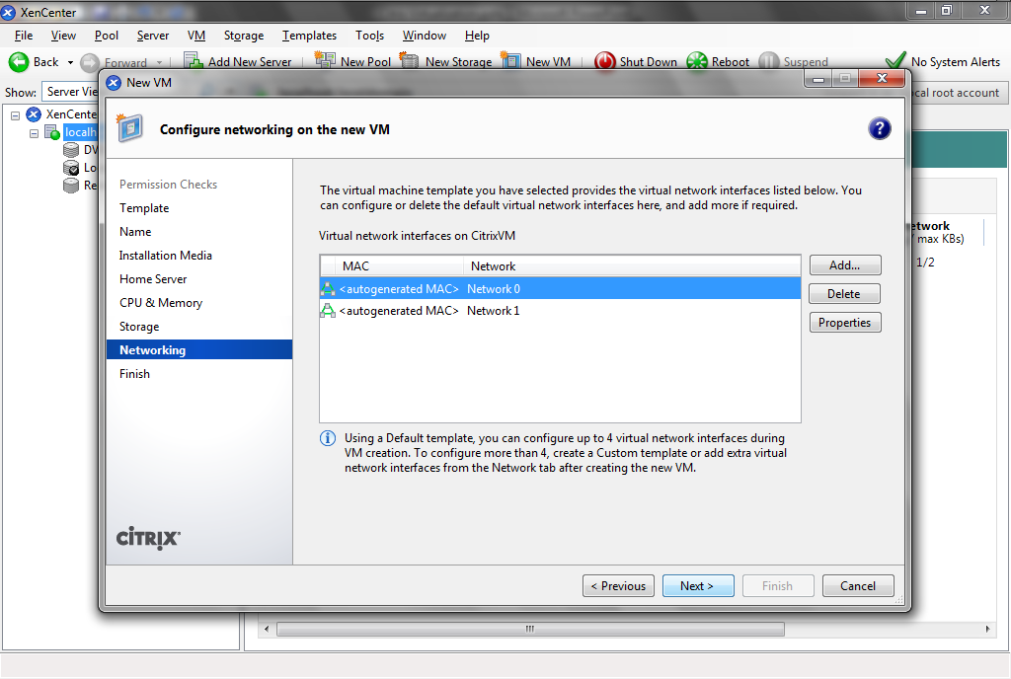
Create a Virtual Machine

Slide 38
Create a Virtual Machine
Verify the setup and click Finish

Slide 39
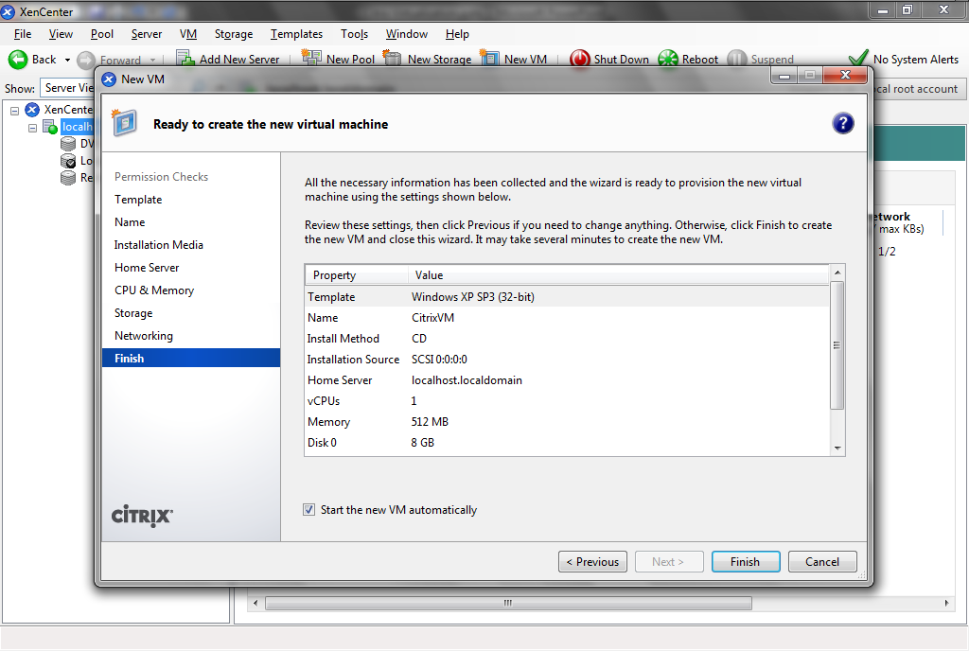
Create a Virtual Machine

Slide 40
Create a Virtual Machine
In the bottom left corner messages appear as the virtual machine is created

Slide 41
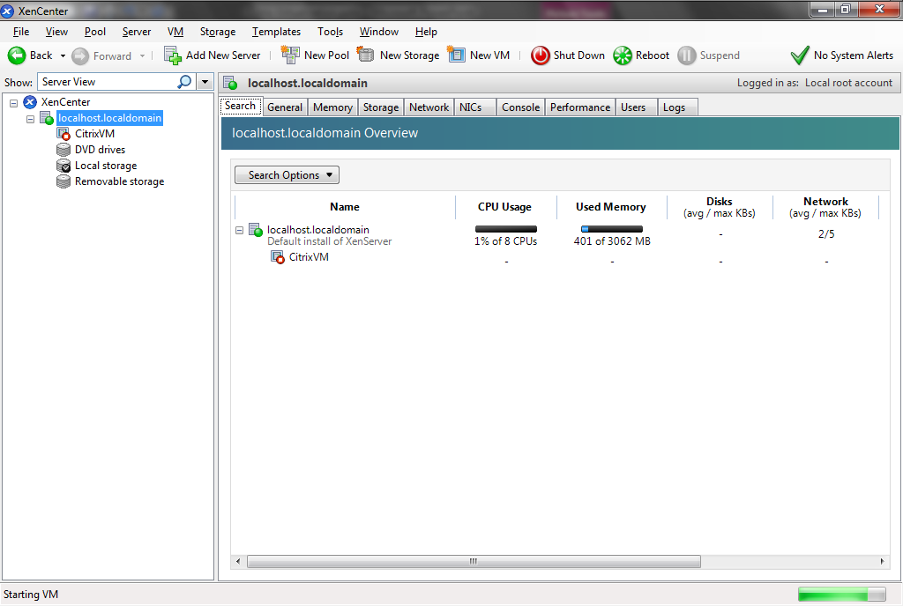
Create a Virtual Machine

Slide 42
Create a Virtual Machine
Now we have a new virtual machine

Slide 43
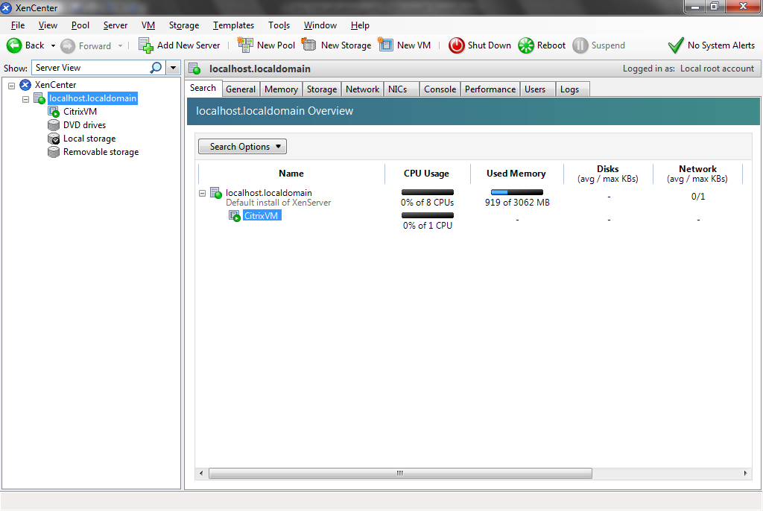
Create a Virtual Machine

Slide 44
Create a Virtual Machine
Select the virtual machine
Click on the Console tab to see the virtual machine operating system installation occurring

Slide 45
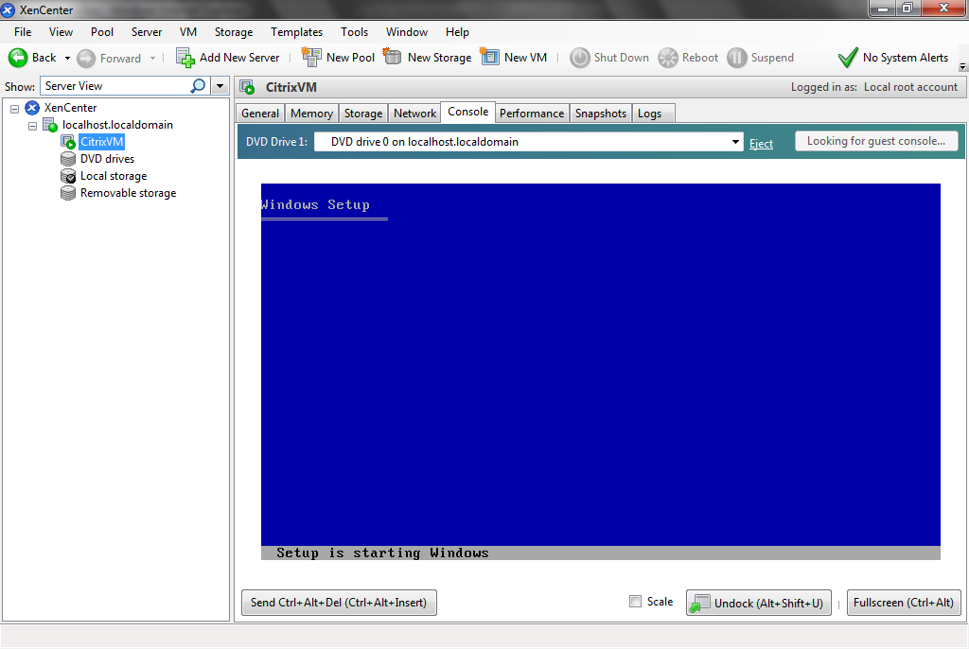
Create a Virtual Machine

Slide 46
Create a Virtual Machine
And now we have a virtual machine with an operating system installed

Slide 47
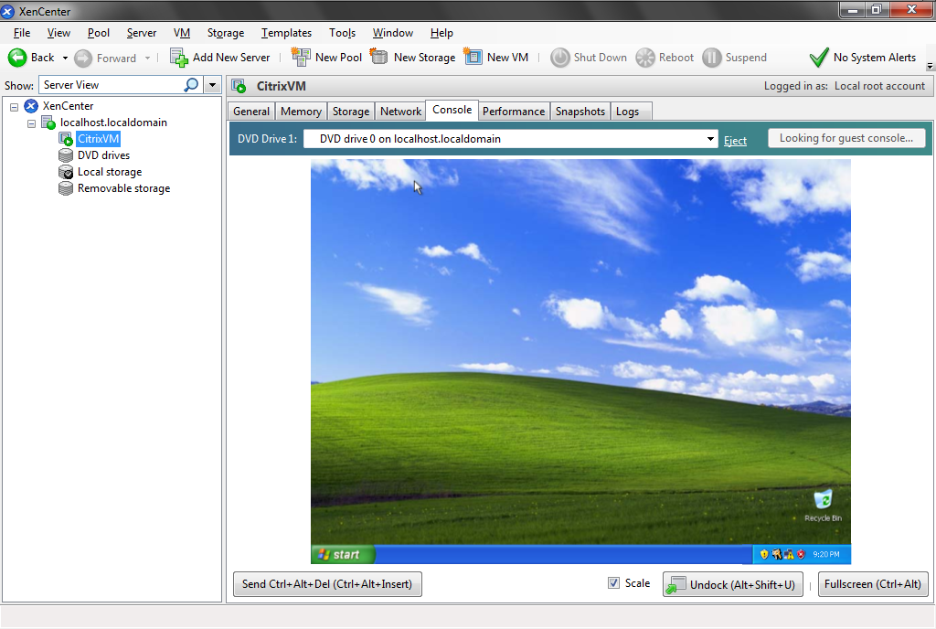
Create a Virtual Machine

Slide 48
Create a Virtual Machine
The last step is to install the XenServer Tools
Select the VM menu item, then Install XenServer Tools

Slide 49
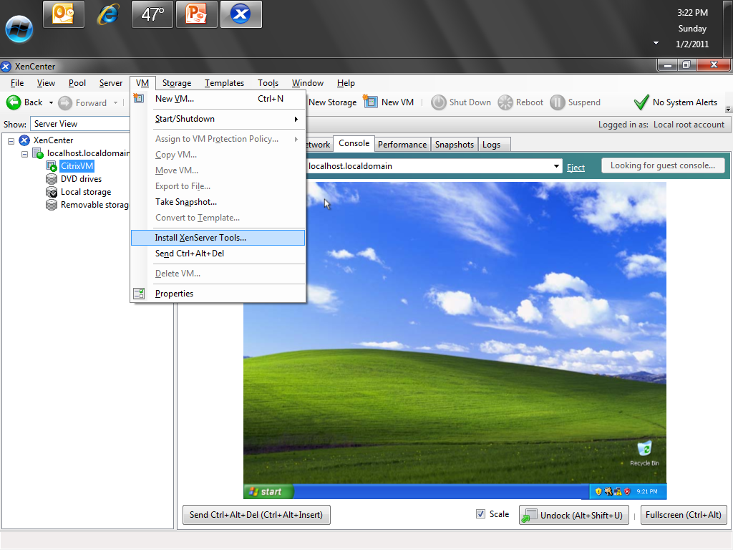
Create a Virtual Machine

Slide 50
Create a Virtual Machine
Agree to the installation
Agree to the license
Select the installation location

Slide 51
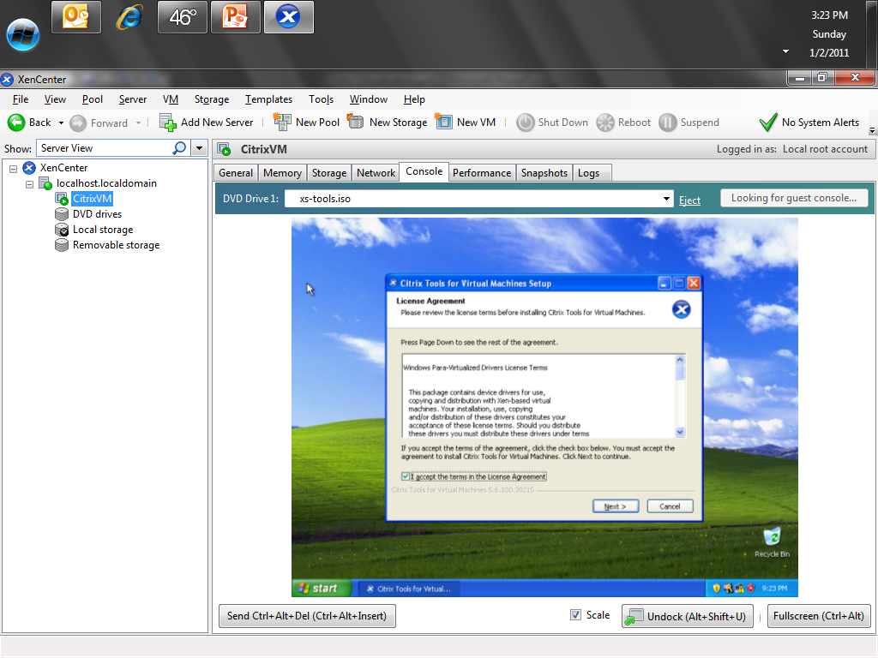
Create a Virtual Machine

Slide 52
Create a Virtual Machine
After the installation, click Finish to reboot the virtual machine operating system

Slide 53
Create a Virtual Machine

Slide 54
Create a Virtual Machine
And we are done

Slide 55
Create a Virtual Machine

Slide 56
Citrix Virtualization
As you can see the process is quite simple

