Slide 1
Backbone Last Update 2009.02.27 1.0.0

Slide 2
Objectives of This Section
Learn
What a backbone connection is
How to layout a backbone

Slide 3
What is a Backbone
At the LAN level, a backbone is a cable or set of cables that extend the size of a LAN or that connect LANs to each other over a short distance, such as between floors in a building

Slide 4
Connections
The connection for a backbone can be by
Cable
Copper
Fiber
Wireless
The connection runs from a switch typically on one end to a corresponding connection on the other end

Slide 5
Physical Layout
The recommended topology is the typical star layout
This is where all wiring radiates out from the main Telecommunications Room, which in this application could also be called the Main Cross Connect
Each backbone cable would then connect to a another Telecommunications Room also called an Intermediate Cross Connect

Slide 6
Physical Layout
One of the main reasons for this type of layout is problem isolation
If a cable is damaged, then only that ICC are is affected

Slide 7
Media
Both copper and fiber can be used for backbone cables
In general fiber is a better choice for future proofing the installation
The possibilities include
UTP Category 5E, 6, or 6A
50 micron Fiber
62.5 micron Fiber
Singlemode Fiber

Slide 8
Maximum Distances
Typical maximum distances between points for these various types of media are

Slide 9
Maximum Distances
Media | MCC to HCC | MCC to ICC | ICC to HCC
UTP | 800m | 500m | 300m
MMF | 2000m | 1700m | 300m
SMF | 3000m | 2700m | 300m
MCC – Main Cross Connect
ICC – Intermediate Cross Connect
HCC – Horizontal Cross-Connect

Slide 10
Development of Backbones
The development of backbones has progressed over the years as new technologies appear
Let’s look at the various designs that have been used and the ones that are now being used

Slide 11
Point-to-Point Backbone
In the first example a LAN that originally covered only a single floor has been extended to cover two floors using a point-to-point backbone design

Slide 12
Point-to-Point Backbone

Slide 13
Collapsed Backbone
In the next design we see the single LAN extended to even more floors
In addition, all of the servers are now centralized in a single location to ease management
In this collapsed backbone design all of the devices are still in a single collision domain and a single broadcast domain, since hubs at layer 1 are used

Slide 14
Collapsed Backbone
This is called a flat design

Slide 15
Collapsed Backbone

Slide 16
Hierarchical Backbone Design
A flat design does not scale well
As more and more devices are added to the shared domains – collision and broadcast – things start to slow down
The solution is to introduce hierarchy to the design so as to divide up these domains

Slide 17
Bridged Backbone
In this first example of a hierarchical design a layer 2 device, in this case a bridge, is used to divide the collision domain

Slide 18
Bridged Backbone

Slide 19
Routed Backbone
Bridges worked well for isolating collisions, but did nothing for the broadcast domain
In the next example a single router was introduced, as a layer 3 device, to isolate the broadcast domains

Slide 20
Routed Backbone

Slide 21
Switched Backbone
Routers are now being replaced with layer 3 switches and the hubs with layer 2 switches
Hubs are being replaced with layer 2 switches on each floor so as to divide up the shared collision domain that still existed on each floor when hubs are used there

Slide 22
Switched Backbone

Slide 23
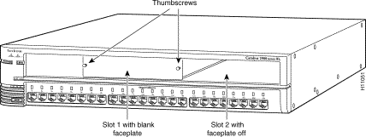
Switched Backbone
In this example the PCs and servers are connected to the layer 2 switches using UTP
These are the ports across the bottom

Slide 24
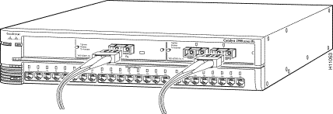
Switched Backbone
The backbone connection is fiber optic cable
A fiber module is inserted in the top part of the layer 2 switch to connect to the layer 3 switch on the bottom floor

Slide 25
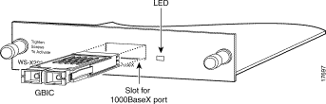
Switched Backbone

Slide 26
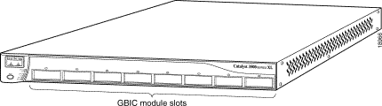
Switched Backbone
On the bottom floor, where all of the layer 2 switches connect together, a layer 3 switch is placed
There must be a module for each layer 2 switch

Slide 27
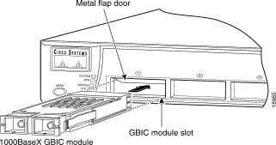
Switched Backbone
And close up

Slide 28
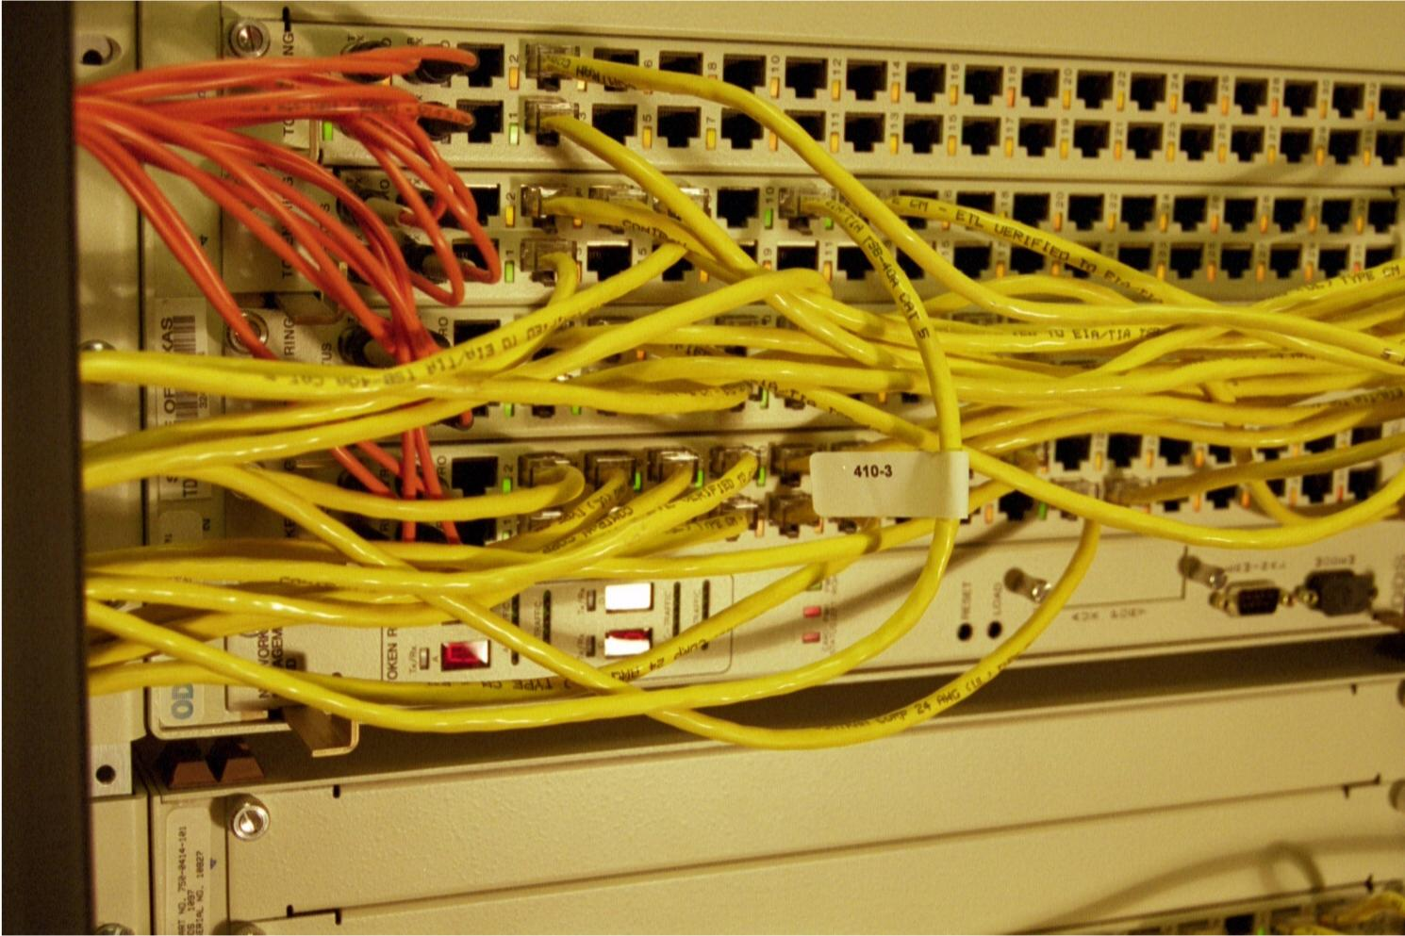
Backbone
Fiber Optic Cable backbone connection

