Slide 1
How To Pass the CCNA Test Last Update 2010.04.13 1.0.0

Slide 2
Cisco Certifications
Cisco has always had three basic levels of certifications
Associate
Professional
Expert

Slide 3
Cisco Certifications
The primary certifications at these three levels are
CCNA
CCNP
CCIE

Slide 4
Cisco Certifications
Cisco has recently added a level at the beginning and one at the end
Entry
Architect
Cisco has also recently added specialist certifications at each level
Such as
CCNA – Security
Here are all of them

Slide 5
Cisco Certifications

Slide 6
CCNA
The CCNA test can be taken as two or one test
As two tests
ICND1 640-822 exam
ICND2 640-816 exam
As one test
CCNA 640-802 exam

Slide 7
CCNA
Interconnecting Cisco Networking Devices Part 1 ICND1- 640-822 covers
Simple Networks
Connected Networks
Cisco IOS Devices
Network Management

Slide 8
CCNA
Interconnecting Cisco Networking Devices Part 2 ICND2- 640-816 covers
More Complex Networks
LANs and VLANs
IP Routing
Access Lists

Slide 9
CCNA
ICND1 640-822
90 min
$125
ICND2 640-816
75 min
$125
CCNA 640-802
90 min
$150

Slide 10
CCNA
The current test is very old
It came out on August 15 2007
I will be surprised if it is not revised within the next year

Slide 11
CCNA 2007 Changes
Here were the changes back then
Prepare students to install, operate and troubleshoot small to medium size enterprise branch networks
Expanded coverage of mitigating security threats
Troubleshooting extended
Introduction to wireless network concepts and terminology
IPv6

Slide 12
CCNA
The CCNA test can be passed with self study and a simulator

Slide 13
CCNP
The CCNP test is recently revised
It is now three tests
The major change is an increased emphasis on troubleshooting
The three tests are now
Switching
Routing
Troubleshooting

Slide 14
CCNP
The CCNP can be passed with self study and some real equipment

Slide 15
CCIE
The CCIE is two tests
One written
The written test can be passed with self study
One lab
In general the CCIE test cannot be passed without considerable daily experience with medium to large networks

Slide 16
Self Study
Self study is done with
Test Preparation Book
Simulator
or
Equipment

Slide 17
Boot Camp
The are numerous boot camp providers
Local ones include
Lammle
Global Knowledge

Slide 18
College Courses
For lower cost community college non-credit courses are a good choice

Slide 19
On the Job Experience
On the job experience is useful but not required
Of course it is hard to find

Slide 20
Web Sites
The Cisco blog on Network World by Wendell Odom is extremely useful
Check it every week
www.networkworld.com/subnets/cisco
Certification Zone’s material is older, but very good as it is written in many cases by well known people such as Berkowitz and Oppenheimer
www.certificationzone.com/cisco

Slide 21
Books
Todd Lammle
Wendell Odom
Richard Deal

Slide 22
Lammle
Lammle’s latest book is the oldest as it is from 2007
But all of his books are good

Slide 23
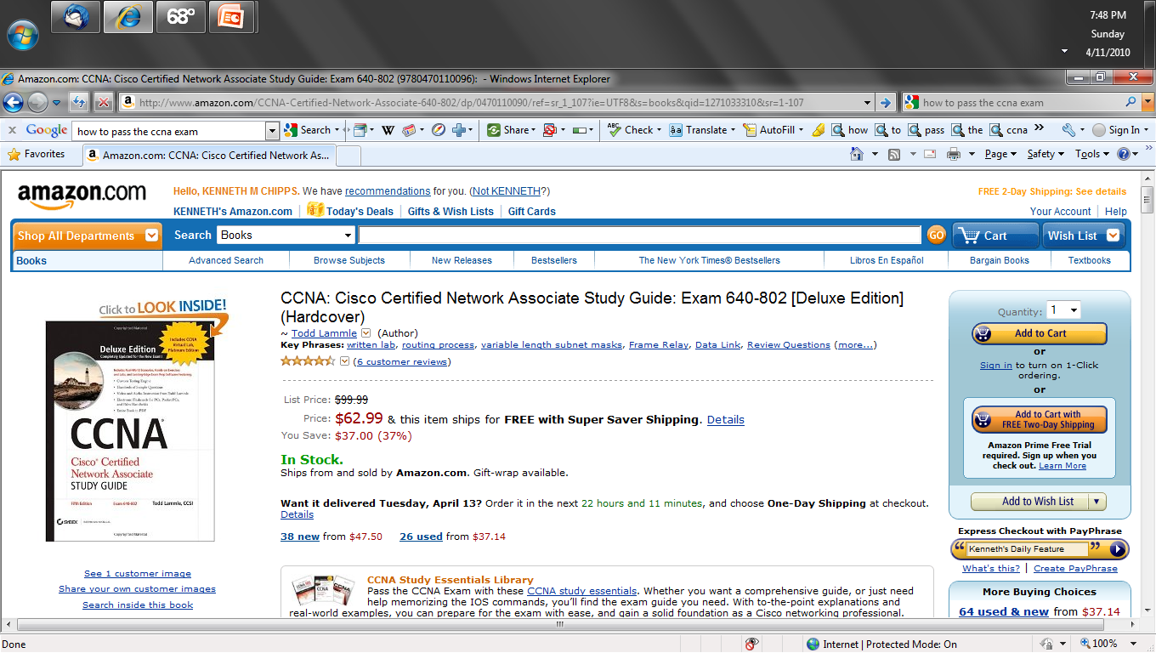
Lammle

Slide 24
Odom
Odom’s latest book is two books, one for each test, and a simulator similar to Packet Tracer
It came out in January 2010

Slide 25
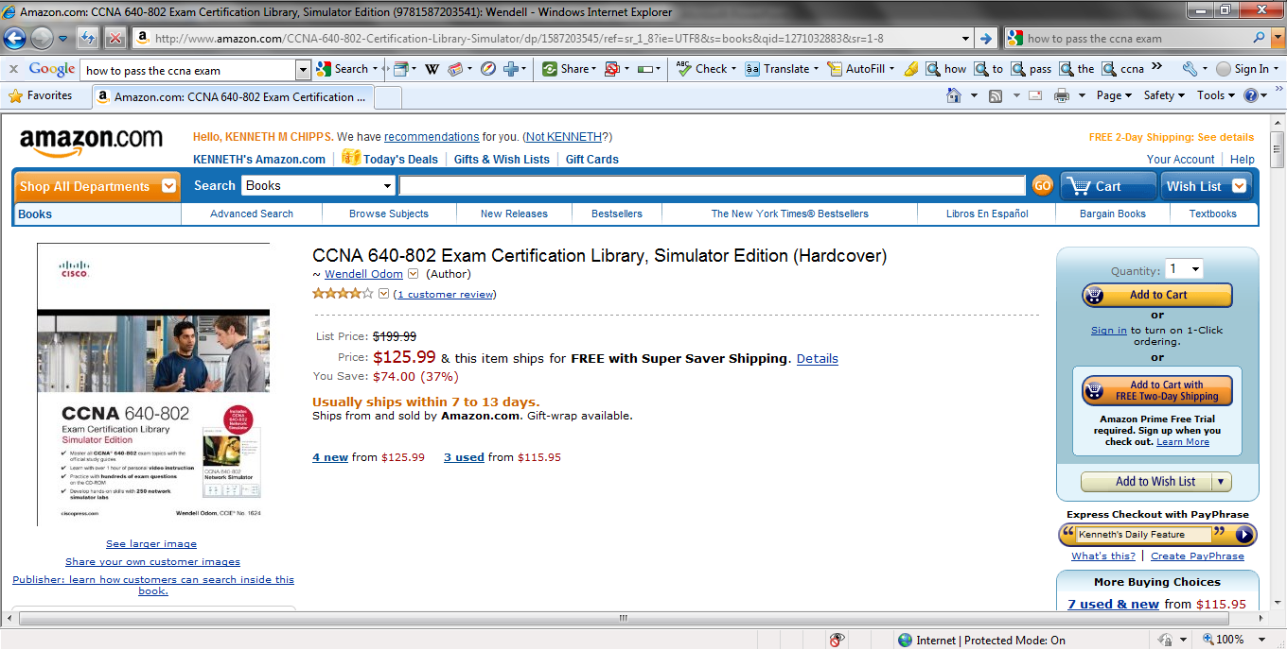
Odom

Slide 26
Deal
Deal has been writing CCNA books for years
I do not usually use his, but I assume they are good

Slide 27
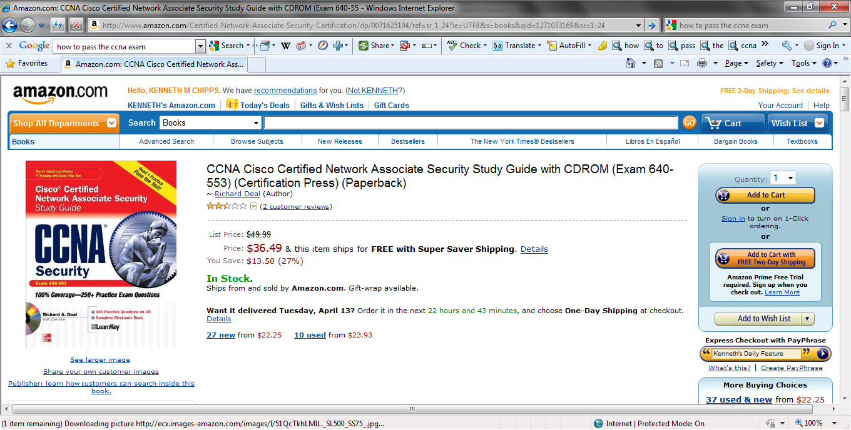
Deal

Slide 28
Renting Time on Equipment
Rather than buying equipment you can rent time on equipment
There are many of these such as
The Bryant Advantage
CCIE4U
IPExpert

Slide 29
Buying Equipment
If you buy equipment at a minimum you will need
Router
Switch
Cables

Slide 30
Routers
Two 1800s with the 2 serial and 1 Ethernet interfaces
or
Two 2501s with the 2 serial and 1 Ethernet interfaces
or
Two 2600s with the 2 serial and 1 Ethernet interfaces

Slide 31
Routers
Two transceivers if the 2501s are used
Two DCE to DTE cables for the specific serial interfaces
Two power cables
Two crossover cables
One rollover cable

Slide 32
Switch
2950
or
2960
With standard IOS image

Slide 33
Sample Configuration

Slide 34
Places to Buy From
eBay
Craigslist
www.cablesandkits.com
www.ciscokits.com
www.optimumdata.com
www.horizondatacom.com
www.usedrouter.com

Slide 35
Using a Simulator
There are several simulators
Packet Tracer
Cisco Press Simulator
RouterSim
Boson
Dynamips or the GNS3 GUI Front End

Slide 36
What Will Cause You Problems
Lack of time
Lack of time
Lack of time
Lack of time
Lack of time
Lack of time
Lack of time
Lack of time

Slide 37
What Will Cause You Problems
No place to make notes before or during the test
They will give you a dirty slate and a dull dry erase marker
It writes too big
The result is hard to read

Slide 38
What Will Cause You Problems
Simulation questions
These are presented as a diagram with a scenario
Questions are asked concerning these

Slide 39
Why is the Test So Hard
A lot of material
Odom’s prep books for example total over 1200 pages
The authorized Cisco courses for CCNA take 10 days
Plus outside of class study time
Most of the other exam courses take 5 days

Slide 40
Why is the Test So Hard
You forget some of the early stuff by the time you finish the preparation for the test as going through the typical preparation sequence will take about 10 hours a week for 3 or 4 months

Slide 41
Why is the Test So Hard
The form of the questions
Sim questions use a simulator
The questions begin with either an incorrect or incomplete configuration
You need to figure out what is wrong then fix it
This requires you to know all CCNA level configuration commands
Then be able to recognize the problem by using show commands and so forth

Slide 42
Why is the Test So Hard
Simlets
This is several multiple choice questions about a simulation
Teslets
These are questions with a central scenario but several questions on each one
Application
This is a more detailed scenario than the testlet that requires higher level analysis

Slide 43
Why is the Test So Hard
Subnetting
Must be done quickly and accurately

Slide 44
Summary
So what should you do
Quit eating
Quit sleeping
Quit work
Quit school
Or decide you love this stuff more than anything else in the world
Because you will make time for what you really want to do

