Slide 1
What is the Difference Between Training and Education Last Update 2011.01.12 1.1.0

Slide 2
Training v Education
This is not a training company
This is a university

Slide 3
What is the Difference
Training is for the short term
Specific intense training over a short time period to master a transitory skill
Education is for life
Learning and using in different situations throughout your life skills such as
The theoretical basis of your field
Critical thinking
Math
English

Slide 4
What is the Difference
Education teaches you how to learn
It also teaches you current knowledge, but just like experience and certifications this current knowledge will soon be out of date
What will not ever be out of date is your ability to learn

Slide 5
Training v Education
In our case we are focusing in this class and in all of the networking classes on a combination of transitory skills as well as the theoretical basis of the field of networking

Slide 6
Training v Education
Why
You need the transitory skills as these are the ones used today on the job
You need the theoretical knowledge to understand and apply new technology as it is developed and deployed
You will learn and apply this new technology using the theoretical basis of the field of networking as well as critical thinking, math, and so forth learned in those other courses

Slide 7
Three Aspects to Success
There are three aspects to success in the network field
Certification
Experience
Education
Many people get by for years or forever with only one of these elements
So why do I say you need all three

Slide 8
Why All Three
Certification
Certification gives you basic familiarity with current systems and procedures
However this will change over time
Therefore certifications require constant updating

Slide 9
Why All Three
Experience
Experience gives you speed
By having done the same thing several times before you need not think about it, just do it, thereby saving time

Slide 10
Why All Three
Education
Education gives you understanding, so that when the basic familiarity gained through certification is not enough or past experience lets you down, you can figure it out for yourself
Because you understand how it works

Slide 11
Why All Three
Where the person that is certified will know how to do something
The person who has experience may know two ways to do something
The person with education will know the why about the something

Slide 12
Why All Three
This why, this knowing how it works, will allow the person with the degree to get back on track when the one way the certified person learned for the test does not work, and neither do the two ways the person with experience knows
The person who knows how it works, can make it work
So of the three, all are important

Slide 13
Why All There
But education in the field is the major element in my view
You need to know the why, not just the how

Slide 14
Training v Education
What is an example of a training organization

Slide 15
Global Knowledge

Slide 16
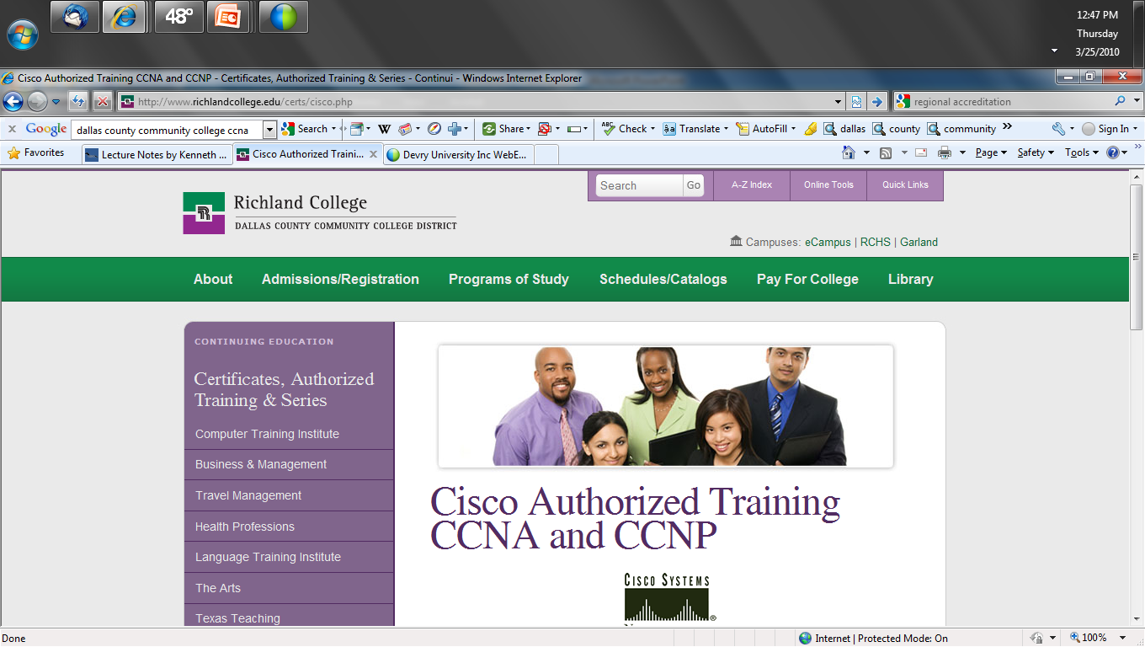
DCCD Continuing Education

Slide 17
What is a University
To understand what a university is let’s consider what every university student’s favorite research source Wikipedia says
A university is an institution of higher education and research, which grants academic degrees in a variety of subjects
A university is a corporation that provides both undergraduate education and postgraduate education

Slide 18
What is a College
The difference between a college and a university is that a college just offers a collection of degrees in one specific area, while a university is a collection of colleges
When you go to a university you are going to be graduating from one of their colleges, such as the business college
Single colleges tend to be smaller while universities are bigger

Slide 19
Types of University
There are two types of universities
Research
Teaching

Slide 20
Research University
There are several levels of research universities
A top level Research I university
Offers a full range of baccalaureate programs
Provides graduate education through the doctorate
Gives high priority to research
Awards 50 or more doctoral degrees each year
Receives $40 million or more in federal support per year

Slide 21
Research University
Notice that nowhere on that list is anything about teaching students
In this type of school the main responsibility of faculty is not teaching, it is research for publication and bringing grant funds into the school

Slide 22
Teaching University
In a teaching university
The faculty does not do research for publication as their primary responsibility
Instead they teach students
Research is a secondary and voluntary activity

Slide 23
UTA
Let’s look at a typical lower tier research university
UTA is an example of this type of school
UTA is a research school, but it is not a tier 1 school
UTA faculty get ahead by doing research

Slide 24
Teaching Assistant
At a research school usually the undergraduate courses are taught by teaching assistants
TAs are graduate students hoping some day to do research at a research university

Slide 25
Research Research Research
When you ask a faculty member at a school like this what they do a typical response is
Research Research Research
Teaching Teaching
Service
Let’s look at a job posting for a faculty position at UTA

Slide 26
Job Description
Here is part of the job description for a current opening in the Computer Science and Engineering department at UTA
The CSE faculty are active researchers, many with multiple grants and established research programs

Slide 27
DeVry
Just like other universities DeVry is
A regional accredited university
Organized as a series of colleges
With a set of programs within each of these colleges
You are in the Network and Communication Management program in the College of Engineering and Information Sciences

Slide 28
University

Slide 29
College

Slide 30
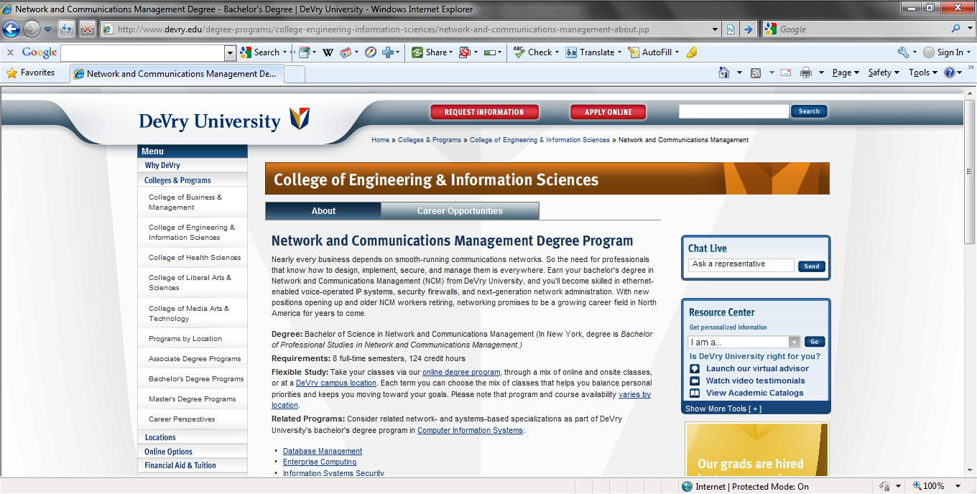
Program

Slide 31
Job Description
Here is part of the job description for a current opening in the Network and Communications Management program at DeVry
Full-time faculty provides the educational focus of teaching, academic advising, and committee work in our academic courses
Service to the College, community, profession, and scholarly activities are integral aspects of this position

Slide 32
Job Description
The qualified individual would be responsible for teaching courses that provide students with a background in network systems administration as applied to practical business situations
These courses would address installing, configuring, securing and administering network systems comprising users, shared resources and network elements, such as routers, in local and Internet-based environments

Slide 33
How is DeVry Different
What is different between a research university and DeVry
The main difference is the added value
I bring decades of on the job experience in this field into the classroom
I do nothing but keep up with developments in this field
I look at what needs to be added
I look at what needs to be deleted

Slide 34
Accreditation
The two major forms of accreditation are
Regional
National
The difference is regionally accredited schools are predominantly academically oriented, non-profit institutions
Nationally accredited schools are predominantly for-profit and offer vocational, career or technical programs

Slide 35
Accreditation
Even though we are a for-profit company we are one of the regionally accredited universities based on our commitment to high quality education, as opposed to simple vocational training schools

Slide 36
Regional Accreditation
All high quality universities including DeVry are accredited by one of the regional accrediting bodies
These are
Middle States Association of Colleges and Schools
New England Association of Schools and Colleges
North Central Association of Colleges and Schools

Slide 37
Regional Accreditation
Northwest Association of Accredited Schools
Western Association of Schools and Colleges
Southern Association of Colleges and Schools
DeVry is part of the North Central Association

Slide 38
North Central Association
Who else is accredited by the North Central Association that you might recognize
Colorado State University
Cornell
Iowa State University
Kent State
Michigan State University
Ohio State University

Slide 39
North Central Association
Oklahoma State University
Purdue
University of Chicago
University of Michigan
University of Oklahoma

Slide 40
Texas Specific Accreditation
In addition in Texas we are governed by the Texas Higher Education Coordinating Board

