Slide 1
EIGRP
Last Update 2014.06.13
1.4.0

Slide 2
Objectives
Learn what EIGRP is and how it operates

Slide 3
What is EIGRP
EIGRP is a distance vector routing protocol
Cisco finally quit calling it a hybrid routing protocol I am pleased to see
This is a Cisco only protocol
It was first released as a replacement for RIP and a follow-on to IGRP in 1992 to support classless addressing

Slide 4
EIGRP Metric
EIGRP is still and will remain in wide use
The metric for EIGRP is theoretically made up of
Bandwidth
Delay
Reliability
Load
MTU
Hop Count

Slide 5
EIGRP Metrics
Despite being in the list MTU and Hop Count are not used
In practice only bandwidth and delay are used
Despite it appearing that these metrics can be adjusted, in practice they are constants
The only one that can be successfully manipulated is delay, but there is really no reason to alter it either

Slide 6
EIGRP Metrics
Just leave them all at their default values
MTU is listed as a metric, but it was never implemented in EIGRP
Much of this metric confusion is due to the need to make IGRP backward compatible with IGRP as well as confusion in the early days of all of this
The maximum hop count is 224

Slide 7
EIGRP Multicast Address
EIGRP uses the multicast address 224.0.0.10

Slide 8
EIGRP Benefits
EIGRP has the following benefits
Rapid convergence
Efficient use of bandwidth as only partial bounded updates are sent as needed only to the routers affected
Supports CIDR
Supports VLSM
Supports IP, IPX, and AppleTalk

Slide 9
EIGRP Concepts
The following three tables are maintained by EIGRP
Neighbor table
Topology table
Routing table

Slide 10
Neighbor Table
The most important table
It lists adjacent routers
There is one table per routed protocol in use
When a hello packet is not received within the hold time the topology change is recomputed due to the change in the neighbor table

Slide 11
Neighbor Table Elements
Neighbor Address
The network layer address of the neighbor router
Smooth Round Trip Timer
The average time it takes to send and receive packets from a neighbor
Queue Count
The number of packets waiting to be sent
Sequence Number
The last packet received

Slide 12
Topology Table
This is a table made up of all of the EIGRP routing tables of the routers that are talking to each other
It is more properly called a list of all the networks known table
EIGRP takes this and the information in the neighbor table to compute the lowest cost path to each destination, which it places in the routing table

Slide 13
Topology Table Elements
Feasible Distance
FD is xxxxxxxx
The lowest calculated metric to each destination
Route Source
via xxx.xxx.xxx.xxx
The source of the route is the identification number of the router that originally advertised the route

Slide 14
Topology Table Elements
Reported Distance
xxxxxxx/xxxxxx
The distance that an adjacent neighbor reports to a specific destination
Interface Information
The interface through which the destination is reached

Slide 15
Topology Table Elements
Router Status
P – Passive
The route is stable and ready for use
A – Active
Route is being recomputed

Slide 16
Topology Table Organization
The organization of the topology table is
Successor routes at the top
Feasible successors next
Possible loops at the bottom

Slide 17
Successor
The successor is the primary router or the next router in the path
This route is identified by the DUAL algorithm from the information in the neighbor and topology tables
This route is placed in the routing table
There can be up to four of these for each route

Slide 18
Feasible Successor
The feasible successor is a backup router
These are identified at the same time as the successors
They are only kept in the topology table
These are not required
In general they are not used
When the route goes away generally the whole thing is just recomputed

Slide 19
Route Selection Rules
Let’s see how this all happens

Slide 20
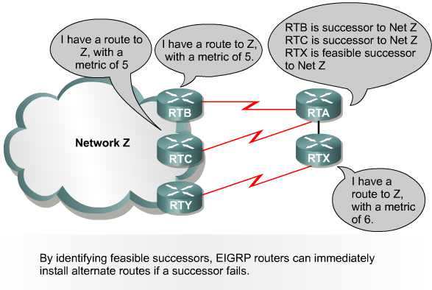
Route Selection Rules

Slide 21
Route Selection Rules
RTA has a route to Z via RTB
For RTA RTB is the current successor for Z
RTA sends packets for Z to RTB
RTC also claims to have a route to Z with same metric
RTA installs RTC as a successor as well
Any of RTA’s neighbors that advertise a loop free route to Z, but with a worse metric than what is already in the table are added as feasible successors
For RTA this is RTX in this example

Slide 22
Route Selection Rules

Slide 23
Route Recomputation
If a route becomes unavailable and a feasible successor does not exist, then the router must ask its neighbors for a route
The neighbors must reply

Slide 24
Routing Table
These best routes are placed in the routing table

Slide 25
Null0
The Null0 interface is not a physical interface
It is only used to advertise routes when
At least one subnet is learned via EIGRP
Automatic summarization is enabled
The Null0 interface is used to discard any packets that match the parent route, but do not match any of the child routes

Slide 26
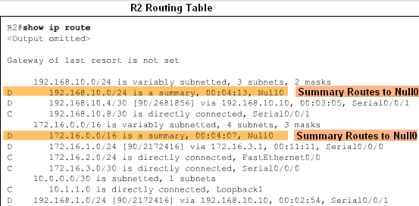
Null0

Slide 27
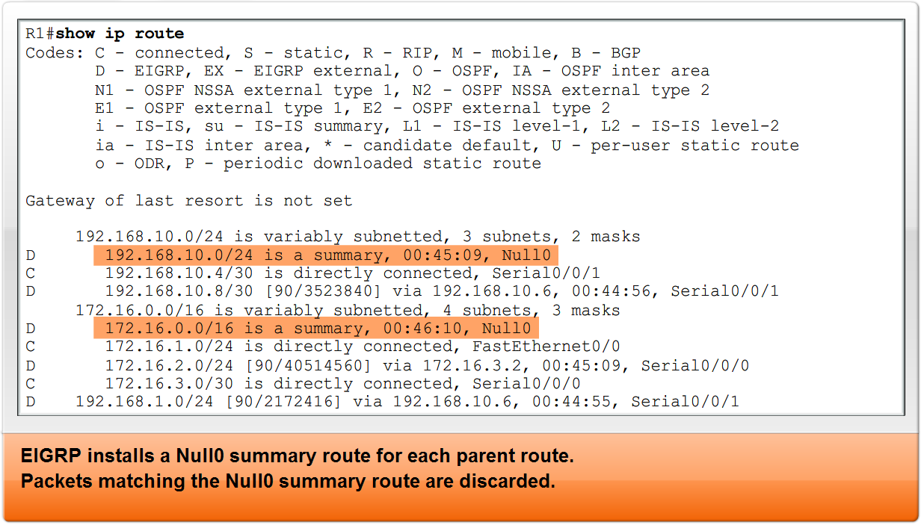
Null0

Slide 28
Configuration
Basic configuration of EIGRP consists of
router eigrp commonrouteinformationnumber
network networknumber
and
eigrp log-neighbor-changes
Recommended by Cisco to monitor stability

Slide 29
Configuration

Slide 30
Configuration
The common route information number is a common source of confusion since Cisco insists on calling it an autonomous system number, it is not
This number has absolutely nothing to do with the concept of an autonomous system
It just represents a common number for each of the routers talking to each other to use

Slide 31
Configuration
It is most similar to a process number
Even though the number can be anything from 1 to 65535 just use 1 all the time

Slide 32
Configuration
The same sort of confusion is seen in the network command
In general you can use just the command
network 192.168.1.0
for example
To use the network command to advertise just specific subnets the wildcard mask can be used

Slide 33
Configuration
Now why not the subnet mask
Because as usual all the Cisco engineers were drunk as skunks on a beach in Cancun
They thought is would be so funny to use a wildcard mask, which is the opposite of the subnet mask, just to make all of this harder to learn

Slide 34
Configuration
Consider that the router does not care as all it sees are ones and zeros
Even worse in some versions of the IOS you can enter a subnet mask, which the IOS then converts to a wildcard
Engineers are such a pain in the rear

Slide 35
Configuration
Use the bandwidth command to adjust the speed to match the actual speed of the data line

Slide 36
EIGRP Capture File
Let’s examine the frames used by EIGRP as it goes about its work
Download this file
HDLC with EIGRP.cap
To open it in Wireshark double-click on it
Select frame 3
Expand all of the fields in the Cisco EIGRP layer

Slide 37
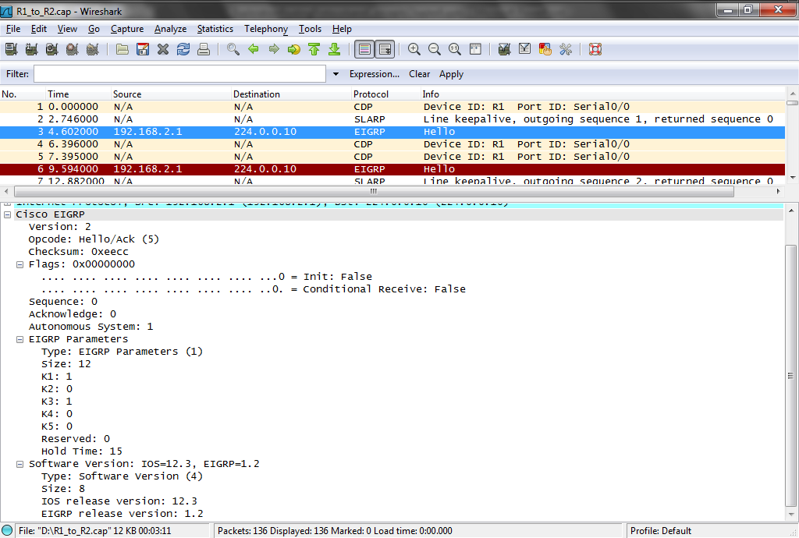
EIGRP Capture File

Slide 38
EIGRP Capture File
What can we learn
The router named 192.168.2.1 says in this Hello frame
Hi, I speak EIGRP
Is there anyone that speaks the same routing protocol at the other end of this link
Notice it sends this to the EIGRP multicast address of 224.0.0.10

Slide 39
EIGRP Capture File
What else do we see
This is Version 2 of EIGRP
The AS is 1
The metrics are K1 to K5 with only K1 and K3 being used
These represent bandwidth and delay which are the default metrics
The router is running IOS version 12.3

Slide 40
EIGRP Capture File
This is EIGRP version 1.2
192.168.2.1 does this again in frames 6, 8, and 10
Then in frame 12 192.168.2.2 sys hi there I am alive and I speak EIGRP
192.168.2.1 says great in frame 13
Here is a network I know about that you do not, the 192.168.1.0 network

Slide 41
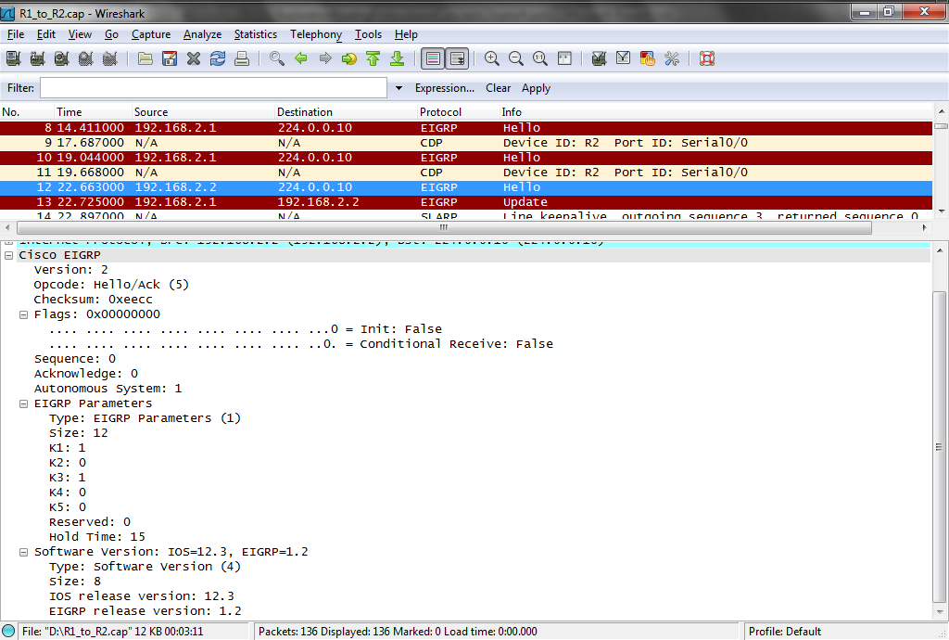
EIGRP Capture File

Slide 42
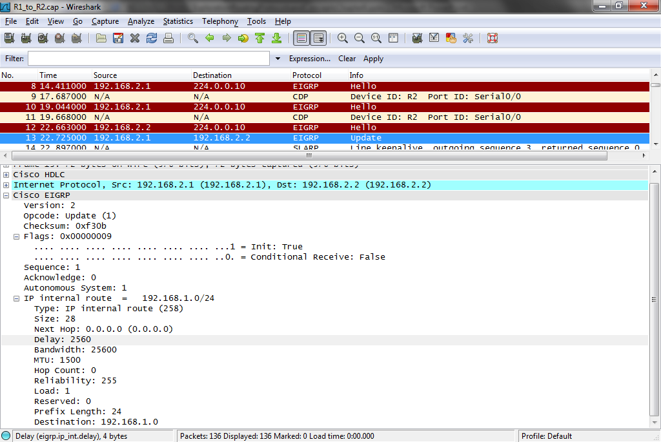
EIGRP Capture File

Slide 43
EIGRP Capture File
As we see in frame 13 the network is
192.168.1.0/24
The delay value is 2560
The bandwidth is 25600
The mtu is 1500
The reliability is high at 255
Notice the network name and prefix length in the bottom two fields

Slide 44
EIGRP Capture File
In frame 21 we have an Update from 192.168.2.2 where it reports on the 192.168.3.0 network

Slide 45
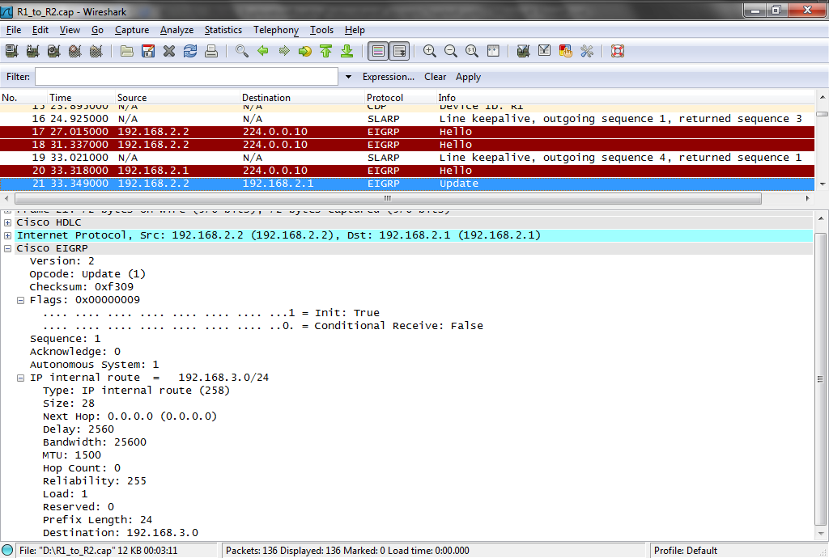
EIGRP Capture File

Slide 46
EIGRP Capture File
There are a few more updates in the next few frames
Then at frame 31 we see a EIGRP ACK frame from 192.168.2.1 to 192.168.2.2
In frame 35 the same thing from 192.168.2.2 to 192.168.2.1

Slide 47
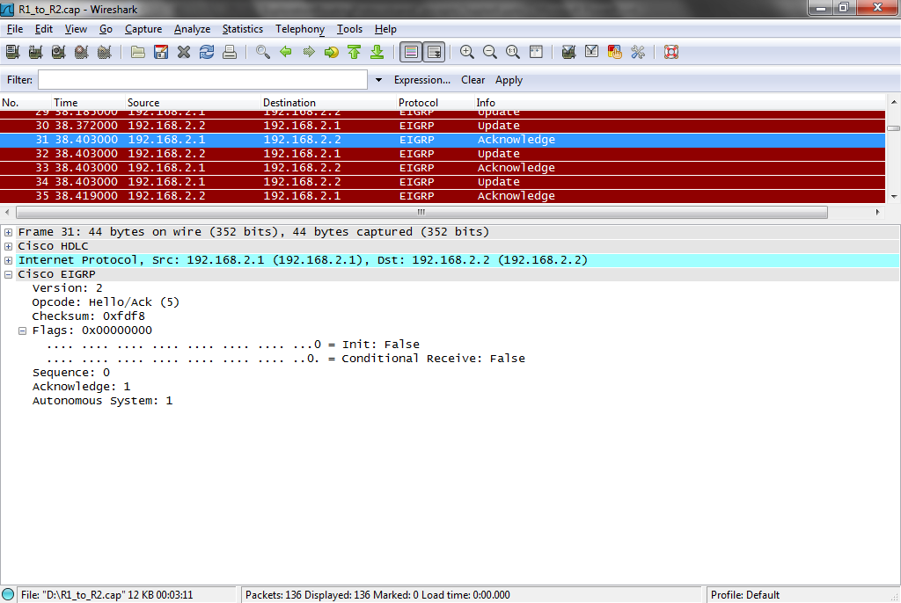
EIGRP Capture File

Slide 48
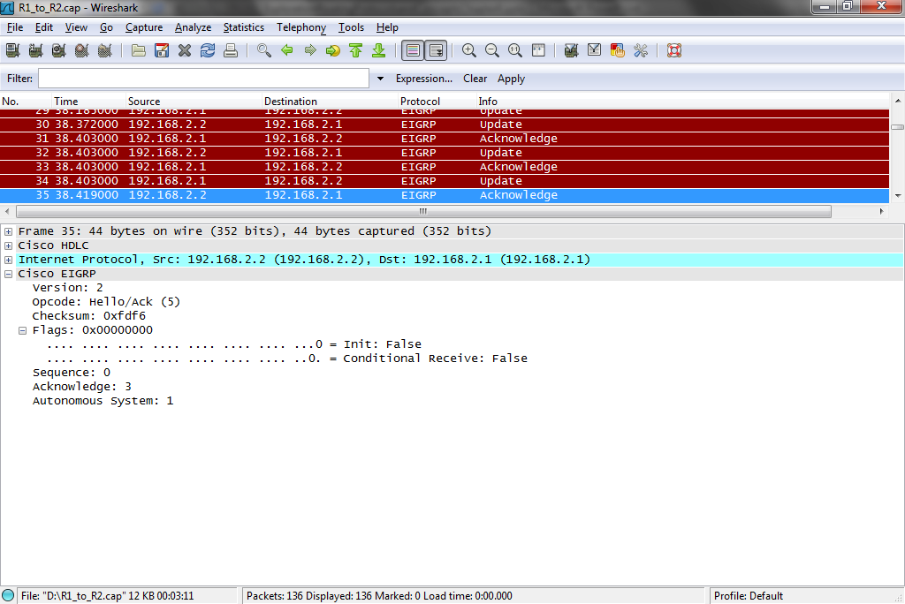
EIGRP Capture File

Slide 49
EIGRP Capture File
At this point everybody knows about everybody else
At frame 37 they start the Hello process to see if there is anyone else out there and whether their current partner is still alive
Notice that nothing else happens for the rest of the capture file, except for this Hello process
Other wise EIGRP is quiet

Slide 50
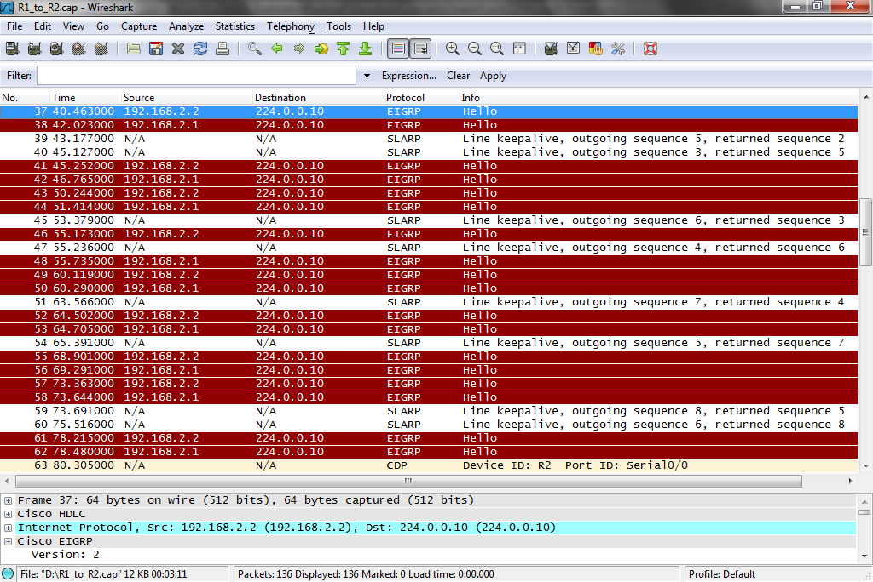
EIGRP Capture File

Slide 51
Verifying EIGRP
These commands are used to check the operation of EIGRP
show ip eigrp neighbors
Used to view the neighbor table
show ip eigrp topology
Used to show the topolgy table
show ip route
Used to show the routing table
show ip protocols
Used to see if EIGRP is enabled

Slide 52
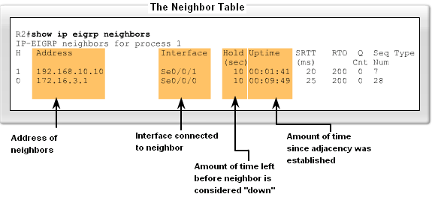
Verifying EIGRP

Slide 53
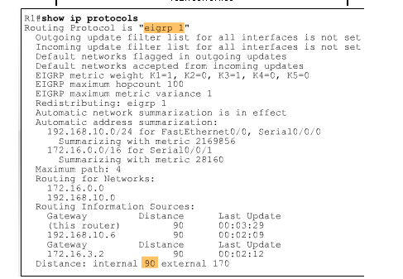
Verifying EIGRP

Slide 54
Lab
Start Packet Tracer
Do activity 9.9.2.6.pka

Slide 55
Lab
Lab 9-1

