Slide 1
The Routing Table
Last Update 2011.01.20
1.1.0

Slide 2
Objectives
Learn how a routing table operates

Slide 3
The Routing Table
To do its job of path determination and switching the router uses its routing table
The routing table is a database held in RAM
This database stores information on the directly connected routes as well as routes to other networks learned by the network administrator informing the router about a route or by talking to other routers

Slide 4
The Routing Table
A directly connected network is one that has a cable directly attached to the router
For local area networks these appear on activation in the IOS
The others are advertised one after another using a network command of one sort or the other
These networks then appear in the table

Slide 5
The Routing Table
Also in the routing table are networks learned from other routers
These remote networks are not directly connected to the router
They may only be reached by sending a packet through at least one more router
These routes are learned by the router through a static route or from a dynamic routing protocol

Slide 6
How a Router Handles Frames
To understand what goes on in building, maintaining, and using a routing table let's first look at what a router does when a frame arrives at one of its interfaces
Recall that a router looks like this in its basic form

Slide 7
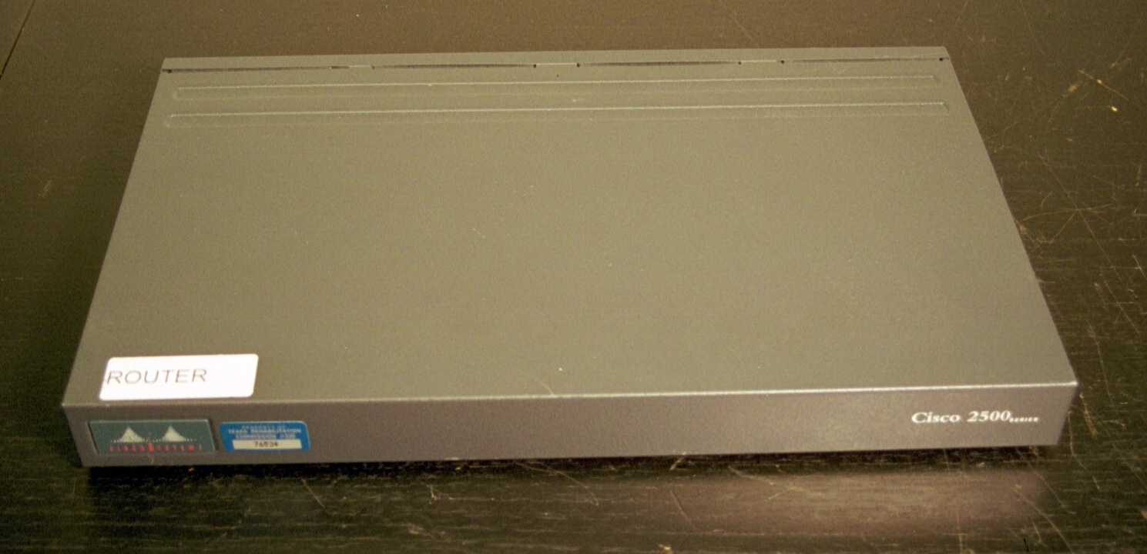
How a Router Handles Frames
This is the front of a medium sized router

Slide 8
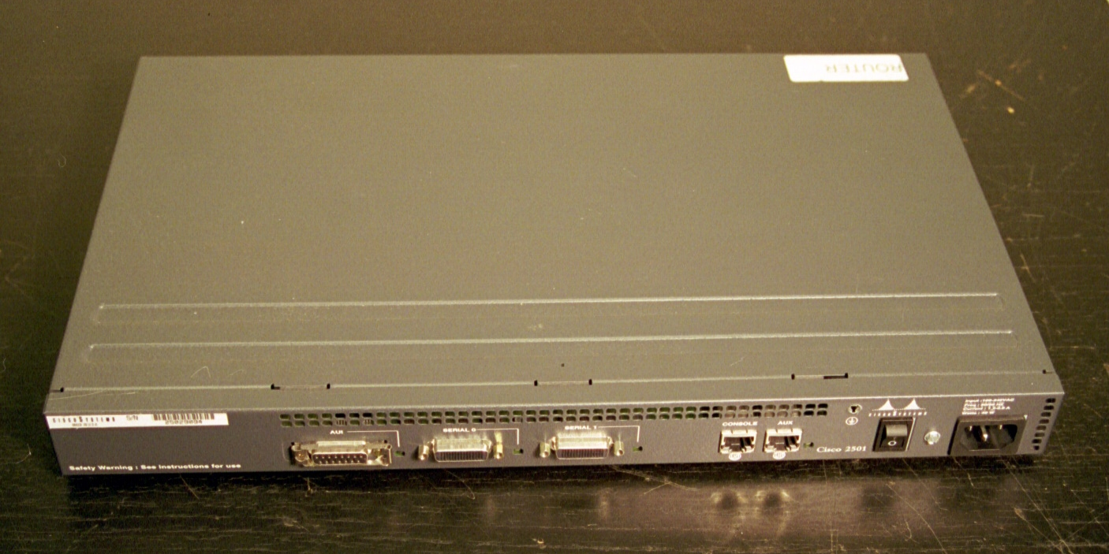
How a Router Handles Frames
This is the back of a medium sized router

Slide 9
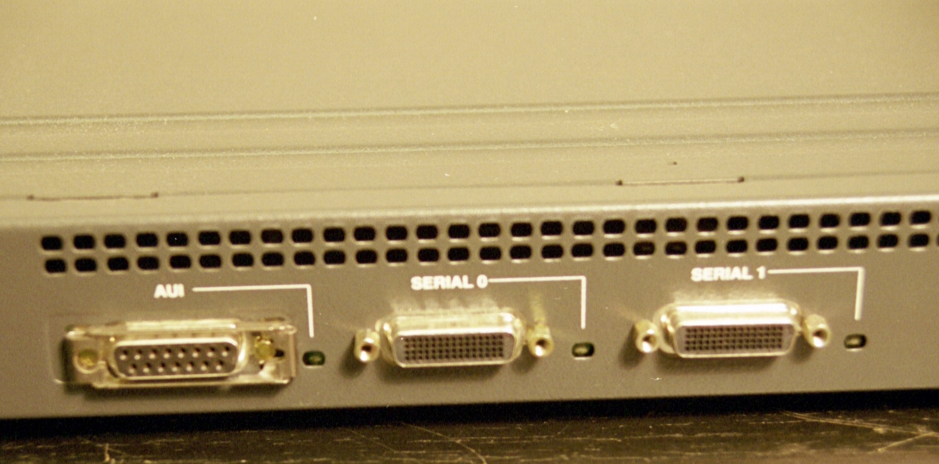
How a Router Handles Frames
These are the interfaces of interest
AUI Ethernet LAN Interface
Serial WAN Interface
Serial WAN Interface

Slide 10
How a Router Handles Frames
Typically a packet will come in one of the serial interfaces
The router must then decide whether it goes to the LAN interface - the AUI port in this case - goes back out the other serial interface because it belongs somewhere else, or should be dropped because the router does not know what to do with it
In detail this process proceeds this way

Slide 11
How a Router Handles Frames
The data-link level identifier in the frame's destination address is examined
If it contains either the identifier of the router's interface or a broadcast identifier, the router removes the packet from the frame and passes the packet to the network layer
At the network layer the destination of the packet is examined

Slide 12
How a Router Handles Frames
If the destination address is either the IP address of the router's interface or an all hosts broadcast address, the protocol field of the packet is examined and the data is switched to the appropriate local network
However, if none of this applies to a frame, then the frame does not belong here

Slide 13
How a Router Handles Frames
It should be somewhere else
So, routing is required
If routing is required, the router will look in the routing table for the correct route
A route table entry must contain at least two things
A destination address
A pointer to the destination

Slide 14
How a Router Handles Frames
The destination address is an address of a network the router can reach
The pointer will indicate the way to this point is through a directly attached interface or the address of another router on a directly connected network
That router is the next hop router since it is one hop closer to the destination

Slide 15
How a Router Handles Frames
If nothing can be found in the routing table, the packet is dropped and a Destination Unreachable message is sent back

Slide 16
Remote Networks
When a network is not directly connected to one of the router’s interfaces an entry must be made into the routing table to tell the router how to reach this remote network
This entry can be done manually for each remote network using a static route or automatically by a dynamic routing protocol

Slide 17
Static Routes
A static route is added to the routing table by an administrator typing on a keyboard
Likewise this route can only be changed by an administrator typing on a keyboard
Therefore these routes are only used for
Very stable connections
Connections where there is only one way out
An S means a static route

Slide 18
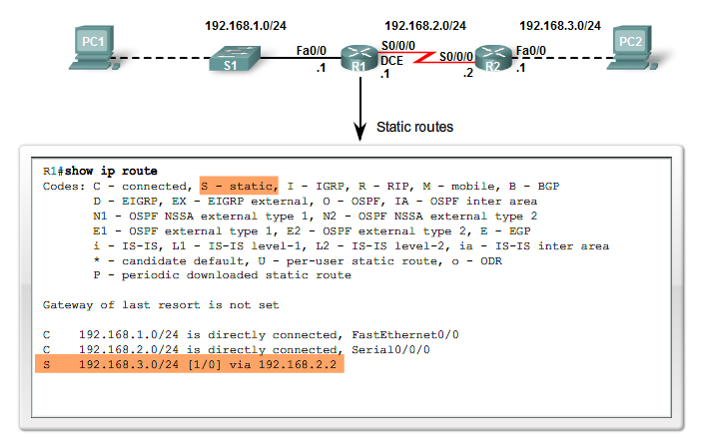
Static Route

Slide 19
Lab
Start Packet Tracer
Do Packet Tracer Activity 1.3.2.2

Slide 20
Lab
Start Packet Tracer
Do Packet Tracer Activity 1.3.3.2

Slide 21
Dynamic Routes
A dynamic route is a route learned by talking to other routers
These routes come and go automatically without the administrator having to do anything

Slide 22
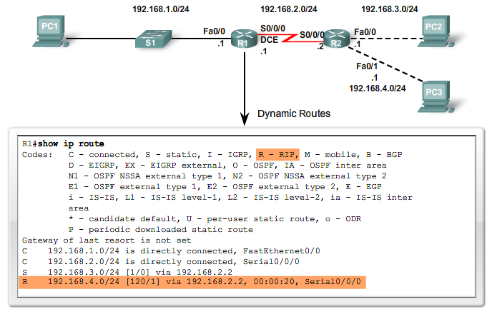
Dynamic Routes

Slide 23
Using the Routing Table
As Cisco points out in their lecture material for this course there are three basic principles that will help you understand, configure, and troubleshoot routing issues
These principles are from Alex Zinin's book, Cisco IP Routing

Slide 24
Using the Routing Table
Every router makes its decision alone, based on the information it has in its own routing table
The fact that one router has certain information in its routing table does not mean that other routers have the same information
Routing information about a path from one network to another does not provide routing information about the reverse, or return, path

Slide 25
Lab
Start Packet Tracer
Do Packet Tracer Activity 1.3.3.4

Slide 26
Asymmetric Routing
A route is one way
The ability of a packet to go from point A to point B says nothing about the ability of a packet to go from point B to point A
As such routing may be asymmetrical where a packet may take one route from point A to point
Then it may take an entirely different route from point B back to point A

Slide 27
Load Balancing
If two equal cost paths exist in a routing table the router can make use of both by performing load balancing

Slide 28
Routing Table Structure
As mentioned a routing table can contain any of three different type of routes
Directly connected
Static
Dynamic

Slide 29
The Routing Table
Let’s look at a routing table
Here is the network

Slide 30
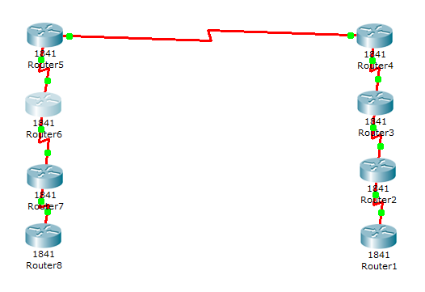
The Routing Table

Slide 31
The Routing Table
Let’s examine the routing table for Router 3
As you can see on the diagram Router 3 knows about networks 2 and 3 as these are directly connected to it
Network 2 exists between Router 3 and Router 2
Network 3 exists between Router 3 and Router 4

Slide 32
The Routing Table
Router 3 has no knowledge of networks 1, 4, 5, 6, and 7 as they are all on the other side of one or more other routers
Here is the routing table for Router 3

Slide 33
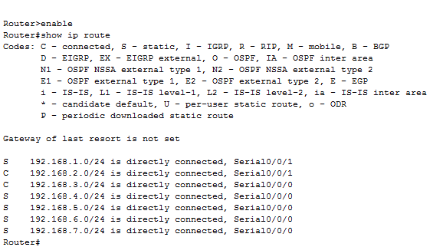
The Routing Table

Slide 34
The Routing Table
As the routing table shows networks 1 and 2 are reached by going out of port serial 0/0/1
While networks 3, 4, 5, 6, and 7 are reached by going out of the serial 0/0/0 port
In this case each of these is reached by use of a static route as the S shows

Slide 35
The Routing Table
With the C indicating the directly connected networks
What if the remote networks were learned from a dynamic routing protocol
Let’s see what the routing table would look like if RIP was the routing protocol used
This view is from Router 6

Slide 36
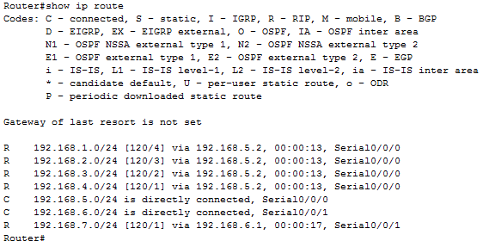
The Routing Table

Slide 37
The Routing Table
The R in the table indicating those routes learned through the RIP dynamic routing protocol

Slide 38
Routing Table Structure
A route in a Cisco routing table can be one of two types
Level 1
These have a subnet mask equal to or less than the classful mask of the network address
Level 2

Slide 39
Level 1 Routes
A level 1 route can function as
Default route
Supernet route
Network route
A level 1 ultimate route is one that includes either
A next hop address
An exit interface

Slide 40
Parent and Child Routes
A level 1 route can also be a parent route
A parent route does not contain either a next hop IP address or exit interface information
A parent route is created any time a subnet is added to the routing table
Child routes are level 2 routes
Child routes are a subnet of a classful network address

Slide 41
Level 2 Routes
Level 2 child routes contain the route source and the network address of the route
Level 2 child routes are also considered ultimate routes as they contain the next hop address or exit interface or both

Slide 42
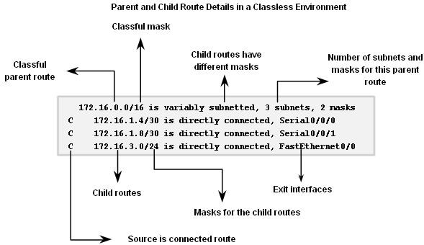
Parent and Child Routes

Slide 43
Route Lookup Process
The route lookup process proceeds this way
Examine the level 1 routes
If the best match is a level 1 ultimate route and is not a parent route this route is used to forward packet
Examine the level 2 child routes
If there is a match with a level 2 child route then that subnet is used to forward the packet

Slide 44
Route Lookup Process
If no match is made then the routing behavior type must be determined
The router determines if it should use classful or classless routing behavior
If classful, then the packet is dropped
If classless, then router searches the level one supernet and default routes
If there is a level 1 supernet or default route match, then the packet is forwarded
If not, the packet is dropped

Slide 45
Route Lookup Process
The default routing behavior is ip classless
Classless routing behavior works for
Discontiguous networks
CIDR supernets
Level 1 routes are searched
Supernet routes are checked first
If a match exists then forward packet
Default routes are checked second
If no match or default route then drop packet

Slide 46
Route Lookup Process
If no match is found, then a match with fewer bits is attempted

Slide 47
The Best Match
The best match is also known as the longest match
The best match is the one that matches the most bits from the left to the right when matching the destination address to the routing table

Slide 48
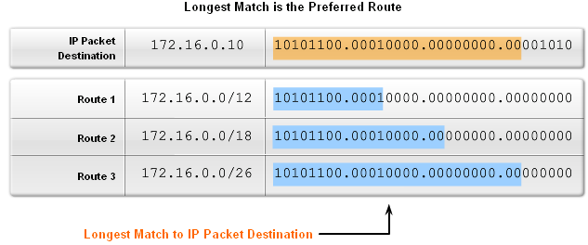
The Best Match

