Slide 1
RIP Version 2
Last Update 2011.06.06
1.2.0

Slide 2
Objectives
Learn about RIP Version 2

Slide 3
Characteristics of RIP
A distance vector routing protocol
Hop count is the only metric

Slide 4
Comparing RIP V1 to V2

Slide 5
RIP Communication
RIP communicates with other routers through the 224.0.0.9 multicast address

Slide 6
RIP Configuration
RIP configuration requires two configuration commands
router rip
network
Cisco insists on defaulting to version 1 so the basic RIP configuration is actually
router rip
version 2
network

Slide 7
Basic RIP Configuration
In this example, each router’s network command tells the router to start using RIP
R1 looks for any interfaces whose IP address is in Class B network 172.16.0.0
R1 sees that both its FA0/0 and S0/0 interfaces have IP addresses in network 172.16.0.0, so R1 starts sending RIP updates on both interfaces
Similarly, R2 finds that both of its interfaces match the network 172.16.0.0 command as well, because both interfaces are in network 172.16.0.0 so, R2 also begins sending RIP updates on both interfaces
As a result, R1 and R2 begin to learn routes from each other using RIP

Slide 8
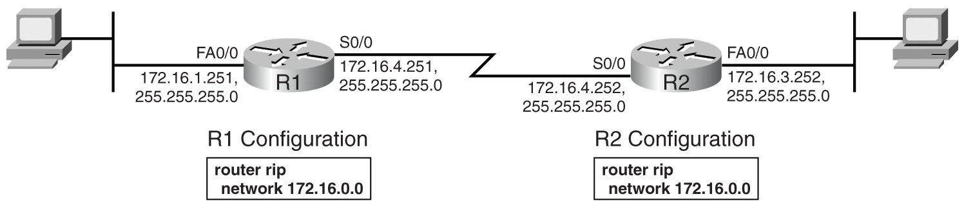
Basic RIP Configuration

Slide 9
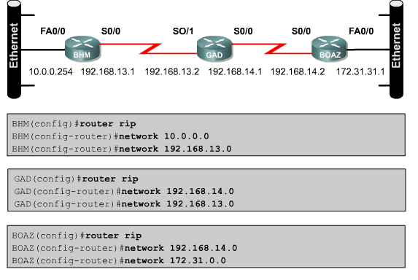
Configuring RIP

Slide 10
Basic RIP Configuration
When a RIP network command matches an interface IP address, the IOS enables RIP on that interface
When RIP is enabled on an interface, three actions related to that interface are carried out

Slide 11
Basic RIP Configuration
It starts sending RIP updates out the interface
It starts listening for RIP updates coming in that interface from some other router
It starts advertising a route to reach the subnet attached to the interface

Slide 12
Preventing Routing Updates
The command passive-interface is used to prevent routers from sending routing updates thorough an interface
This is to prevent devices from learning about routes you would prefer they not know about
This disables the sending out of RIP updates from that interface, but the router still receives updates through it

Slide 13
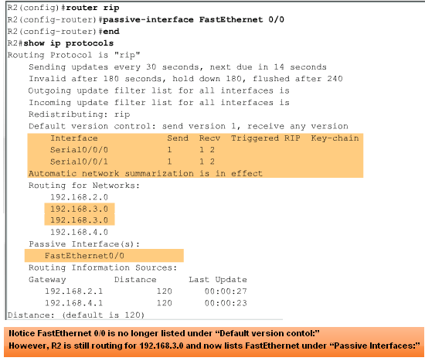
Preventing Routing Updates

Slide 14
Load Balancing with RIP
RIP can do simple load balancing using up to six equal cost paths
It uses the round robin method

Slide 15
RIP Capture File
Let’s look at a capture file showing the RIP process
Download this file
HDLC with RIP.cap
Open it in Wireshark by double-clicking it

Slide 16
RIP Capture File
Select frame 1
Looking at the frame list we can see that in frames 2, 3, and 4 the router at 192.168.2.1 has had RIP enabled on it
We know this as it sends out two RIP Requests to the multicast RIP address of 224.0.0.9

Slide 17
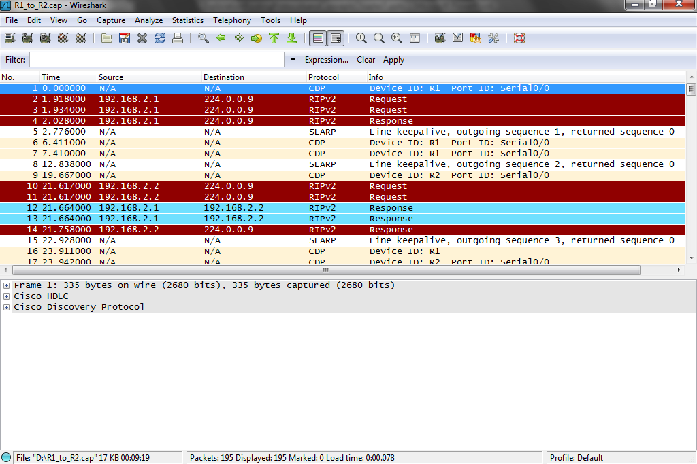
RIP Capture File

Slide 18
RIP Capture File
What it is saying is
Is there anyone at the other end of this link that is alive and speaks RIP Version 2
A short time later it says
Well in any event I speak RIP
Besides the network I am on, the 192.168.2.0 network, I also know where the 192.168.10 network lives
Let’s look at these three frames

Slide 19
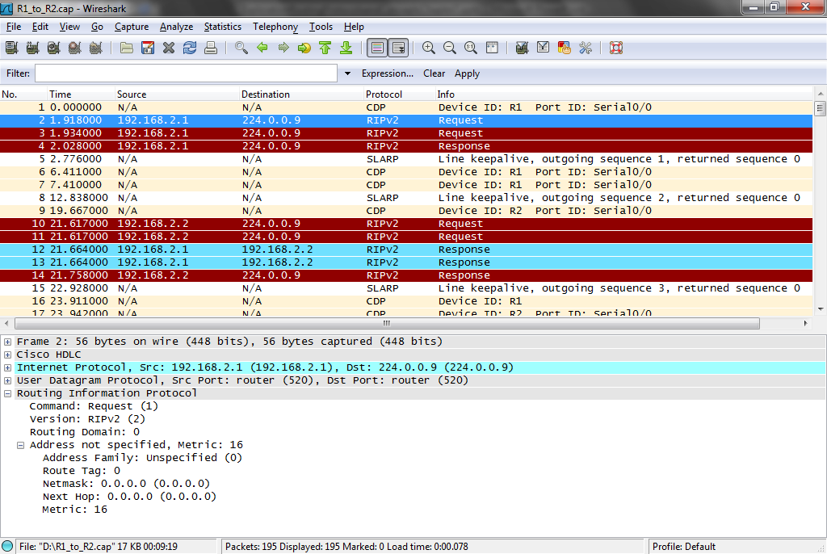
RIP Capture File

Slide 20
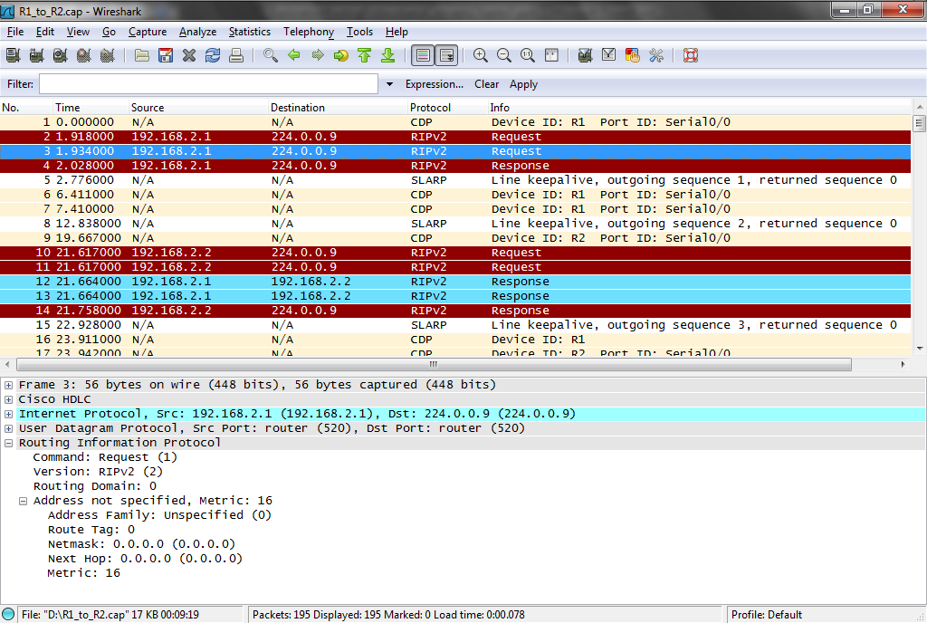
RIP Capture File

Slide 21
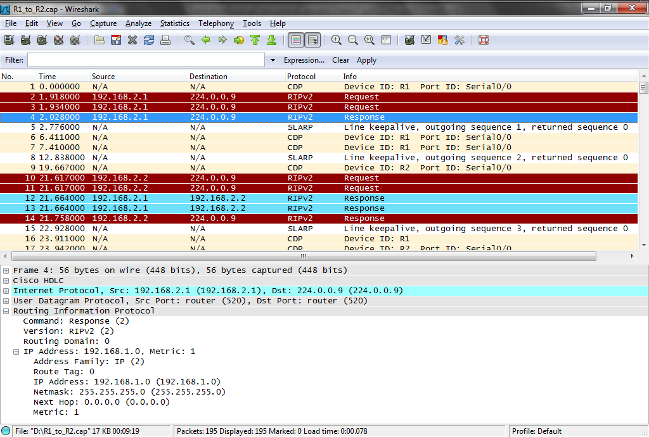
RIP Capture File

Slide 22
RIP Capture File
Select frames 10 and 11
The router at the other end of the link, 192.168.2.2, wakes up and does the same thing
However, in between the two RIP Requests and its RIP Response, its neighbor at 192.168.2.1, says in frames 12 and 13

Slide 23
RIP Capture File
Great, a friend let me tell you about the networks I know about

Slide 24
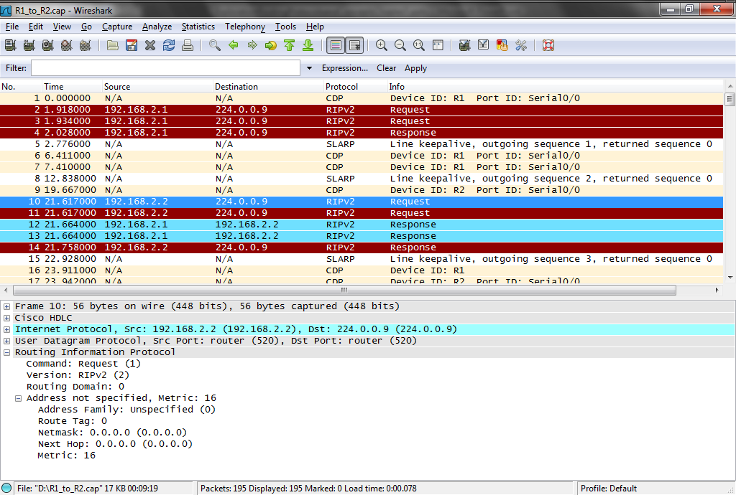
RIP Capture File

Slide 25
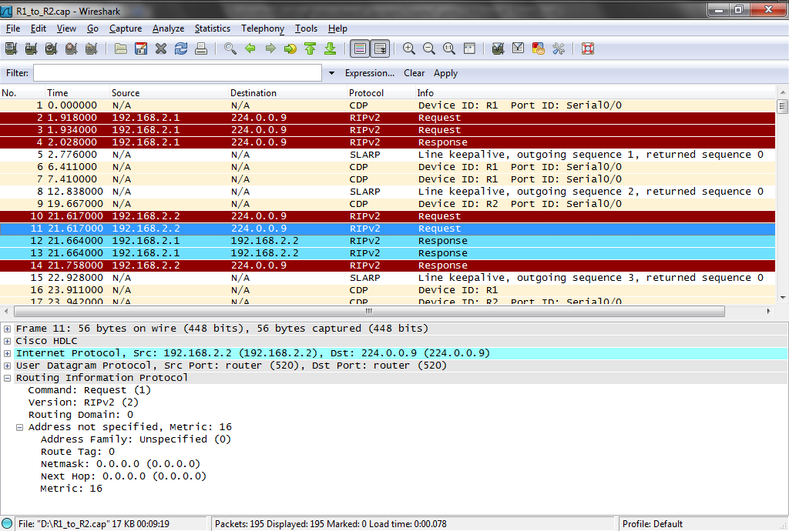
RIP Capture File

Slide 26
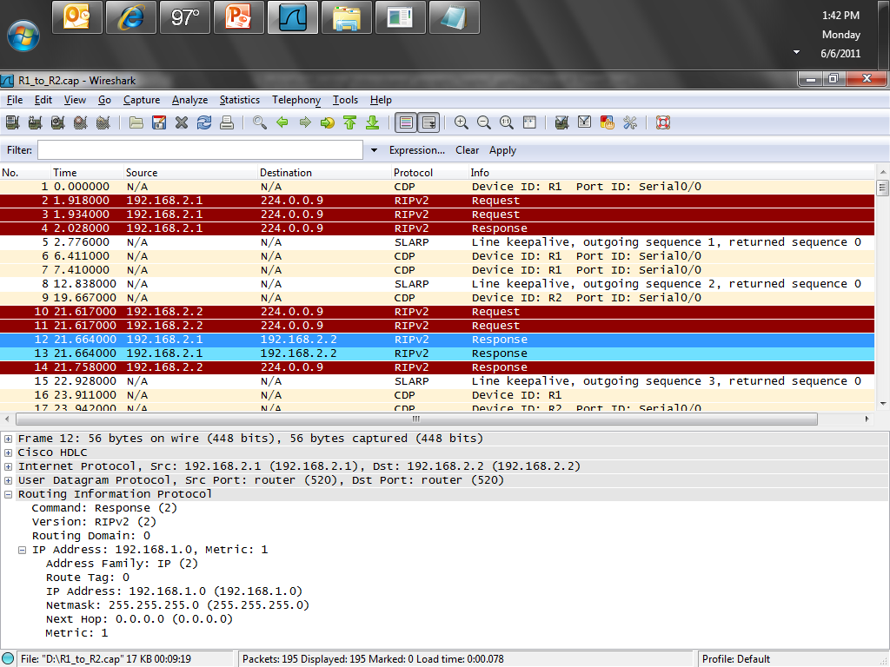
RIP Capture File

Slide 27
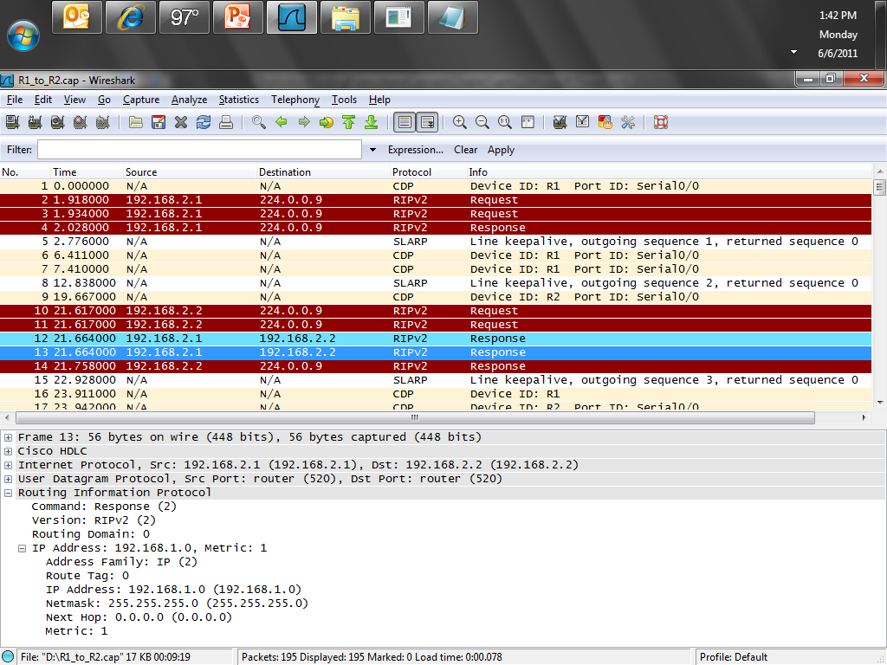
RIP Capture File

Slide 28
RIP Capture File
In frame 14 192.168.2.2 says
Here is who I know about
Which is the 192.168.2.0 and 192.168.3.0 networks

Slide 29
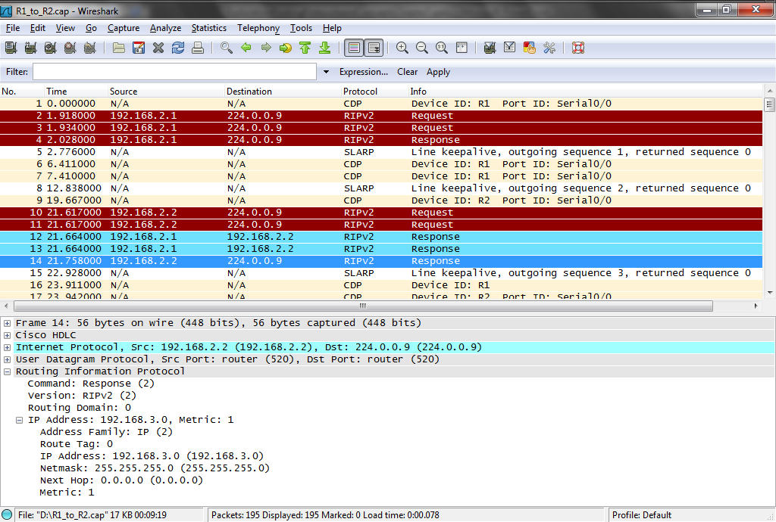
RIP Capture File

Slide 30
RIP Capture File
RIP quiets down until frames 22, 23, 24, and 25 where 192.168.2.1 says to anybody listening on 224.0.0.9
What’s going on
192.168.2.2 answers
I am still here
Nothing changed, see

Slide 31
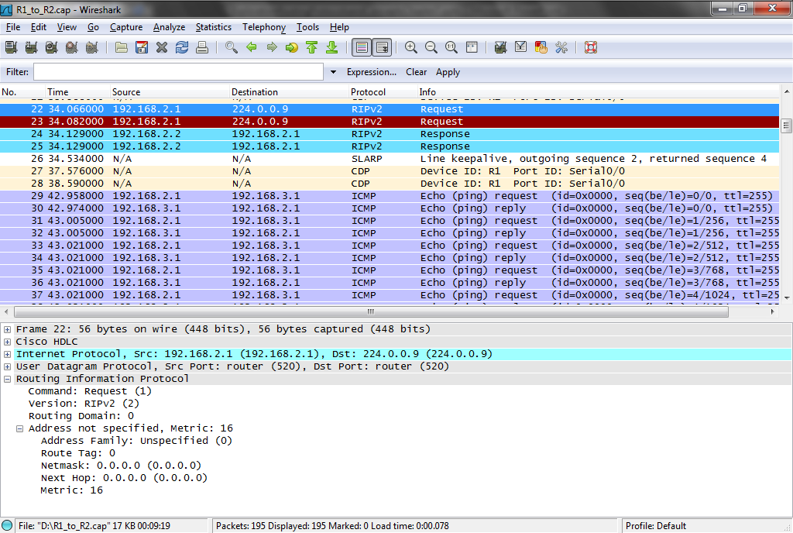
RIP Capture File

Slide 32
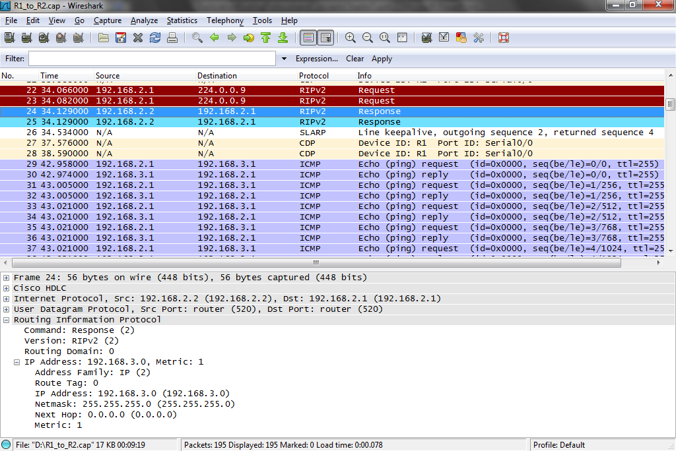
RIP Capture File

Slide 33
RIP Capture File
In frames 41, 44, 49, and 53 we see RIP sending it’s routing table every 30 seconds even though nothing has changed

Slide 34
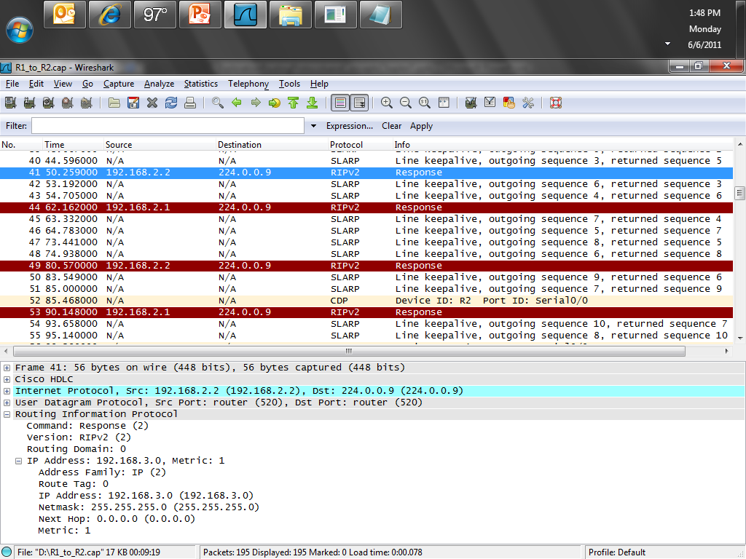
RIP Capture File

Slide 35
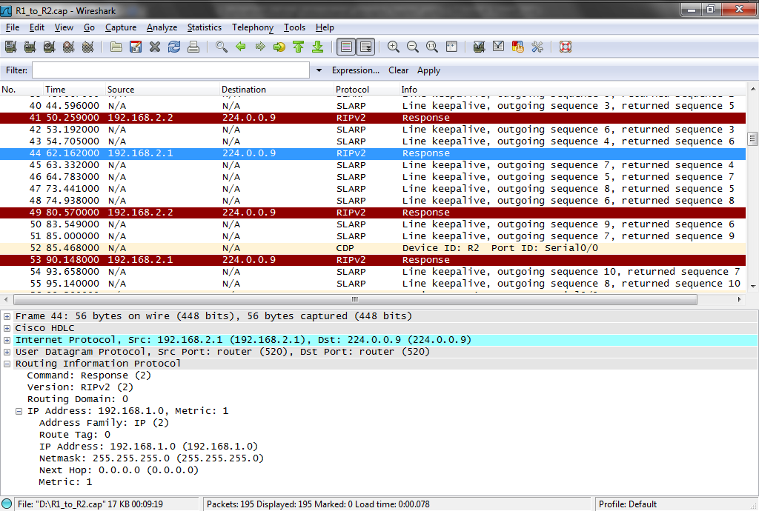
RIP Capture File

Slide 36
RIP Capture File
Thus it goes over and over like this for the rest of the capture file
Notice that RIP uses the Well Known port number 520

Slide 37
Troubleshooting RIP Update
Common RIP troubleshooting commands include
show ip rip database
show ip protocols
show ip route
show ip interface brief
debug ip rip

Slide 38
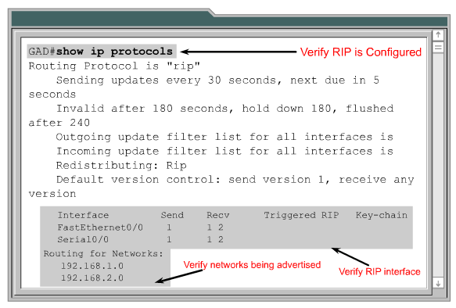
Show IP Protocols Command

Slide 39
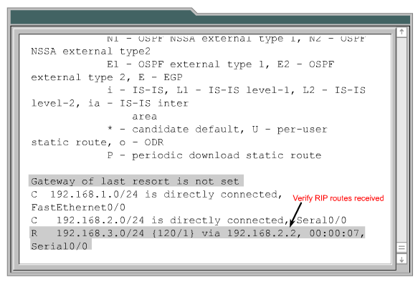
Show IP Route Command

Slide 40
Lab
Let’s look at some RIP traffic
Start Wireshark
Open RIP_v1.pcap
Examine the back and forth

Slide 41
Lab
Lab 7-1

