Slide 1
VLSM and CIDR
Last Update 2008.05.02
1.0.0

Slide 2
Objectives
Review VLSM and CIDR

Slide 3
First Form of an IP Address
Long ago and far away
I say this since California is certainly far away from Texas, at least in a cultural sense
The form of IP addresses was first developed in January 1980
An IP address in its simplest form is
network.host.host.host
No classes, no subnetting, no nothing

Slide 4
First Form of an IP Address
Just an address that indicates a network and a host on that network
As RFC 760 says
Addresses are fixed length of four octets (32 bits)
An address begins with a one octet network number, followed by a three octet local address
This three octet field is called the "rest" field

Slide 5
First Form of an IP Address
Source Address: 32 bits The source address
The first octet is the Source Network, and the following three octets are the Source Local Address
Destination Address: 32 bits The destination address
The first octet is the Destination Network, and the following three octets are the Destination Local Address

Slide 6
Why Classful Addressing
Recall that when IP addressing was first defined in January 1980 in RFC 760 an address was simple, just
network.host.host.host
Soon, September 1981, this proved too restrictive
The first change made was to define classes of addresses

Slide 7
Why Classful Addressing
As RFC 791 says
Addresses are fixed length of four octets (32 bits).
An address begins with a network number, followed by local address (called the "rest" field).

Slide 8
Why Classful Addressing
There are three formats or classes of internet addresses: in class a, the high order bit is zero, the next 7 bits are the network, and the last 24 bits are the local address; in class b, the high order two bits are one-zero, the next 14 bits are the network and the last 16 bits are the local address; in class c, the high order three bits are one-one-zero, the next 21 bits are the network and the last 8 bits are the local address.

Slide 9
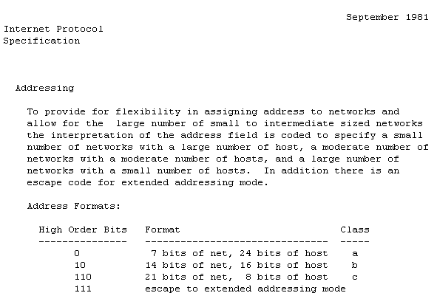
Why Classful Addressing

Slide 10
Why Classful Addressing
The nerds that developed TCP/IP assumed that the world as they knew it, would always be
What world did they know
One made up of large, expensive, terminal based, time sharing computers
One where things like a LAN and Ethernet had not deployed outside of test environments

Slide 11
Why Classful Addressing
One where one of the most forward thinking creators of computers once said
“Why would anyone want a computer on their desk?”
Kenneth Olsen of Digital Equipment Corporation
Before Compaq – a maker of computers designed to be put on their desk - bought them out and they disappeared from the face of the earth
When these first networks were created, they linked directly to each other

Slide 12
Why Classful Addressing
Large blocks of addresses were assigned to each institution
For example, Stanford, like many of the first Internet sites, was allotted all addresses having a certain first octet of the IP address - 36 for Stanford - only the first 8 bits of the IP address were needed to know that a packet was destined for the Stanford network

Slide 13
Why Classful Addressing
Although it turned out to be wasteful and short-sighted, it did have advantages
By aggregating each site behind a large subnet, only one route in every router on the Internet was needed for each institution, regardless of whether the institution had 10 computers or 10 million

Slide 14
Why Classful Addressing
ISPs didn't exist then, so each site maintained its connection to the Internet by keeping a direct link to another connected institution
The global routing tables only contained one route per institution, which was expected to be a total of a few hundred or thousand routes at most

Slide 15
Why Classful Addressing
Only having to read the first octet to determine the network also helped routers
The address was defined so that by reading the first octet only, the address could be categorized by class
Once categorized by class, the network portion is easy and quick to read
Early routers needed as much help as they could get

Slide 16
Why Classful Addressing
Routers only need know the network, they are not concerned with the specific host on that network
These classes were designed for different size organizations

Slide 17
Classful Addressing
Class A
Was for large companies with many hosts
Of which there would be few
126 networks each with 16,774,215 hosts
Class B
For medium size companies
16,385 networks each with 65,535 hosts
Class C
For small companies with few hosts
Of which there would be many
2,097,151 networks each with 254 hosts

Slide 18
Classful Addressing
Class | 0 to 8 | 8 to 16 | 16 to 24 | 24 to 32
A | NETWORK | HOST
B | NETWORK |  | HOST
C | NETWORK |  |  | HOST
D | MULTICAST ADRRESSES
E | EXPERIMENTAL

Slide 19
Address Ranges
Class | First Octet Range
A | 1 – 126
B | 128 – 191
C | 192 – 223
D | 224 – 239
E | 240

Slide 20
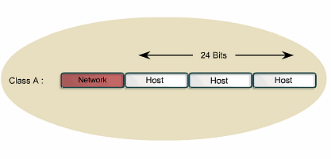
Class A Address

Slide 21
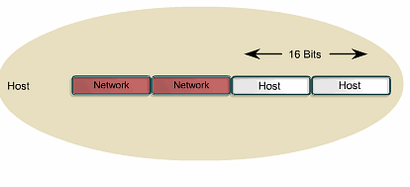
Class B Address

Slide 22
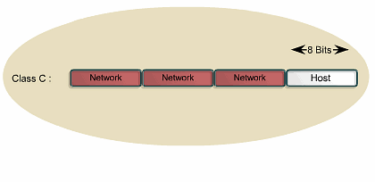
Class C Address

Slide 23
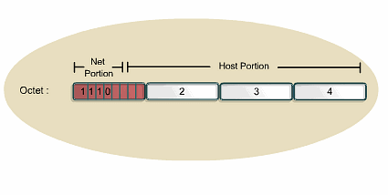
Class D Address

Slide 24
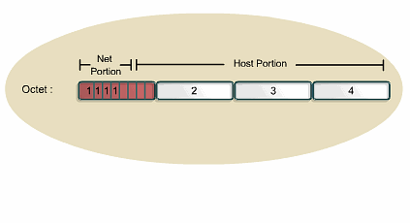
Class E Address

Slide 25
What is CIDR
By 1993 or so it became clear that subnetting alone would not prevent address exhaustion

Slide 26
What is CIDR
So CIDR was developed to
Prevent the immediate exhaustion of addresses
Ease the load on routers
Without CIDR Internet routing tables would be even larger than they are
Even more important is the number of updates all of these routes generate
Further all of this churning means convergence is slower
To see the current size of the BGP routing table go to http://bgp.potaroo.net

Slide 27
What is CIDR
Allow a distribution of addresses from the regional registries to higher level ISPs, to lower level ISPs, then to end users
For example I once had control of 6 Class A addresses, yet with only 12 hosts in my entire network I certainly do not qualify for a Class A address range as used in the old scheme of things

Slide 28
What is CIDR
CIDR – Classless Inter-Domain Routing or classless addressing eliminates the concept of address classes
Although shown differently, the mask operates like a standard subnet mask by delineating the end of the prefix or network portion of the address

Slide 29
What is CIDR
CIDR allows routers to group routes together in order to cut down on the quantity of routing information carried by core routers
With CIDR several IP networks appear to networks outside the group as a single larger entity

Slide 30
What is CIDR
The grouping of routes is also known as summarization, aggregation, or supernetting

Slide 31
What is CIDR
In the CIDR scheme of things a block of addresses is shown as
network/bits in the mask
For example
128.211.168.0/21
Which means with this address in binary form read in 21 bits from the left and this is where the network portion of the address ends and the host portion begins

Slide 32
What Do The Masks Look Like
CIDR Notation | Subnet Mask | CIDR Notation | Subnet Mask | CIDR Notation | Subnet Mask
/13 | 255.248.0.0 | /18 | 255.255.192.0 | /23 | 255.255.254.0
/14 | 255.252.0.0 | /19 | 255.255.224.0 | /24 | 255.255.255.0
/15 | 255.254.0.0 | /20 | 255.255.240.0 | /25 | 255.255.255.128
/16 | 255.255.0.0 | /21 | 255.255.248.0 | /26 | 255.255.255.192
/17 | 255.255.128.0 | /22 | 255.255.252.0 | /27 | 255.255.255.224

Slide 33
What is CIDR
Classless addressing, as used by ISPs, treats IP addresses as arbitrary integers; which allows a network administrator to assign addresses in contiguous blocks, where the number of addresses in a block is a power of two
An IP address advertised as a /20 for example could be a former Class A, B, or C it does not matter what the first octet is

Slide 34
What is VLSM
VLSM – Variable Length Subnet Masking is an improvement on the original method of subnetting called FLSM – Fixed Length Subnet Masking
In FLSM the same subnet mask is used for all of the subnetworks inside of a network, regardless of the number of hosts on any of the networks

Slide 35
The Problem With FLSM
There are two problems with using FLSM
It wastes addresses if the number of hosts on the subnets vary in size
It forces the routers that talk to these subnets to process too much information

Slide 36
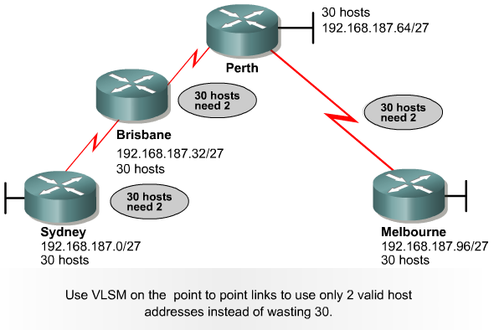
When to Use VLSM

Slide 37
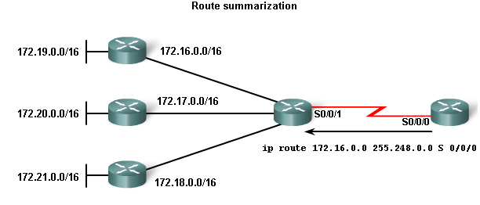
VLSM Example

Slide 38
Lab
Lab 6-1

