Slide 1
Distance Vector Routing Protocols
Last Update 2008.05.02
1.0.0

Slide 2
Objectives
Learn about the details of distance vector routing protocols

Slide 3
Distance Vector Protocols
In the previous module the concept of distance vector routing protocols was introduced
In this module the details on this type of routing protocol will be discussed
A distance vector routing protocols only knows about two things
Distance to final destination
Vector or direction to that destination

Slide 4
Distance Vector Protocols
These protocols have the following characteristics
Whether changes have taken place or not periodic updates are sent out
Direct knowledge is of their neighbors only
The entire routing table is included with each routing update

Slide 5
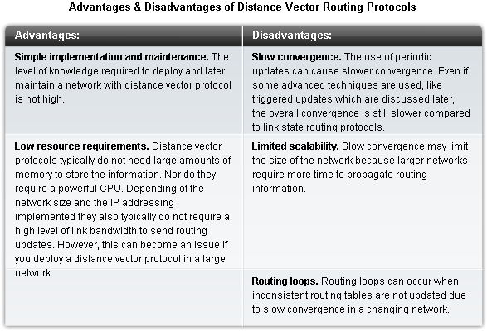
Distance Vector Protocols

Slide 6
Routing Loops
Routing loops can occur when inconsistent routing tables are not updated due to slow convergence in a changing network

Slide 7
Routing Loop Problem Example
For example let's say the following network had converged
That is all routers have the same, consistent knowledge and all routing tables in all routers are correct
This diagram assumes that Router C's preferred path to Network 1 is by way of Router B, and Router C has a distance of three hops to Network 1 in its routing table

Slide 8
Routing Loop Problem Example

Slide 9
Routing Loop Problem Example
The link to Network 1 fails
Router E sends an update to Router A telling Router A that it can no longer get to Network 1
Router A stops sending stuff to Network 1, But Routers B, C, and D keep on sending packets to Network 1 because they have not been informed of the change
Router A then sends out its update

Slide 10
Routing Loop Problem Example
This tells Routers B and D to stop and they do
Router C still has not been informed
Router C stills thinks Network 1 is reachable through Router B
Router C now sends its regular update to Router D

Slide 11
Routing Loop Problem Example
This update tells Router D that Network 1 is reachable through Router B
Router D says great
It updates its table and sends the good news on to Router A
Router A then tells Router E the news
Of course none of this is correct

Slide 12
Routing Loop Problem Example
So packets for Network 1 just loop around the network from C to B to A to D and back to C

Slide 13
Counting to Infinity Problem
This brings in the second problem, which is the count to infinity
The bad data will continue around the network unless there is a metric in it that says enough is enough
The common metric for this is the distance metric

Slide 14
Counting to Infinity Problem
For example after 15 trips through a router a RIP packet will be discarded based on the assumption that the network is unreachable
This takes care of the problem, but it took a bunch of bandwidth wasting traffic to figure this out

Slide 15
Split Horizon
Split horizon is a method of preventing a routing loop in a network
With split horizon information about routing for a packet is never sent back in the direction from which it was received

Slide 16
Route Poisoning
The route poisoning rule says once a route is learned through an interface, advertise it as unreachable back through the same interface
Route poisoning is implemented by setting the hop count to one more than the maximum

Slide 17
Triggered Updates
With triggered updates a change in the routing table is sent immediately rather than waiting for the scheduled update

Slide 18
Holddown Timers
Count to infinity can be avoided by using holddown timers
When a router receives an update from a neighbor indicating that a previously unreachable network is now accessible
The router marks the route as inaccessible
Then it starts a holddown timer

Slide 19
Holddown Timers
If an update is received from the same neighbor before the holddown timer expires indicating the network is accessible, the timer is released and the network is marked as reachable

Slide 20
Holddown Timers
If an update arrives from a different neighboring router with a better metric than the one originally recorded for the network, the router marks the network as accessible and removes the timer

Slide 21
Holddown Timers
If an update is received from a different neighbor router with a poorer metric, the update is ignored

Slide 22
Techniques In Combination
When route poisoning is used with triggered updates, it speeds up the convergence time since neighboring routers do not have to wait 30 seconds before sending out information on the poisoned route
The combination of split horizon with poison reverse is called route poisoning

Slide 23
Summary of Techniques

Slide 24
Comparing RIP V1 to V2

Slide 25
RIP Communication
RIP version 2 communicates with other routers through the 224.0.0.9 multicast address

Slide 26
RIP Configuration
RIP configuration requires three configuration commands
router rip
version 2
network

Slide 27
Basic RIP Configuration
In this example, each router’s network command tells the router to start using RIP
R1 looks for any interfaces whose IP address is in Class B network 172.16.0.0
R1 sees that both its FA0/0 and S0/0 interfaces have IP addresses in network 172.16.0.0, so R1 starts sending RIP updates on both interfaces
Similarly, R2 finds that both of its interfaces match the network 172.16.0.0 command as well, because both interfaces are in network 172.16.0.0 so, R2 also begins sending RIP updates on both interfaces
As a result, R1 and R2 begin to learn routes from each other using RIP

Slide 28
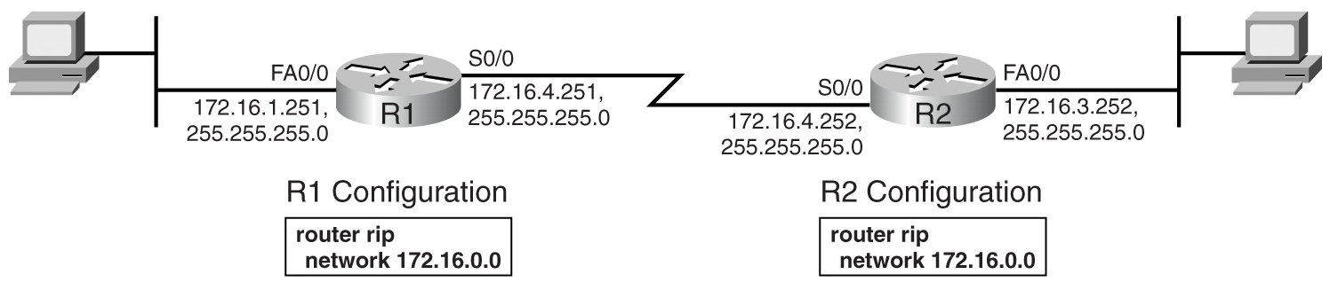
Basic RIP Configuration

Slide 29
Basic RIP Configuration
When a RIP network command matches an interface IP address, the IOS enables RIP on that interface
When RIP is enabled on an interface, three actions related to that interface are carried out

Slide 30
Basic RIP Configuration
It starts sending RIP updates out the interface
It starts listening for RIP updates coming in that interface from some other router
It starts advertising a route to reach the subnet attached to the interface

Slide 31
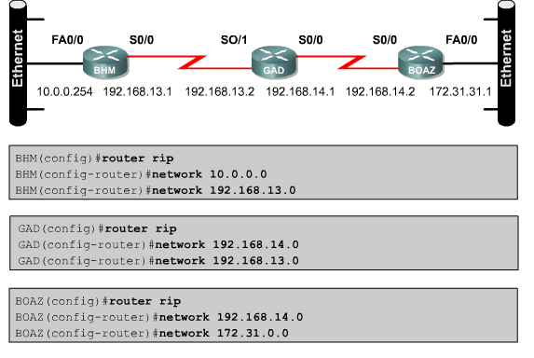
Configuring RIP

Slide 32
Preventing Routing Updates
The command passive-interface is used to prevent routers from sending routing updates thorough an interface
This is to prevent devices from learning about routes you would prefer they not know about
This disables the sending out of RIP updates from that interface, but the router still receives updates through it

Slide 33
Load Balancing with RIP
RIP can do simple load balancing using up to six equal cost paths
It uses the round robin method

Slide 34
Troubleshooting RIP Update
Common RIP troubleshooting commands include
show ip rip database
show ip protocols
show ip route
show ip interface brief
debug ip rip

