Slide 1
Introduction to Dynamic Routing Protocols
Last Update 2008.05.02
1.0.0

Slide 2
Objectives
Learn about routing protocols

Slide 3
Two Ways to Look at Protocols
Protocols are used in various ways
Two of those ways relate to moving information from one network to another
In this case we are interested in
Routed Protocols
Routing Protocols

Slide 4
What is a Routed Protocol
These protocols are routed by the routing protocols
They are concerned with the construction and transport of the data itself regardless of how it arrives at its destination
When the OSI model talks about encapsulation, this is what it is referring to

Slide 5
What is a Routed Protocol
These cover all 7 layers of the OSI model
These protocols contain enough information in the fields in their headers that allow the packet to be routed from one network to another by the routing protocol
In other words it is the box we need to get from one place to another

Slide 6
What is a Routed Protocol

Slide 7
What is a Routing Protocol
These are network layer protocols that are responsible for path determination and switching
These have to do with the actual routes the packets take and how that path is calculated
This is the truck that takes the box from one place to another

Slide 8
What is a Routing Protocol

Slide 9
Static v Dynamic Routing
Static routes, as we have seen, are entered from the keyboard and do not require routing protocols
Dynamic routes are created by routing protocols
Static routing consists of entries made into the routing table in the router by the network administrator prior to the beginning of routing

Slide 10
Static v Dynamic Routing
These entries do not change unless the network administrator alters them
This method works well in environments where network traffic is relatively predictable and where network design is relatively simple

Slide 11
Static v Dynamic Routing
Because static routing systems cannot react to network changes, they generally are considered unsuitable for today's large, changing networks

Slide 12
Static v Dynamic Routing
Whereas dynamic routing protocols can adjust to changing network circumstances by analyzing incoming routing update messages
If the message indicates that a network change has occurred, the routing software recalculates routes and sends out new routing update messages

Slide 13
Static v Dynamic Routing
These messages permeate the network, stimulating routers to rerun their algorithms and change their routing tables accordingly

Slide 14
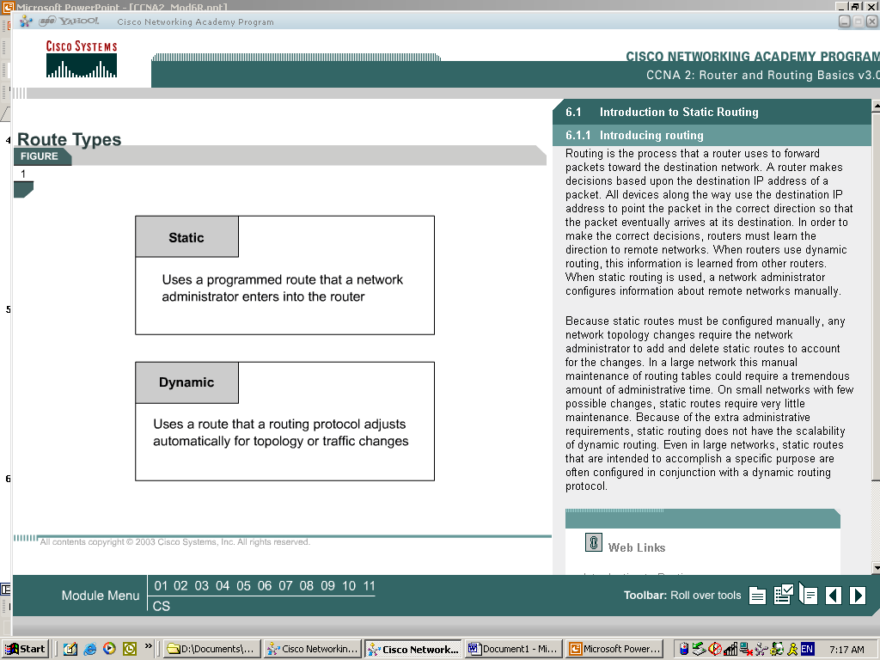
Static v Dynamic Routing

Slide 15
Static v Dynamic Routing

Slide 16
Dynamic Routing Protocols
Dynamic routing protocols usually have one or more of the following design goals
Optimality
Low overhead
Robustness
Flexibility
Rapid convergence

Slide 17
Routing Protocol Optimality
Optimality refers to the capability of the routing protocol to select the best route, which depends on the metrics and metric weightings used to make the calculation

Slide 18
Routing Protocol Overhead
Low overhead refers to simple and efficient overhead

Slide 19
Routing Protocol Robustness
Routing protocols must be robust, which means that they should perform correctly in the face of unusual or unforeseen circumstances, such as hardware failures, high load conditions, and incorrect implementations

Slide 20
Routing Protocol Flexibility
Routing protocols should also be flexible, which means that they should quickly and accurately adapt to a variety of network circumstances
Assume, for example, that a network segment has gone down
As they become aware of the problem, many routing protocols will quickly select the next-best path for all routes normally using that segment

Slide 21
Routing Protocol Convergence
Routing protocols must converge rapidly, which is a process of agreement, by all routers, on optimal routes
When a network event causes routes either to go down or become available, routers distribute routing update messages that permeate networks, stimulating recalculation of optimal routes and eventually causing all routers to agree

Slide 22
Routing Protocol Convergence
Routing protocols that converge slowly can cause routing loops or network outages
An example of the need for rapid convergence is seen in the use of distance vector protocols
Routers using routing protocols based on the distance vector method receive their neighbor’s routing table

Slide 23
Routing Protocol Convergence
Using this they build a network map
This approach to learning can cause problems such as routing loops and counts to infinity
Routing loops can occur if the internetwork is slow to converge on a new configuration after a route fails
This situation will produce inconsistent entries in the router tables

Slide 24
Lab
Start Packet Tracer
Do Packet Tracer Activity 3.3.2.5.pka

Slide 25
Dynamic Routing Protocols
Let’s organize the different types of routing protocols and then discuss each one

Slide 26
Dynamic Routing Protocols
Dynamic Routing Protocols
Intradomain or Interior |  |  |  | Interdomain or Exterior
Distance Vector |  | Link State |  | Path Vector
Standard | Proprietary | Standard | Proprietary | Standard
HELLO ¹ | IGRP¹ | OSPF | NLSP¹ | EGP¹
RIP V1¹ | EIGRP | IS-IS |  | BGP
RIP V2
1 No Longer Used

Slide 27
No Longer Used
HELLO
The original NSFnet backbone consisted of six Digital Equipment Corporation LSI-11 computers located across the United States
These computers ran special software colloquially called fuzzball that enabled them to function as routers
These fuzzball routers connected various networks to the NSFnet and the ARPAnet

Slide 28
No Longer Used
The six NSFnet routers worked as an autonomous system and like any AS, used an interior routing protocol to exchange routing information
The routing protocol used in these early routers was called the HELLO protocol
It was developed in the early 1980s and documented in RFC 891 published December 1983

Slide 29
No Longer Used
The name HELLO is capitalized, but is not an acronym; it simply refers to the word hello, since the protocol uses messages that are sort of analogous to the routers talking to each other
The HELLO protocol uses a distance-vector algorithm, like the RIP
Unlike RIP, HELLO does not use hop count as a metric

Slide 30
No Longer Used
Instead, it attempts to select the best route by assessing network delays and choosing the path with the shortest delay
One of the key jobs of routers using HELLO is to compute the time delay to send and receive datagrams to and from its neighbors
On a regular basis, routers exchange HELLO messages that contain clock and timestamp information

Slide 31
No Longer Used
By comparing the clock value and timestamp in the message to its own clock using a special algorithm, a receiving device can compute an estimate for the amount of time it takes to send a datagram over the link
HELLO messages also contain routing information in the form of a set of destinations that the sending router is able to reach and a metric for each

Slide 32
No Longer Used
However in this case, the metric is an estimate of the round-trip delay cost for each destination
This information is added to the computed round-trip delay time for the link over which the message was received, and used to update the receiving router's own routing table

Slide 33
No Longer Used
RIP Version1
This version of RIP only supports FLSM based on address classes
As address classes no longer exist version 1 is useless

Slide 34
No Longer Used
IGRP
With the deployment of EIGRP and OSPF there is no longer any need for IGRP
Therefore, no one uses it any longer

Slide 35
No Longer Used
NLSP
NLSP - NetWare Link Services Protocol is a link-state routing protocol in the Novell NetWare architecture
NLSP is based on the OSI IS-IS or Intermediate System-to-Intermediate System protocol and was designed to replace IPX RIP and SAP, Novell's original routing protocols that were designed for small scale internetworks

Slide 36
No Longer Used
Compared to RIP and SAP, NLSP provides improved routing, better efficiency, and scalability
As no one uses NetWare anymore, no one uses NLSP any longer

Slide 37
No Longer Used
EGP
EGP – Exterior Gateway Protocol was the first routing protocol used to allow autonomous systems to talk to each other
It was developed in 1982 by Eric C. Rosen and David L. Mills
It was first formally described in RFC 827 and formally specified in RFC 904 in 1984
EGP is no longer used

Slide 38
No Longer Used
BGP - Border Gateway Protocol is now the accepted standard for Internet routing and has essentially replaced the more limited EGP

Slide 39
Interior and Exterior Protocols
What is the difference between the various classes of routing protocols
Where are exterior and interior protocols used

Slide 40
Interior and Exterior Protocols

Slide 41
Intradomain v Interdomain
Some routing protocols work only within domains
Others work between domains
A domain in these terms is an autonomous system, which is a group of routers under a single administrative control

Slide 42
Intradomain v Interdomain
The nature of these two types of routing protocols is different
In that the intradomain routing protocols are concerned with talking to only their close relatives
Whereas interdomain routing protocols are concerned with talking to strangers

Slide 43
Intradomain v Interdomain
Using these two types enables the organization to control the type and amount of outside traffic that comes in and goes out of its network
The terms are also expressed as interior – intradomain and exterior – interdomain

Slide 44
Background
The first routing protocol was developed in the 1960s
RIP released in 1982 was the first mainstream routing protocol

Slide 45
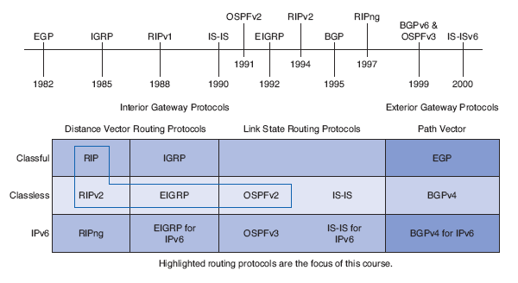
Background

Slide 46
Distance Vector Protocols
A distance vector protocol is so named because its routes are advertised as vectors - distance and direction - where distance is defined in terms of a metric and direction is defined in terms of the next hop router
These, known as Bellman-Ford protocols, call for each router to send all or some its routing table, but only to its neighbors

Slide 47
Distance Vector Protocols
In this arrangement each router depends on its neighbors for information, which its neighbors may have learned from their neighbors, and so on
An individual router has no way of knowing if the information in the routing table it receives is accurate
These routers just believe everything they hear

Slide 48
Distance Vector Protocols
As such distance vector routing protocols are sometimes referred to as routing by rumor
A typical distance vector routing protocol uses a routing algorithm in which routers periodically send routing updates to all neighbors by broadcasting their entire routing table

Slide 49
Distance Vector Protocols
In this case periodically means to transmit on a regular schedule
Neighbors are those routers at the other end of a data line
The originating router sends its update to this neighbor
It expects the neighbor to send the information on to that router's neighbors, and so on

Slide 50
Distance Vector Protocols
This update includes everything the router knows
In other words its entire routing table with a few exceptions is sent out

Slide 51
Link State Protocols
The information that a distance vector protocol has available has been likened to a road sign
That is it is just one more step on the journey
Whereas the information available to a link state protocol is more like a road map

Slide 52
Link State Protocols
A link state routing protocol cannot be easily fooled into making a bad routing decision because - with the map - it has a complete picture of the network
This is because link state routers have first hand information from all of their peer routers, those that speak the same routing protocol

Slide 53
Link State Protocols
Each of these routers originates information about itself, its directly connected links, and the state of those links
This information is passed around from router to router, each router making a copy, but no router changing the information
How does this all work

Slide 54
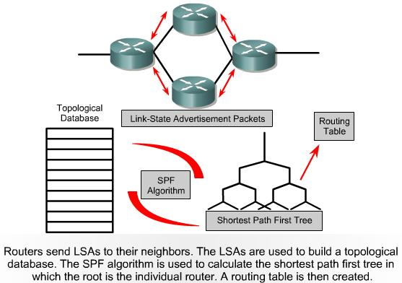
Link State Concepts

Slide 55
Link State Protocols
Like this
Each router establishes a relationship - an adjacency - with each of its neighbors
Each router sends link state advertisements to each neighbor
One link state advertisement is created for each of the router's links, identifying the link, the state of the link, the metric cost of the link, and the neighbors that are connected to the link

Slide 56
Link State Protocols
Each router receiving this information in turns forwards it to its neighbors
Each router stores the link state advertisements it has received in a database
Since all routers receive all link state advertisements, all routers have the same information
The algorithm for the routing protocol is then applied to the information in the link state database to create a routing table

Slide 57
Dijkstra Algorithm
Link-state protocols use the Dijkstra SPF - Shortest Path First algorithm to calculate and add routes to the IP routing table
The SPF algorithm calculates all the possible routes to each destination network, and the cumulative metric for the entire path

Slide 58
Dijkstra Algorithm
Each router views itself as the starting point, and each subnet as the destination, and use the SPF algorithm to look at the LSDB - Link State Database to create a roadmap and pick the best route to each subnet

Slide 59
Characteristics of Link State
The main features of link-state routing protocols
All routers learn the same detailed information about the states of all the router links in the internetwork
The individual pieces of topology information are called LSAs, with all LSAs stored in RAM in the LSDB

Slide 60
Characteristics of Link State
Routers flood LSAs when they are created, on a regular but long time interval if the LSAs do not change over time, and immediately when an LSA changes
The LSDB does not contain routes, but it does contain information that can be processed by the Dijkstra SPF algorithm to find a router’s best routes

Slide 61
Characteristics of Link State
Each router runs the SPF algorithm, with the LSDB as input, resulting in the best - lowest cost - routes being added to the IP routing table
Link-state protocols converge quickly by immediately reflooding LSAs and rerunning the SPF algorithm

Slide 62
Characteristics of Link State
Link-state protocols consume much more RAM and CPU than do distance vector routing protocols
If the internetwork changes a lot, link-state protocols can also consume much more bandwidth due to the relative to distance vector protocols large number of bytes of information in each LSA

Slide 63
Routing Metrics
Routing protocols use metrics to determine the best or optimal route
The following metrics are often used
Path Length
Reliability
Delay
Bandwidth
Load
Cost

Slide 64
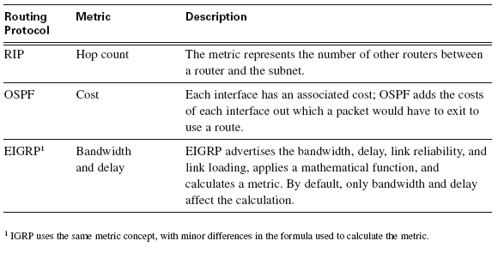
Example Routing Metrics

Slide 65
Administrative Distance
A single router may learn routes from many different sources
For example, from static routes and from running multiple routing protocols
When a router learns more than one route to the same subnet, from different sources, the router needs to decide which route is best and then add that route to the IP routing table

Slide 66
Administrative Distance
Because each routing protocol uses a different metric, a router cannot use the metric to determine which route is the best route
When choosing between multiple routes to the same destination but learned from different sources, the router picks the route with the lowest administrative distance

Slide 67
Administrative Distance
The administrative distance is a number assigned to all the possible sources of routing information, routing protocols and static routes included

Slide 68
Default Distance Values

Slide 69
Administrative Distance
The administrative distance is shown by issuing the show ip route command
The show ip route command output lists the administrative distance for most routes, with the notable exception of connected routes, which default to an administrative distance of 0
The example shown next shows the output of the show ip route rip command

Slide 70
Administrative Distance
The output highlights the administrative distance for the one RIP route known on router R1, which defaults to RIP’s setting of 120

Slide 71
Administrative Distance

Slide 72
Which One to Use
In the real world the two main interior routing protocols are
OSPF
OSPF is used by both Cisco only and mixed vendor shops
EIGRP
EIGRP is used by Cisco only operations

Slide 73
Which One to Use
There is a reasonable amount of RIP in use still
IGRP should be replaced if it is still being used
IS-IS is used by some ISPs and the like

Slide 74
Lab
Start Packet Tracer
Do activity 3.3.4.4.pka

