Slide 1
Static Routing
Last Update 2011.05.15
1.3.0

Slide 2
Objectives
Learn what a static route is

Slide 3
What is Static Routing
A static route is a route added to the routing table by the administrator using the keyboard
For example
ip route 0.0.0.0 0.0.0.0 s0
This command says to send everything that does not belong on one of the directly connected networks out the serial 0 port
It is then the problem of the router at the other end of the line to deal with this packet

Slide 4
Why Use a Static Route
A common use of a static route is a stub network
This is a network at the end of the line
Such as

Slide 5
Stub Network

Slide 6
IP Route Command
The ip route command is used to enter a static route into the routing table
The form of the command is
ip route
Network address
Subnet mask
The way out of the network
For example
ip route 0.0.0.0 0.0.0.0 s0

Slide 7
IP Route Command
The command is read this way
ip route
Tells the router you are about to enter a route into the routing table by using the keyboard
0.0.0.0
Means any ip address matches
0.0.0.0
Means any subnet address matches

Slide 8
IP Route Command
s0
Tells the router to send everything that does not belong on the directly connected local area network out the serial 0 port

Slide 9
Static Route in Routing Table
Here is what a static route looks like in the routing table

Slide 10
Static Route in Routing Table

Slide 11
IP Route Command
Notice that the ip route command shown just above ends differently than the first one shown
In this form it does not state the name of the interface of the router through which the packets should be sent
Rather it shows the ip address of the interface of the router on the other end of the connection

Slide 12
IP Route Command

Slide 13
Recursive Route Lookup
When the next router’s ip address is specified as the exit point the router must do a two step lookup
First, the route for the packet must be determined
Then the exit interface for that route must be determined
This two step process is referred to as a recursive lookup, which should be avoided

Slide 14
Modifying Static Routes
A static route cannot actually be modified
To alter a static route
Delete the existing route
Enter the new route
To delete the static route precede the command with no
no ip route 0.0.0.0 0.0.0.0 s0

Slide 15
Verifying Static Routes
Two show commands are used to verify the static routes
show ip route
This displays the routing table
show running-config
This shows what you really entered regardless of what you think you entered

Slide 16
Configuration
In this section of the chapter Cisco expands on the basic configuration steps introduced in chapter 1
Therefore, we will expand on this topic as well now
When a router is booted
All interfaces are turned off
The routing table is empty

Slide 17
Basic Router Configuration
A basic router configuration is very simple
Go to global configuration level
Activate the directly connected interfaces
Populate the routing table
Let’s look at an example

Slide 18
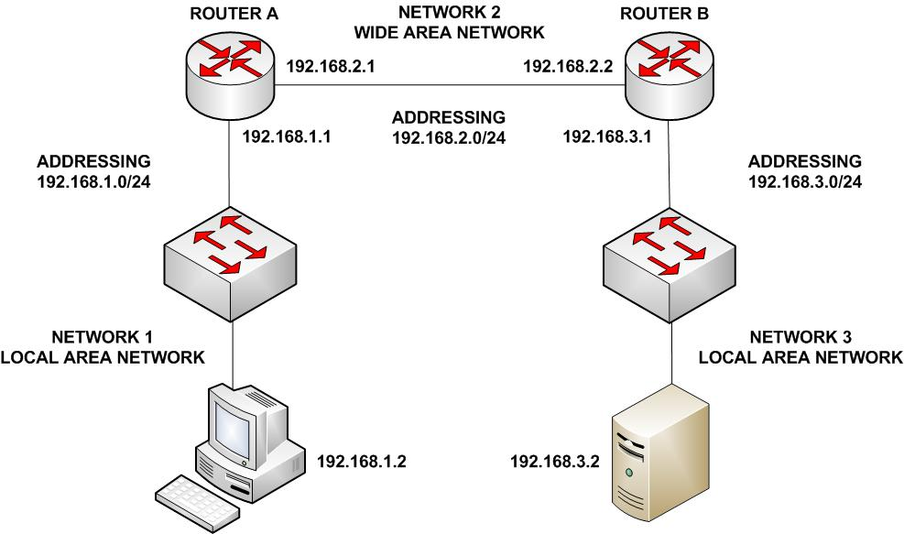
Basic Router Configuration

Slide 19
Basic Router Configuration
For Router A
Go to global configuration level
enable
configure terminal
Activate the directly connected interfaces
interface e0
ip address 192.168.1.1 255.255.255.0
no shutdown

Slide 20
Basic Router Configuration
interface s0
ip address 192.168.2.1 255.255.255.0
no shutdown
exit
Populate the routing table
router rip
network 192.168.1.0
network 192.168.2.0
end

Slide 21
Basic Router Configuration
For Router B
Go to global configuration level
enable
configure terminal
Activate the directly connected interfaces
interface e0
ip address 192.168.3.1 255.255.255.0
no shutdown

Slide 22
Basic Router Configuration
interface s0
ip address 192.168.2.2 255.255.255.0
no shutdown
exit
Populate the routing table
router rip
network 192.168.2.0
network 192.168.3.0
End

Slide 23
Basic Router Configuration
Pretty easy isn’t it
Of course in practice we would add additional commands such as passwords, hostname, and interface descriptions

Slide 24
Basic Router Configuration
Notice two important aspects of basic router configuration
An interface requires two things to activate it
An ip address and subnet mask
The no shutdown command
The only networks advertised are those directly connected to the router using a cable

Slide 25
Only in the Lab
When a serial link is used in a lab environment, but never in the real world
One side of a serial connection must be designated the DCE side
This also requires placing a clocking signal on that interface
R1(config)#interface serial 0/0
R1(config-if)#clockrate 64000
Because serial interfaces require a clock signal to control the timing of the signal

Slide 26
Lab
Start Packet Tracer
Do Packet Tracer Activity 2.2.3.3

Slide 27
Lab
Start Packet Tracer
Do Packet Tracer Activity 2.3.1.3

Slide 28
Lab
Start Packet Tracer
Do Packet Tracer Activity 2.6.2.3

Slide 29
Examining What Was Done
Various show and debug commands are used to see what you really did to the router
It does not matter what you think you typed, you use show commands to see what you really entered
Such as

Slide 30
Show Commands
show running-config
To show the configuration stored in RAM
show protocols
For a quick look at the status of the interfaces
show interfaces
To show the status of an interface
show ip interface brief
To show a portion of the interface information

Slide 31
Show Commands
show controllers serial 0/0
For each physical interfaces being used
show ip route
To view the routing table

Slide 32
CDP
Cisco likes the CDP – Cisco Discovery Protocol because Cisco invented it
Its purpose is to discover the Cisco devices connected to a network
Of course if you are the network administrator, and you do not know what devices are connected to your network, you have a major problem already
CDP operates at layer 2

Slide 33
CDP Commands
Common CDP commands include
Show cdp neighbors command which displays
Neighbor device ID
Local interface
Holdtime value, in seconds
Neighbor device capability code
Neighbor hardware platform
Neighbor remote port ID

Slide 34
CDP Commands
To disable CDP
Router(config)#no cdp run

