Slide 1
OSPF
Last Update 2011.06.06
1.4.0

Slide 2
Objectives
Learn about OSPF

Slide 3
History of OSPF
OSPF was developed to replace RIP
Unfortunately being a committee project it took quite a while to be developed
Begun in 1987 OSPFv1 was not released until 1989 as RFC 1131
However, this version was experimental and never used

Slide 4
History of OSPF
Only in 1991 was the first useable version - OSPFv2 - released as RFC 1247
RFC 2328 from 1998 updated 1247
In 1999 OSPFv3 was published as RFC 2740 to support IP Version 6

Slide 5
Metric
OSPF uses cost as the metric for determining the best route
The best route will have the lowest cost
Cost is an arbitrary value according to the RFCs
Cisco uses the bandwidth of the interface
This form of the cost is calculated using the formula 10⁸ / bandwidth

Slide 6
Metric
It defaults to 100Mbps
This can be modified using the auto-cost reference-bandwidth command

Slide 7
Shortest Path Algorithm
The algorithm that OSPF uses to create the routing table is the SPF algorithm
Using this algorithm the preferred path is the shortest path
The shortest path being the fastest connection
This may or may not be the one with the fewest hops

Slide 8
Steps in OSPF Operation
There are five steps in basic OSPF operation
Establish router adjacencies
Elect a DR and BDR, if needed
Discover routes
Select the routes to use
Maintain the routing table

Slide 9
Multiaccess Networks
In a multiaccess network such as Ethernet or Frame Relay a designated router is needed
This election does not take place in a point to point network
The DR and BDR are selected based on the highest OSPF interface priority

Slide 10
Multiaccess Networks
The election occurs as soon as the first router has its interface enabled on a multiaccess network
When a DR is elected it remains as the DR until one of the following occurs
The DR fails
The OSPF process on the DR fails
The multiaccess interface on the DR fails

Slide 11
Multiaccess Networks
The winner can be manipulated
To do this
Boot up the DR first, followed by the BDR, and then boot all other routers
Shut down the interface on all routers, followed by a no shutdown on the DR, then the BDR, and then all other routers
Use the ip ospf priority interface command
Router(config-if)#ip ospf priority {0 - 255}
Priority number range 0 to 255
0 means the router cannot become the DR or BDR
1 is the default priority value

Slide 12
OSPF Relationships
There are seven states in the relationship between two OSPF conversant routers
Down
Init
Two Way
ExStart
Exchange
Loading
Full Adjacency

Slide 13
Down
This is the initial interface state
In this state, the lower-level protocols have indicated that the interface is unusable
No protocol traffic at all will be sent or received on such a interface
In this state, interface parameters should be set to their initial values

Slide 14
Down
All interface timers should be disabled, and there should be no adjacencies associated with the interface

Slide 15
Init
In this state, an Hello packet has recently been seen from the neighbor
However, bidirectional communication has not yet been established with the neighbor
The router itself did not appear in the neighbor's Hello packet
All neighbors in this state or higher are listed in the Hello packets sent from the associated interface

Slide 16
Two Way
In this state, communication between the two routers is bidirectional
This has been assured by the operation of the Hello Protocol
This is the most advanced state short of beginning adjacency establishment
The Designated Router is selected from the set of neighbors in state 2-Way or greater

Slide 17
ExStart
This is the first step in creating an adjacency between the two neighboring routers
The goal of this step is to decide which router is the master, and to decide upon the initial DD sequence number
Neighbor conversations in this state or greater are called adjacencies

Slide 18
Exchange
In this state the router is describing its entire link state database by sending Database Description packets to the neighbor
Each Database Description Packet has a DD sequence number, and is explicitly acknowledged
Only one Database Description Packet is allowed outstanding at any one time

Slide 19
Exchange
In this state, Link State Request Packets may also be sent asking for the neighbor's more recent LSAs
All adjacencies in Exchange state or greater are used by the flooding procedure
In fact, these adjacencies are fully capable of transmitting and receiving all types of OSPF routing protocol packets

Slide 20
Loading
In this state, Link State Request packets are sent to the neighbor asking for the more recent LSAs that have been discovered, but not yet received in the Exchange state

Slide 21
Full Adjacency
In this state, the neighboring routers are fully adjacent
These adjacencies will now appear in router-LSAs and network-LSAs

Slide 22
OSPF Packet Types
To exchange information OSPF uses five packets types
Type 1 - Hello
Type 2 – Database Description Packet - DBD
Type 3 – Link State Request
Type 4 – Link State Update - LSU
Type 5 – Link State Acknowledgement - LSACK

Slide 23
Hello
Establishes and maintains adjacency information with neighbors

Slide 24
Database Description Packet
Describes the contents of an OSPF router’s link state database

Slide 25
Link State Request
Requests specific pieces of a router’s link state database

Slide 26
Link State Update
Transports link state advertisements

Slide 27
Link State Acknowledgment
Acknowledges receipt of a neighbor’s LSA

Slide 28
OSPF Network Types
OSPF can operate in three type of networks
Broadcast Multiaccess
NBMA – Nonbroadcast multiaccess
Point to Point

Slide 29
Broadcast Multiaccess
Ethernet or Token Ring segment would be a multiaccess link

Slide 30
NBMA
A Frame Relay or X.25 cloud would be classified as non-broadcast multiaccess

Slide 31
Point to Point
A serial link connecting two routers together would be a point-to-point link

Slide 32
OSPF Hello Protocol
What a router is running the OSPF routing process on an interface it sends Hello packets at regular intervals addressed to the multicast address 224.0.0.5
These are sent every 10 seconds for Broadcast Multiaccess and Point to Point networks
Every 30 seconds for NBMA – Nonbroadcast multiaccess networks

Slide 33
OSPF Capture File
Let’s look at some of the OSPF activities just described in some frames from an OSPF network
Download this file
HDLC with OSPF.cap
Double-click on it to open it in Wireshark
Go to frame 2
Expand all of the OSPF layer

Slide 34
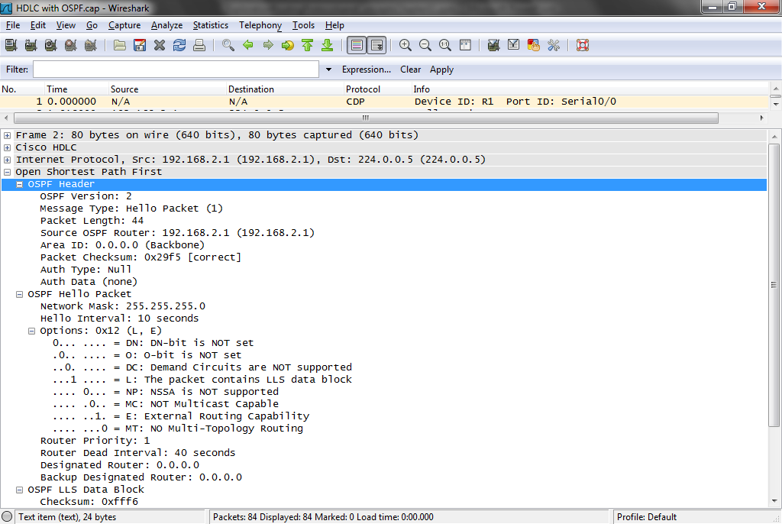
OSPF Capture File

Slide 35
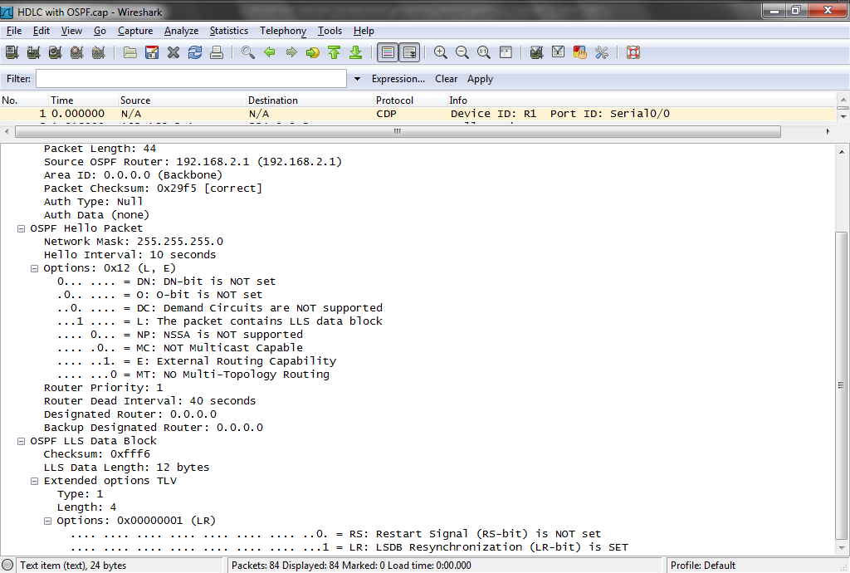
OSPF Capture File

Slide 36
OSPF Capture File
This is a Hello packet from 192.168.2.1
As layer 3 shows it is being sent to the OSPF multicast address of 224.0.05
OSPF version 2 is being used
Hellos are sent every 10 seconds
There is no Designated Router

Slide 37
OSPF Capture File
In frame 9 we see the other side of the link wake-up as it sends a Hello packet as well

Slide 38
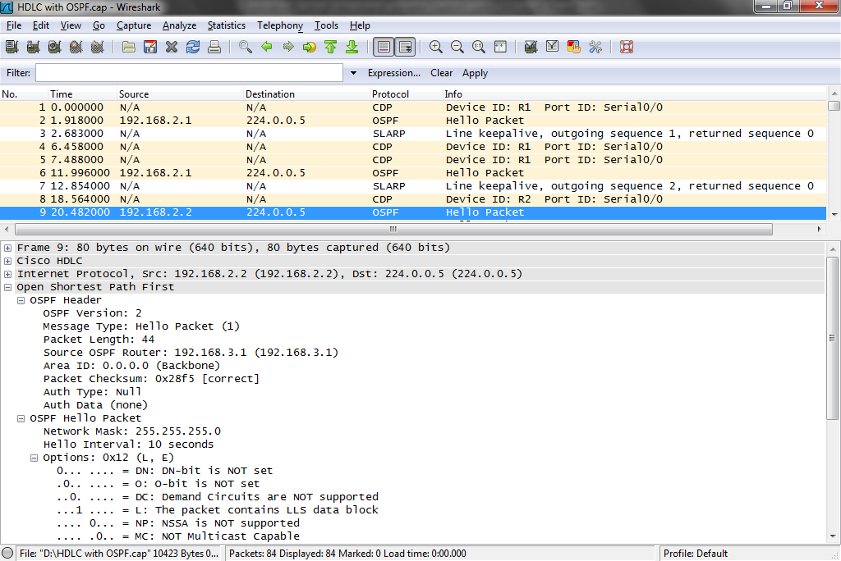
OSPF Capture File

Slide 39
OSPF Capture File
In frames 11 to 23 the OSPF routes start exchanging information
Frame 11 is a Database Description packet from 192.168.2.2
In frame 13 the other side provides their information
Both sides have the same view of the network so they will use the information

Slide 40
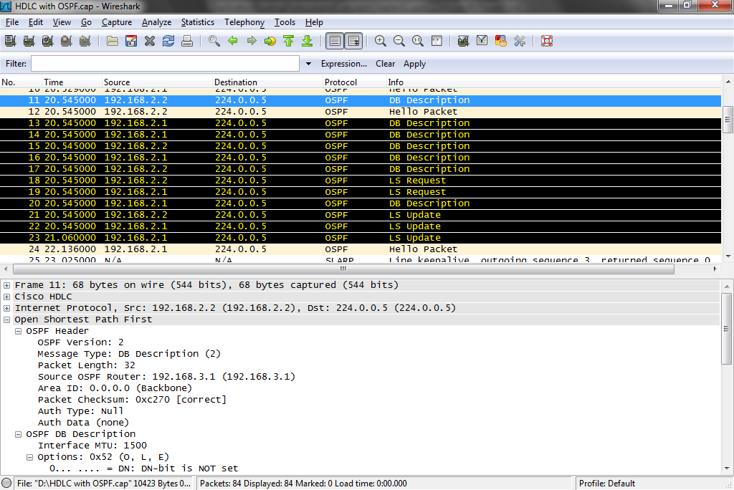
OSPF Capture File

Slide 41
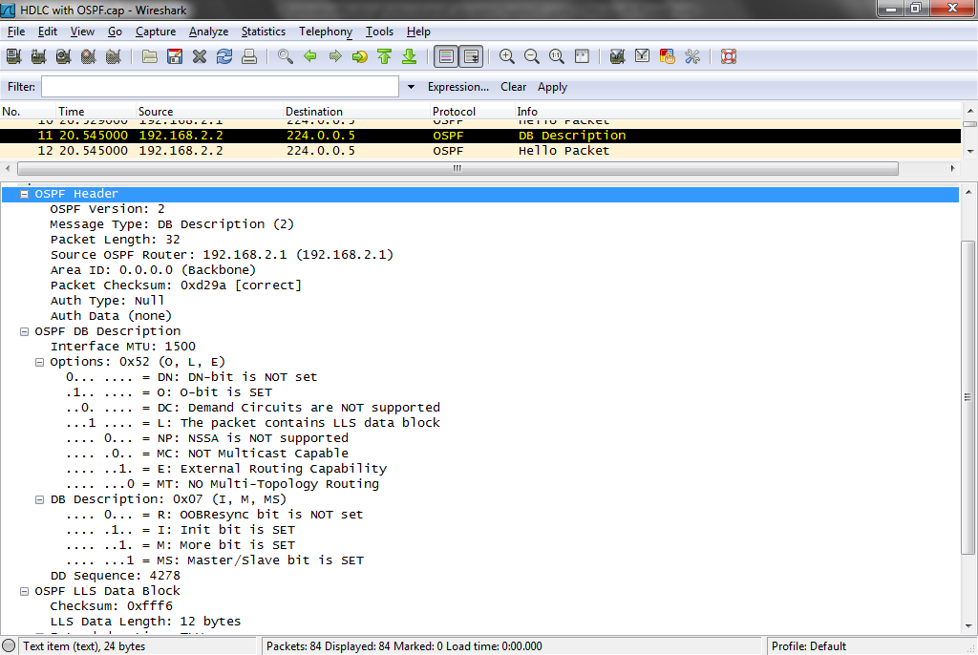
OSPF Capture File

Slide 42
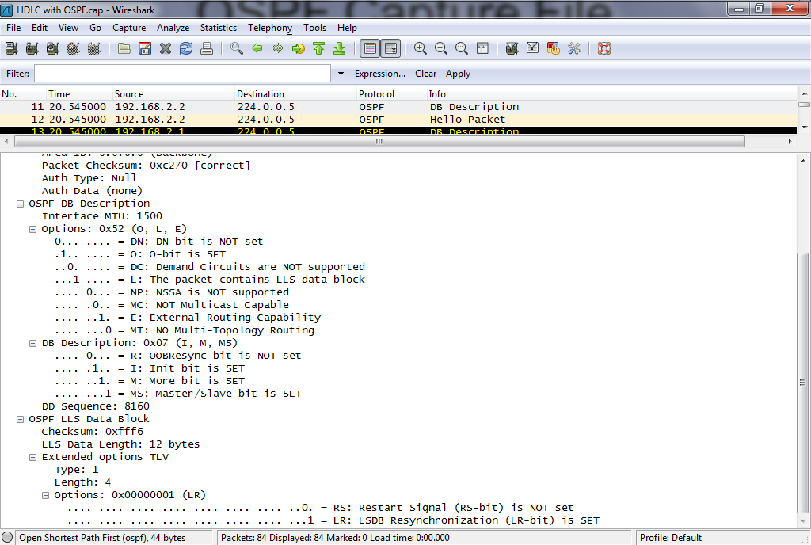
OSPF Capture File

Slide 43
OSPF Capture File
In this Database Description packet this router says it is in area 0
The mtu is 1500 bytes

Slide 44
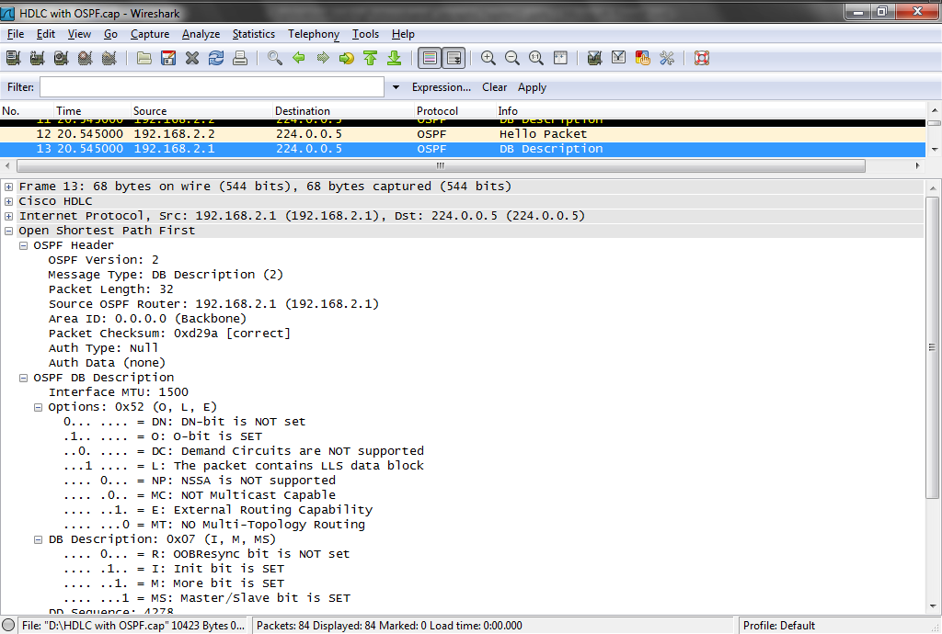
OSPF Capture File

Slide 45
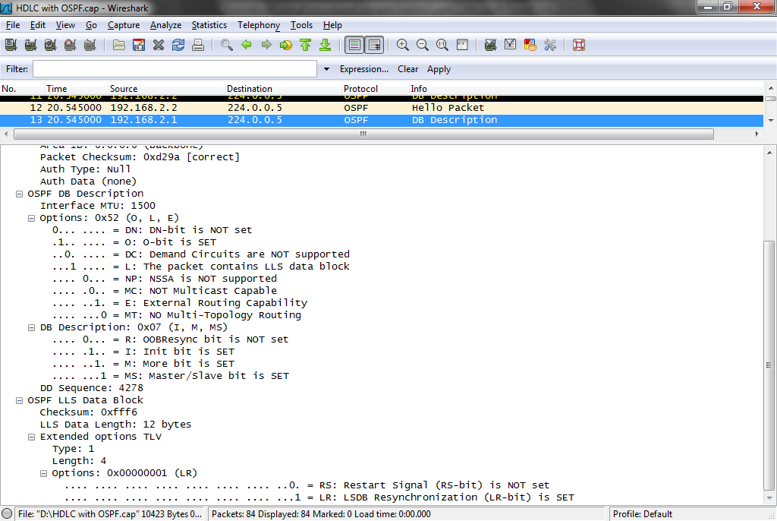
OSPF Capture File

Slide 46
OSPF Capture File
Frame 18 is a Link State Request from 192.168.2.2
Followed by a LSR from the other side in Frame 19

Slide 47
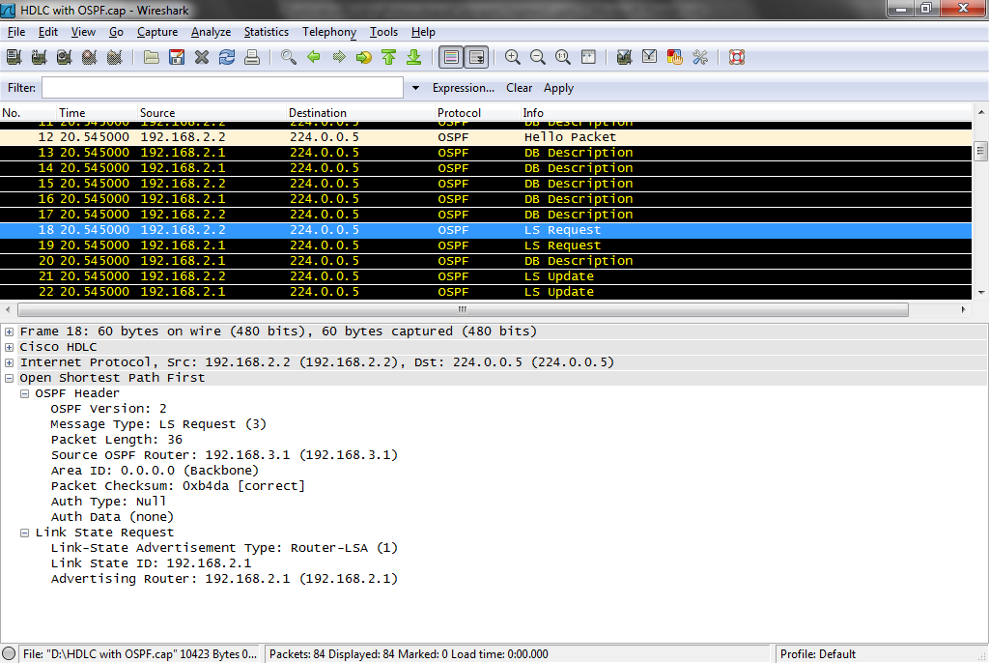
OSPF Capture File

Slide 48
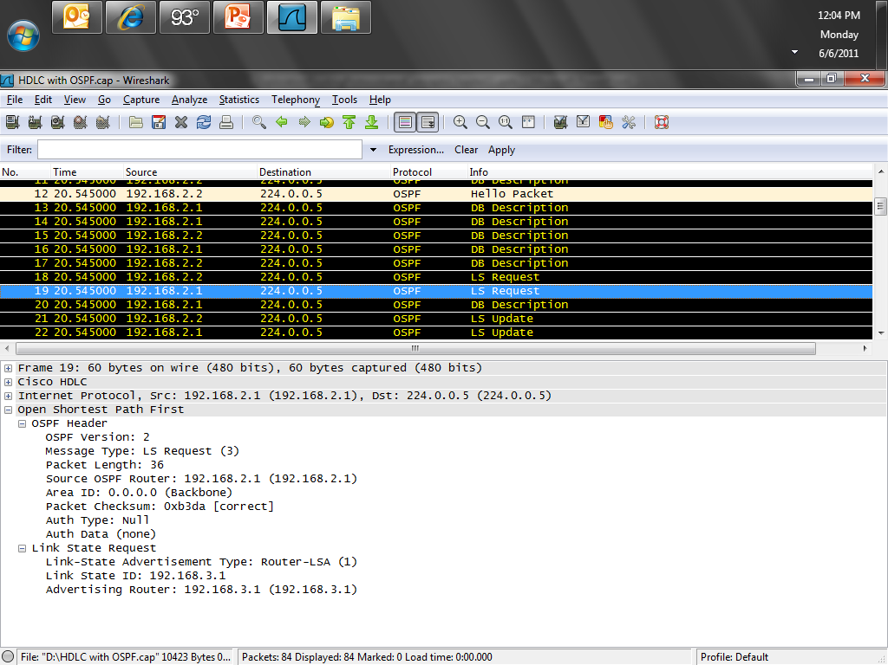
OSPF Capture File

Slide 49
OSPF Capture File
In frame 21 the 192.168.2.2 router sends a Link State Update saying hey wait a minute I just discovered another network hooked to me
In this case the 192.168.3.0 network
This is reported to be a stub network

Slide 50
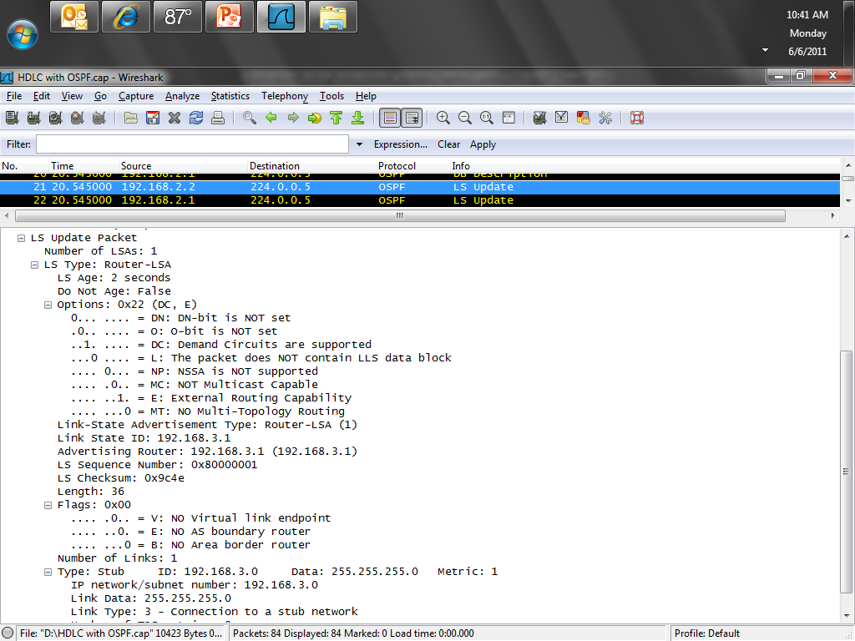
OSPF Capture File

Slide 51
OSPF Capture File
In frame 23 we see all of the networks being reported by 192.168.2.1

Slide 52
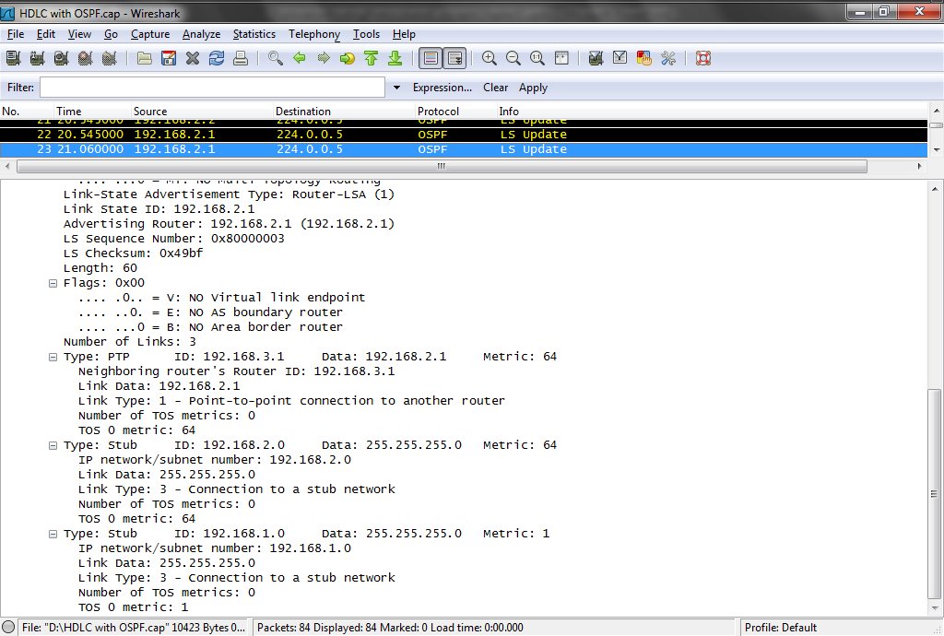
OSPF Capture File

Slide 53
OSPF Capture File
In frame 26 and 27 we see a Link State Acknowledgement from each side

Slide 54
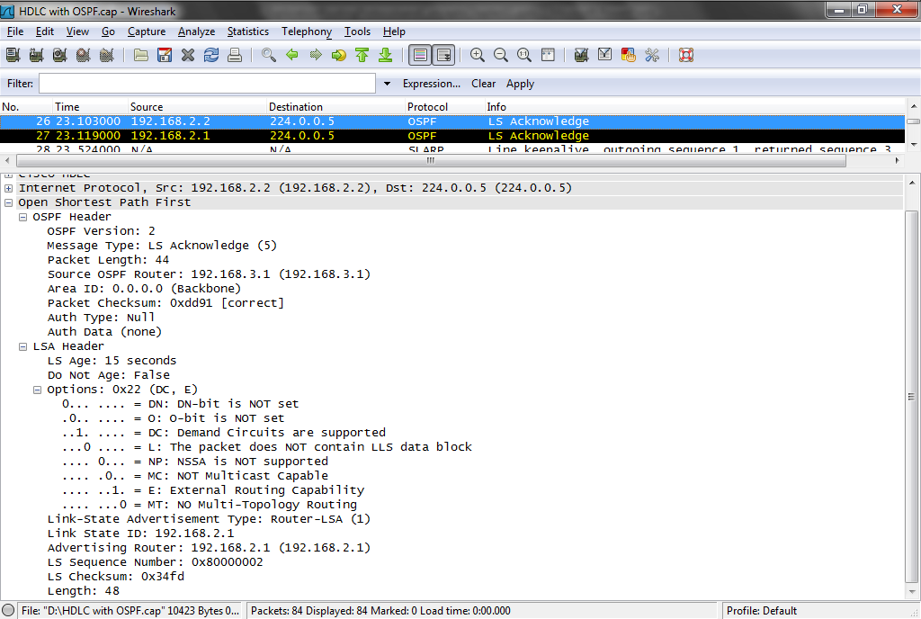
OSPF Capture File

Slide 55
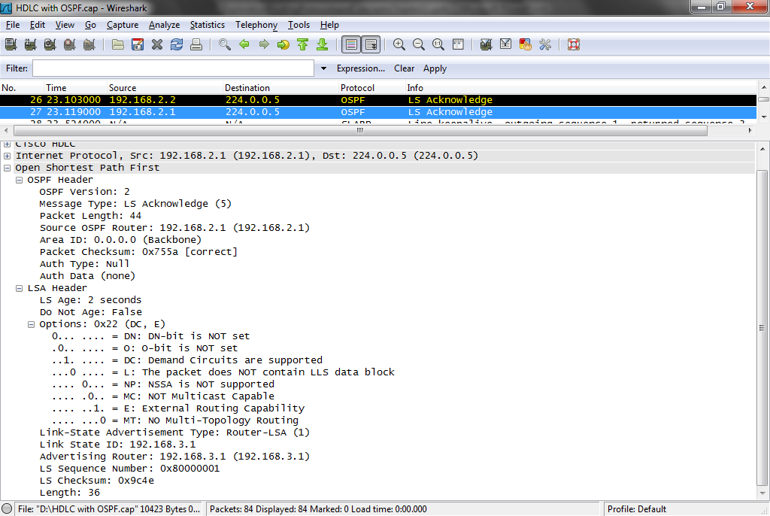
OSPF Capture File

Slide 56
OSPF Loopback
When the OSPF process starts on a router the IOS uses the local IP address as its OSPF router ID
If a loopback address is configured, it is used regardless of its value
A loopback address ensures stability as the loopback interface is not affected by links going up and down

Slide 57
OSPF Loopback
Set the loopback address before enabling OSPF on an interface
To avoid routing problems use a 32 bit subnet mask for the loopback address

Slide 58
Loopback Addressing
It is considered best practice, in configuring Cisco routers, to define one loopback interface, and designate it as the source interface for most traffic generated by the router itself

Slide 59
Loopback Addressing
Adopting this practice yields several benefits for the overall stability and security management of a network, because the address of the loopback interface is fixed

Slide 60
Loopback Addressing
When a router is configured to use the loopback interface for services, it is possible to configure the security of other devices in the network more tightly
When a service is configured to use the loopback interface as its source, we say that the service is bound to that interface

Slide 61
Loopback Addressing
It means that IP packets generated by the router will have the loopback interface’s address as their source address
Also, the loopback interface’s address does not appear in any route-based network maps; hiding administrative aspects of your network from potential attackers is usually good practice

Slide 62
Loopback Addressing
To create a loopback interface, simply assign it an IP address
For a border router, the loopback’s address usually should be in the range of the internal or DMZ network, not the external network

Slide 63
Loopback Addressing
Note that the loopback address cannot be the same as the address of any other interface, nor can it be part of the same network as any other interface

Slide 64
Loopback Addressing
For example
Central# config t
Central(config)# interface loopback0
Central(config-if)# description Main Loopback Interface
Central(config-if)# ip address 14.2.11.250 255.255.255.255

Slide 65
Loopback Addressing
In general, router network services that can be bound to the loopback interface should be

Slide 66
OSPF Authentication
Routers trust the routing information they receive from other routers
To ensure this is from a router that should be trusted, authentication can be set

Slide 67
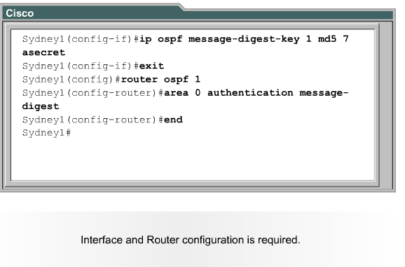
OSPF Authentication

Slide 68
Configuring OSPF Timers
To speed link state failure notifications the OSPF timers can be adjusted

Slide 69
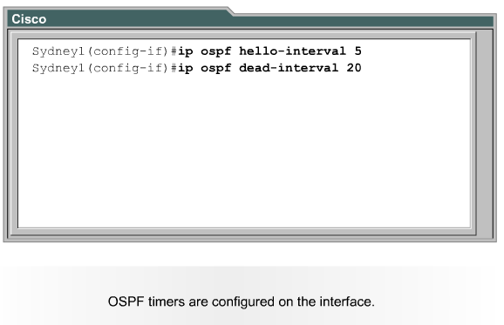
Configuring OSPF Timers

Slide 70
Configuration is Simple
In the vast majority of networks there is nothing needed other than enabling OSPF or any other routing protocol
It just works
This is true up to 30 routers or so talking to each other
Above that some tuning will be required

Slide 71
Configuring OSPF
router ospf 1
The process id from 1 to 65535 is a locally significant number that does not have to be the same on all routers
It just links to a OSPF database held by the router
network 192.168.1.0 0.0.0.255 area 0
network 192.168.2.0 0.0.0 255 area 0

Slide 72
Router ID
The router id is an IP address used to identify a router
Three criteria are applied to derive this
The IP address configured with the OSPF router-id command
This takes precedence over loopback and physical interface addresses

Slide 73
Router ID
If the router-id command is not used, then the router chooses highest IP address of any loopback interface
If no loopback interfaces are configured then the highest IP address on any active interface is used

Slide 74
Verifying OSPF Configuration
show ip protocol
show ip route
show ip ospf interface
shop ip ospf
show ip ospf neighbor detail
show ip ospf database

Slide 75
Lab
Start Packet Tracer
Do activity 11.2.6.2.pka

Slide 76
Lab
Lab 11-1

