Slide 1
Introduction to Routing and Packet Forwarding
Last Update 2014.01.30
1.9.0

Slide 2
Objectives
Learn what routers do and how they do it

Slide 3
A Computer as a Router
A router is just a special purpose computer
Indeed the first router called an IMP – Interface Message Processor was a minicomputer
This first router was used in the first non-proprietary network of networks called APRANET

Slide 4
Development of Routers
To see how the need for a device such as a router developed we must look at how ARPANET developed into the Internet
The original concept of the ARPANET was for a relatively few computers to be connected to a single network
This slowly changed as it grew into a collection of multiple, independent networks joined together

Slide 5
Development of Routers
This produced the question of how to ensure that computers attached to different networks, and running on different platforms, would be able to communicate with each other
The main protocol originally used was NCP - Network Control Protocol
This protocol did not have the ability to handle this function

Slide 6
Development of Routers
One option was to modify the NCP
The design of NCP as more of a device driver than a true protocol made this difficult
So, it was decided to develop a new protocol stack, TCP/IP
It was also seen that additional functionality outside of just software would be needed

Slide 7
Development of Routers
Four ground rules for these functions were specified
Any network should be able to connect to the Internet without making internal changes
If a packet fails to reach its destination, it will be retransmitted by the source
No global control should exist at the operational level
The independent networks will be connected by black boxes

Slide 8
Development of Routers
These black boxes became routers

Slide 9
What Does a Router Look Like

Slide 10
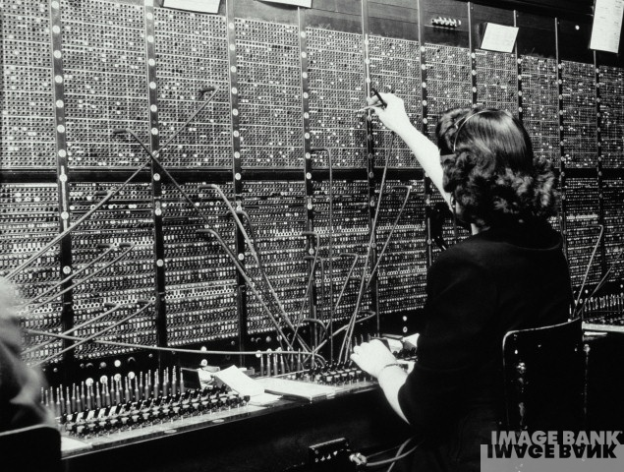
This is a Router

Slide 11
What Does a Router Look Like
You may be thinking, this is not a router, this is an old telephone switchboard
Well it is, but it illustrates exactly what a router does
So, what does a router do

Slide 12
What Does a Router Do
A router is a simple device
It does exactly what a telephone switchboard operator does
Path Determination
and
Switching
For example

Slide 13
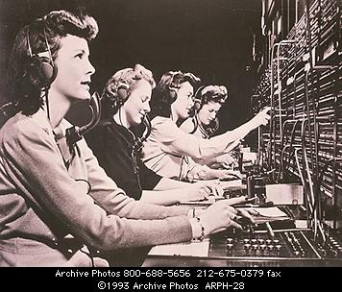
Doing Path Determination

Slide 14
Doing Path Determination
The preceding is a perfect picture of path determination
You can see it in the look on the router’s face – I mean the telephone operator’s face
Someone has called in and said, “Get me New York” or some such place
The router I mean operator is thinking, ok to connect this call I need to take the cable in my right hand and plug it into …

Slide 15
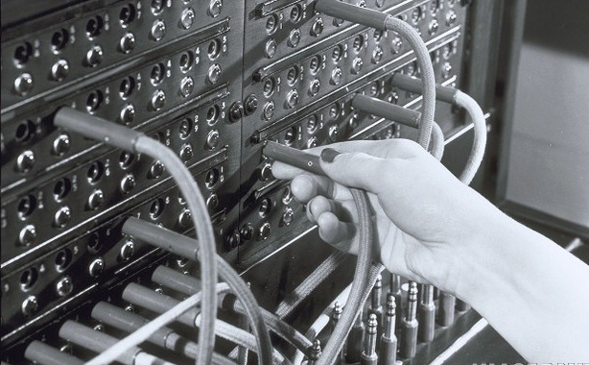
Doing Switching

Slide 16
Doing Switching
How does a router do switching, in other words complete the call
By plugging the wire into the correct hole or by sending the packet out the correct interface
Just like the preceding photograph showed

Slide 17
What Does a Router Do
These photographs showing a switchboard operator at an old style telephone switchboard illustrate the operation of a router perfectly
What is the person doing
A call has come in
The person talking to the operator has asked to speak to someone

Slide 18
What Does a Router Do
The operator is the intermediary in this transaction
Based on who the person making the call wants to talk to the operator makes a determination as to which plug on the switchboard the connector must go into to make the connection - path determination

Slide 19
What Does a Router Do
Then the operator completes the circuit by plugging the connector into the switchboard - switching
This is all there is to it
This is all a router does
What complicates the picture, just as what complicates the human operator above, is how the routing table is built and maintained, which we will discuss later

Slide 20
Routers and Intersections
How about another way of looking at what a router does
A router is like an intersection
Just as an intersection allows you to get from one street to another, a router allows you to get from one network to another
Lets look at an example

Slide 21
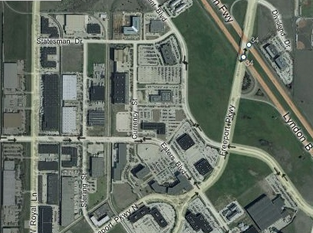
Routers and Intersections
REGENT
DEVRY BUILDING AT 4800 REGENT
INTERSECTION
FREEPORT

Slide 22
Routers and Intersections
In this example the building we are in is located at 4800 Regent
This means the street is Regent and the building number on that street is 4800
In the city of Irving there can only be one street named Regent
But there could be many buildings with the 4800 number

Slide 23
Routers and Intersections
192.168.1.0 NETWORK
WORKSTATIONON ONE NETWORK AT BUILDING NUMBER 23
ROUTER
10.1.1.0 NETWORK
SERVER ON ANOTHER NETWORK AT BUILDING NUMBER 3

Slide 24
Routers and Intersections
The same is true of networks and routers
In this example the workstation is on the street named 192.168.1.0 at house number 23
The server is one the street named 10.1.1.0 at house number 3

Slide 25
Routers and Intersections
When the workstation wants something from the server the router passes the request from the workstation to the server
And then sends the answer back from the server to the workstation
When you are in the building on Regent and need something from a building on Freeport, you would go through the intersection of Regent and Freeport

Slide 26
Router Operation by Layer
Recall that the OSI model is made-up of seven layers and the commonly used TCP/IP routed protocol is made-up of four layers
In both cases the bottom layers are the same
These layers are

Slide 27
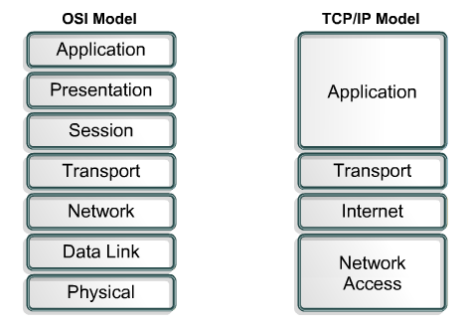
Router Operation by Layer

Slide 28
Router Operation by Layer
A router operates at the bottom layers as it does its two functions of
Path Determination
Switching
The first step in router operation occurs at layer 3 in the OSI model called the Internet or Network Layer in the TCP/IP model
This is where the router determines in which network a packet belongs

Slide 29
Router Operation by Layer
Based on this determination at layer 2 in the OSI model the Data Link layer the packet is changed to a frame in whatever format is required for the type of connection that is used at the Physical layer
At the Physical layer or layer 1 in the OSI model the frame is switched out of the router onto a link for it to exit the router

Slide 30
Cisco Routers
Let’s now look at the physical aspects of some typical routers
We will start with a Cisco 2501 router
The 2501 is part of the 2500 series
This is an older router that has been used in small to medium size sites
Current routers have the same characteristics

Slide 31
Cisco 2501 Tour
The 2501 has a single AUI Ethernet port and two serial interfaces
It is powered by a 25Mhz Motorola CPU
On the front of the router is – nothing
How boring
I would think Cisco could at least put a light on the front to blink and keep us amused

Slide 32
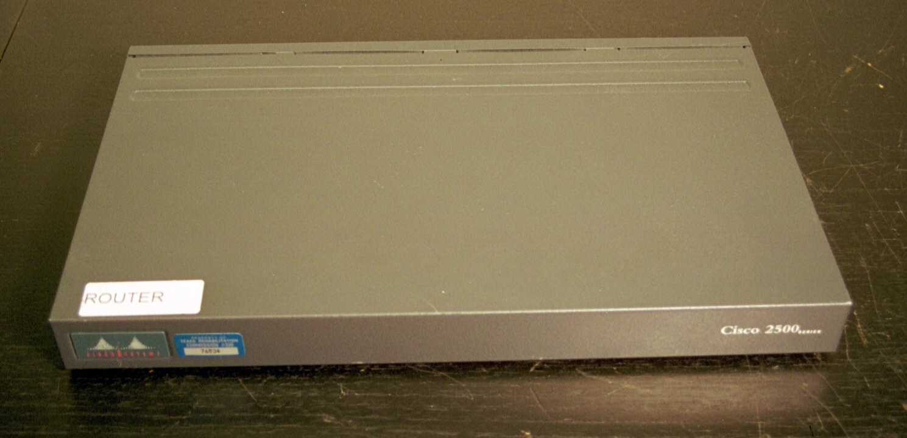
Cisco 2501 Front

Slide 33
Cisco 2501 Tour
At least the back is a little more interesting

Slide 34
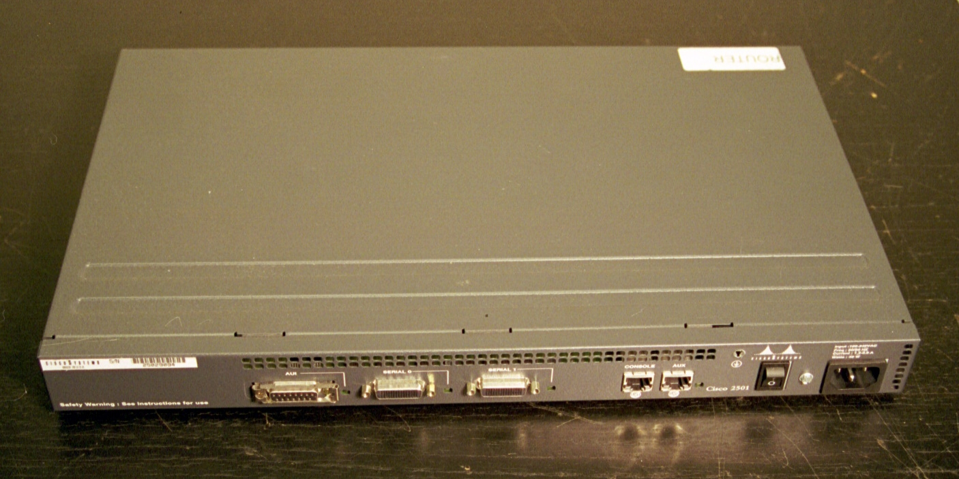
Cisco 2501 Back

Slide 35
Cisco 2501 Back
On the back of the router, in the case of the 2501 we have
Ethernet AUI port
Serial port number 0
Serial port number 1
Console port
Auxiliary port
Power switch
Plug for the power cord

Slide 36
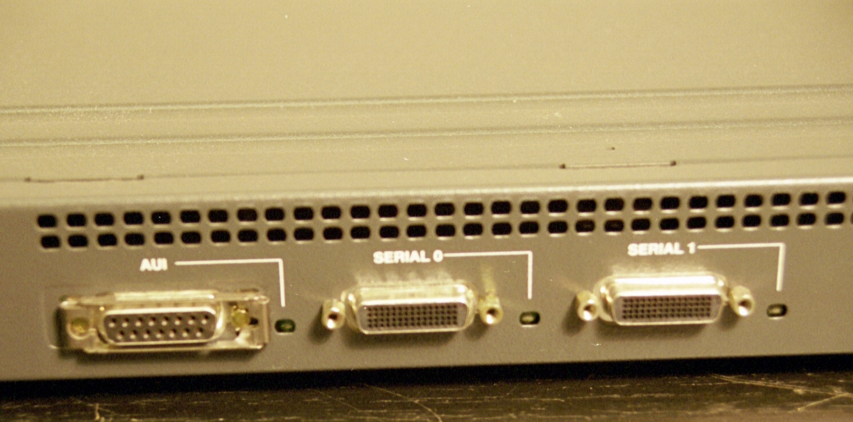
Cisco 2501 Back
Ethernet Port
Serial Port
Serial Port
Activity Light
Activity Light
Activity Light

Slide 37
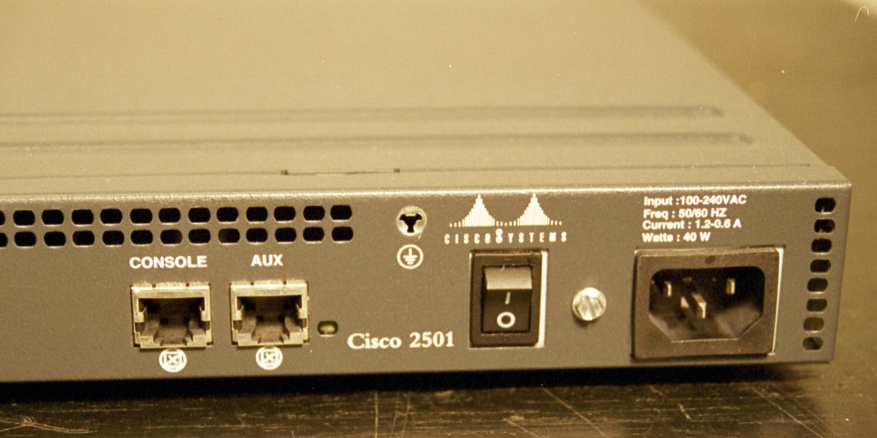
Cisco 2501 Back
Power Cord Plug
Console Port
Auxiliary Port
Power Switch
Hardware Failure Light

Slide 38
Cisco 2501 Back
On the back we have at least a few lights
Next to the Ethernet and serial ports is an activity light for each one
Next to the Auxiliary Port is a hardware failure light
If this light does not come on when the router is powered up, the router has a bad memory card or chip most likely

Slide 39
Cisco 2501 Back
The Ethernet port is an AUI style
This was designed for a 10Base5 network
No one has used such a network in twenty years
Why Cisco has used this port for so long is beyond me

Slide 40
Cisco 2501 Back
To actually use this port a transceiver will have to be attached to it to convert the port to an RJ-45 connector as is used in the real world
This is the device shown next

Slide 41
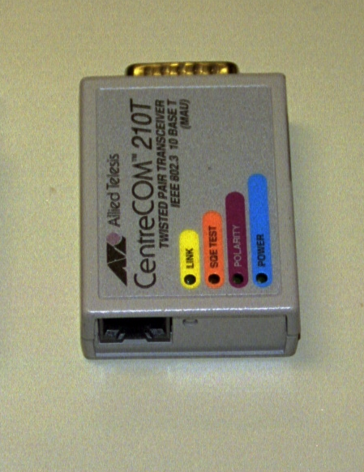
Transceiver

Slide 42
Transceiver
You must be very careful with an AUI connector
The transceiver will just plug straight onto the port, but you must lock it in place
This is done by sliding the locking tab over the knobs on the transceiver
If you do not do this the transceiver, which is heavy, may come loose

Slide 43
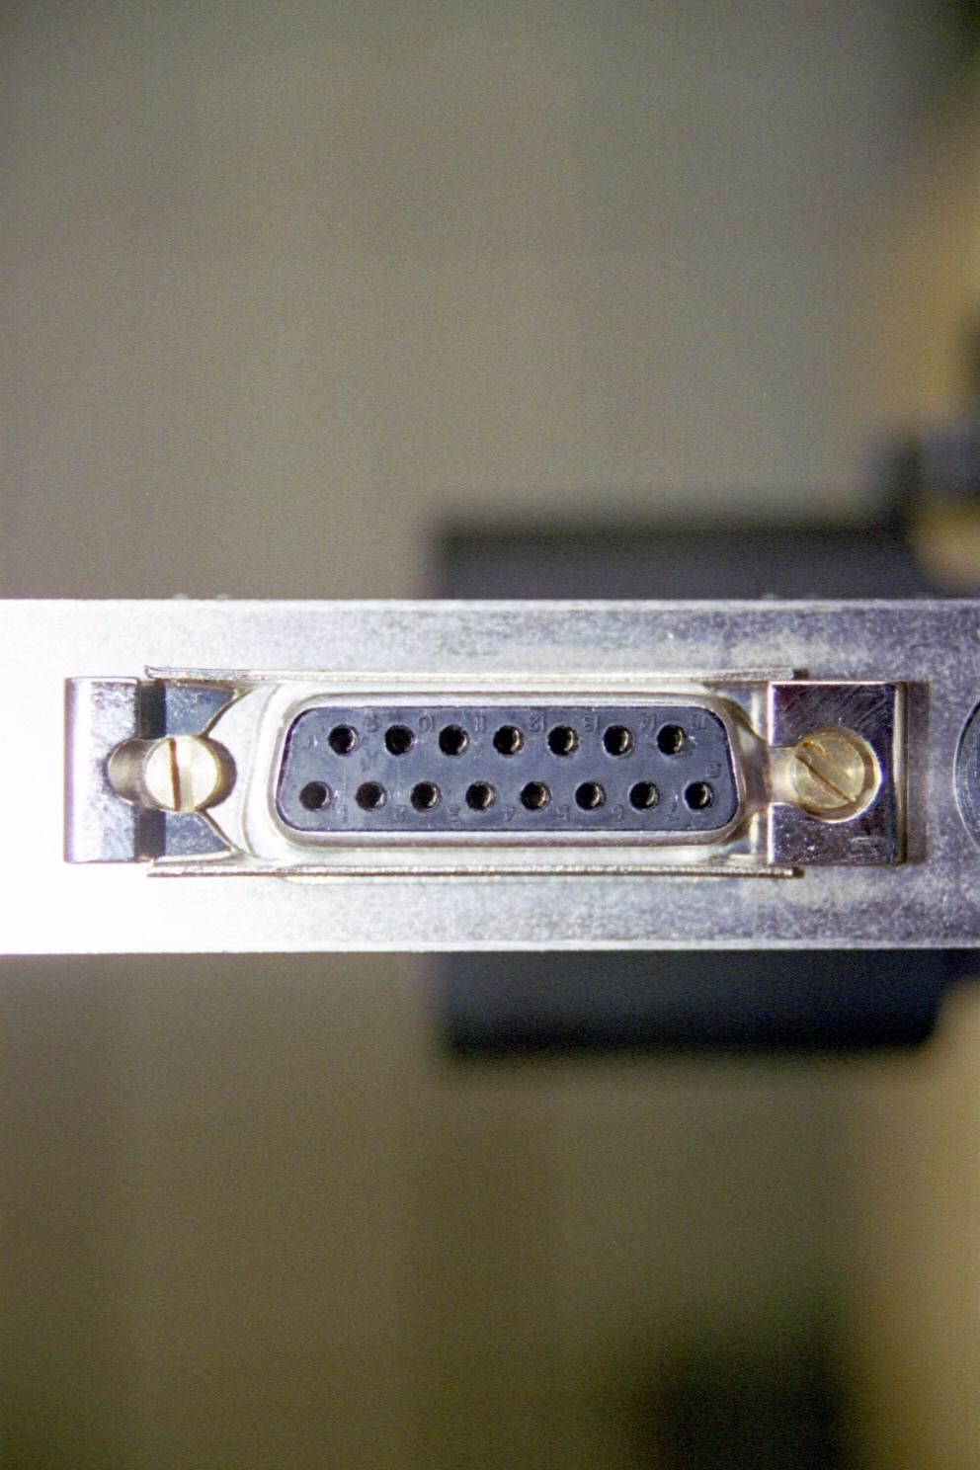
AUI Interface Locking Tab
Locking tab

Slide 44
Transceiver
Fortunately the newer routers use a standard RJ-45 connector

Slide 45
Serial Ports
The next two ports over are used for the serial – WAN connections
In the case of a 2501 router these are high-density 60-pin connectors
This is where the V.35 cable attaches as it comes over from the CSU/DSU
These connectors are called fixed interface connectors because they are attached directly to the router motherboard

Slide 46
Serial Ports
In the newer style routers these are modular interfaces
These plug into a bus on the motherboard
As such they may be changed for others
For example

Slide 47
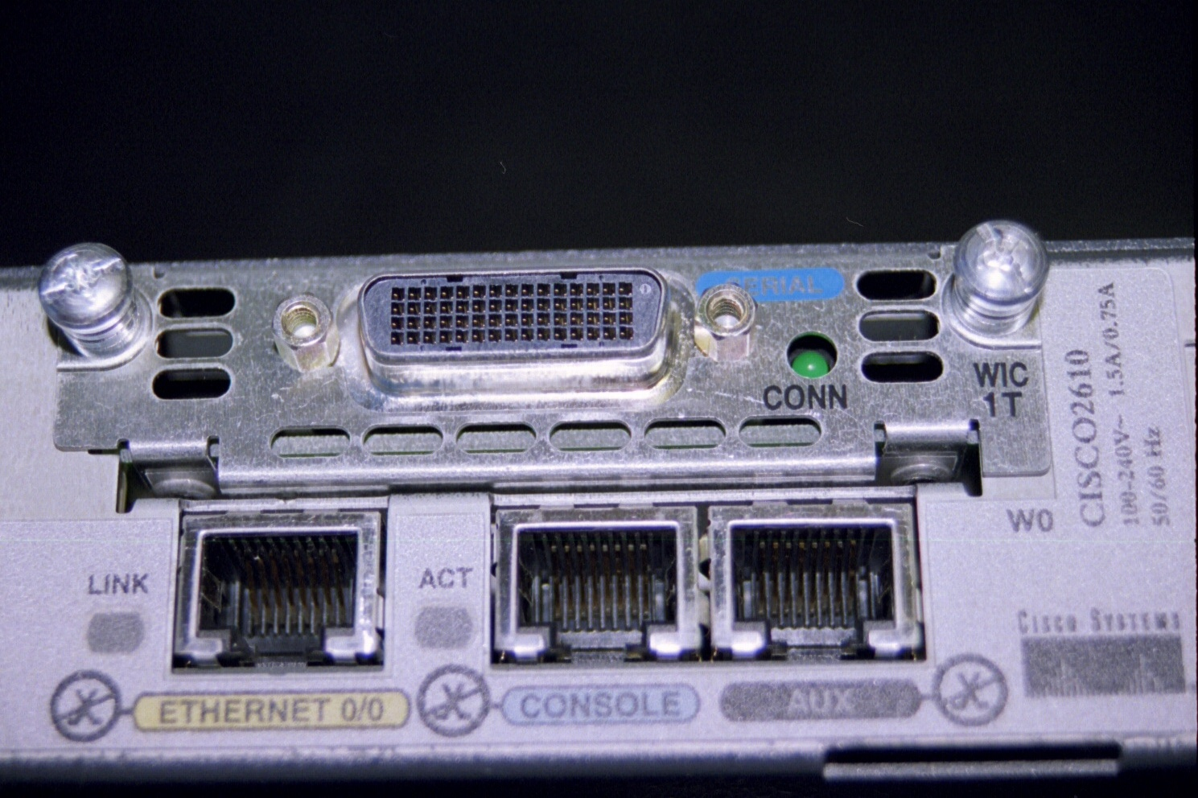
T Carrier Modular Interface

Slide 48
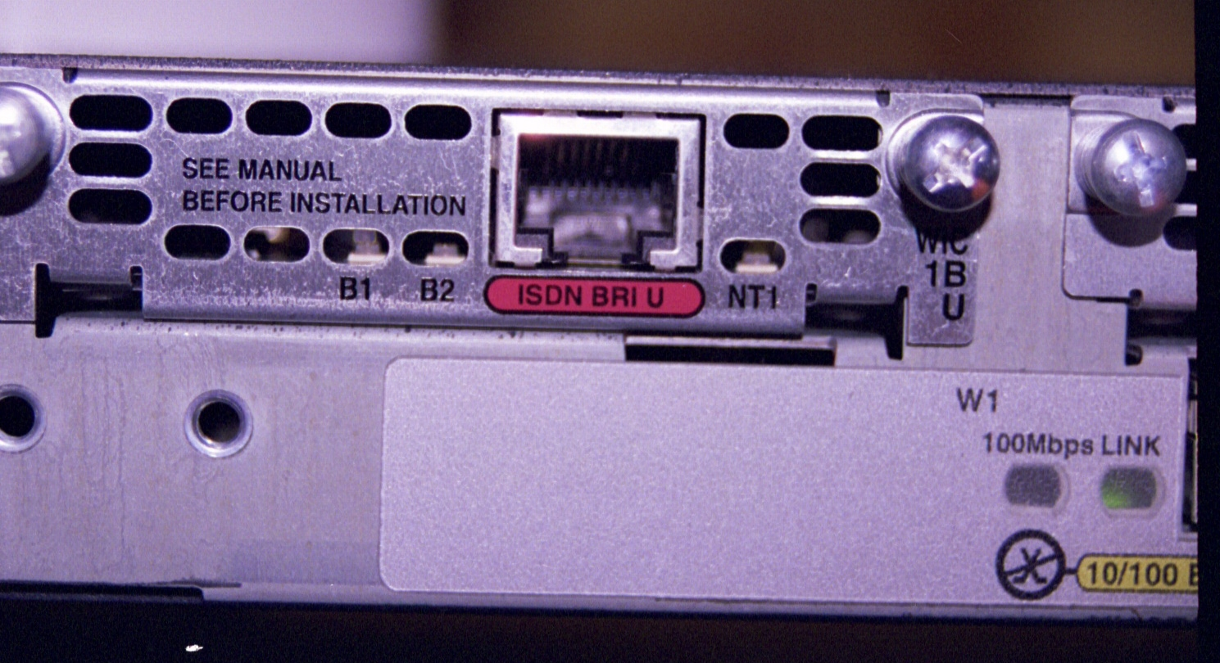
ISDN Modular Interface

Slide 49
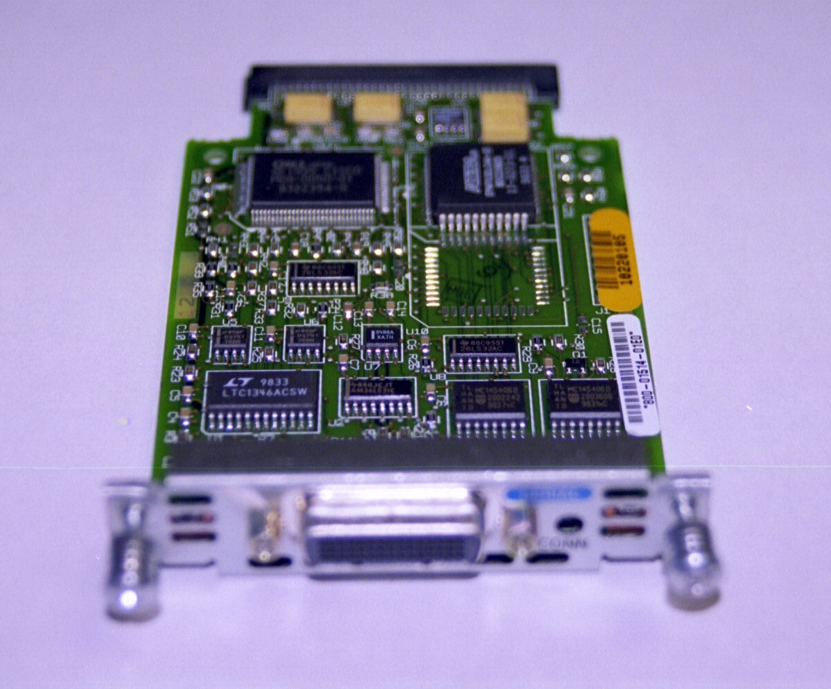
Cisco Modular Interface

Slide 50
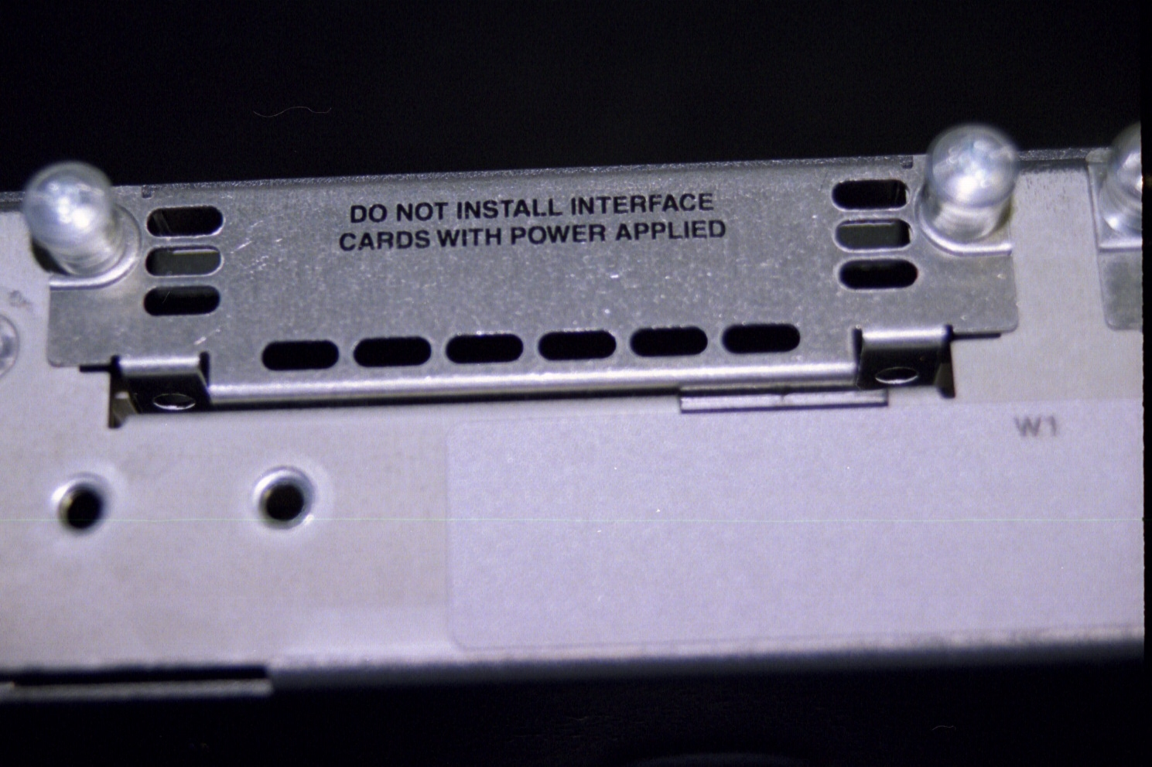
2600 Module Cover

Slide 51
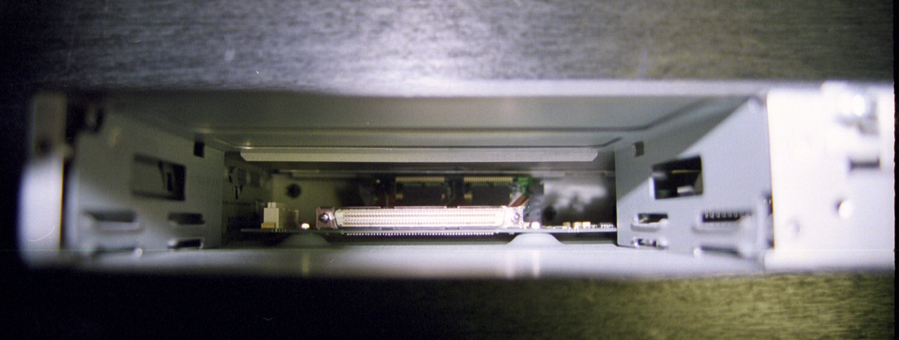
2600 Module Slot Open

Slide 52
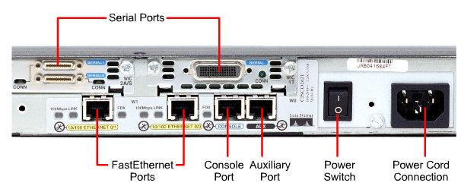
2600 External Connections

Slide 53
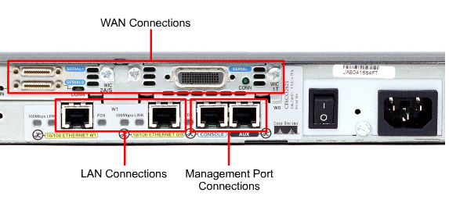
External Router Connections

Slide 54
More Serial Ports
When two serial ports are not enough a larger router is called for
In this case a Cisco 7000 is shown
The serial ports are on a slide-in board called a blade
As more ports are needed, another blade is put into the 7000’s chassis

Slide 55
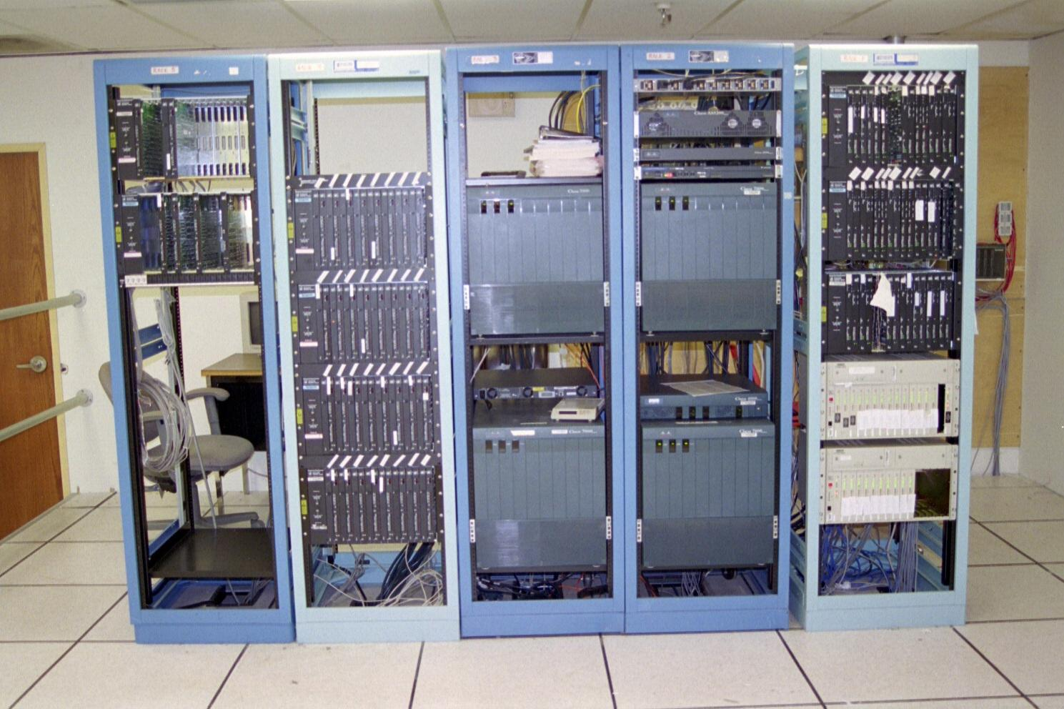
Cisco 7000

Slide 56
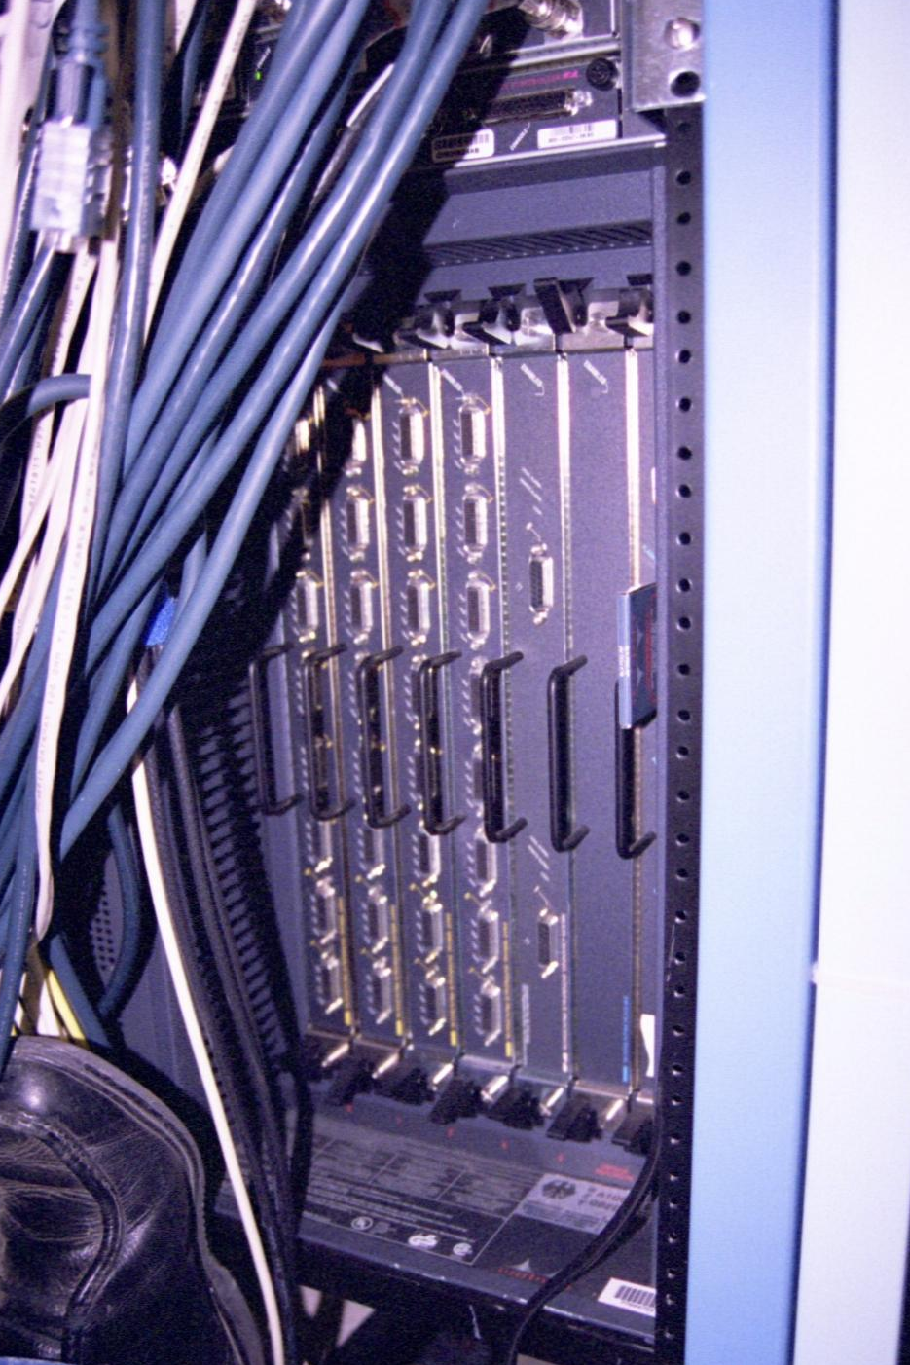
Cisco 7000 Multiple Ports

Slide 57
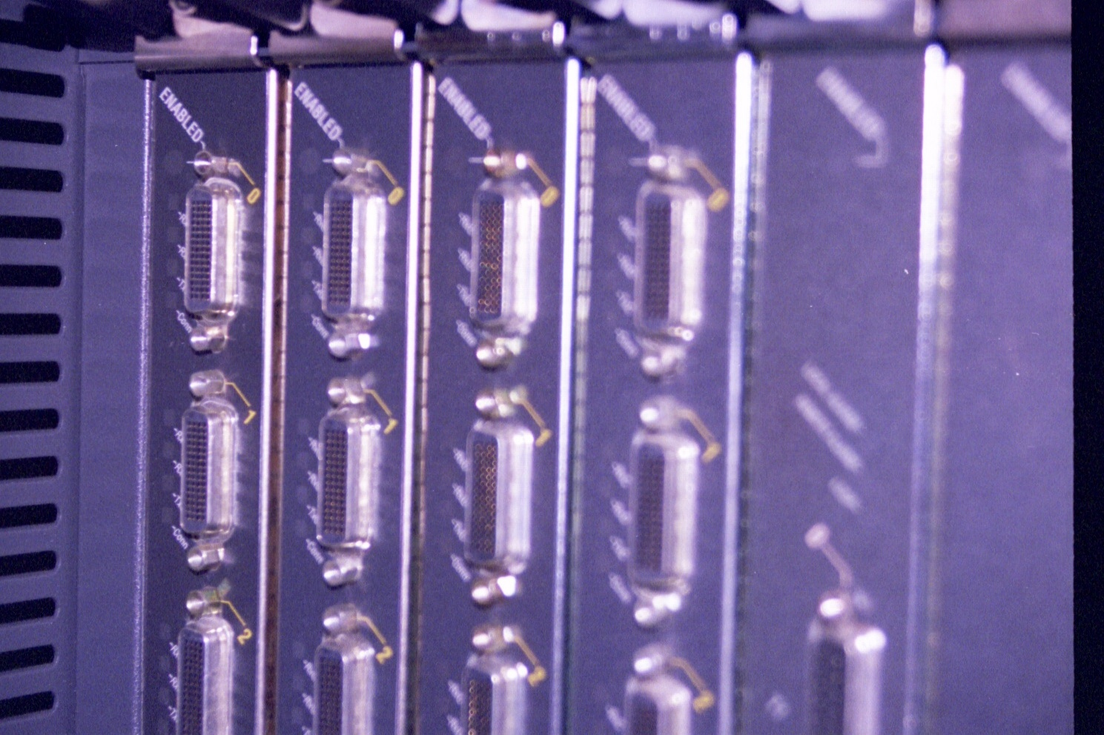
Cisco 7000 Multiple Ports

Slide 58
Router Interfaces
When buying a router be sure to specify the correct interface based on the type of access line that will be used
In other words, an ISDN line cannot connect to an interface designed for a T Carrier line
Although a Frame Relay line can use the T Carrier interface, since Frame Relay is provided over a T Carrier line usually

Slide 59
Router Interfaces
This is easier to do with the newer model routers that use the modular interfaces
These newer model routers just have slots as shown above
Any access line interface – that the manufacturer makes – can be plugged in
If the line is changed, there is no need to change the entire router

Slide 60
Router Interfaces
The point is to be sure everything will connect properly to everything else being used

Slide 61
Lab
Start Packet Tracer
Do Packet Tracer Activity 1.1.5.3

Slide 62
Lab
Start Packet Tracer
Do Packet Tracer Activity 1.1.5.4

Slide 63
Inside the Box
The only thing inside the router is a single circuit board
The only thing that can be done here is to add or change the memory or ROM chips

Slide 64
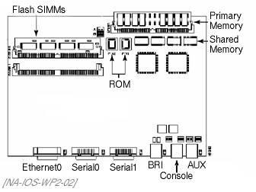
Inside the Box

Slide 65
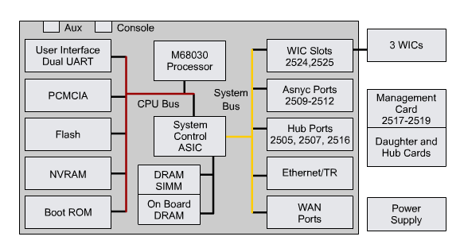
Router Internal Components

Slide 66
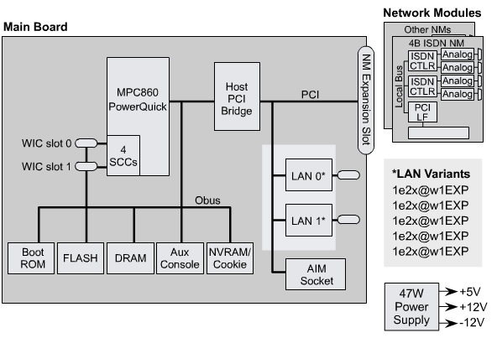
Router Internal Components

Slide 67
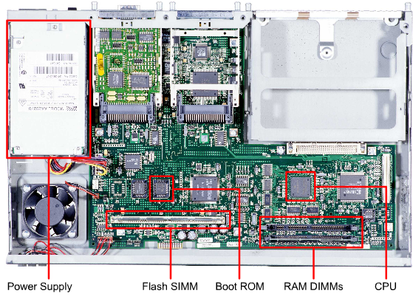
2600 Internal Components

Slide 68
The Cisco IOS
The Cisco IOS in all its forms is the main asset of Cisco
The hardware upon which the various IOSs run are fairly unremarkable
What makes Cisco the market leader in many segments of the market is the quality and scope of the IOS

Slide 69
Forms of the Cisco IOS
The Cisco IOS is used in
Switches
Routers
Firewalls
Wireless Access Points
and so on
Each version is specific to its use

Slide 70
Forms of the Cisco IOS
One of the problems with this is as Cisco buys companies, which they often do to expand market share, the operating system it comes with is different from those developed by Cisco
An example is the menu driven switch IOS
Over time it has been migrated to the more common Cisco command line style

Slide 71
IOS Versions
There are many versions of the Cisco IOS
I will let Wendell Odom explain the simplified version of this
It is more complicated than this, but here are the basics

Slide 72
IOS Versions
Cisco produces a legion of IOS images, although over time, they've been reducing the number of different images
For instance, each model series has a different IOS image
In fact, inside one model series, they may be more than one image for different subsets of the model series

Slide 73
IOS Versions
To make bug fixes, Cisco fixes the code, compiles the IOS into an image file, gives it a new release number, and posts it
For every model series that has a different IOS image, and every subset in that series that has a different IOS, Cisco then has to create a new IOS image for that next minor bug fix release

Slide 74
IOS Versions
On top of that, Cisco maintains different major versions of software, as you would expect, so a single bug fix may need to roll out into multiple major versions - all of which means different IOS images are recompiled
Cisco also produces different trains of IOS, using a suffix on the main version number to identify the train

Slide 75
IOS Versions
A train is a series of IOS images that Cisco updates either with an eye towards safety, adding new features (which isn't as safe), or some compromise between the two
Some trains are build to reduce risk, at the expense of adding less features; some have more features, but at the risk that those features cause other problems
For example, 12.2, with no suffix, is the core train, called "mainline“

Slide 76
IOS Versions
It is the most stable train, with no new features added
The T-train, named 12.2T, has the same bug fixes as 12.2 mainline, plus some new features when Cisco completes them, so it's potentially less stable, but it may give you a feature you need

Slide 77
IOS Versions
Other suffixes identify other trains, sometimes with newer features that are riskier, sometimes with newer features meant for a particular market
Here is a chart on this

Slide 78
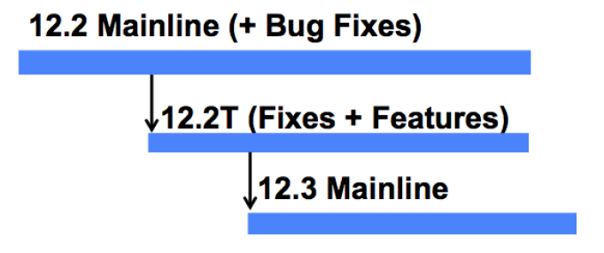
IOS Versions

Slide 79
IOS Versions
In addition to the version numbers each one has one or more feature sets

Slide 80
IOS Versions
Jessie Pagan in a presentation from the 2011 Cisco Academy Conference titled Cisco Tools, Online Resources and IOS Fundamentals expands on this
He says

Slide 81
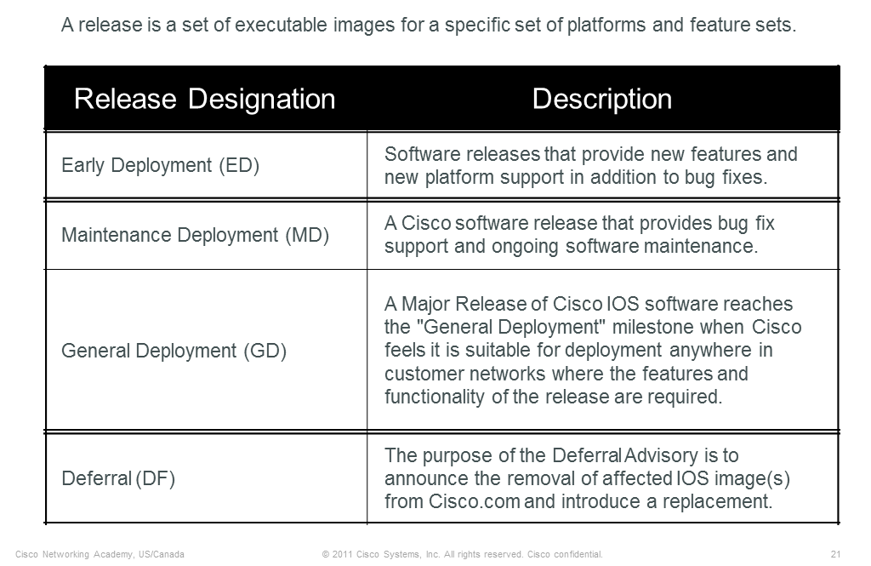
IOS Versions

Slide 82
IOS Versions
A Cisco IOS image is a binary executable file of a feature set for a specific platform
Multiple different images exist of any one release
The Cisco IOS software image name represents the hardware, feature set, format, and other information about the image file

Slide 83
IOS Versions
The figure below shows the image name of a 12.4(6)T Release with the Enterprise Base feature set for the Cisco 3725

Slide 84
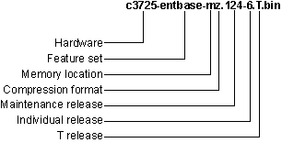
IOS Versions

Slide 85
IOS Version 15
Although you will use the 12 version of the Cisco IOS for a long time you need to also know that Cisco has moved on to version 15
It has several major differences
Kevin Hamilton and Dwight Hughes discussed version 15 at the 2011 Cisco Academy conference
They say the first change is

Slide 86
IOS Version 15
There is only a single universal IOS image that contains all Cisco IOS features
A single universal IOS image is shipped with the devices
The IOS functionality is determined by licenses applied to the devices

Slide 87
IOS Version 15
There are only two IOS images for each release
universalk9
This universal image offers all the Cisco IOS features including strong crypto features such as VPN payload, Secure UC, and so on
universalk9_npe
With no payload encryption as is required to meet export restrictions
It does not support any strong payload encryption, such as VPN payload

Slide 88
IOS Version 15
For example for the 2901 router
c2900-universalk9-mz.SPA.151-4.M.bin
c2900-universalk9_npe-mz.SPA.151.4-M.bin

Slide 89
IOS Version 15
Within each of these images are multiple feature sets
For example for the 2901 router the feature sets or technology packages are
IP Base
Security
UC
Data

Slide 90
IOS Version 15
The IP Base Technology Package is enabled by default
Security, UC and Data Technology Package licenses activate more features

Slide 91
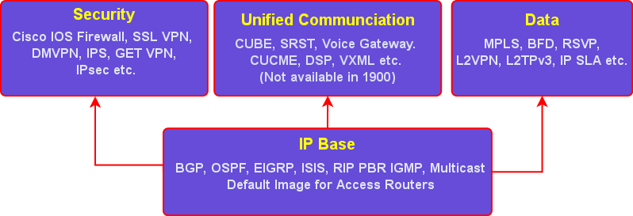
IOS Version 15

Slide 92
IOS Version 15
Here is the naming scheme for 15

Slide 93
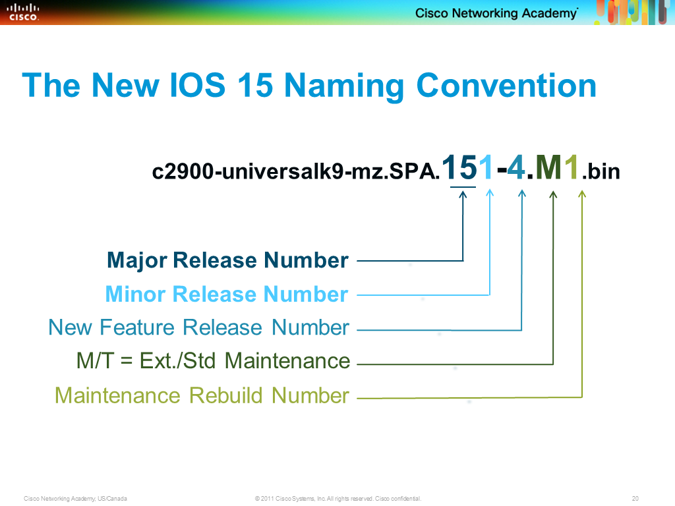
IOS Version 15

Slide 94
IOS Version 15
To allow some stability between releases there will be about 20 months between mainline M releases
So if the new technology added in a T release is not needed, then these Ts can be ignored

Slide 95
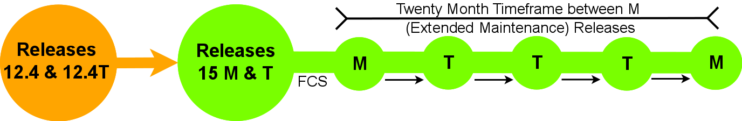
IOS Version 15

Slide 96
IOS 15 Licensing
Now let’s look at the new licensing method
Here are the main licenses
Permanent Licenses
Temporary Licenses
Features Licenses
Software Activation Feature Licenses
Right to Use Feature Licenses

Slide 97
Permanent License
A Permanent License never expires
Once a permanent license is installed on a router, it is good for that particular feature set for the life of the router even across IOS versions
A permanent license is the most common license type used when a feature set is purchased for a device

Slide 98
Temporary License
A Temporary License is good for a limited amount of time
For example an ISR G2 includes a full set of 60 day Temporary Licenses for the Data, UC and Security feature sets
These can be activated and deactivated at any time to evaluate a feature set before making the decision to convert to a Permanent License

Slide 99
Temporary License
Once a Temporary License expires, it cannot be extended

Slide 100
Feature License
A Feature License typically upgrades to one or more Technology Package licenses
This can be delivered with new router or upgraded at a later time
Licenses are enforced through Cisco Software Licensing framework

Slide 101
License Management
There are several ways to manage these licenses including commands and web based tools on the Cisco site

Slide 102
Versions 12 and 15
So the mainstream versions are currently 12 and 15
What happened to 13 and 14
Cisco is superstitious or at least they think their customers are
What are they afraid of
Todd Lammle explains it this way in an article from his website
Part of which is below

Slide 103
Versions 13 and 14
Cisco®’s 12.x code has definitely proven to be a very stable operating system
But since change is a given, Cisco has gone through a lot of revisions, and it’s finally time to morph into the 13.x code
But no… wait
13 is bad

Slide 104
Versions 13 and 14
Buildings don’t have a 13th floor, and even if they do, elevators don’t go there!13 is a superstitiously cursed, unlucky number here in the U.S.
Friday the 13th has been cursed since the 16th Century because that’s the day that the King of France attacked and attempted to jail all of the members of the secretive society, the Knights Templar

Slide 105
Versions 13 and 14
Cisco appears to feel a bit superstitious too… they skipped the 13.x code and went to… 14.x code
Nope
Not 14 either, because 14 happens to be a really nasty number in parts of Asia
So to keep anyone from getting the willies, Cisco jumped to the new 15.x code

Slide 106
Versions 13 and 14
The actual reason for skipping versions 13 and 14 code is of course, nothing but a rumor, but it it’s a fun way to start to this blog

Slide 107
Cisco Router Boot Process
When the router is first powered on the boot process starts
The first step is the POST – Power On Self Test
This is a test routine that checks the CPU, memory, and interfaces to make sure there are no hardware problems

Slide 108
Cisco Router Boot Process
After the POST, the router will begin the boot sequence
The boot sequence steps are
The Bootstrap Program, which is stored in ROM, runs
The bootfield is read to find out the proper Operating System source
The Operating System Image is loaded into RAM from Flash, TFTP, or ROM

Slide 109
Cisco Router Boot Process
The Startup Configuration File is read from NVRAM or TFTP server and then loaded into the RAM
The Configuration File is then executed one line at a time and starts the processes to run the router according to that file
If no Configuration File is found in NVRAM, the Cisco IOS will offer the chance to use the Initial Configuration Dialog

Slide 110
Cisco Router Boot Process
If the Initial Configuration Dialog is refused, then the router must be configured by hand from the command line

Slide 111
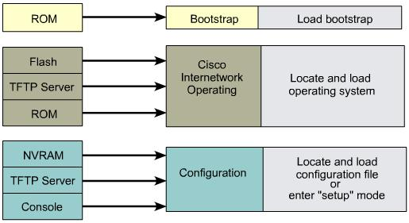
Steps in Router Initialization

Slide 112
Lab
Let’s see this in action
Start Packet Tracer
Bring a router into the workspace
Double click the router
Select the Config tab
Turn off the router, then turn it back on
Click on the CLI tab to watch the bootup
Select another router and do this again

Slide 113
Initial Router Output
The process of doing the overhead work to make the computer ready to use is called booting, or the boot process, or rebooting the computer
When booting, the router generates messages about the boot process and sends them out the console port

Slide 114
Initial Router Output
Router output during the boot process
The version of IOS being loaded
The number of interfaces
The types of interfaces
The amount of NVRAM
The amount of flash memory

Slide 115
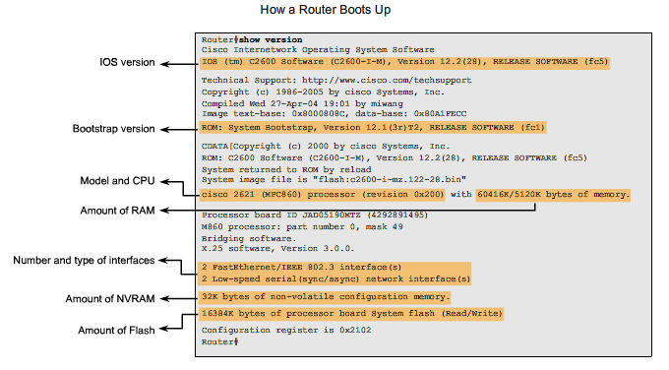
Initial Router Output

Slide 116
Router Operation Layers
A router does its work at layers 1, 2, and 3
For the path determination function the work is on layer 3
For the switching function the frames move on layers 1 and 2

Slide 117
Routers at Layers 1 2 3
Routers make decisions at layer 3
But they also carry out functions at layers 1 and 2
At layer 2 the router must create a frame appropriate for the connection type attached to the interface, such as Ethernet or PPP
At layer 1 the frame is encoded onto the media

Slide 118
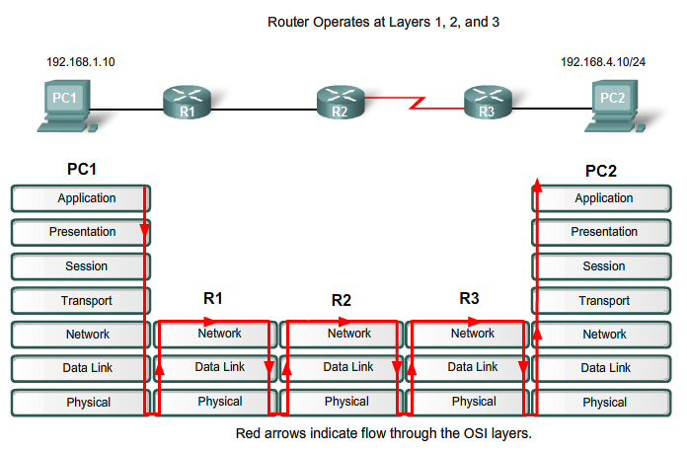
Routers at Layers 1 2 3

Slide 119
Command Line Interface
The router’s user interface is called the command-line
It is not a GUI as Cisco believes the use of the command line is superior to a GUI
The command line is accessed through a terminal emulator
There are three main methods to reach the command line

Slide 120
Command Line Access
Console Port
Uses the rollover or USB cable to make a local connection
SSH or Telnet
Use a data line to make a remote connection
Auxiliary Port
Uses a modem to make a remote connection

Slide 121
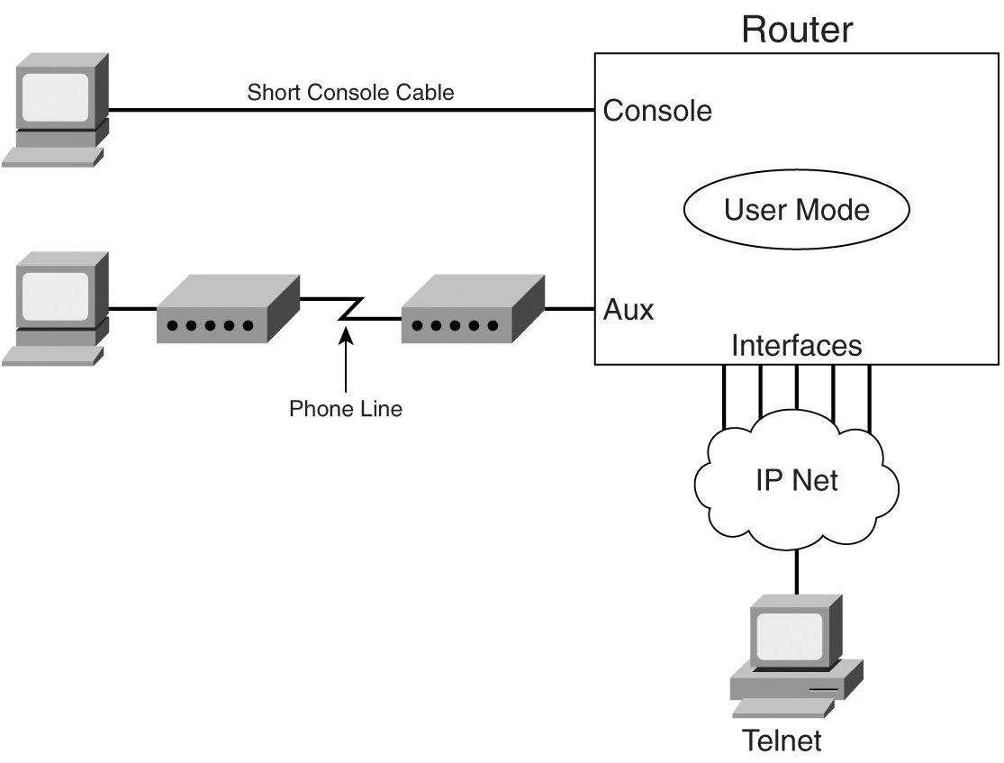
Command Line Access

Slide 122
Console Port
Some hardware and software is required to configure a Cisco router through the console port
You must also have direct physical access to the device
There is an old style and a new style console port

Slide 123
Serial Console Port
Power Cord Plug
Console Port
Auxiliary Port
Power Switch
Hardware Failure Light

Slide 124
Serial Console Port
For the serial console port the hardware required includes
Rollover cable
There are three types of these
USB to serial port adaptor
If the computer does not have a serial port as is very common these days a USB must be used

Slide 125
Serial Console Port
A Rollover Cable has the wires on one end reversed in order at the other end
The newest version is a single cable with the adaptor built as part of it
The older version of this cable must be used with an adaptor that changes the connection for the serial port from a 9 pin D connector to a RJ-45 jack

Slide 126
Serial Console Port
The are also adaptors that will turn a standard patch cable into a rollover cable
The cable is then attached to this connector with the other end in the Console Port on the back of the router
Cisco provides the cable with the router

Slide 127
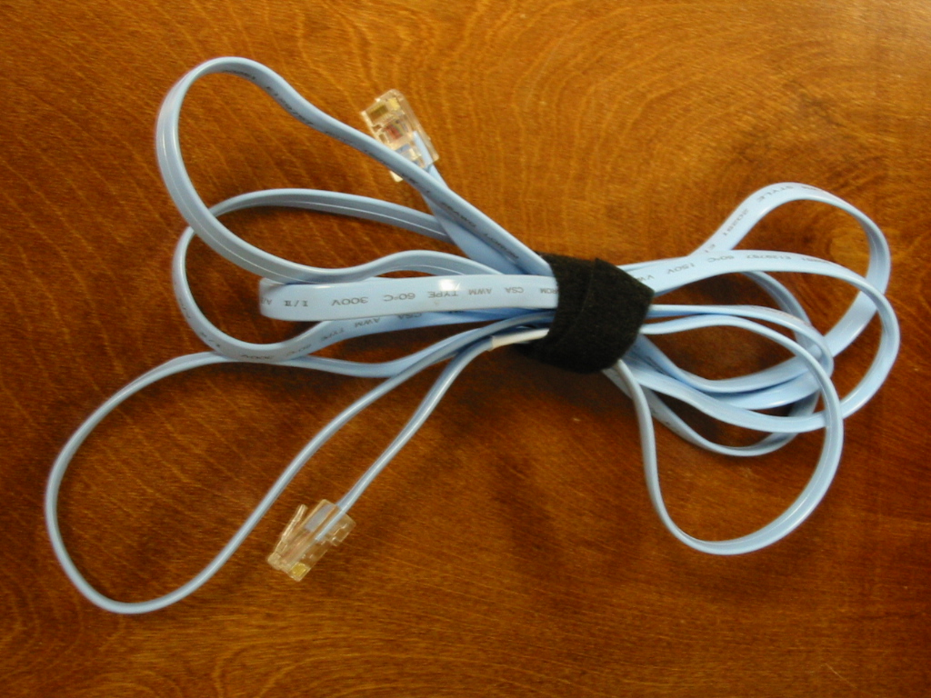
Rollover Cable

Slide 128
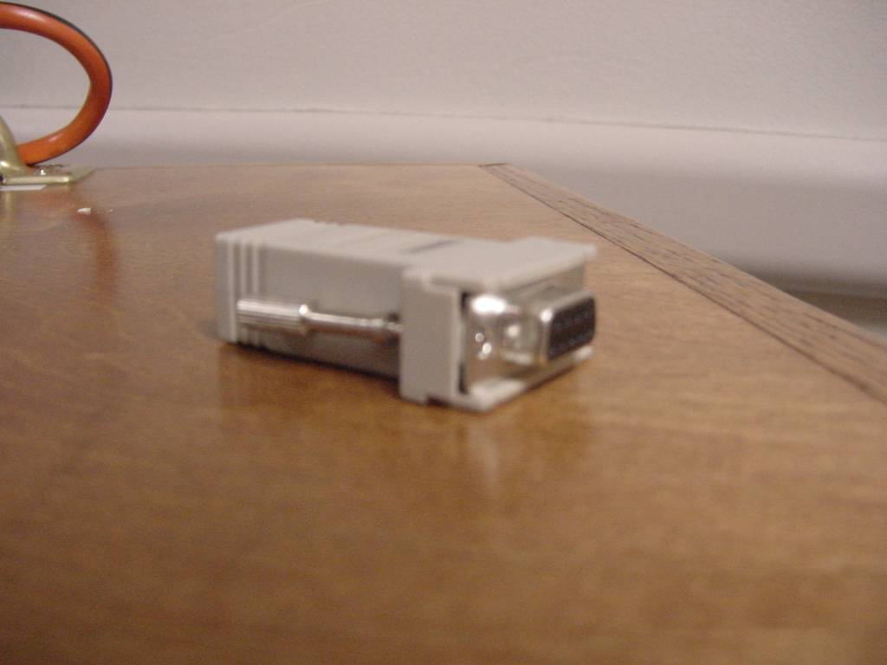
Serial Port Adaptor

Slide 129
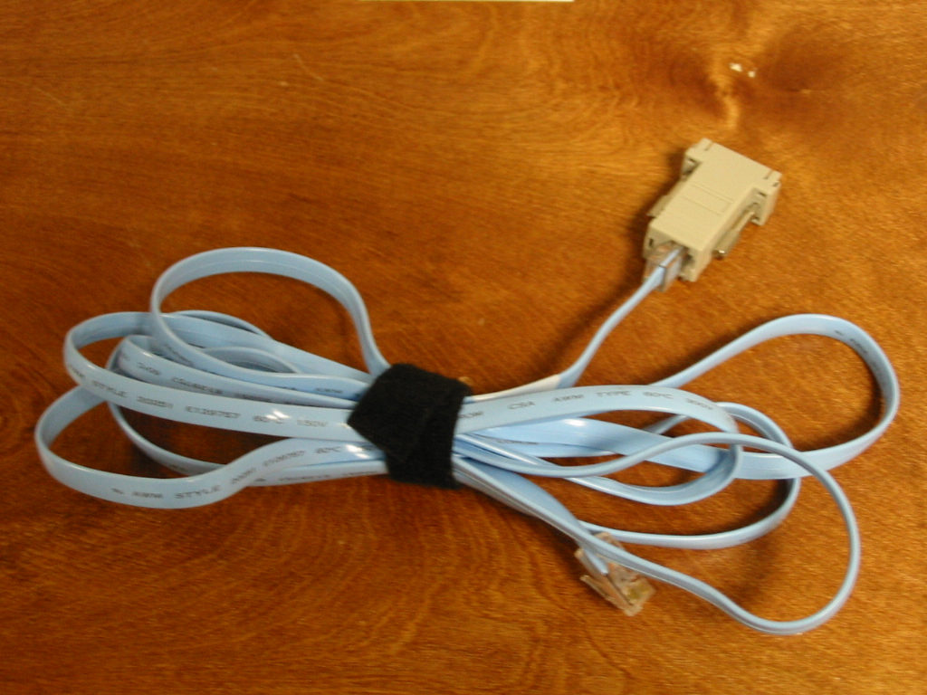
Rollover Cable and Adaptor

Slide 130
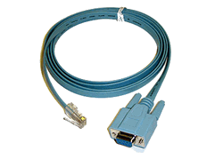
Rollover Cable

Slide 131
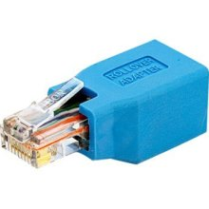
Rollover Cable Adaptor

Slide 132
USB Console Port
Starting with the G2 hardware version of the ISR – Integrated Services Routers which includes the 1941, 2901, and 2911 routers the console port is now a USB port
For example

Slide 133
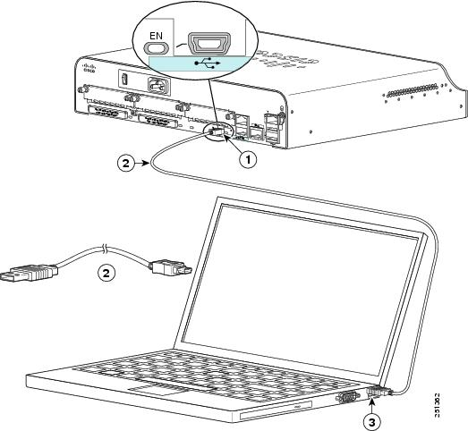
USB Console Port

Slide 134
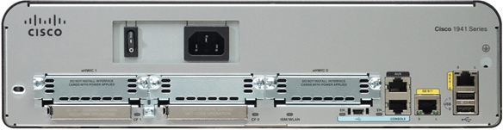
USB Console Port

Slide 135
USB Console Port
You need the USB console driver from Cisco as well
It only took Cisco about as long as it did to replace the AUI port on the routers to do this
USB has only been the dominate port on PCs for years

Slide 136
Terminal Program
A terminal program is needed to enter commands through
HyperTerminal as is included in Windows is commonly used, but it is not very suitable
The older version named Terminal that came with Windows 3.1 is much better
There are also many third party programs that do this, such as Putty

Slide 137
Terminal Program
Set the communications parameters to
9600 baud
8 data bits
No parity
1 stop bits
No flow control

Slide 138
SSH Connection
SSH is used for remote connection to the router over the network
SSH will not work on all routers with basic IOS feature sets
First, install the required image on your router
SSH requires you to have an IPSec DES or 3DES encryption software image from Cisco IOS Release 12.1(1)

Slide 139
SSH Connection
To configure SSH
Router(config)# hostname hostname
Router(config)# ip domain-name domainname
Router(config)# crypto key generate rsa
To disable telnet
Router(config)# line vty 0 4
Router(config)# transport input ssh

Slide 140
Auxiliary Port Connection
A connection to a router through the auxiliary port using a modem attached to it is less common these days
More used is a separate management network of some sort that allows secure remote access

Slide 141
Auxiliary Port Connection
But of course if this network as well as the main network are both down, the onsite access through the console port or remote access through the auxiliary port must be used

Slide 142
Auxiliary Port Connection
To make this type of connection a modem is attached at one end to the auxiliary port and at the other end to a standard PSTN line

Slide 143
Auxiliary Port Connection
Power Cord Plug
Console Port
Auxiliary Port
Power Switch
Hardware Failure Light

Slide 144
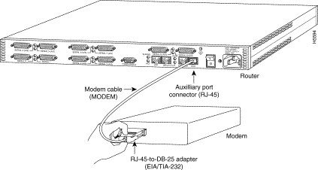
Modem Attached

Slide 145
Auxiliary Port Connection
The configuration on the router is
Router(config)#line 1
Router(config−line)#modem in
Router(config−line)#speed 115200
Router(config−line)#transport input all
Router(config−line)#flowcontrol hardware
Router(config−line)#login
Router(config−line)#password cisco

Slide 146
Lab
Let’s make a console port connection to a router

Slide 147
Lab
Let’s make a telnet connection to a router
Enable telnet by entering
Router(config)#line vty 0 4
Router(config-line)#login
Router(config-line)#password letmein
Configure the directly connected interfaces
From a remote router enter
telnet 192.168.1.2
or whatever the IP address is of the remote router

Slide 148
Initial Configuration
There are three ways to do the initial configuration of a new router or one that has had its configuration wiped out
AutoInstall
System Configuration Dialog
Configuration Mode

Slide 149
Auto Install
The first method of configuring a Cisco router is the Auto Install method
This process will automatically configure the router after it is connected to the WAN
This requires that a host on the network be setup to provide the required configuration files

Slide 150
Auto Install
The procedure at the router end is
Attach the WAN cable
Turn on the router
The router will load the IOS from Flash memory
The AutoInstall process will begin
After the AutoInstall process completes, the administrator must copy the configuration to NVRAM

Slide 151
Auto Install
With many bootstrap versions if a cable is detected on a WAN port it will attempt the AutoInstall procedure
The system will spend several minutes determining that no AutoInstall is available
To avoid this leave the cables unhooked until the IOS load finishes

Slide 152
System Configuration Dialog
At bootup when no configuration is found in NVRAM and there is no Auto Install file waiting on some host, the system will ask if it should start the Initial Configuration Dialog, which is also called the System Configuration Dialog
This is a set of information required by the router for it to function at just a basic level

Slide 153
System Configuration Dialog
In this approach a series of questions are asked by the system
The user need only supply the answers
When the router is first turned on it displays the following

Slide 154
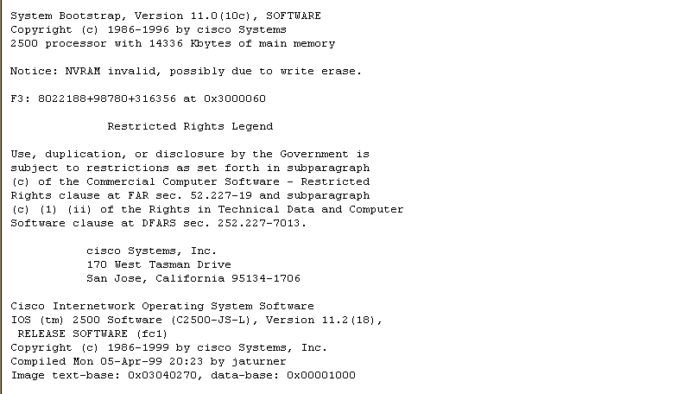
System Configuration Dialog

Slide 155
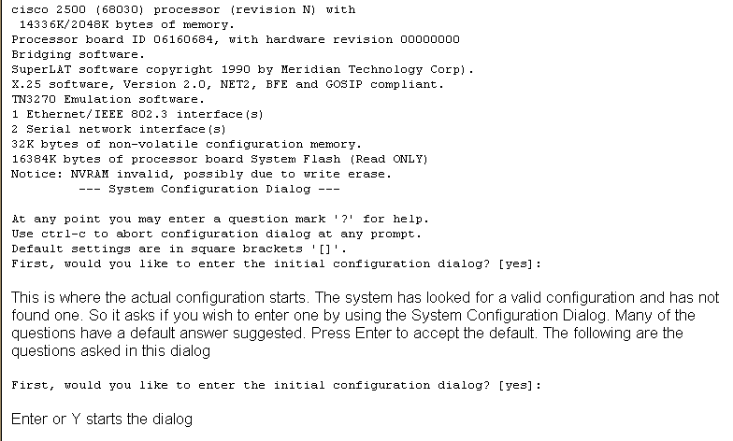
System Configuration Dialog

Slide 156
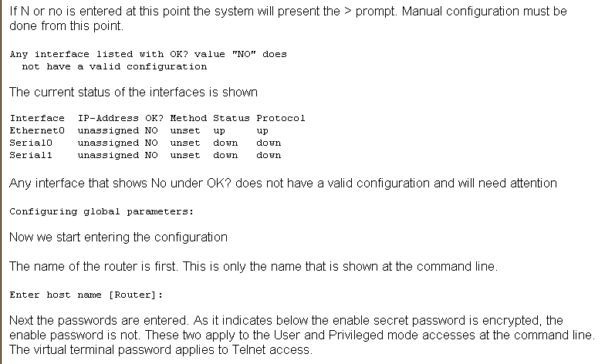
System Configuration Dialog

Slide 157
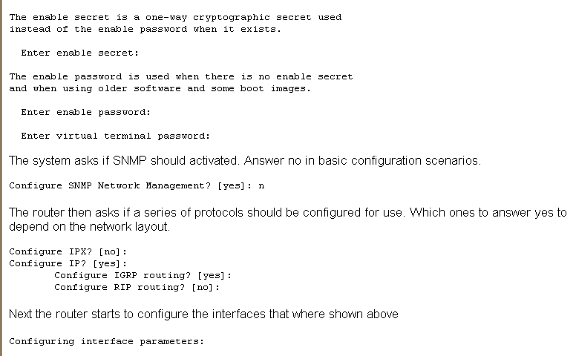
System Configuration Dialog

Slide 158
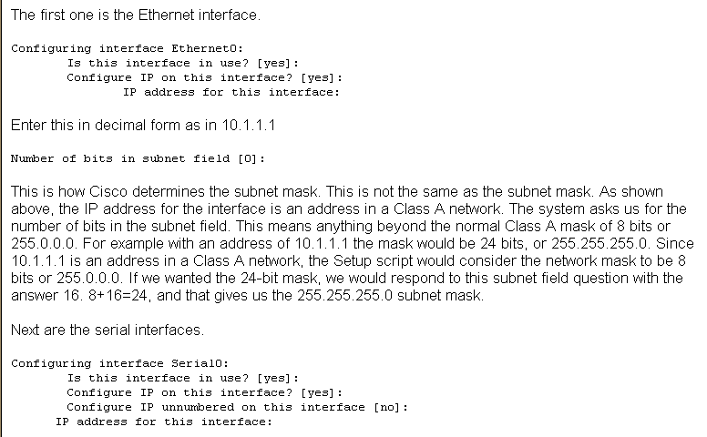
System Configuration Dialog

Slide 159
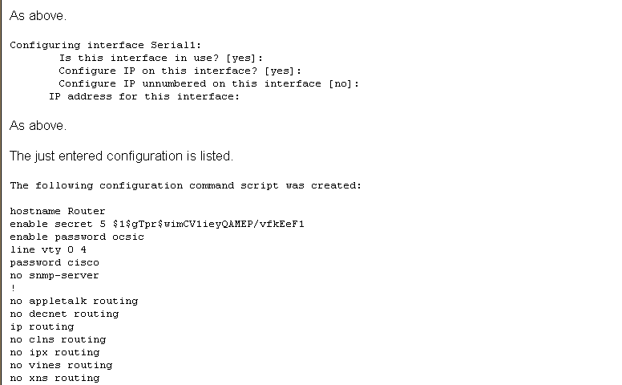
System Configuration Dialog

Slide 160
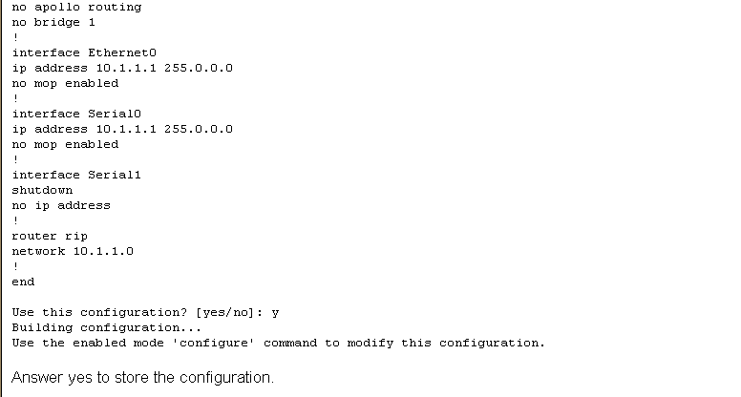
System Configuration Dialog

Slide 161
System Configuration Dialog
This is all there is for basic configuration when it is done using the System Configuration Dialog

Slide 162

System Configuration Dialog

Slide 163
Command Line Configuration
The last and most basic method of setting up a Cisco router is to configure it from the command line
In this method all configuration is done manually from the keyboard
The keyboard is called the terminal in Cisco talk, just to confuse you

Slide 164
Command Line Configuration
Enter
config t
To begin the configuration from the keyboard

Slide 165
Router Modes
When the router boots and the IOS loads the IOS stops at a prompt
At this prompt the router expects the human to do something
There are two main modes
These are

Slide 166
Router Modes

Slide 167

Router Modes

Slide 168

Router Levels

Slide 169
Privilege Levels
At the EXEC level the IOS provides 16 privilege levels ranging from 0 to 15
Two of these are predefined
User EXEC mode runs at privilege level 1 and enabled mode privileged EXEC mode runs at level 15
Every IOS command is pre-assigned to either level 1 or level 15
This assignment can be changed

Slide 170

Moving Between Levels

Slide 171
Basic Router Configuration
Basic router configuration is very simple
Plan first
Decide on the IP addressing scheme to use for the networks that will be connected
Decide which interfaces will need to be activated to connect those networks
Next setup the router
Move from user to privileged level
Move to global configuration level
Move to interface configuration level

Slide 172
Basic Router Configuration
Activate the interfaces for the directly connected networks
Move back to global configuration level
Populate the routing table
Tell the router to put all of this to use

Slide 173

Basic Router Configuration

Slide 174
Basic Router Configuration

Slide 175
Lab
Start Packet Tracer
Do Packet Tracer Activity 1.2.2.4

Slide 176
The Do Command
If you are running version 12.2(8) or later of the IOS the do command can be used to run privileged level commands in global configuration mode
For example show run can be issued while entering configuration commands
Just add do in front of the command
For example
switch(config-if)#do show run

Slide 177
Planes
Conceptually, a router operates on three distinct domains or planes
The management plane handles administration, configuration, and generally the persistent state of the router
The control plane covers monitoring, route table updates, and generally the dynamic operation of the router

Slide 178
Planes
The data or forwarding plane handles the packets transiting the router among the networks it serves

Slide 179

Planes

Slide 180
Planes
When traffic is being forwarded from one network to another, it usually does not touch the CPU
The packets travel across the routing fabric from the incoming interface to the appropriate destination interface
Only management and control traffic for the router travel to or from the CPU

Slide 181
IP Datagram
The thing that IP uses to carry stuff is the IP datagram
Like all such devices it has a header and a data area
HEADER | DATA

Slide 182
IP Datagram Header
VERS
HLEN
SERVICE TYPE
TOTAL LENGTH
IDENTIFICATION
FLAG
FRAGMENT OFFSET
TTL
PROTOCOL
HEADER CHECKSUM
SOURCE IP ADDRESS
DESTINATION IP ADDRESS
IP OPTIONS

Slide 183
IP Datagram Header
VERS
HLEN
SERVICE TYPE
TOTAL LENGTH
IDENTIFICATION
FLAG
FRAGMENT OFFSET
TTL
PROTOCOL
HEADER CHECKSUM
SOURCE IP ADDRESS
DESTINATION IP ADDRESS
IP OPTIONS

Slide 184
IP Datagram Header
VERS or Version
4 bits
The version of IP
Always 4 right now
Shows as binary 0100
To ensure everyone agrees on the format of the datagram

Slide 185
IP Datagram Header
VERS
HLEN
SERVICE TYPE
TOTAL LENGTH
IDENTIFICATION
FLAG
FRAGMENT OFFSET
TTL
PROTOCOL
HEADER CHECKSUM
SOURCE IP ADDRESS
DESTINATION IP ADDRESS
IP OPTIONS

Slide 186
IP Datagram Header
HLEN or Header Length
4 bits
Datagram header length in 32 bit words
Used to indicate whether IP OPTIONS and PADDING fields are being used

Slide 187
IP Datagram Header
VERS
HLEN
SERVICE TYPE
TOTAL LENGTH
IDENTIFICATION
FLAG
FRAGMENT OFFSET
TTL
PROTOCOL
HEADER CHECKSUM
SOURCE IP ADDRESS
DESTINATION IP ADDRESS
IP OPTIONS

Slide 188
IP Datagram Header
SERVICE TYPE
8 bits
Specifies how the datagram should be handled
QoS mechanism

Slide 189
IP Datagram Header
VERS
HLEN
SERVICE TYPE
TOTAL LENGTH
IDENTIFICATION
FLAG
FRAGMENT OFFSET
TTL
PROTOCOL
HEADER CHECKSUM
SOURCE IP ADDRESS
DESTINATION IP ADDRESS
IP OPTIONS

Slide 190
IP Datagram Header
TOTAL LENGTH
16 bits
The length of the datagram in octets including the header and data

Slide 191
IP Datagram Header
VERS
HLEN
SERVICE TYPE
TOTAL LENGTH
IDENTIFICATION
FLAG
FRAGMENT OFFSET
TTL
PROTOCOL
HEADER CHECKSUM
SOURCE IP ADDRESS
DESTINATION IP ADDRESS
IP OPTIONS

Slide 192
IP Datagram Header
IDENTIFICATION or Fragment Identifier
16 bits
Holds a unique integer that identifies which datagram a fragment belongs to if the packet has been fragmented, which most are

Slide 193
IP Datagram Size
Minimum datagram size is 576 bytes
With at least 552 bytes of data
Maximum size for an IP datagram is 65,535 bytes
With at most 65,515 bytes of data
But Ethernet only handles 1500 bytes of data
So how is a 65,535 byte datagram to go into a 1500 byte data area
By fragmentation

Slide 194
IP Datagram Size
It is then reassembled as seen above using the Fragment Offset part of the datagram header

Slide 195
IP Datagram Header
VERS
HLEN
SERVICE TYPE
TOTAL LENGTH
IDENTIFICATION
FLAG
FRAGMENT OFFSET
TTL
PROTOCOL
HEADER CHECKSUM
SOURCE IP ADDRESS
DESTINATION IP ADDRESS
IP OPTIONS

Slide 196
IP Datagram Header
FLAG or Fragmentation Flag
3 bits, but part of the FRAGMENT OFFSET field
Indicating that the datagram has been fragmented
Bit 1 is not currently used
Bit 2 is turned on to tell routers to not fragment a packet
If the router must, but cannot, the packet is dropped and a message is sent to the receiver

Slide 197
IP Datagram Header
Bit 3 when on indicates more fragments are coming
When set to 0 it indicates this is the last fragment
All of this information is used to reassemble everything

Slide 198
IP Datagram Header
VERS
HLEN
SERVICE TYPE
TOTAL LENGTH
IDENTIFICATION
FLAG
FRAGMENT OFFSET
TTL
PROTOCOL
HEADER CHECKSUM
SOURCE IP ADDRESS
DESTINATION IP ADDRESS
IP OPTIONS

Slide 199
IP Datagram Header
FRAGMENT OFFSET
13 bits
This tells the receiver what piece of a datagram this packet is of a datagram that has been cut up due to the MTU of the underlying method being used to carry the datagram from point-to-point

Slide 200
IP Datagram Header
To distinguish fragments, each has its offset field set to the distance, measured in 8 byte units, between the beginning of the original datagram and the beginning of that particular fragment
So the first fragment has an offset of 0, the second fragment has an offset value of the payload size of the first fragment, and so on

Slide 201
IP Datagram Header
VERS
HLEN
SERVICE TYPE
TOTAL LENGTH
IDENTIFICATION
FLAG
FRAGMENT OFFSET
TTL
PROTOCOL
HEADER CHECKSUM
SOURCE IP ADDRESS
DESTINATION IP ADDRESS
IP OPTIONS

Slide 202
IP Datagram Header
TTL or Time to Live
8 bits
Supposed to be in seconds, but things run so fast today it is normally hops
Each router decrements the value by 1

Slide 203
IP Datagram Header
VERS
HLEN
SERVICE TYPE
TOTAL LENGTH
IDENTIFICATION
FLAG
FRAGMENT OFFSET
TTL
PROTOCOL
HEADER CHECKSUM
SOURCE IP ADDRESS
DESTINATION IP ADDRESS
IP OPTIONS

Slide 204
IP Datagram Header
PROTOCOL
8 bits
Indicates the higher level protocol used to create the datagram

Slide 205
IP Datagram Header
VERS
HLEN
SERVICE TYPE
TOTAL LENGTH
IDENTIFICATION
FLAG
FRAGMENT OFFSET
TTL
PROTOCOL
HEADER CHECKSUM
SOURCE IP ADDRESS
DESTINATION IP ADDRESS
IP OPTIONS

Slide 206
IP Datagram Header
HEADER CHECKSUM
16 bits
Checks the integrity of the header itself
Not the data, the header

Slide 207
IP Datagram Header
VERS
HLEN
SERVICE TYPE
TOTAL LENGTH
IDENTIFICATION
FLAG
FRAGMENT OFFSET
TTL
PROTOCOL
HEADER CHECKSUM
SOURCE IP ADDRESS
DESTINATION IP ADDRESS
IP OPTIONS

Slide 208
IP Datagram Header
SOURCE IP ADDRESS
32 bits
Where it came from

Slide 209
IP Datagram Header
VERS
HLEN
SERVICE TYPE
TOTAL LENGTH
IDENTIFICATION
FLAG
FRAGMENT OFFSET
TTL
PROTOCOL
HEADER CHECKSUM
SOURCE IP ADDRESS
DESTINATION IP ADDRESS
IP OPTIONS

Slide 210
IP Datagram Header
DESTINATION IP ADDRESS
32 bits
Where its going

Slide 211
IP Datagram Header
VERS
HLEN
SERVICE TYPE
TOTAL LENGTH
IDENTIFICATION
FLAG
FRAGMENT OFFSET
TTL
PROTOCOL
HEADER CHECKSUM
SOURCE IP ADDRESS
DESTINATION IP ADDRESS
IP OPTIONS

Slide 212
IP Datagram Header
IP OPTIONS
24 bits
Not used except in testing

Slide 213
IP Datagram Header
PADDING
8 bits
To bring the datagram up to a minimum size

Slide 214
IP Datagram Header
DATA
Size varies
The important stuff

Slide 215
Ethernet II Frame Format
Field | Bytes
Preamble | 8
Destination Address | 6
Source Address | 6
Type | 2
Data | 46-1500
Frame Check Sequence | 4

Slide 216
Ethernet II Frame Format
Preamble
This is a sequence of 7 bytes or 56 bits of alternating ones and zeros
It is used for synchronization
It gives components time to detect the signal, and be ready before the frame arrives
It was set at this length because it originally took the equipment this long to sync up
A preamble is not required for speeds above 10 Mbps

Slide 217
Ethernet II Frame Format
SFD - Start Frame Delimiter
Also part of the preamble is a sequence of 1 byte or 8 bits having the bit configuration 10101011 that indicates the start of the frame
Note the similarity of the bit pattern between the Preamble and the SFD
The only difference is that the last two bits of the SFD are both 1’s
Many people do not separate the Preamble and Start Frame Delimiter

Slide 218
Ethernet II Frame Format
They consider it to all be the preamble
Because it takes a station an unknowable amount of time to lock on, it does not know how many bits of the Preamble have gone by
For this reason, it is said that the Preamble is lost in the synching up process

Slide 219
Ethernet II Frame Format
As such no part of the Preamble ever enters the NIC’s buffer
This is why the size of the Preamble/SFD is excluded when the minimum and maximum Ethernet frame sizes are discussed

Slide 220
Ethernet II Frame Format
Destination Address
This is the MAC address of the station the message is for
This address may specify either an individual address destined for a single station, a multicast address destined for a group of stations, or an address of all 1s bits that refers to all stations on the LAN and is called a broadcast address

Slide 221
Ethernet II Frame Format
Source Address
This is the MAC address of the sending station
Type
Type indicates the protocol type that the frame is for at the network layer, such as
0800 for TCP/IP
8137 for IPX
These are hexadecimal numbers

Slide 222
Ethernet II Frame Format
Data
This is the important stuff and has a maximum size of 1500 bytes
If the size is less than 46 bytes, then bytes are placed in the Pad field to bring the frame length up to at least 64 bytes
What goes into this data area is the original message and the headers placed in front of that message at each of those layers

Slide 223
Ethernet II Frame Format
CRC - Frame Check Sequence
This is used for error checking
When the source station assembles a MAC frame, it performs a CRC calculation on all the bits in the frame from the Destination MAC Address through the Pad fields
The source station stores the value in this field and transmits it as part of the frame
When the frame is received by the destination station, it performs an identical check

Slide 224
Ethernet II Frame Format
If the calculated value does not match the value in this field, the destination station assumes an error has occurred during transmission and discards the frame

Slide 225
Lab
Start Wireshark
Capture a few frames
Examine the IP header
Examine the Ethernet header

