Slide 1
Cisco CCNA Exploration
CCNA 2
Routing Protocols and Concepts
BGP
Last Update 2012.04.03
1.1.0

Slide 2
Objectives
Learn about using BGP to route between autonomous systems

Slide 3
BGP
BGP – Border Gateway Protocol is a path vector routing protocol that is used to connect autonomous systems to each other
It is an interdomain routing protocol
It is a standard

Slide 4
Why BGP is Used
BGP is an exterior or interdomian routing protocol
This means it is used to route between autonomous systems
What is an autonomous system or AS
RFC 4271 defines it this way

Slide 5
AS
  The classic definition of an Autonomous System is a set of routers under a single technical administration, using an interior gateway protocol (IGP) and common metrics to determine how to route packets within the AS, and using an inter-AS routing protocol to determine how to route packets to other ASes

Slide 6
AS
  Since this classic definition was developed, it has become common for a single AS to use several IGPs and, sometimes, several sets of metrics within an AS

Slide 7
AS
  The use of the term Autonomous System stresses the fact that, even when multiple IGPs and metrics are used, the administration of an AS appears to other ASes to have a single coherent interior routing plan, and presents a consistent picture of the destinations that are reachable through it

Slide 8
Autonomous Systems in Use
In practice some autonomous systems are quite large and some much smaller
Here is a table of the largest ones from a presentation by Mike Smith of Anglia Ruskin University to the Cisco Networking Academy community
The following slides are also from this same presentation from March 2012

Slide 9
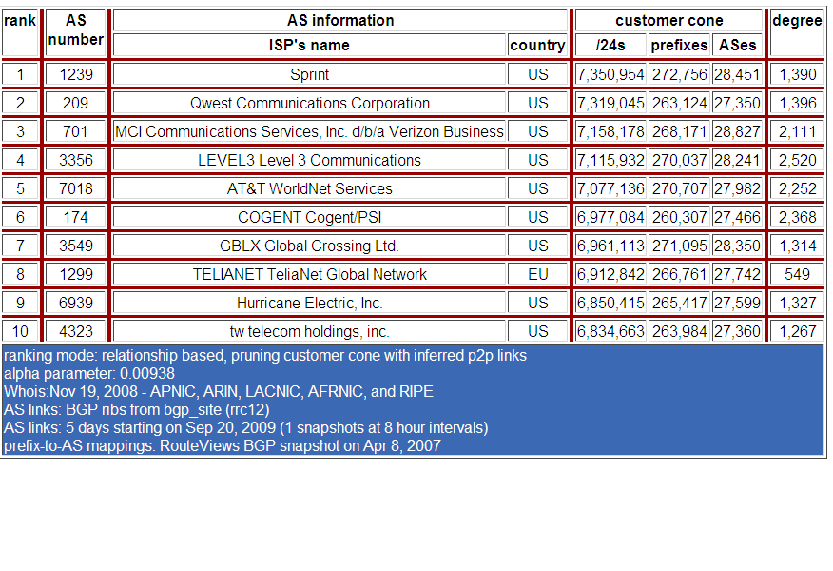
Autonomous Systems in Use
Notes:
A list of top 10 ASs by CIDR block
SPRINT which is the largest has access to 272K networks containing over 7 Million /24 equivalent networks
SPRINT has connectivity to over 28000 over ASs

Slide 10
Autonomous Systems in Use
This table says that Sprint in the US, AS number 1239, can see 28,451 other ASs
It advertises 272,256 network prefixes
That is a lot of networks
As you can see the other backbone providers are not far behind

Slide 11
BGP Routing Table Growth
This means the number of routes a router running BGP must deal with is growing and growing and growing as seen here

Slide 12
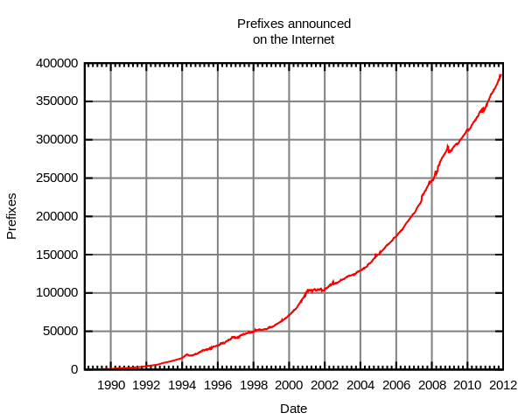
BGP Routing Table Growth

Slide 13
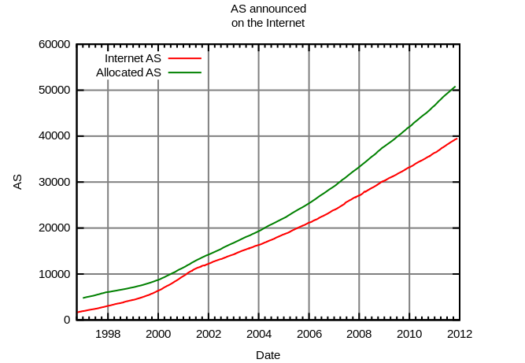
BGP Routing Table Growth
Growth in the number of ASs
Growth rate = 3500 new AS per year

Slide 14
IPXs
How do all of these ASs talk to each other
They interconnect through peering points called IXP – Internet Exchange Points
There are hundreds of these managed by many different organizations
For example, here are the ones offered by Equinox as of March 2012

Slide 15
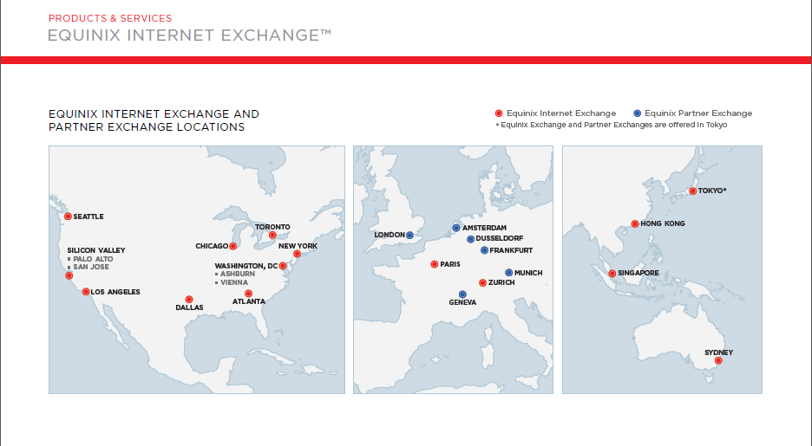
IPXs

Slide 16

IPXs

Slide 17
IPXs
Inside of these IPXs those that subscribe to them exchange traffic
This is called peering
As Mike Smith further points out there are two types of peering
  Public peering is accomplished using a shared fabric which is usually a Layer 2 switch technology

Slide 18
IPXs
  Multiple carriers interconnect with one or more other carriers across a single physical port
  Private peering is the direct connection between two networks across a Layer 1 or Layer 2 medium that provides dedicated network capacity and is not shared
  Private peering is commonly used between very large networks

Slide 19
IPXs
  Peering is a voluntary interconnection of Autonomous Systems for the purpose of exchanging traffic
  The pure definition of peering is settlement free – peers exchange traffic on the basis that I will forward your traffic if you will forward mine

Slide 20
BGP
Mike Smith explains the use of BGP this way
  The key features of BGP are
    Policy based routing
    Uses TCP for connectivity
    Incremental updates
    Rich metrics
  It is designed to scale to huge internetworks, such as the Internet

Slide 21
Why Use BGP
BGP is an appropriate routing protocol to use when
  An AS allows packets to transit through to reach other ASs
  An AS has multiple connections to other ASs as in multi-homing
  Routing policy and route selection for traffic entering and leaving the AS must be manipulated

Slide 22
Why Not to Use BGP
Do not use BGP when
  There is a limited understanding of route filtering and BGP path-selection process among the technical staff
  There is a single connection to the Internet or another AS
  There is a lack of memory or processor power in the routers to handle constant updates on BGP routers

Slide 23
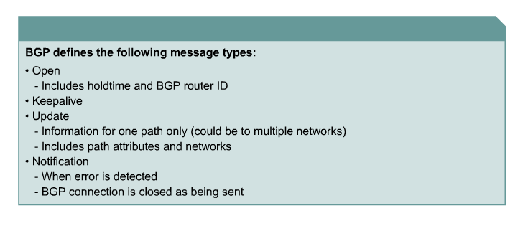
BGP Message Types

Slide 24
Update Messages
Update messages contain the following information
  Unfeasible Routes Length (2 bytes)
  Withdrawn Routes (variable)
  Total Path Attributes Length (2 bytes)
  Path Attributes (variable)
  Network Layer Reachability Information (variable)

Slide 25
Update Messages
The Path Attributes field is of variable length and contains a sequence of attributes about a path
The Path Attributes field will be present in every Update message
The information contained in the Path Attribute field is used to track specific route information and is also used for routing decisions and filtering

Slide 26
Update Messages
The Path Attribute field consists of
  Attribute type
  Attribute length
  Attribute value

Slide 27
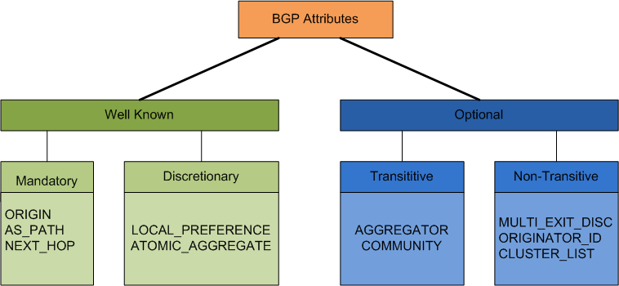
BGP Attributes

Slide 28
BGP Attributes
Well known
  The attribute must be recognised by all implementations of BGP
Optional
  The attribute not recognised by an implementation of BGP

Slide 29
BGP Attributes
Mandatory
  The attribute must be present in an Update message
Discretionary
  The attribute does not need to be present in an UPDATE message

Slide 30
BGP Attributes
Transitive
  The attribute forwarded to another BGP peer that may not be recognised by this peer
Non-transitive
  The attribute not forwarded to another BGP peer

Slide 31
BGP Attributes
Type Code | Name | Category | Description
1 | ORIGIN | Well-known mandatory | The AS that originated the routing information
2 | AS_PATH | Well-known mandatory | A list of all ASs the routing information has transited
3 | NEXT_HOP | Well-known mandatory | Specified the IP address of the next-hop router to the specified destination
4 | MULTI_EXIT_DISC | Optional non-transitive | Used to determine the best exit/entry point to the same AS if multiple points exist
5 | LOCAL_PREF | Well-known discretionary | Is used to set a preference of a route to a iBGP peer
6 | ATOMIC_AGGREGATE | Well-known discretionary | Used to choose a less specific (shorter mask) route rather than a more specific (longer mask) when receiving overlapping routes from a BGP speaker
7 | AGGREGATOR | Optional transitive | When a BGP peer perform route aggregation, it will include in the AGGREGATOR attribute its AS number and BGP Id
8 | COMMUNITY | Option transitive | Specifies the communities a route belongs to. A community is a group of destinations that have a common attribute
9 | ORIGINATOR_ID | Optional non-transitive | A BGP speaker that has the role of Route reflector creates this attribute. A route reflector can advertise iBGP learned routes to other iBGP peers. This is not normally allowed
10 | CLUSTER_LIST | Optional non-transitive | Used by a route reflector to specify the BGP peers that a part of its clients.

Slide 32
Local Preference Attribute
The local pref attribute is used to force the selection of one path over another
For example

Slide 33
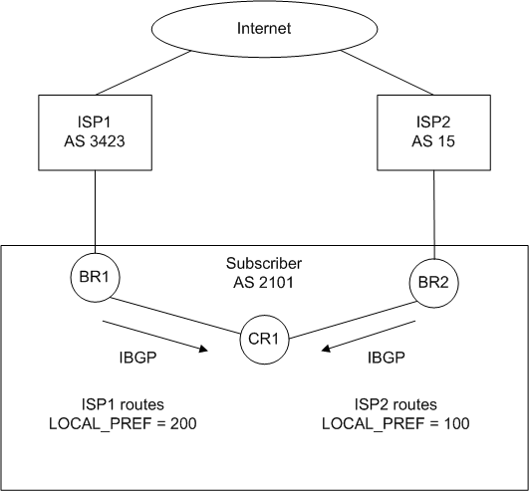
Local Preference Attribute

Slide 34
Multi Exit Attribute
This attribute is used to select a faster path to the same place such as a T3 over a T1

Slide 35
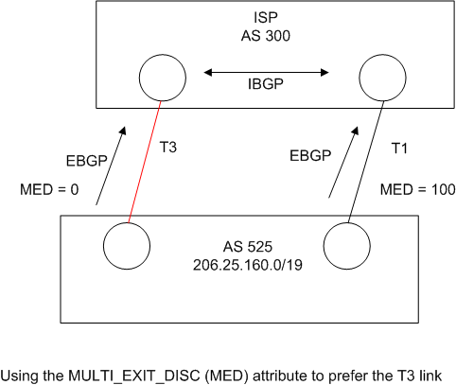
Multi Exit Attribute

Slide 36
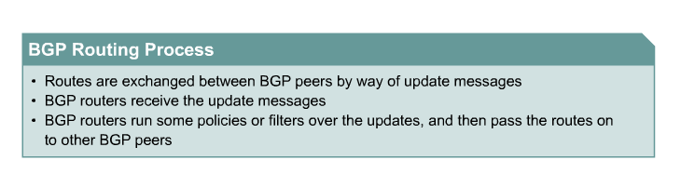
BGP Routing Process

Slide 37
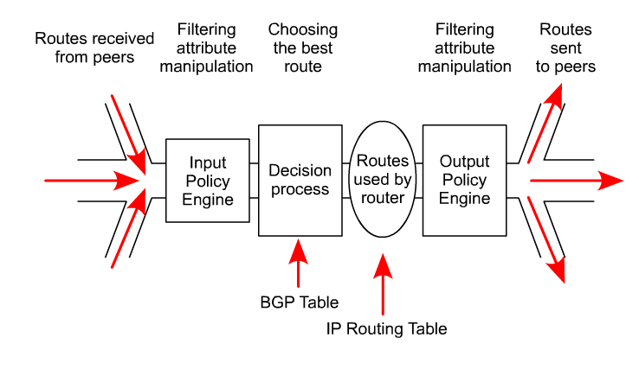
BGP Routing Process

Slide 38
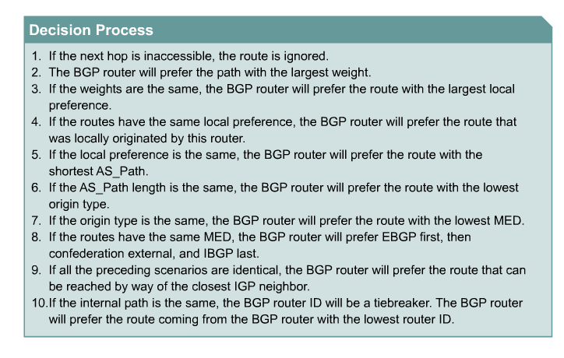
BGP Routing Process

Slide 39
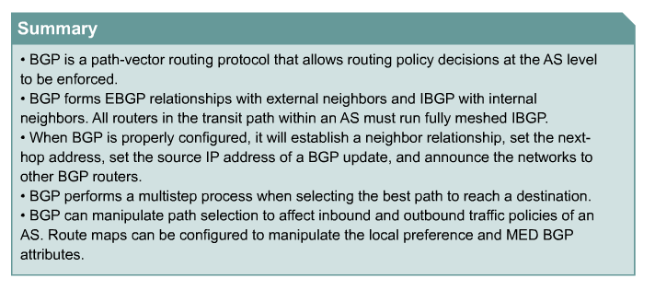
BGP Routing Process

Slide 40
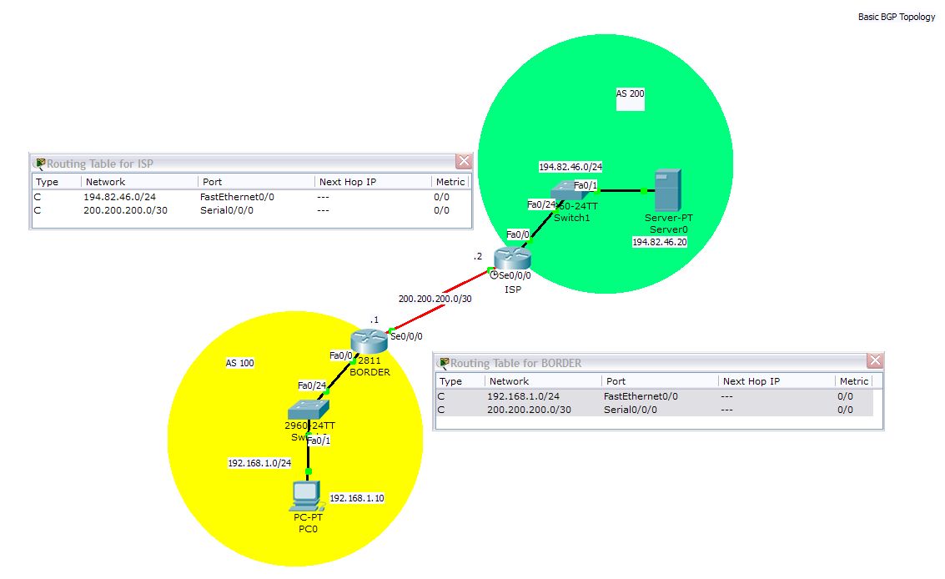
Example BGP Configuration

Slide 41
Example BGP Configuration
BORDER
router bgp 100
neighbor 200.200.200.2 remote-as 200
network 192.168.1.0
ISP
router bgp 200
neighbor 200.200.200.1 remote-as 100
network 194.82.46.0
Specifies the AS this router belongs to
Specifies the IP address of the remote AS and its AS number
Specifies the network to be advertised
Notes:
BGP acts classfully unless you specify a mask.
There is no need to add the network address of the link between the two ASs – this is implicit in the neighbor statement

Slide 42
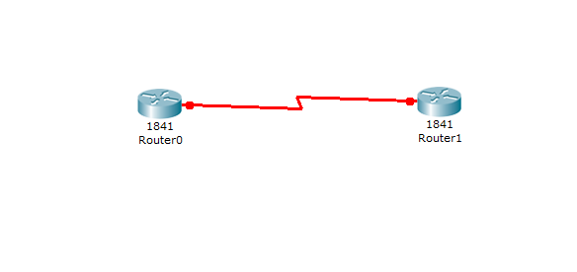
Sample BGP Network

Slide 43
BGP Configuration
enable
config t
int s0/0/0
ip address 192.168.2.1 255.255.255.0
no shutdown
exit

Slide 44
BGP Configuration
router bgp 100
neighbor 192.168.2.2 remote-as 200
end

Slide 45
BGP Configuration
enable
config t
int s0/0/0
ip address 192.168.2.2 255.255.255.0
no shutdown
exit

Slide 46
BGP Configuration
router bgp 200
neighbor 192.168.2.1 remote-as 100
end

Slide 47
BGP Commands
What do these various commands do
Let’s see what the Cisco BSCI book says about these

Slide 48
BGP Commands
Router(config)#
router bgp autonomous-system
This command just enters router configuration mode; subcommands must be entered in order to activate BGP.
Only one instance of BGP can be configured on the router at a single time.
The autonomous system number identifies the autonomous system to which the router belongs.
The autonomous system number in this command is compared to the autonomous system numbers listed in neighbor statements to determine if the neighbor is an internal or external neighbor.
Notes:
The syntax of basic BGP configuration commands is similar to the syntax for configuring internal routing protocols. However, there are significant differences in how BGP functions.
Use the router bgp autonomous-system command to identify to the router that any subsequent subcommands belong to this routing process. This command also identifies the local autonomous system in which this router belongs. The router needs to be informed of the autonomous system so it can determine if the BGP neighbors to be configured next are either Internal Border Gateway Protocol (IBGP) or External Border Gateway Protocol (EBGP) neighbors. The following table describes the router bgp command parameter:
The router bgp Command Parameter
autonomous-system Identifies the local autonomous system number. The route bgp command alone cannot activate BGP on a router. You must enter at least one subcommand under the router bgp command to activate the BGP process on the router.
If you place your router in autonomous system “A” and then try to configure a new router bgp “B” command, the router informs you that you are currently configured for autonomous system A. You must insert the autonomous system number in the router bgp command so that the router can properly identify the relationship between the neighboring router and itself.

Slide 49
BGP Commands
Router(config-router)#
neighbor {ip-address | peer-group-name}
remote-as autonomous-system
The neighbor command activates a BGP session with this neighbor.
The IP address that is specified is the destination address of BGP packets going to this neighbor.
This router must have an IP path to reach this neighbor
before it can set up a BGP relationship.
The remote-as shows what AS this neighbor is in. This AS number is used to determine if the neighbor is internal or external.
This command is used for both external and internal neighbors.
Notes:
You use the neighbor ip-address remote-as autonomous-system command to activate a BGP session for external and internal neighboring routers.
This command identifies a peer router with which the local router will establish a session. The following table describes the neighbor remote-as command parameters:
Parameter Descriptions
ip-address Identifies the peer router.
peer-group-name Identifies the name of a BGP peer group.
autonomous-system Identifies the autonomous system of the peer router. A peer group is a group of BGP neighbors of the router being configured that all have the same update policies. Peer groups are described later in this lesson.
This command is mandatory for the establishment of each neighboring router relationship.
The address that is used in this command is the destination address for all BGP packets going to this neighboring router. In order for BGP to pass BGP routing information, this address must be reachable, because BGP attempts to establish a TCP session and exchange BGP updates with the device at this IP address.
The autonomous system number that is a part of this command is used to identify if this neighbor is an EBGP neighbor or an IBGP neighbor. If the autonomous system number is the same as the autonomous system number for this router, that neighbor is an IBGP neighbor and the IP address listed in this neighbor command does not have to be directly connected. If the autonomous system number is different from the autonomous system number for this router, this neighbor is an EBGP neighbor and the address in this neighbor command must be directly connected by default.

