Slide 1
Database Management
Last Update 2014.03.19
2.0.1

Slide 2
Sources
Most of the material below on databases in general is copied from
Management Information Systems
12th Edition
Ken Laudon and Jane Laudon

Slide 3
What is a Database
A database is created when a computer system organizes data in a hierarchy that starts with bits and bytes and progresses to fields, records, and files
In this representation

Slide 4
A Database
A bit represents the smallest unit of data a computer can handle
A group of bits, called a byte, represents a single character, which can be a letter, a number, or another symbol
A grouping of characters into a word, a group of words, or a complete number is a field
A group of related fields, such as student name and the course taken is a record
A group of records of the same type is a file

Slide 5
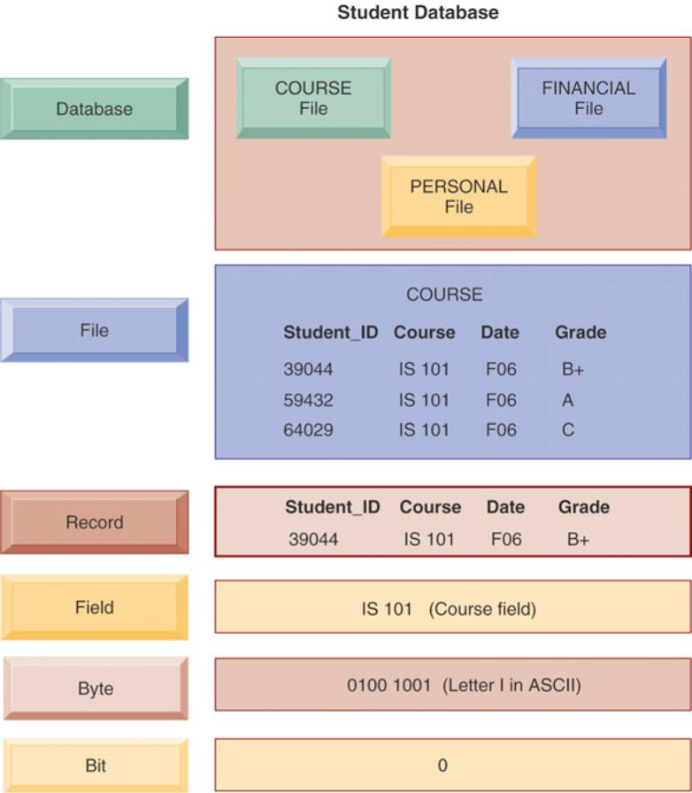
A Database

Slide 6
Data Redundancy
In most organizations, systems tend to grow independently without a company-wide plan
Accounting, finance, manufacturing, human resources, and sales and marketing all develop their own systems and data files

Slide 7
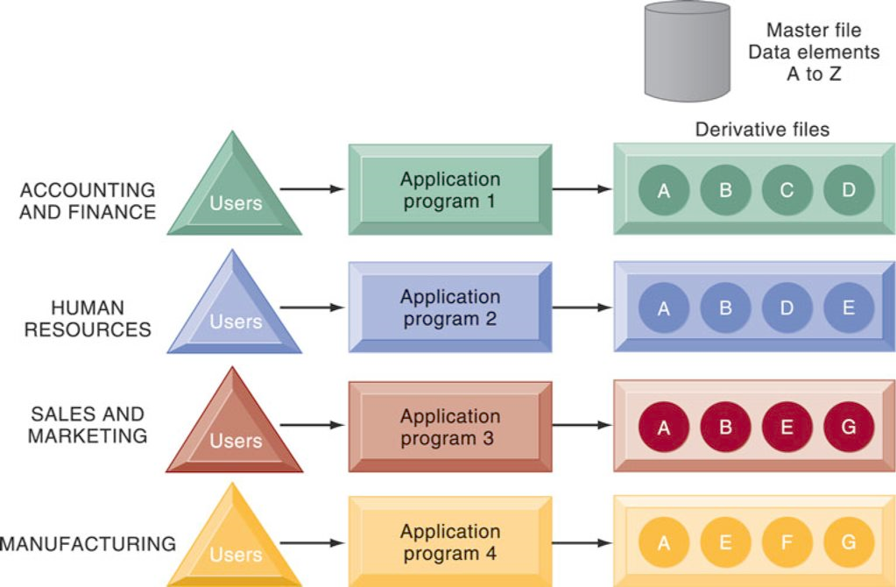
Data Redundancy

Slide 8
Data Redundancy
Data redundancy is the presence of duplicate data in multiple data files so that the same data are stored in more than place or location
Data redundancy occurs when different groups in an organization independently collect the same piece of data and store it independently of each other

Slide 9
Data Inconsistency
Data redundancy wastes storage resources and also leads to data inconsistency, where the same attribute may have different values

Slide 10
DBMS
A DBMS - Database Management System permits an organization to centralize data, manage it more efficiently, and provide access to the stored data by application programs
The DBMS acts as an interface between application programs and the physical data files

Slide 11
DBMS
When the application program calls for a data item, such as gross pay, the DBMS finds this item in the database and presents it to the application program
Using traditional data files, the programmer would have to specify the size and format of each data element used in the program and then tell the computer where they were located

Slide 12
DBMS
The DBMS relieves the programmer or end user from the task of understanding where and how the data are actually stored by separating the logical and physical views of the data

Slide 13
DBMS
The logical view presents data as they would be perceived by end users or business specialists, whereas the physical view shows how data are actually organized and structured on physical storage media
The database management software makes the physical database available for different logical views required by users

Slide 14
DBMS
For example, for the human resources database a benefits specialist might require a view consisting of the employee’s name, social security number, and health insurance coverage
A payroll department member might need data such as the employee’s name, social security number, gross pay, and net pay

Slide 15
DBMS
The data for all these views are stored in a single database, where they can be more easily managed by the organization
A DBMS reduces data redundancy and inconsistency by minimizing isolated files in which the same data are repeated

Slide 16
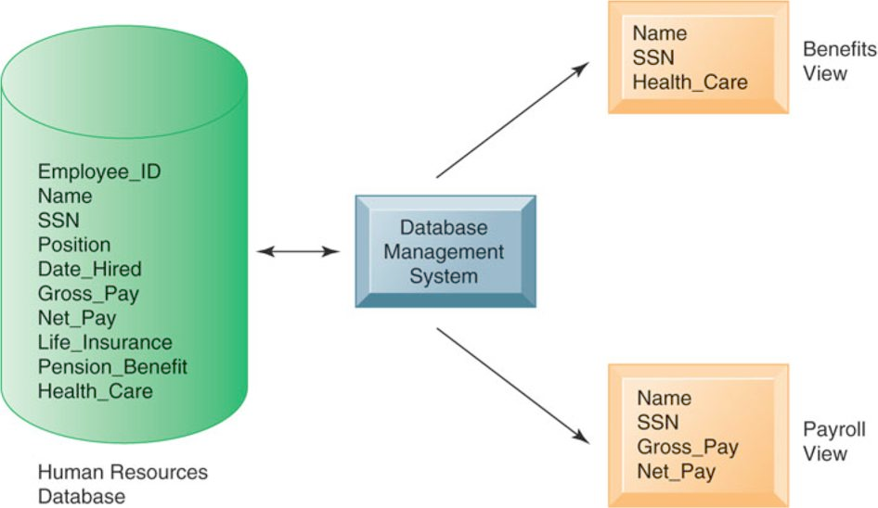
DBMS

Slide 17
Relational Database
The most popular type of DBMS today for PCs as well as for larger computers is the relational database
Relational databases represent data as two-dimensional tables called relations
Tables may be referred to as files
Each table contains data on an entity and its attributes

Slide 18
Relational Database
Microsoft Access is a relational DBMS for desktop systems, whereas DB2, Oracle Database, and Microsoft SQL Server are relational DBMS for large mainframes and midrange computers
MySQL is a popular open-source DBMS, and Oracle Database Lite is a DBMS for small handheld computing devices

Slide 19
Relational Database
Let’s look at how a relational database organizes data about suppliers and parts

Slide 20
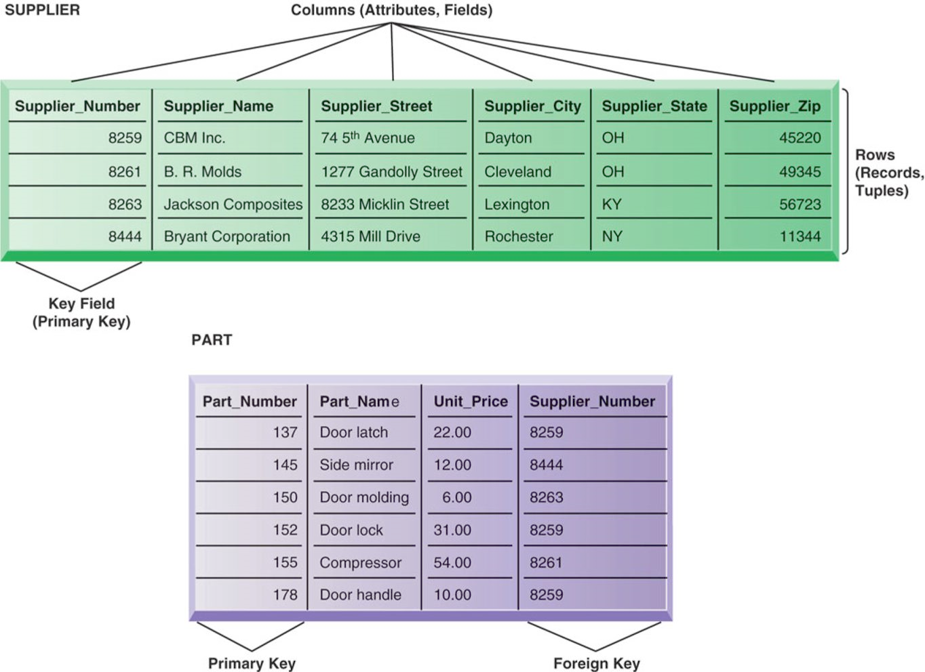
Relational Database

Slide 21
Relational Database
The database has a separate table for the entity SUPPLIER and a table for the entity PART
Each table consists of a grid of columns and rows of data
Each individual element of data for each entity is stored as a separate field, and each field represents an attribute for that entity

Slide 22
Relational Database
The actual information about a single supplier that resides in a table is called a row
Rows are commonly referred to as records, or in very technical terms, as tuples
Data for the entity PART have their own separate table

Slide 23
Relational Database
The field for Supplier_Number in the SUPPLIER table uniquely identifies each record so that the record can be retrieved, updated, or sorted
It is called a key field
Each table in a relational database has one field that is designated as its primary key

Slide 24
Relational Database
This key field is the unique identifier for all the information in any row of the table and this primary key cannot be duplicated

Slide 25
Relational Database
Relational database tables can be combined easily to deliver data required by users, provided that any two tables share a common data element
Suppose we wanted to find in this database the names of suppliers who could provide us with part number 137 or part number 150

Slide 26
Relational Database
We would need information from two tables: the SUPPLIER table and the PART table
Note that these two files have a shared data element: Supplier_Number
In a relational database, three basic operations, are used to develop useful sets of data: select, join, and project

Slide 27
Relational Database
The select operation creates a subset consisting of all records in the file that meet stated criteria
Select creates, in other words, a subset of rows that meet certain criteria

Slide 28
Relational Database
In our example, we want to select records rows from the PART table where the Part_Number equals 137 or 150
The join operation combines relational tables to provide the user with more information than is available in individual tables

Slide 29
Relational Database
In our example, we want to join the now-shortened PART table - only parts 137 or 150 will be presented - and the SUPPLIER table into a single new table

Slide 30
Relational Database
The project operation creates a subset consisting of columns in a table, permitting the user to create new tables that contain only the information required
In our example, we want to extract from the new table only the following columns: Part_Number, Part_Name, Supplier_Number, and Supplier_Name

Slide 31
Object Oriented Database
Many applications today and in the future require databases that can store and retrieve not only structured numbers and characters but also drawings, images, photographs, voice, and full-motion video
DBMSs designed for organizing structured data into rows and columns are not well suited to handling graphics-based or multimedia applications

Slide 32
Object Oriented Database
Object-oriented databases are better suited for this purpose
An object-oriented DBMS stores the data and procedures that act on those data as objects that can be automatically retrieved and shared

Slide 33
Object Oriented Database
Object-oriented database management systems (OODBMS) are becoming popular because they can be used to manage the various multimedia components or Java applets used in Web applications, which typically integrate pieces of information from a variety of sources

Slide 34
Object Oriented Database
Although object-oriented databases can store more complex types of information than a relational DBMS, they are relatively slow compared with relational DBMS for processing large numbers of transactions
Hybrid object-relational DBMS systems are now available to provide capabilities of both object-oriented and relational DBMS

Slide 35
DBMS Capabilities
A DBMS includes capabilities and tools for organizing, managing, and accessing the data in the database
The most important are its data definition language, data dictionary, and data manipulation language
DBMS have a data definition capability to specify the structure of the content of the database

Slide 36
DBMS Capabilities
It would be used to create database tables and to define the characteristics of the fields in each table
This information about the database would be documented in a data dictionary
A data dictionary is an automated or manual file that stores definitions of data elements and their characteristics

Slide 37
DBMS Capabilities
A DBMS includes tools for accessing and manipulating information in databases
Most DBMS have a specialized language called a data manipulation language that is used to add, change, delete, and retrieve the data in the database

Slide 38
DBMS Capabilities
This language contains commands that permit end users and programming specialists to extract data from the database to satisfy information requests and develop applications
The most prominent data manipulation language today is Structured Query Language, or SQL

Slide 39
Designing Databases
To create a database, you must understand the relationships among the data, the type of data that will be maintained in the database, how the data will be used, and how the organization will need to change to manage data from a company-wide perspective
The database requires both a conceptual design and a physical design

Slide 40
Designing Databases
The conceptual, or logical, design of a database is an abstract model of the database from a business perspective, whereas the physical design shows how the database is actually arranged on direct-access storage devices

Slide 41
Designing Databases
The design process identifies relationships among data elements and the most efficient way of grouping data elements together to meet business information requirements
The process also identifies redundant data elements and the groupings of data elements required for specific application programs

Slide 42
Designing Databases
Groups of data are organized, refined, and streamlined until an overall logical view of the relationships among all the data in the database emerges

Slide 43
Normalization
To use a relational database model effectively, complex groupings of data must be streamlined to minimize redundant data elements and awkward many-to-many relationships
The process of creating small, stable, yet flexible and adaptive data structures from complex groups of data is called normalization

Slide 44
Before Normalization

Slide 45
After Normalization

Slide 46
Normalization
Database designers document their data model with an entity-relationship diagram
This diagram illustrates the relationship between the entities such as SUPPLIER, PART, LINE_ITEM, and ORDER
The boxes represent entities
The lines connecting the boxes represent relationships

Slide 47
Normalization
A line connecting two entities that ends in two short marks designates a one-to-one relationship
A line connecting two entities that ends with a crow’s foot topped by a short mark indicates a one-to-many relationship
The figures show that one ORDER can contain many LINE_ITEMs

Slide 48
Normalization
A PART can be ordered many times and appear many times as a line item in a single order
Each PART can have only one SUPPLIER, but many PARTs can be provided by the same SUPPLIER

Slide 49
Data Warehouse
A data warehouse is a database that stores current and historical data of potential interest to decision makers throughout the company
The data originate in many core operational transaction systems, such as systems for sales, customer accounts, and manufacturing, and may include data from Web site transactions

Slide 50
Data Warehouse
The data warehouse consolidates and standardizes information from different operational databases so that the information can be used across the enterprise for management analysis and decision making
The data warehouse makes the data available for anyone to access as needed, but it cannot be altered

Slide 51
Data Warehouse
A data warehouse system also provides a range of ad hoc and standardized query tools, analytical tools, and graphical reporting facilities
Many firms use intranet portals to make the data warehouse information widely available throughout the firm

Slide 52
OLAP
OLAP – Online Analytical Processing supports multidimensional data analysis, enabling users to view the same data in different ways using multiple dimensions
Each aspect of information—product, pricing, cost, region, or time period—represents a different dimension

Slide 53
OLAP
So, a product manager could use a multidimensional data analysis tool to learn how many washers were sold in the East in June, how that compares with the previous month and the previous June, and how it compares with the sales forecast

Slide 54
OLAP
OLAP enables users to obtain online answers to ad hoc questions such as these in a fairly rapid amount of time, even when the data are stored in very large databases, such as sales figures for multiple years

Slide 55
Data Mining
Data mining is more discovery-driven
Data mining provides insights into corporate data that cannot be obtained with OLAP by finding hidden patterns and relationships in large databases and inferring rules from them to predict future behavior

