Slide 1
NETW-250 Video Traffic Last Update 2014.03.14 1.3.0

Slide 2
Objectives of This Section
Learn how to
Integrate video traffic into data networks

Slide 3
Video Traffic
More and more video traffic is appearing on networks from LAN to WAN
Sources include
Surveillance
IPTV
Video Conferencing
Live Streaming of Events

Slide 4
Traditional Surveillance
Traditionally video surveillance has been done using analog cameras
These types of cameras can be integrated into the data network using a video server that converts the analog coax based camera to a digital signal sent over a UTP cable through a local area network
However the trend is toward cameras that can be directly attached to the network

Slide 5
Planning for Surveillance Traffic
A sound infrastructure is required to support the refresh rate and throughput required by high resolution IP cameras
Camera and video recorder placement is an important consideration as well, particularly with regard to the wiring topology and location of network switches

Slide 6
Planning for Surveillance Traffic
Larger systems may require a distributed architecture with network video recorders located throughout the facility to help localize and optimize bandwidth use
Environmental conditions must also be considered to ensure equipment life, especially for recording devices using hard disk drives that run continuously and generate excessive heat

Slide 7
Planning for Surveillance Traffic
Lighting conditions and systems should be assessed for specific monitoring assignments and to eliminate troublesome conditions, such as high contrast, and to accommodate specific camera functions, such as day/night switchover or automatic back focus
For surveillance traffic a site survey is needed

Slide 8
Site Survey
An effective way to initiate the site survey is by determining zones of protection, beginning at the most remote point of contact with your facility, such as the street
Then proceed to actual entry points, followed by internal areas of high importance

Slide 9
Site Survey
The farthest points will require good peripheral coverage, while the middle and interior locations will need more focused surveillance

Slide 10
The Video Network
If the traffic generated by IP cameras is large enough, it may make sense to install a network for just the cameras in parallel to the data and voice networks
Video traffic is different from data and voice traffic as it is continuous
Data and voice traffic is by its nature bursty
This is not the case for camera traffic

Slide 11
Lens Field of View
It is important to select the correct lens for the application
You do not want too wide of a field of view with too little detail, nor to narrow a field of view that ignores significant areas that need to be monitored
Field of View calculators assist in selecting the lens

Slide 12
Lens Field of View
For example, Pelco has an online calculator that will do this

Slide 13
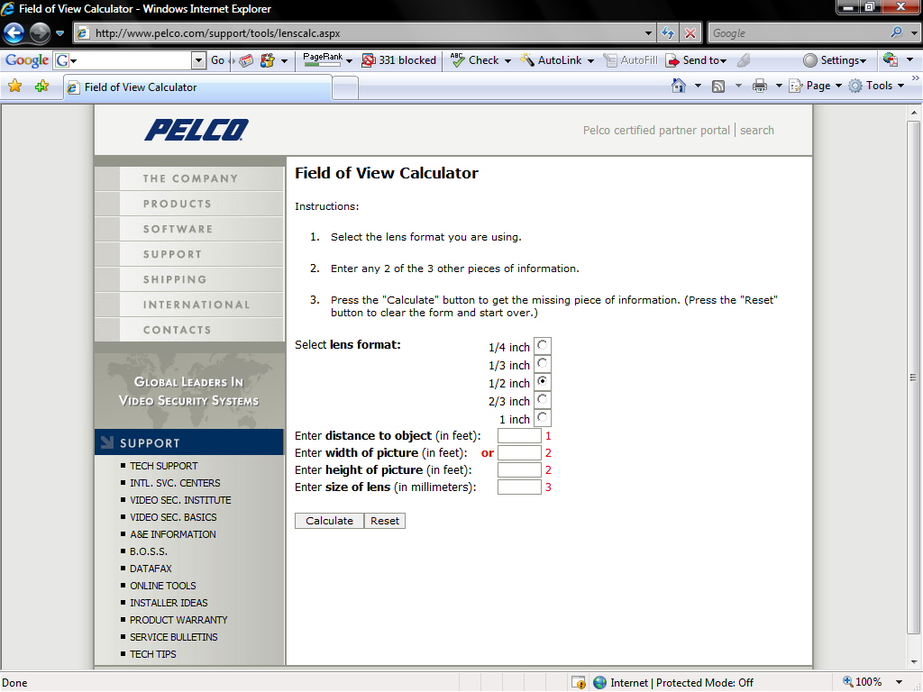
Pelco Field of View Calculator

Slide 14
Bandwidth Considerations
Three factors impact the amount of traffic a camera generates
Frame Rate
Resolution
Compression
These three can be adjusted as needed for quality or to save bandwidth

Slide 15
Frames Per Second
FPS is the number of full video frames displayed in one second
Movies are shown at 24 frames per second

Slide 16
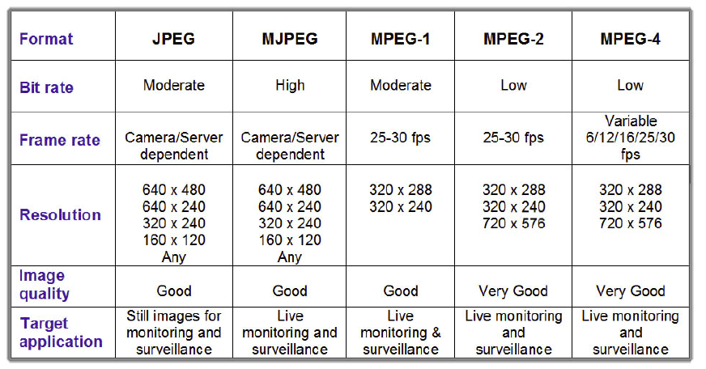
Resolution

Slide 17
Bandwidth
The issue of bandwidth allocation can be tricky
Higher bandwidth correlates to higher resolution and motion, but requires a greater investment
This equation rises exponentially when large numbers of cameras and recorders are added to a network

Slide 18
Bandwidth
In general a good quality video stream over an Ethernet network will require 1 to 2 Mbps per stream

Slide 19
Bandwidth
MPEG-4 is best for monitoring and multicast capability, while JPEG is more appropriate for higher-resolution recording
H.264 is another method to watch
It will cut bit rates below the MPEG levels
Programs are available that will provide an estimate of the bandwidth that will be required

Slide 20
Bandwidth Calculator
Such as this one from Toshiba
www.toshibasecurity.com/support/tools/Toshiba_IP_Camera_Calculator.xls
Consideration will need to be given to the additional power required for a camera with a housing that contains a heater or blower

Slide 21
PPF
Santiago Beron in an article in The Journal of Information Technology Systems by BICSI suggests that a better measure of image quality is PPF or pixels per foot
Here is what he has to say about this
The ppf is a function of the resolution of the camera, as well as the camera’s field of view and the distance to the target

Slide 22
PPF
An online calculator can be used for this or this formula can be entered in Excel
ppf=M/(2*D*tan(0/2)
Where
M is the number of horizontal pixels in the image
D is the distance to the target in feet or meters
0 is the horizontal field of view of eh camera and lens combination

Slide 23
PPF
Guidelines for the use of ppf are
<40 for general surveillance
>40 for forensic detail
>80 for high detail

Slide 24
Cabling System
Video typically only uses wires 7 and 8
Baluns are used to convert from one type of connector to another for cable changes
A problem with UTP cable is the common distance limitation of 328 feet
Runs longer than this must use a powered repeater of some sort

Slide 25
Cabling System
Siemon says this about the type of UTP cable to use

Slide 26
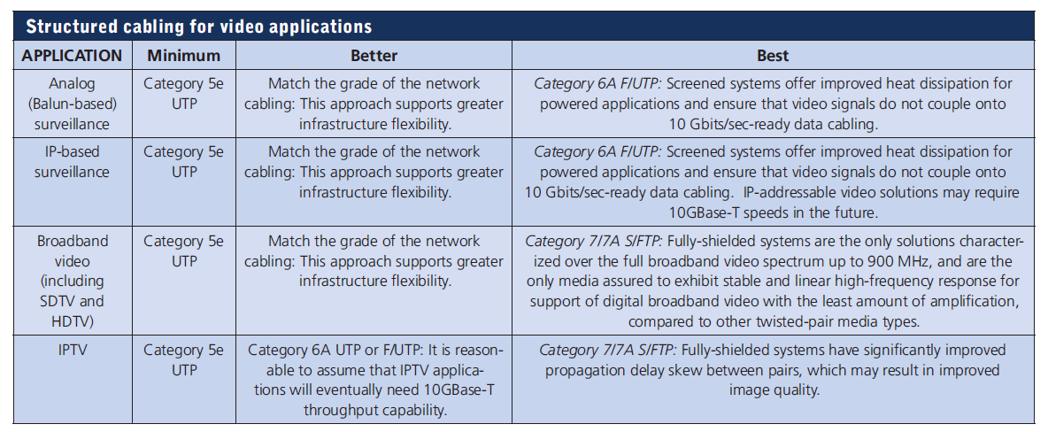
Cabling System

Slide 27
System Testing
Once these determinations have been made and the installation is complete, test the system response by going through the most common network usage scenarios
Simulate as many network conditions and loads as possible for components, edge devices, and infrastructure, and provide recovery scenarios for the most common and reasonable failures

Slide 28
Standards
There are few standards on this subject
The Open Network Video Interface Forum is working on some
Watch the trade press for progress on standardizing this sort of thing

Slide 29
IPTV
IPTV is characterized by three distinct things
It uses the MPEG transport stream
It is used by service providers such as cable companies and telcos to deliver IP video
It is more sensitive to network packet loss than any other form of video

Slide 30
IPTV
With IPTV at the source, if video is captured into a file, it is often referred to as a container
Popular formats for this file include avi, mpeg, and wmv

Slide 31
IPTV
If the file is intended for immediate delivery and play out, such as in IPTV provided by a service provider, the file is encapsulated in a transport stream and delivered in near real-time
In these cases, UDP protocol is used and retransmissions of lost data are not possible

Slide 32
IPTV
At the destination, the video is buffered very briefly for the purpose of smoothing play out with a set-top box
This delay is usually no more than a few seconds

Slide 33
Browser Based
When a browser based method is used the steps are essentially the same as the set top box method
However, play out is done in the software by a video player that replaces the role of the set-top box

Slide 34
Browser Based
Since a video file is transferred from a server to a client PC in this method and played out whenever the player has enough video for presentation, the transfer is almost always a form of TCP based file transfer, similar to when data files are moved using FTP
If packets are lost or delayed, retransmission is automatic

Slide 35
Video Conferencing
Most video conferencing systems follow one of the ITU standards in the H.260 family, either H.261 or H.263 to compress the video
Before IP was introduced, video conferencing was very proprietary in nature and required expensive leased circuits from the telephone company

Slide 36
Video Conferencing
But with the introduction of IP to the conferencing networks, almost everything changed
While H.263 codes were still used, the vendors began to support the idea of H.264 compression

Slide 37
Video Conferencing
This would bring them in line with the rest of the video industry in using a standard packet format and standard compression technologies
Unlike the other video types, video conferencing has two critical requirements

Slide 38
Video Conferencing
The video must be symmetrically passed between all endpoints
There cannot be more than about one half to one second of delay between the source and the destination

Slide 39
Video Conferencing
This last streaming technique is unique because it generally involves two-way delivery of the video
For years the video conferencing industry depended on Telco circuits such as ISDN and T-1
Today, virtually all video conferencing systems use an IP backbone and many use the Internet

Slide 40
Video Conferencing
Conferees on a call have cameras and microphones to generate the audio and video signals
However, practically no buffering of these signals takes place at the source and they are compressed, encapsulated in IP, and sent immediately

Slide 41
Video Conferencing
If two parties are conferring, the packets are nearly always carried in UDP using RTP - Real Time Protocol
When the third and successive caller joins, a device comprised of hardware or software called a bridge is used
The audio and video from each source is transferred to the bridge

Slide 42
Video Conferencing
In the bridge, the signals are combined to create an image that shows two or more of the participants
This combined signal is sent to each participant allowing all conferees to see and to hear the current presenter

Slide 43
Video Conferencing
Each of the individual source streams and the combined stream are delivered using unicast addressing so the amount of bandwidth consumed can be considerable
The video conferencing industry has not yet embraced multicast addressing but there are reports that several vendors have products under development that will incorporate it

Slide 44
Live Streaming
Live streaming can be done from a server on a local computer or from the computer to an online streaming service and then to whoever wants to view the stream
There are a seeming unlimited number of live streaming servers and service providers
One of these, Telestream, provides some advice on live streaming

Slide 45
Live Streaming
Here is their suggested basic setup

Slide 46
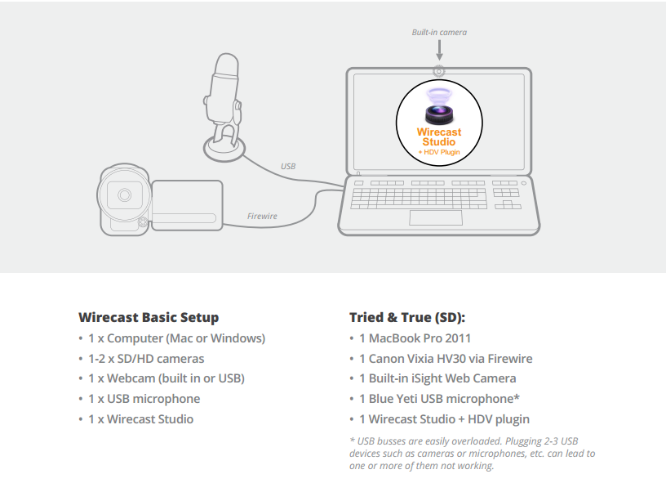
Live Streaming

Slide 47
Live Streaming
Their high end setup includes this

Slide 48
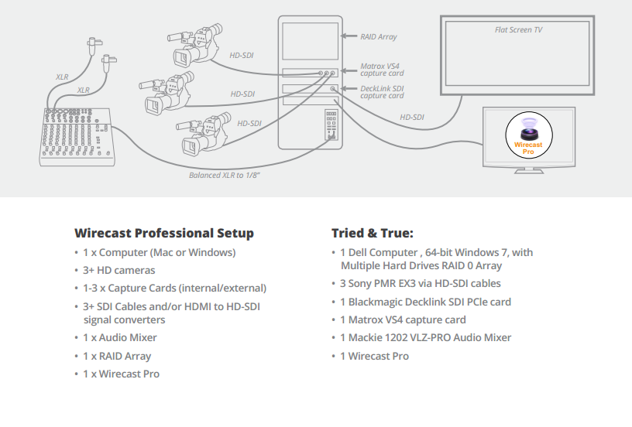
Live Streaming

Slide 49
Live Streaming
The data line required for this depends on the resolution used
They define SD – Standard Definition as 640 x 360 at 25 to 30 frames per second
HD – High Definition is 1280 x 720 at 25 to 30 frames per second

Slide 50
Live Streaming
The broadcast bitrate should be no higher than half of the data line’s upload speed to allow for peaks in the variable bit rate encoding
The bandwidth needed for SD is typically 1 Mbps
HD requires 3 to 4 Mbps

Slide 51
Live Streaming
Ustream adds this advice
However, really high-quality video sources can cause more harm than good
For example, an HD camera feed into a Ustream Producer canvas set to HD resolution, then broadcast out in HD, requires a lot of work for the graphics processor
If the frame rate starts to drop but the CPU usage stays steady, it creates a bottleneck

Slide 52
Live Streaming
The solution is to reduce the frame size going through Producer
Therefore, there is no need to bring input video in at HD resolution if Ustream Producer is streaming out a lower resolution.
Keep in mind that resizing down is good but resizing up reduces quality
As a rule, you should try to keep your resolution as constant as possible from source to output

Slide 53
Live Streaming
There is no benefit from using an HD camera if you’re only broadcasting a low resolution stream
This only increases the work your computer must do without any increase in output quality

Slide 54
Live Streaming
The type of hardware also has an impact on successful streaming
For example
FireWire is a hardware protocol that you can use to connect devices to your computer
But it is important to understand that saturating your FireWire bus - using up all available bandwidth - leads to problems in Producer

Slide 55
Live Streaming
As a result the audio and video appears choppy
There is an absolute limit to the bandwidth available to your FireWire devices - 400 or 800 megabits per second
If the sum of your devices goes over the limit, you saturate - use up - all the available bandwidth

Slide 56
Live Streaming
For example, if you have a camera attached to the FireWire bus and you saturate the bus, you see dropped frames - choppy video
The same is true for USB connected cameras as USB has even less available bandwidth

Slide 57
Live Streaming
Ustream goes on to say
So be mindful of this limitation when connecting hardware to your computer
Just because your setup works when you first put it together does not mean it always works
Experiment with your setup and make sure that you have enough FireWire bandwidth to share all of your devices without experiencing choppy video

Slide 58
Live Streaming
Normally, a camera requires around 25 Mbps to deliver audio and video to Producer
However, some cameras may require 100 Mbps or more

Slide 59
Analysis of Video Traffic
Let’s look at some video traffic
In this case it is a person speaking while the scene is being live streamed from their location to a video service to be streamed out onto the Internet
The time span is 46 seconds
Here are the first few frames

Slide 60
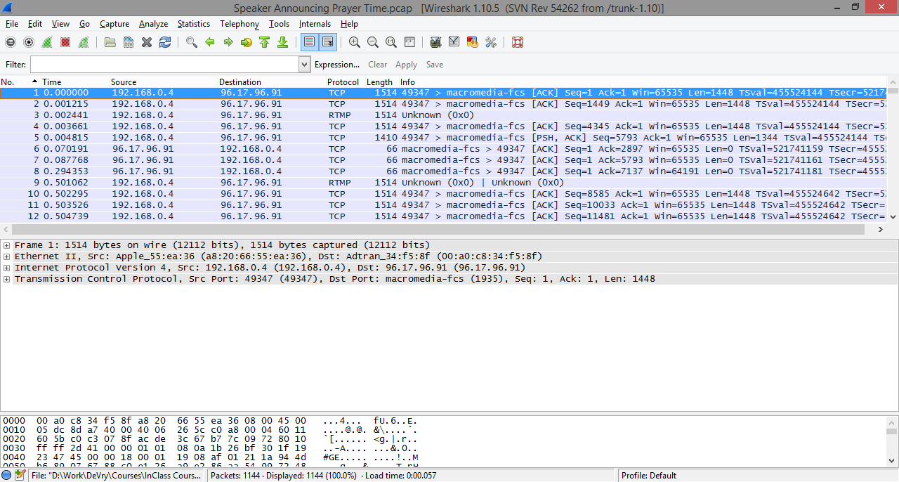
Analysis of Video Traffic

Slide 61
Analysis of Video Traffic
Notice that the stream is being carried by RTMP – Real Time Messaging Protocol
RTMP is designed to carry multi streams of audio and video traffic from one device to another

Slide 62
Analysis of Video Traffic
These move in parallel
A timestamp manages the flows to ensure they are displayed in the proper order
This is the protocol hierarchy

Slide 63
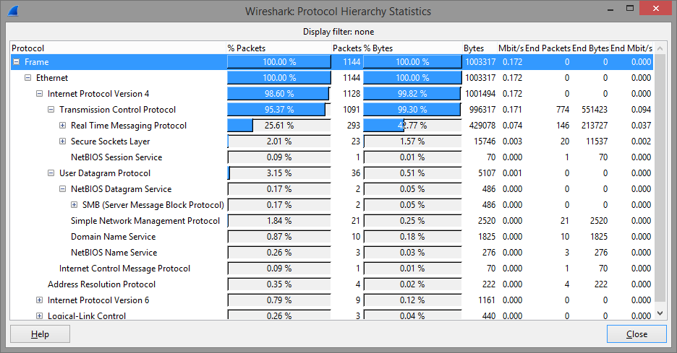
Analysis of Video Traffic

Slide 64
Analysis of Video Traffic
Let’s look at one of these

Slide 65
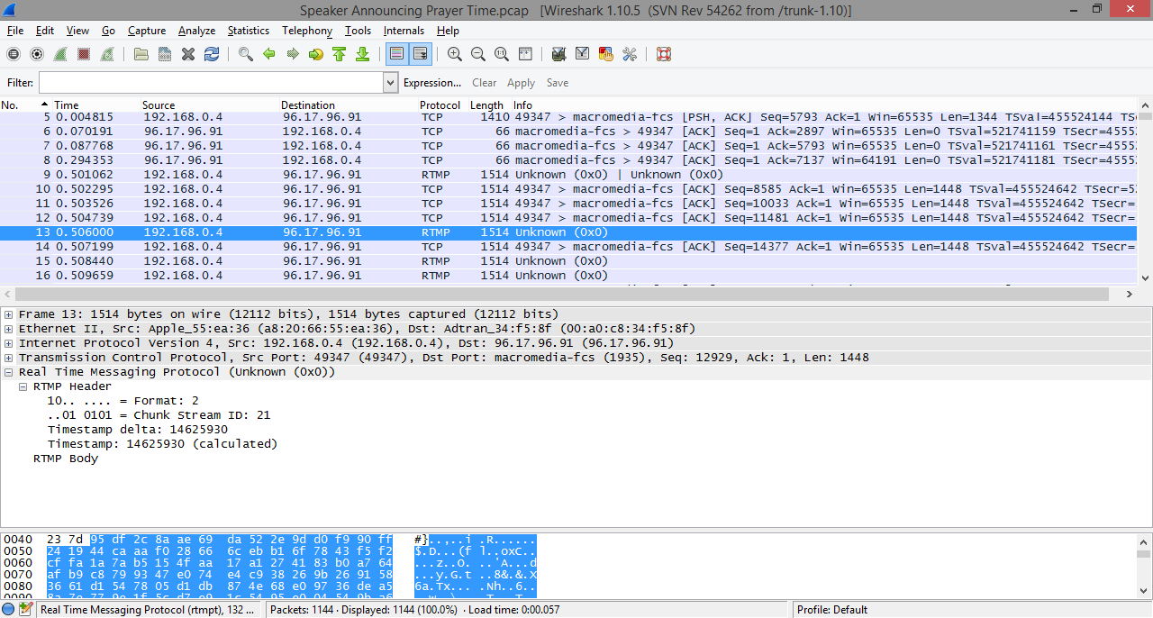
Analysis of Video Traffic

Slide 66
Analysis of Video Traffic
The main fields in a RTMP packet are the chunk, chunk stream, and the timestamp
Here is what the keeper of RTMP Adobe says about these fields
Chunk
A fragment of a message. The messages are broken into smaller parts and interleaved before they are sent over the network
The chunks ensure timestamp-ordered end-to-end delivery of all messages, across multiple streams

Slide 67
Analysis of Video Traffic
Chunk stream
A logical channel of communication that allows flow of chunks in a particular direction
The chunk stream can travel from the client to the server and reverse
Chunk stream ID
Every chunk has an ID associated with it to identify the chunk stream in which it is flowing

Slide 68
Analysis of Video Traffic
Why chunk, Adobe says
Chunking allows large messages at the higher-level protocol to be broken into smaller messages, for example to prevent large low priority messages (such as video) from blocking smaller high-priority messages (such as audio or control)

Slide 69
Analysis of Video Traffic
Chunking also allows small messages to be sent with less overhead, as the chunk header contains a compressed representation of information that would otherwise have to be included in the message itself

Slide 70
Sources
The material on surveillance traffic was copied word for word from an article by Steve Surfaro with Panasonic System Solutions Company
Additional parts were copied from a Fluke Networks white paper from 2010
The information on live streaming is from Telestream and Ustream

