Slide 1
NETW-250 The VOIP Concept Last Update 2013.03.07 1.1.0

Slide 2
VOIP
There is an alternative way of sending calls over the PSTN using its ability to handle both voice and data traffic
This alternate way is to place the voice into a frame for conversion to a packet for transmission over the Internet
Thus it is called VOIP – Voice Over Internet Protocol

Slide 3
VOIP
This can be used as a replacement for traditional telephony even though it runs over the PSTN
Using this method a PBX can be implemented on a PC

Slide 4
VOIP Advantages
The CCNA Voice certification prep book by Cioara and Valentine provide this list of advantages to VOIP over the PSTN
Reduced cost of communicating
Instead of relying on expensive tie lines or toll charges to communicate between offices, VoiP allows you to forward calls over WAN connections

Slide 5
VOIP Advantages
Reduced cost of cabling
VoiP deployments typically cut cabling costs in half by running a single Ethernet connection instead of both voice and data cables
Seamless voice networks
Because data networks connect offices, mobile workers, and telecommuters, VoiP naturally inherits this property
The voice traffic is crossing "your network" (relatively speaking) rather than exiting to the PSTN

Slide 6
VOIP Advantages
Take your phone with you
Cost estimates for moves, adds, and changes to a traditional PBX system range from $55 to $295 per MAC
With VoiP phone systems, this cost is virtually eliminated

Slide 7
VOIP Advantages
IP SoftPhones
SoftPhones represent an ideal example of the possibilities when combining voice and data networks
Users can now plug a headset into their laptop or desktop and allow it to act as their phone
Unified e-mail, voicemail, fax
All messaging can be sent to a user's e-mail inbox
This allows users to get all messages in one place and easily reply, forward, or archive messages

Slide 8
VOIP Advantages
Open, compatible standards
In the same way that you can network Apple, Dell, and IBM PCs together, you can now connect devices from different telephony vendors together. Although this benefit has yet to be fully realized, this will allow businesses to choose the best equipment for their network, regardless of the manufacturer

Slide 9
VOIP Problem Areas
How you choose to migrate from your conventional telephone system to VOIP is important
The quality and reliability of the VOIP system is tied directly to the underlying data network
Poor perceived call quality is the leading cause of failed VOIP implementation

Slide 10
VOIP Problem Areas
VOIP is more than just call management and voice conversations
It is also a comprehensive set of methods to deal with quality of service
Lack of attention to these aspects of VOIP will doom even the most well-intentioned implementer

Slide 11
Messages
In networks that use TCP/IP at the software layers a conversational approach to data exchange is used
Messages are communicated using datagrams or when they are fragmented packets
Voice delivered over these networks as packets is the essence of VOIP

Slide 12
VOIP or IP Telephony
Two similar terms are often seen in the literature referring to VOIP or IP Telephony
In one view
IP telephony is an IP-based voice offering
Whereas VOIP refers to the specific act of transmitting digitized sound data on an IP network

Slide 13
VOIP or IP Telephony
In another view
VOIP refers to the overall technology family
Whereas IP telephony is the act of mimicking traditional telephony applications
In general VOIP and IP telephony can be used interchangeably with VOIP the preferred term

Slide 14
Network Convergence
A single converged network means there is only one network to manage
A single network also means that a failure can bring down both the data and phone systems

Slide 15
The Layers of a VOIP Network
Recall that there are two hardware based layers
The Physical Layer
The layer that provides for the electrical, mechanical, radiant, or optical signaling pathways
The Data Link Layer
The layer that provides a medium for detecting errors
It works link by link
The data is carried by a frame

Slide 16
The Layers of a VOIP Network
And there are several software based layers
The Network Layer
It provides a scheme for data routing across wide area links
It provides an addressing scheme, so that disparate physical connections can be referenced by higher-layer services and by each other
Provides a definition for connection-oriented and connectionless datagram structures

Slide 17
The Layers of a VOIP Network
The Transport Layer
This layer provides error control across the entire network – from sender to receiver – regardless of the number of physical links between them
It provides for two kinds of service
High reliability using TCP that is complex with high overhead
Less reliability using UDP that is less complex with low overhead
VOIP generates 30 to 50 datagrams per second, therefore UDP is used
Call setup and signaling may use TCP

Slide 18
The Layers of a VOIP Network
The Application Layer
The Application Layer provides the services needed by the application sending and receiving the VOIP call as signaling and traffic management

Slide 19
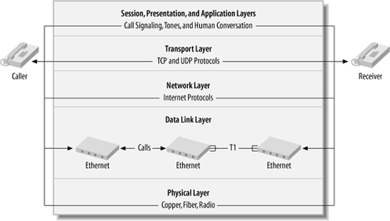
The Layer of a VOIP Network

Slide 20
VOIP Servers
VOIP servers are software-based devices that direct or participate in VOIP conversations in order to facilitate calling and other VOIP applications, such as
Call switching and management like a traditional PBX
Call recording and autoattendant functions like a voice mail system
Call conferencing

Slide 21
VOIP Servers
VOIP servers and voice endpoints in the same network make a SoftPBX system

Slide 22
VOIP Endpoints
Endpoints are valid hosts on the IP network
Phones that connect directly into the network are IP Phones
Voice applications that run on an IP phone allow it to act like a traditional phone
Traditional analog phones can be connected to the network using a ATA - Analog Telephone Adapter

Slide 23
VOIP Endpoints
Being IP hosts means that IP Phones must have a compatible IP address

Slide 24
Type of Phone
Using existing traditional phones mean less capital investment
IP phones tend to have greater feature sets and programmability
IP phones can be completely software-based, so they can run as an application on a PC, Mac or Linux box

Slide 25
Type of Phone
Wireless IP Phones can solve the wiring challenge but can introduce some problems of their own, such as a lack of QoS
100BaseT Ethernet and Cat 5e are the minimum for connecting IP phones

Slide 26
Network Convergence
When you support only one transport type for all networked applications, including telecommunications, you’ve achieved complete convergence
Convergence increases administrator productivity
Costs drop the more voice and data networks are converged

Slide 27
Pure IP or IP Enabled
Pure IP voice switches can’t make direct use of traditional circuit-switched telephones and trunks
Switches are totally packet-based
Connections to outside non-IP systems, like PSTN require outboard hardware

Slide 28
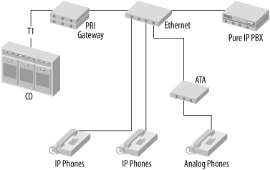
Pure IP or IP Enabled

Slide 29
Pure IP or IP Enabled
The media interfacing required to use traditional telephony devices with an IP-enabled switch is all contained within the switch chassis
IP-enabled switches are sometimes called hybrid switches

Slide 30
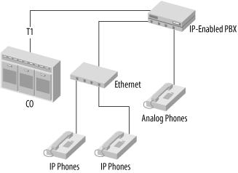
Pure IP or IP Enabled

