Slide 1
NETW-250
PSTN
The Past and The Future
Last Update 2012.08.01
1.0.0

Slide 2
Telephony
Telephony is the communication of spoken information between two or more participants
These days this is commonly done in whole or at least always in part over the PSTN

Slide 3
The PSTN
The PSTN is the Public Switched Telephone Network first deployed in the 1880s
Traditional wired landlines as used by the PSTN peaked in about 2000 at 192,512,992 according to Google
They have been in decline ever since as more and more households use only a cellular phone connection

Slide 4
The PSTN
Here is a nice illustration of this from Google

Slide 5
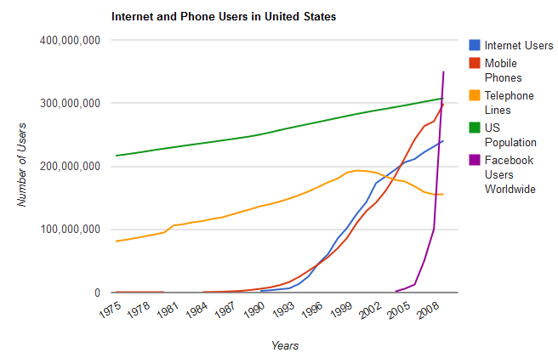
The PSTN

Slide 6
The PSTN
These wireless calls are only wireless over the last mile or the distance from the user to the cell tower
From the cell tower it is back to the traditional wired PSTN

Slide 7
The PSTN
As such the PSTN will not disappear as fiber optic cables are much better than the older style microwave radio frequency backhauls that were once used to carry long distance calls across the country

Slide 8
The PSTN
The problem for the PSTN is the last mile
This is the connection from the customer to the local telephone office
The only thing that will save the landline over the last mile is for the ILECs to replace the copper with singlemode fiber optic cable

Slide 9
The PSTN
Verizon has done this with their FIOS service as has AT&T with the U-verse offering
The problem is these are limited deployments

Slide 10
History of Communication
Let’s look the development of long distance communication and how the PSTN was developed, before we spend the rest of the course seeing where it is going
This order of events is from the lecture notes of James Sterbenz of the University of Kansas from 2011

Slide 11
Human Messengers
The first form of long distance communication as reported in the earliest historical records was the use of messengers to travel from point to point such as the run by a messenger from Marathon to Athens to announce the Greek victory over the Persians

Slide 12
Horse Mounted Messengers
Along with humans on foot, horse mounted messengers were used as well
This could be as a single messenger or as part of a sequence of riders between established stations
Over time this turned into a postal service around 1200 in China
In the US this was seen in the Pony Express

Slide 13
Horse Mounted Messengers
Here is a map of this route from the lecture notes of James Sterbenz of the University of Kansas

Slide 14
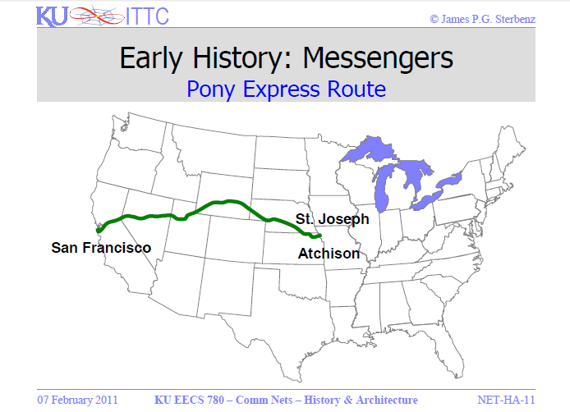
Horse Mounted Messengers

Slide 15
Carrier Pigeons
In addition to horses, carrier pigeons were used from ancient times as well
Not to jump too far ahead but be sure you examine RFCs 1149, 2549, and 6214 in relation to the current use of this transmission method

Slide 16
Telegraph
Several forms of telegraphs have been developed over the centuries
Let’s look at these

Slide 17
Beacons
Beacons of various forms have been used since ancient times in the form of fire beacons, smoke signals, and most well know Chappe’s semaphore signals from 1794
First an illustration from Wikipedia of the Chappe system and then the layout of the network from Sterbenz

Slide 18
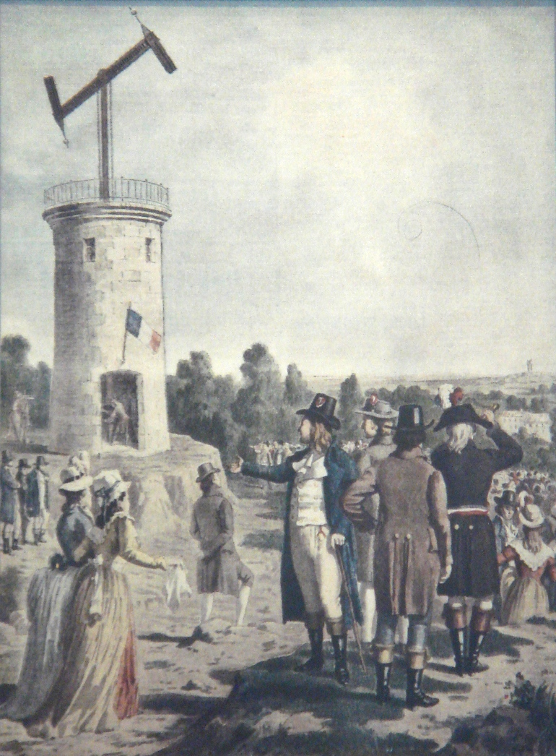
Beacons

Slide 19
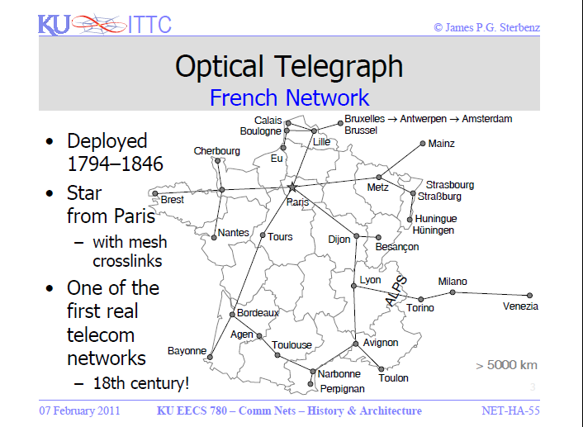
Beacons

Slide 20
Beacons
Edelcrantz improved on Chappe’s system when he introduced the optical shutter method
More modern forms of this system are the light shutter system used for ship to ship communication in the 20th century

Slide 21
Flag Signals
Flag based signaling systems appeared in the 1800s
These are were most commonly used between ships
Be sure to read RFC 4824 for more on this in relation to packet transmission
Here is an example from Sterbenz

Slide 22
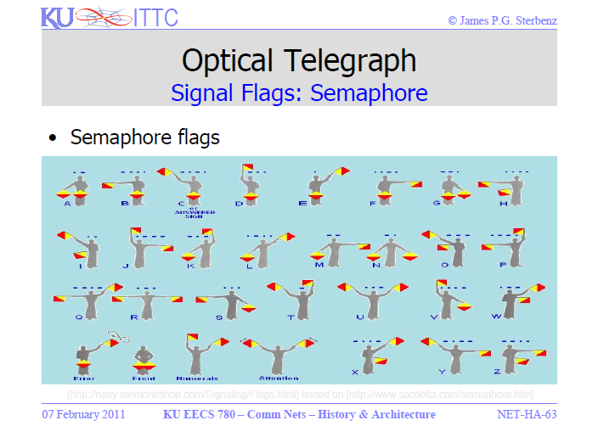
Flag Signals

Slide 23
Electric Telegraphs
With the mastery of electricity the telegraph became possible
This was an important advance as the telegraph did not require line of site
Worldwide communication became possible with the laying of oceanic cables
Telegrams are similar to email messages

Slide 24
Radio Telegraphy
With the development of telegraphy over radio waves the distances could be increased
Wires were no longer needed

Slide 25
PSTN
The next advance in communication was the development of the telephone and the subsequent PSTN – Public Switched Telephone Network
The PSTN developed from the original Bell Telephone Company formed by Alexander Graham Bell and his business partners in 1877

Slide 26
The Bell System
The first telephones were directly connected to each other
It became obvious very quickly that this would not scale well
The solution was to run all wires to a central point
The first Bell system exchange went into operation in 1878 in New Haven Connecticut

Slide 27
The Bell System
By 1878 most major urban areas had a telephone exchange that operated under a license from the Bell System
In this period before Bell's second patent expired in 1894, only Bell Telephone and its licensees could legally operate telephone systems in the United States

Slide 28
Competition
With the expiration of the patent the number of phone companies grew to over six thousand by 1904
The number of telephones in operation went from 285,000 to 3,317,000
This large number of telephone companies created a new set of problems such as the interconnection of customers to different telephone companies

Slide 29
The Bell System
From its formation the Bell system sought to gain control of the entire US telephone network
Over time they were able to do this
This form was maintained until 1984
In its final form AT&T consisted of
  The AT&T company with its long distance operation

Slide 30
The Bell System
  The 22 operating companies providing local service in their area of the country
  Western Electric providing the equipment
  Bell Labs providing the research arm
In all AT&T constituted a complete vertical monopoly of the PSTN which by this time had become the dominate form of communication

Slide 31
Kingsbury Commitment
In the period from 1877 to 1984 the Bell company came under increasing degrees of oversight by the government
The first time the government restricted the actions of AT&T was the Kingsbury Commitment from 1913 that recognized AT&T as a regulated monopoly

Slide 32
Kingsbury Commitment
A regulated monopoly is allowed to provide a service without competition, but with oversight and some constraints on exactly what it can offer
In this case the government set the rates
Other natural monopolies are
  National Defense
  Sewer Service
  Postal Service, at least for letters

Slide 33
Kingsbury Commitment
The idea behind a natural monody is that control by a single entity is the best way to deliver a service, but that these monopolies need to be watched
There were other smaller PSTN companies but AT&T was by far the dominate and only nationwide PSTN company

Slide 34
Graham-Willis Act of 1921
This commitment was an agreement with AT&T, not legislation
The Graham-Willis Act of 1921 formalized the Kingsbury Commitment in legislation

Slide 35
Communications Act of 1934
The regulatory environment we see today started in 1934 with the Communications Act of 1934
This legislation grew out of the Graham-Willis Act of 1921
In addition to being a natural monopoly, it was recognized that this monopoly required at least some regulation

Slide 36
Communications Act of 1934
This watching was done by the FCC - Federal Communications Commission
The government let AT&T be that monopoly

Slide 37
Growth of the PSTN
By 1945 fifty percent of US households had phone service

Slide 38
1956 Consent Decree
Things were fine until the 1950s
From the 1930’s through the early 1950’s the FCC decided that AT&T was getting out of hand
After much argument – note the 1956 date – the FCC got to more closely regulate AT&T
AT&T got a monopoly over most long distance service as their part of the deal

Slide 39
Hush-a-Phone Decision
The first attempt to penetrate this monopoly was the Hush-a-Phone decision from 1956 that forced AT&T to allow equipment other than that provided by Western Electric to be attached to the PSTN
In this case it was just an attachment to AT&T equipment

Slide 40
Carterphone Decision of 1968
The first hole in the natural monopoly held by AT&T appeared in the 1960s
The Carterphone company decided to make a device, that they would sell directly to phone users, that would use AT&Ts natural monopoly network
AT&T said no, no, no
We have a monopoly on making stuff that plugs into the network

Slide 41
Carterphone Decision of 1968
The courts said yes, anyone could make equipment for the telephone network
This allowed everyone to make stuff to attach to the phone company network, which they do now

Slide 42
Full Service
By 1969 ninety percent of US households had PSTN service which is as close to universal service as possible

Slide 43
Modification of Final Judgment
Judge Harold Greene messed up this nice, well organized, and understandable arrangement in 1984
He decided that the phone system was not a natural monopoly
The result of this decision was the breakup of AT&T

Slide 44
Modification of Final Judgment
Now we have
  ILECs
  CLECs
  and so on

Slide 45
Telecommunications Act
To spur on competition, the Congress decided to pass the Telecommunications Act of 1996
This act decided that everyone should be in everyone else’s business, just as soon as everyone else was in all the other businesses
Confusing isn’t it
So is this act

Slide 46
Telecommunications Act
Basically it lets any company do anything
It was meant to give everyone full choice by promoting competition
More specifically the legislation was supposed to
  Open local service to competition
  Let the regional Bell operating companies provide long-distance service
  Deregulate some cable rates

Slide 47
Telecommunications Act
  Let local telephone companies sell video services
  Protect Universal Service
  Change broadcast ownership rules

Slide 48
Why Doesn’t Competition Exist
The problem with the 1996 Communications Act is nothing changed
The ILECs still control the last mile
Real competition does not exist
For example, the ILECs say they cannot charge enough to cover their costs and still rent access to the customer connection for a reasonable rate

Slide 49
The Current PSTN
After all of this the PSTN now consists of three companies that control it
  Verizon
  AT&T
  Qwest
Is this starting to look like the original AT&T monopoly all over again

Slide 50
Limits of Traditional Telephony
While working well for over 100 hundred years the PSTN has some disadvantages in today’s telecommunications market
  New features take a while to roll out
  New features usually require new hardware
  There are capacity and cost constraints
  Data has overtaken voice as the main driver of traffic

Slide 51
Voice or Data
By mid 2000 the PSTN designed for voice was carrying more data than voice traffic
Of course the PSTN had from the earliest days carried more than just voice
In the 1920s radio programs and wire photos began to be carried
In the 1930s teletypewriter service sent text as digital signals

Slide 52
Voice or Data
Television was sent over the wires in the 1940s
By mid 2000 more data was carried than voice over the PSTN

Slide 53
Transition of the PSTN
In 1958 modems allowed computers to transmit digital data over voice grade analog telephone circuits
At this point computers were still mainframe based networks owned by a few companies
By the late 1970s the transmission of digital data increased dramatically between these networks

Slide 54
Transition of the PSTN
Then in the 1980s with the rise of personal computers and local area networks the need to send data over the PSTN increased rapidly every year
The origins of the Internet began in 1969 with the ARPANET funded by the Advanced Research Projects Agency of the Department of Defense

Slide 55
Transition of the PSTN
This was the first standards based internetwork
Unlike the proprietary networks that only allowed transmission of data between machines of the same company the ARPANET was designed to interconnect any type of device

Slide 56
Transition of the PSTN
The first connected nodes were UCLA, Stanford Research Institute, University of California at Santa Barbara, and University of Utah

