Slide 1
NETW-250
PSTN
How It Works
Last Update 2012.09.03
1.0.0

Slide 2
Mesh Versus Switched
Telephones can be connected with three approaches
  As a mesh network where every phone is connected to every other phone
  As a switched network where links are established and removed as needed
  As a stateless packet based network
Let’s look at how the PSTN developed from its earliest days to today

Slide 3
Mesh
In the beginning around 1877 each site that wanted to talk to another site had to be connected to it with dedicated wires
This is a mesh network layout

Slide 4
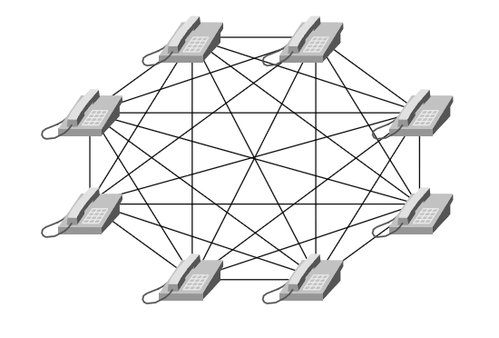
Mesh

Slide 5
Mesh
In a mesh network a ring-down circuit is used
In a ring-down circuit there is no dialing of numbers
Instead, a physical wire connects the two devices
One for the connection and the other one attached to ground

Slide 6
Mesh
One person picks up the phone and the other person is on the other end
Moving the voices across the wire requires a carbon microphone, a battery, an electromagnet, and an iron diaphragm
Mesh networks do not scale well as they require too many wires from each site

Slide 7
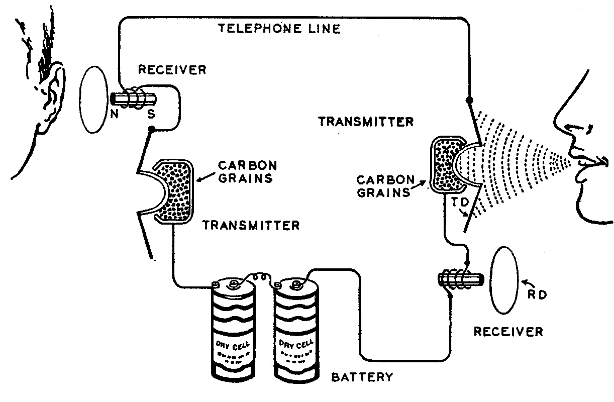
Mesh

Slide 8
Exchanges
It became obvious very quickly that this would not work on a large scale
The solution was to run all wires to a central point called an exchange
The first Bell system exchange went into operation in 1878 in New Haven Connecticut

Slide 9
Exchanges
By 1878 most major urban areas had a telephone exchange that operated under a license from the Bell System

Slide 10
Operators
These exchanges required operators and switchboards in order to create the end to end connection
The operators at first wrote down the number the person wanted to call, and then called back the originator of the call once the connection was ready
The route of the call was built from office to office operator by operator

Slide 11
Switching
Operator assisted calls began to be automated in 1926 with the Combined Line and Recording method
With it the first operator the customer spoke to was the one who built up the circuit and placed the call
For the first time, most calls were completed while the customer stayed on the line

Slide 12
Switching
The average call completion time dropped to 2.1 minutes
In 1929 the Bell system put the national General Toll Switching Plan into operation
This plan established a hierarchical, national circuit switching network

Slide 13
Switching
A call went to the local office where it was connected to one of more than 2,000 toll offices or 140 primary centers, and then up to 8 interconnected regional centers
Sectional centers were added in the 1950s
Here is what it looked like

Slide 14
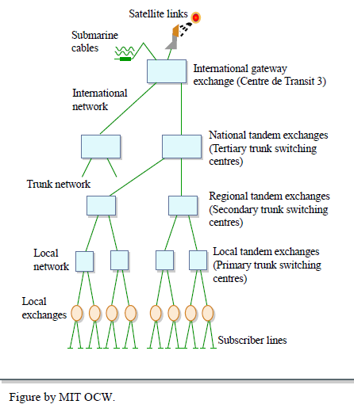
Switching

Slide 15
Switching
Automated switching began in 1943 when the first No. 4 Crossbar Switch was added to the system in Philadelphia
These switches were able to automatically route operator-dialed routing codes or customer-dialed numbers

Slide 16
Switching
With it a single operator built up the needed circuit by dialing a series of routing codes to instruct this automatic electromechanical switch
Dialed routing codes soon gave way to the familiar area codes, which the switch itself could translate into the needed routing information

Slide 17
Switching
AT&T soon modified the switch to handle customer-dialed long distance calls
The modified design became the No. 4A crossbar switch
No. 4A crossbar switches and direct-distance dialing spread to subscribers across the country during the 1950s

Slide 18
Switching
Call-completion time dropped to 10-20 seconds
In 1976, the first electronic switch was introduced as the 4ESS in Chicago
The 4ESS was in essence a special purpose computer
Call completion dropped to 1 to 2 seconds

Slide 19
Switching
The hierarchical call structure where a call went from office to office up a chain and then back down could now be bypassed as the 4ESS was capable of selecting the best route across the network

Slide 20
Transmission
In addition to the developments in switching the transmission system underwent a course of development as well
The original system was copper wires of various sizes connecting the end users and the telephone office, and then one telephone office to the next all around the world

Slide 21
Copper Cabling
Copper is a flexible, resilient material that is highly conductive of electricity
It has excellent transmission characteristics over short-distances
Over long distant runs it suffers from attenuation

Slide 22
Transmission
In order to carry the increasing number of calls outside of local areas the Bell system began to introduce new methods in the 1940s to replace and supplement the copper lines
Copper cables over long distances were replaced by microwave radio links through the AT&T Long Lines system

Slide 23
AT&T Long Lines Network
The towers used still exist in some areas
You have probably seen the signs of this wireless WAN when traveling down the highway, especially outside of a major city
The sign to look for to identify the remains of this network is

Slide 24
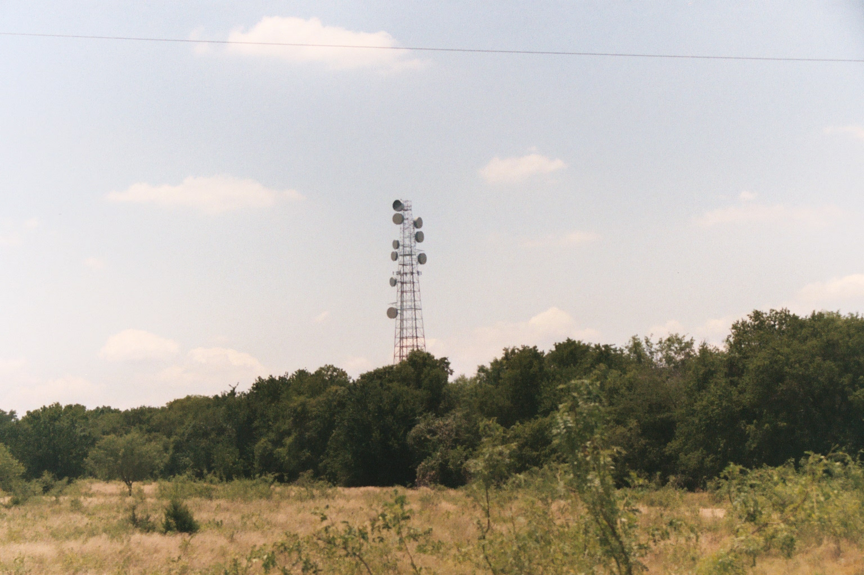
AT&T Long Lines Network

Slide 25
AT&T Long Lines Network
AT&T used these towers from 1947 to the late 1990’s
This was the long distance network you used whenever you called someone in another city
It connected the central offices throughout the country to each other, and to other provider’s networks

Slide 26
AT&T Long Lines Network
This network used microwave radio frequency links
Each link went from tower to tower

Slide 27
Fiber Optic Cabling
In the 1960s the copper analog transmission system was switched to a digital fiber optic cable based system
Switching the light source on and off or changing intensity allows you to transmit a digital bit stream over the fiber

Slide 28
Fiber Optic Cabling
Fiber optic cabling is a good choice for longer runs because of its lower attenuation characteristics
Between the mid 1980s and the early 1990s the entire long distance network became an all digital, fiber optic cable based network with the radio links going away and all but the last mile being fiber optic cabling

Slide 29
Circuits
Over these transmission lines circuits of various types carried the traffic
The most common voice circuit is the PRI – Primary Rate Interface version of a T1 line

Slide 30
Circuits
A PRI circuit is a digital signal carried across 23 digitally encoded voice channels, called DS0s, to be carried across a T1 circuit between the central office and an enterprise PBX
The 24th channel is the carrier channel or the signaling channel

Slide 31
Circuits
The basic PRI circuit is grouped with others to create larger circuits
SONET - Synchronous optical network STS-1s and DS3 - 44.736 Mbps also called T3 lines carry several T1s providing high-bandwidth-signaling pathways between switches on the PSTN

Slide 32
Circuits
The transmission system circuit hierarchy looks like this
  T1/E1
    T1 is a 1.544-Mbps digital transmission link normally used in North America and Japan
    E1 is a 2.048-Mbps digital transmission link normally used in Europe

Slide 33
Circuits
  T3/E3, T4 over coaxial cable
    T3 carries 28 T1s or 672 64-kbps connections and is 44.736 Mbps
    E3 carries 16 E1s or 512 64-kbps connections and is 34.368 Mbps
  T4 handles 168 T1 circuits or 4032 4-kbps connections and is 274.176 Mbps

Slide 34
Circuits
  SONET is normally deployed in OC-3, OC-12, and OC-48 rates, which are 155.52 Mbps, 622.08 Mbps, and 2.488 Gbps, respectively
    OC-1 = 51.85 Mbps
    OC-3 = 155.52 Mbps
    OC-12 = 622.08 Mbps
    OC-24 = 1.244 Gbps
    OC-48 = 2.488 Gbps
    OC-192 = 9.952 Gbps
    OC-255 = 13.21 Gbps

Slide 35
Circuit
Another circuit that has been used for voice calls is an ISDN BRI circuit
It uses two channels of voice called B channels, each using 64 kbps of bandwidth, while the third channel called the D channel uses 16 kbps for call signaling

Slide 36
Channel Banks
A channel bank is used to multiplex, that is combine, separate digital voice signals into a single T1 circuit and demux or split it back into its individual signals again at the other end
A channel bank combines up to 24 separate phone lines into a single digital link

Slide 37
Channel Banks
One purpose of a channel bank might be connecting a group of digital phones to a PBX through that PBX's T1 interface

Slide 38
The Network
All of these transmission lines and circuits are laid out in a network where they are used to connect the end user to the various offices of the phone company so as to enable communication around the world

Slide 39
The Network
This network consists of
  From the customer site to the nearest central office
  From the central office to a higher level office
  Across the PSTN
  From the higher level office to the central office
  From the central office to the customer site

Slide 40
The Network
For connections from the central office to a residence customer an analog phone line is used
  There is usually only one conversation on each one of these
For connections from the central office to a business a PBX trunk is used
  Usually several simultaneous conversations can be carried on these

Slide 41
The Network
Connections between PBXs at a customer site are trunks
Connections between central office switches are trunks

Slide 42
The Network
The telephone infrastructure starts with a simple pair of copper wires running to your home
This physical cabling is known as a local loop
The local loop physically connects the end user telephone to the central office switch also known as a Class 5 switch or end office switch

Slide 43
The Network
The communication path between several central office switches is known as a trunk
Just as it is not cost-effective to place a physical wire between your house and every other house you want to call, it is also not cost-effective to place a physical wire between every central office switch

Slide 44
The Network
End office switches or central office switches interconnect through trunks to tandem switches also referred to as Class 4 switches
Higher layer tandem switches connect local tandem switches
For example

Slide 45
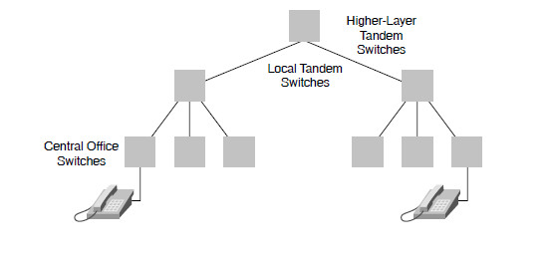
The Network

Slide 46
Trunks
Trunk lines are use for several purposes

Slide 47
Switch-to-Switch Trunks
A switch-to-switch trunk is one that carries calls between two switches in the PSTN
Trunks that connect a PBX to the local phone company are also considered switch-to-switch trunks

Slide 48
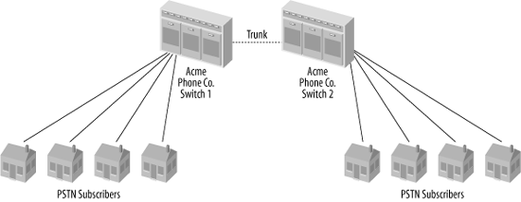
Switch-to-Switch Trunks

Slide 49
Point-to-Point Trunking
High-density copper cables used to interconnect PBXs that are within a few hundred meters of each other are called point-to-point trunks or private trunks
These interconnect PBXs at a site without going back through the PSTN

Slide 50
POTS
The result of all of these transmission lines, circuits, and networks is the POTS – Plain Old Telephone Service
This is the traditional wired telephone connected by a two wire circuit that is installed between your home or business and the central office of the local phone company

Slide 51
POTS
All power to the phone comes from the central office
Ringing, dial tone, and busy signals come from the central office
Any other feature that you may have all come from the central office
Simplicity and reliability have been key reasons for its longevity

Slide 52
Analog Telephone
An analog phone is composed of five parts
  Ringer
  Dial Pad
  Hybrid
  Hook Switch
  Handset
These all work together in this manner

Slide 53
Ringer
To activate the ringer when the central office wants to signal an incoming call, it will connect an alternating current signal of roughly 90 volts to the circuit
This will cause the bell in the telephone to produce a ringing sound
This current is different from the PSTN supplied DC current that powers the phone

Slide 54
Dial Pad
The dial pad in the telephone sends a tone to the central office to tell it who it wants to call, as well as to respond to prompts
Today these are DTMF tones
For example

Slide 55
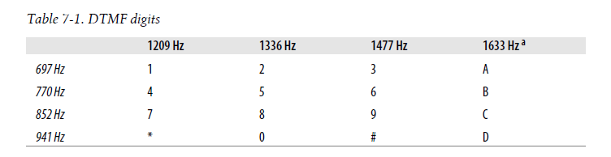
Dial Pad

Slide 56
Hybrid
The hybrid also called the network is a type of transformer that combines the signals transmitted and received across a single pair of wires and the two pairs of wires in the handset
One of the functions the hybrid performs is regulating sidetone, which is the amount of your transmitted signal that is returned to your earpiece

Slide 57
Hybrid
Its purpose is to provide a more natural-sounding conversation
Too much sidetone, and your voice will sound too loud, too little, and you’ll think the line has gone dead

Slide 58
Hook Switch
This device signals the state of the telephone circuit to the central office
When you pick up the telephone, the hook switch closes the loop between you and the central office, which is seen as a request for a dial tone
When you hang up, the hook switch opens the circuit, which indicates that the call has ended

Slide 59
Hook Switch
The hook switch can also be used for signaling purposes as a flash

Slide 60
Handset
The handset or telephone consists of a transmitter and receiver
It performs the conversion between the sound energy humans use and the electrical energy the telephone network uses

Slide 61
Tip and Ring
In an analog telephone circuit, there are two wires
In North America, these wires are referred to as Tip and Ring
This terminology comes from the days when telephone calls were connected by live operators sitting at cord boards

Slide 62
Tip and Ring
The plugs that they used had two contacts, one located at the tip of the plug and the other connected to the ring around the middle
For example

Slide 63
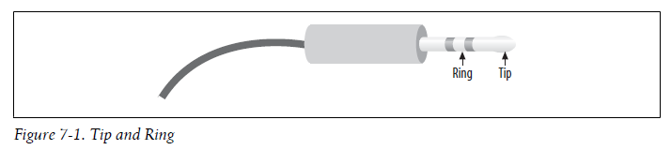
Tip and Ring

Slide 64
Tip and Ring
The Tip lead is the positive polarity wire
In North America, this wire is typically green and provides the return path
The Ring wire is the negative polarity wire
In North America, this wire is normally red
For modern Cat 5 and 6 cables, the Tip is usually the white wire, and Ring is the coloured wire

Slide 65
Tip and Ring
When your telephone is on-hook, this wire will have a potential of –48V DC with respect to Tip
Off-hook, this voltage drops to roughly –7V DC

Slide 66
Signals
To make the POTS work over these circuits carried by the transmission lines various types of signals have been and are carried over these
Let’s look at these

Slide 67
Analog Signals
Everything you hear, including human speech, is in analog form
In the beginning the PSTN was based on an analog infrastructure
Analog communication is ideal for human interaction, but it does not work well over long distances due to line noise

Slide 68
Analog Signals
In the early telephony network, analog transmission was passed through amplifiers to boost the signal
But, this practice amplified not just the voice, but the line noise as well
This line noise resulted in an often unusable connection

Slide 69
Analog Signals
The reason for this is analog communication is a mix of time and amplitude
Here is what it looks like in a view from a Cisco book

Slide 70
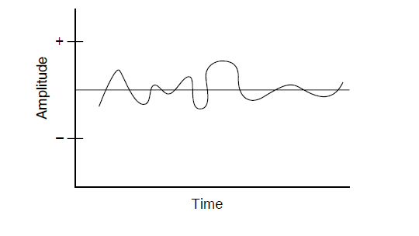
Analog Signals

Slide 71
Analog Signals
If you were far away from the end office switch, an amplifier might be required to boost the analog transmission
Analog signals that receive line noise can distort the analog waveform and cause garbled reception
This is more obvious to the listener if many amplifiers are located between your home and the end office switch

Slide 72
Analog Signals
As this figure shows an amplifier does not clean the signal as it amplifies, but simply amplifies the distorted signal

Slide 73
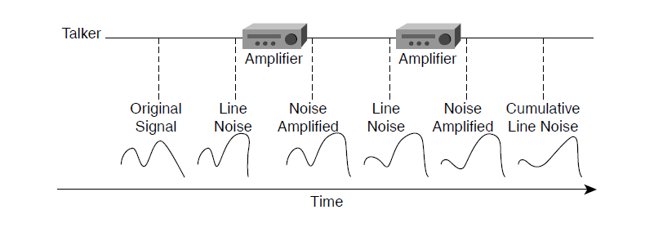
Analog Signals

Slide 74
Analog Signals
This process of going through several amplifiers with one voice signal is called accumulated noise

Slide 75
Sound Range
Humans can hear in the range of 20 to 20,000 Hz
However, human speech is mostly in the 250 to 3,000 Hz range
So the PSTN was designed to carry signals in the 300 to 3,500 Hz range

Slide 76
Digital Signals
In digital networks, line noise is less of an issue because repeaters not only amplify the signal, but clean it to its original condition
This is possible with digital communication because such communication is based on 1s and 0s

Slide 77
Digital Signals
So, as shown in this figure a repeater, which is a digital amplifier, only has to decide whether to regenerate a 1 or a 0

Slide 78
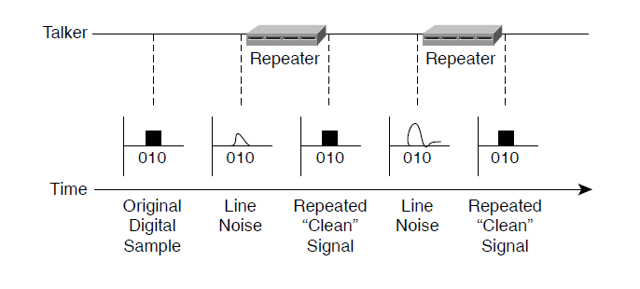
Digital Signals

Slide 79
PCM
PCM – Pulse Code Modulation is the most common method of encoding an analog voice signal into a digital stream of 1s and 0s
All sampling techniques use the Nyquist theorem, which basically states that if you sample at twice the highest frequency on a voice line, you achieve good-quality voice transmission

Slide 80
PCM
The PCM process is as follows
  Analog waveforms are put through a voice frequency filter to filter out anything greater than 4,000 Hz
  These frequencies are filtered to 4,000 Hz to limit the amount of crosstalk in the voice network
  Using the Nyquist theorem, the signal is sampled at 8,000 samples per second to achieve good quality voice transmission

Slide 81
PCM
  After the waveform is sampled, it is converted into a discrete digital form
  This sample is represented by a code that indicates the amplitude of the waveform at the instant the sample was taken
  The telephony form of PCM uses eight bits for the code and a logarithm compression method that assigns more bits to lower amplitude signals

Slide 82
PCM
For PCM if you multiply the eight-bit words by 8,000 times per second, you get 64,000 bits per second
The basis for the telephone infrastructure is 64,000 bps or 64 kbps

Slide 83
Digital Signals
Two basic variations of 64 kbps PCM are commonly used
  μ-law, the standard used in North America
  a-law, the standard used in Europe
The methods are similar in that both use logarithmic compression to achieve from 12 to 13 bits of linear PCM quality in only eight-bit words, but they differ in relatively minor details

Slide 84
Signaling System
To manage these signals as they transit the transmission lines a signaling system is required to setup, maintain, and teardown the calls

Slide 85
Signaling System
Generally, two types of signaling methods run over these various transmission media
The signaling methods are broken into the following groups
  User-to-network signaling
    How an end user communicates with the PSTN
  Network-to-network signaling
    How the switches in the PSTN intercommunicate

Slide 86
User-to-Network Signaling
The most common signaling method for user-to-network analog communication is DTMF - Dual Tone Multi-Frequency
DTMF is known as in-band signaling because the tones are carried through the voice path
Tones consist of two pitches
Here is how DTMF tones are derived

Slide 87
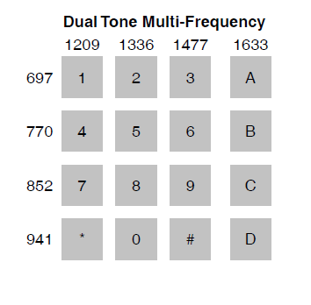
User-to-Network Signaling

Slide 88
User-to-Network Signaling
When you pick up your telephone handset and press the digits, the tone that passes from your phone to the central office switch to which you are connected tells the switch what number you want to call
DTMF is defined by the ITU Q.23 and Q.24 specifications

Slide 89
Standard Tones
The other tones used in the network are called standard tones
These are the dial tone, the ringback tone - the ringing the caller hears while waiting for his call to be connected, and the busy tone
These tones are also defined by the ITU, in specifications E.180 and Q.35

Slide 90
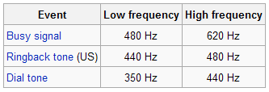
Standard Tones

Slide 91
Network-to-Network Signaling
To manage the PSTN itself a network-to-network signaling system is required
Network-to-network signaling types include in-band signaling methods such as MF - Multi-Frequency and RBS - Robbed Bit Signaling and out of band signaling such as the common Signaling System 7

Slide 92
SS7
SS7 is the PSTN’s network-to-network signaling system
It coordinates communication between switches, telephone company databases, and billing systems
SS7 was developed by the ITU Telecommunications Standardization Sector

Slide 93
SS7
It is called C7 in Europe
SS7 is a separate network whose duties are setting up, tearing down, monitoring, and routing calls on the PSTN
Like TCP/IP, SS7 is packet-based

Slide 94
SS7
SS7 is an out-of-band signaling standard because, it doesn't use the same frequency band, or the same transport, as the voice transmission

Slide 95
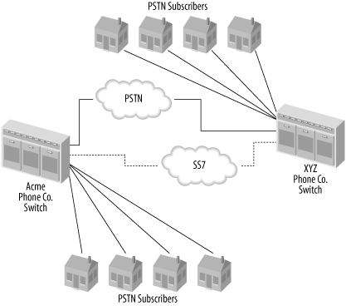
SS7

Slide 96
Numbering Systems
To keep all of this straight a worldwide numbering system is used as well as the interior extension numbers

Slide 97
Geographic Codes
An area code is a geographic code grouped into logical, compact geographic areas large enough to support from five or six million phone numbers each
These area codes, are used to help the PSTN and SS7 route calls between subscribers in remote areas of the network

Slide 98
Geographic Codes
Country codes are similar prefixes, but for calls between different national PSTN designations
These codes are defined in the ITU recommendation E.164

Slide 99
PSTN Numbering Plans
One feature that slowly changed over time is the dial plan
The addition of second lines for Internet access, cell phones, and fax machines has created a relative shortage of phone numbers
In some places in the United States, it is necessary to dial 10 digits for even a local call

Slide 100
PSTN Numbering Plans
This will become more and more prevalent as more devices require telephone numbers
The need to dial 10 digits for a local number is normally due to an overlay
An overlay can result in next-door neighbors having different area codes

Slide 101
PSTN Numbering Plans
An overlay is when a region within an existing area code has another area code overlaid
This offers the existing customers the benefits of not having to switch area codes, but forces everyone in that region to dial 10 digits to call anywhere

Slide 102
PSTN Numbering Plans
NANP is an 10-digit dialing plan that contains three parts
  The NPA - Numbering Plan Area also referring to as area code)
  The NXX Central Office Code
  The Station Number
This plan is often referred to as NPA-NXX-XXXX

Slide 103
PSTN Numbering Plans
NPA codes use the following format
  NXX, where N is a value between 2–9 and X is a value between 0–9
  NANP is also referred to as 1+10
  This means that when a 1 is the first number dialed, and then the 10-digit NPA-NXX-XXXX number

Slide 104
PSTN Numbering Plans
This enables the end office switch to determine whether it should expect a 7 or 10 digit telephone number

Slide 105
Applications
As with almost every industry, it is usually better and easier to acquire additional business from current customers than it is to go out and get new customers
The PSTN is no different
To grow the system the Local Exchange Carriers have been increasing the features they offer to create a higher revenue stream per consumer

Slide 106
Applications
Numerous services are now available, for example, which were not available just a few years ago
These services come in two common flavors
  Custom calling features
  CLASS features

Slide 107
Applications
Custom calling features rely upon the end office switch, not the entire PSTN, to carry information from circuit-switch to circuit-switch
CLASS features, however, require SS7 connectivity to carry these features from end to end in the PSTN

Slide 108
Applications
A few of the popular custom calling features commonly available are
  Call waiting
    This notifies customers who already placed a call that they are receiving an incoming call
  Call forwarding
    This enables a subscriber to forward incoming calls to a different destination
  Three-way calling
    This enables conference calling

Slide 109
Applications
Some of the CLASS features are
  Display
    Displays the calling party’s directory number, or Automatic Number Identification
  Call blocking
    Blocks specific incoming numbers so that callers are greeted with a message saying the call is not accepted

Slide 110
Applications
  Calling line ID blocking
    Blocks the outgoing directory number from being shown on someone else’s display
  Automatic callback
    Enables you to put a hold on the last number dialed if a busy signal is received, and then place the call after the line is free
  Call return
    Enables users to quickly reply to missed calls

Slide 111
Applications
Many interexchange carriers also offer business features, such as
  Circuit-switched long distance
    Basic long-distance services at a discounted rate

Slide 112
Applications
  Calling cards
    Pre-paid and post-paid calling cards
    You dial a number, enter a password, and then call your destination
  800/888/877 numbers
    The calling party is not charged for the call
    Instead the party called is charged

Slide 113
Service Providers
The telecommunications network in the US is made up of ILECs, CLECs, and IXCs
The ILECs are the original telephone network providers such as
  AT&T
  Century Link
  Frontier

Slide 114
ILECs
The only significant ones left are
  AT&T
  Verizon
  Qwest

Slide 115
CLECs
The CLECs are newer companies that compete against them in one or more of the ILEC’s market areas
Such as
  Cbeyond
  Earthlink
  Level 3 Communications
  Windstream
  XO Communications

Slide 116
IXCs
IXCs are network operators that provide connections between PSTN network carriers

Slide 117
ISPs
ISPs are not a part of the PSTN
They are often operated by the same companies that provide PSTN services

Slide 118
LATAs
As part of the 1984 breakup of Ma Bell the country was divided into LATAs - Local Access Transport Areas
160 of these cover the US

Slide 119
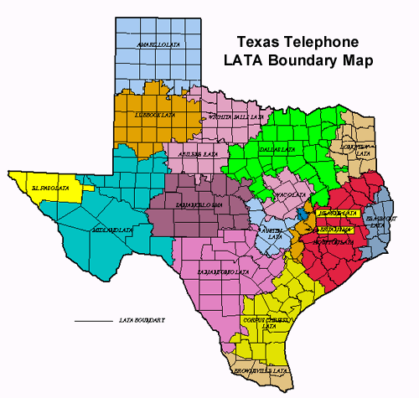
Texas LATAs

Slide 120
Customer Premises Equipment
At the end of all of this and the area we will be working in is the customer premises
Any equipment installed by the telephone company for use in terminating voice calls or other connections is called CPE - Customer Premises Equipment
Things found at the CPE include

Slide 121
Customer Premises Equipment
The Demarc
  The point at which telephone company-owned facilities terminate
Inside Wiring and the Cable Plant
  The privately owned network of communications cabling and wiring terminals located on the customer side of the demarc
Switches
  Usually a PBX or a KSU

Slide 122
Customer Premises Equipment
CP Distribution Frames
  Cross-connect blocks, terminals, or patch panels where endpoint locations are aggregated and centralized
Let’s look at this equipment in more detail

Slide 123
Demarc
A demarc is a demarcation point
It is where you stop and the phone company starts
This means that whatever does not work on your side is your problem
Whatever does not work on their side is also your problem, but you’ll have to call them to get it fixed

Slide 124
Demarc
The demarc can be called several things
For example, I use demarc as short for demarcation point
Others write demark
BICSI, who certifies cable installers, calls it the RDP – Rate Demarcation Point

Slide 125
Demarc
The phone company calls it several different things
  Network Interface
  NID – Network Interface Device
  Network Interface Unit

Slide 126
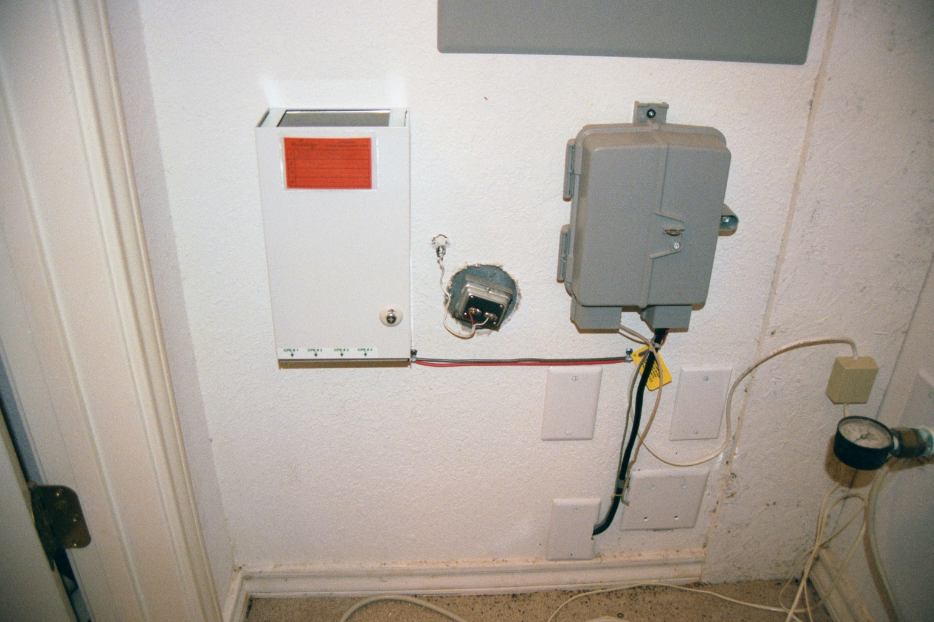
Demarc at a House

Slide 127
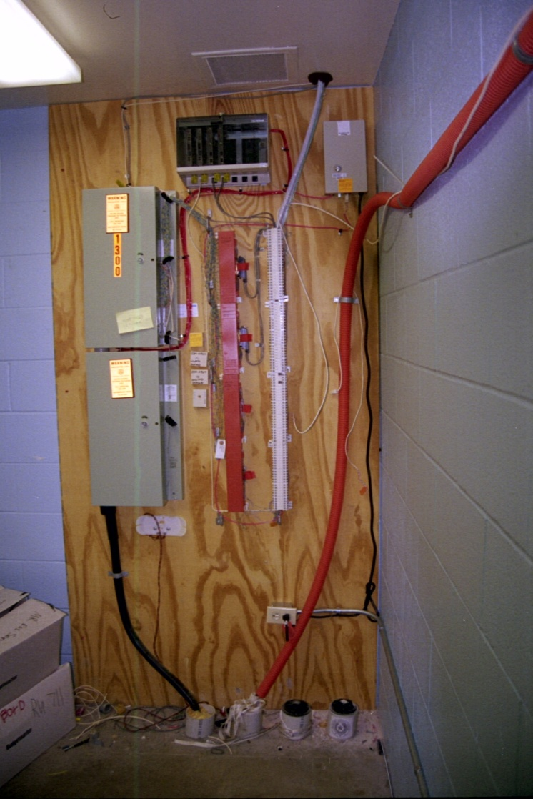
Demarc at a Small Business

Slide 128
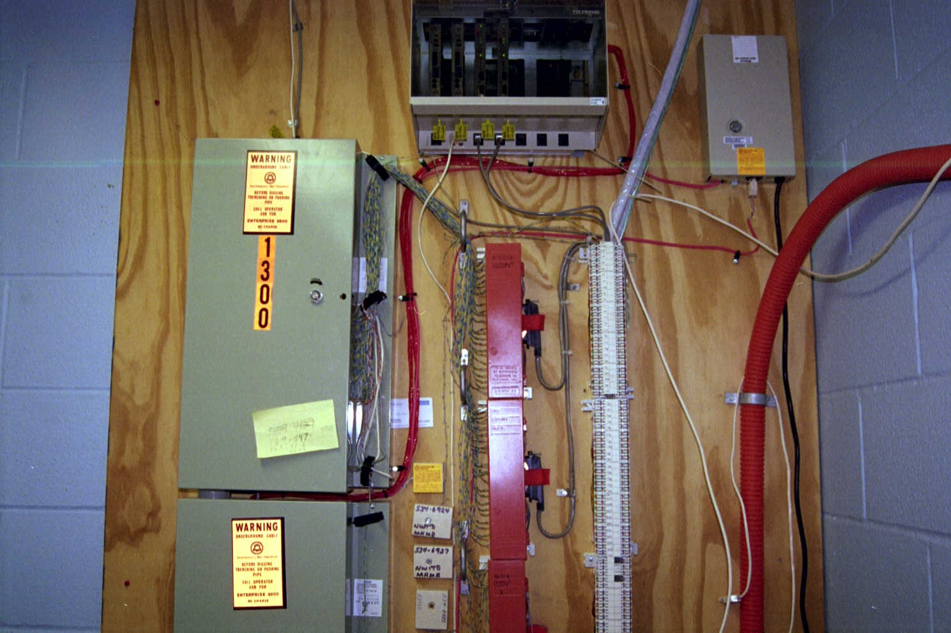
Demarc at a Small Business

Slide 129
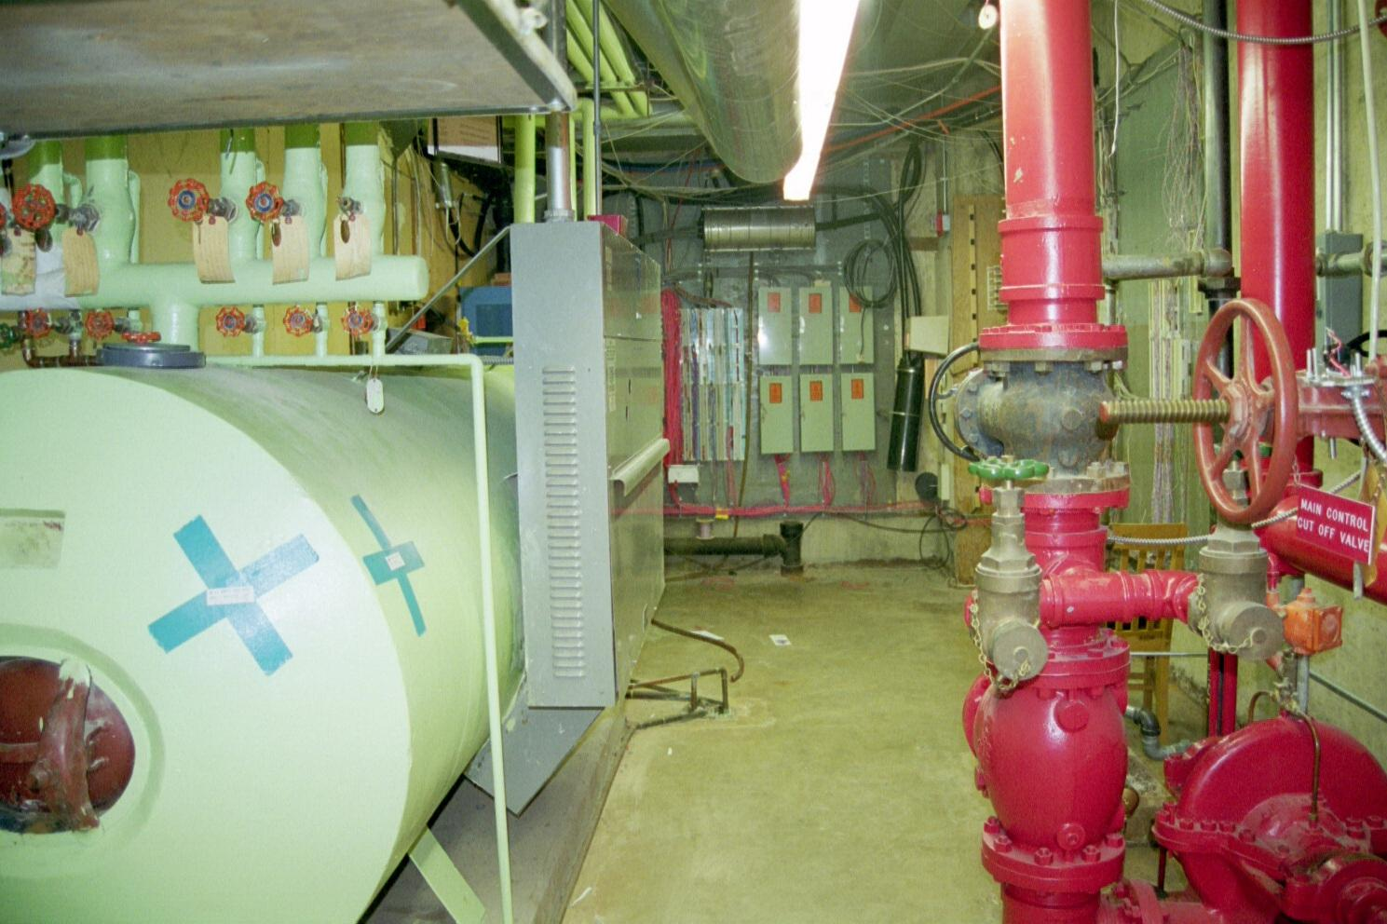
Demarc at a Large Business

Slide 130
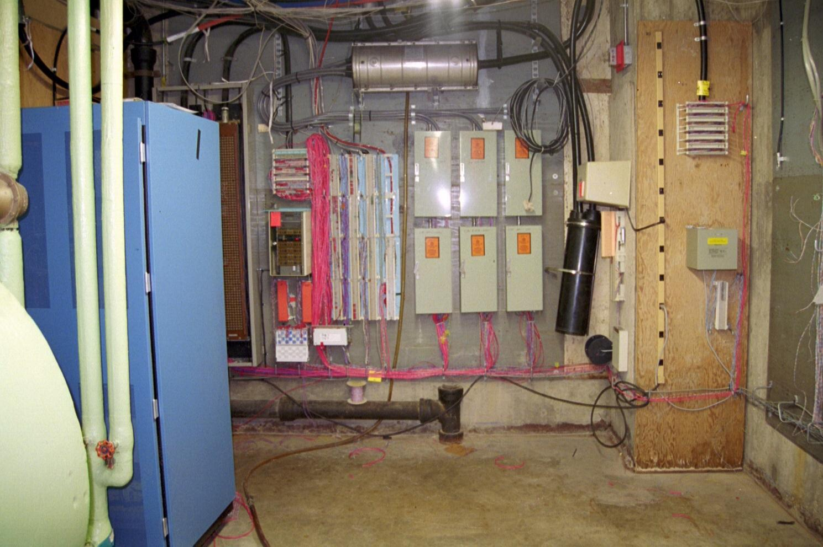
Demarc at a Large Business

Slide 131
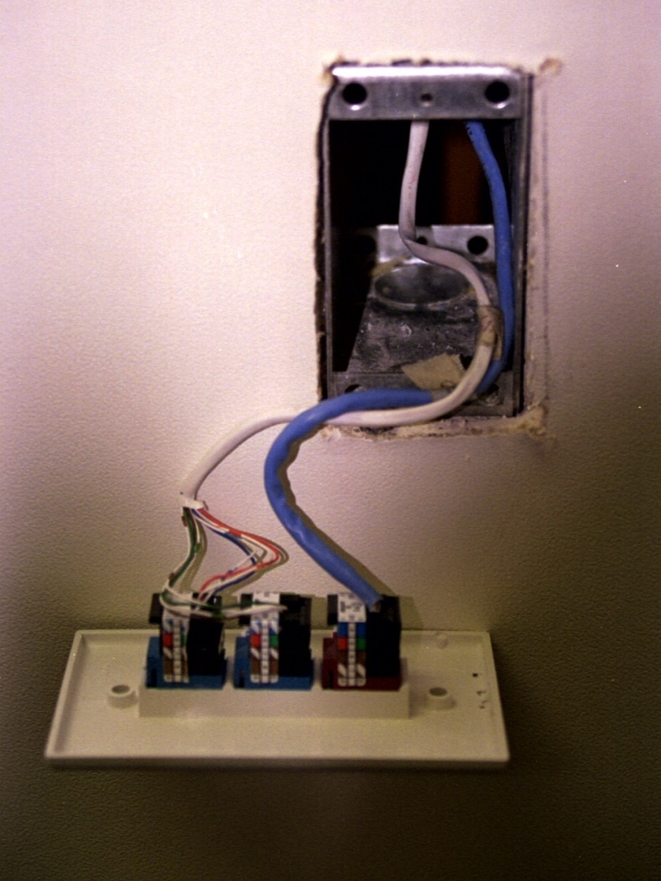
Inside Wiring

Slide 132
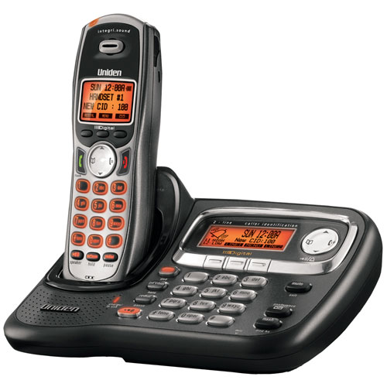
Telephone

Slide 133
Telephone
In conventional telephony, every endpoint - telephone - is an analog transducer set with a touch tone dial-pad or a rotary-dial pulse wheel in the old days
Both touch-tone and rotary phones share support for some variant of FXS signaling

Slide 134
CPE Signaling Methods
FXS and FXO Signaling
  FXS - Foreign Exchange Station refers to the signaling used by switch interfaces that serve analog telephones
  An FXS interface is on the switch, with a phone connected to it
  FXO - Foreign Exchange Office refers to the signaling used by telephones or PBX systems
  An FXO interface is on a phone or PBX that is connected to a port at the central office

Slide 135
CPE Signaling Methods
Loop Start Signaling is
  Used to initiate a call on an analog phone by lifting the handset thus closing the loop
  Current creates the sound of the dial-tone in the handset's transducer

Slide 136
CPE Signaling Methods
Channel Associated Signaling is
  A digital cousin of FXS and FXO that uses an in-band or robbed-bit approach
  Also called channel associated signaling, or CAS robbed-bit means that a portion of the digital bit stream normally used for sound transmission is allocated for signaling
  Unless you use channel banks extensively, you're unlikely to encounter CAS

Slide 137
Lines and Line Appearances
There are two ways to refer to voice channels on each phone
  A line is a physical connection to the PBX, a single voice circuit that is capable of carrying one concurrent phone call
  A line appearance, conversely, is the one concurrent phone call

Slide 138
Lines and Line Appearances
For example from a PBX subscriber's phone, you may dial extension 101, put that call on hold, dial extension 102, put that call on hold, dial extension 103, put that call on hold, and then switch back and forth among them
Three line appearances, one phone, one line to that phone from the PBX

Slide 139
FXS Analog Endpoints
The VOIP systems we will be working with require additional interfacing in order to use analog phones
SoftPBX vendors support analog endpoints with FXS signaling using an
  Analog telephone adapter
    ATAs usually have one RJ11 port, for the phone, and one RJ45 port, for the Ethernet switch
    These digitize and encode packets as needed to use the analog phone in a VOIP environment

Slide 140
FXS Analog Endpoints
  Outboard analog media gateway
    This is a device that serves the same purpose as an ATA, but allows more than one analog phone to be used
    It may also have some built-in call-routing functionality
  Onboard analog media interface
    This is an interface port on the softPBX server itself that allows for direct connection of a single analog phone

Slide 141
Digital Endpoints
Digital phones are functionally similar to analog phones
Their digital connection is carried on two pairs of copper instead of a single loop

Slide 142
Managing Multiple Lines
When the end user needs more than one or two phone lines a device is needed to manage these lines
For a small concern a key system is used
For larger organizations a PBX is used

Slide 143
Key System
This key system or KTS is used to share a group of telephone company POTS lines
  Each phone has several lines coming in to it
  Buttons are used to select a line
  It allows a single operator to place a call on hold while answering a call on another line

Slide 144
PBX
PBX – Private Branch Exchange
  Used by large businesses
  It is a small version of a telephone company switch
  Phones connect to the PBX
  Internal calls don’t need access to external telephone lines
  Public lines connect to the PBX for external access

Slide 145
Ring Groups Hunt Groups
PBXs whether PSTN based or VOIP based have features that make management of the premises easier
For example
  Ring groups allow two or more phones to ring simultaneously when a call is incoming
  Once answered on any phone in the ring group, the ringing stops

Slide 146
Ring Groups Hunt Groups
  Private hunt groups are more advanced ring groups
  Sequential hunt groups seek the next available channel from a list

Slide 147
Ring Groups Hunt Groups
  RNA - Ring No Answer hunt groups roll the call to the next channel when there's no answer on the first phone, in addition to when that first phone is in a call
  Simultaneous hunt groups may ring all phones simultaneously, like a ring group, but only when a lead phone is busy on a call

Slide 148
Dial Plan
A dial plan is set of rules that governs the call-routing behavior of a PBX
Generally they describe
  How phones are uniquely identified on the network, usually through extension numbers
  How to connect calls based on the caller's DTMF digits
  How to connect or restrict calls based on their origin

Slide 149
Dial Plan
  What effects the origin of a call has on its priority
  How to group phones together for common applications, such as group ring or hunt groups
While the principle of dial plan design and capabilities are more or less universal, the platform specific implementations of a dial plan can be vastly different in structure

Slide 150
Dial Plan
With a traditional PBX, phones are called extensions
Connections to the phone company are called dial tone trunks
Connections to other private PBXs are called private trunks
Typically the terminology is applied the same way in a VOIP network

Slide 151
Dial Plan
Many of the same considerations have to be made when creating a dial plan
  How many phones will there be in the network
  Does the extension number allow for enough digits for all of them
  Will phone users dial a special digit, such as 8 or 9, at the beginning of PSTN bound calls, or will the phone system just figure out how to route their calls

Slide 152
Dial Plan
  Will calling between private switches be possible
  Will extension numbers be based on a mitigating or symbolic convention, such as the organizational location of the phone or a desire to match a particular user's DID phone number
  Will each user's voice mail box number match her extension number

Slide 153
Dial Plan
  Will calls routed from a particular user to the PSTN always travel the same trunk, or will the trunks be selected randomly when calls are placed

Slide 154
Centrex
All of this Key System and PBX work can be turned over to the service provider by signing up for a extra cost service such as Centrex
This offering was designed to curb the need for small businesses to invest in PBX equipment in order to get modern telephony features

Slide 155
Erlang Traffic Engineering
Dial tone trunks are the PSTN pathways of a PBX
Outbound or PSTN bound traffic flows to the dial tone trunks
Inward traffic flows across them to the PBX
Traditional dial-tone trunks can be POTS, Centrex, BRI channels, or PRI DS0 channels

Slide 156
Erlang Traffic Engineering
Having too few trunks means missed calls or busy signals
Having too many trunks means extra expense
In order to achieve a balance the Erlang calculation method is used
An Erlang is a unit of voice traffic

Slide 157
Erlang Traffic Engineering
It is used to balance the cost of trunks against the system's capacity requirements
Each Erlang is equal to the average number of calls to a system in an hour times the average duration of the calls in seconds, divided by the number of seconds in an hour

Slide 158
Erlang Traffic Engineering
For example
  For a system with 120 calls per hour at 250 seconds apiece, the formula is applied like this
  (120 cph x 250 seconds ) / 3,600 = 8.3 Erlangs
The Erlang is a unit of voice traffic, not a unit of physical capacity so, you need a conversion table to correlate the results

Slide 159
Erlang Table
Trunks required | Blocking 1%, Erlangs | Blocking 5%, Erlangs
1 | .01 | .05
2 | .15 | .4
3 | .5 | .9
4 | .9 | 1.5
5 | 1.4 | 2.2
6 | 1.9 | 3.0
7 | 2.5 | 3.7
8 | 3 | 4.5
9 | 3.8 | 5.4
10 | 4.5 | 6.2
11 | 5.2 | 7.1
12 | 5.9 | 8.0
13 | 6.6 | 8.8
14 | 7.4 | 9.7
15 | 8.1 | 10.6
16 | 8.9 | 11.5
17 | 9.7 | 12.5
18 | 10.4 | 13.4
19 | 11.2 | 14.3

Slide 160
DID
Direct inward dial service allows inbound PSTN calls to the PBX to be routed directly to certain private extensions based on the phone number that the caller dialed
Regular POTS lines have an assigned phone number that cannot be changed

Slide 161
DID
DID channels on a PRI can have a different phone number every time they are used to connect an incoming call to the PBX

Slide 162
Extension Numbering Plan
As part of the design process of the internal communication network an extension plan must be developed
It can be based on
  DID – Direct Inward Dialed numbers
    Where the numbers match the DID number given to each phone user
    For example, the DID phone number is 335-1464, then extension would be 1464

Slide 163
Extension Numbering Plan
  Based on geography
    Where the extension number has a geographical significance
    For example
      Extensions 1100-1199 are the Detroit Sales Office
      Extensions 1200-1299 are the Southfield Sales Office
  Based on department
    For example
      Extensions 1000-1199 for Marketing
      Extensions 1200-1299 for Accounting

Slide 164
Extension Numbering Plan
There's no right or wrong way to establish a call-routing scheme unless its complexity or economy make it unmanageable
VOIP networks can be eminently more programmable than the old PBX system

Slide 165
An Example
Let’s look at an example of the PSTN POTS service from the user end to the central office

Slide 166
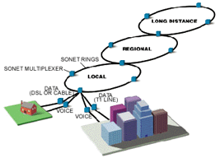
PSTN

Slide 167
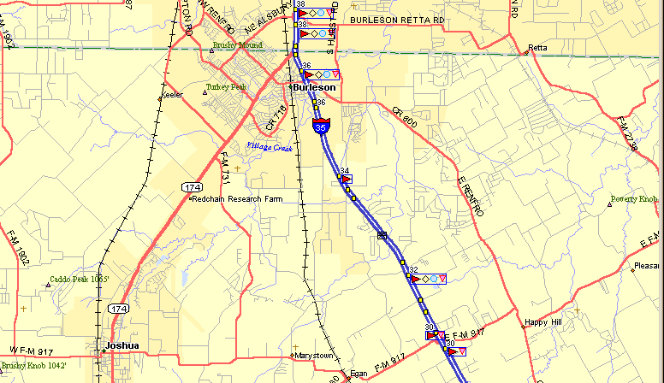
The Last Mile
The service provider’s central office is here
34,000 wire feet away
I am here

Slide 168
Demarc
All of the copper lines from the PSTN to the house come in here

Slide 169
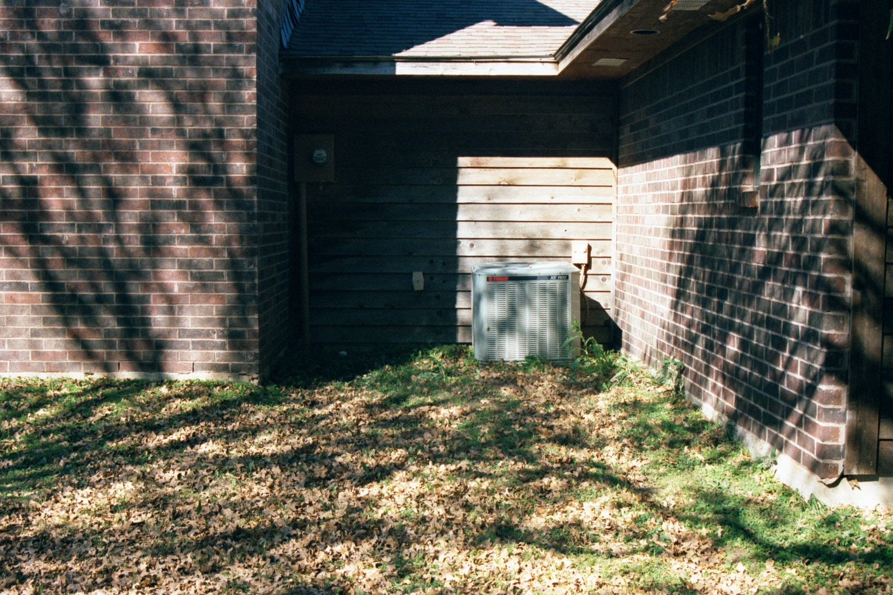
Copper Wire
The copper wires leave the house and cross the yard

Slide 170

Copper Wire
The lines go across the yard underground

Slide 171

Copper Wire
Down the side of the road

Slide 172

Copper Wire
Across the hay field

Slide 173

End User Pedestal
To the connection box

Slide 174
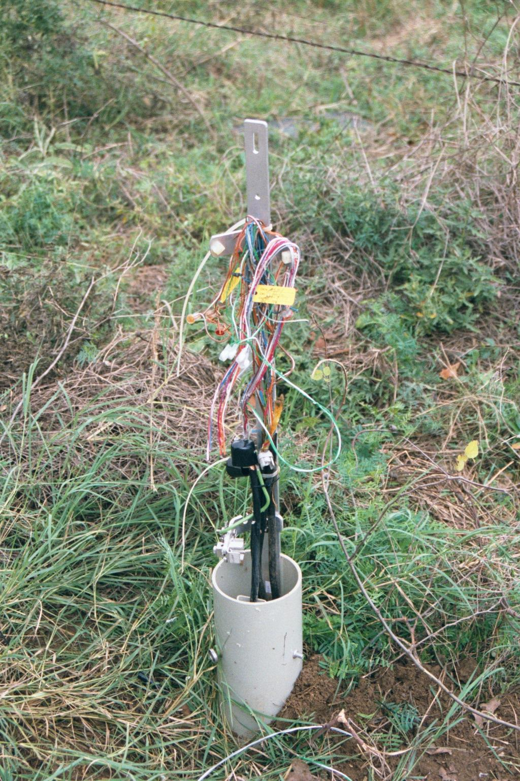
End User Pedestal
The circuit is just a set of copper wires like all the others that serve the house

Slide 175
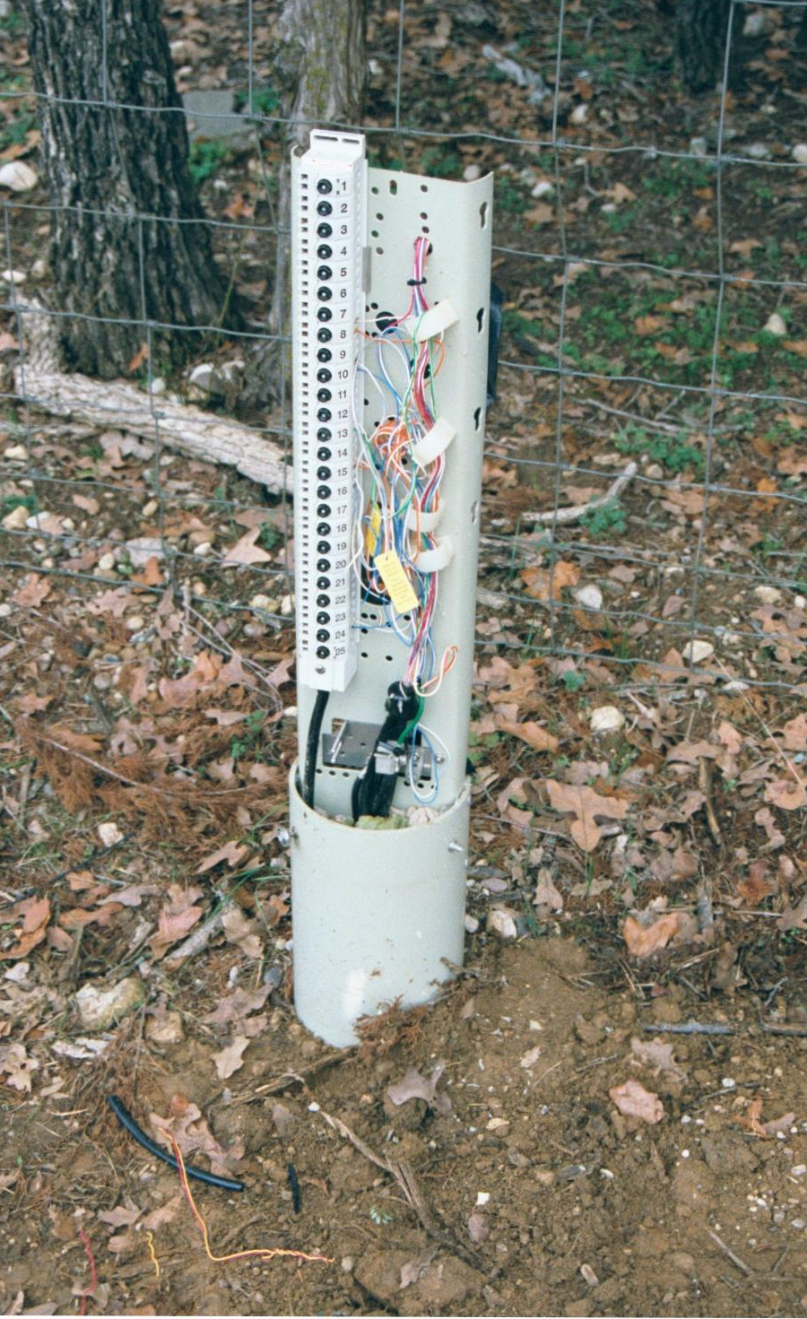
Street Pedestal
The circuit goes across the road to another copper connection post for all the lines in this section of the street

Slide 176
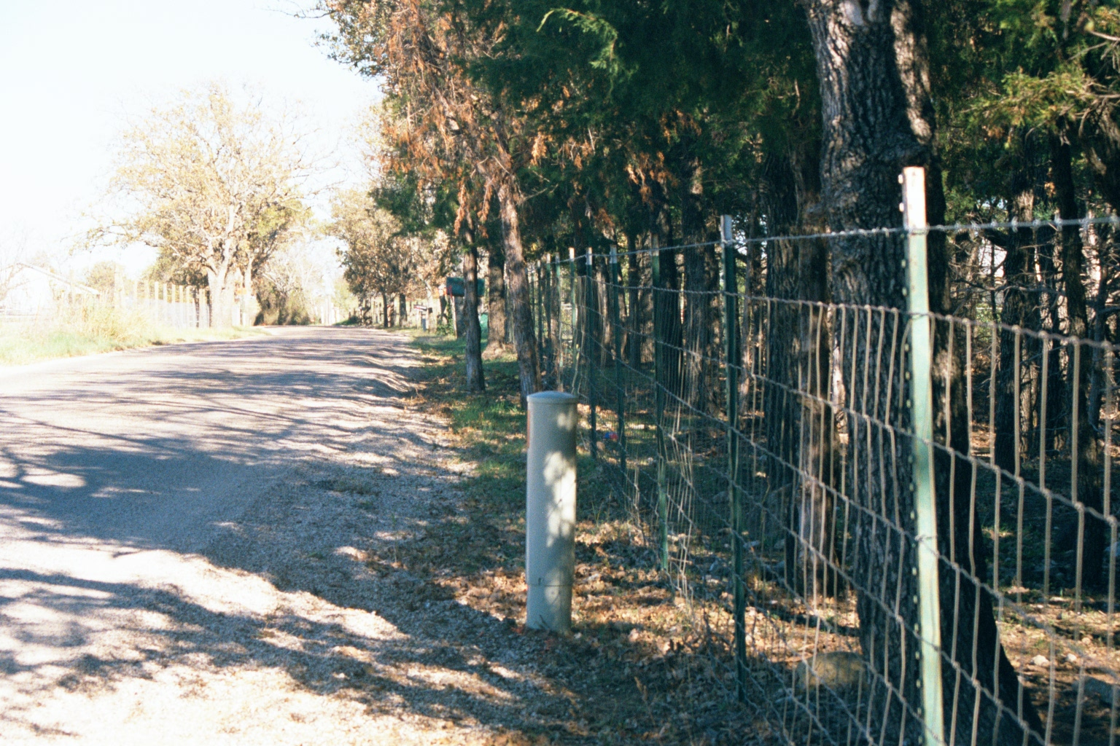
Street Circuit
The copper lines go down the road toward the highway

Slide 177
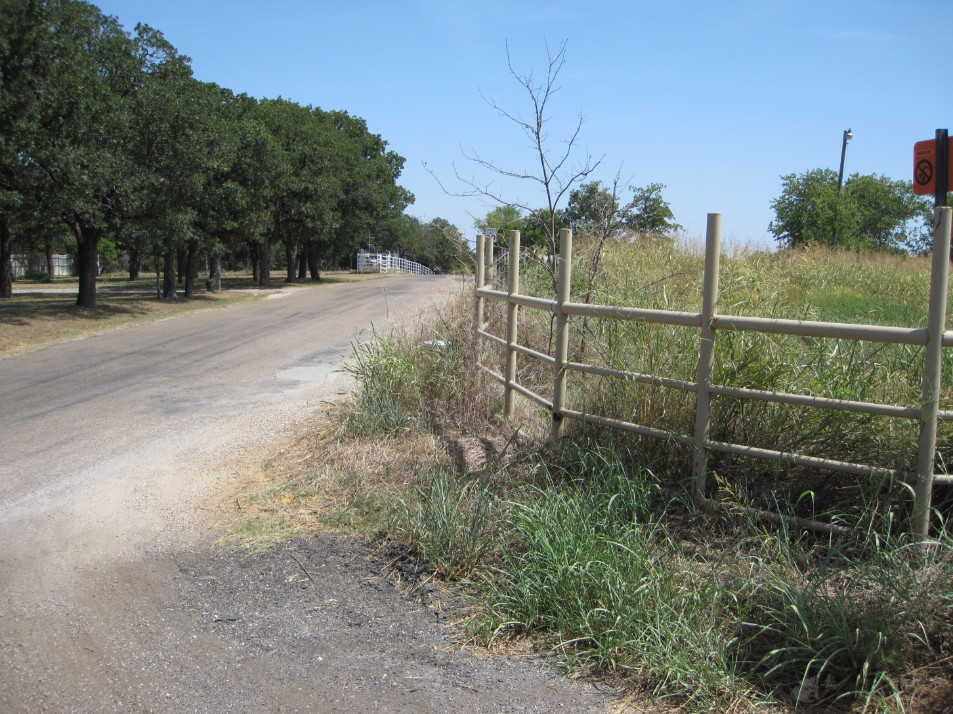
Neighborhood Connection
To the neighborhood connection pedestal where all of the nearby street circuits interconnect

Slide 178
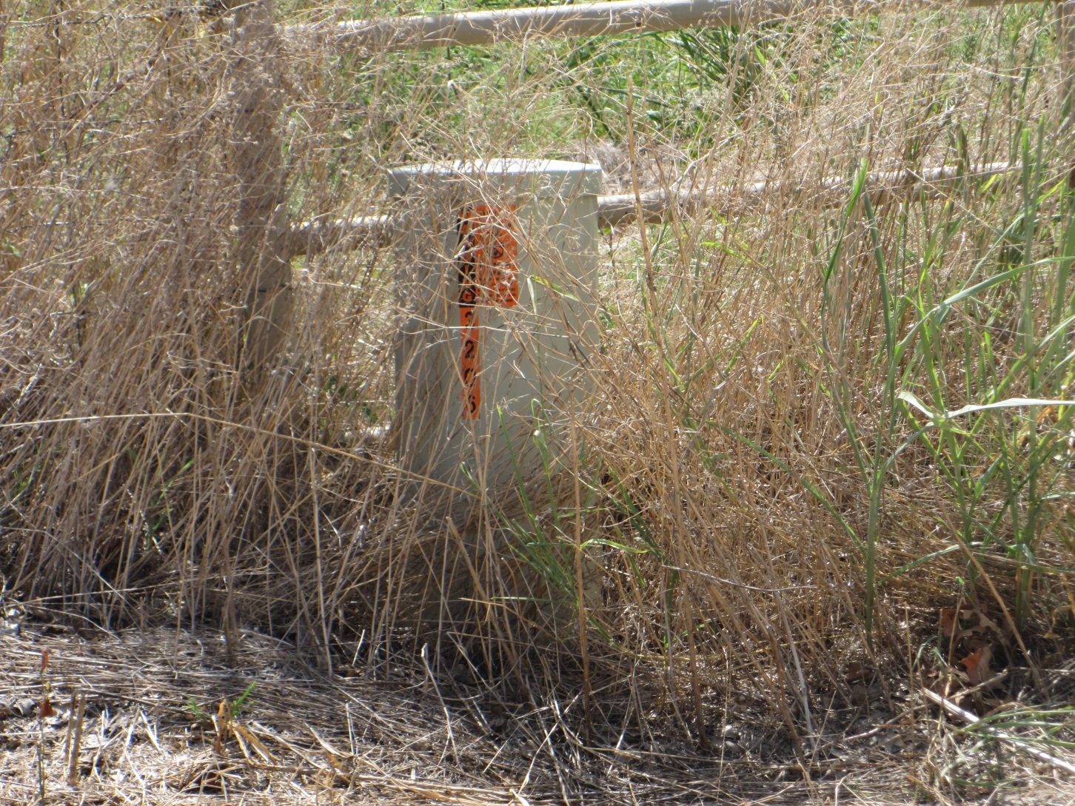
Neighborhood Connection

Slide 179
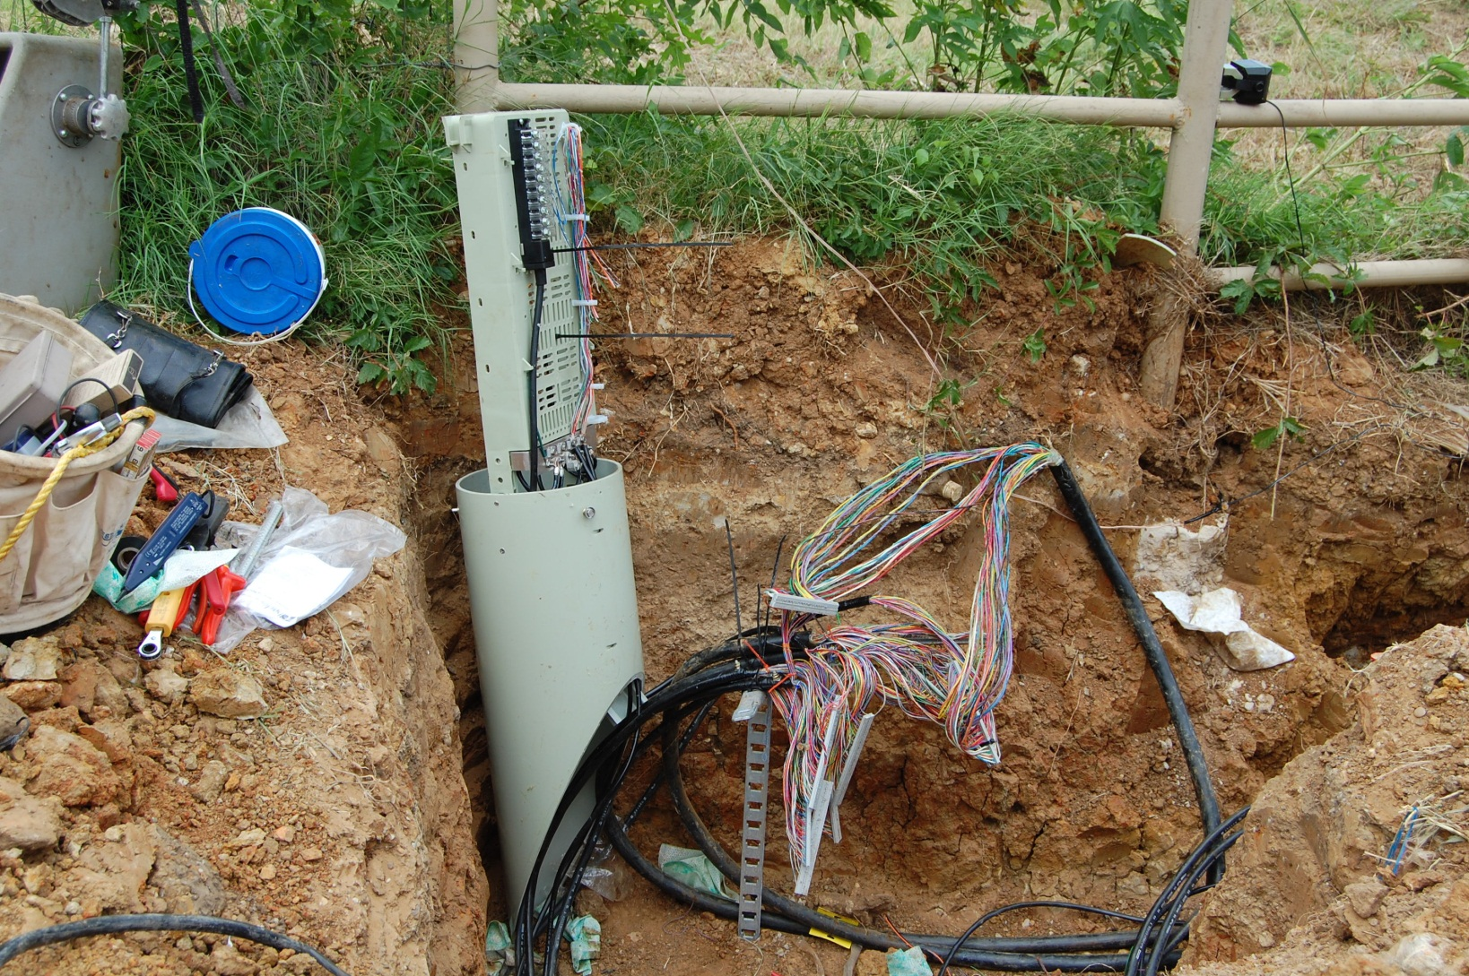
Neighborhood Connection
Here is what it looks like underground

Slide 180
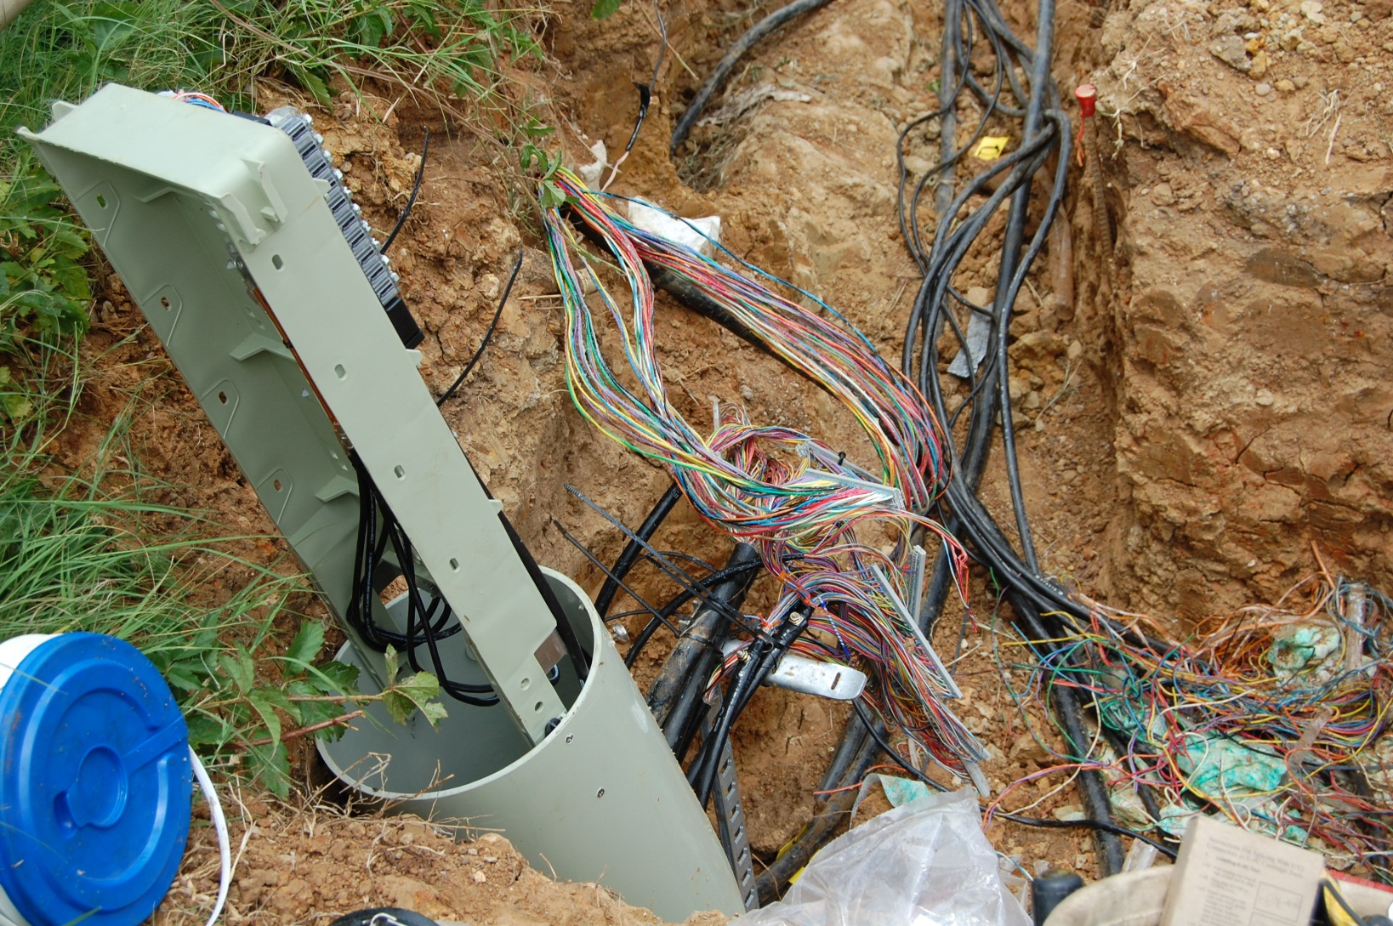
Neighborhood Connection

Slide 181
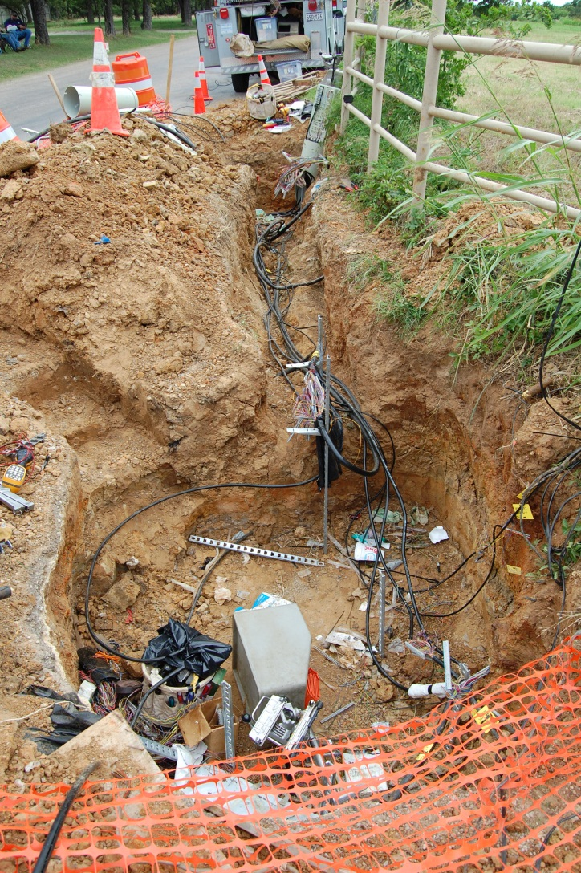
Neighborhood Connection

Slide 182
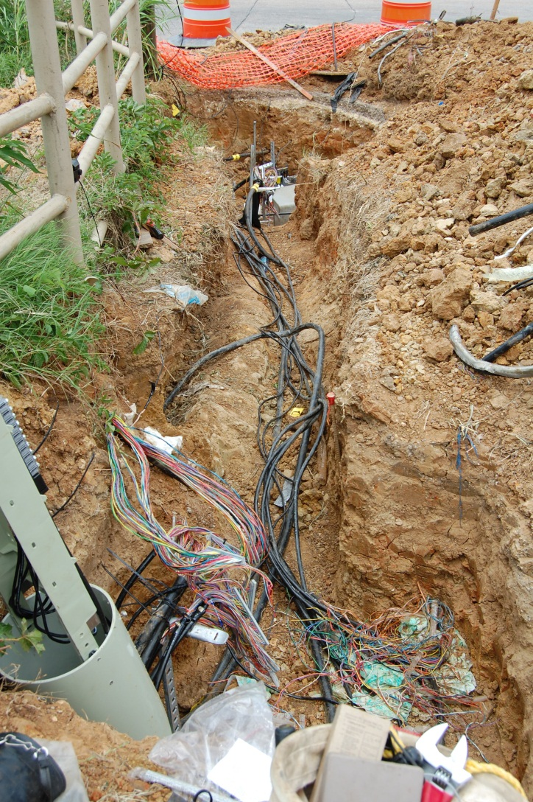
Neighborhood Connection

Slide 183
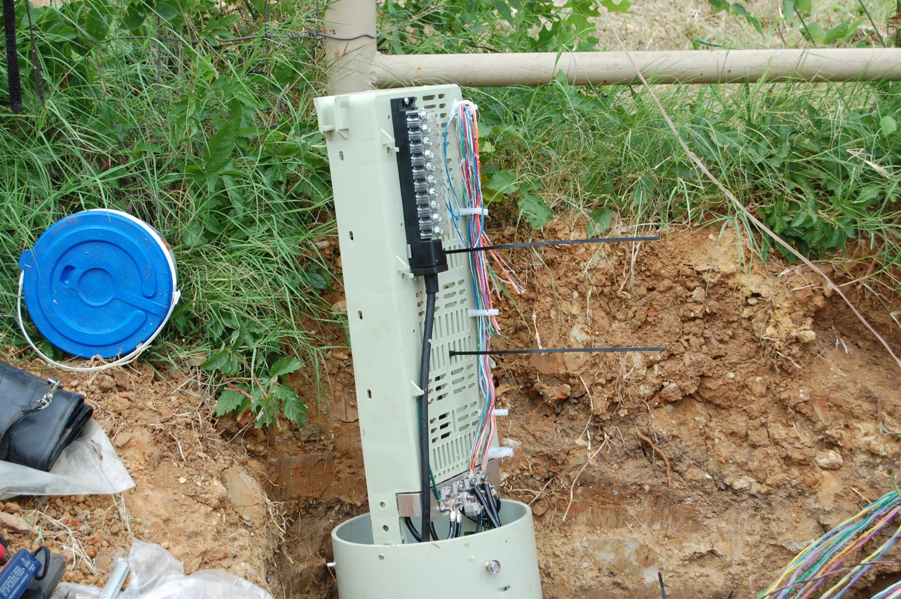
Neighborhood Connection

Slide 184
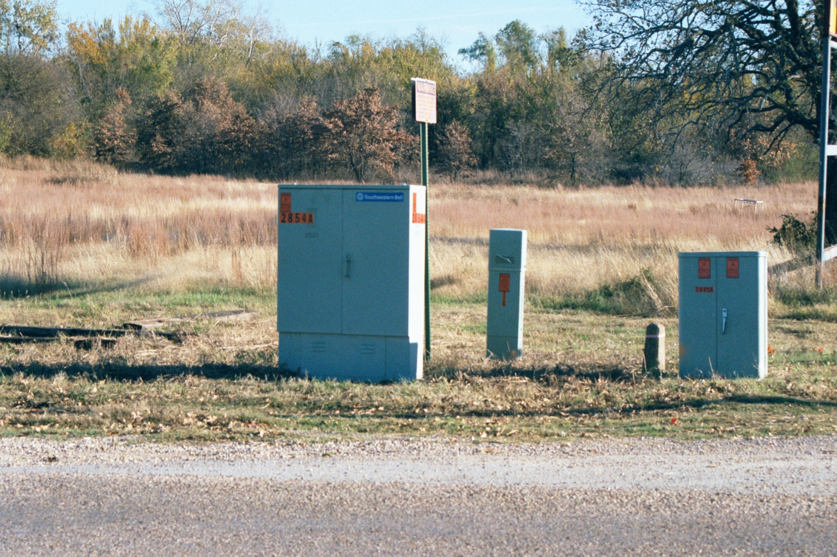
Copper Box
All of the copper lines from these neighborhood pedestals are terminated here in this box

Slide 185
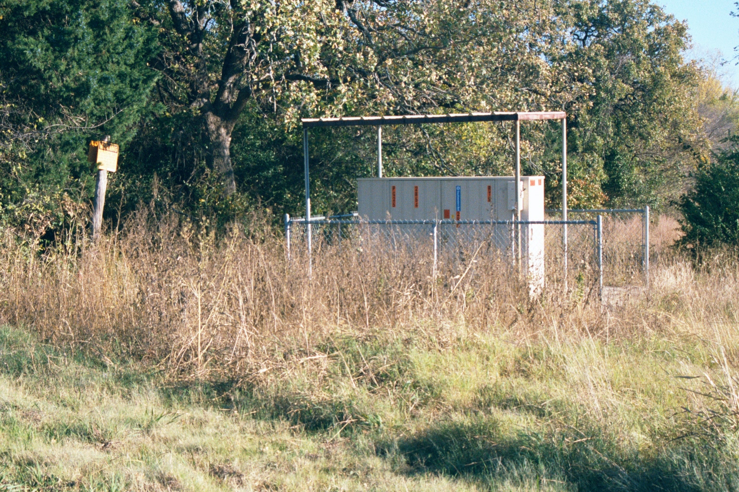
Fiber Box
The copper lines are combined and converted to fiber optic cables in this box

Slide 186
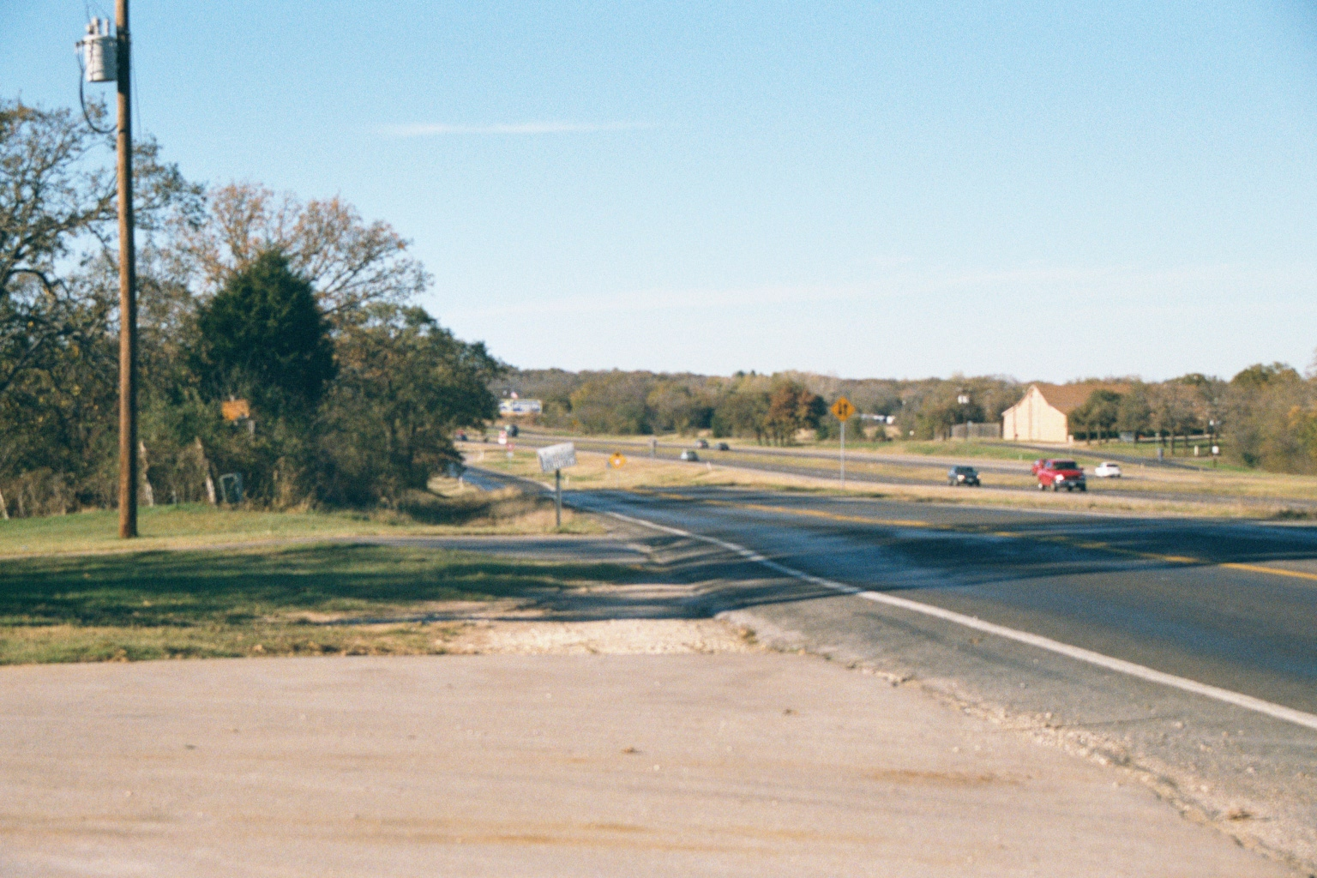
PSTN
The fiber goes down the highway

Slide 187
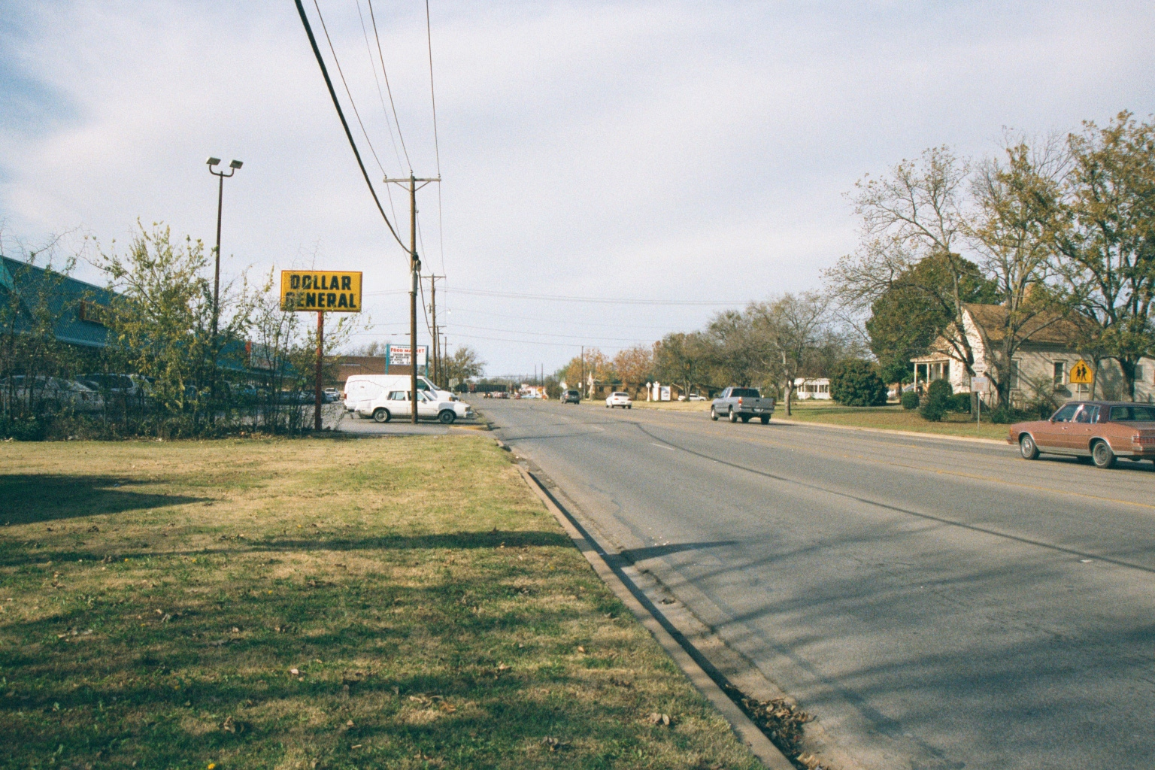
PSTN
In town the fiber leaves the highway and proceeds down the street

Slide 188
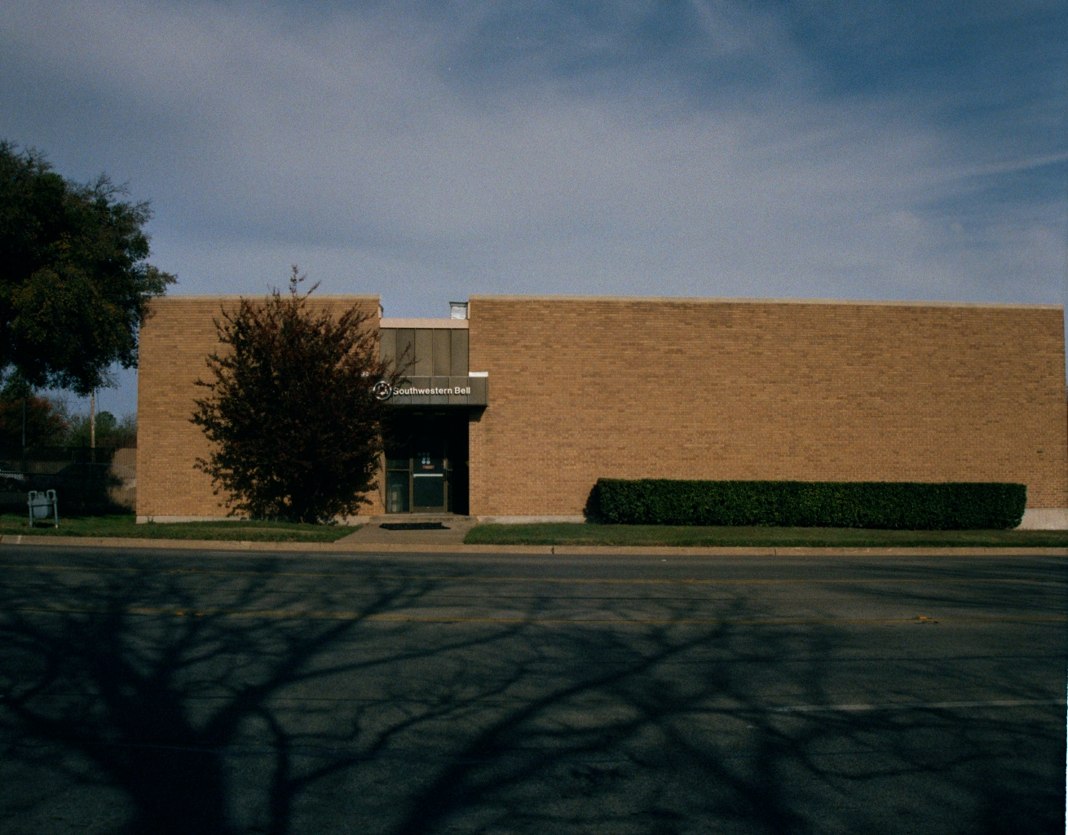
Central Office
To the service provider’s central office

Slide 189
Circuit Switching
The PSTN is based on circuit switching
Circuit switching is characterized by the reservation of bandwidth for the duration of a call
This reservation involves an initial call establishment or set-up phase using signaling messages, and the release of the bandwidth in a call termination or clearing phase at the end of a call

Slide 190
Circuit Switching
In modern digital networks, reserved bandwidth means periodically repeating time slots in time division multiplexed type links
Circuit switching works well for voice calls, for which it is designed
All voice is basically at the same rate of 64 Kbps without compression

Slide 191
Circuit Switching
TDM can easily handle bandwidth reservations of this amount
Also, voice calls require minimal delay between the two parties because excessive delays interfere with interactivity
Circuit switching imposes only propagation delay through the network which is dependent only on the distance

Slide 192
Circuit Switching
Delay is considered one of the important quality of service metrics
There is also minimal information loss, another QoS metric, because the reserved bandwidth avoids interference from other calls

Slide 193
Problems With Circuit Switching
A number of drawbacks to circuit switching are typically cited for data
The first drawback is inefficiency when data is bursty
The reserved bandwidth is wasted during the periods of inactivity
The inefficiency increases with the burstiness of traffic

Slide 194
Problems With Circuit Switching
Another drawback cited for circuit switching is its inflexibility to accommodate data flows of different rates

Slide 195
Packet Switching
IP is connectionless and works a little differently
Instead of carrying a virtual circuit number, IP packets carry a destination address and source address
An IP router examines the destination address and decides on the egress port after consulting a routing table

Slide 196
Packet Switching
The routing table lists the preferred egress port calculated from a routing algorithm that usually selects the least cost route for each destination address
The great advantage of connectionless packet switching is the lack of state in the router

Slide 197
Packet Switching
In connection-oriented packet switching, the switch must keep state or memory of every virtual circuit
A disruption of the switch will necessitate each virtual circuit to be reset, a process that will involve the hosts
In comparison, a disruption of an IP router will cause the dynamic routing protocol to adapt and find new routes

Slide 198
Packet Switching
This will be done automatically within the network without involving the hosts
IP offers a flexible and relatively simple method to accommodate a wide variety of data applications
Whenever data is ready, it is packetized and transmitted into the network

Slide 199
Packet Switching
Routers are easy to deploy and dynamically figure out routes through standard routing protocols
Routers are simple by design, and costs have fallen dramatically with the growth of the Internet

Slide 200
Problems with Packet Switching
The main problem with a packet switched network is providing QoS

Slide 201
Comparison
Circuit v Packet
Reserved v Statistical
Stateful v Stateless
Homogeneous v Heterogeneous
Specialized v Nonspecialized

Slide 202
Sources
Some of the description of the PSTN is copied word for word from a chapter on the PSTN in a Cisco Press book on VOIP
Other parts are copied or based on the book Asterisk The Future of Telephony from O’Reilly by Meggelen, Madsen, and Smith

