Slide 1
NETW-250 PBX Last Update 2013.03.13 1.0.0

Slide 2
PBX
PBXs connect the internal telephones of a private organization inside the building as well as connecting these internal phones to the outside world using trunk lines provided by the ILEC or CLEC
These connections are called extensions
An extension can be a hardphone, fax machine, modem, or any other device

Slide 3
PBX
PBXs are different from key systems in that the users of key systems must manually select their own outgoing lines
PBXs select the outgoing line automatically
Hybrid systems combine features of both
This PBX function can be outsourced, such as the Centrex service from years ago

Slide 4
PBX
It is impossible to buy an old style analog only PBX these days
They are still being used and will be for quite some time, but new ones are just not being sold anymore
The nearest you can get is a hybrid system that supports PSTN and VOIP

Slide 5
PBX
Panasonic was a long time suppler of these systems
Even they have changed their pitch to unified communications as seen on their web site

Slide 6
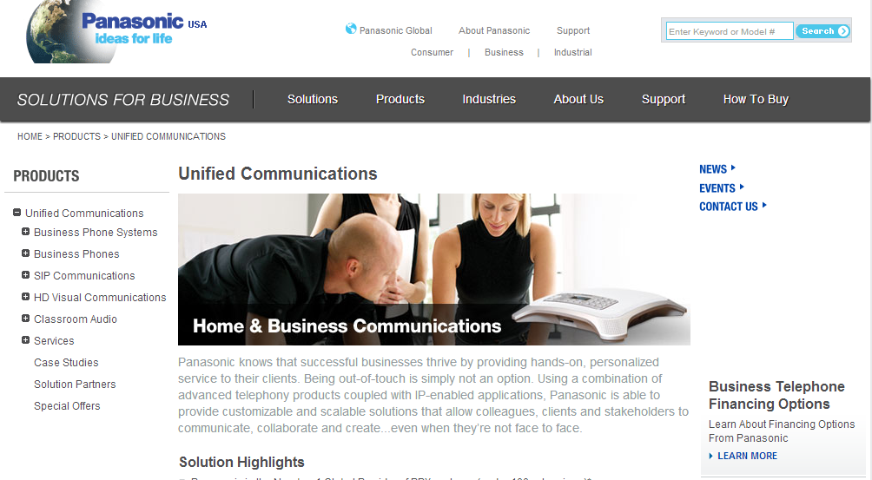
PBX

Slide 7
PBX
Here is their current highend system

Slide 8
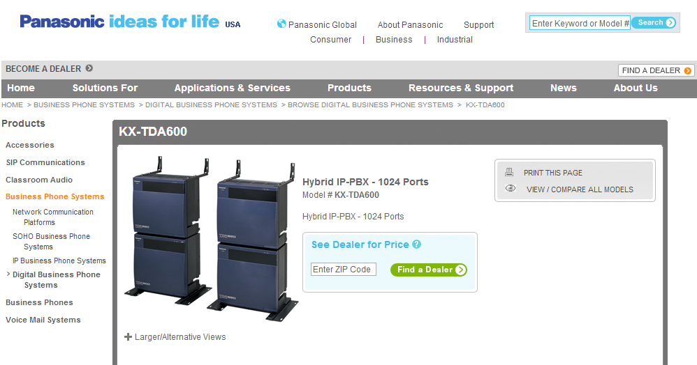
PBX

Slide 9
PBX

Slide 10
PBX

Slide 11
PBX
Notice that this system supports up to 640 analog lines and 960 phones

Slide 12
Nortel
At one time Nortel was by far the most popular highend large business PBX provider
What happened to them

Slide 13
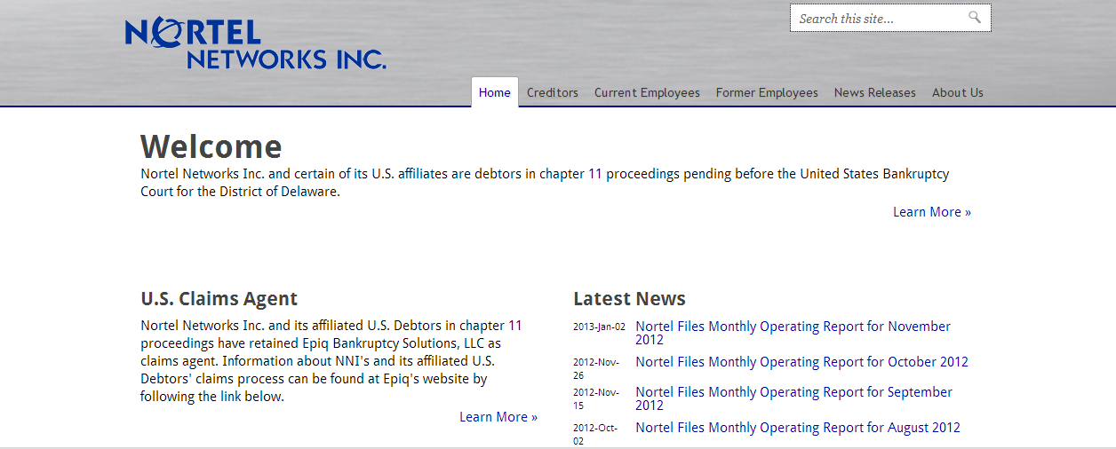
Nortel

Slide 14
Nortel Meridian
Nortel’s claim to fame was their Meridian system
These PBXs could be huge
In a Hilton hotel about 10 years ago I looked at one that took up an entire room about the size of a two car garage
This PBX could handle from 60 to 80,000 lines

Slide 15
Nortel Meridian
Wikipedia at least says that
The Meridian has 43 million installed users worldwide, making it the most widely used PBX
The Meridian is one of the few PBX's still available from a major communications supplier that can be configured as non-VOIP PBX

