Slide 1
NETW-250
Outsourcing Telephony
Last Update 2014.10.08
1.1.1

Slide 2
Outsourcing Telephony
If setting up your own telephone system does not seem like the way to go, then you can always outsource it to someone else
This could be a VAR – Value Added Reseller who will work with you to select one of the solutions we have just talked about using an open source, Cisco, Avaya, Panasonic, or any number of other vendor's solutions

Slide 3
Outsourcing Telephony
They will set it up and manage
All for a fee of course

Slide 4
Outsourcing Telephony
Another way to outsource this is to let a company provide it you as a service
This is service through the cloud as it is termed these days
For example, Digium offers an open source based telephony service and AT&T offers a service based on proprietary systems
Let’s look at these

Slide 5
Open Source
Digium offers a service called Switchvox Cloud
Here is what an article from Network World dated 11 March 2013 said about this service

Slide 6
Open Source
  Digium announced it is now offering "Switchvox Cloud," a hosted version of the company's phone system, targeting small and midsize business (SMB) customers who want enterprise-class features at a price they can afford
  Digium is a primary developer and sponsor of the Asterisk project, using open source software to provide unified communications

Slide 7
Open Source
  Digium's Switchvox Cloud provides the same unified communications (UC) features and flexibility offered with its on-premises system, but with the inherent benefits of a hosted offering
  The service is available with a month-to-month payment plan, helping businesses manage their budgets by avoiding capital expenditures and a maintenance-free business phone system

Slide 8
Open Source
  Switchvox Cloud comes with unlimited local and long distance minutes, local DID, unlimited extension-to-extension dialing, and HD voice; UC features are included for the same monthly price on a per-user basis features with no additional licensing fees or add-on charges
  Prices range from $29/user per month with a three-year contract up to $35/user per month with a month-to-month, no-obligation contract

Slide 9
Open Source
  Fixed mobile convergence (FMC) is included with the offer, as are other features like voice mail, chat, presence, call queues, advanced IVRs, conferencing on-demand recording and integration with external systems like Salesforce.com

Slide 10
AT&T
AT&T offers a service for larger companies
Here is what their literature says about it
  Cloud-Based IP Telephony as a Service scale with ease to meet dynamic business needs
  Add new communications features on the fly
  As your business grows, AT&T makes it easy to stay connected and productive

Slide 11
AT&T
  Reach for the AT&T cloud and rethink what’s possible while you also bring the cost and complexity of unified communications down to earth
  AT&T cloud services transform the way you deliver communications services to your organization

Slide 12
AT&T
  Unlike on-premises solutions, the unified communications “cloud” gives you access to virtual resources over the global AT&T network
  You purchase communications as a service, not as an asset, and AT&T delivers those services where and when you need them
  This makes scalability easy
  As your business grows and changes, so do your communication needs

Slide 13
AT&T
  AT&T keeps this growth lean, efficient, and effective – not to mention, easy
  AT&T Unified Communications Services (AT&T UC Services) integrates multiple communication and collaboration tools such as IM/chat, email, VoIP calling, web/audio and video conferencing, voicemail, unified messaging and mobility, with presence, behind a single user interface

Slide 14
AT&T
  Accessible from mobile phones, desktops, laptops, and other wired and wireless devices, AT&T UC Services enables real-time communication and collaboration, regardless of your location or device
  Work with team members around the globe on desktops, laptops, landlines, smart phones, and tablets at the same time – almost anywhere or anytime

Slide 15
AT&T
  Offered as a service, AT&T UC Voice helps you control costs and eliminate unpredictable expenditures
  Capital costs can be kept to a minimum with a convenient and reliable monthly subscription-based price model

Slide 16
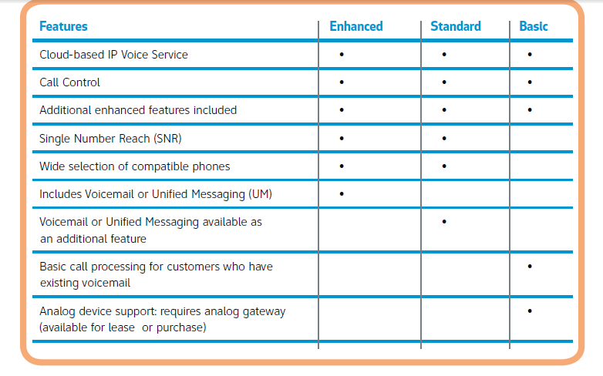
AT&T

Slide 17
Hosted VOIP v PBX VOIP
Columbia Business Products in a 2012 white paper provided a nice discussion of hosted versus on-site VOIP solutions
They note the following
  With Hosted VoIP, an outside company manages our entire phone system
  Your company simply downloads any necessary software to make the system operational and keep it up to date

Slide 18
Hosted VOIP v PBX VOIP
  In addition to any initial setup and activation costs, you will also need to purchase IP telephones for use with Hosted VoIP
  A VoIP PBX setup is a much more elaborate phone system than a Hosted VoIP service, but it is also much more robust
  You can also easily add a VoIP PBX setup to an existing phone system with a VoIP gateway

Slide 19
Hosted VOIP v PBX VOIP
  The main difference between the two types of phone systems lies in the upfront costs, as well as ongoing costs
And they summarize it all with this table

Slide 20
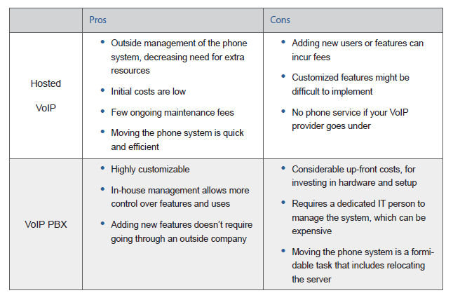
Hosted VOIP v PBX VOIP

