Slide 1
NETW-250
Key Systems
Last Update 2013.03.13
1.0.0

Slide 2
Key Systems
For a small to medium sized organization the traditional telephone solution is to arrange for one or more PSTN analog lines, and then connect them to a key system type of office telephone management system
Let’s look at an example of this type of approach

Slide 3
Panasonic Key System
Panasonic has always been one the major suppliers of key systems
In this example the organization is using a Panasonic Model KX-TA624 key system
They have 5 analog lines and two 800 numbers that connect to the key system
10 phones, one of which is the management phone, connect to these seven lines through the key system

Slide 4
Panasonic Key System
The system was installed about seven years ago
Here are some views of the installation

Slide 5
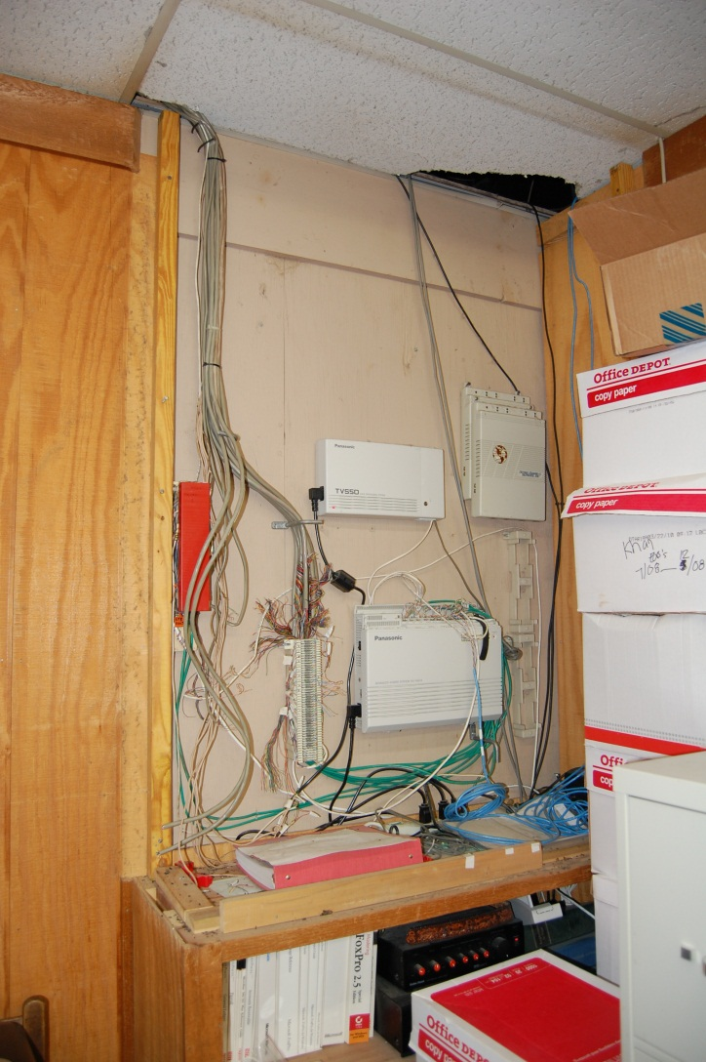
The Entire System

Slide 6
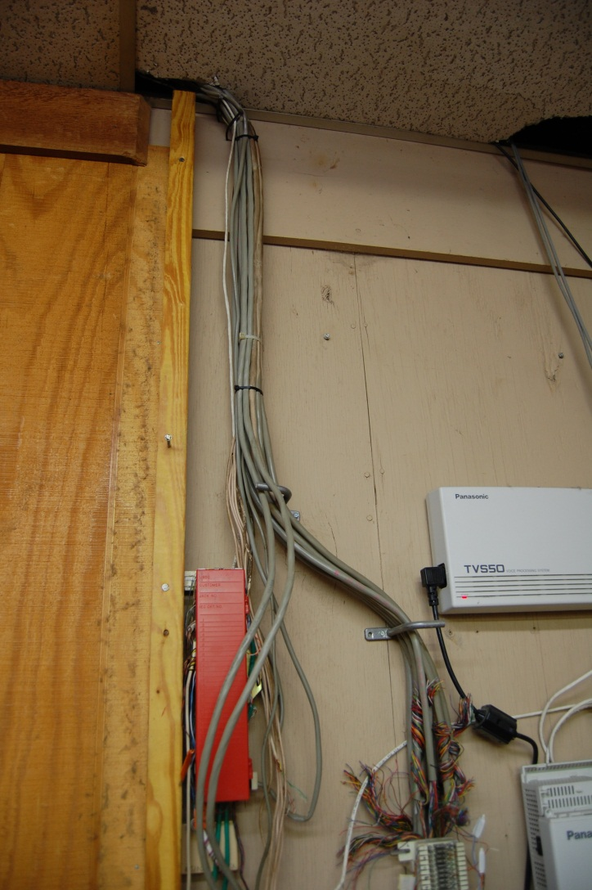
Wiring From Phones and PSTN

Slide 7
66 Punchdown Block
All of the wiring terminates at this 66 connector punchdown block

Slide 8
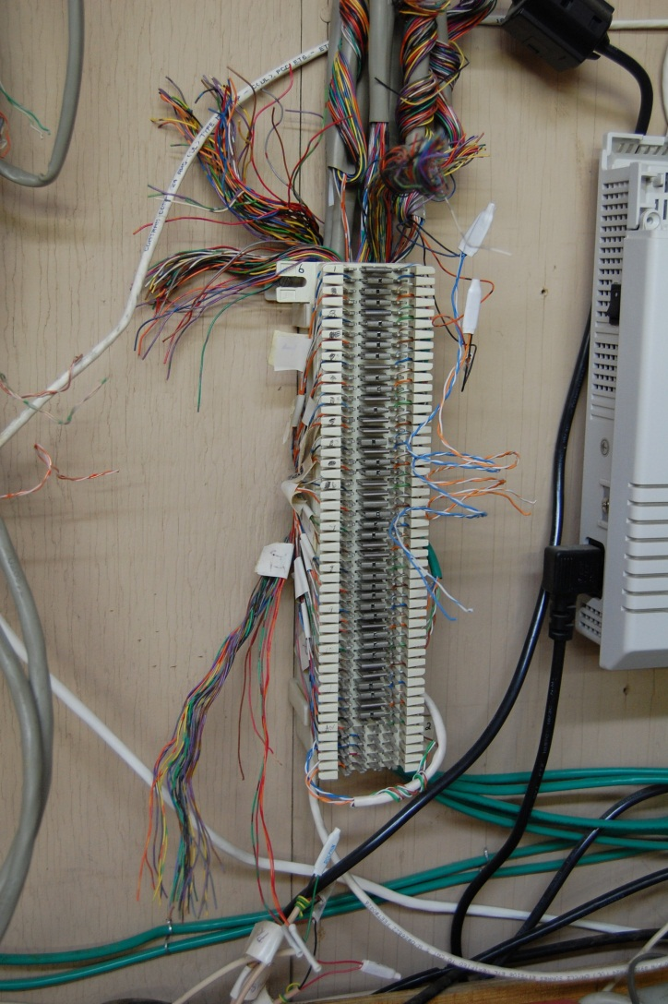
66 Punchdown Block

Slide 9
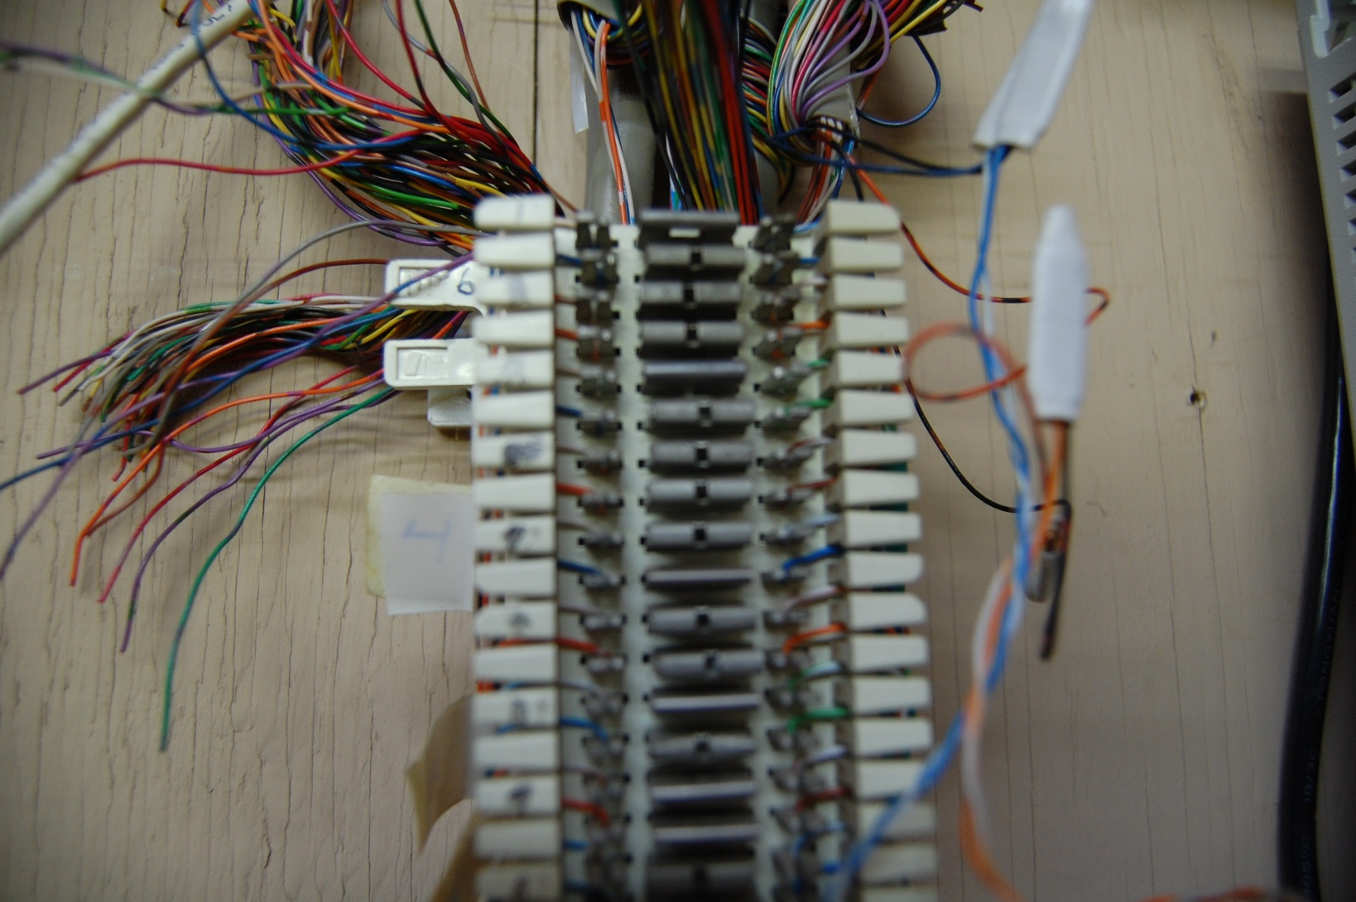
66 Punchdown Block

Slide 10
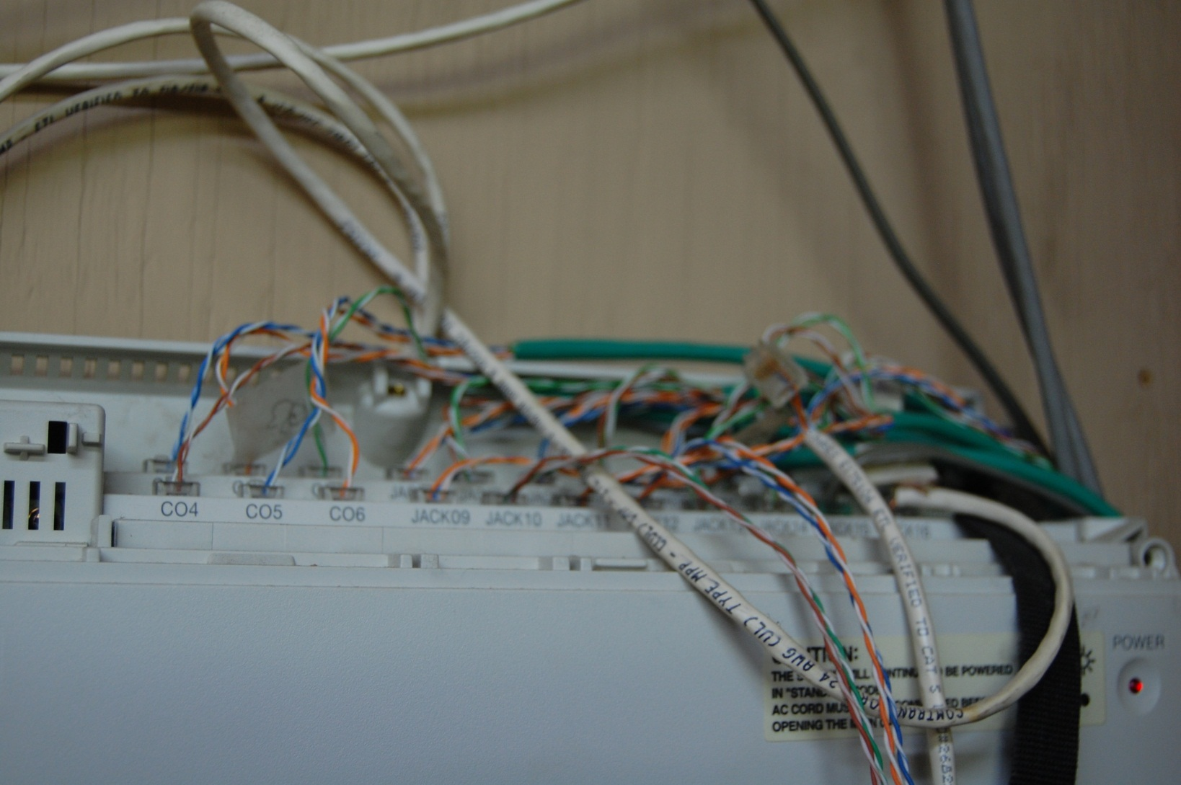
Punchdown to Key System

Slide 11
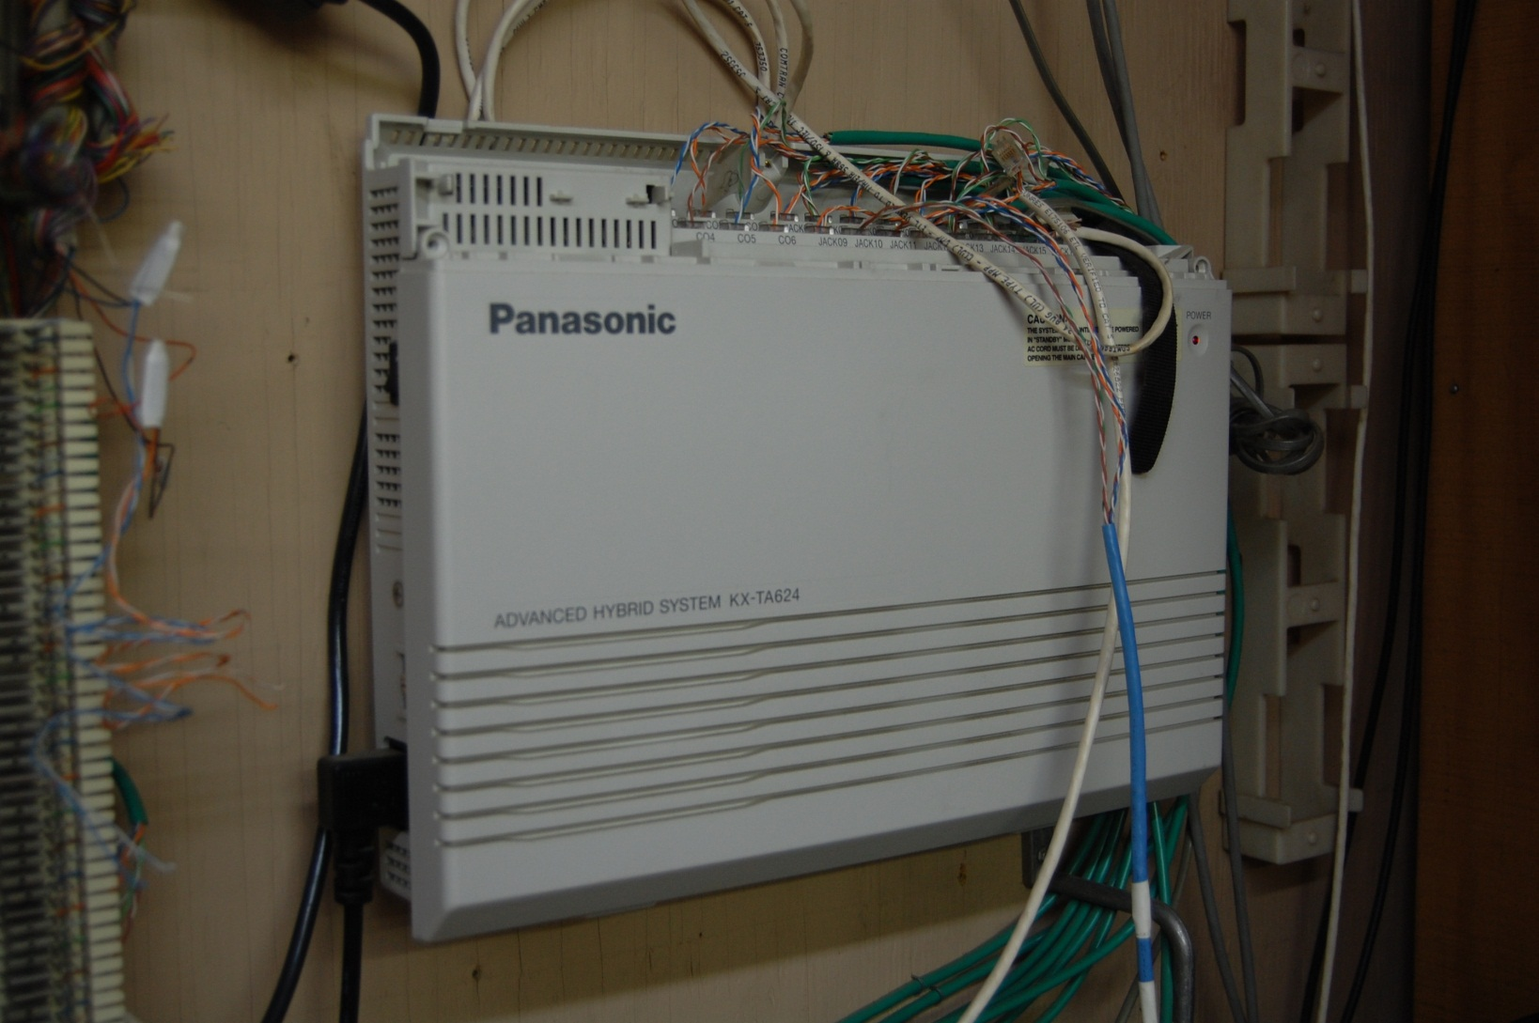
The Key System

Slide 12
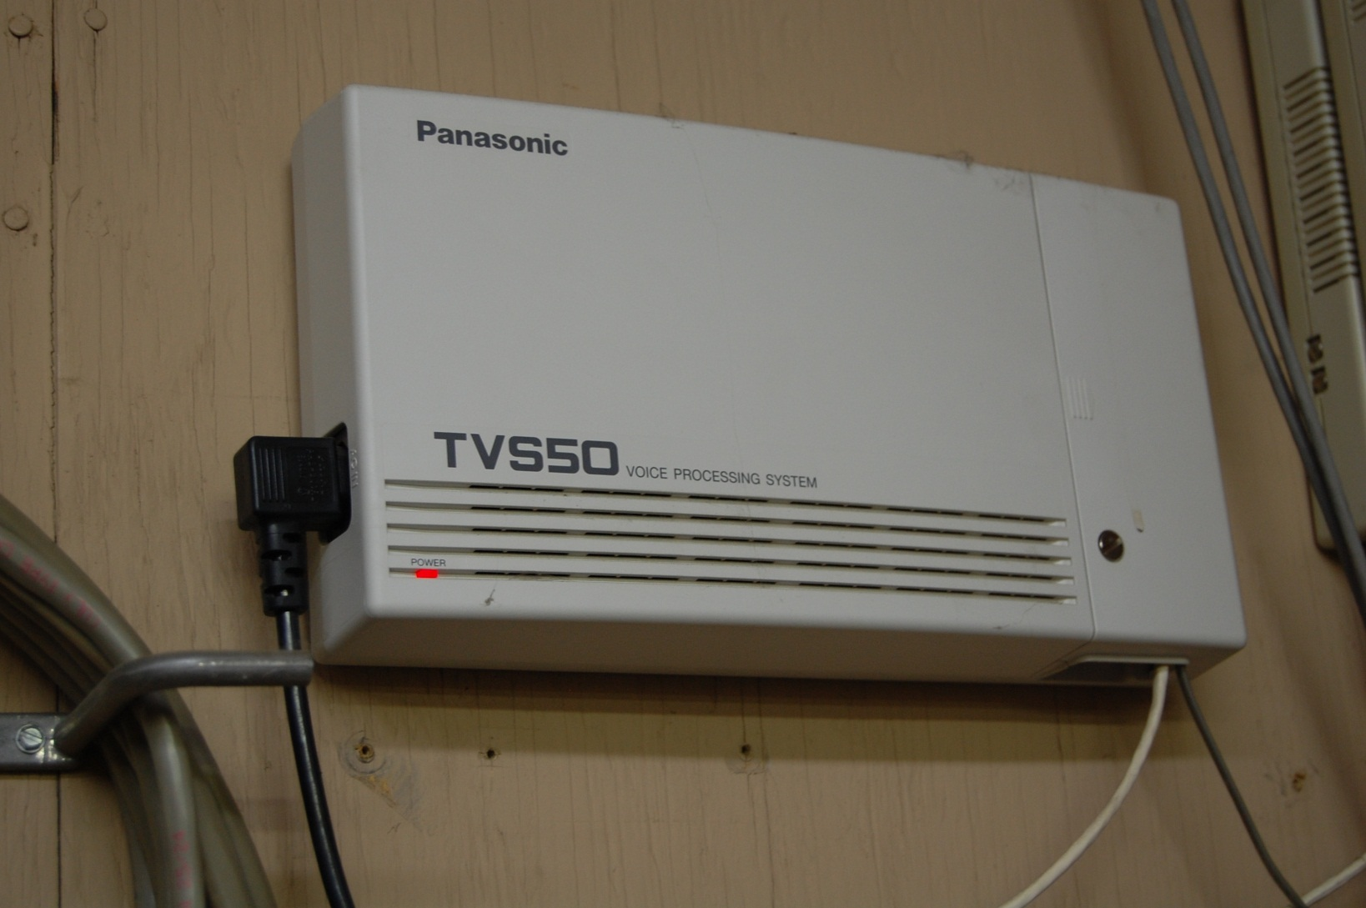
The Voicemail Module

Slide 13
Telephones
The telephone being used is the Panasonic KX-T7020
As Panasonic says this is a
  12 CO line speakerphone telephone
  It can be used with Panasonic KX-T30810, KX-T61610, KX-T123211D, KX-TA624 & KX-TA1232 Hybrid System Control Units
  The phone will also work on Panasonic Digital Hybrid systems KX-TD1232 and KX-TD816

Slide 14
Telephones
  Available in white KX-T702) and black KX-T7020B
  KX-T7000 Series line was discontinued by Panasonic and only refurbished are available

Slide 15

Telephone

Slide 16
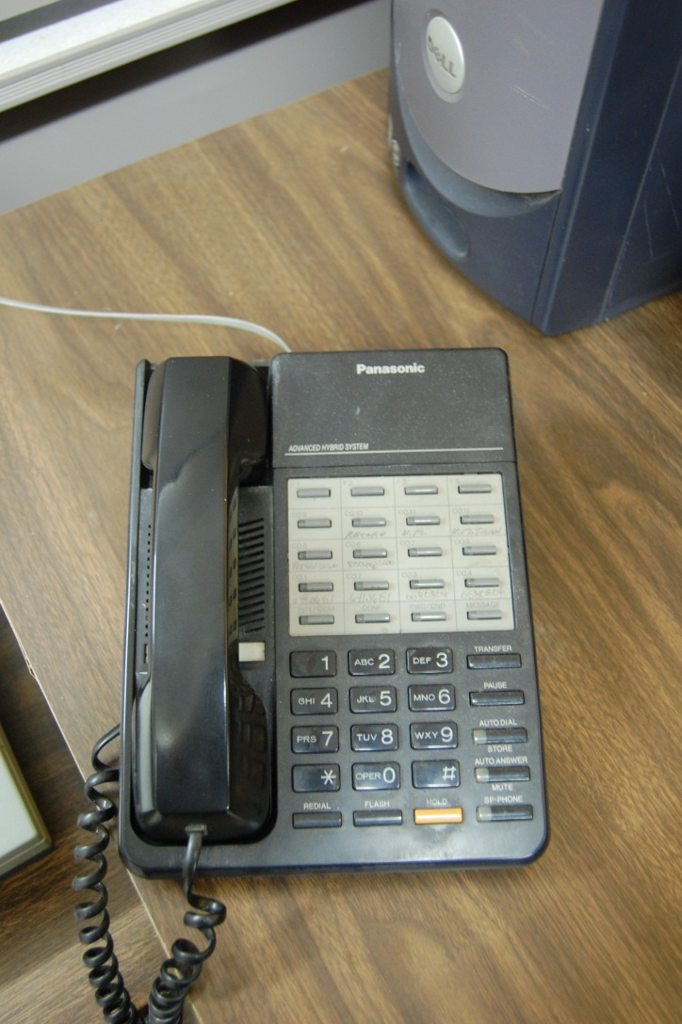
Telephone

Slide 17

Telephone

Slide 18
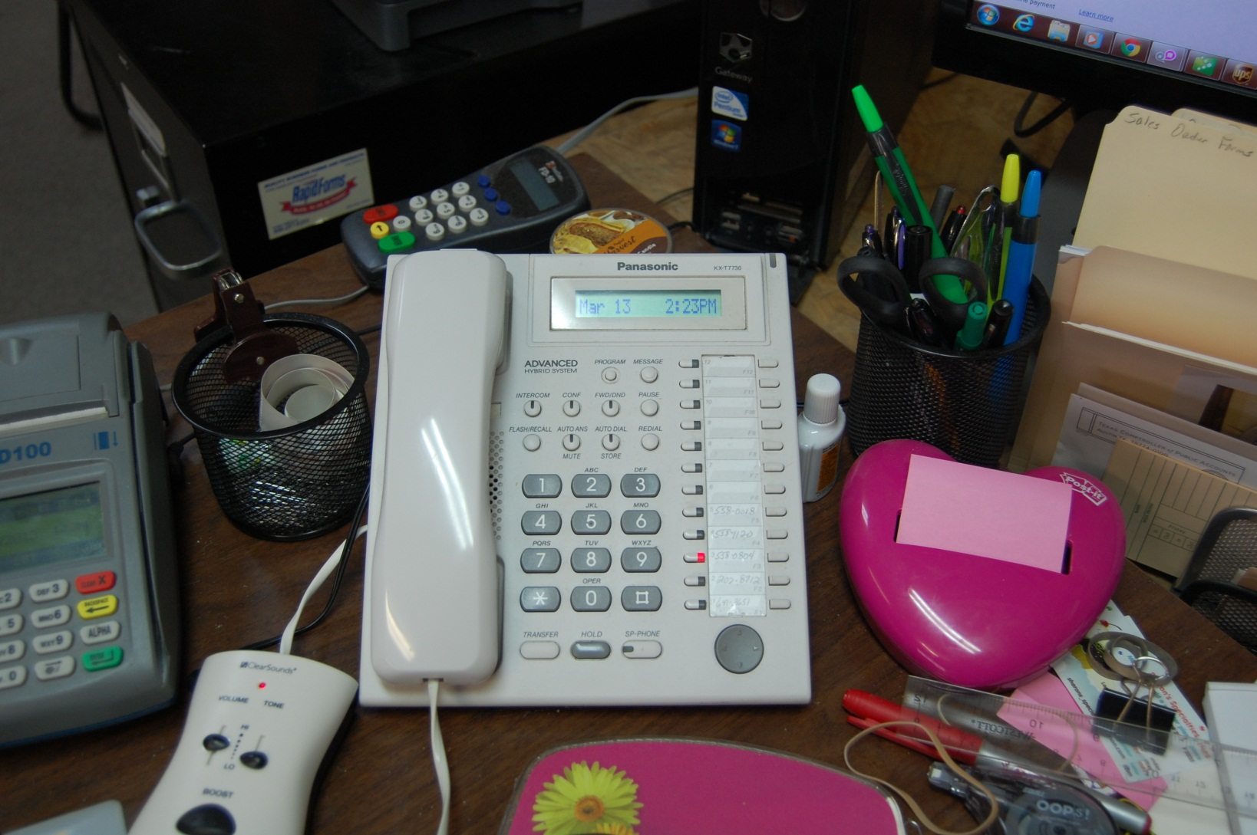
Management Telephone

Slide 19
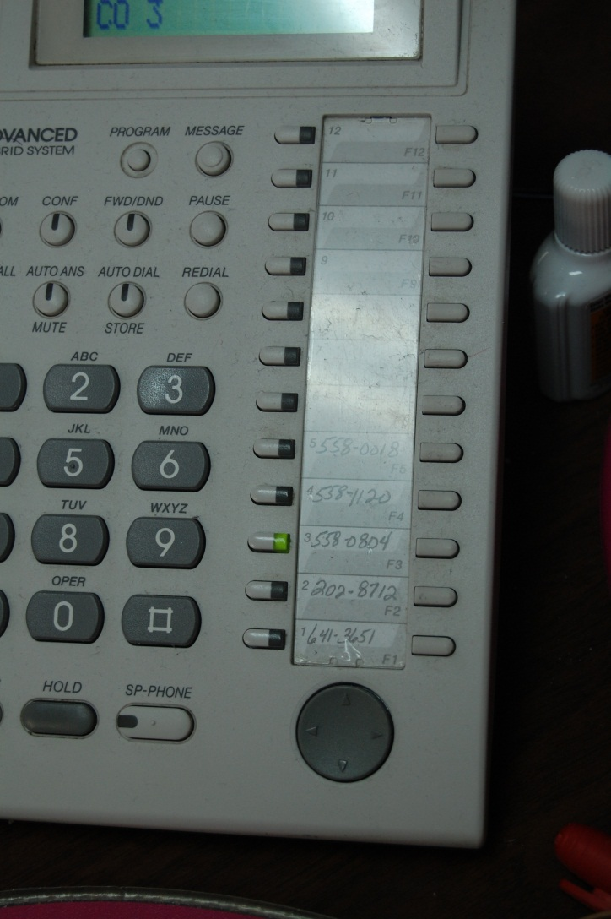
A Call Comes In Green Light

Slide 20
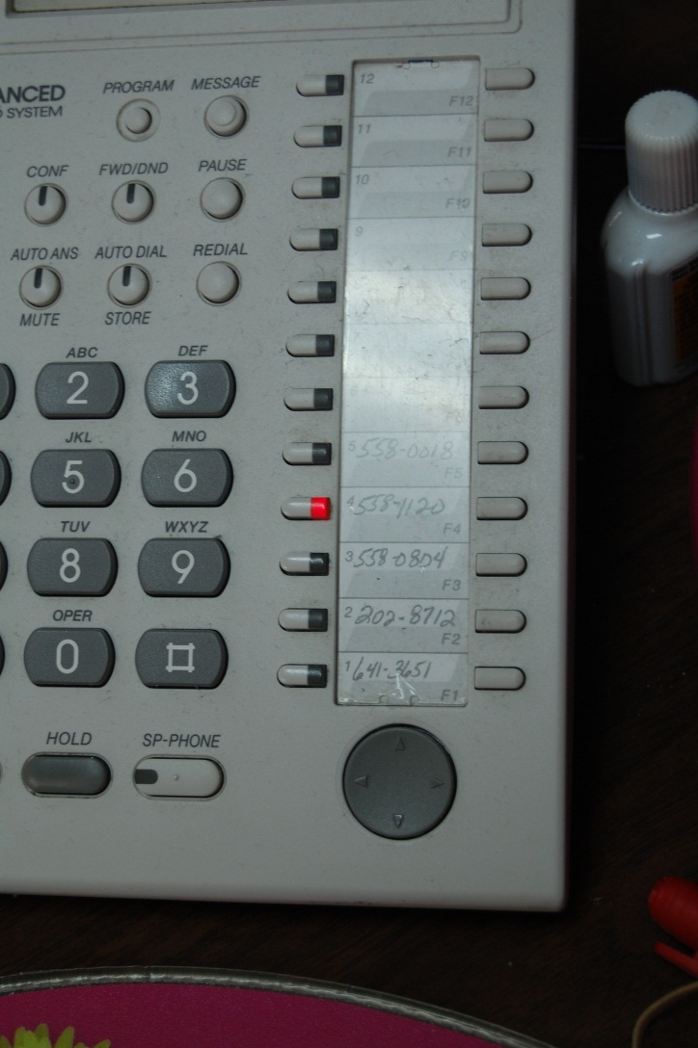
Line in Use Red Light

Slide 21
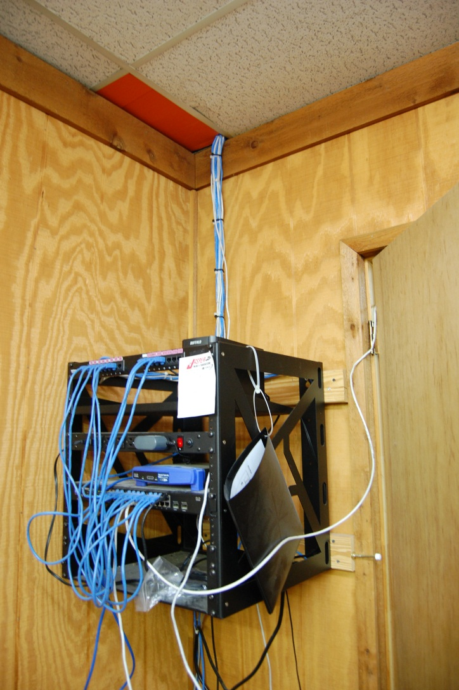
The Data Side of the Network

Slide 22
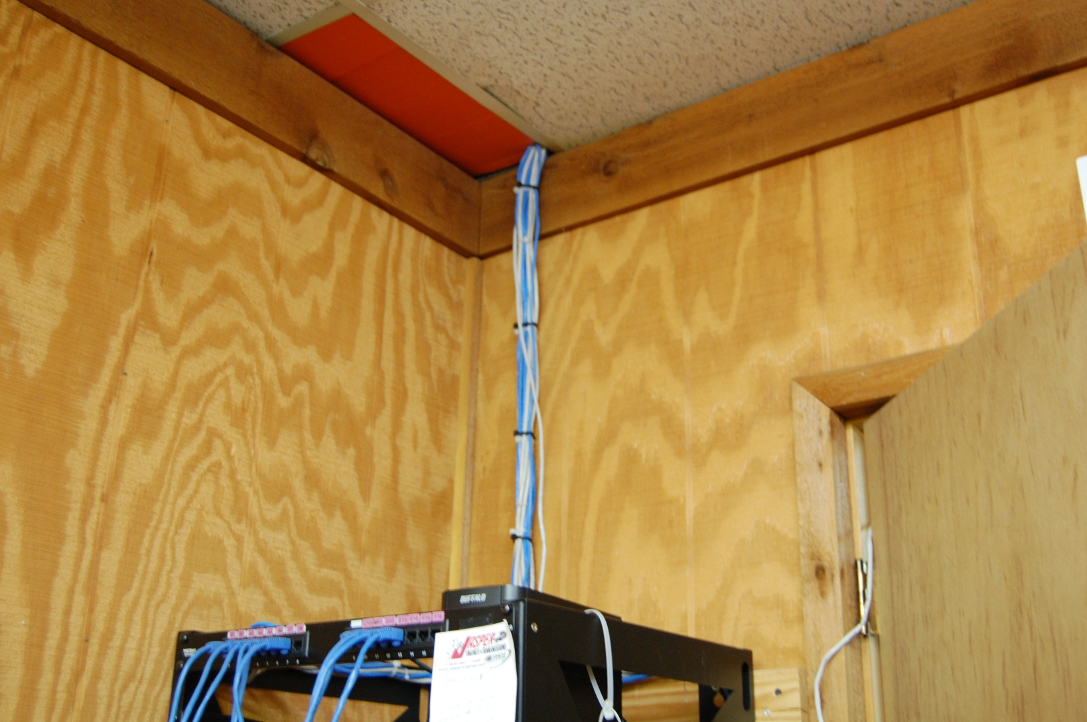
The Data Side of the Network

Slide 23
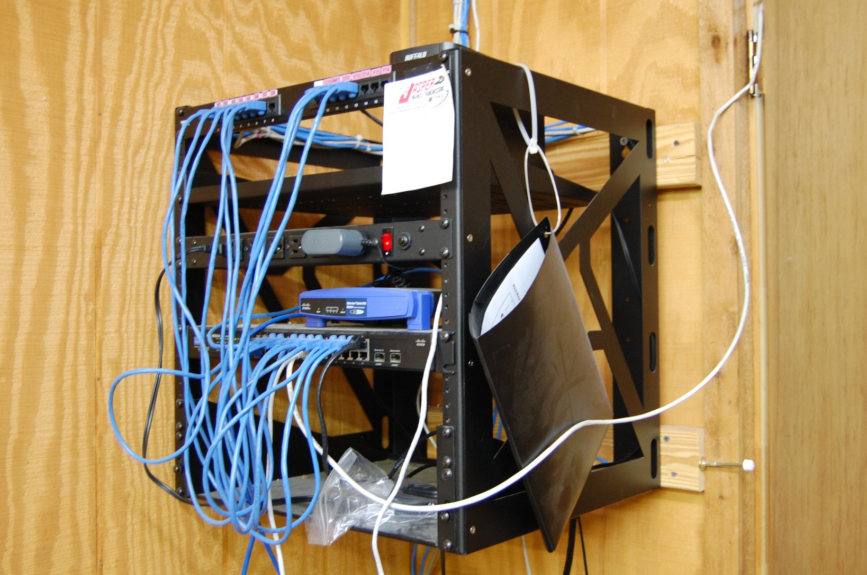
The Data Side of the Network

Slide 24
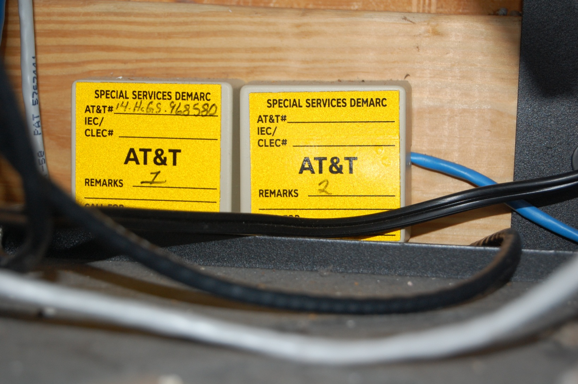
Data Side Demarc

Slide 25
Separate Networks
As is typical in organizations of this size the voice and data networks are entirely separate including the demarcs

