Slide 1
NETW-250 Avaya Voice Solutions Last Update 2013.03.05 1.0.0

Slide 2
Avaya
Avaya has a significant market share in small to very large voice systems
Like all other vendors they are migrating their customers away from traditional TDM connected PBXs and KSUs to a unified communications system that sends all of the traffic over the data network

Slide 3
Avaya
Avaya has two systems they typically use
IP Office
Aura

Slide 4
IP Office
IP Office is designed to handle from two to 1,000 end devices at up to 32 different locations
The system can handle voice or video calls
It comes in two basic versions with several editions

Slide 5
IP Office Versions
The versions are designed to support different levels of complexity in the hardware used to run it, which is typically driven by the organization size
The two versions are
IP Office 500
IP Office Server

Slide 6
IP Office 500
IP Office 500 has four editions available to support different organization sizes
These are
Basic
Essential
Preferred
Advanced

Slide 7
IP Office Server
IP Office Server comes in one edition

Slide 8
IP Office Versions
Here is how Avaya describes these two versions and the editions

Slide 9
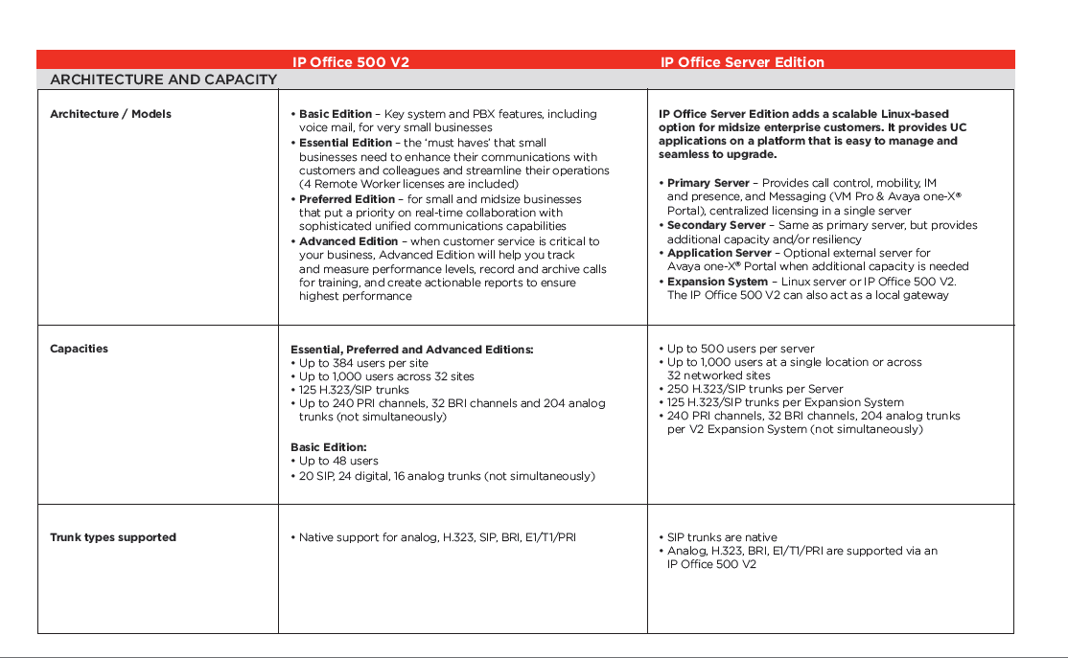
IP Office Versions

Slide 10
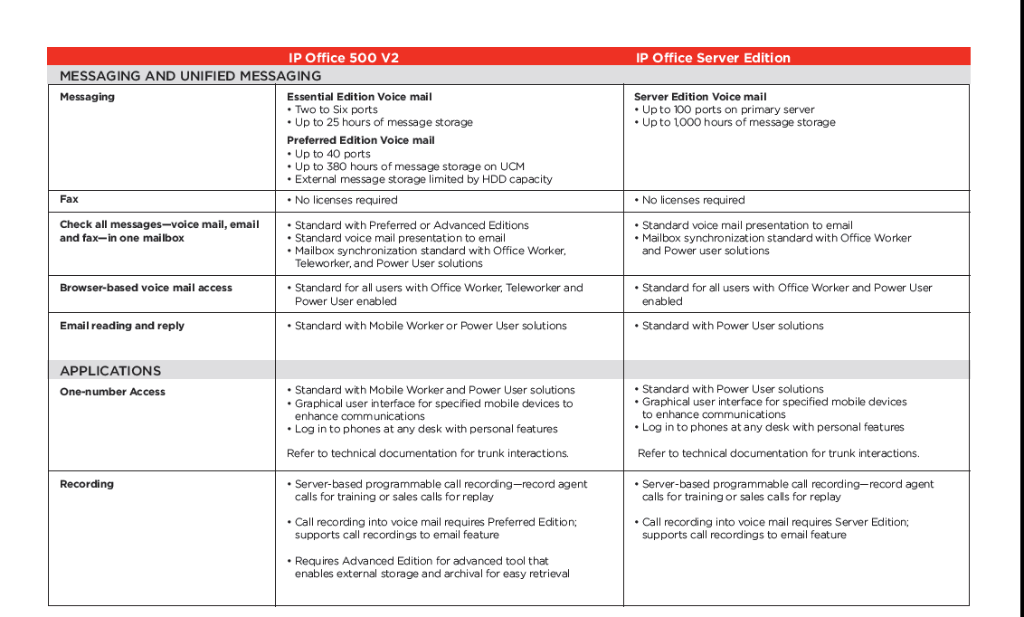
IP Office Versions

Slide 11
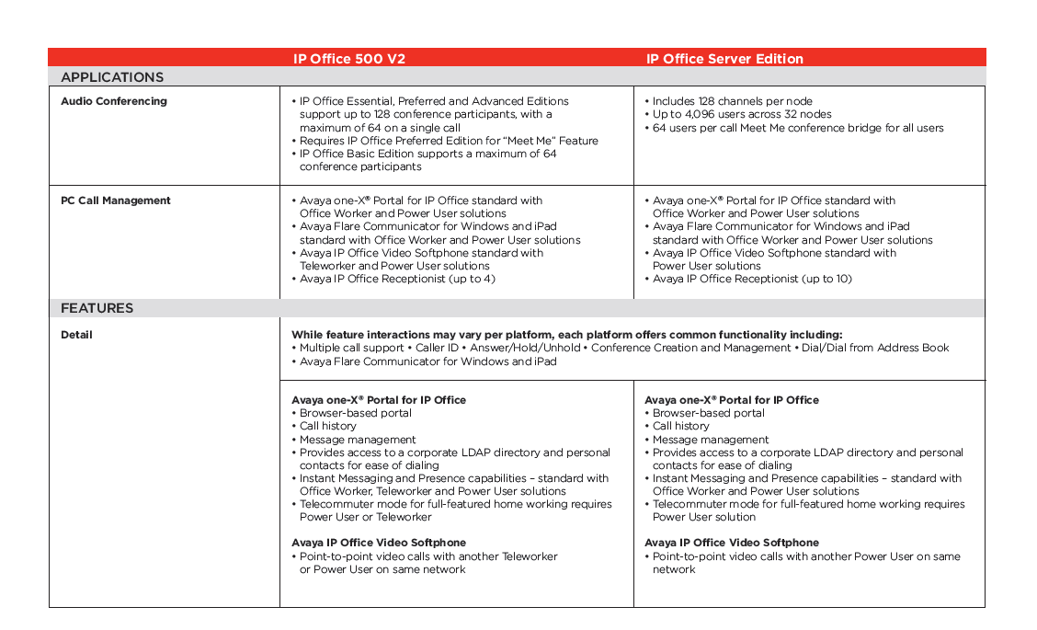
IP Office Versions

Slide 12
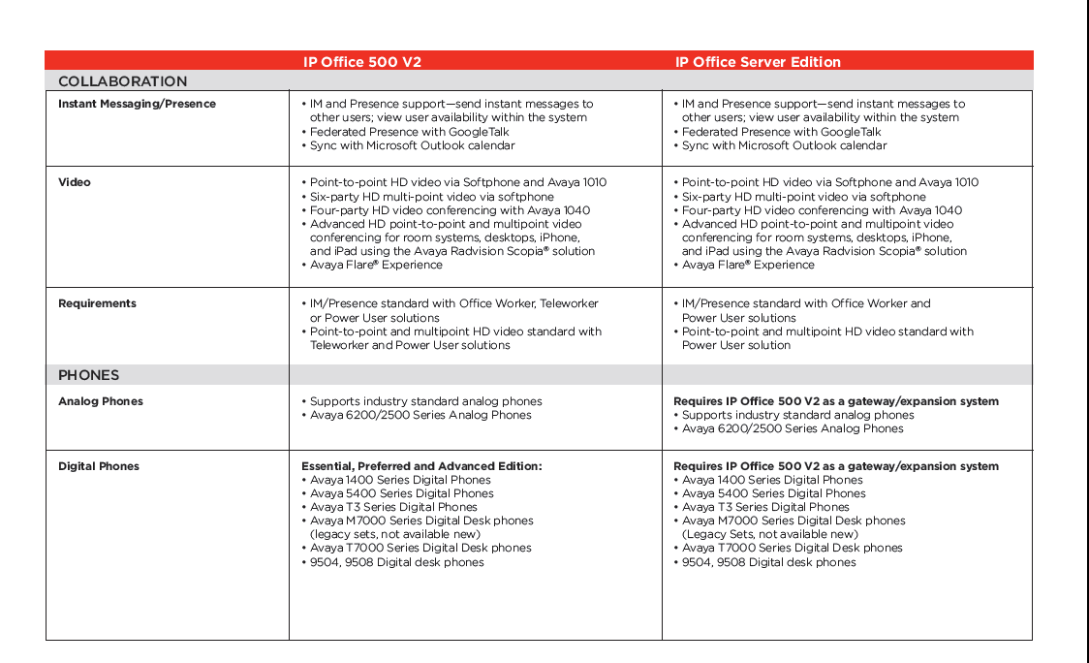
IP Office Versions

Slide 13
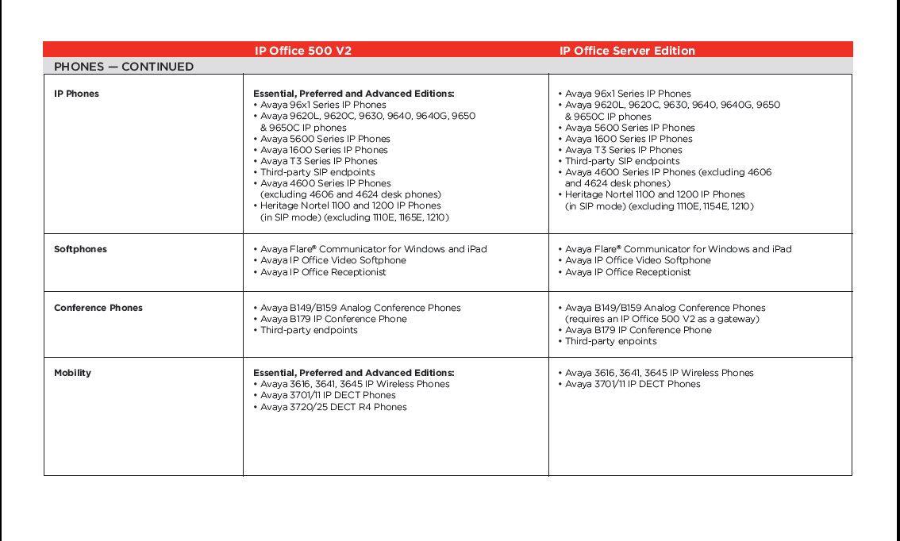
IP Office Versions

Slide 14
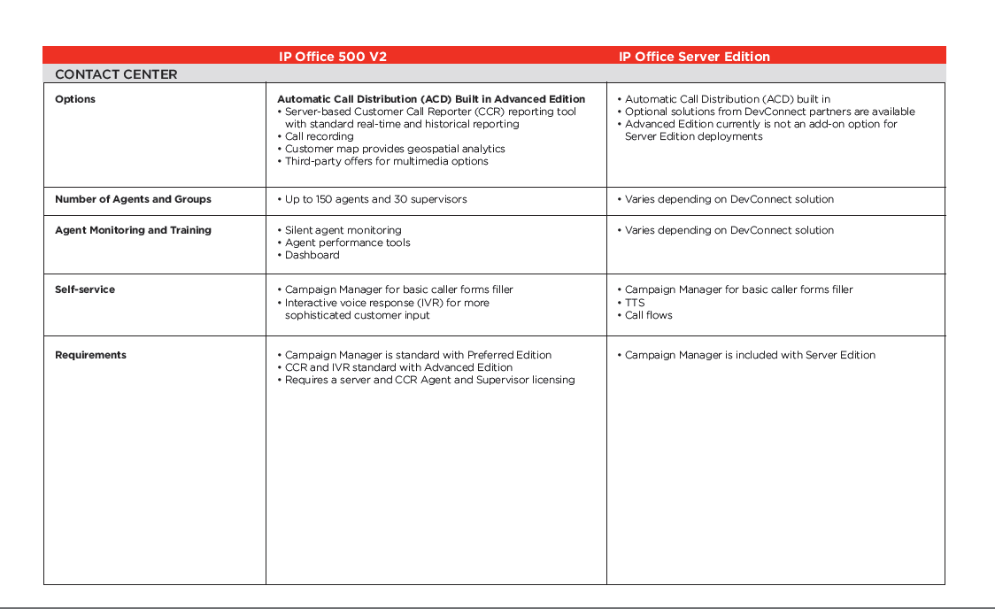
IP Office Versions

Slide 15
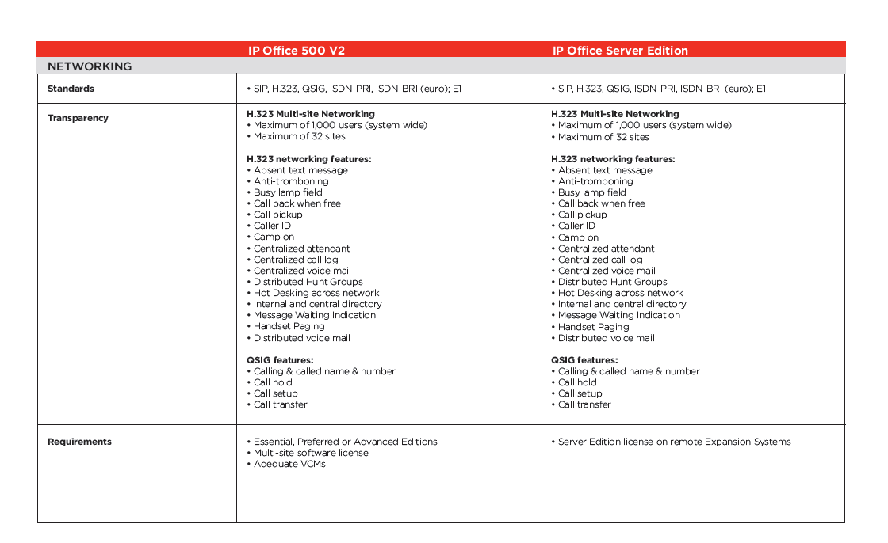
IP Office Versions

Slide 16
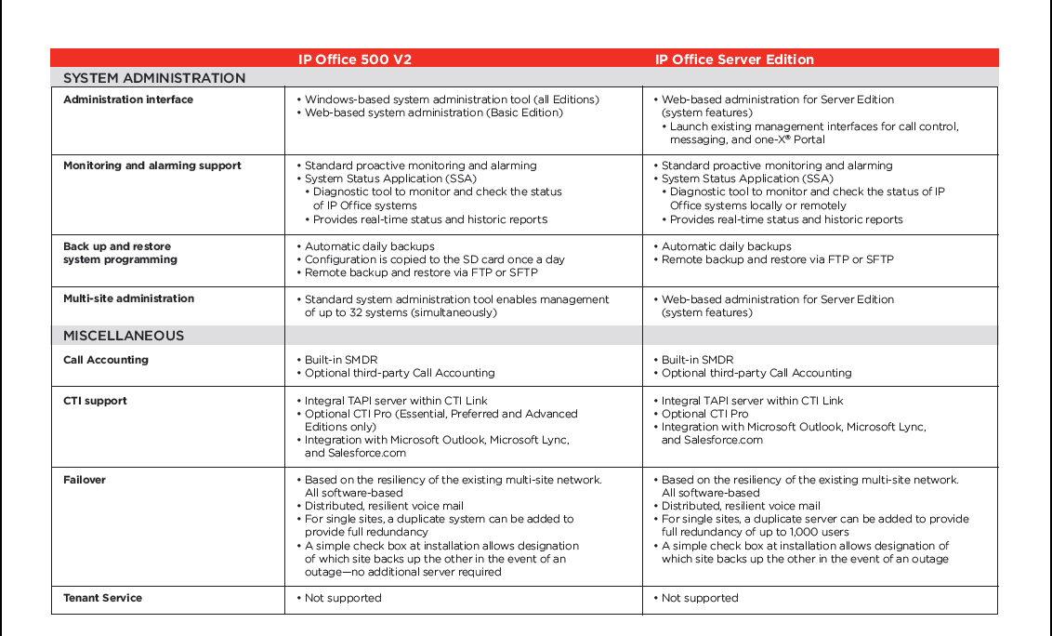
IP Office Versions

Slide 17
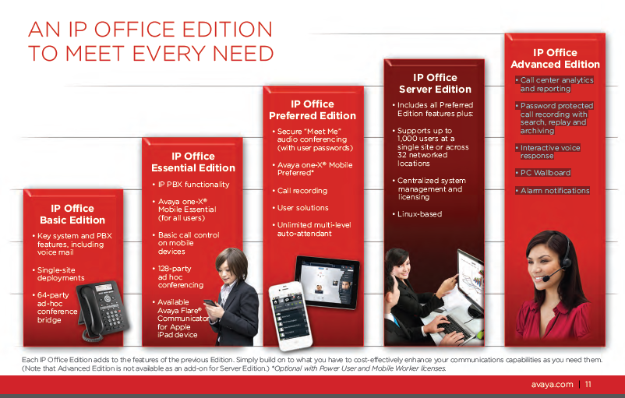
IP Office

Slide 18
Software and Hardware
IP Office itself is a software solution running on one of your existing computers or one provided by Avaya
This software is then paired with two or more telephones from Avaya or third parties
Here for example are some of the Avaya phones

Slide 19
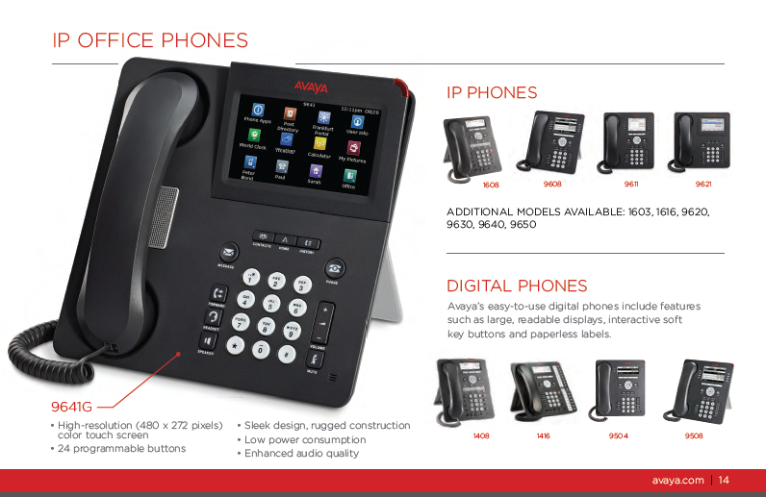
Telephones

Slide 20
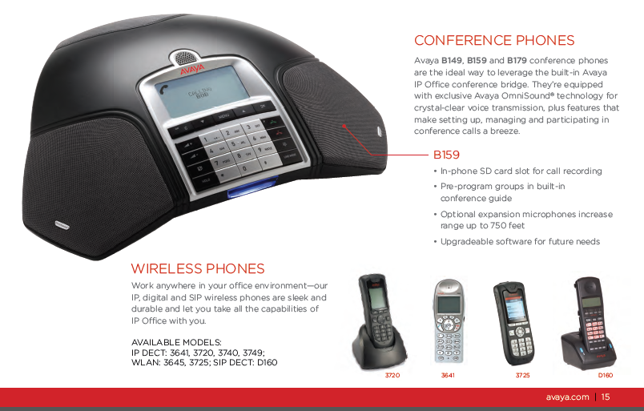
Telephones

Slide 21
Aura
Aura comes in a midsize and a large version
The midsize solution is for organizations with from 250 to 2,400 endpoints
It runs on a single server
The large version scales up to thousands of users

Slide 22
Aura

