Slide 1
NETW-250
Asterisk
Last Update 2014.01.23
1.1.0

Slide 2
What is Asterisk
As the Asterisk web site says Asterisk is
  An open source framework for building communications applications
  Asterisk turns an ordinary computer into a communications server
  Asterisk powers IP PBX systems, VoIP gateways, conference servers and more
  It is used by small businesses, large businesses, call centers, carriers and governments worldwide

Slide 3
What is Asterisk
  Asterisk is free and open source
  Asterisk is sponsored by Digium
  Asterisk is named after the Unix/Linux wild-card character because, like the wild-card Asterisk can be virtually anything
Here is a diagram of this from Digium

Slide 4
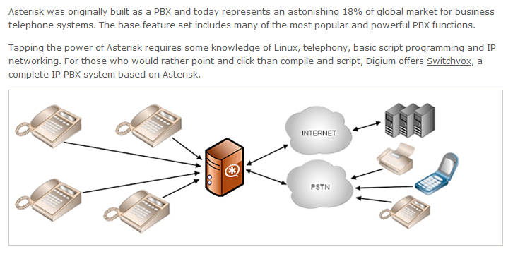
What is Asterisk

Slide 5
What Does Asterisk Require
Here is another diagram from them showing what else is needed to make Asterisk work

Slide 6
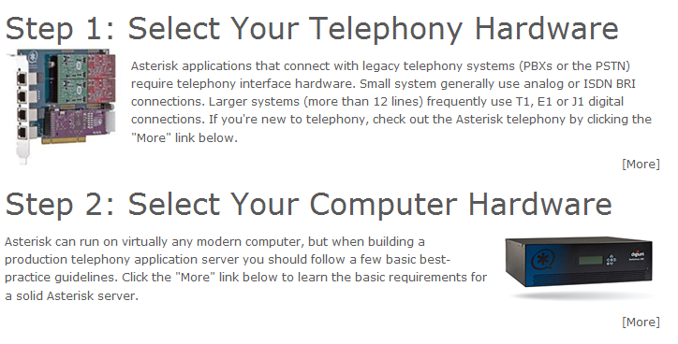
What Does Asterisk Require

Slide 7
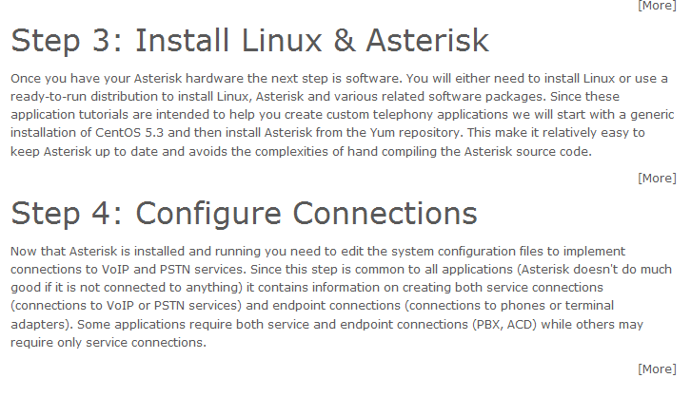
What Does Asterisk Require

Slide 8
Versions of Asterisk
The Asterisk version numbering system is a little strange
It started with the normal 1.0, then 1.1 and so on
Recently instead of going from the 1.8 to 2.0 they jumped to 10
Why might that be
Let’s let them explain it

Slide 9
Versions of Asterisk
Early versions in the 0.x range appeared as early as December 1999
Version 1.0.0 was released at the first AstriCon in September 2004
The major releases have been the even numbers such as 1.2, 1.4, 1.6, and 1.8

Slide 10
Versions of Asterisk
Recently the developers of Asterisk decided to rewrite the basis of the program in order to support traffic other than voice
As they said in June 2011
  The conclusion that we’ve reached, and that we hope you’ll agree with, is that Asterisk is always going to be Asterisk, and that you don’t need a 1 prefix on the version number to be able to identify it

Slide 11
Versions of Asterisk
  So, starting with the next major release, we’re going to drop the 1 completely
  The next major release, which was going to be Asterisk 1.10, will now be just Asterisk 10 and subsequent major releases will be Asterisk 11, Asterisk 12, and so forth
  Version 11 is the current one
  Version 12 is under test, but it does not look like it will alter the user experience much
  The changes in 12 are more under the hood

Slide 12
Directories Used By Asterisk
Asterisk stuff is stored in several directories
As explained in the Asterisk The Future of Telephony these include
  /etc/asterisk/
    Contains the Asterisk configuration files
  /usr/lib/asterisk/modules/
    Contains all of the Asterisk loadable modules

Slide 13
Directories Used By Asterisk
  /var/lib/asterisk
    Contains the astdb file and a number of subdirectories
    The astdb file contains the local Asterisk database information, which is somewhat like the Microsoft Windows Registry
    The subdirectories within /var/lib/asterisk/ include
      agi-bin/
        Contains any custom scripts

Slide 14
Directories Used By Asterisk
      firmware/
        Contains firmware for various Asterisk-compatible devices
      images/
        Applications that communicate with channels supporting graphical images look in the images/ directory
        Most channels do not support the transmission of images, so this directory is rarely used
      keys/
        Asterisk can use a public/private key system to authenticate peers connecting to your box via an RSA digital signature

Slide 15
Directories Used By Asterisk
      mohmp3/
        When you configure Asterisk for Music on Hold, applications utilizing this feature look for their MP3 files in this directory
      sounds/
        All of the available voice prompts for Asterisk reside here

Slide 16
Directories Used By Asterisk
  /var/spool/asterisk/
    The Asterisk spool directory contains several subdirectories, including dictate/, meetme/, monitor/, outgoing/, system/, tmp/, and voicemail/
  /var/run/
    The /var/run/ directory contains the process ID – PID - information for all active processes on the system, including Asterisk as specified in the asterisk.conf file
    /var/run/ is OS-dependent and may differ

Slide 17
Directories Used By Asterisk
  /var/log/asterisk/
    The /var/log/asterisk/ directory is where Asterisk related log files are stored
  /var/log/asterisk/cdr-csv
    This directory is used to store the CDRs in comma-separated value – CSV – format

Slide 18
Concepts of Communication
To make Asterisk work it is important to understand how it is designed to form connections between end points
We will follow the guidelines for this in the book on Asterisk from O’Reilly by Meggelen, Madsen, and Smith

Slide 19
Channels
First the Asterisk system needs a transport network onto which it can place the calls made through it
These are called channels in this book
There are many possible channels to which this system can be connected
The authors discuss three of these as they view them as being the most likely ones used by a small Asterisk system

Slide 20
Channels
These are
  FXO and FXS
  IAX
  SIP

Slide 21
FXO and FXS
The FXO FXS setup is the way to connect to the PSTN in order to use the POTS
This requires a board inserted into the computer on which Asterisk will be running or an external gateway box to which the computer running Asterisk will connect

Slide 22
FXO and FXS
If it is a card which is the most common way of doing this it will have one or more FXO and FXS ports
The FXO – Foreign Exchange Office port connects to the PSTN
The FXS – Foreign Exchange Station port attaches to the telephones

Slide 23
FXO and FXS
Here is an example of one of these

Slide 24
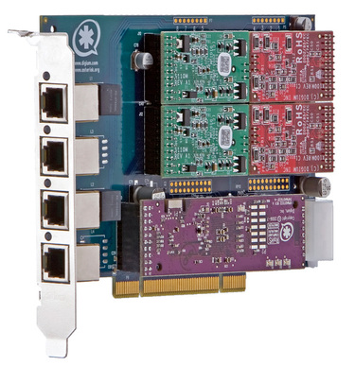
FXO and FXS

Slide 25
FXO and FXS
Here is what the supplier says about this card
  The Digium Wildcard TDM400P is a half-length PCI 2.2-compliant card that supports FXS and FXO station interfaces for connecting analog telephones and analog POTS lines through a PC

Slide 26
FXO and FXS
  Using Digium's Asterisk Open Source PBX software and standard PC hardware, one can create a SOHO telephony environment that includes all the sophisticated features of a high-end business telephone system
  The TDM400P takes the place of an expensive channel bank and brings the system price point to a low level

Slide 27
FXO and FXS
  By using X100M and S110M modules with the TDM400P, one can create a solution with support for a range of telephones
  To scale this solution, simply add additional TDM400P cards populated with modules, such as the
    X100M
    S110M

Slide 28
Channel Bank
What is this channel bank that is being replaced
A channel bank is a device that multiplexes or demultiplexes a telecommunications channel, such as an analog or digital telephone line provided by a PSTN service provider
A channel bank may be located at a PSTN central office or at the end user's premises

Slide 29
Channel Bank
If at the end user’s site it breaks channels out of the trunk line from the central office for use by a PBX

Slide 30
FXO and FXS
A FXO port connects to the PSTN as it is designed to accept a dialtone from it
A FXS port provides a dialtone and ringing voltage to an analog telephone at the end user location

Slide 31
FXO and FXS
To use a setup such as this after installing the card in the computer connect the FXO port on the card to an active PSTN demarc that is supplying a standard analog POTS signal using a RJ11 phone cable
Connect an analog telephone to the FXS port also using a RJ11 phone cable
For example as the manual for one of these cards shows

Slide 32
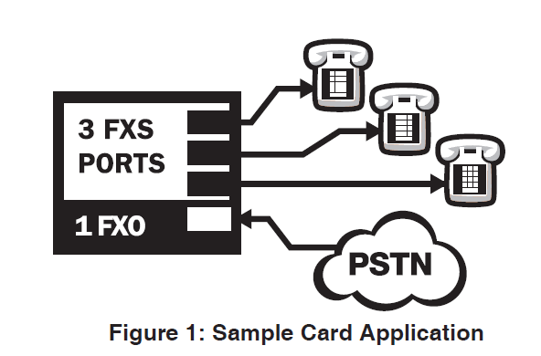
FXO and FXS

Slide 33
FXO and FXS
In this case the RJ11 connector is the six pin version as wired in this manner as shown from the manual for the board

Slide 34
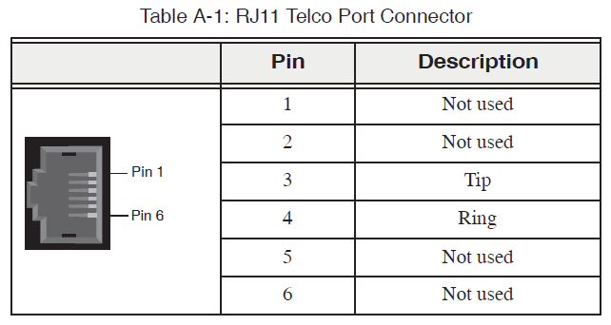
FXO and FXS

Slide 35
FXO and FXS
As the manual explains
  Each card consists of four RJ11 ports located on the PCI bracket
  Each port correlates to a single module containing either FXO or FXS modules
  The ports are numbered in sequence from one to four
  The top port is Port 1 and the bottom port is Port 4

Slide 36
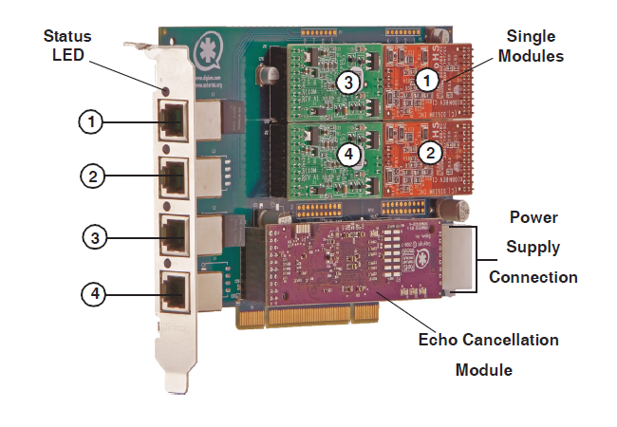
FXO and FXS

Slide 37
Gateway
A separate box can be used instead of a card in the computer running Asterisk
An example of one of these is the G100 from Digium
Here is what it does as they explain
  Digium's Gateway Series is a converged media gateway product line designed to interface between TDM (T1/E1) and IP networks (SIP)

Slide 38
Gateway
  The Gateway Series connects legacy telephone systems to IP networks and seamlessly integrates VoIP PBXs with the PSTN
It looks like this

Slide 39

Gateway

Slide 40
Gateway
It fits in the setup like this

Slide 41
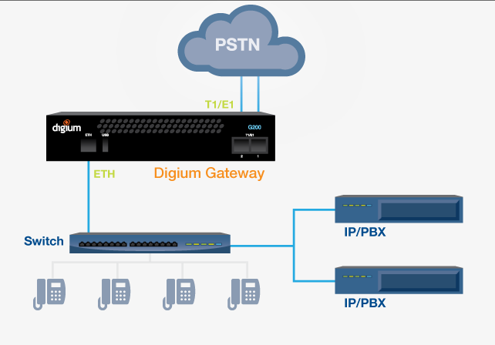
Gateway

Slide 42
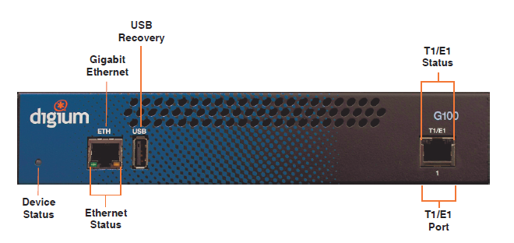
Gateway

Slide 43
Hardware
Let’s look at all of the hardware that Asterisk says it can use

Slide 44
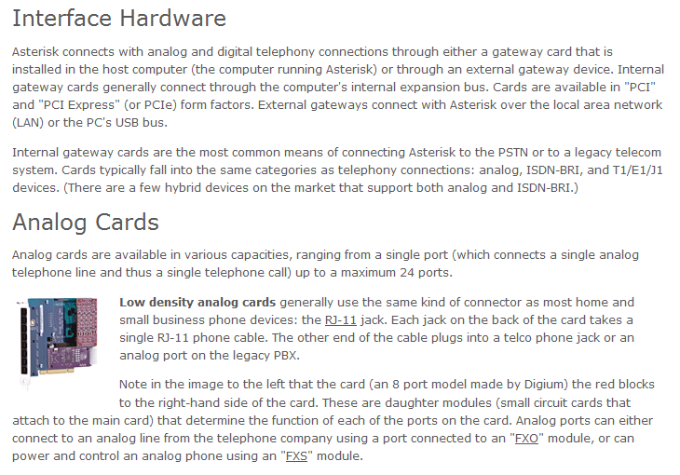
Hardware

Slide 45
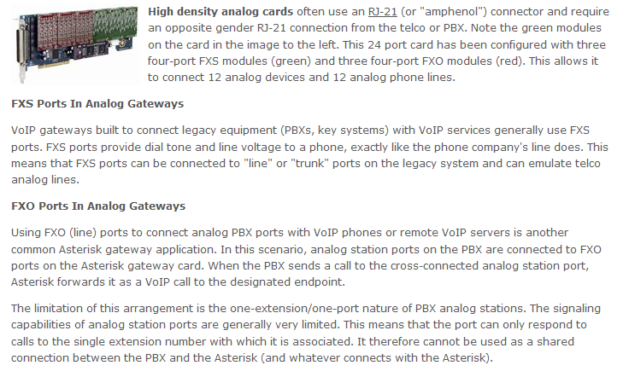
Hardware

Slide 46
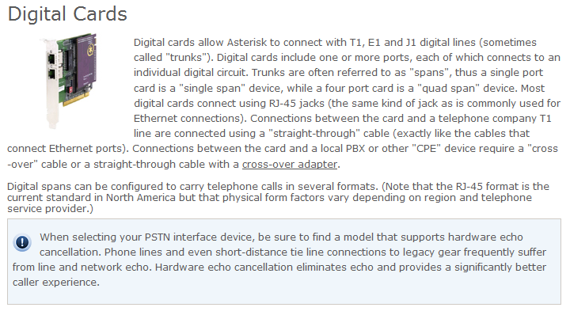
Hardware

Slide 47
Hardware
Despite what Asterisk says about the T1 line connection, this is not exactly correct
A T1 line uses a RJ-48 - an RJ-48c to be precise - connector which is exactly the same as a RJ-45 connector
Why the different names
Data people say RJ-45 and telephone people say RJ-48

Slide 48
Hardware
Also there are two types of cables that can be used to connect the T1 demarc to the card in the computer or gateway
The first one is the correct type according to the telecommunication’s industry standards
This is shielded twisted pair cable

Slide 49
Hardware
The second type is what everybody uses in the real world
This is unshielded twisted pair cabling
In other words, plain old Cat 5 cable as mentioned above by Asterisk
To be safe it is best to use a shielded twisted pair cable if the cable is more than 1,000 feet

Slide 50
Hardware
In shielded twisted pair cable each pair of wires is encased in a foil shield as shown below

Slide 51
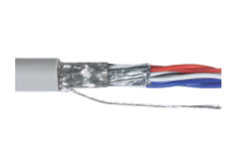
Shielded Twisted Pair Cable

Slide 52
Connection Types
The hardware used would then need to be connected to the PSTN
Here are the types of connections Asterisk says are the most common

Slide 53
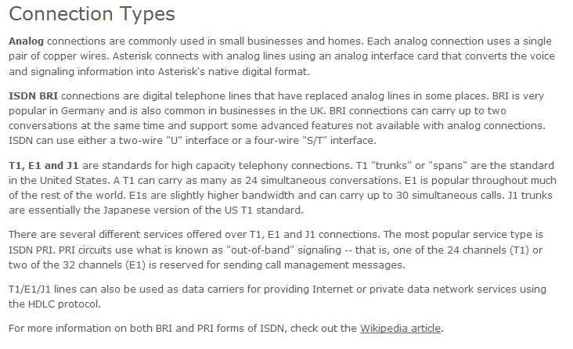
Connection Types

Slide 54
Connection Types
This line or connection can be arranged for with the local ILEC, a CLEC, or an ITSP
An analog line is only useable for up to about 10 lines and less than 30 phones
Above that one or more digital lines are needed

Slide 55
Connecting to an ITSP
An ITSP – Internet Telephony Service Provider connects you to a service provider so that you can use their network to bypass the PSTN ILEC that controls your service area
This is often done by connecting to the ITSP using a SIP trunk
Here is what XO Communications says about this

Slide 56
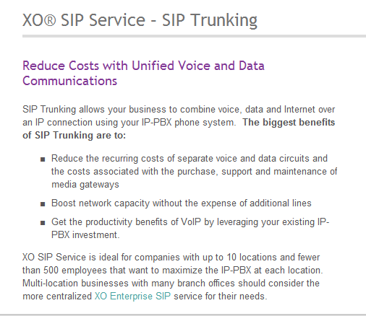
Connecting to an ITSP

Slide 57
What is SIP Trunking
SIP as we will see is a way to create a dial tone for, setup, and terminate VOIP calls
A SIP trunk is a connection from the customers equipment directly to a provider’s SIP network bypassing the traditional use of a dedicated PRI or T1 line for this purpose

Slide 58
What is SIP Trunking
It has been adapted to allow PBXs to connect to the Internet
This allows the Internet to be used in place of the PSTN
In other words, the need for a voice trunk line is eliminated thus reducing costs and complexity
Voice, video, and data can be carried over the same line

Slide 59
What is a SIP Trunk
SIP Trunking is more flexible that the traditional PRI ISDN 24 channel T Carrier line as bandwidth can be reassigned as needed unlike T Carrier channels which are set
The cost savings over traditional PBX lines can be considerable

Slide 60
Equipment
Depending on the existing equipment the SIP trunk connection can be made in one of three ways
  IP telephone system
    Many new IP telephone systems have a SIP interface that merely needs to be connected to the SIP trunk
  Recent PBX optional interface
    Recently manufactured PBXs maybe upgradeable to a SIP interface

Slide 61
Equipment
  Older PBX IAD
    An intervening device such as an IAD will be needed between an older PBX and the SIP trunk

Slide 62
Connecting to an ITSP
Here is a sample configuration from the Meggelen, Madsen, and Smith book
  [my_service_provider]
  type=peer
  host=10.251.55.100
  fromuser=my_unique_id
  secret=my_special_secret
  context=incoming_calls
  dtmfmode=rfc2833

Slide 63
Connecting to an ITSP
  disallow=all
  allow=gsm
  allow=ulaw
  deny=0.0.0.0/0
  permit=10.251.55
  insecure=invite

Slide 64
IAX
The IAX - Inter-Asterisk eXchange protocol is usually used for server-to-server communication only as there are few telephones that support it
IAX differs from SIP in the way the voice traffic is passed between the endpoints
Unlike SIP that works along with RTP each one using different ports IAX uses only port 4569

Slide 65
IAX
This means it gets along better with NAT

Slide 66
Telephones
At the other end of things a telephone of some sort is needed by the end user to initiate the call or receive the call
These are called endpoints in Asterisk
There are three types of endpoints or telephones
  Hardphone
  Softphone
  ATA – Analog Terminal Adaptor

Slide 67
Hardphone
A hardphone is what most people call a telephone
Such as

Slide 68
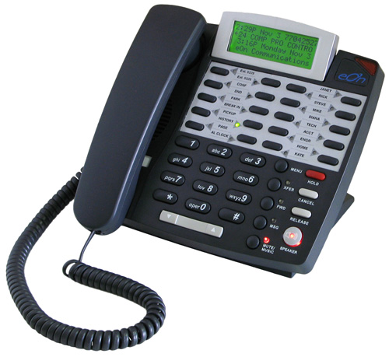
Hardphone

Slide 69
Hardphone
Meggelen, Madsen, and Smith in their book have this to say about hardphones
  Hardphones have the advantage that the handsets have good acoustic properties for voice communications
  Any decent-quality telephone is engineered to pick up the frequencies of the human voice, filter out unwanted background noise, and normalize the resulting waveform

Slide 70
Hardphone
  People have been using telephones for as long as the telephone network has existed, and we tend to like what is familiar, so having a device that communicates with Asterisk using a familiar interface will be attractive to many users
  Also, a hardphone does not require your computer to be running all the time

Slide 71
Hardphone
  Disadvantages to hardphones include that they are nonportable and expensive, relative to the many quality softphones on the market today that are available for free.
  Also, the extra clutter on your desk may not be desirable if you have limited work space, and if you move around a lot and are not generally at the same location, a hardphone is not likely to suit your needs

Slide 72
Softphone
A softphone is a software application that runs on a computer or smartphone of some sort
The audio must come through the device's sound system
The device must also have a microphone of some sort
For example

Slide 73
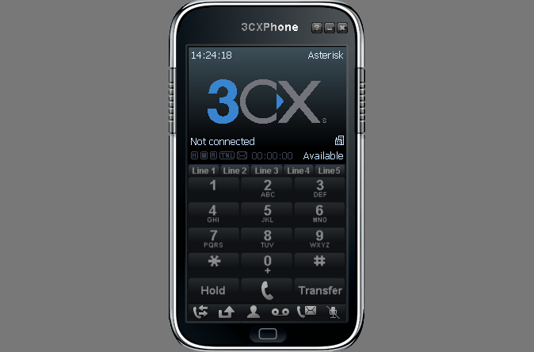
Softphone

Slide 74
Softphone
Meggelen, Madsen, and Smith in their book have this to say about softphones
  Softphones solve the portability issue by being installed on a device that is likely already moving with you, such as your laptop or smart phone
  Also, their minimal cost (typically free, or around the $30 price range for a fully featured one) is attractive

Slide 75
Softphone
  Also, because softphones are just software, they are easy to install and upgrade, and they commonly have other features that utilize other peripherals, like a webcam for video calling, or perhaps an ability to load files from your desktop for faxing

Slide 76
Softphone
  Some of the disadvantages of softphones are the not-always-on nature of the devices, the necessity to put on a headset each time you take a call, and the fact that many PCs will at random times during the day choose to do something other than what the user wants them to do, which might cause the softphone to stop working while some background task hogs the CPU

Slide 77
ATA
An ATA is designed to allow traditional analog telephones or other device such as a fax machines to connect to a SIP network,
This will be a small box with a RJ-11 connector for the phone and a RJ-45 connector with a NIC behind it for the network
For example

Slide 78
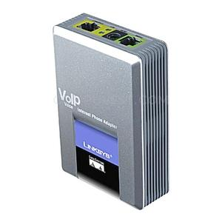
ATA

Slide 79
ATA
Meggelen, Madsen, and Smith in their book have this to say about ATAs
  ATAs have the advantage of allowing you to connect to your SIP network analog devices, such as cordless phones, paging amplifiers, and ringers. ATAs can also sometimes be used to connect to old wiring, where a network connection might not function correctly

Slide 80
ATA
  The main disadvantage of an ATA is that you will not get the same features through an analog line as you would from a SIP telephone

Slide 81
Main Configuration Files
To get all of these parts to talk to each other and the PSTN or the Internet or both a set of configuration files is used
The exact ones depend on what is connecting to what
To illustrate this we will begin with the two main types of configuration files
  The channel configuration file
  The dialplan

Slide 82
The Channel
Recall that the channel is what we discussed just above when we talked about
  FXO and FXS
  IAX
  SIP
Each channel used must have a configuration file the ISTP setup we just looked at is an example of this type of file

Slide 83
Channel Configuration File
The one we will deal with in the most detail is
  sip.conf
Since we will be using a SIP channel running over the LAN

Slide 84
Dialplan
The dialplan as we will see in more detail later is the configuration file that Asterisk uses to route the calls
The name of this file is
  extensions.conf
These are both located in the
  /etc/asterisk/

Slide 85
Configuration Files
For the Asterisk system to work properly the channel files and the dialplan file must be configured in a way that allows Asterisk to pass control from one to the other as calls are processed
Here is what Meggelen, Madsen, and Smith have to say about this relationship

Slide 86
Configuration Files
  When a call comes into Asterisk, the identity of the incoming call is matched in the channel configuration file for the channel being used
  Such as the sip.conf file
  The channel configuration file also handles authentication and defines where that channel will enter the dialplan
  Once Asterisk has determined how to handle the channel, it will pass call control to the correct context in the dialplan

Slide 87
Configuration Files
  In Asterisk this is the extensions.conf file
  The context parameter in the channel configuration file tells the channel where it will enter the dialplan
  This contains all the information about how to handle and route the call
  For example

Slide 88
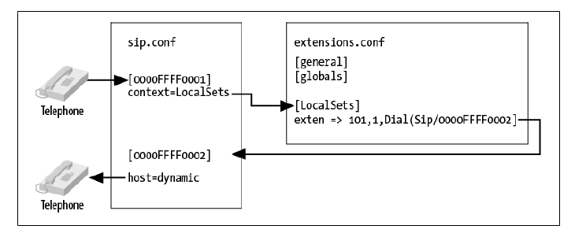
Configuration Files

Slide 89
Configuration Files
Let’s create these beginning with the channel we will be using, SIP
SIP is very commonly used as all it requires in terms of hardware nothing more than a NIC in a computer connected to the Internet

Slide 90
SIP
As the Meggelen, Madsen, and Smith book explains
  SIP - Session Initiation Protocol is used in VOIP phones, whether hardphones, or softphones, to take care of the setup and teardown of calls, along with any changes during a call such as call transfers
  The purpose of SIP is to help two endpoints talk to each other

Slide 91
SIP
  The SIP protocol is simply a signaling protocol, which means that its purpose is only to get the two endpoints talking to each other, and not to deal with the media of the call
  In other words the voice being transported
  The voice is carried using another protocol called the RTP – Real Time Transport Protocol as defined in RFC 3550
  It is used to carry the traffic from one point to the other

Slide 92
SIP
SIP defines the endpoints as user agents
There are two types of these
  Client
    The client is the endpoint that generates the request
  Server
    The server processes the request and generates a response

Slide 93
SIP Process
When an endpoint wants to place a call to another endpoint, such as softphone to softphone, a request is created that is sent to a SIP proxy server
The SIP proxy server will take the request, determine where the request is destined for, and forward it on

Slide 94
SIP Process
Once the two user agents have negotiated a successful call setup SIP gets out of the way
The call is then transported via the RTP protocol and sent directly between the two user agents

Slide 95
SIP Configuration File
To tell Asterisk how to connect to the SIP channel the sip.conf file is used
This file tells Asterisk what phones it should talk to
Let’s look at a sip.conf in its most basic form

Slide 96
SIP Configuration File
  [general]
  [1000]
  type=friend
  context=phones
  host=dynamic

Slide 97
SIP Configuration File
This all means
  [1000]
    An identifier for a device
    This can be anything
    In this case it is going to be the extension number, but it does not have to be

Slide 98
SIP Configuration File
  type=friend
    This could be user, peer, or friend
    Friend allows this device to place and receive calls
    Friend provides both user and peer functions
    In general use it for all devices
  context=default
    This is where in the dialplan – the extensions.conf – will look to see what to do with this device

Slide 99
SIP Configuration File
  host=dynamic
    When set to dynamic and the client is configured to register with Asterisk it will receive a register packet from the telephone telling Asterisk which IP address the SIP device is using

Slide 100
SIP Configuration File
After these commands are placed in the configuration file to place this into Asterisk from the CLI prompt enter
  sip reload
  or
  service asterisk restart

Slide 101
SIP Connection
The only type of connection a SIP system needs is one to the Internet with as low and consistent latency

Slide 102
Asterisk Configuration Files
Outside of any hardware related configuration such as those discussed above Asterisk uses only a single configuration file for the dialplan
This file is
  extensions.conf

Slide 103
Extensions.conf
The dialplan is the key configuration file for Asterisk as it defines how calls are handled
Extensions.conf is the dialplan file that tells Asterisk what to do when one of the phones defined in the sip.conf file dials a number
There are four concepts that are central to the operation of the dialplan

Slide 104
The Dialplan
These are
  Contexts
  Extensions
  Priorities
  Applications

Slide 105
Contexts
A dialplan is divided into sections called contexts
Contexts are named groups of extensions, which serve different purposes
Contexts also keep different parts of the dialplan from interacting with one another
Contexts are marked by placing its name inside a set of [] brackets, such as
  [incoming]

Slide 106
Contexts
At the beginning of the dialplan are two contexts named
  [general]
  [globals]
A channel is defined with a context
A context is also used to provide security to the system

Slide 107
Contexts
For example, it is used grant access to features, such as long distance calling, to some and not to others

Slide 108
Extensions
As used by Asterisk an extension defines a series of steps that Asterisk will take
For example, when a series of keys are pressed on a telephone registered with Asterisk it will carry out the steps defined for that telephone one after the other
The extensions.conf file then defines what will happen to each call

Slide 109
Extensions
Each of these steps in the extensions.conf file begins with
  exten=>
Each of these exten lines consists of
  The name of the extension
  The priority or which step in a sequence of steps it is
  The application or command to do something during that step

Slide 110
Extensions
It is organized like this
  exten=>name,priority,application
For example
  exten=>1000,1,Answer()

Slide 111
Priorities
Each named extension can have multiple steps, called priorities
Each priority is numbered sequentially, starting with 1, and executes one specific application
For example
  exten=>1000,1,Answer()
  exten=>1000,2,Hangup()
Would answer the phone and then hangup

Slide 112
Priorities
In current versions of Asterisk only the first step need be numbered
The others can have an n instead
As in
  exten=>1000,1,Answer()
  exten=>1000,n,Hangup()
Asterisk just takes the previous number and adds one to it

Slide 113
Priorities
This makes adding and deleting steps easier

Slide 114
Applications
An application does something such as
  Answer the telephone
  Play music while on hold
  Hangup

Slide 115
Applications
In the extensions.conf file applications look like this
  Answer()
    To answer the phone when it rings
  Playback(thefilename)
    To playback a sound to the listener
  Hangup()
    To hangup the phone

Slide 116
Extensions.conf
All of this Contexts, Extensions, Priorities, and Applications come together in the dialplan file called extensions.conf
The dialplan is what directs the actions Asterisk will take

Slide 117
Extensions.conf
Once this file is altered it must be reloaded into Asterisk by entering
  extensions reload
  dialplan reload
  or
  service asterisk restart

Slide 118
Extensions.conf
Let’s look at a basic extensions.conf file
  [incoming]
  exten=>200,1,Answer()
  exten=>200,n,Playback(hello-world)
  exten=>200,n,Hangup()

Slide 119
Dial Application
The Dial application is commonly used in a dialplan
As Meggelen, Madsen, and Smith point out
  One of Asterisk’s most valuable features is its ability to connect different callers to each other
  This is especially useful when callers are using different methods of communication

Slide 120
Dial Application
For example, caller A might be communicating over the traditional analog telephone network, while user B might be sitting in a café halfway around the world and speaking on an IP telephone
Asterisk using the Dial application as defined in the dialplan will handle this interconnection

Slide 121
Dial Application
The Dial() application requires four arguments
  The destination you’re attempting to call
    This is the technology or transport system across which to make the call
    In Asterisk these would be
      Zap for PSTN lines
      SIP
      IAX2
  A / forward slash

Slide 122
Dial Application
  The remote endpoint
For example, you could call the makers of Asterisk in order to test you setup using SIP by adding this line to the dialplan
  exten=>500,1,Dial(SIP/guest@misery.digium.com/s)

Slide 123
Contexts
Let’s look at some common contexts that are likely to be seen in all extensions.conf files
  [globals]
    This is the first context
    It appears at the top of the file
    It is typically used to define variables

Slide 124
Outbound Dialing
In order to allow dialing of numbers outside of the organization a context must be added to extensions.conf and to make things easier a variable added to the [globals] section
In [globals] the trunk to the outside world will be defined
For example
  outboundtrunk=zap/4

Slide 125
Outbound Dialing
Next to allow local outbound calls add this context
  [outbound-local]
  exten=>_9NXXXXXX,1,Dial(${OUTBOUNDTRUNK}/${EXTEN:1})
  exten=>_9NXXXXXX,n,Congestion()
  exten=>_9NXXXXXX,n,Hangup()

Slide 126
Other Common Commands
[general]
  autofallthrough=yes
    This tells Asterisk to continue when an extension runs out of things to do as defined in the dialplan
    If this is set to no, Asterisk will wait for some input after all priorities have been completed

Slide 127
Starting Asterisk
To start Asterisk from the command prompt type
  asterisk
This is the normal way of running the program
However, it provides no console access to Asterisk, which in normal operation you do not need

Slide 128
Starting Asterisk
Console access can be made after starting the Asterisk daemon as above by next entering
  asterisk –r
This will make a remote terminal connection to it

Slide 129
Starting Asterisk
To start Asterisk and see all the details as to what is happening with it type
  Asterisk –cvvvvv
    -c means Console
      It will start Asterisk as a user process instead of a server process
      This is used to debug startup parameters, but not for production
    -v means Verbose
      The more vs the more verbose it will be
      This is for debugging

Slide 130
Checking on Asterisk
To be sure Asterisk is running enter this
  ps aux | grep asterisk

Slide 131
Phone Registration
Once a phone is ready to connect to Asterisk we can check to see if it did by using the
  sip show peers
  sip show users
And for more detail on a particular device
  sip show peer 1000

Slide 132
To Stop the Linux Firewall
If the Linux firewall if stopping the softphones from connecting turn it off by entering
  service iptables stop

Slide 133
To Stop Asterisk
To stop Asterisk enter
  core stop now from the Asterisk console prompt

