Slide 1
Troubleshooting Methodology
Last Update 2013.03.10
3.2.0

Slide 2
Objectives
Learn about basic network troubleshooting methods

Slide 3
Changes Cause Problems
A problem is always caused by a change
In other words if it was working before and it is not now, what changed
The first question to always ask yourself and the users is
  What just happened
  What did I do
  What did you do
  What did the user do

Slide 4
Isolate the Problem Domain
If the cause of the problem is not readily apparent after considering what just changed, then the problem domain should be isolated to make resolution easier
For example
  Does the problem just affect one application
  Does the problem affect this application everywhere
  Does the problem affect just one computer

Slide 5
Isolate the Problem Domain
How to isolate the problem domain depends on the stability of the network
In general a stable network should be approached from the top down, since most problems in this type of network will be with applications
In a new network, one that has just undergone significant changes, or one that is unreliable, start at the bottom layer

Slide 6
Isolating the Problem Domain
Let’s look at an example from the real world to see how this is done
The first step in troubleshooting is isolating the problem domain
This means to reduce the area of examination to the smallest possible area so as to eliminate those areas that are not contributing to the problem

Slide 7
Isolating the Problem Domain
First a diagram of the components in the system experiencing problems

Slide 8
Weather
Station
Wireless
About ¼ Mile
RF Signal
Wall Display
Wireless
RF Signal
Repeater
Wireless
About
200 Feet
USB Receiver Wireless
RF Signal
About
250 Feet
USB Connection Wired
Computer
Wired
Windows 7
On Host
Computer
Windows 7
On Virtual Machine

Slide 9
The Boxes
Here is what each of the components do in this system
  Weather Station
    This is a weather station in a pasture about ¼ mile from the location where the readings are to be displayed

Slide 10
The Boxes
  Repeater
    Since the signal from the weather station will not penetrate all the way though a stand of trees between it and where the readings are to be displayed, the repeater sends them on from a location that has line of sight to the weather station and to the weather station displays

Slide 11
The Boxes
  Wall Display
    The readings are shown in two locations
    First on a wall mounted display by an outside door
  Receiver
    The output from the weather station as regenerated by the repeater is also received by a box that connects to a computer using a USB port

Slide 12
The Boxes
  Computer
    A program running on a computer displays the readings received at the receiver and feed to it through the USB port

Slide 13
The Problems
All of this had worked for several years until the virtual machine in which the weather station display was running began to display uncorrectable errors
This failure of the virtual machine caused three problem areas that each required an unrelated solution

Slide 14
Problem One
The first problem was the failed virtual machine
The problem domain here was clear
This virtual machine was no longer functional

Slide 15
Problem One Solution
The best solution to this first problem was to recreate the virtual machine, reload the program needed to display the weather station readings, and reactivate the ports required to receive the weather station data

Slide 16
Problem One Solution
The reason why was not clear, not was it important as it was quicker to just recreate the virtual machine, and then clone it in case it failed again
If it did, then the cloned copy of the virtual machine could be used in place of the failed virtual machine until the cause of the failure could be determined

Slide 17
Problem Two
The second problem occurred after the new virtual machine was setup
The driver required for the USB connection from the computer to the receiver is not included with any version of Windows
It must be loaded separately
This was done in the virtual machine

Slide 18
Problem Two
At this point the weather station display software running in the virtual machine would start and state it had found and connected to the USB receiver
No data was displayed
However, data from the weather station was displayed correctly on the wall mounted display

Slide 19
What is the Problem Domain
What is the problem domain here
Where should the search for the source of the problem begin
What has failed
What is not functioning properly
Let’s see what the solution was

Slide 20
Problem Two Solution
Notice this statement above
  The driver required for the USB connection from the computer to the receiver is not included with any version of Windows
  It must be loaded separately
  This was done in the virtual machine

Slide 21
Problem Two Solution
Once the USB driver for the receiver was loaded on the host computer it could then be virtualized and access to the actual physical port on the physical host computer could communicate with the virtualized port in the virtual machine where the weather station display program was installed

Slide 22
Problem Two Solution
Even though the USB port existed in the virtual machine for it to pass data it had to also exist in the host computer

Slide 23
Problem Three
After Problem Two was corrected once again the weather station display program would report it had found the receiver through the USB connection
Yet no data was displayed
The wall mounted display still showed current and correct data

Slide 24
What is the Problem Domain
What is the problem domain here
Where should the search for the source of the problem begin
What has failed
What is not functioning properly
Let’s see what the solution was

Slide 25
Problem Three Solution
It was found that the weather station display program would report that it had located and connected to the USB receiver
The diagnostic function that is part of the weather station display program reported a connection to the USB receiver, but no data being received

Slide 26
Problem Three Solution
The log file that showed the raw data received by the weather station display program from the USB receiver showed that no valid data has been received from 28 February through the current date nine days later
The solution to this final problem was a solution that is typical to many computer related problems

Slide 27
Problem Three Solution
The USB receiver was power cycled
After the USB receiver booted back up, current and correct data was displayed by the weather station display program and the wall mounted display

Slide 28
Isolating the Problem Domain
Here we see one failure that produces three unrelated problems
Indeed it uncovered a problem that had not been recognized for nine days, the USB receiver, that was not apparent until the virtual machine failed
In each case the problem domain was isolated and a solution found to each problem

Slide 29
Problems by Layer
One way to isolate a problem is to look for it layer by layer

Slide 30
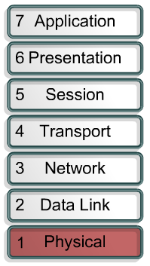
Physical Layer Problems
Broken cables
Disconnected cables
Cables connected to the wrong ports
Intermittent cable connection
Wrong cables used
Transceiver problems
DCE cable problems
DTE cable problems
Devices turned off

Slide 31
Physical Layer Problems
Noise can be an issue at the physical layer
Fluke says this about noise
  There are three general types of noise
    Impulse noise that is more commonly referred to as voltage or current spikes induced on the cabling
    Random white noise distributed over the frequency spectrum
    Alien crosstalk
  Of the three, impulse noise is most likely to cause network disruptions

Slide 32
Physical Layer Problems
  Impulse and random noise sources include nearby electric cables and devices, usually with high current loads
    These may include large electric motors, elevators, photocopiers, coffee makers, fans, heaters, welders, compressors, and so on
  A less obvious source is radiated emissions from transmitters, including TV, radio, microwave, cell phone towers, hand-held radios, building security systems, avionics, and anything else that includes a transmitter

Slide 33
Physical Layer Problems
Fluke provided this table listing common physical layer problems

Slide 34
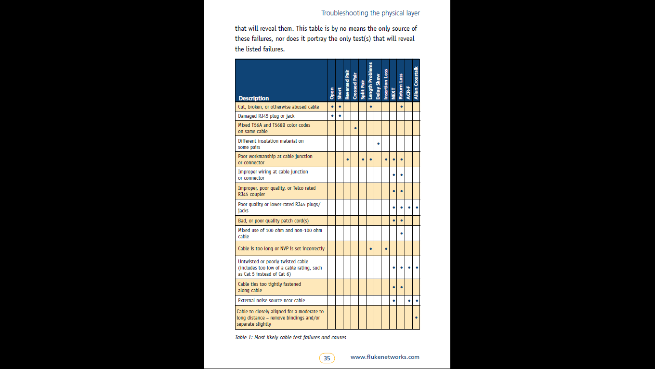
Physical Layer Problems

Slide 35
Physical Layer Problems

Slide 36
Physical Layer Problems
If a switch port problem is suspected move as far away from the suspect port as possible as a single circuit board may control several adjacent ports, typically four

Slide 37
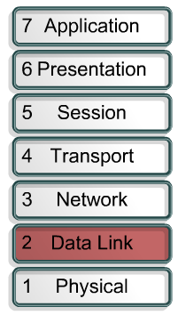
Data Link Layer Problems
Improperly configured serial interfaces
Improperly configured Ethernet interfaces
Improper encapsulation set
Improper clock rate settings on serial interfaces
Network interface card problems

Slide 38
Data Link Layer Problems
In current networks only switches are used to connect devices at layers 1 and 2
If a hub is present, it should be removed as it is cheaper to replace the hub than to spend the time troubleshooting a half duplex problem
Here are the errors commonly seen on full duplex switch based networks

Slide 39
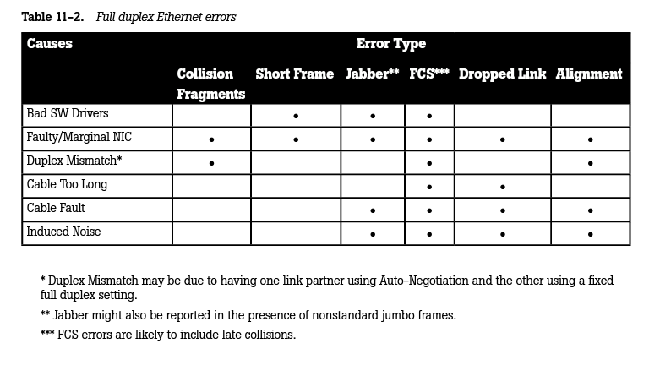
Data Link Layer Problems

Slide 40
Data Link Layer Problems
Let’s look at each one of these
Collisions should never occur on a switch based network as each port is its own collision domain
A short frame is just that
A jabber is a frame that is too long
In all of these cases the Frame Check Sequence will be bad causing the frame to be dropped

Slide 41
Data Link Layer Problems
A dropped link is usually due to bad cabling or failing ports
An alignment error is a message that does not end at an octet boundary
In other words some bits are left over

Slide 42
Data Link Layer Problems
Link state lights are not as useful as they once were for troubleshooting
This is due to their being controlled by the software driver instead of the hardware in many cases
Many errors and slow downs seen on heavily used links in switch based networks are due to duplex mismatches
One side is set to half the other to full

Slide 43
Data Link Layer Problems
Broadcast traffic as a percentage of total traffic should be very low on a network with it going lower and lower as the link speed goes up
The Fluke troubleshooting book says this
  Check for unusually high broadcast levels
  Broadcasts should be relatively low because each station must stop what it is doing and evaluate each broadcast

Slide 44
Data Link Layer Problems
  The average should be well below 5–10 percent of available bandwidth at 10Mbps, which supports up to about 14,000 frames per second
  The broadcast rate should be very low indeed on faster Ethernet implementations, which support far higher numbers of frames per second

Slide 45
Data Link Layer Problems
  A 100Mbps switch port on a typical network experiences below 0.5 percent broadcast rates
  If there is a very large switched broadcast domain, this number can climb up into single-digit broadcast rates

Slide 46
Data Link Layer Problems
  Although no industry standard for broadcasts in a switched environment has been recognized, efforts should be taken to reduce the size of the broadcast domain whenever the average broadcast rate exceeds one percent of a 100Mbps link
  Because each station processes each broadcast frame, the broadcast rate measurably slows network performance

Slide 47
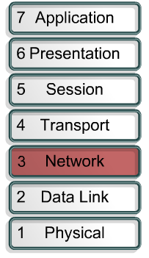
Network Layer Problems
Routing protocol not enabled
Wrong routing protocol enabled
Incorrect static routes
Incorrect IP addresses
Incorrect subnet masks
Incorrect default gateway

Slide 48
Troubleshooting Steps
With the problem domain isolated Fluke Networks in a white paper on troubleshooting suggests following these steps to locate and solve the problem
  Identify the exact issue or problem
  Recreate the problem if possible
  Localize and isolate the cause
  Formulate a plan for solving the problem
  Implement the plan

Slide 49
Troubleshooting Steps
  Test to verify that the problem has been resolved
  Document the problem and solution
  Provide feedback to the user
Let’s look at each one of these steps in more detail

Slide 50
Identify the Issue
Identify the issue by having the person who reported the problem explain how normal operation appears, and then demonstrate the perceived problem
If the reported issue is described as intermittent, instruct the user to contact you immediately if it ever happens again

Slide 51
Recreate the Problem
Further instruct the user what symptoms are likely and provide a written list of what questions you are seeking answers to so the user can gather some of the information if you are unable to respond quickly enough to see it yourself
When possible, leave a diagnostic tool to gather information continuously

Slide 52
Recreate the Problem
A protocol analyzer may be left gathering all traffic from the network and overwriting the buffer as it fills

Slide 53
Localize the Cause
Localize the extent of the problem
In other words isolate the problem domain

Slide 54
Formulate a Plan
Whatever the solution plan may be always put an escape plan in place
You need to be able to back out of whatever changes you make
For example
  Copy all configuration files
  Document any changes made as they are made by keeping a change log

Slide 55
Implement the Plan
As the solution plan is implemented only make one change at a time
Record the changes made as they are made

Slide 56
Test the Solution
Check to see that the solution actually solved the problem

Slide 57
Document the Solution
Document what was done in the change log
This is both to be able to do it elsewhere as well as to be able to back out the change if it proves to be the wrong change
It is also possible that a change will break something else

Slide 58
Provide Feedback to the User
The user must agree that the problem is solved or the problem will not really be solved as the pesky user will continue to complain

Slide 59
Basic Things to Check
There are some basic steps that should be taken when the source of the problem is not readily apparent
Fluke suggests these as a start
  Cold-boot the workstation as a warm-boot does not reset all adapter cards
    This will also apply any loaded but unapplied patches
    In addition, some PnP devices seem to require two or three reboots to install fully

Slide 60
Basic Things to Check
  Verify that the station does not have any hardware failures
  Verify that the required network cables are present and properly connected
  Verify that the network adapter is not disabled
  Verify that the IP address is valid for the subnet as well as the source of the IP address
  Check also to see what the operating system NIC status reports frames sent and received, if either is zero then investigate

Slide 61
Basic Things to Check
  Ask what has changed or been upgraded lately

Slide 62
Sources
Several of the passages here are copied directly or adapted from a white paper and book on network troubleshooting from Fluke Networks

Slide 63
For More Information
Frontline LAN Troubleshooting Guide
  A white paper from Fluke
  2008
Introduction to Network Analysis, 2nd Edition
  Laura Chappell
  ISBN 1-893939-36-7

Slide 64
For More Information
Network Maintenance and Troubleshooting Guide
  Neal Allen
  ISBN 978-0-321-64741-2

