Slide 1
Slow Web Site Problem Analysis
Last Update 2013.08.16 1.0.0

Slide 2
The Problem
A web site is selected using a bookmark
The site’s home page is extremely slow to appear
Why is that
We will use this example to see how to determine if the problem is the client, the network, or the server
The steps required are to receive a page are

Slide 3
Why Is This
Determine the IP address of the server
Establish a reliable connection using TCP
Issue a request for the web site’s home page file using HTTP
Display the web site’s home page
Close the connection using TCP

Slide 4
DNS
The first task is to translate the web site name into an IP address
To do this a DNS server is consulted
Here is a trace showing this process for this site

Slide 5
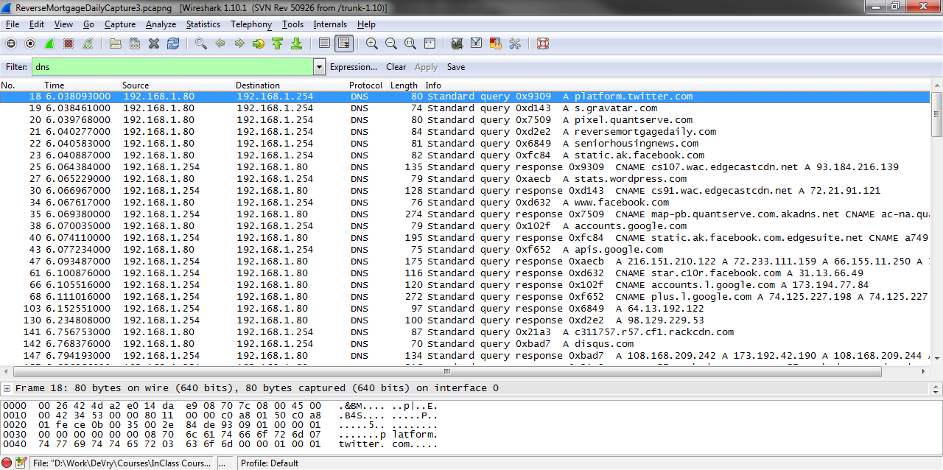
DNS

Slide 6
DNS
Notice how this site is built
It is constructed from pieces from a number of sites
Is this a problem
Somewhat as it takes .768 seconds to do this
Humans get cranky if they have to wait more than 100 ms

Slide 7
DNS
In contrast here is the DNS for my web site which uses static pages
First the request in frame 9

Slide 8
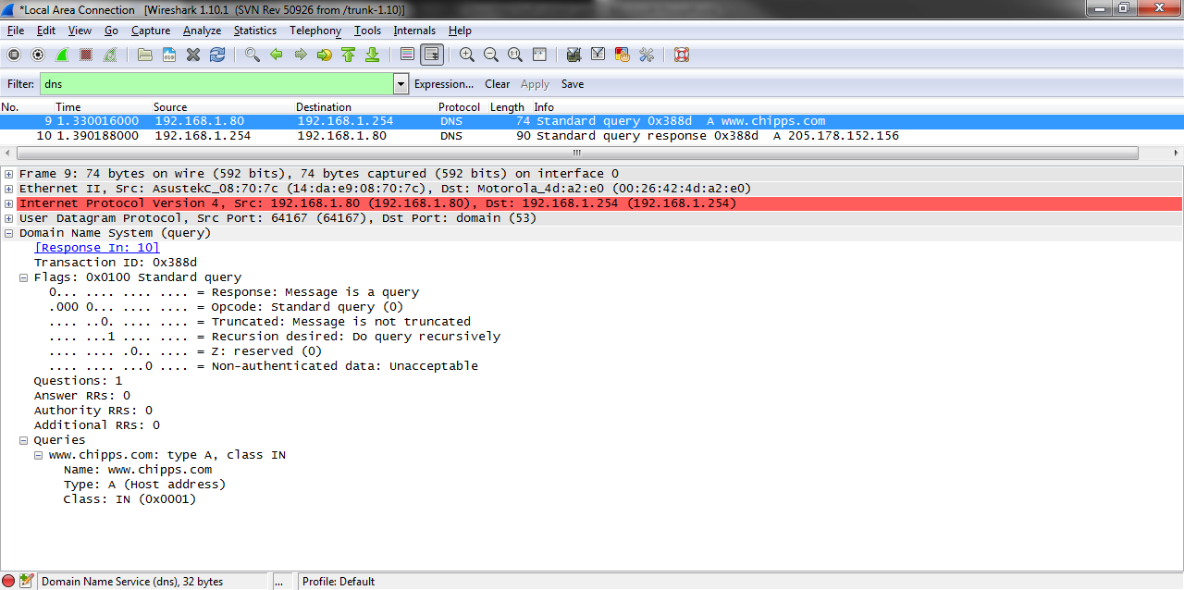
DNS

Slide 9
DNS
And then the response in frame 10

Slide 10
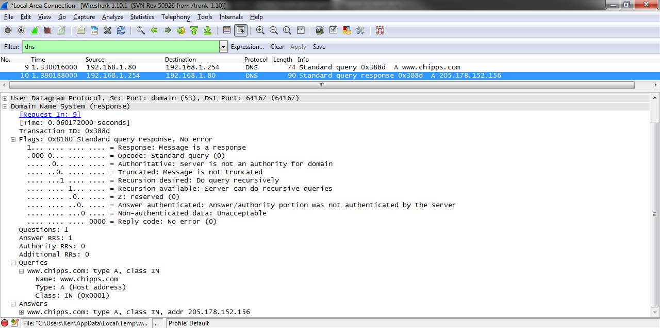
DNS

Slide 11
DNS
Notice that this site requires only a single DNS query
The time is .060 seconds

Slide 12
Establish the Connection
Next a connection must be established with the various sources in order to transfer the elements that will create the home page
TCP is used to establish a reliable connection between the end user and the web server
As in all cases where TCP is used the end user’s device sends out a SYN

Slide 13
Establish the Connection
We can see it here in the capture file in frames 38, 40, and 41
This was not a problem as the time for this three way handshake was .028 seconds

Slide 14
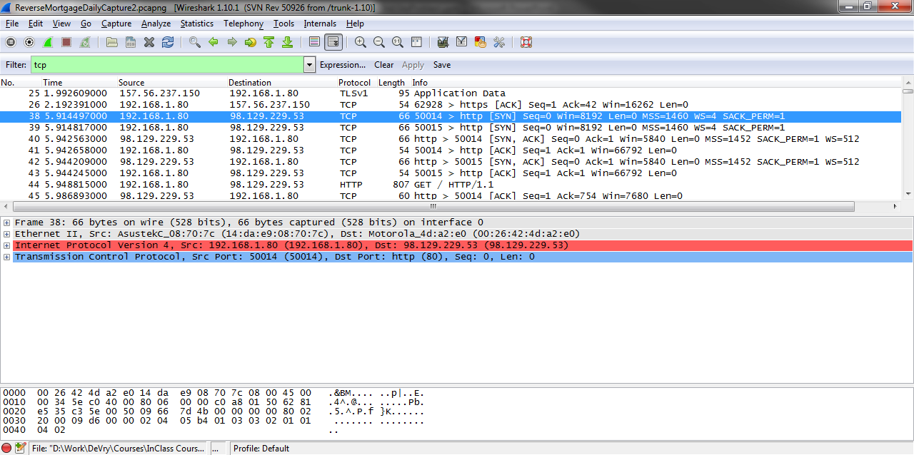
Establish the Connection

Slide 15
Request the File
The next step is for the end user device to initiate the transfer of the desired file by issuing the GET command with the file name included
We see this in frame 44 at 5.948 seconds

Slide 16
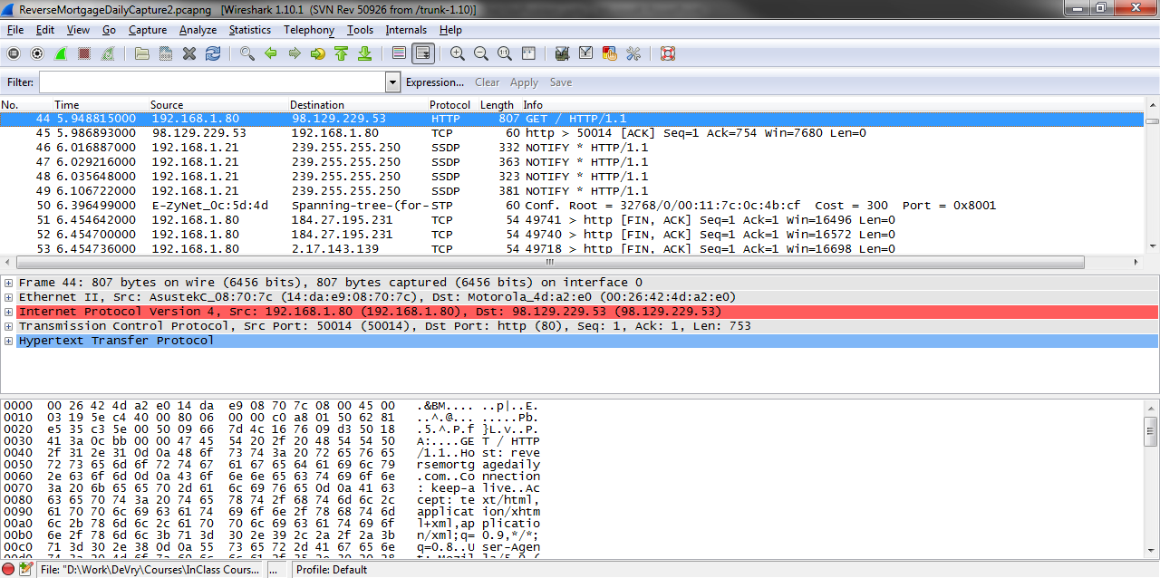
Request the File

Slide 17
Request the File
The transfer from the site itself does not begin until frame 183 at 26.746 seconds
Now here is the problem
20 seconds before the page appears
That is way too slow

Slide 18
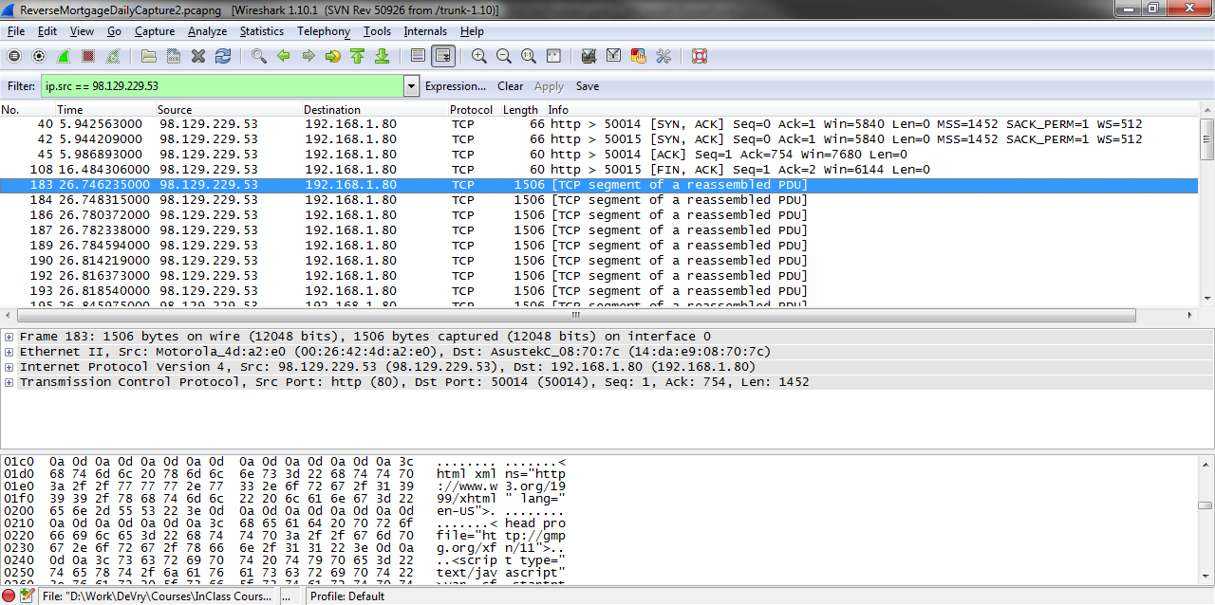
Request the File

Slide 19
Summary
This delay lasted for a few days
Then the home page loading suddenly began appearing within a second or two
Still to slow but much better than 20 something seconds

